Slide 1
101
Presented by: Whitney Asher
Assistant Director of Financial Aid

Slide 2
Our Goals for Today…
Have Fun!
Review various forms of financial aid
Share information regarding Barton’s available scholarships
Overview of the Free Application for Federal Financial Aid (FAFSA)
What to expect once the FAFSA is completed
Time for Q & A

Slide 3
to: 37607 Text: whitneyasher038
Before we get started:

Slide 4
Getting To Know You

Slide 5
Notes:
Poll Title: How many of your children are already attending college? https://www.polleverywhere.com/multiple_choice_polls/d6oiBdcxk9UsxFO

Slide 6
Notes:
Poll Title: When you think of Financial Aid, what is the first word that comes to mind? https://www.polleverywhere.com/free_text_polls/WycahXrMfD3Wgc6

Slide 7
Notes:
Poll Title: Have you completed a FAFSA application before? https://www.polleverywhere.com/multiple_choice_polls/xLY0FSi5vjikmoh

Slide 8
Types of “Financial Aid”

Slide 9
Financial aid has Many forms…
Federal Financial Aid (FAFSA)
Federal Pell Grants
Federal Supplemental Educational Opportunity Grant (SEOG)
Federal Student Loans
Federal Work Study
Scholarships
Institutional Scholarships (From Barton)
Community Scholarships (Businesses, Churches, Foundations, etc)
State Scholarships
Scholarship Searches

Slide 10
Financial aid has Many forms…
Loans
Federal Direct Loans (Students)
Federal PLUS Loans (Parents)
Alternative (Private) Student Loans
Campus Employment (Work-Study Jobs)
Federal Work Study (FAFSA)
Barton Campus Employment

Slide 11
Financial Aid Has Many Forms…
Grant/Scholarship Aid – Money that the student does not have to repay.
Self-Help Aid – Money that the student agrees to repay such as student loans or money that the student must work for such as work-study funds.

Slide 12
Scholarships

Slide 13
Academic Scholarships
Barton Bound Scholarships – Awarded to first time college students who graduated the previous academic year.
Award | Award Amount
Elite Award | Tuition & Books
Excellence Award | $1,000
Honor Award | $800
Achievement Award | $500

Slide 14
Notes:
Poll Title: Is your student an athlete? If so, what sport are they considering here at Barton? https://www.polleverywhere.com/free_text_polls/A9iVUgWXw37MM0L

Slide 15
Notes:
Poll Title: What program is your student interested in pursuing here at Barton? https://www.polleverywhere.com/free_text_polls/YkZc8XfW4tyEGlm

Slide 16
Athletic Scholarships
Women’s Athletics | Men’s Athletics
Basketball | Baseball
Bowling | Basketball
Cross Country | Bowling
Golf | Cross Country
Soccer | Golf
Softball | Soccer
Swimming | Swimming
Tennis | Tennis
Track & Field | Track & Field
Volleyball | Wrestling
Other Athletic Scholarships
Athletic Trainers
Cheerleading
Dance Line
Student Managers

Slide 17
Department/Activity Scholarships
Barton Departmental and Activity Scholarships
Band | Choir
Agriculture | Drama
Admissions | Student Senate
Art | Automotive
Business | Criminal Justice
Early Childhood | Education
Engineering | Emergency Medical Services
Medical Assistant | Medical Lab Technician
Music | Computer Networking
Natural Gas | Hispanic American Leadership Organization (HALO)

Slide 18
Foundation Scholarships
Bartoncccfoundation.org

Slide 19
Federal Financial Aid

Slide 20
Don’t Let This Be You!!

Slide 21
Notes:
Poll Title: Which of the following items will you need to complete the 2019-2020 FAFSA application https://www.polleverywhere.com/multiple_choice_polls/V7P2oWDfKxthL2A

Slide 22
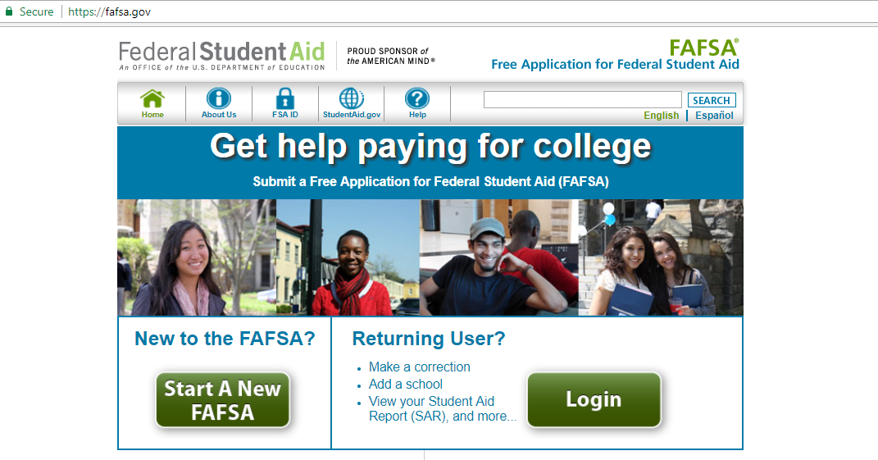
Step #1 – Creating FSA ID’s

Slide 23
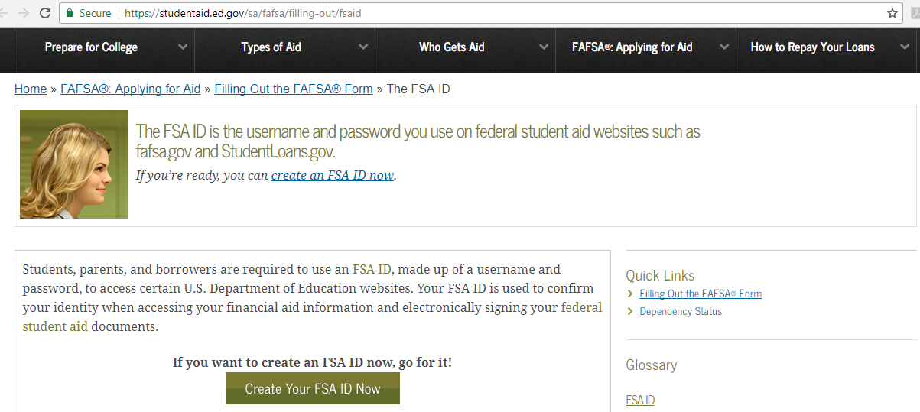
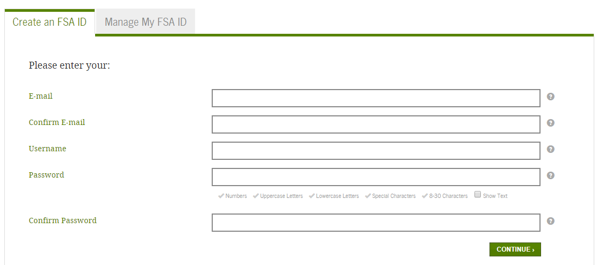
Creating FSA ID’s

Slide 25
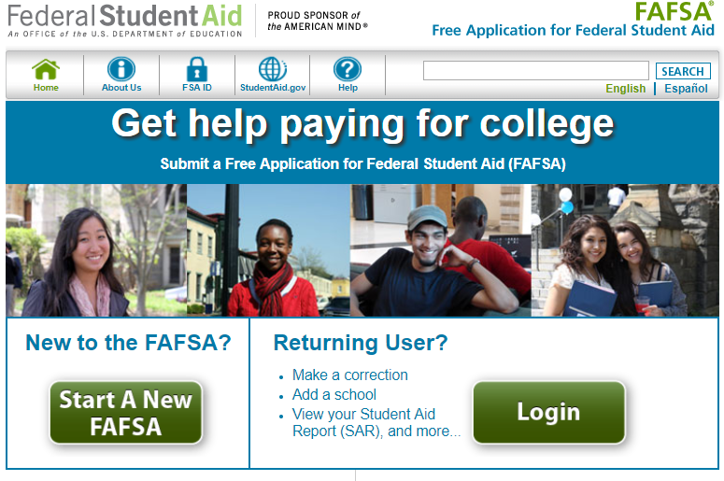
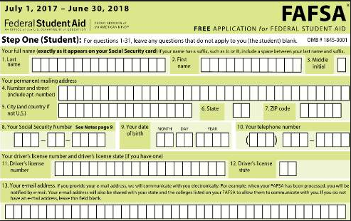
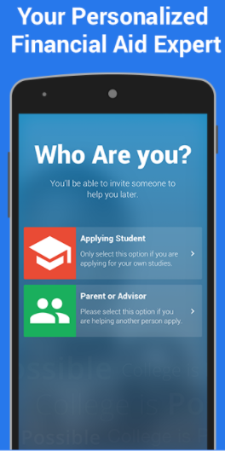
Step #2 – Complete the FAFSA
Complete the FAFSA online at www.FAFSA.gov
Request a paper copy of the application or print a paper copy to complete and mail
Use the FAFSA App

Slide 26
Complete the FAFSA
Always use the Data Retrieval Tool option (when possible)
Make sure both parent and student signatures are on the FAFSA before it is submitted.
Wait for follow-up from the schools that you sent the FAFSA application to.
Submit any requested information to the financial aid office.
**Never assume that your financial aid is in place simply because the FAFSA was submitted, ALWAYS follow up with us if you have not received an award notification**

Slide 27
Notes:
Poll Title: Which of the following are NOT eligibility factors for Federal Financial Aid? https://www.polleverywhere.com/multiple_choice_polls/1Wgg3EL5h9ZeR5S

Slide 28
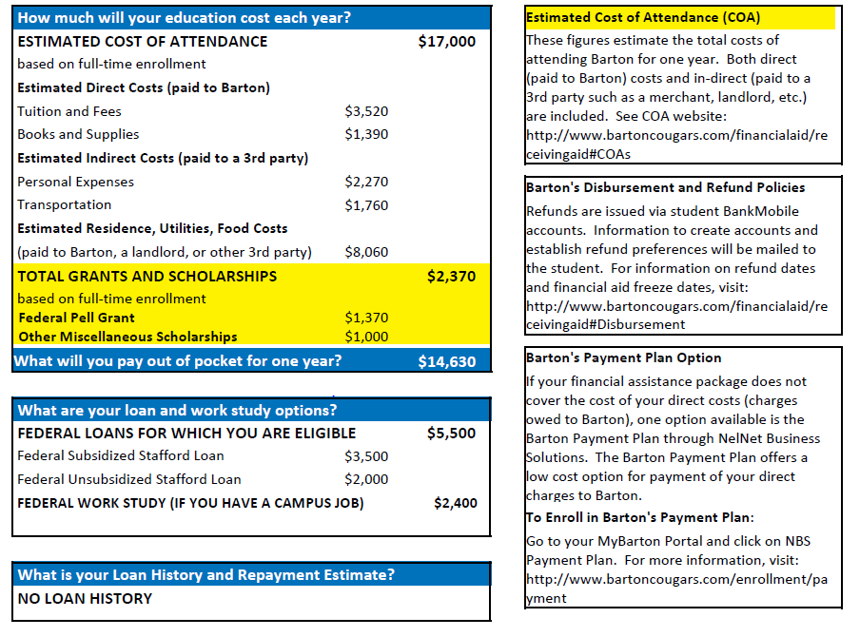
Step #3 – Understanding your Awards
“Cost of Attendance” is not your ACTUAL cost.
Pay attention to different types of aid.
If a student wishes to use loans, they will have additional steps to complete.

