Slide 1
WELCOME

Slide 2

OVERVIEW
Policies
Administration
Introductions
Schedule
Building Tour
Pre Test

Slide 3
ADMINISTRATION
Course Objective:
Graduates will acquire the knowledge, skills, and abilities to be certified in load planning for C-130, C-17 and C-5M aircraft using ICODES program.

Slide 4
TSgt Jonathan Riera (Course Director)
Cell: 201-456-7323
TSgt Javier Hernandez (Instructor)
Cell: 347-601-1330

Slide 5
ADMINISTRATION
Complete Class Roster
Student Disk
Notes:
MAKE SURE EACH STUDENT LOGS IN THE COMP: ICODES

Slide 6
POLICIES
Adverse Weather
Student Rights
Fire Safety
Cell Phones
Covid Policy

Slide 7
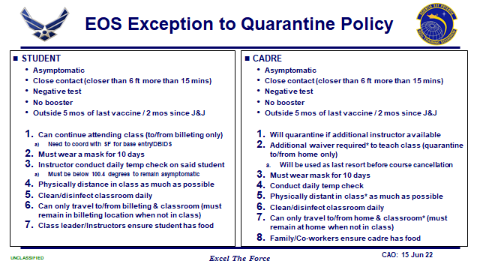

Slide 8
STUDENT RIGHTS
Students enrolled in either resident or non-resident EOS courses are afforded certain rights that contribute to their overall success and satisfaction. Rights include, but are not limited to, the following:
The right to be free from discrimination on the basis of race, gender, color, religion, sexual orientation, and national origin.
The right to be free from sexual harassment.
The right to open and free expression of thoughts and concepts in an environment of academic freedom, consistent with the interests of good order and discipline under the Uniform Code of Military Justice.
The right to submit a written complaint on EOS policies, procedures or actions through the EC chain of command.
Student Complaints/Grievances. Students who believe their rights to a professional learning environment have been violated can seek assistance through the EOS Chain of Command (class leader, instructors, course director, unit commander, EOS/CC/CD/CCC), EOS First Sergeant, Dean of Academic Affairs or 87 ABW support agencies (MEO, IG, etc.). Student complaints and communications with the EOS chain of command or 87 ABW support agencies are protected from reprisals.
The right to due process. See AFI 90-301, Inspector General Complaints Resolution.

Slide 9
STUDENT
RESPONSIBILITIES
Students enrolled in EOS courses are ultimately responsible for their success by fulfilling course requirements with due diligence and dedication to excellence. They have the responsibility to:
Abide by appropriate military/department/agency rules, regulations and standards of conduct.
Abide by EOS academic policies and procedures, and those of the school/course in which they are enrolled.
Respect the opinions and rights of other students.
Adequately prepare for each class.
Uphold academic integrity.

Slide 10
In the EVENT of a FIRE EMERGENCY
PRIMARY EVACUATION RALLY POINT
Rally
Accountability
Go Home…Standby for more info

Slide 11
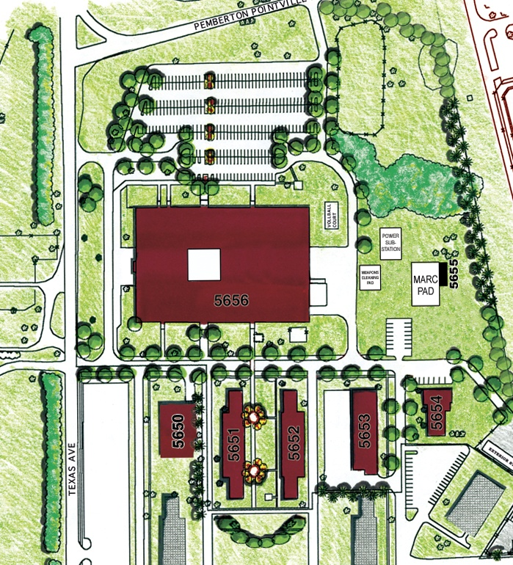
FIRE EMERGENCY
PRIMARY EVACUATION
RALLY POINT

Slide 12
FIRE EMERGENCY
ALTERNATE EVACUATION
RALLY POINT

Slide 13
CLASS START TIME 0800
CELL PHONE CHECK
1st Offense = Stared by Class
2rd Offense = Leave phone outside for remainder of schedule
If you are late…
1st Offense = Stared by Class
2nd Offense = Class Donuts
3rd Offense = Lead Instructor Coordinates w/ POC for removal & Supervisor CC’d for Academic removal

Slide 14
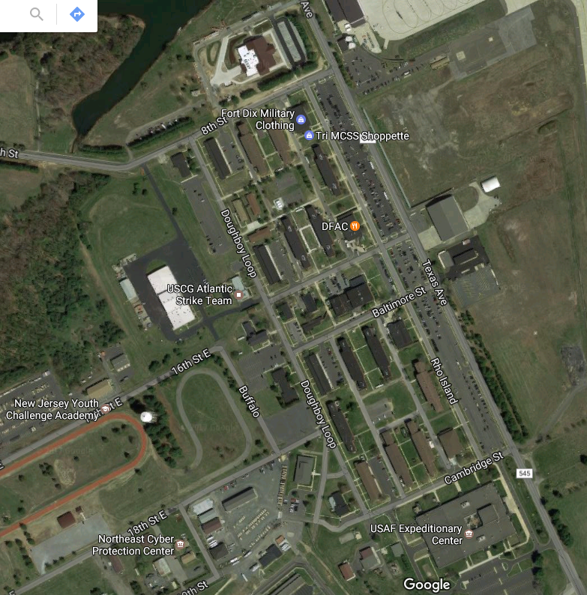
DFAC

Slide 15
SCHEDULE
See printed Schedule

Slide 16
SCHEDULE

Slide 17
Intros

Slide 18
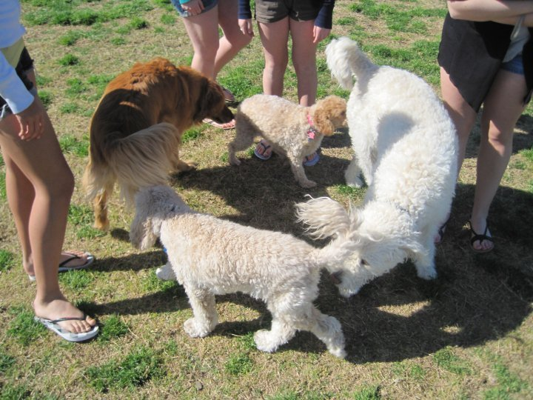
Name or Go by Name
Worse Base? Best Base?
Where is home? And Hobbies?
Why are you here?
What is your experience with Load Planning ?

Slide 19
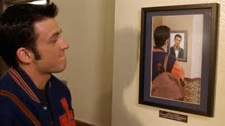
BUILDING TOUR

Slide 20

PRE TEST

Slide 21
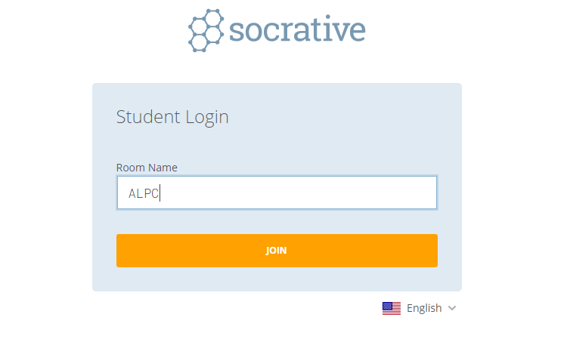
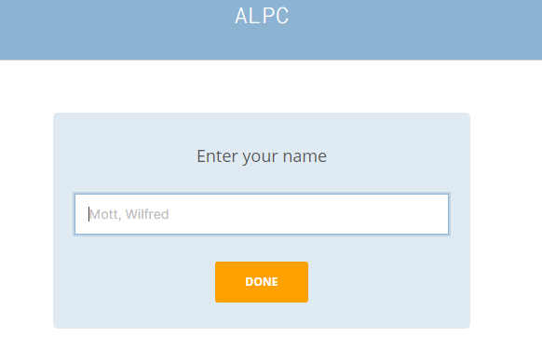
https://b.socrative.com/student
JALPC
LAST NAME, FIRST NAME

Slide 22
PRE TEST
60 Minutes
Start Time:
Finish:

Slide 23
10 MINUTE BREAK NEXT LESSON: JALP INTRO

