Slide 1
Joint Aircraft Load Planning INTRODUCTION

Slide 2
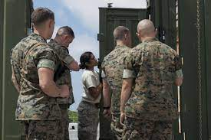
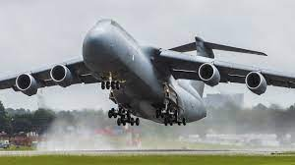
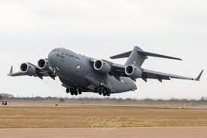
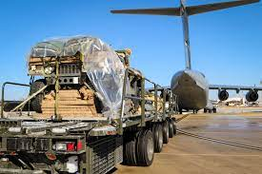
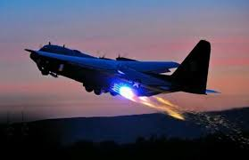

Slide 3
OVERVIEW
Roles and Responsibilities
Organizational Structure
Intro to Joint Aircraft Load Planning Course

Slide 4
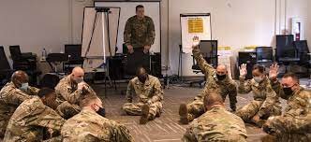
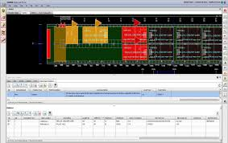
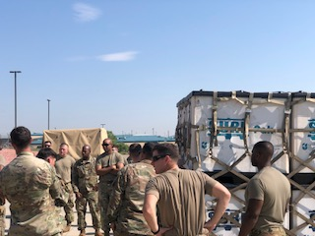
Building Cargo From The Ground Up
Preparation
Creating Load Plans

Slide 5

Expeditionary Warfare Training Group Pacific, San Diego, CA
U.S. Army’s Transportation School’s, Air Deployment Planning Course, Fort Lee, VA
82d Airborne Division, Air Movement Operations School, Fort Bragg, NC
101st Airborne Division (Air Assault), Strategic Deployment School, Fort Campbell, KY
160th Special Operations Aviation Regiment (Airborne), Fort Campbell, KY
Combat Arms Training Center, Rose Barracks, Germany
Naval Construction Group 1, Port Hueneme, CA
Naval Construction Group 2, Port Hueneme, CA
III Corps Command Group, Fort Hood, Texas
Naval Expeditionary Logistics Support Group, Cheatham Annex, VA.

Slide 6
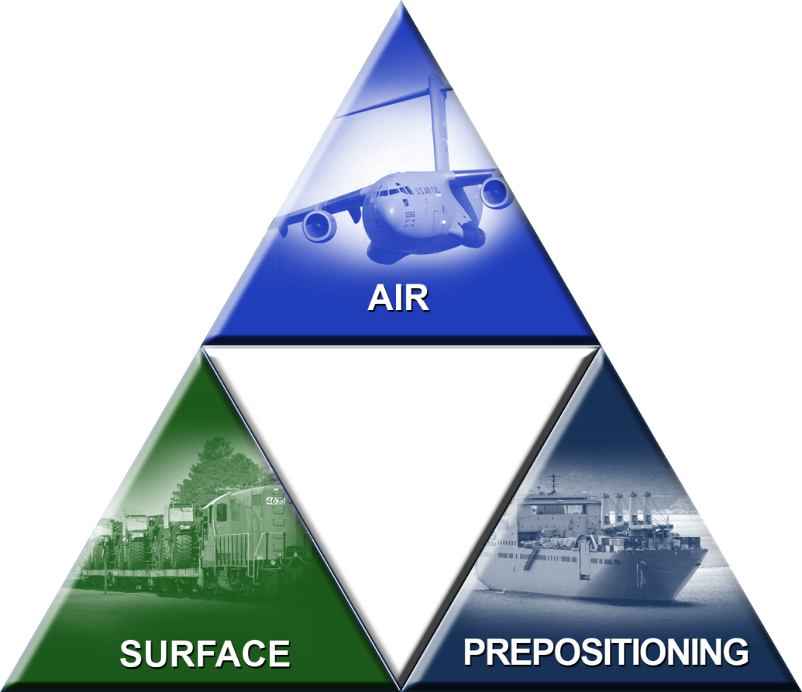

USTRANSCOM Velocity Initiative -
As the Air Component to USTRANSCOM, AMC designed the Joint Aircraft Load Planning Course (JALPC) to develop a mutual understanding of air mobility requirements and reduce user reliance on Air Mobility Support.
S

Slide 7
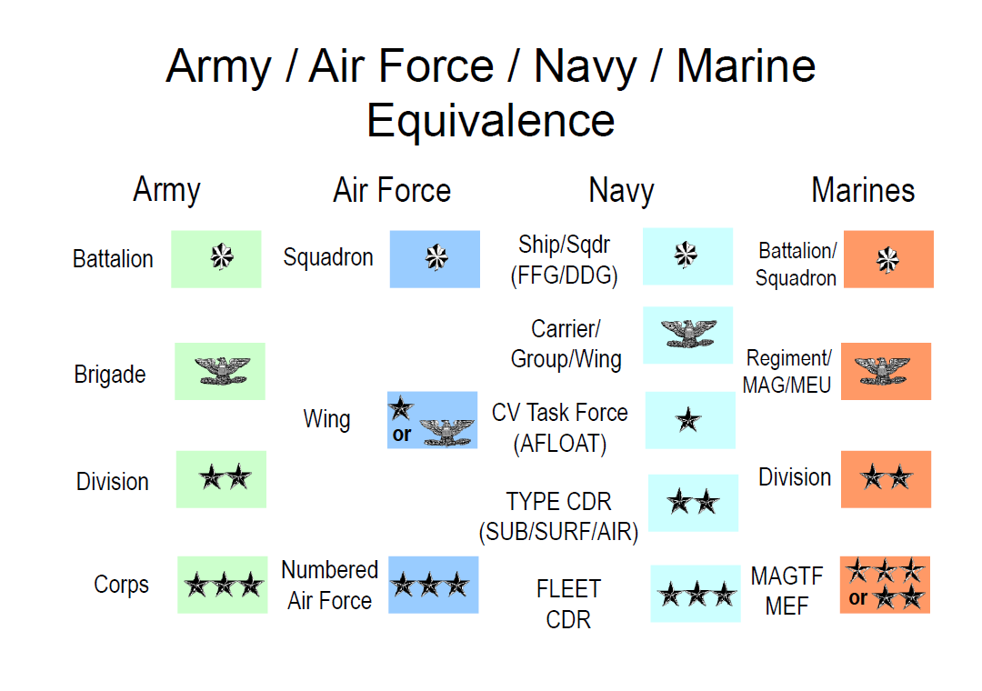
O

Slide 8
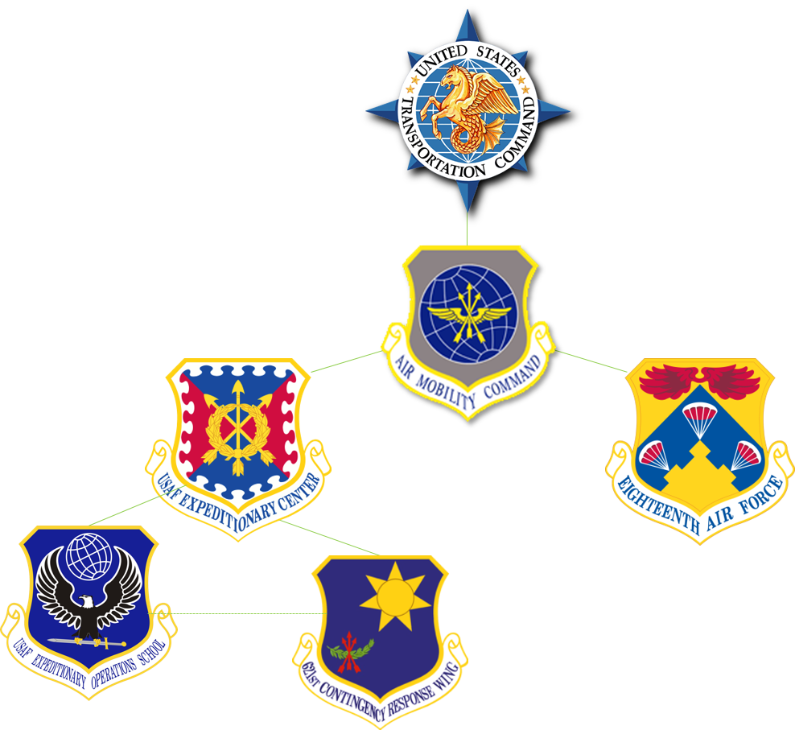
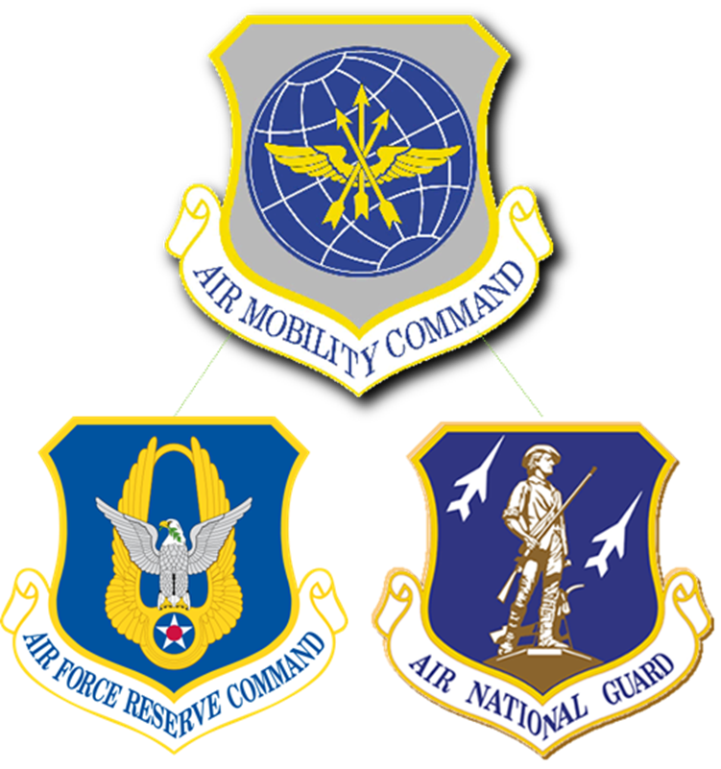
R

Slide 9
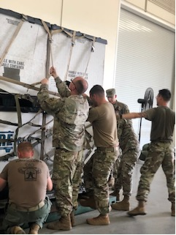
HQ AMC/A39
Overall Course Program Owner
Affiliates: DoD
Execution of JALPC for Assigned Affiliates
USAF-Expeditionary Operations School
Initial Instructor Training for Sister Service Schools & Curriculum
Conduct Evaluations and Maintain Standards
EAGLE Team
Advises, Develop & Mentors Units

Slide 10
Air Mobility Liaison Officer
(AMLOs)
Affiliated Unit POCs
Support staff orientation visits
Introduce and/or brief during JALP course.
Communicates with EAGLE reps during visits
Focal point between AMCU & Affiliates
Provide students that need training, classrooms and resources execute the course
Provides course and logistical support (as required for static training)
JALPC

Slide 11
Enlisted Air Ground Liaison Element
(EAGLE TEAM )
UNIT Cargo Reps
Builds relationships btw Joint Users
Visits upon request
Assists with UMO/DTO/ALPs
Communicates with AMLO/unit leadership/HHQ of status of cargo readiness/issues/trends
Gives a validation of cargo prior to Joint Inspection (JI).
Determine timeline on upcoming schedule
Provide communication between members and AMLO/EAGLE
Provides course and logistical support or shows status of prepared cargo
Ask questions to training shortfalls.
Works/Communicates With

Slide 12
Questions?

Slide 13
SUMMARY
Roles and Responsibilities
Organizational Structure
Intro to Joint Aircraft Load Planning Course

