Slide 1



Slide 2
OVERVIEW
Defense Transportation Regulation Part III
Departure Airfield Operations

Slide 3
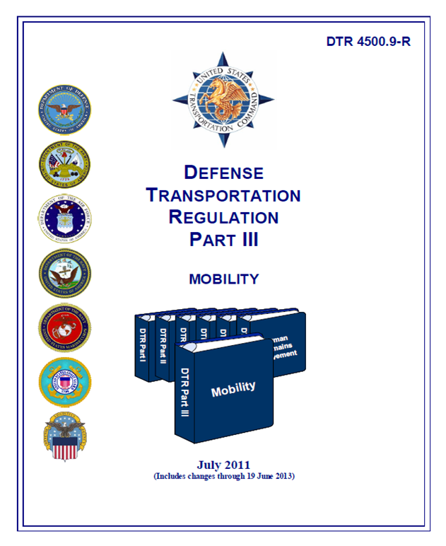
DTR Part III – Mobility:
Establishes criteria for passenger, cargo and mobility movements
Google search DTR
Provides policy procedures and guidance
Deployment
Sustainment
Redeployment
Notes:
Click on link to show students what the site looks like: https://www.ustranscom.mil/dtr/dtrp3.cfm...NAVIGATE and show students

Slide 4
DTR Part III – Mobility, Chapter 303 Deployment Activities
Mission & Functions
USTRANSCOM - Schedules airlift to move units from APOE to APOD
Channel Mission
SAAM (Special Airlift Assignment Mission)
Unified Commands - Designates the service component to perform A/DACG functions in joint operations
Major Commands (CORPS Level)- Ensures the parent organization or home station installation CDR from which deploying units originate, organize, equip, and train personnel for A/DACG duties.
Host or supporting installations - Provide A/DACG and support deploying mobility forces as requested (i.e., MHE, container handling equipment, manpower, fuel, or staging facilities).
Notes:
Channel Mission: Flights over fixed routes where a user would put in a request for cargo to move. When aircraft show up is when it’s moved
SAAM(Special Airlift Assignment Mission: Special user request to where an aircraft is providing an exclusive service to user.
AMC Major Command (example): located in Scott AFB provides unrivaled airlift, air refueling, aeromedical evacuation, global air mobility support and Global Mobility Mission Command to project, connect, maneuver and sustain the Joint Force to achieve national objectives
3 Commands: USTranscom, Military Sealift command, Military Surface Deployment and Distribution Command

Slide 5
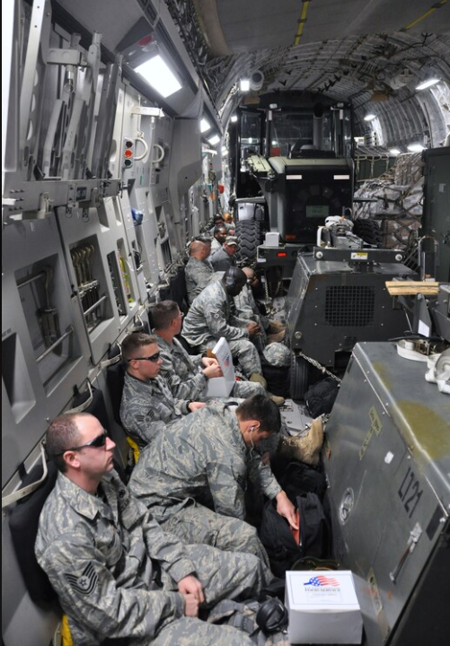
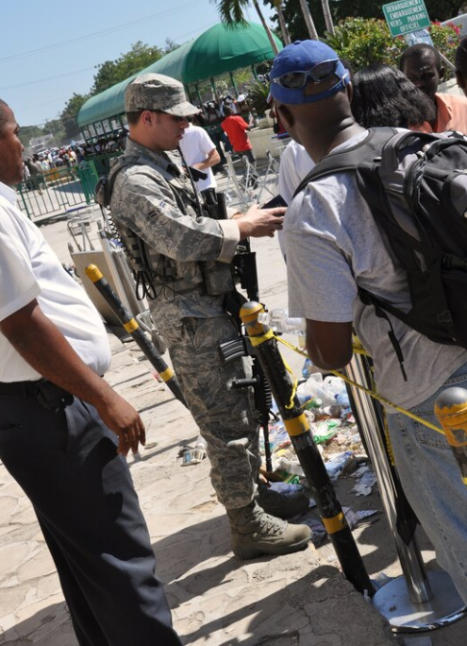
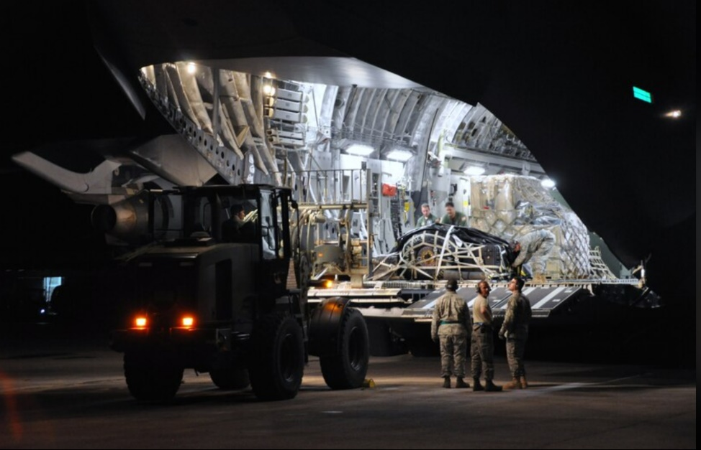
DTR Part III – Mobility, Chapter 303 Deployment Activities
Mobility Forces
Contingency Response Group - CRG
CRE, CST, CSE, EAGLE
Notes:
CRE- Led by an officer for large scale operations/airfield setups
CSE- perform maintenance, flying safety, weather, aerial port, and intelligence support.
CST- (contingency support team) A CST performs maintenance, aerial port, and related support functions as required. Performs same functions as CRE (not as large) but is managed by an enlisted supervisor

Slide 6
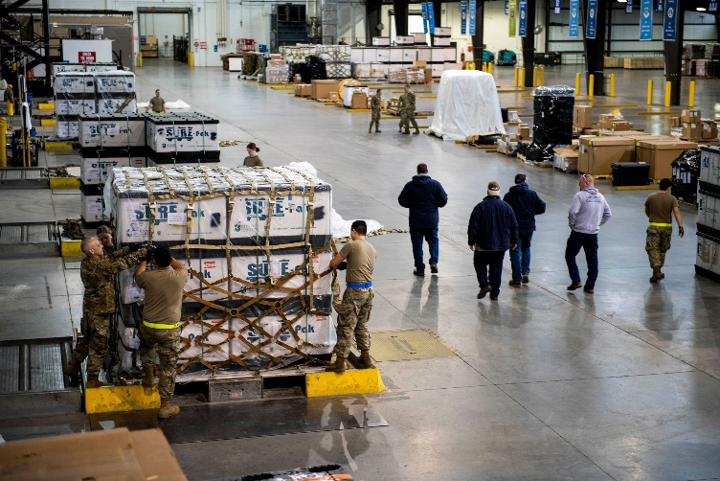
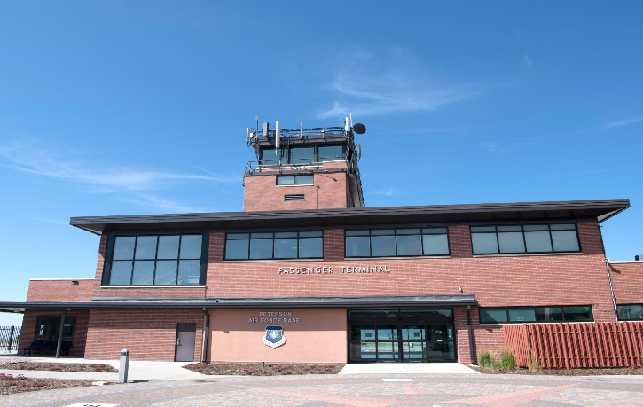
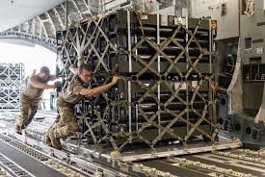
Mobility Forces con’t…
Fixed Aerial Port or Air Terminal
Air Terminal Operation Centers – ATOC
Arrival/Departure Airfield Control Group – A/DACG
D

Slide 7
DTR Part III – Mobility, Chapter 303 Deployment Activities
The deploying unit will:
Prepare passengers and cargo
Prepare and certify hazardous cargo and equipment
Prepare and certify aircraft load plans
Provide trained load teams to load, offload, and secure cargo to aircraft
Furnish any required shoring, dunnage, and vehicle operators
Provide personnel and equipment to perform A/DACG functions
Notes:
Pax- the passenger terminal or base operations at the POE and en route stops are responsible for passenger manifesting and anti-hijacking. However, the aircraft CDR is ultimately responsible for compliance with these procedures. If no passenger terminal, base operations, or other agency is responsible for filing the manifest or if passengers do not process through such an agency, the aircraft CDR will file a copy of the passenger manifest with the most responsible on-scene agency.

Slide 8
DTR Part III – Mobility, Chapter 303 Deployment Activities
The deploying unit will:
Prepare and transmit personnel and cargo electronic manifests and forward…
Provide and operate MHE to load and unload aircraft when it is within the units’ capability
Prepare cargo and equipment using designated automatic identification technology enablers
A

Slide 9
DTR Part III – Mobility, Chapter 303 Deployment Activities
A/DACG
Provisional organization designed to assist the AMC and the deploying unit in receiving, processing, and loading or unloading personnel and equipment.
Coordinate and control the reception and/or loading of units for deployment or redeployment
Coordinate with the installation CDR and the CDR of each service-deploying unit
Provide a liaison to the mobility force (normally the ATOC)
Perform those functions when no mobility force is available.

Slide 10
DTR Part III – Mobility, Chapter 303 Deployment Activities
User Training & Certification
Joint Aircraft Load Planners Course Training
Planning & Preparation Phase
Movement of units by airlift demands extensive advanced planning on the part of the unit to be moved.
Primary objective: to minimize time a unit is non-operational
Execution Phase
Involves the movement of the unit between the APOE and APOD including the Departure Airfield Operations
Air movement from APOE to APOD

Slide 11
DTR Part III – Mobility, Appendices
Appendix B – Unit Airlift Affiliation, Load Planner Cert
Appendix H – Unit Move Documentation
Appendix J – HAZMAT Certification
Appendix L – A/DACG Checklist
Appendix N – Deploying Unit Activities
Appendix O – Joint Inspection Preparation
Appendix P – Center of Balance
Appendix R/S/U – Deployment Airfield Areas
Appendix V – Aircraft Load Plan
Appendix BB – Weapons, Ammunition, & HAZMAT

Slide 12
DEPARTURE AIRFIELD OPERATIONS

Slide 13
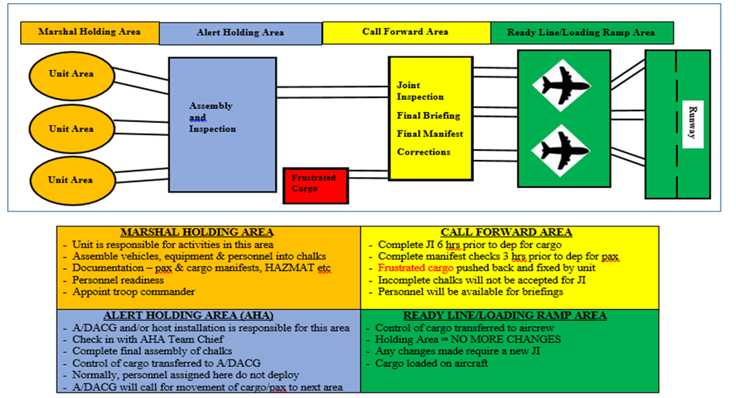

Slide 14
Troop CDR
Senior military member of the deploying chalk
Assigned by the service deployment authority at the APOE
More guidance: DTR Chapter 303, Mobility-Appendix T

Slide 15
Air Mobility Command (AMC) Mobility Forces
Contingency Response Force (CRF) - a deployable individual unit that performs specific functions required to support airlift operations.
Aerial Port - an airfield that has been designated for sustained air movement of personnel and material.
Air Terminal - a facility on an airfield that functions as an air transportation hub and accommodates the loading and unloading of airlift aircraft.

Slide 16
Non-AMC Mobility Forces
Arrival/Departure Airfield Control Group ( A/DACG) - a provisional organization designed to assist AMC and the deploying unit in receiving, processing and loading or unloading personnel and equipment.
Installation Deployment Forces (IDF) - includes all installation support elements that assist through the different stages of the deployment process. Functions performed differ between services and installations.

Slide 17
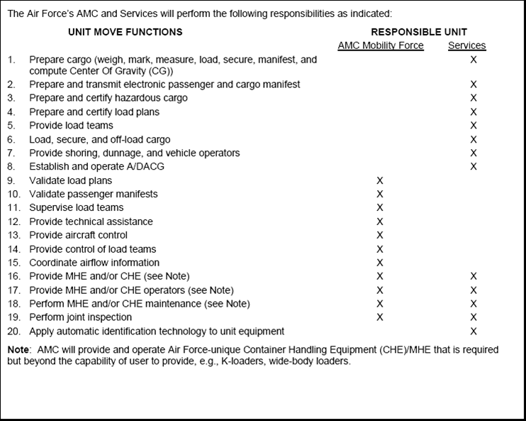
Functions
AMC will provide and operate Air Force-unique MHE
that is required but beyond the capability of the user
to provide, e.g., K-loaders

Slide 18
You may not carry on your person:
Shotguns with barrels under 18” long
Rifles with barrels under 16” long
Automatic weapons
Switchblade knives
Brass knuckles
Incendiary devices (e.g., flares)
Tear gas or mace
Gunpowder, cartridges, or primers
All torch lighters
These government issued items may be shipped in properly packed,
checked baggage/containers.
These items may be shipped in checked baggage:
Unloaded government weapons
Weapons/ammo count against your authorized weight allowance
Knives or knife-like items
Alcohol
You cannot ship alcoholic beverages in checked baggage
Individuals who are obviously intoxicated will not be allowed on board
Illegal drugs
Q

Slide 19
QUESTIONS?

Slide 20
SUMMARY
Defense Travel Regulation Part III
Departure Airfield Operations

