Slide 1

Palletization and Weighing Marking

Slide 2
OVERVIEW
Palletization
Material Handling Equipment
Weighing and Marking

Slide 3
PALLETIZATION

Slide 4
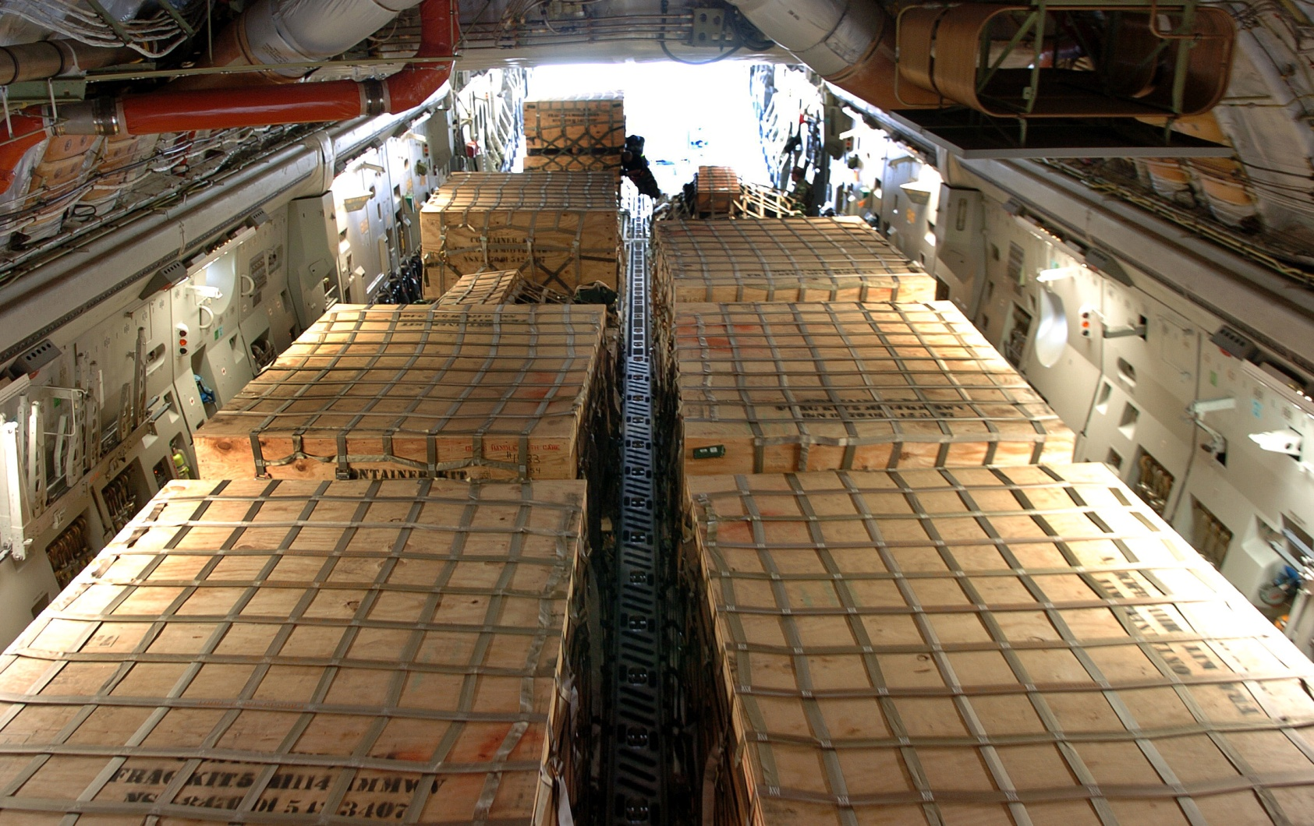
463L SYSTEM
Facilitates the movement of general cargo in and out of the aircraft
The system encompasses all aspects of cargo loading
Standard for movement of cargo in Air Force
Efficient system that reduces ground times
Notes:
Standardized System
1. Facilitates the movement of general cargo in and out of the aircraft
2. The system encompasses all aspects of cargo loading
a. Material handling equipment
b. Cargo loading platforms
c. Restraint equipment
d. In-aircraft systems
3. This system is the Air Force standard for movement of cargo
B. Efficient system
1. Extremely efficient system, can reduce ground time by as much as 75 percent
2. Your first encounter with the system will probably be a 463L pallet

Slide 5
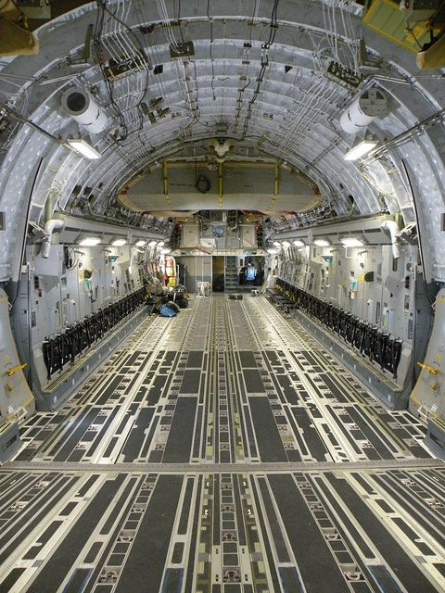
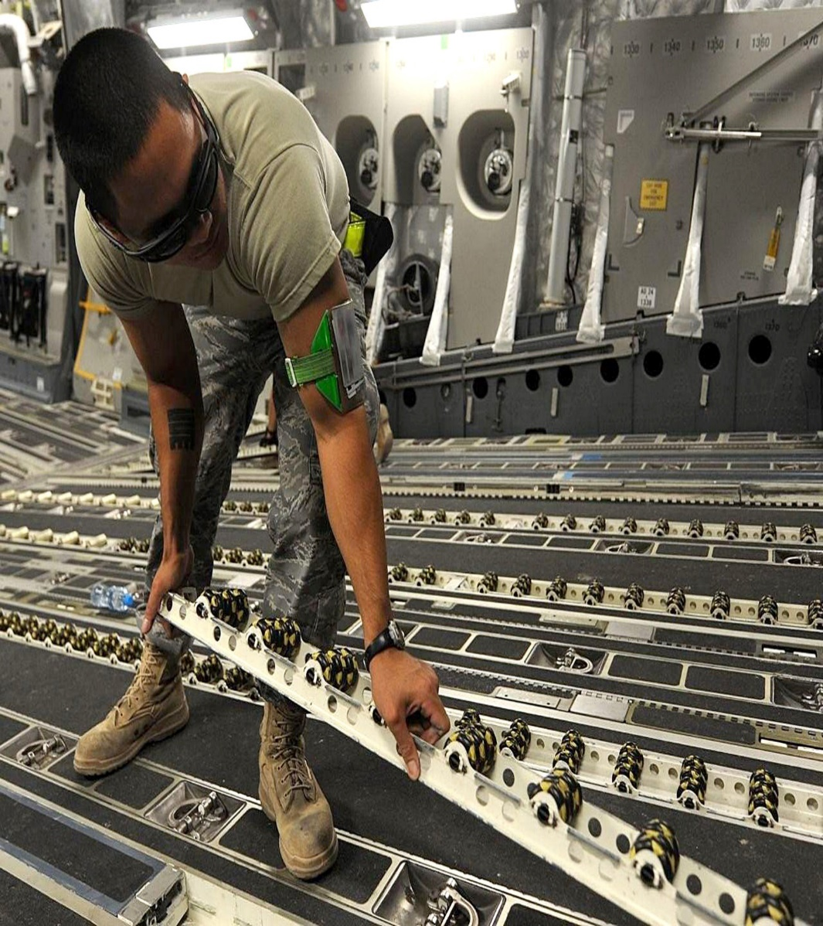
You can go from a slick floor to pallet ready in minutes

Slide 6
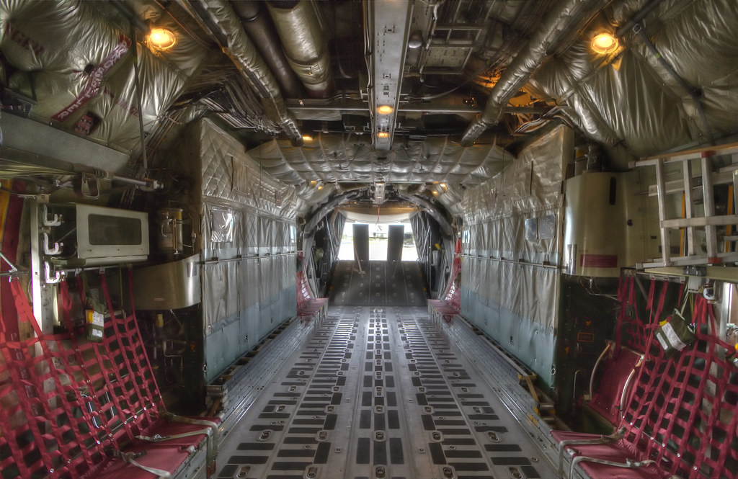
Rollers are storable to convert the cargo deck to a smooth surface for loading wheeled cargo
Notes:
2. Dual rail system consists of rows of rollers that allow easy movement of the palletized cargo into the aircraft
a. Many of these rollers are storable to convert the cargo deck to a flat, clear loading surface for wheeled cargo
b. Side rails guide the pallets into the aircraft and provide lateral and vertical restraint

Slide 7
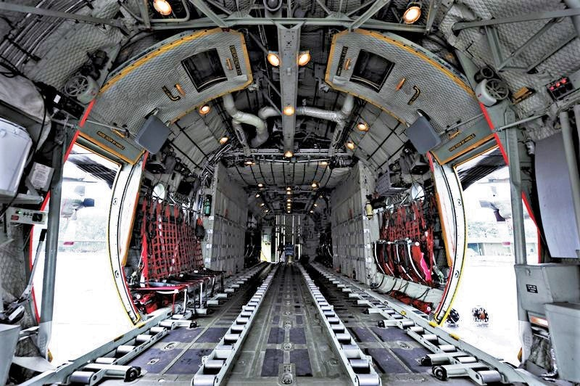
Rollers attach to floor enabling Pallets to be loaded

Slide 8
Made of corrosion resistant aluminum with a soft wood core framed on all sides by aluminum rails.
PALLET CHARACTERISTICS

Slide 9
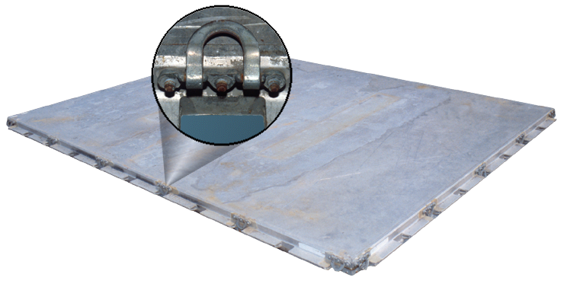
22 steel tie down rings
Max cargo carrying capacity of 10,000 lbs. when using nets
250 PSI limitation
Pallet weighs 290 lbs.
Useable Dimensions
84”
104”
88”
108”
Notes:
2. 463L pallets have 22 steel tie down rings attached in such a manner that six rings are on each long side and five rings are on each short side
a. They have indents (notches) which are designed to accept the detent locks
b. Locks are located on numerous types of materials handling equipment and are found on board all airlift capable aircraft
Overall dimensions
1. 88 inches by 108 inches by 2 ¼-inch thick
a. Usable dimensions are-84 inches by 104 inches
b. This allows for 2 inches around the periphery of the pallet to attach straps, nets, or other restraint devices
2. An empty 463L pallet weighs 290 pounds
a. 355 pounds with nets
b. Maximum cargo carrying capacity of 10,000 pounds when using nets
c. 250 PSI limitation
3. The desired load capacity is 7,500 pounds to prolong pallet life
4. Pallets weighing less than 7,500 pounds can waste valuable aircraft space

Slide 10
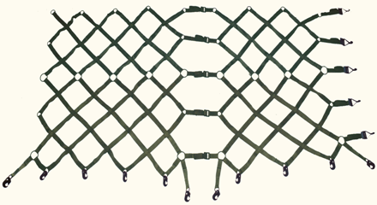
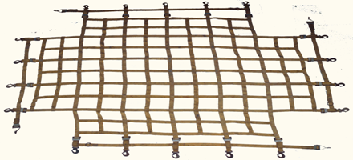
463L Net Sets
    Two side nets
    One top net
  A complete set of nets weighs 65 lbs
Notes:
1. Net sets
a. Two side nets
b. Usually green in color
c. Attaches to rings on pallet
2. One top net
a. Usually yellow in color
b. Attaches by hooks to the side net
d. A complete set of 463L nets (2 side nets and 1 top net) weighs 65 pounds

Slide 11
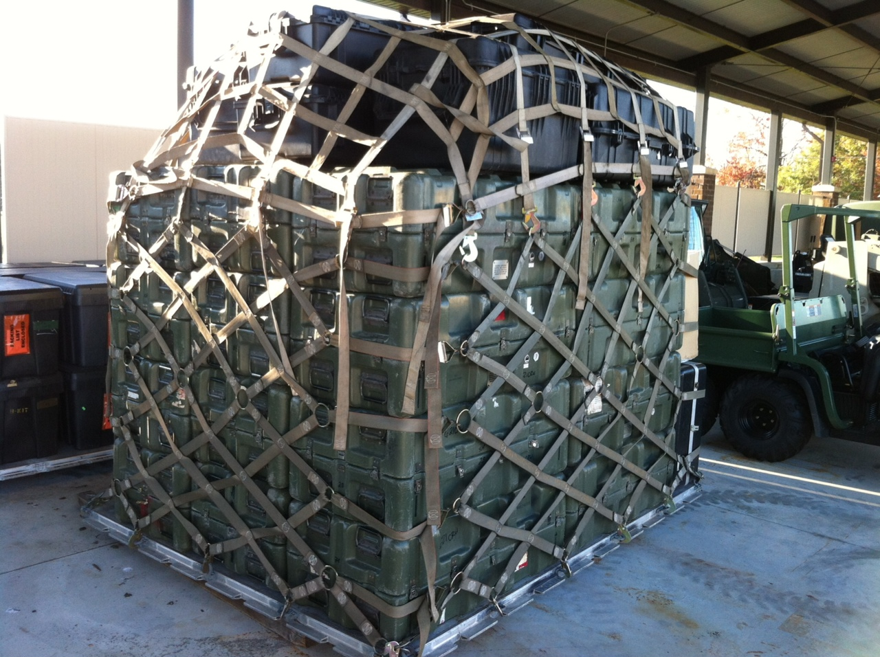
Adequate restraint is provided for:
    10,000 lbs. of cargo with heights not exceeding 96” above the surface of the pallet
    8,000 lbs. of cargo with height not exceeding 100” above the surface of the pallet

Slide 12
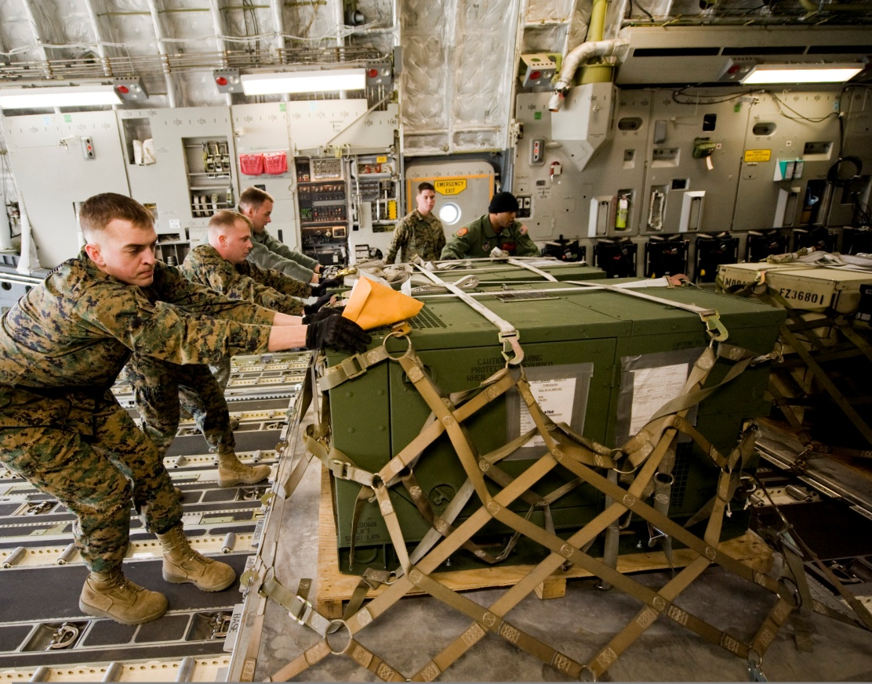
Securing cargo
    Side nets can be used with seven straps instead of the top net
      Four on the 108” side and three on the 88” side, hooked to the highest row of side net rings
    This configuration of straps cinches the side nets up and provides vertical restraint for the cargo
    The seven strap option can restrain 10,000 lbs. of cargo to a 463L pallet

Slide 13
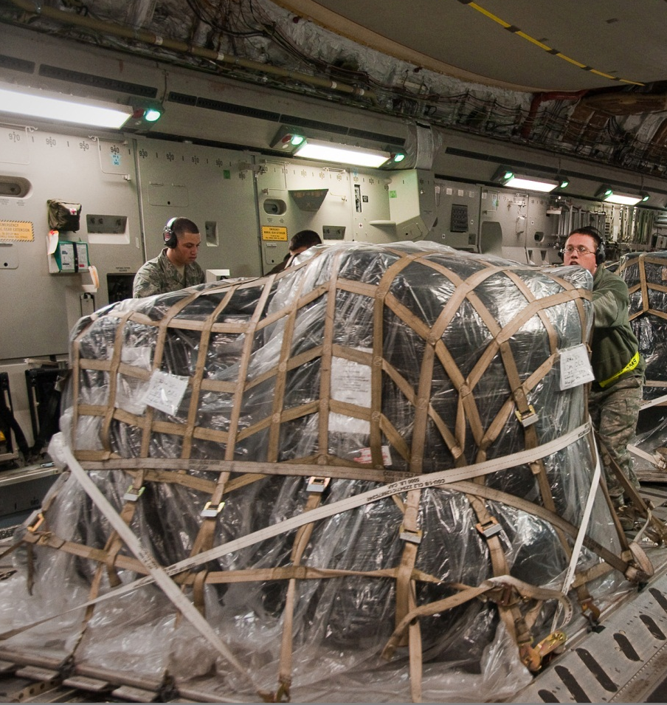
Top net only
    Provides adequate restraint for low profile items of cargo up to 45” tall
      Weighing up to 2,500 lbs. (net cargo weight)
      If exceeded, supplemental restraint will be required

Slide 14
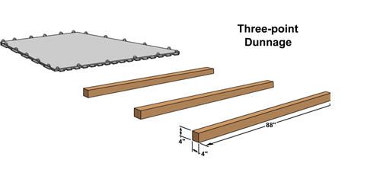
DUNNAGE
Always put adequate dunnage under 463L pallets:
    Aids in pallet movement
    Protects lower surface of pallet
  Minimum dimensions of each piece of dunnage is 4” x 4” x 88”
  All pallets are required to be shipped with dunnage and a complete net set (2 side/1 top), for both deployment and redeployment and must be provided by the user
Notes:
http://antarcticarctic.files.wordpress.com/2011/11/463l-pallet.jpg
Sources:AFI 36-101 Vol 1
AFI 36-101 Vol 2
ADAPT Equipment Preparation Workbook Vol 1
ADAPT Air Load Planners Course Workbook Vol 2

Slide 15
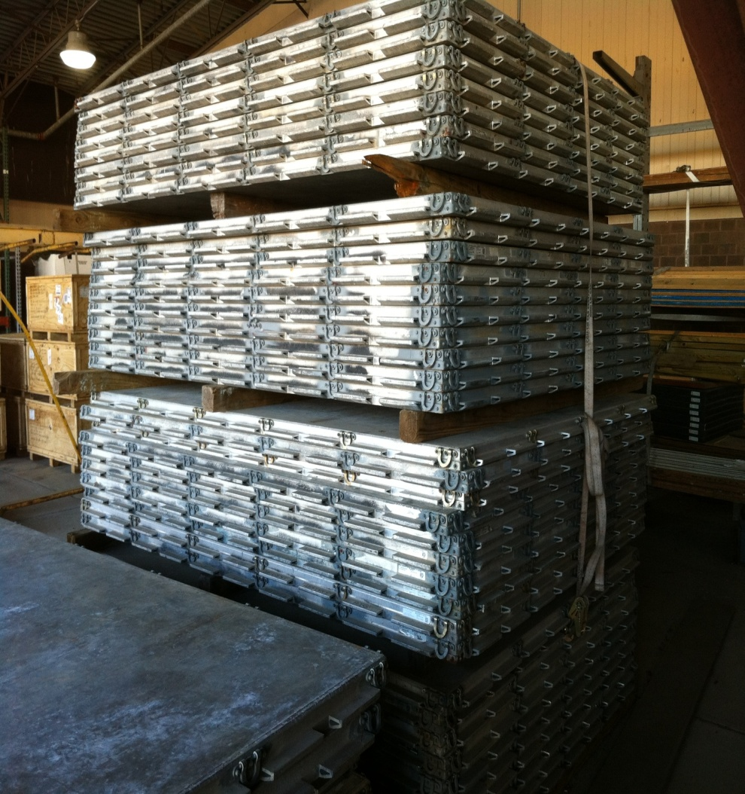
STORAGE AND HANDLING
Pallets may be stacked 20 high for air shipment
This number does not include the base support pallet separated by 3 pieces of dunnage.
Up to 50 high are authorized for unit, APOE, and APOD storage areas
Do not stack upside down, damage may occur
Notes:
1. Normally, three pieces of dunnage are placed between stacks of ten pallets
2. Never stack empty pallets upside down, damage could occur

Slide 16
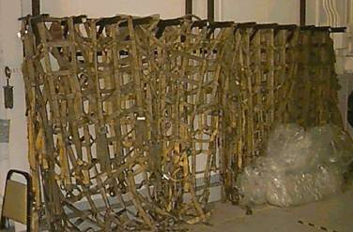
Protecting nets:
    Hang and dry all nets after use
    Never pile wet nets together
      Nets can mildew
      Hooks can rust
      Protect nets from adverse climatic conditions
Notes:
Protect nets from adverse climatic conditions
1. Netting materials will mildew and deteriorate
2. The metal hooks will also rust if not properly cared for
3. Hang and dry all nets after use
4. Never pile wet nets together for storage

Slide 17
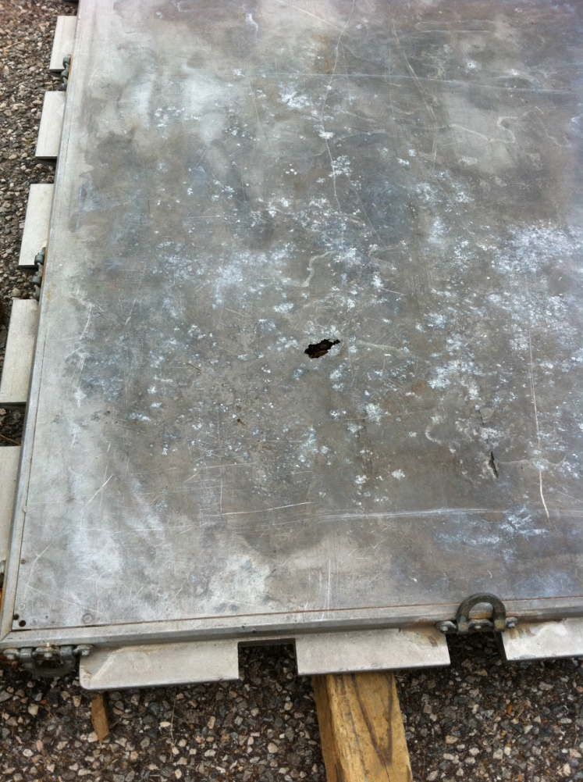

Protect the upper surface of the pallet (shoring for sharp cargo)
Never push or slide 463L pallets across any solid surface
Notes:
Protect the upper surface of the pallet from sharp edged cargo, place adequate shoring or cushioning materials between the cargo and the pallet
Be careful when transporting 463L pallets with a forklift, the tine tips can easily damage the pallet surface making it unusable
Never push or slide 463L pallets across any solid surface, to do so will cause damage to the skin

Slide 18
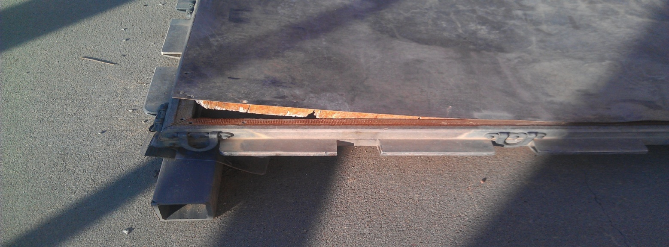
Ensure serviceability:
    Do not use pallets if aluminum skin is separating or punctured
    The skin-to-rail bond is an important part of the pallet’s strength
  Use pallets with minor dents, gouges, and scratches that do not fracture the skin
  Keep pallets as clean as possible
Notes:
Ensure the pallet is level and not warped

Slide 19
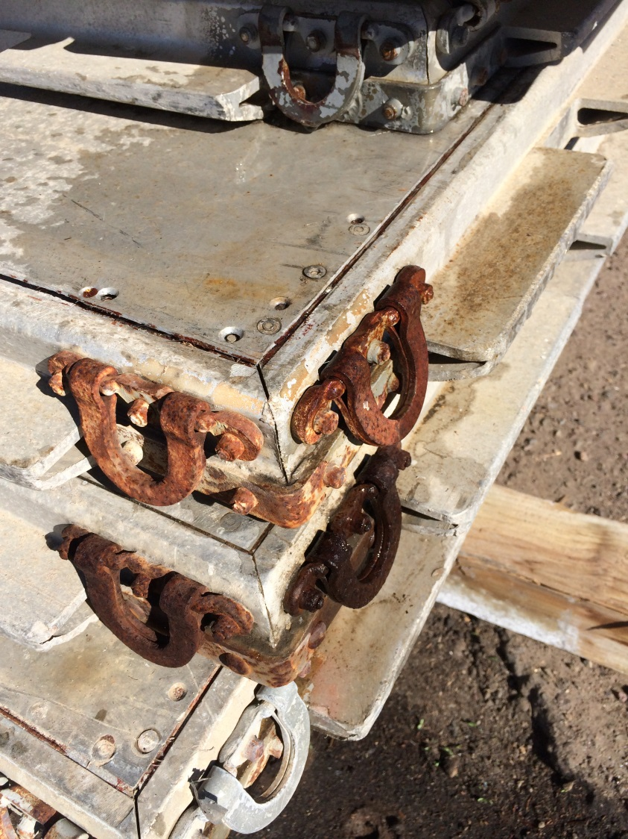


Slide 20
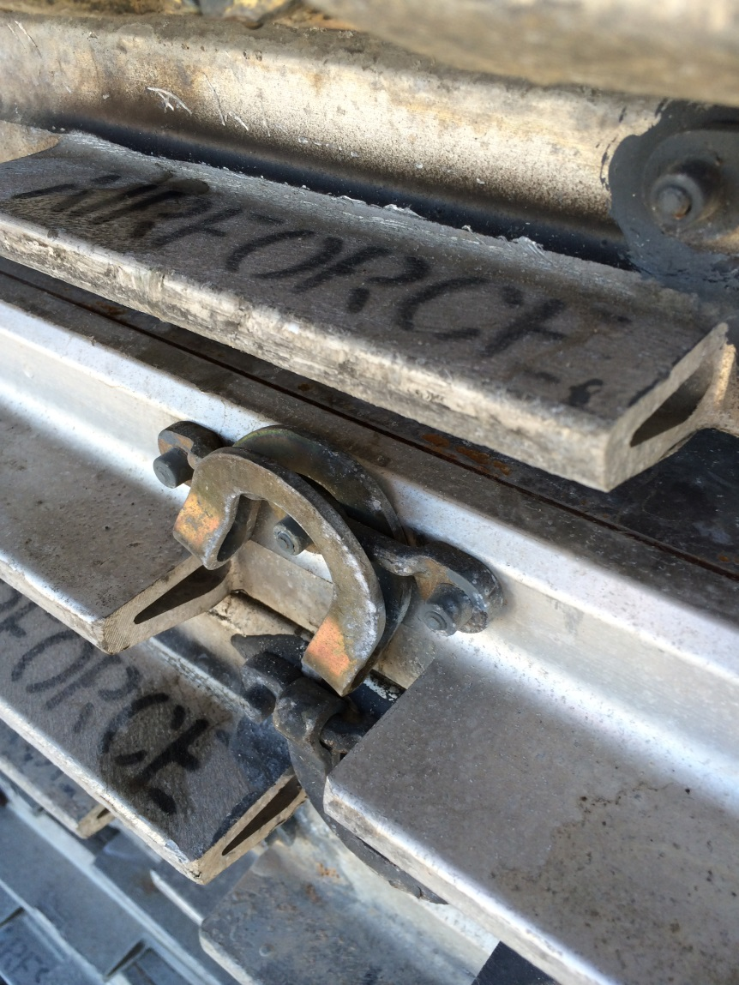
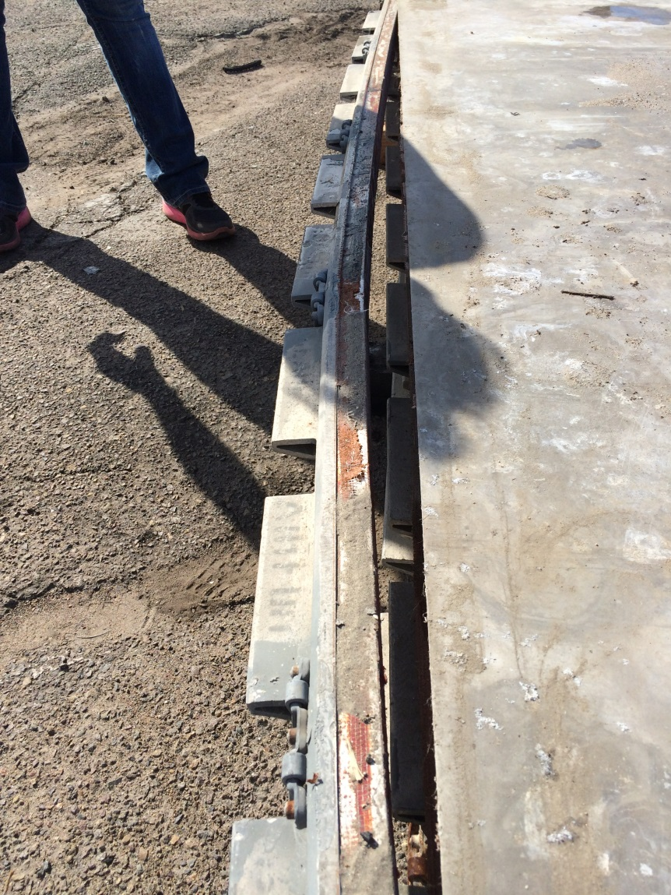
Notes:
For more extensive damage (such as bent rails or damaged/missing tiedown rings), the pallet will not be accepted for air shipment

Slide 21
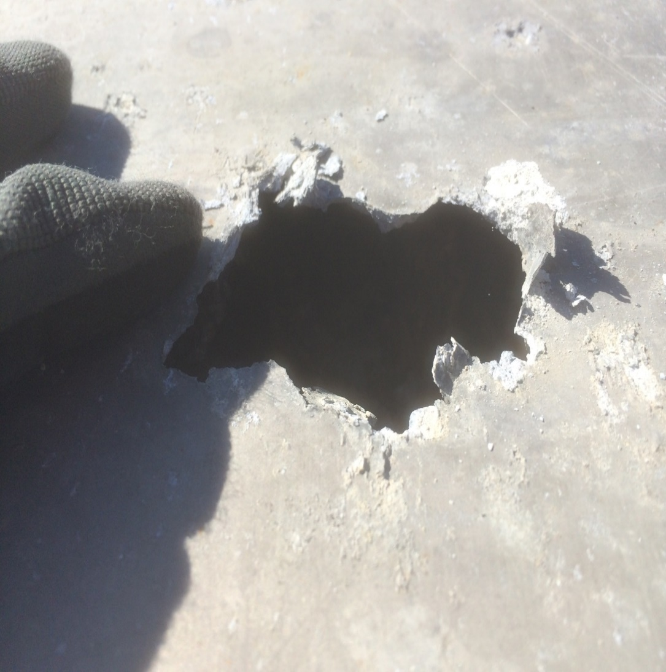

Notes:
It must be sent to depot for repairs

Slide 23
  Distribute large and heavy objects evenly from the center of the pallet outward:
      Prevents pallet from becoming heavy on one end
      Maintains pallet center of balance
Notes:
2. Place lighter and/or smaller items on top or along the side of the heavier cargo
3. Construct the load in a square or pyramid shape when possible
a. Do not allow cargo to extend beyond the vertical stacking line (84 by 104 inches) of netted pallets
b. This makes the load stable, easy to handle, easy to secure to the pallet, and prevents binding in the aircraft 463L dual rail system

Slide 24
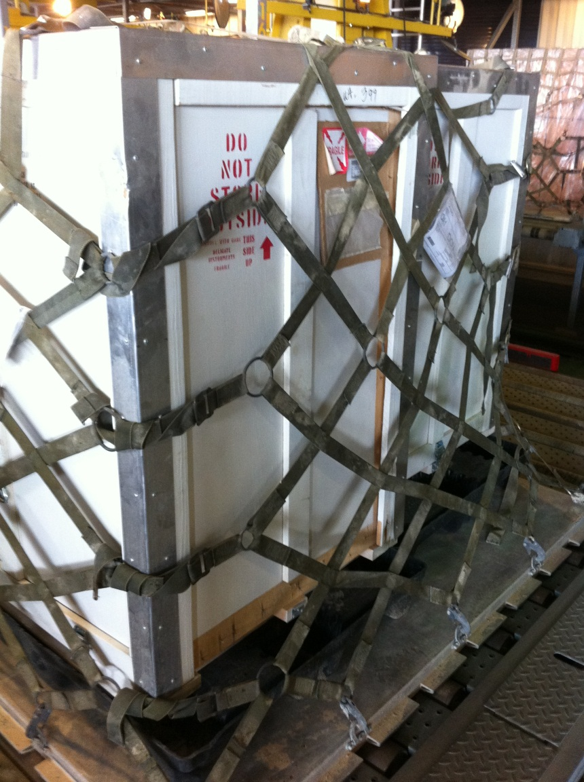

Containers marked “this side up” must be placed upright
Cargo with special labels should have labels facing outward

Slide 25

Hole in bottom of C-17 from battery packed upside down on pallet. The acid ate a hole through the pallet and aircraft floor

Slide 26

Hazardous materials:
    Must be placed on the pallet with the label clearly visible and never buried or hidden
    Must be accessible in flight in case of leakage
Notes:
A pallet build up procedures checklist will be discussed during the hands on pallet build up and weighing and marking exercise

Slide 27
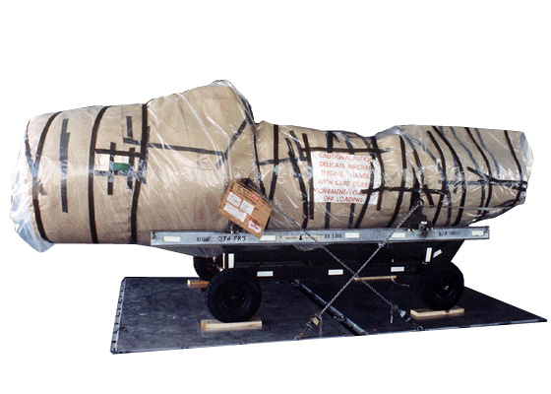
MARRIED PALLETS EXCEEDING PALLET DIMENSIONS
When cargo exceeds the dimensions of a single pallet, you must join two or more pallets together
Notes:
1. Exceeding Pallet Dimensions
a. When there is a requirement to ship cargo that exceeds these dimensions, we may join two or more pallets together
1. Referred to as the marrying of pallets or pallet trains (double or two)
2. The same applies to three, four, five, or six pallets when joined
b. Before marrying pallets, inspect them to be sure they are clean and in good repair
1. Ensure the rails are not bowed and the tiedown rings are securely mounted

Slide 28
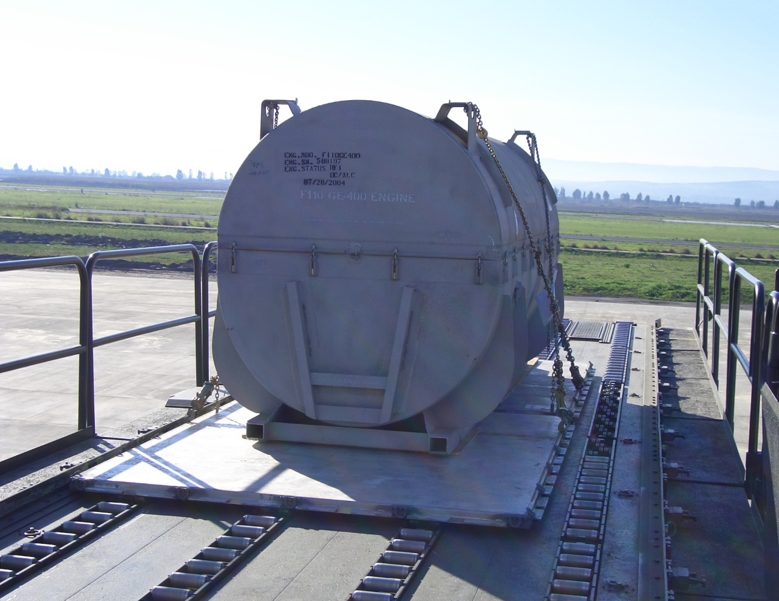
Equipment needed for build-up:
    High line/cargo dock
    Rollerized flatbed
    K-loader

Slide 29
Align the indents along the 108” side of each pallet
Exceptions: C-17 – ADS align on 108” bias
LRS align on 88” bias
Install couplers between the pallets
They keep the pallets connected, aligned, and properly spaced so pallets will lock into the aircraft rail system

Slide 30
Commercial Aircrafts uses a unique 1” coupler and can only accept two pallet trains (88” or 108” bias)
Your local AMLO/ADACG/UMO may be able to help you get any required coupler

Slide 31
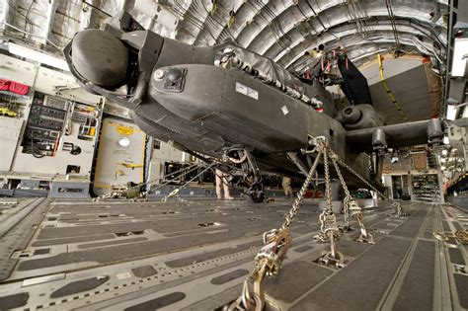
RESTRAINT REQUIREMENTS
Criteria for Cargo is:
  3G’s forward
  1½ G’s left, right, and aft,
  2G’s vertical

Slide 32
Use barriers and chain bridles
If over 30in. 2 bridles minimum will
Be used for low and high
The minimum thickness for the barrier is ¾”
Notes:
Use barrier boards and chain bridles for loose heavy items such as lumber and pipe
If height exceeds 30 inches, apply multiple chain bridles

Slide 33

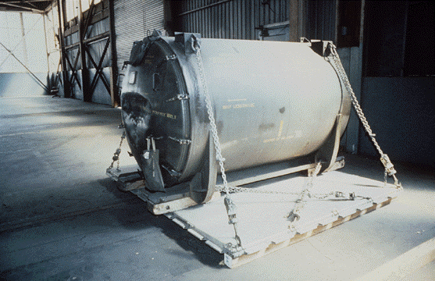
Use chains and tie-down devices for large items such as canned engines or palletized wheeled items
Notes:
Lateral restraint must be symmetrical

Slide 34
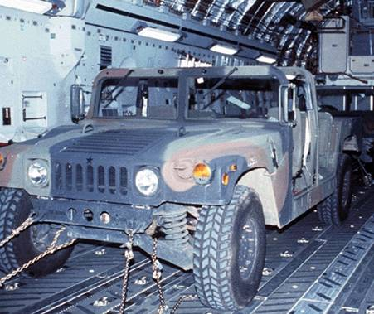
Do not attach more than half of the required restraint, in a given direction to the axles of wheeled equipment
Notes:
a. More than ½ of the required restraint applied to the axles will require the vehicle’s suspension to assume the majority of restraint
b. This could result in suspension failure and loose equipment in-flight

Slide 35
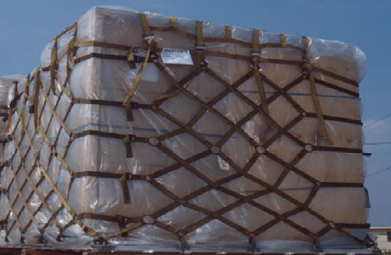
Use chains for heavy items
Use 463L nets for multiple loose items

Slide 36
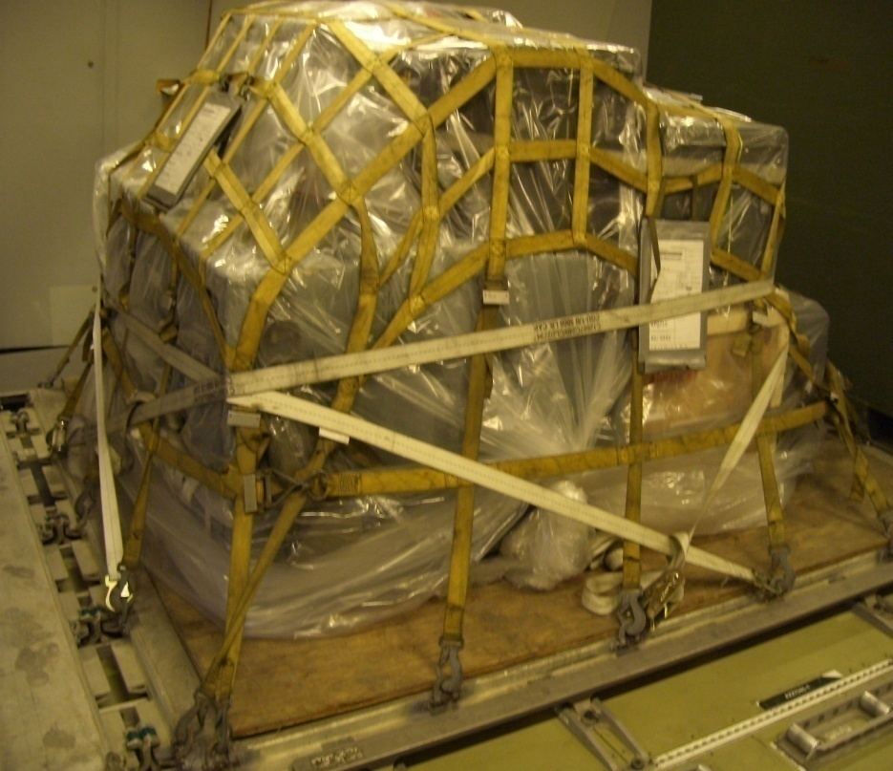
Use 5,000 lb. tie-down straps to provide restraint for single items or as supplemental restraint in conjunction with 463L pallet nets

Slide 37
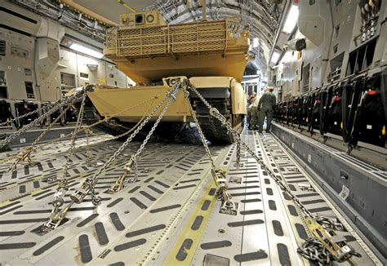
Do not use a mixture of nylon straps and metal chains to provide restraint in the same direction for any item of cargo
  The nylon can stretch forcing the metal chain to assume the entire applied load which could result in chain failure

Slide 38


Slide 39
Material Handling Equipment (MHE)

Slide 40
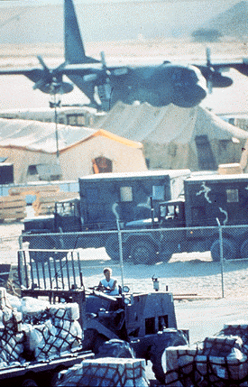
You have a responsibility to provide MHE whenever possible:
  Plan and coordinate for its use:
        Locally
        Deployed locations
  If you need MHE support, contact your local AMLO/ADACG/UMO
Notes:
Many pieces of MHE may be found within your unit or on your installation

Slide 41
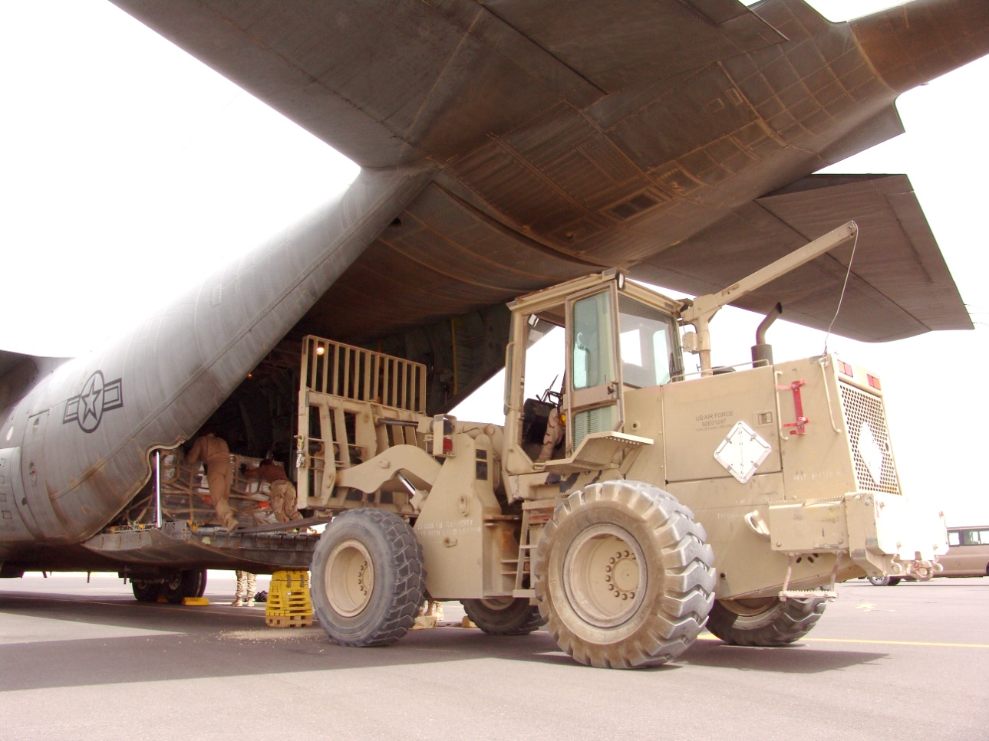
Forklifts are used to lift, transport, and stack cargo or equipment
Notes:
They are located at almost every military installation
These pieces of equipment are extremely valuable in all phases of cargo movement
They aid in cargo build-up at the unit area, transporting cargo to the airfield, and aircraft loading
Most forklifts can be used to load airplanes
The only forklifts authorized to operate inside aircraft cargo compartments is the 10/13 K Adverse Terrain forklift & 4K USMC MHE-237

Slide 42
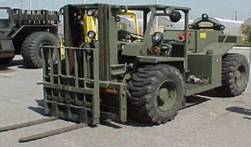
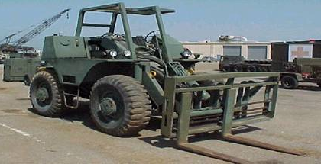
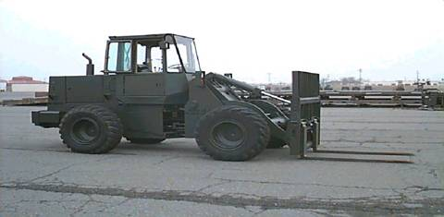
4K
6K R/T
10K Standard
10/13K A/T
Notes:
4K Forklift
4,000 pound capacity
Designed for use in close quarters for storage and shipping operations
In the air terminal area, it’s used primarily for loading and unloading warehouse skids and secondary cargo on vehicles
With the tines (forks) removed and the addition of a front-mounted pintle hook, the 4K forklift makes an excellent pusher vehicle
Tines will raise or lower and tilt forward or aft
Some models can even shift the load right or left
Some models can even shift the load right or left
Limited weight lifting capability
Short tines - cannot handle a 463L pallet
6K Rough Terrain (RT) forklift
Considerably larger than the 4K
Normally only found in US Army and Marine Corps inventories
Designed to rapidly build up and move air transportable cargo
When equipped with a set of tine extenders it can lift 6,000 pounds and may be used to load aircraft with 463L pallets
10K Standard Forklift
The 10K can lift and transport 10,000 pounds of cargo
Capable of loading the C-130, KC-135, C-17, and C-5
Can’t be used as a prime mover
10/13K Adverse Terrain (AT) forklift
Can lift and transport 10,000 or 13,000 pounds of cargo depending on the configuration of the counter weights
Capable of loading the C-130, C-17, and C-5
May be used as a prime mover to load and offload rolling stock within the aircraft, with the following restrictions:
Forklift limitations and aircraft limitations must not be exceeded
Maximum speed on aircraft ramp and cargo floor is 3 mph
The 10/13K can be loaded, as an item of cargo, on the C-5, C-17, and C-130
Must be placed within specified locations on C-130 aircraft
Requires the use of sleeper shoring and removal of the cab for shipment
Some 10/13K (AT) forklifts require counterweights be removed prior to air shipment

Slide 43
Rollerized
Tines
Bare Tines
Forklift tines must be at least 72” long for use with 463L pallets
Tine extenders come in two configurations

Slide 44
K-loaders provide the capability to rapidly on and offload 463L pallets from airlift aircraft
  They’re large and heavy, and may be difficult to transport
  Early coordination with your local AMLO/ADACG/UMO is essential if your unit needs one

Slide 45
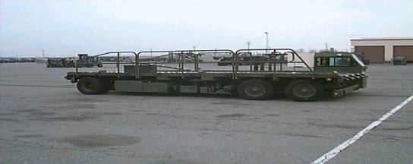
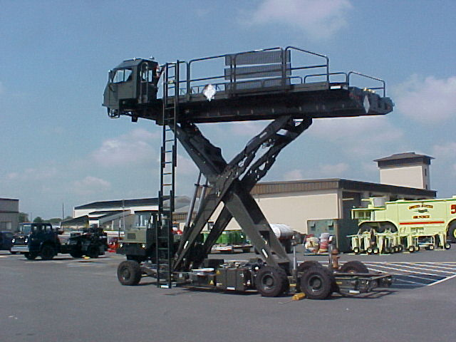
25K (3 Pallets)
“Halverson” Next Generation Small Loader (NGSL)
Notes:
25K
A self-propelled cargo transportation platform
It can lift and transport three 463L pallets up to a maximum cargo weight of 25,000 pounds
The deck may be raised, lowered, tilted forward or aft permitting alignment with aircraft floors. The deck also can roll from side to side
The deck has rows of recessed rollers installed the entire length of the vehicle
These rollers are used as conveyers for palletized loads
Guide rails run the entire length of the deck to align the pallets with the aircraft rail system
Locks are installed in the rails to prevent the pallets from moving
The loader has removable safety rails and a side catwalk
Access to the deck in either the up or down position is by a telescoping ladder
May be transported on the C-130, C-17, or C-5
Capable of loading the C-130, KC-135, C-17, and C-5
Halvorsen, Next Generation Small Loader
Supports all military and civilian cargo
It is air transportable on C-130, C-5, and the C-17
Has the ability to lift and transport up to three pallets and up to 25,000 pounds
Equipped with removable safety rails, catwalks, ladder, and 463L system rails and locks
Deck can service floor heights from 39 inches to 225 inches

Slide 46
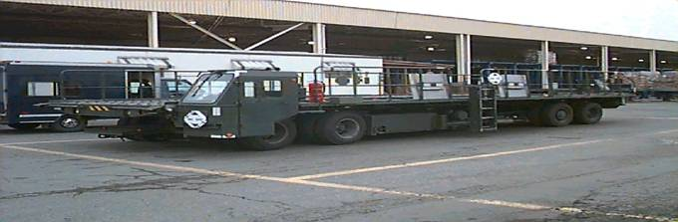
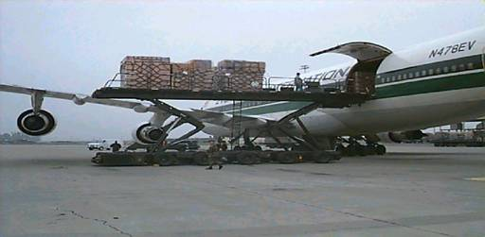
40K (4 pallets)
60K “Tunner” (6 pallets)
Notes:
40K IS VERY RARE TO SEE AS IT HAS BEEN PHASED OUT AND REPLACED BY THE 60K AND NGSL
60K (Tunner)
Has increased capacity over the 25K and the Halvorsen loaders
Can be used to service all military and civilian aircraft
Equipped with removable safety rails, catwalks, ladder, and 463L system rails and locks
It is air transportable on C-5 and C-17 aircraft
When airlifted it does not require the use of shoring
Has the ability to lift and transport up to six pallets and/or 60,000 pounds of cargo

Slide 47
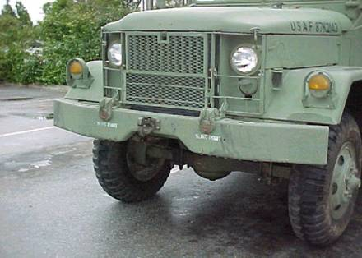
PUSHER VEHICLES
Any type of vehicle modified with a front mounted pintle hook
Notes:
These vehicles aid dramatically in loading trailers on military cargo aircraft
Pusher vehicles allow the driver to have a direct view of the trailer as it moves into the aircraft. It is quicker and safer than having the driver back the trailer onto the aircraft
The best vehicles to use as pusher vehicles are M-Series trucks or the MHE 237, US Marine Corps 4K forklift
Do not exceed the pusher vehicle’s cargo capacity

Slide 48
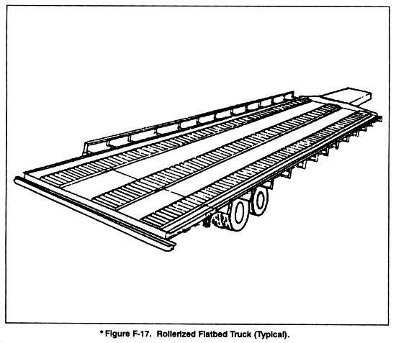
They come in a variety of sizes, lengths, and capacities
Help with speedy handling of palletized cargo
Notes:
Roller conveyors can be attached to the bed to accommodate cargo build-up, transportation, and loading of 463L pallets

Slide 49
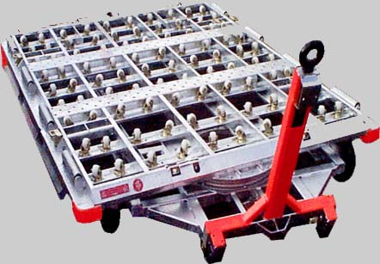
Aid in the building, transporting, storing, and loading of cargo on 463L pallets
Dollies have a towbar and pintle hook for attaching to a towing vehicle or coupling the dollies into a train
Notes:
Equipped with swivel casters or rollers to aid in pallet movement, they are used in conjunction with forklifts
As a loading device
Rollerized tines are not required

Slide 50
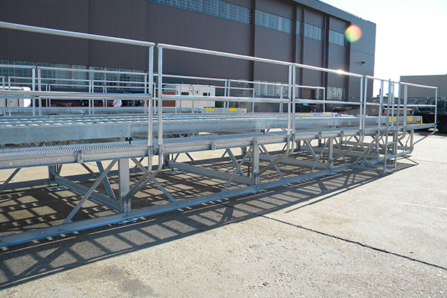
HIGH-LINE DOCK
Notes:
K-Loader Ramps
Commonly known as “High Line” Dock
Used for pallet train assembly/disassembly
Permits on/offload of Rolling Stock using K-Loader with bridge plates

Slide 51
Weighing and Marking

Slide 52
WEIGHING CARGO
All cargo offered for shipment must be weighed
  Portable or fixed scales
  Indicate actual weight on both sides of items offered for shipment
  Scale weight must be recorded on all copies of the manifest

Slide 53
Accuracy of weights
  Don’t weigh cargo until secondary load is secured
  Don’t add or remove cargo
  Any changes require cargo to be weighed again
  The driver and/or passengers must be out of the vehicle prior to weighing

Slide 54
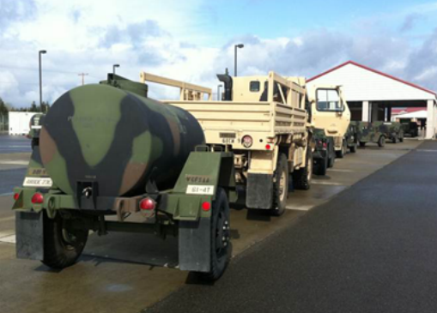
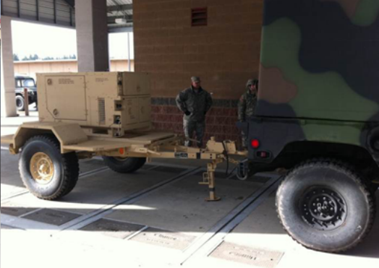
Fixed Scales
  Permanently installed weighing devices
  These scales are capable of weighing most items of cargo
Notes:
Scales
Fixed scales are permanently installed weighing devices
Located at most major military installations
They are similar to most truck scales seen along side of major American highways
These scales are capable of weighing most items of cargo

Slide 55
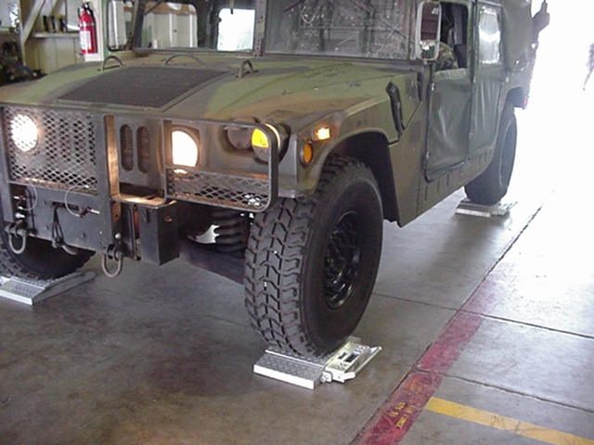
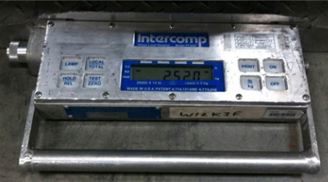
Portable scales
  Most commonly used
  Capacity 20,000 lbs. per scale
Units should have their own scales to help expedite deployment
Notes:
Portable scales
The most commonly used portable scales are capable of weighing cargo up to 20,000 pounds per scale
These scales are used extensively at airfields, unit areas, marshalling areas, inspection areas, and forward operating locations
Portable scales are normally used in multiples of four
A minimum of two scales will be used
It is advisable for all units to have their own scales to help ensure a smooth deployment

Slide 56
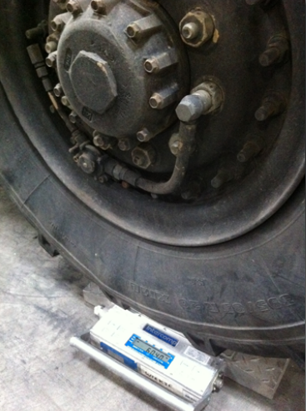
When only two portable scales are available:
    Place the scales in front of the tires of the first axle
    Drive the vehicle onto the scales; keep tires centered
    Determine the axle weight
    Continue process until all axles are weighed
Notes:
Note: The driver and/or passengers must be out of the vehicle prior to weighing the axle/axles

Slide 57
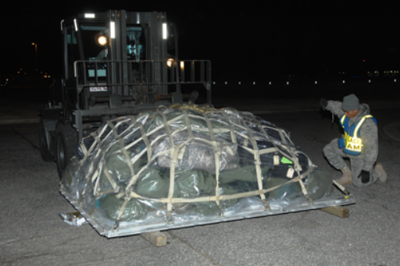
Each 463L pallet must be weighed
Scale weights must be recorded on all copies of the manifest

Slide 58
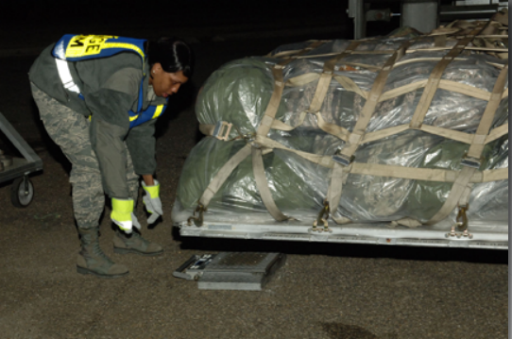
Place a loaded pallet evenly on two portable scales (Note: Three pieces of dunnage must be weighed with the pallet)
Add the two scale weights together to get the pallet gross weight
Notes:
Ensure the scale weight is clearly marked on:
Use DD Form 2775 (Pallet Identifier), to annotate the required information for cargo documentation
All container/pallet weights will also be marked with a Military Shipping Label or DD Form 1387

Slide 59

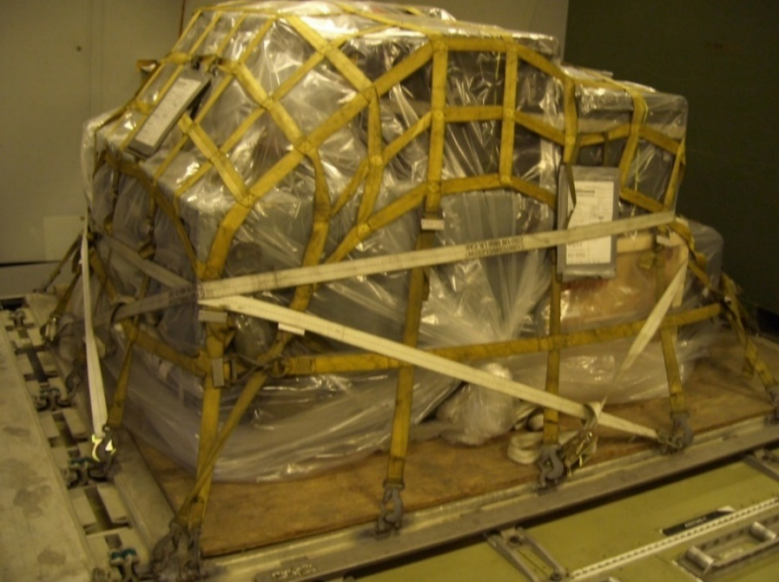
Two copies of the pallet identifier will be completed for all 463L pallet/trains loaded with cargo/mail

Slide 60
If the DD Form 2775 is unavailable, a legible substitute can be accepted with the following information, as a minimum:
    Point of Embarkation (POE)
    Point of Debarkation (POD)
    Gross weight
    Net weight
    TCN
    Height

Slide 61

Attach the copies to the upper left hand corner at eye level (when pallet height permits)
One on a 88” side
and one on a 108”
side of the pallet

Slide 62
Place the form inside interlocking closure plastic bags for protection
Entries on the form are self-explanatory
Never reflect words “classified”, “small arms/weapons”, “munitions”, or other highly sensitive items by name

Slide 63

Military Shipping Label/DD Form 1387
  All containers and built-up 463L Pallets will also be marked with a Military Shipping Label (MSL)
  The MSL allows automatic identification Technology to process unit move Shipments expeditiously
  Two properly completed copies are required for each container/pallet
Notes:
The DD Form 1387, Military Shipment Label may be used only for contingency
operations when the automated MSL is
unavailable
Refer to DTR Part III Appendix H for detailed guidance

Slide 64
Center Of balance calculation and terms

Slide 65



(RDL) = Reference datum line
(CB) = Center of Balance
(GW) = Gross weight
(W1) = Weight one
(W2) = Weight two
Notes:
Reference datum line (RDL)
A line from which all measurements are taken, normally, the RDL is established at the forward edge of a vehicle
Once the reference line is established, don’t change it
Center of Balance (CB)
The point of balance of a piece of cargo
Gross weight (GW)
The total weight of an item of cargo, including all secondary cargo
Gross Weight (GW) and Total Weight (TW) are interchangeable terms
Weight one (W1)
Used in computing the CB
W1 - first weight from the RDL
Weight two (W2)
Used in computing the CB
W2 defines the second weight contacting the floor from the RDL
W3, W4, and W5 = weight three, weight four, and weight five. Terms used to define subsequent weights after W1 and W2

Slide 66

(D1) = Distance one
(D2) = Distance two
(M) = Moment (inch pound)
Notes:
Distance (arm) one (D1)
The distance from the RDL to W1, measured in inches
Distance (arm) two (D2)
The distance from RDL to W2, measured in inches
D3, D4, and D5 = distance three, distance four, and distance five. Subsequent distances (always measured in inches) from the RDL to the appropriate weights
Moment (M)
M = product obtained by multiplying weight (in pounds) by distance (in inches) from the RDL

Slide 67

(FAW) = Front/forward axle weight
(MAW) = Middle axle weight
(RAW) = Rear axle weight
(FFE) = From forward end
Notes:
Front/forward axle weight (FAW)
The front axle of a vehicle. The first axle from the RDL (see figure 8.10.)
Middle axle weight (MAW)
The axle(s) between the front and rear axles. The middle axle weight is measured from the RDL (see figure 8.10.)
Rear axle weight (RAW)
The rear axle of the vehicle. The last axle of the vehicle from the RDL (see figure 8.10.)
Front forward edge (FFE)
Distance measured from the most forward edge of a vehicle to the CB of a vehicle

Slide 68

Center of balance markings are not required on individual 463L pallets
Mark the CB on all items of
cargo that meet the following
criteria
  All vehicles
  Any items of cargo 10’ or longer
  Any item with a CB point other than its center
Notes:
If 463L pallets are built correctly, the center of balance will be at or near the center
You must place center of balance (CB) markings on married pallets (pallet trains)

Slide 69

To determine the center of balance for a tracked vehicle, drive the vehicle over an object large enough to allow the vehicle to teeter
The location of where the vehicle teeters will be marked as the center of balance

Slide 70
GW 17,530
C.B.
99"
FAW 6320
F.F.E.
MAW 5690
RAW 5520
After computing the CB of the vehicle:
Mark its location and gross weight on both sides of the vehicle
Using weather resistant masking tape and grease pencil/magic marker, forming the letter “T”
MAW 5690
RAW 5520
FAW 6320
GW 17,530 empty
C.B.
99"
F.F.E.

Slide 71

“T” marking
  The horizontal portion of the “T” will contain the gross weight
  The vertical portion indicates the exact position of CB
  Indicate number of inches from the RDL to the CB location and mark axle weights above each axle on both sides of the vehicle

Slide 72
Weight 1 × Distance 1 = Moment 1
Weight 2 × Distance 2 = Moment 2
Total Moment ÷ Total Weight = C/B
NOTES:
Gross Moment and Total Moment are interchangeable terms
Round decimals to the nearest whole number

Slide 73

W1 × D1 = M1
W2 × D2 = M2
W1 + W2 = GW
M1 + M2 = GM
GM ÷ GW = CB
Round decimals to the nearest whole number

Slide 74
W1
W2
D1
D2

Slide 75
W1
W2
W3
W4
D1
D2
D3
D4
(W1 × D1) + (W2 × D2) + (W3 × D3) + (W4 × D4)
GW
= CBFE

Slide 76
CB Calculation PRACTICE

Slide 77
WEIGHT × DISTANCE = MOMENT
1,400 × 25” = 35,000
1,050 × 97” = 101,850
GW = 2,450 GM = 136,850
GM GW CGFE
136,850 ÷ 2450 = _____ inches

Slide 78
RDL
W1
W2
D1
D2

Slide 79
WEIGHT × DISTANCE = MOMENT
50 × 14” = 700
490 × 60” = 29,400
GW = 540 GM = 30,100
GM GW CGFE
30,100 ÷ 540 = _____ inches

Slide 80
QUESTIONS?

Slide 81
Summary
Palletization
Material Handling Equipment
Weighing and Marking

