Slide 1
CARGO PREPARATION

Slide 2
Overview
Cargo Preparation
Joint Inspection Procedures
DD Form 2133 Joint Inspection Form Instructions

Slide 3
The deploying unit is responsible for preparation of cargo, including weighing, marking, palletization, and documentation

Slide 4
Containers – ISU containers and palletized freight containers are certified for airlift. Keys for containers WILL be available & ACCESSIBLE during all phases of the airlift process

Slide 5
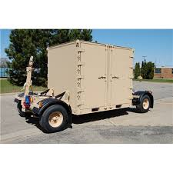
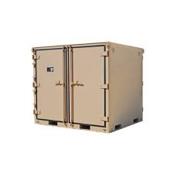
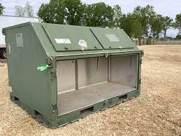
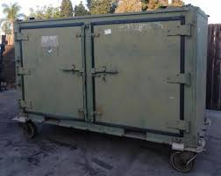

Slide 6
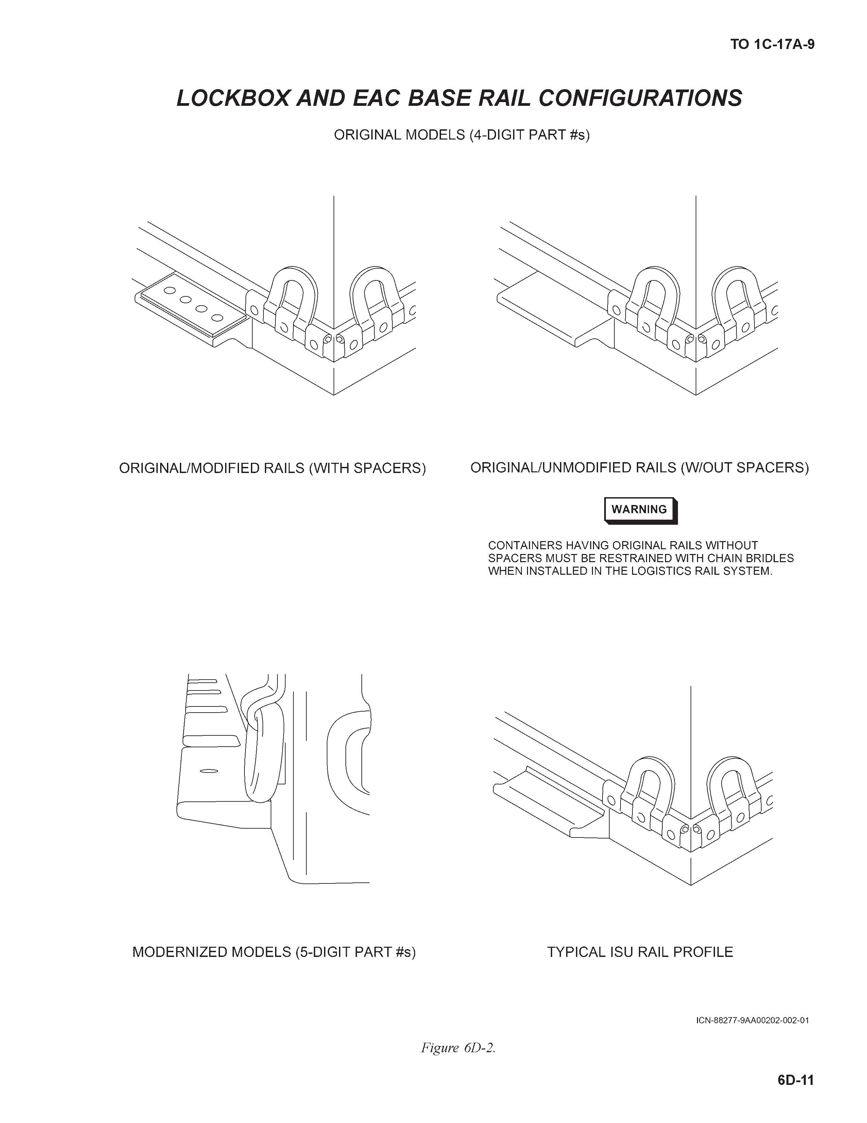
Be aware of which model isu containers you have.

Slide 7

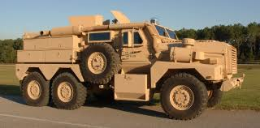
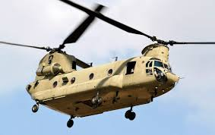
Vehicles & Helicopters – follow weighing and marking procedures

Slide 8
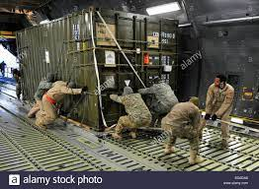
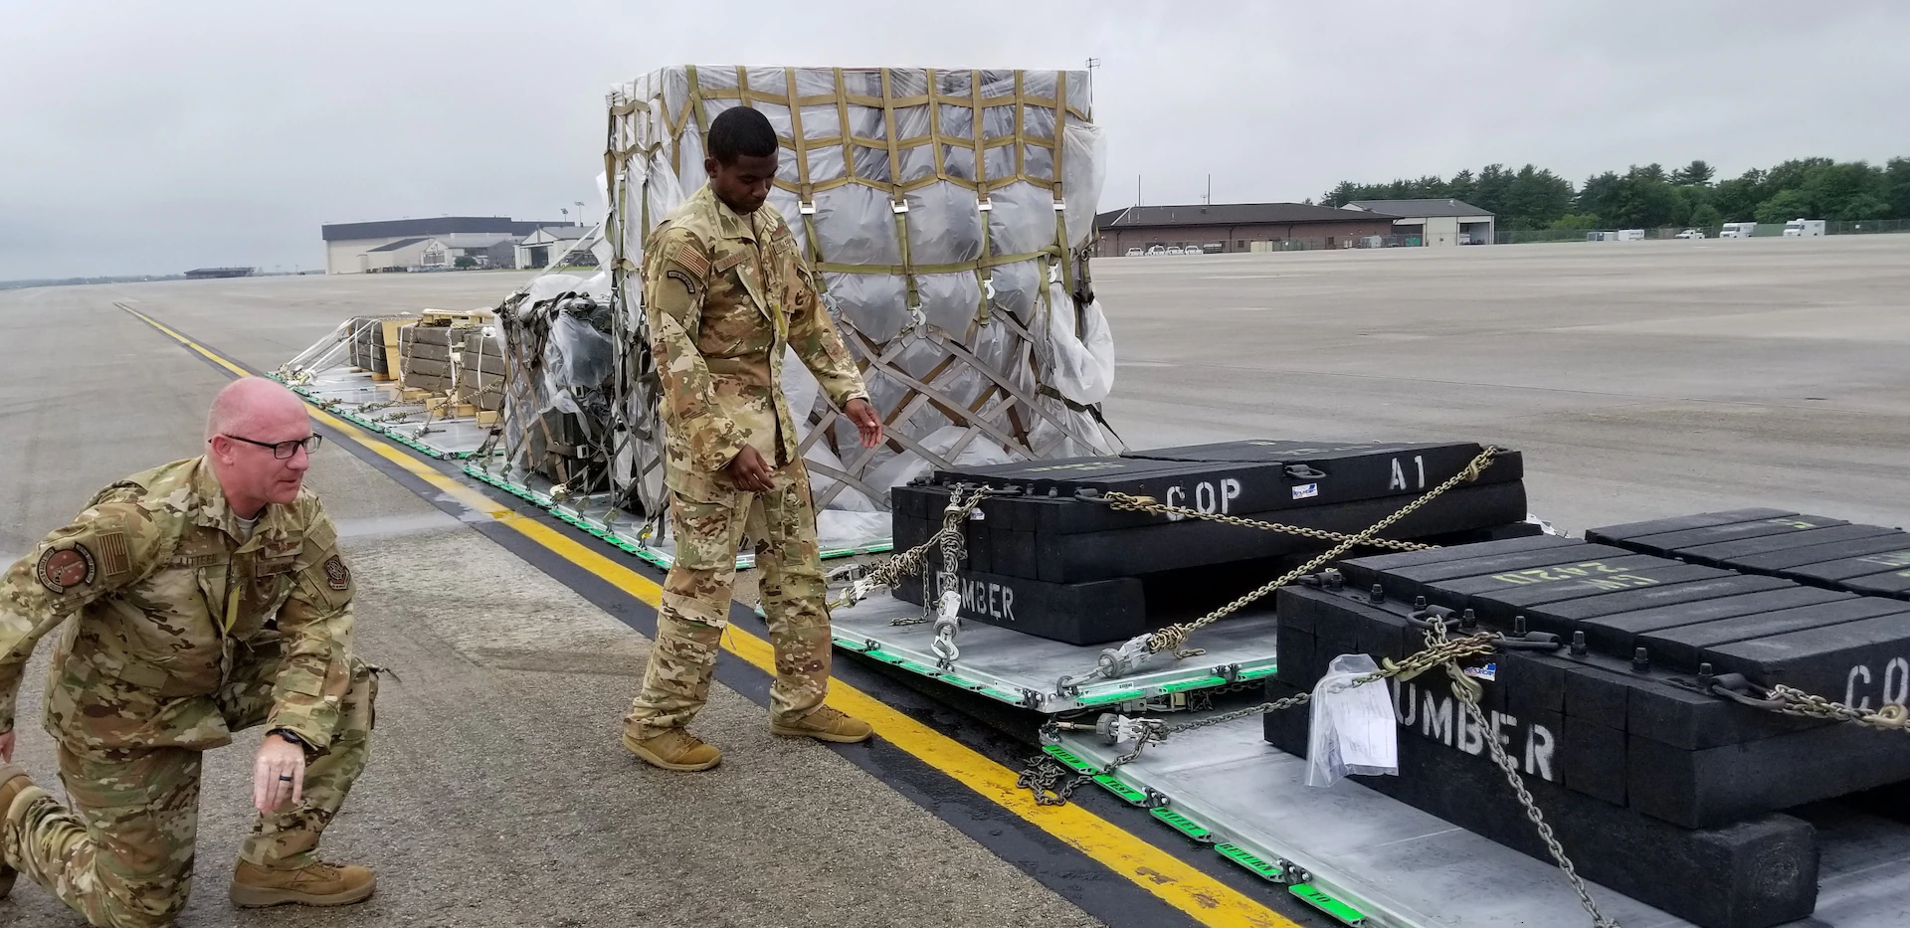
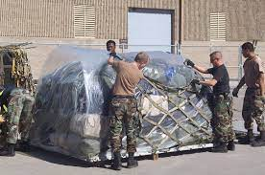
Palletized Cargo – follow Pallet Build-up and weighing and marking procedures as previously discussed
H

Slide 9
The deploying unit is responsible for the certification of ammunition, explosives, and other HAZMAT for movement on DoD owned and controlled aircraft
Refer to DTR Part III Appendix J and AFMAN 24-604(I), for detailed preparation, packaging, and handling of HAZMAT for airlift: https://www.ustranscom.mil/dtr/part-iii/dtr_part_iii_app_j.pdf
Notes:
Show them appendix J

Slide 10
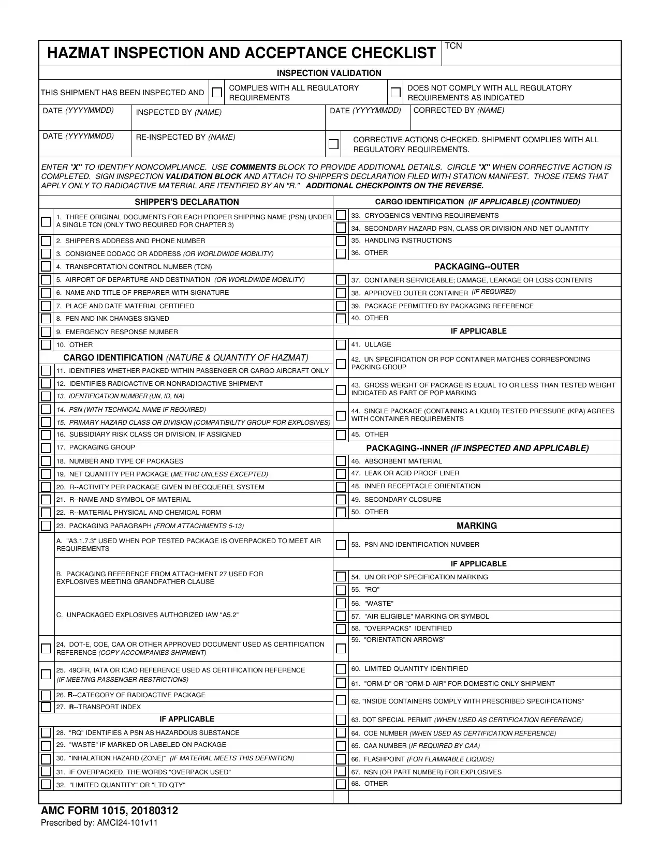
Inspection AMC Form 1015- Checklist used by JI team to ensure Hazardous cargo is safe to ship

Slide 11
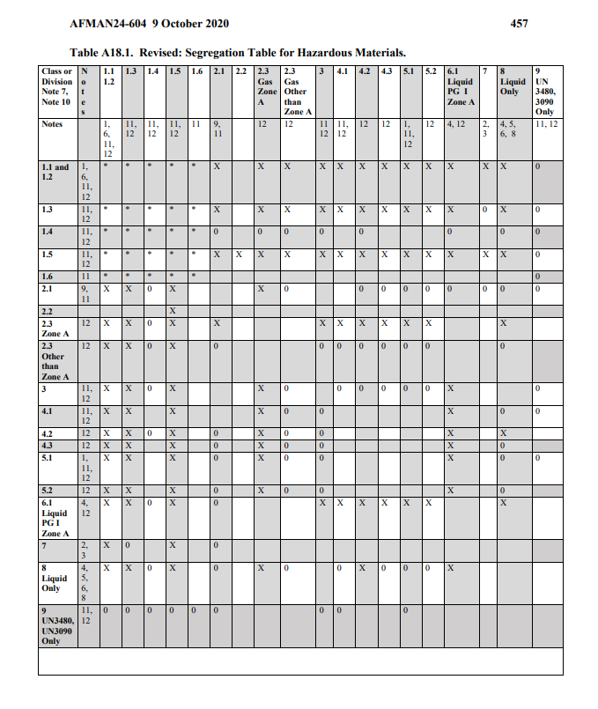
Segregation Table
All DoD personnel participating in the movement of HAZMAT must comply by the 24-604
Only primary hazards considered for segregation

Slide 12
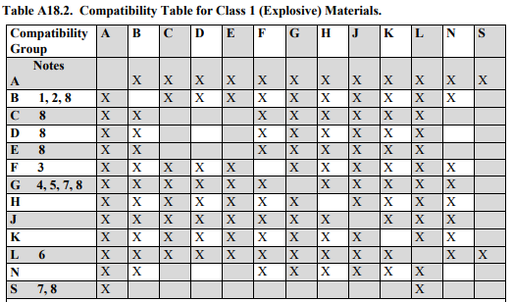
Segregation table for class 1 explosives

Slide 13
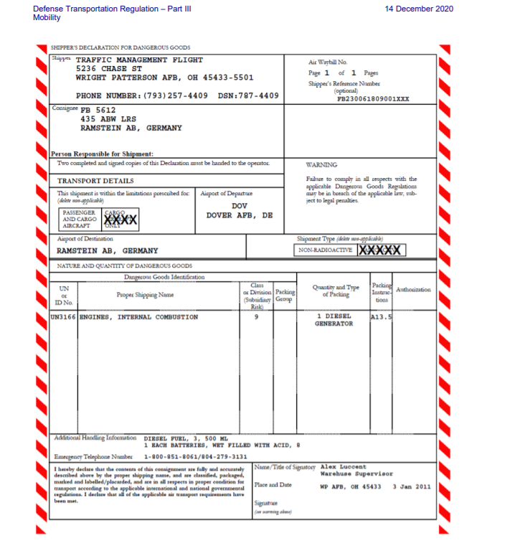
Complete at least 3 Shipper’s Dec’s (1033)
1 attached to manifest
1 attached to originating station file manifest
1 attached to cargo/if multiple pieces attach to piece 1

Slide 14
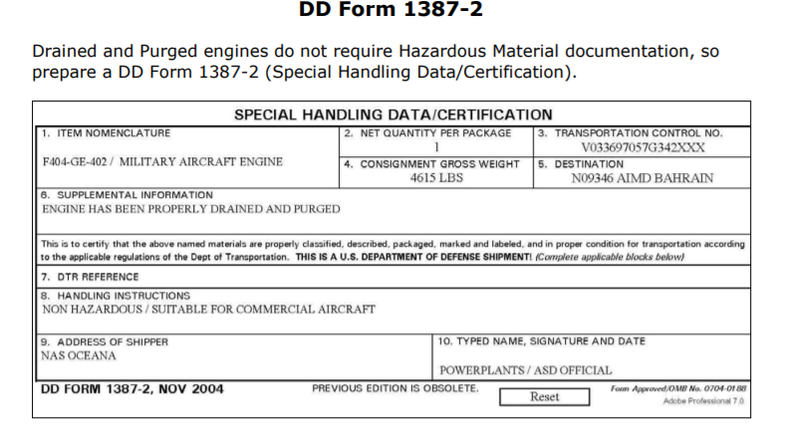
Used when a normally hazardous item is void of the hazard

Slide 15
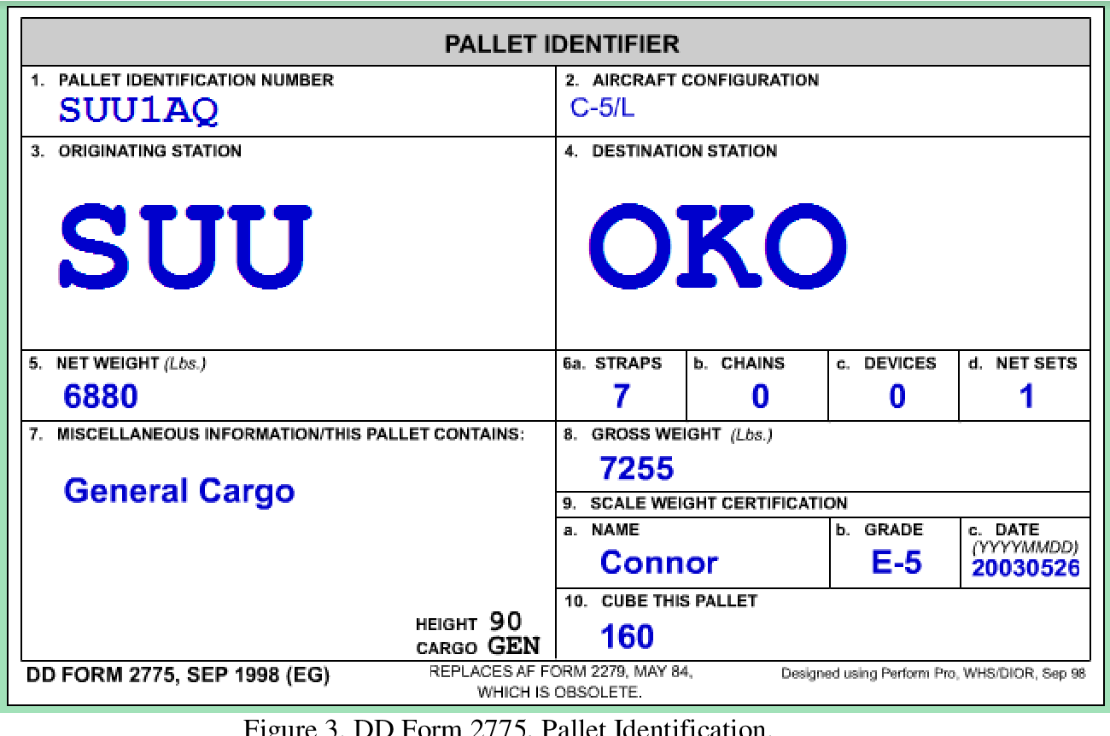
J

Slide 16



Slide 17
QUESTIONS?

Slide 18
Summary

Slide 19


Slide 20
Qualified Air Force and transported force representatives will conduct final inspections
Hazardous cargo certification personnel must also be present
When no other Air Force personnel are available, the aircraft loadmaster or boom operator can conduct the final inspection
This course does not qualify you to be a Joint Inspector
DD Form 2133 is used as the final joint inspection document*
This form will indicate to the aircrew that the required inspections are complete
Form must be legible
Notes:
No “Before Loading Inspection” by the aircrew required if all noted discrepancies are corrected

Slide 21
Three copies are completed for each aircraft load
Minimum distribution for the completed copies is as follows:
Attach the original signed copy to the aircraft cargo manifest
CR Forces/ATOC/DACG/DCC will keep one copy for station
Deploying unit will keep one copy

Slide 22
Joint Inspection Form
Notes:
https://lms-jets.cce.af.mil/moodle/

Slide 23
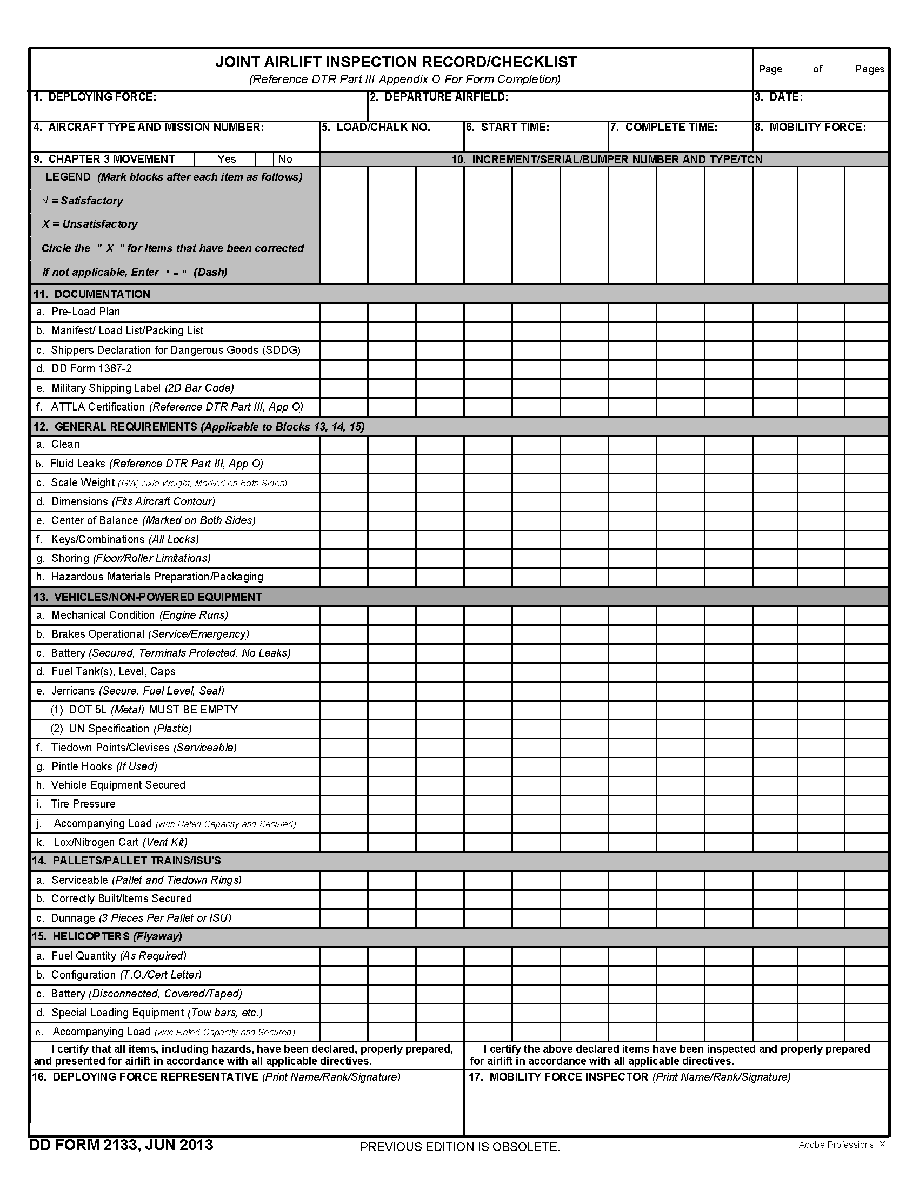
Notes:
Go over the entire 2133 with students and have them take notes on their form

Slide 24
Questions?

Slide 25
Summary
Cargo Preparation
Joint Inspection Procedures
DD Form 2133 Joint Inspection Form Instructions

