Slide 1
SHORING

Slide 2
OVERVIEW
General
Load Spreading
Shoring Categories
Student Activity

Slide 3
GENERAL PURPOSE

Slide 4

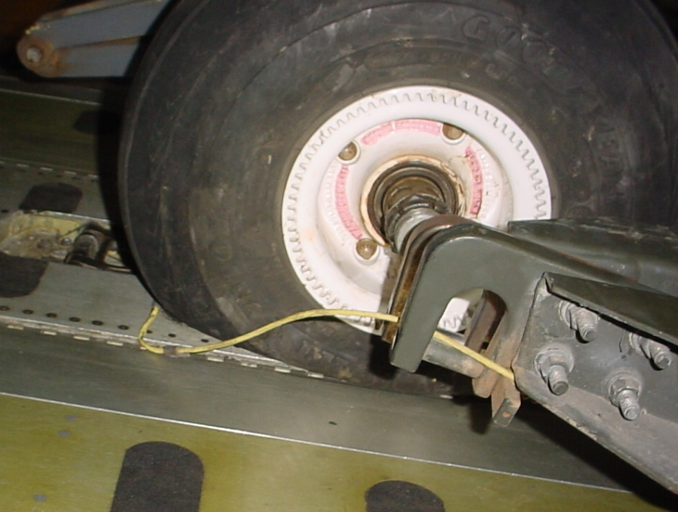
Provides protection
Performance
Contact your affiliated local AMLO/ADACG/UMO about specific shoring requirements
L
Notes:
Provides protection
Protects the aircraft cargo floor and 463L pallet surfaces
Protects aircraft parking ramps
Performance
Increases cargo contact areas for better load distribution
It decreases the approach angle of the aircraft cargo ramps

Slide 5
LOAD SPREADING

Slide 6
Load spreading is a physical process that distributes a concentrated weight over a larger area
Weight exerts a certain amount of pressure determined by its supporting contact area

Slide 7
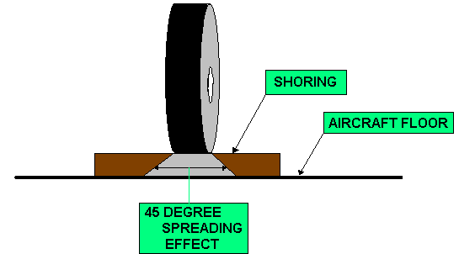
The contact area is increased at a 45 degree angle from the upper surface of the shoring to the cargo floor

Slide 8
The increased contact area decreases the pressure on the floor
Important notes:
Shoring will only increase the area of contact
Shoring does not increase PSI limitations
S

Slide 10
Shoring Categories

Slide 11
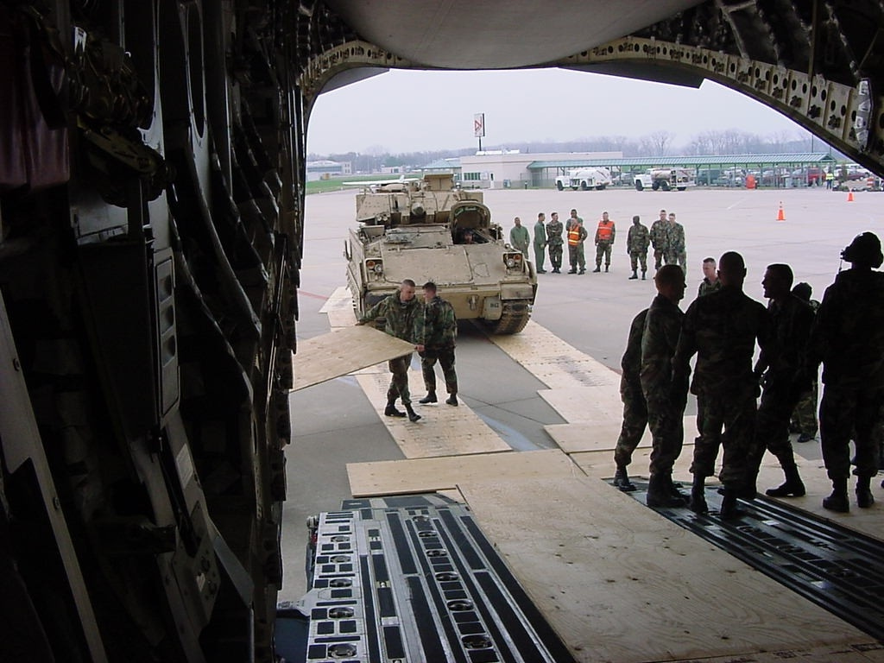
ROLLING SHORING
Protects floors and ramps
Generally not required for most vehicles
Notes:
1. Use rolling shoring to protect the aircraft parking ramp, and the cargo floor when transporting a vehicle across it
2. Most vehicles shipped by air do not exceed weight limitations, and consequently, do not require rolling shoring

Slide 12
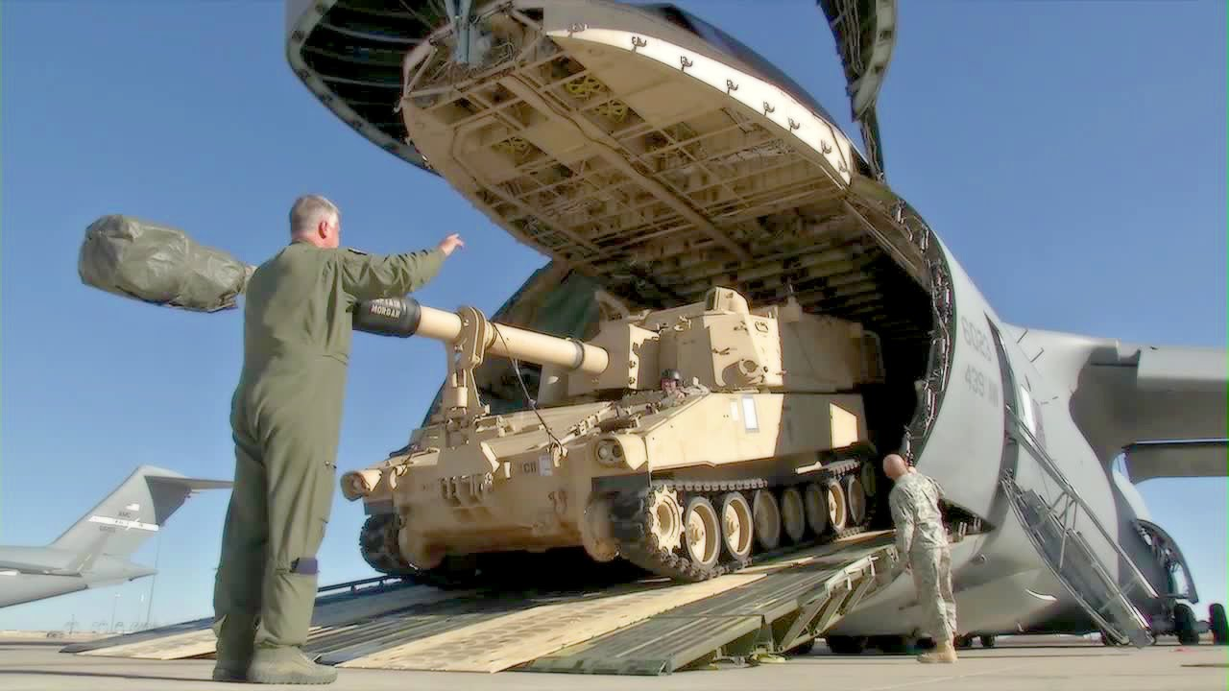
Protects the floor from vehicles with cleats, studs, or other gripping devices
Note: The minimum thickness of shoring is 1/2 inch f/C17 & C5.
¾ f/C130
Notes:
3. Vehicles with cleats, studs, or other gripping devices and treads that allow concentrated contact require rolling shoring
a) Cleated or lugged wheels can easily cause damage to the aircraft floor or soft surfaces
b) The total weight of the vehicle is transferred to the small, concentrated, contact area of the cleats or lugs
c) Vehicles that have concentrated contacts require rolling shoring thick enough to prevent damage to the cargo floor
d) In all cases, the minimum thickness is ¾ inch

Slide 13

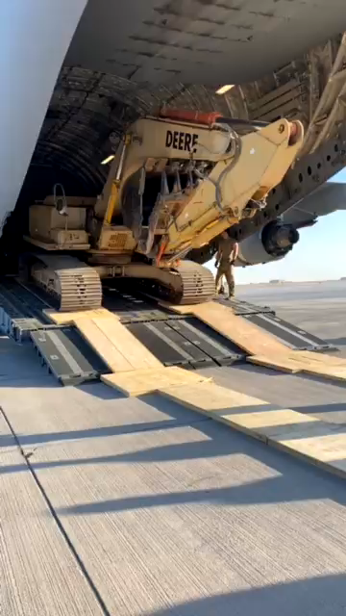

Slide 14
PARKING SHORING
If you need
rolling shoring,
you will need
parking shoring
Notes:
3. Each aircraft has specific floor weight limitations that apply to wheeled and non-wheeled items of cargo
4. If the vehicle exceeds these weight limitations, you must provide parking shoring before the item can be transported by air
a) General considerations regarding parking shoring you may want to remember when planning an airlift
i. Minimum thickness of parking shoring is ¾ inch
ii. Use parking shoring to protect the aircraft floor or ramps from contact such as blades, buckets, fork-lift tines, steel wheels, trailer tongue supports, etc

Slide 15
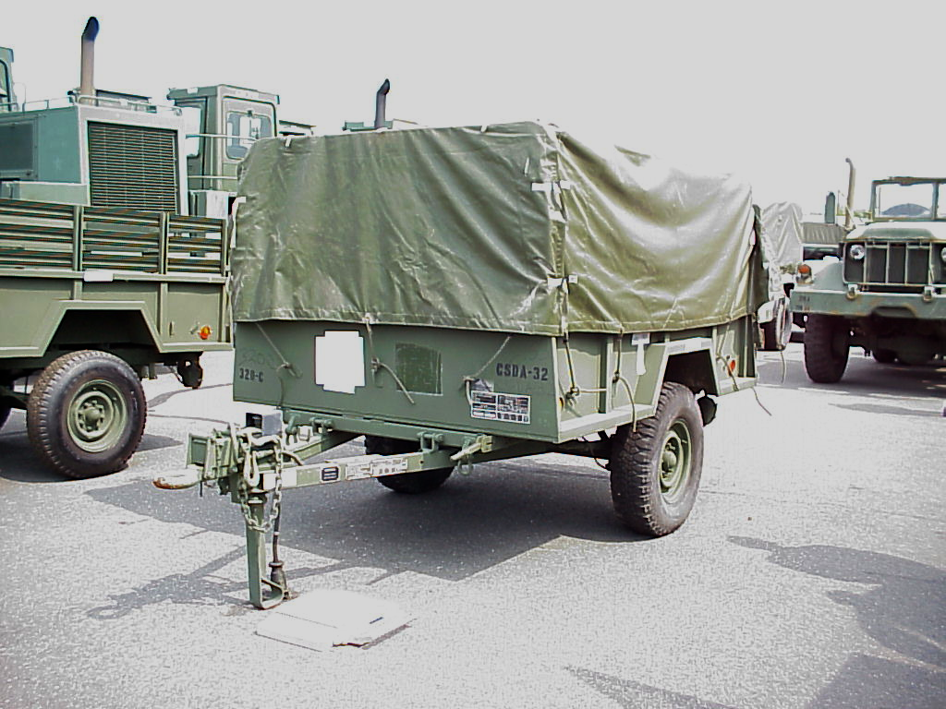
All trailers with a tongue that could rest on the aircraft floor will have parking shoring
Notes:
iii. All trailers with a tongue that could rest on the aircraft floor must be shipped with parking shoring, whether connected to or disconnected from its prime mover

Slide 16
Pneumatic tires do not normally require parking shoring
Notes:
iv. Most pneumatic tires do not normally require parking shoring, the tires that do are usually narrow and/or very heavy

Slide 17
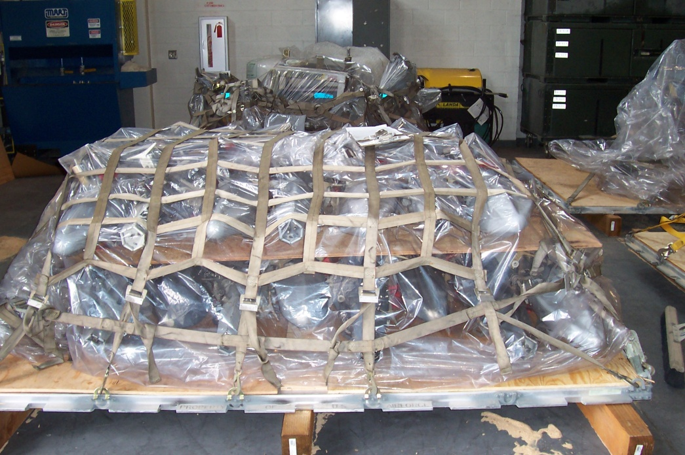
Always use whenever
there are sharp edges
or protrusions that could
damage the aluminum
surface of a 463L pallets
Contact your local AMLO/ADACG/UMO
if you are unsure about shoring
requirements

Slide 18
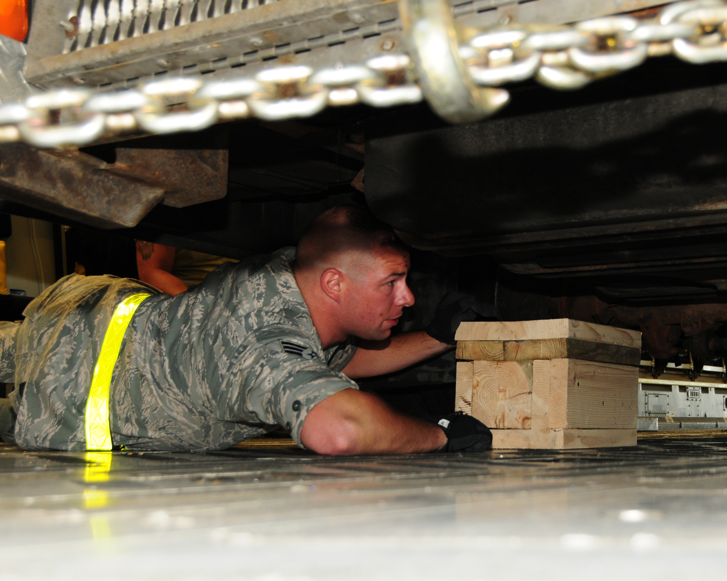
SLEEPER SHORING
Use under frames or axles of vehicles that weigh over 20,000 lbs. and have soft, low pressure, balloon-type, off road tires
Notes:
1. Sleeper shoring is used to prevent vertical movement of a vehicle where the tires or suspension system cannot withstand G-loads without failure or depression producing slack in the tiedown devices
2. This prevents the vehicle from bouncing and possibly pulling the tie down rings out of the aircraft floor

Slide 19
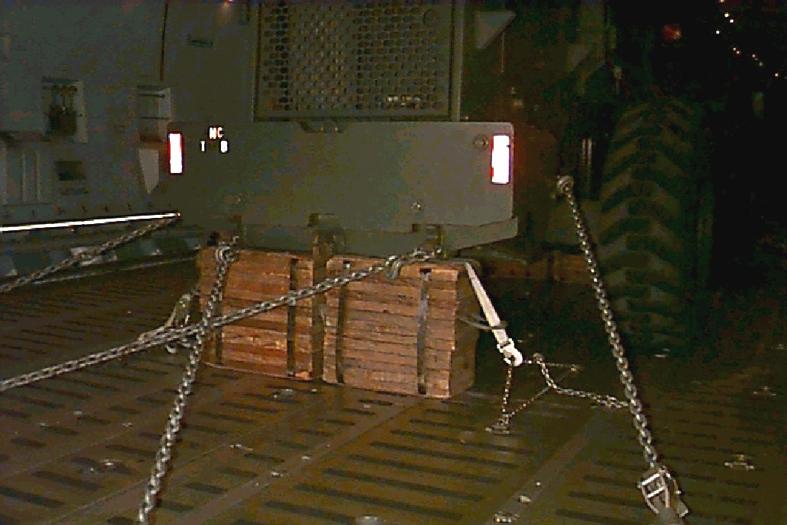
PSI limitations vary according to aircraft
Notes:
3. The base of the sleeper shoring must be large enough to support the entire weight of the vehicle it’s beneath without exceeding the P.S.I. limitation of the aircraft floor
4. P.S.I limitations are variable depending on the type aircraft and location within the aircraft

Slide 20
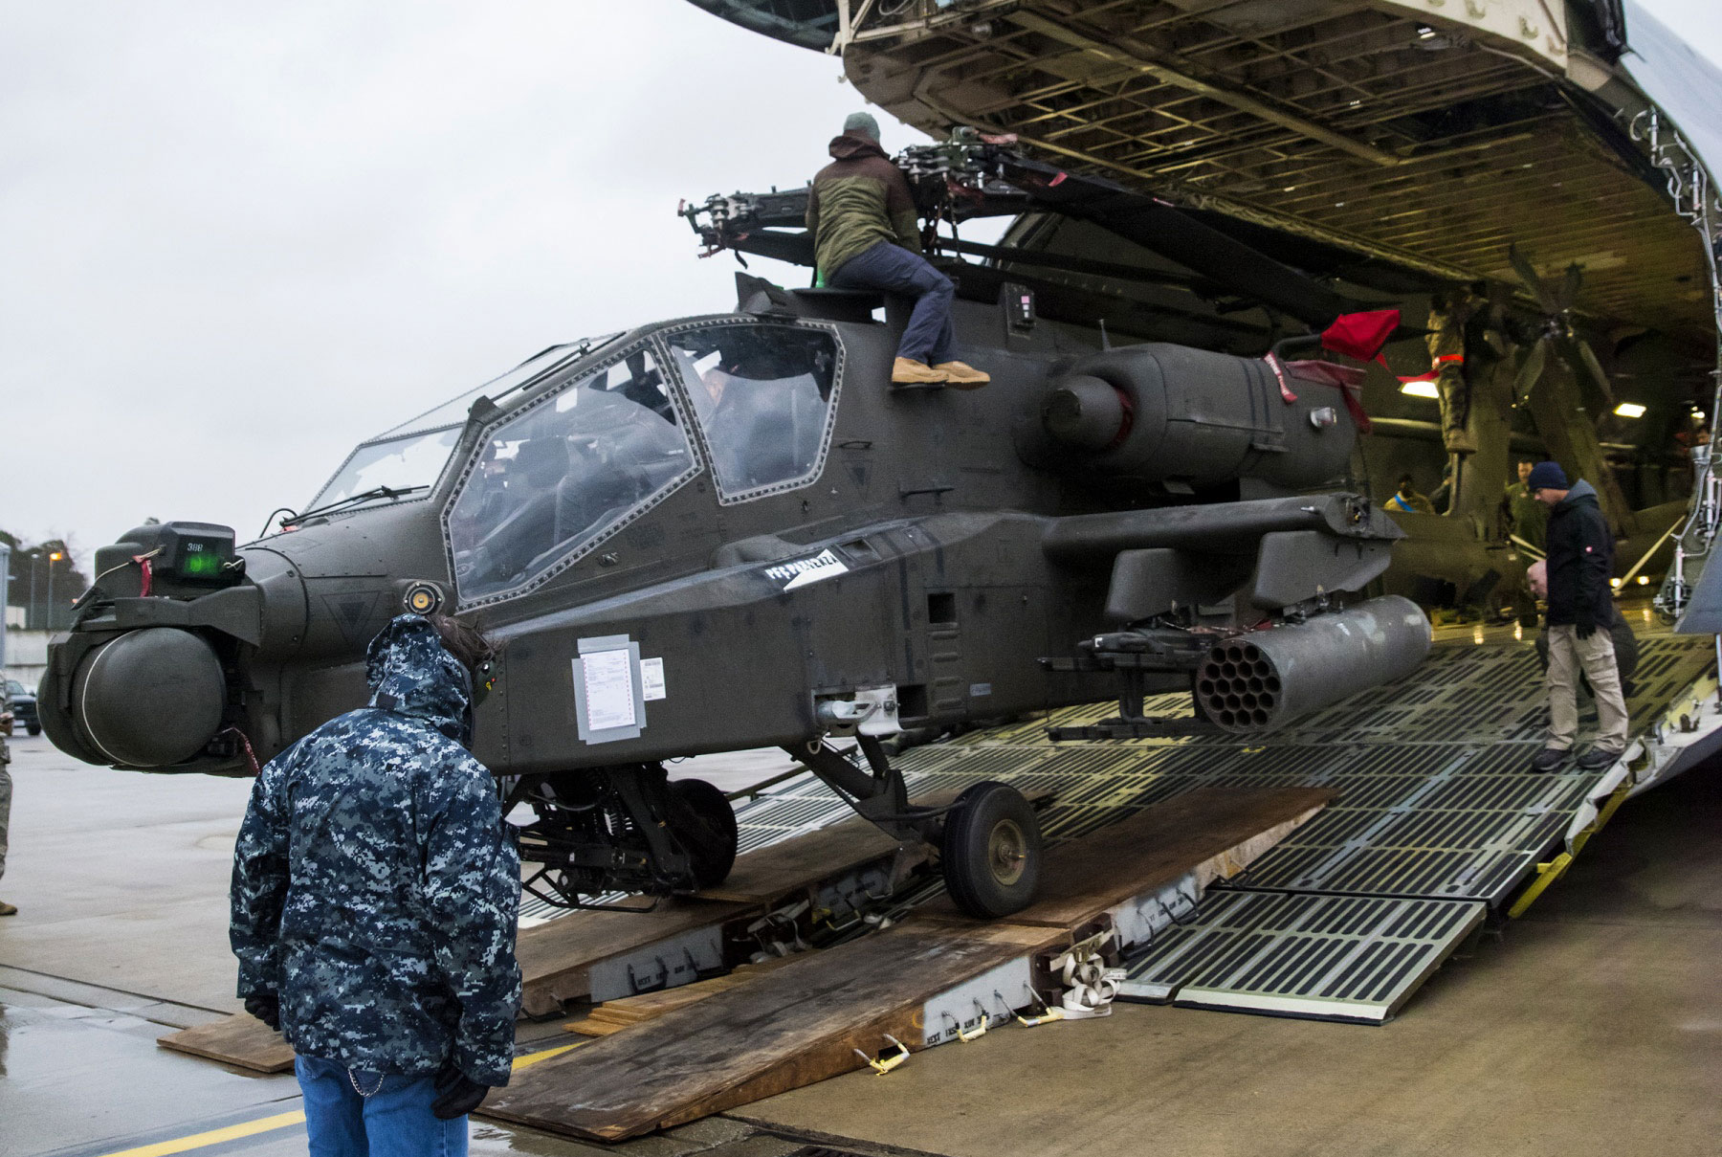
APPROACH SHORING
Use approach shoring to decrease the approach angle of aircraft loading ramps
Some items of cargo may strike the aircraft or ground during loading/offloading operations

Slide 21
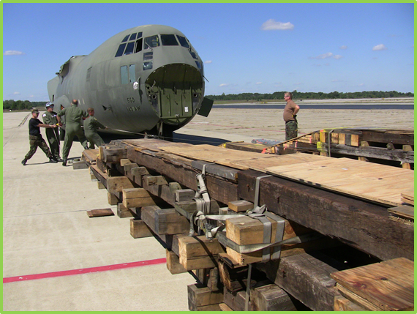
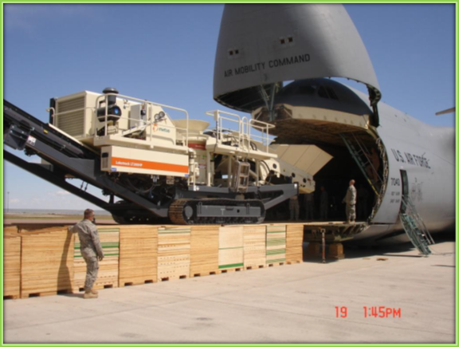
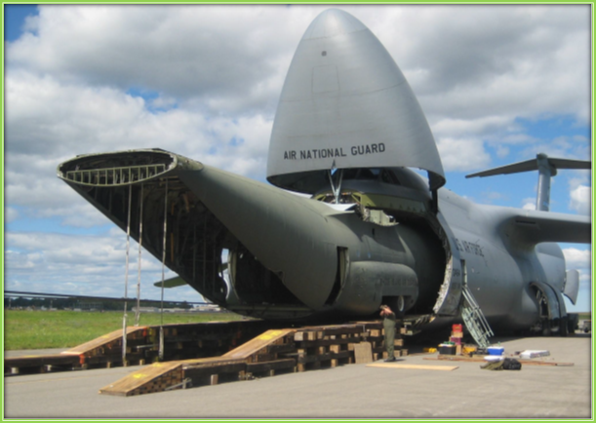

Slide 22
There is no standard method to calculate how much Approach Shoring is required
These are pieces of equipment that normally require Approach Shoring:
Most helicopters
All 40K loaders
Long vehicles
Notes:
3. Extremely tall and long items may also contact the top of the aircraft cargo compartment without a reduced approach angle provided by approach shoring

Slide 23
Student Activity
Notes:
3. Extremely tall and long items may also contact the top of the aircraft cargo compartment without a reduced approach angle provided by approach shoring

Slide 24
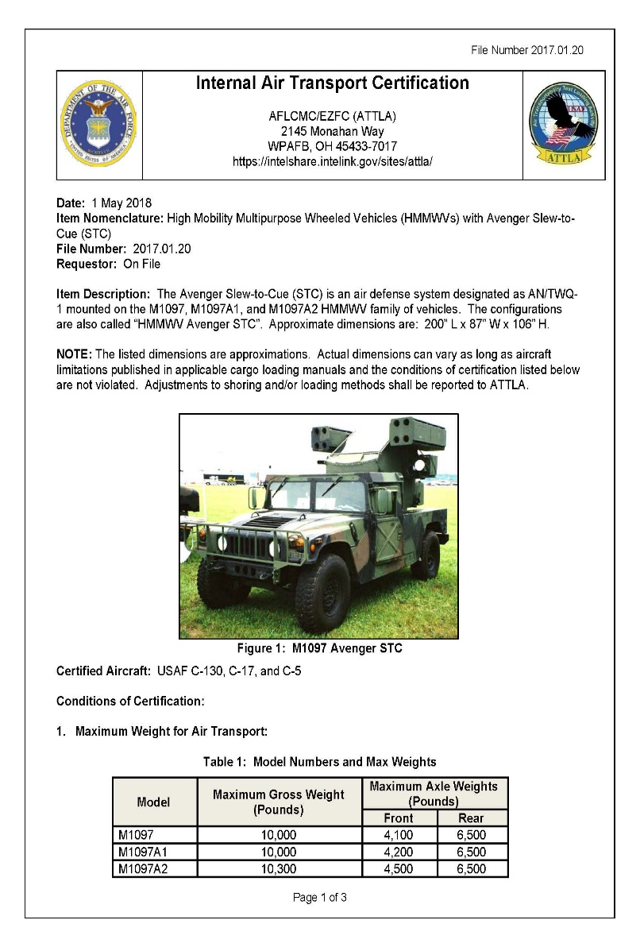
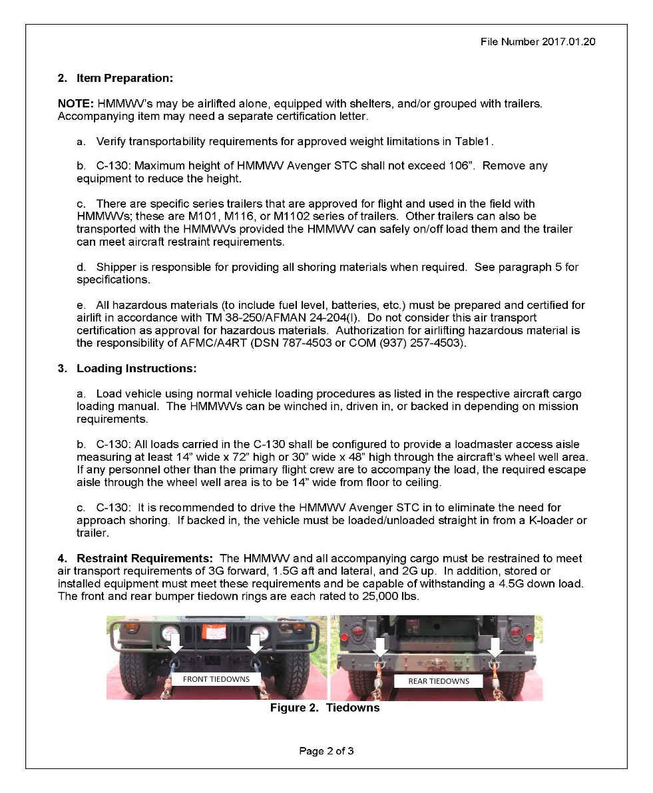
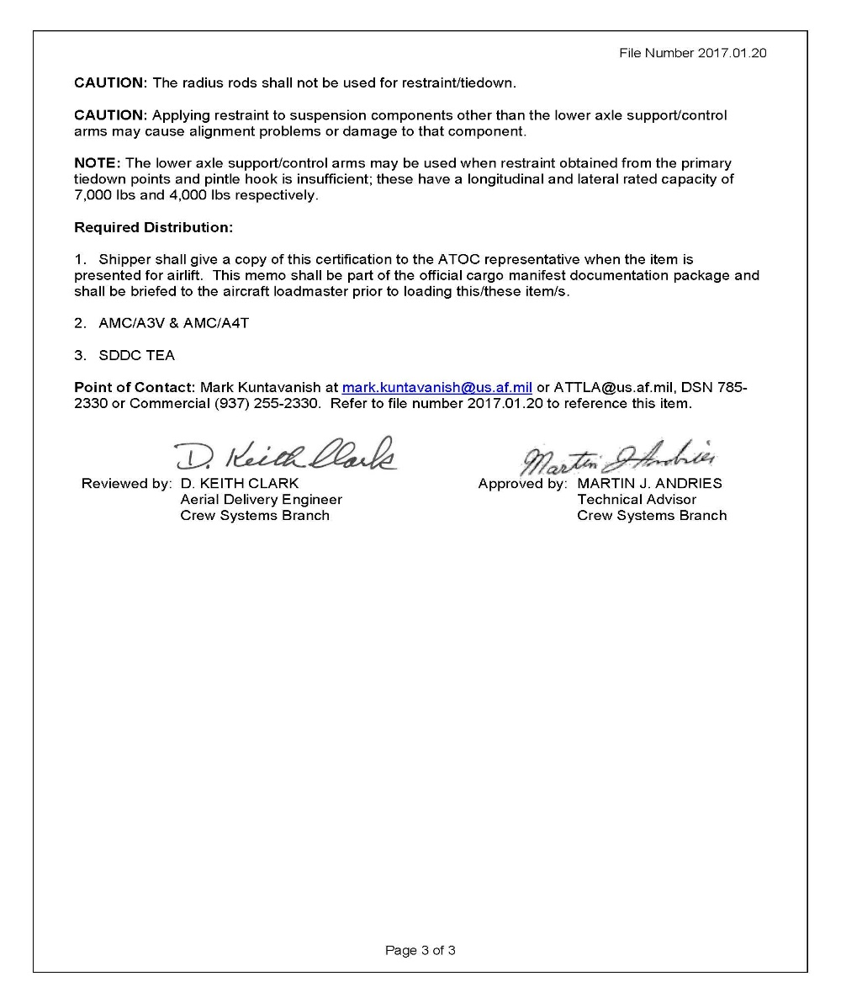
ATTLA #1
Notes:
3. Extremely tall and long items may also contact the top of the aircraft cargo compartment without a reduced approach angle provided by approach shoring

Slide 25
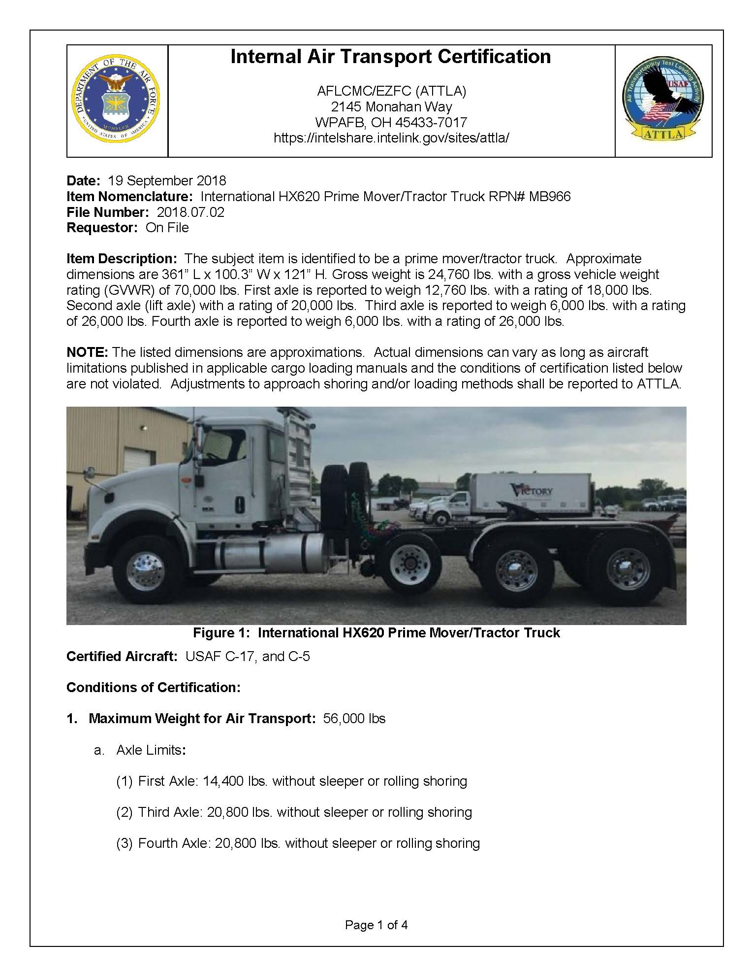
ATTLA #2
Notes:
3. Extremely tall and long items may also contact the top of the aircraft cargo compartment without a reduced approach angle provided by approach shoring

Slide 26
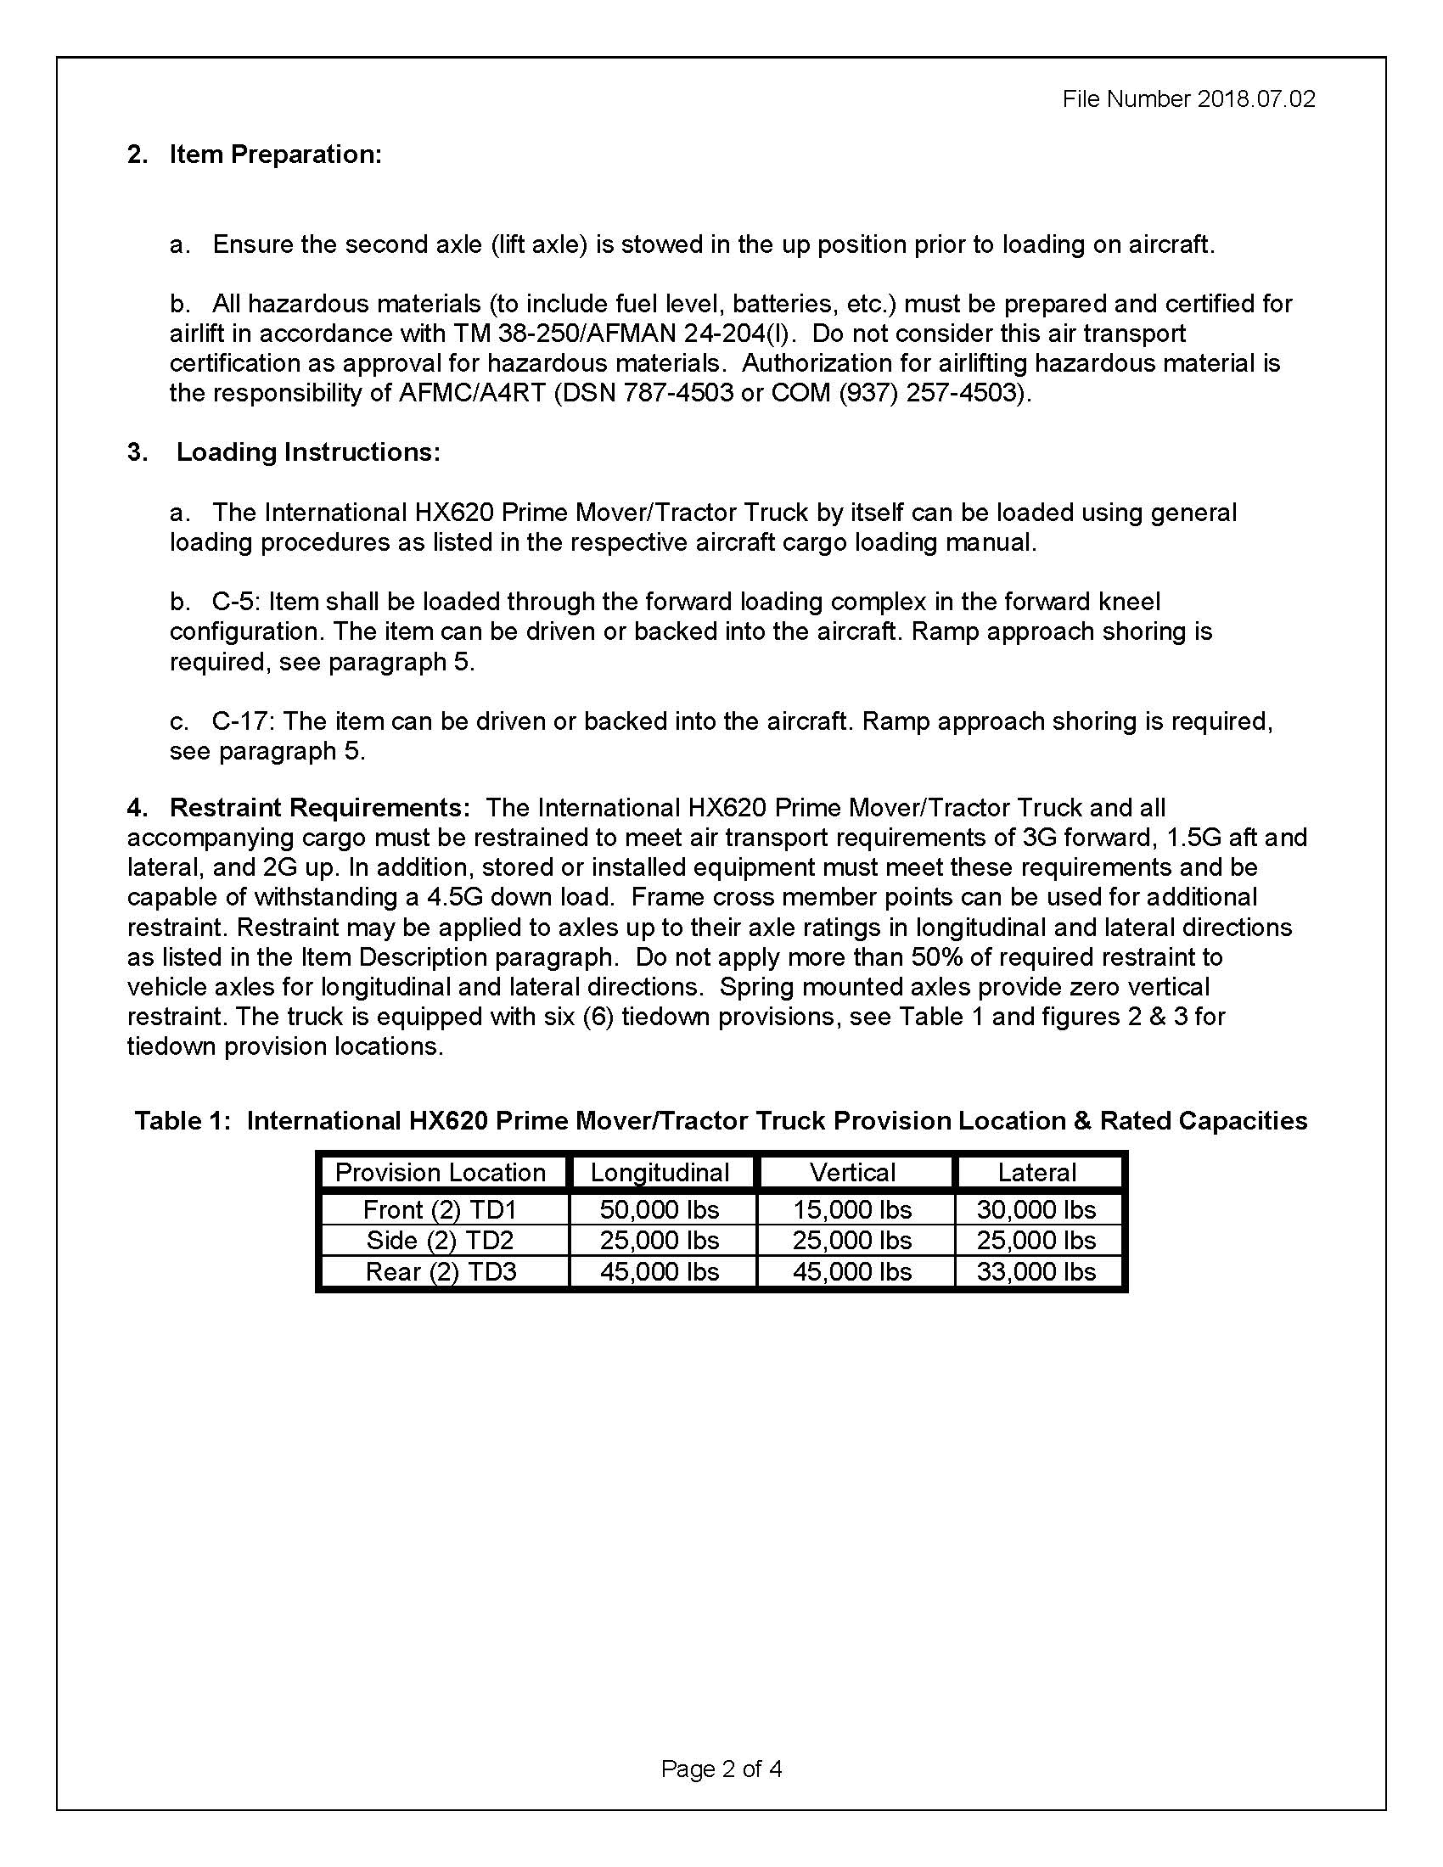


Slide 27
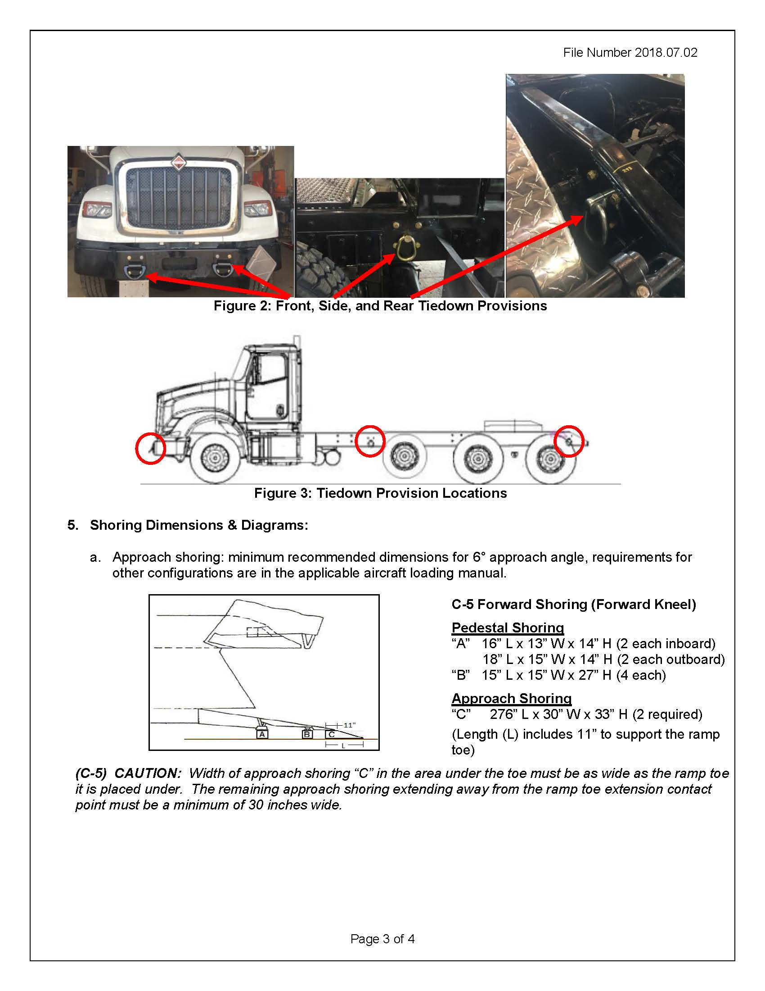
ATTLA #2 Cont.
Notes:
3. Extremely tall and long items may also contact the top of the aircraft cargo compartment without a reduced approach angle provided by approach shoring

Slide 28
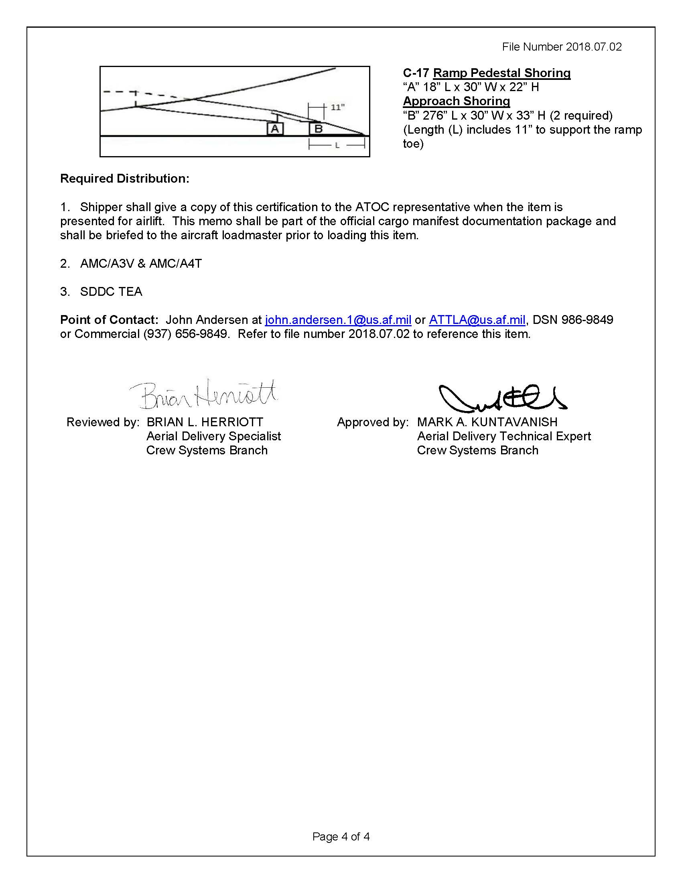

Slide 29
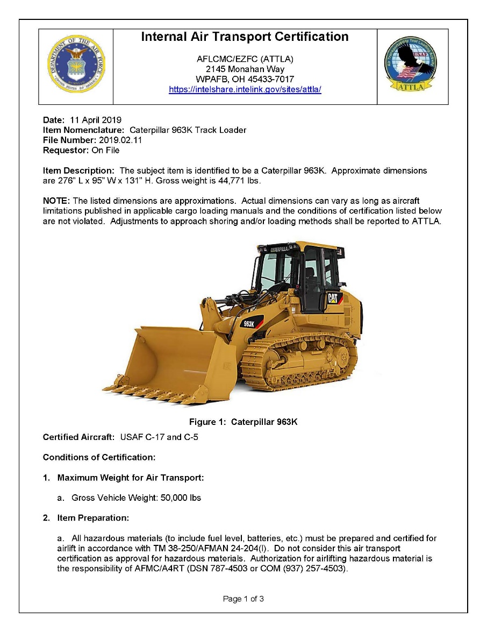
ATTLA #3
Notes:
3. Extremely tall and long items may also contact the top of the aircraft cargo compartment without a reduced approach angle provided by approach shoring

Slide 30
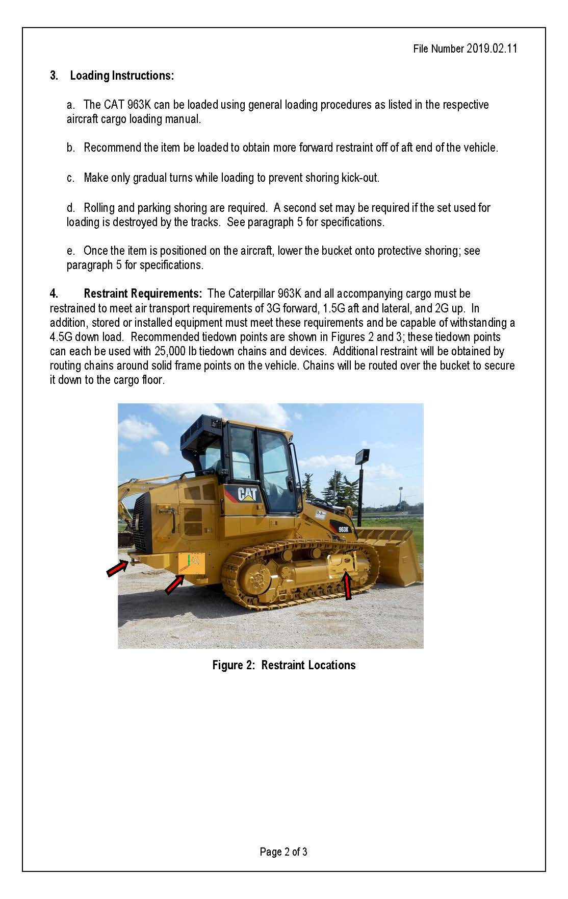

Slide 31
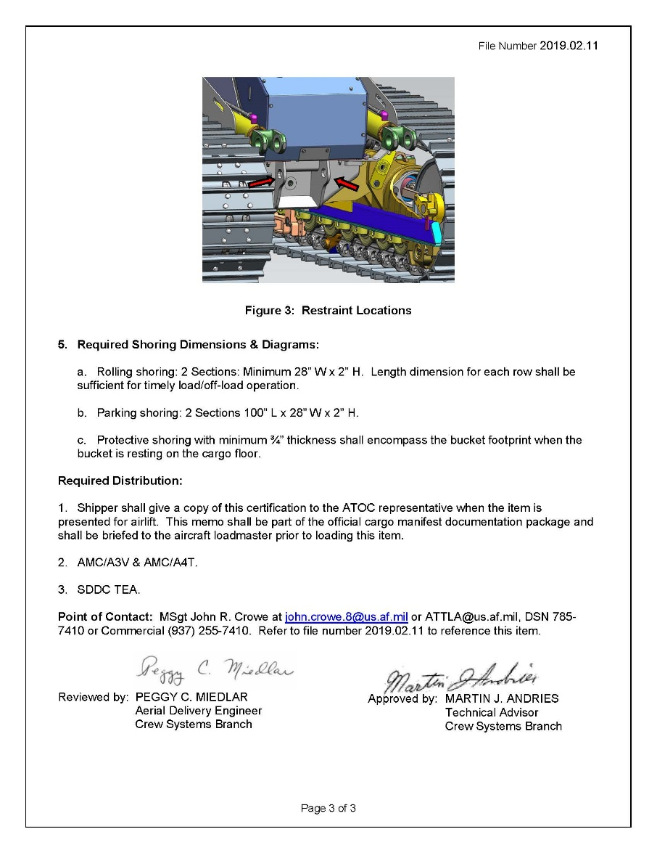

Slide 32
QUESTIONS?

Slide 33
SUMMARY
General
Load Spreading
Shoring Categories
Student Activity

