Slide 1
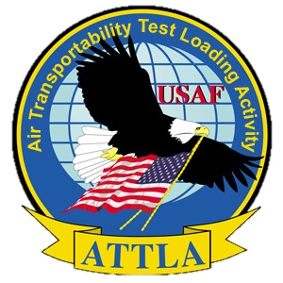

Slide 2

OVERVIEW
Description of ATTLA Responsibilities
ATTLA Requirements
Shipper’s Responsibilities
ATTLA Letter Overview
Student Activity

Slide 3
ATTLA RESPONSIBILITIES

Slide 4
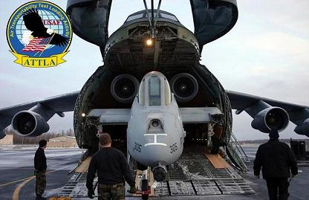
Air Transportability Test Loading Activity
DoD focal point for certification to load items on USAF aircraft
ATTLA will provide assistance to manufacturers to ensure compliance with airlift limitations and procedures.
Notes:
ATTLA is the sole authority for certifying equipment for airlift on USAF aircraft

Slide 5
ATTLA LETTER OVERVIEW

Slide 6
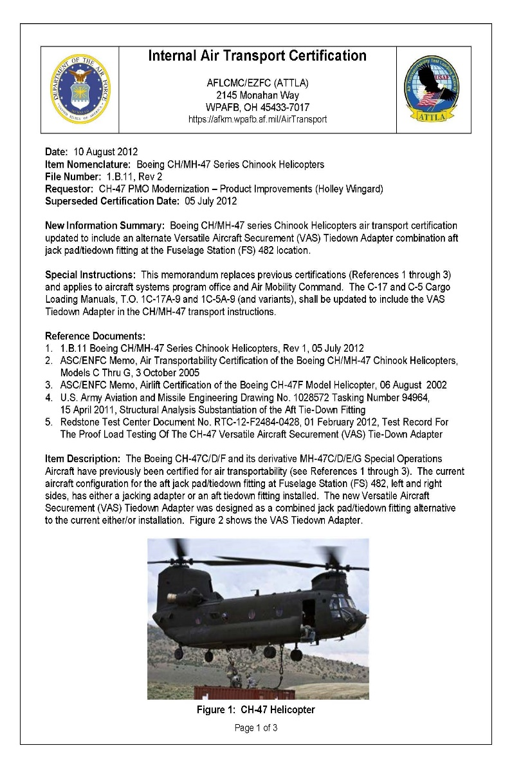
Notes:
3. Extremely tall and long items may also contact the top of the aircraft cargo compartment without a reduced approach angle provided by approach shoring

Slide 7
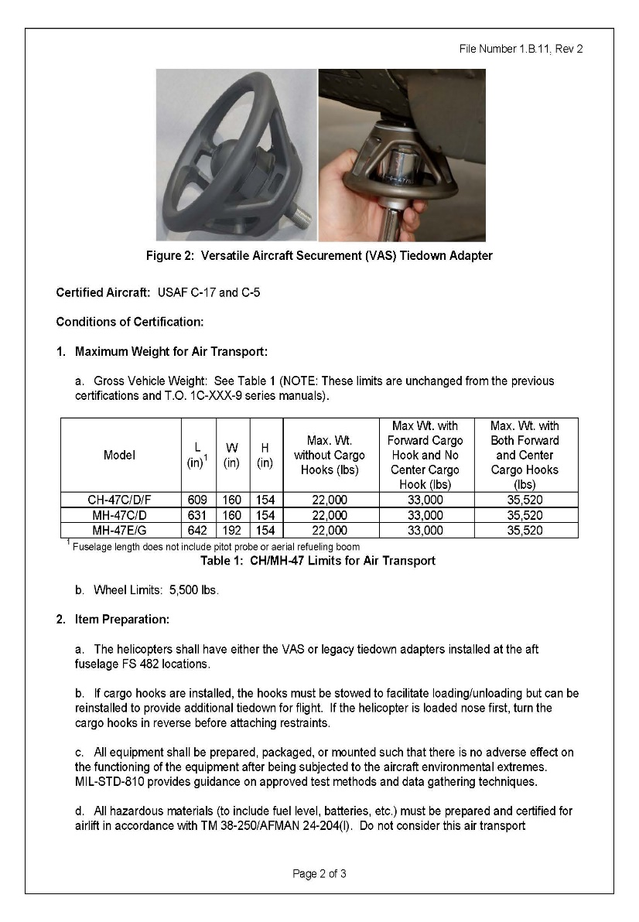

Slide 8
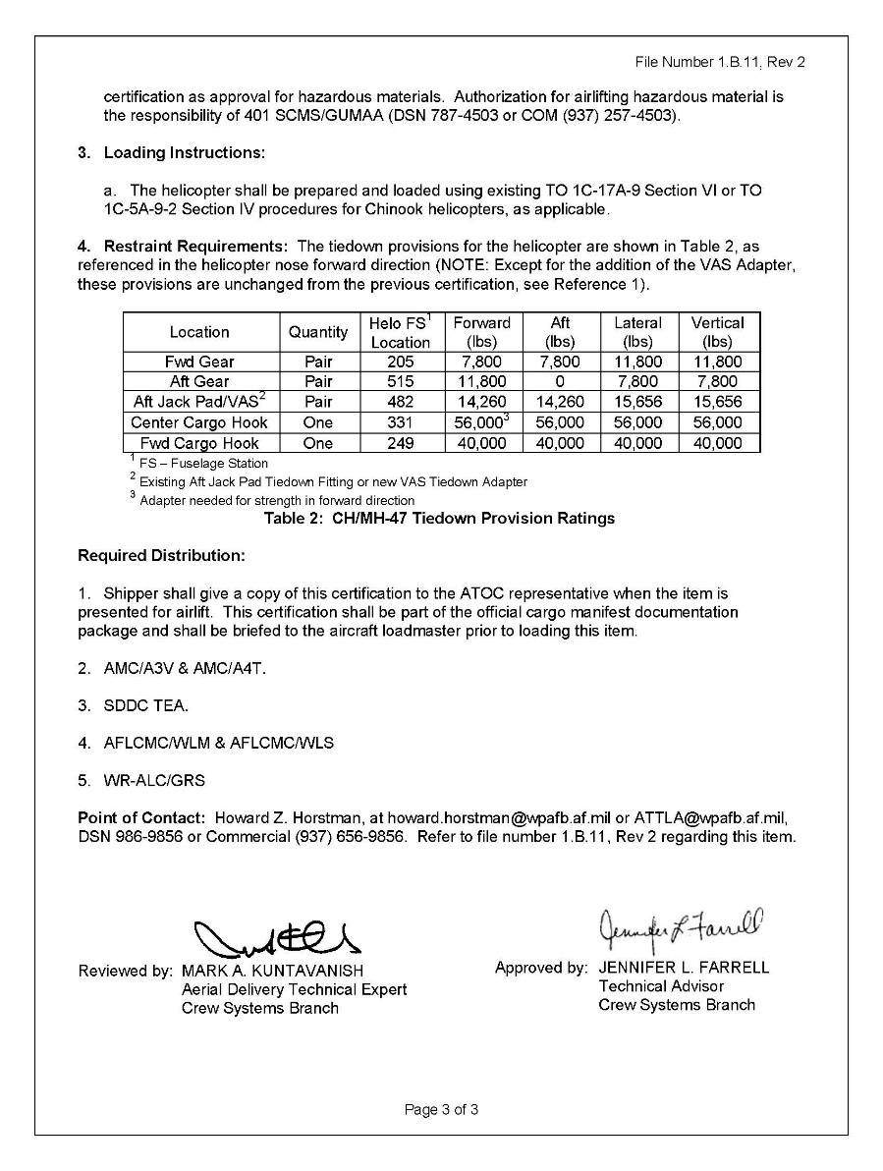

Slide 9
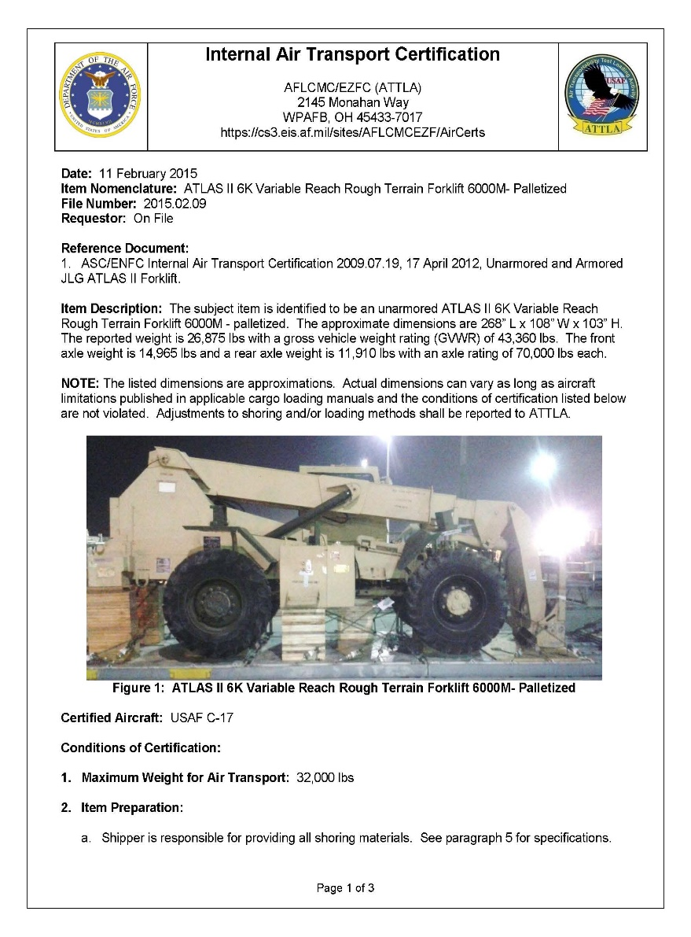
Notes:
3. Extremely tall and long items may also contact the top of the aircraft cargo compartment without a reduced approach angle provided by approach shoring

Slide 10
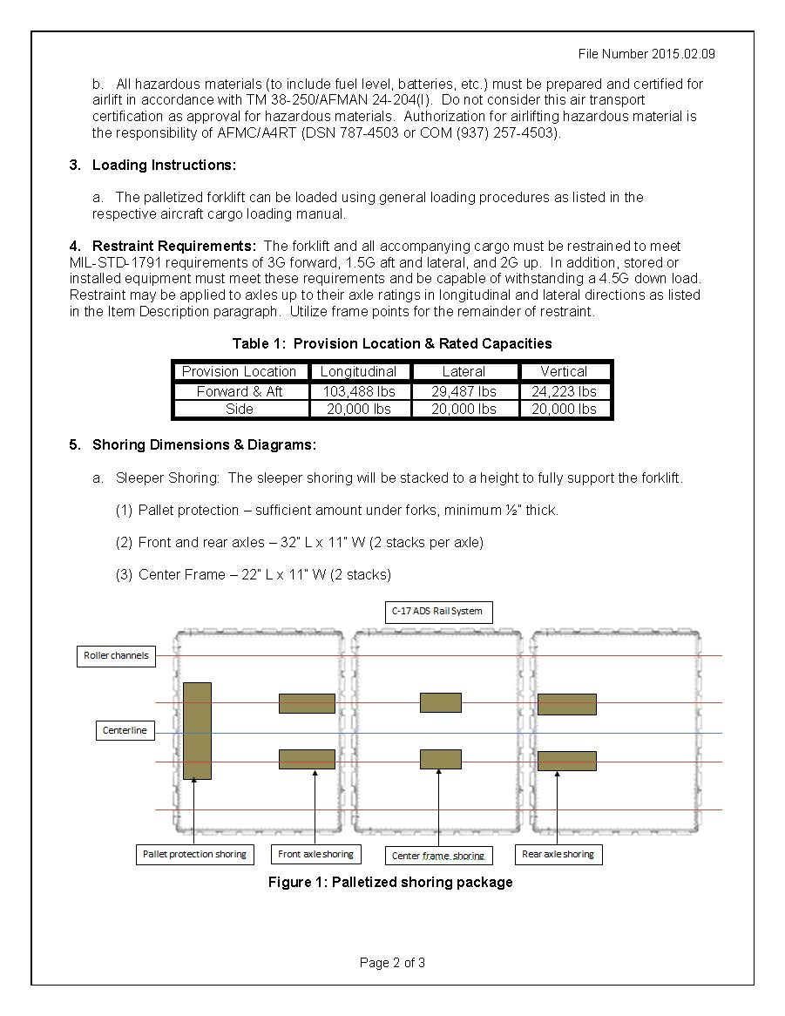

Slide 11
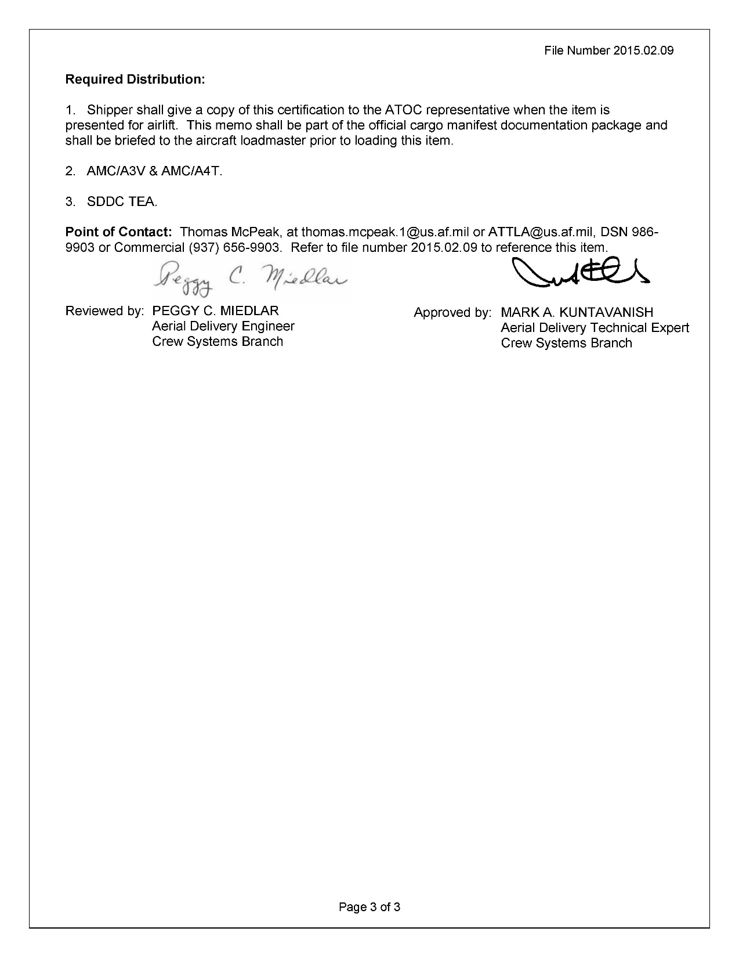

Slide 12
ATTLA LETTER REQUIREMENTS

Slide 13
ATTLA Certification Letter is required for items:
  Exceed TO 1C-XXX-9 (Dash -9) loading limits
  Special loading procedure not listed in Dash -9
  Items designed to interfere with aircraft rail system (i.e. LSA Adapters)
  Enclosed items not designed with pressure relief valves

Slide 14
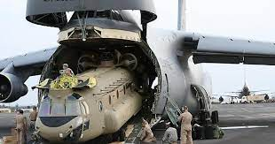
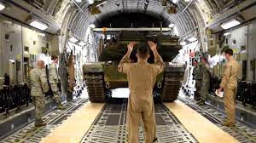
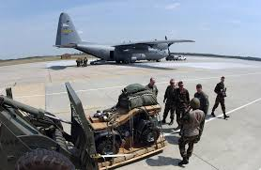
  Items with questionable structural integrity
  Items with significant damage to the frame or structural components
  Items that cannot be restrained using standard restraint procedures listed in aircrafts Dash -9
  Items that operate in flight

Slide 15
Determine if ATTLA certification may be required, use the following criteria as a flag:
  Length greater than 20 feet
  Height or Width is greater than 8 feet
  Weight is greater than 10,000 lbs.
  Floor contact pressure is more that 50 psi
  Axle loads greater than 5,000 lbs.

Slide 16
  Wheel loads greater than 2,500 lbs.
  Cargo that exceeds weight limits stated in a certification letter
  Unfamiliar items designed to be loaded into the aircraft rail system
  Items that require special equipment or procedures for loading and/or securing for flight

Slide 17
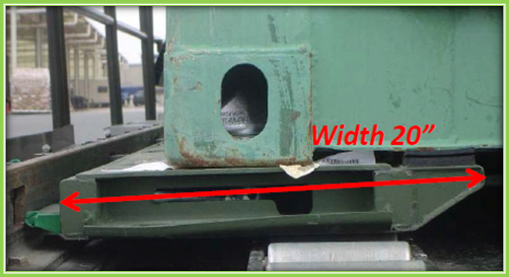
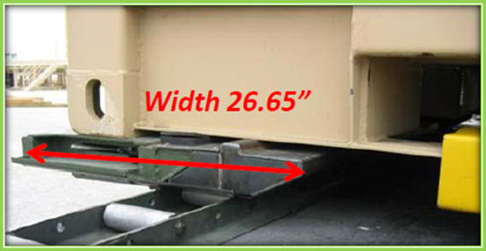
                Safety investigation discovered the shipper installed decertified Land, Sea, Air (LSA) Adaptors on two Tri-con containers
Two Containers of Army Medical Supplies came loose from aircraft restraints during landing
Decertified for Airlift (LSA108TQA)
Certified for Airlift (LSA108TQC)

Slide 18
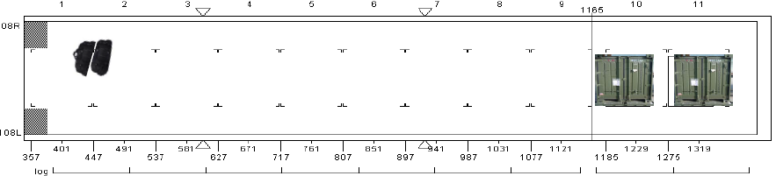
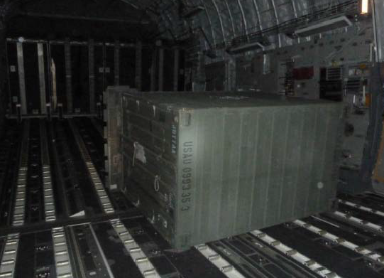
Notes:
Rear Tricon tipped over during landing; knocking forward Tricon out of rails
Forward Tricon traveled towards the front of the aircraft via the aircraft rollers
Tricon hit floor loaded baggage; spun 180 degrees, and impacted aircraft bulkhead

Slide 19
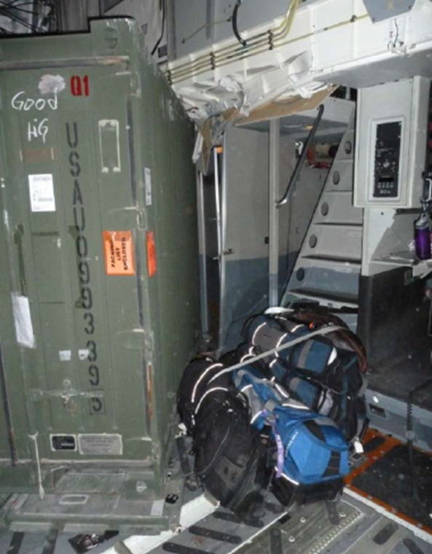
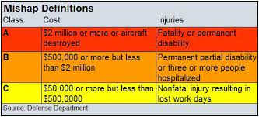
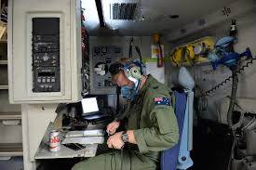

Slide 20
SHIPPER’S RESPONSIBILITIES

Slide 21
https://intelshare.intelink.gov/sites/attla/
Identify which pieces of cargo will require an ATTLA certification letter, based on the criteria previously listed.
Obtain and provide current ATTLA Certification Letters during loading
Air Load Planners must maintain an active account for viewing/verifying ATTLA Certification letters
Notes:
Take students to ATTLA site and ensure they are able to log in. Navigate to search a specific equipment for their equipment

Slide 22
If cargo exceeds parameters, the designated unit representative must request ATTLA certification for that item before airlifting.
Requesting Certification:
  Requests can be sent from design of the item up to the airlift of the item.
  Certification will only happen after completion of construction.
  Normally takes 60-90 days after all data is submitted.
  Cargo is broken down into 3 different categories for certification, each type has a different certifying path.
  ATTLA will provide a listing of all required measurements.

Slide 23
Student Activity
Notes:
3. Extremely tall and long items may also contact the top of the aircraft cargo compartment without a reduced approach angle provided by approach shoring

Slide 24
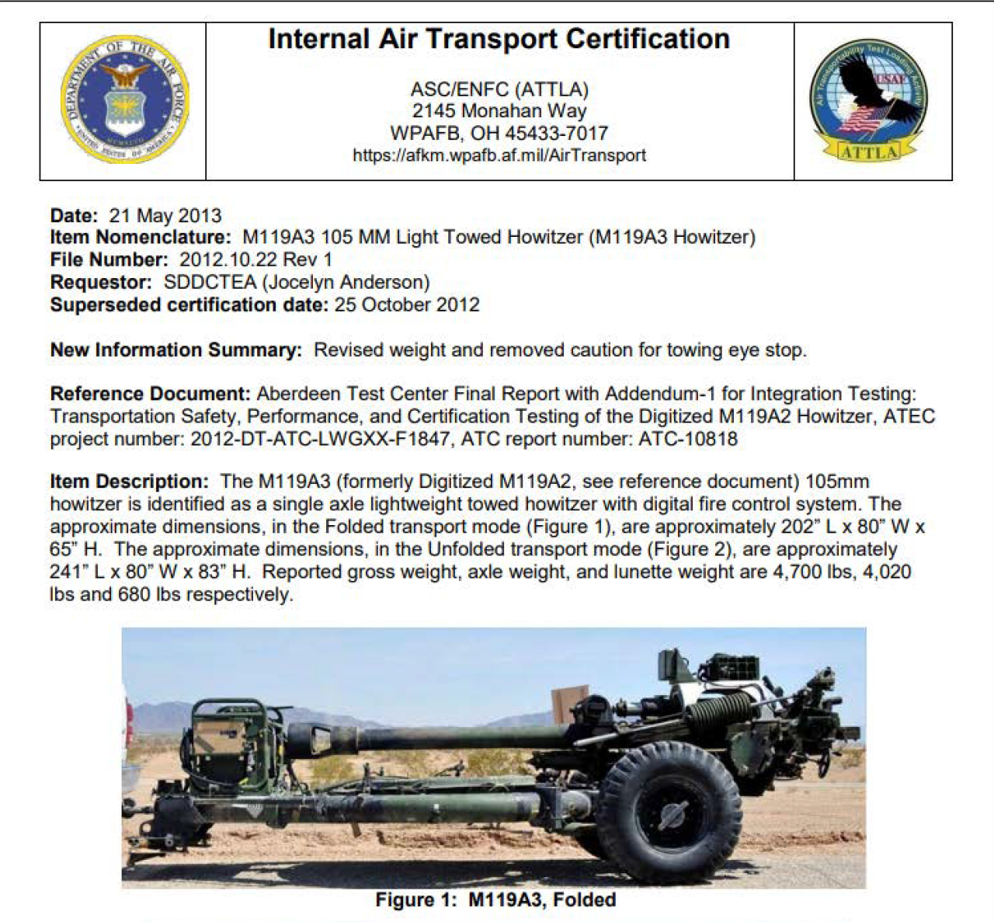
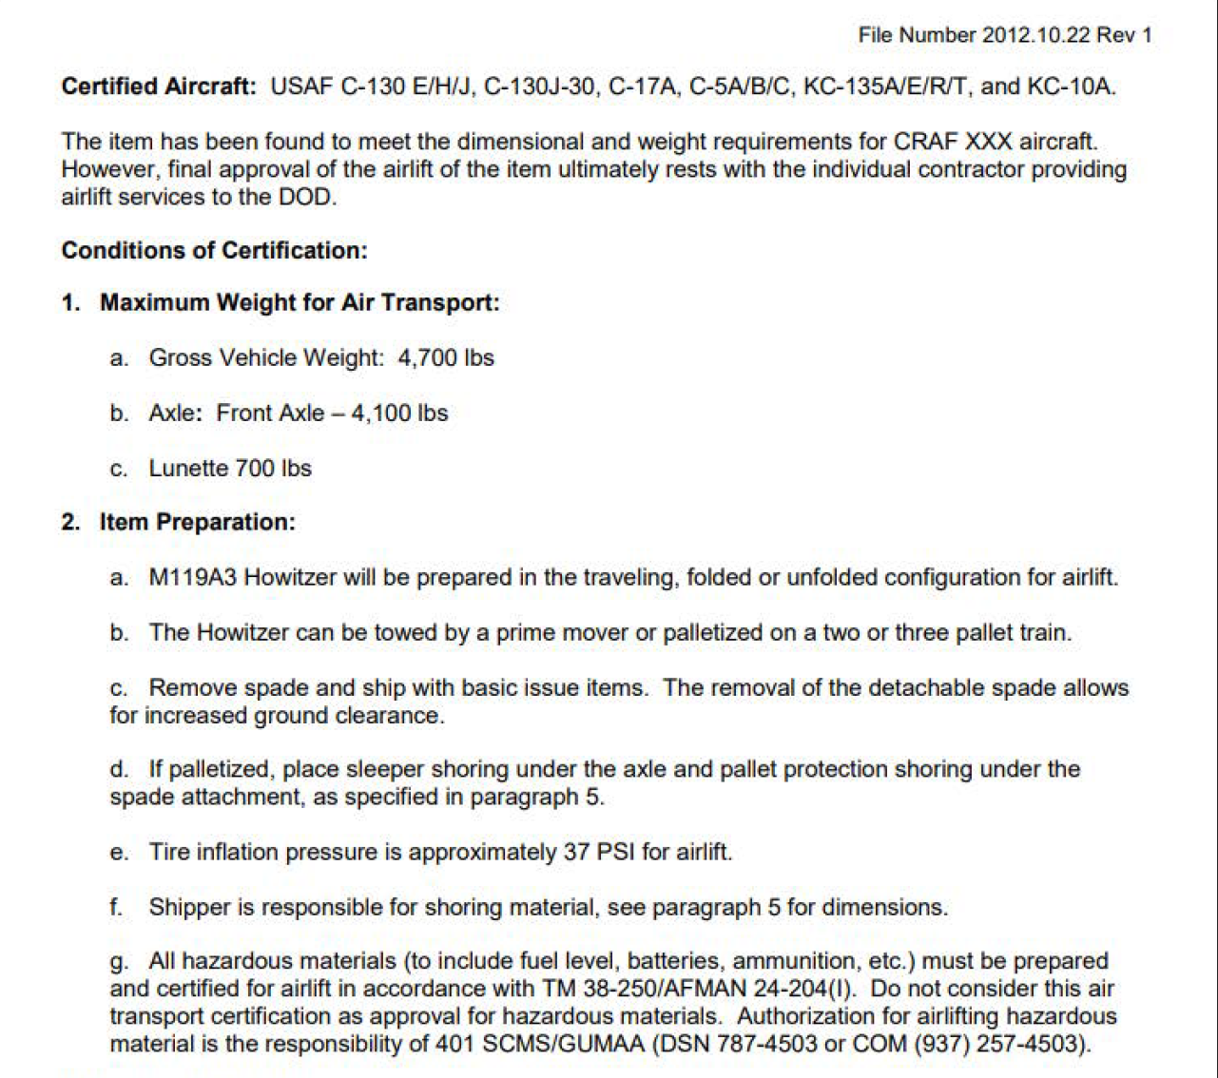

Slide 25
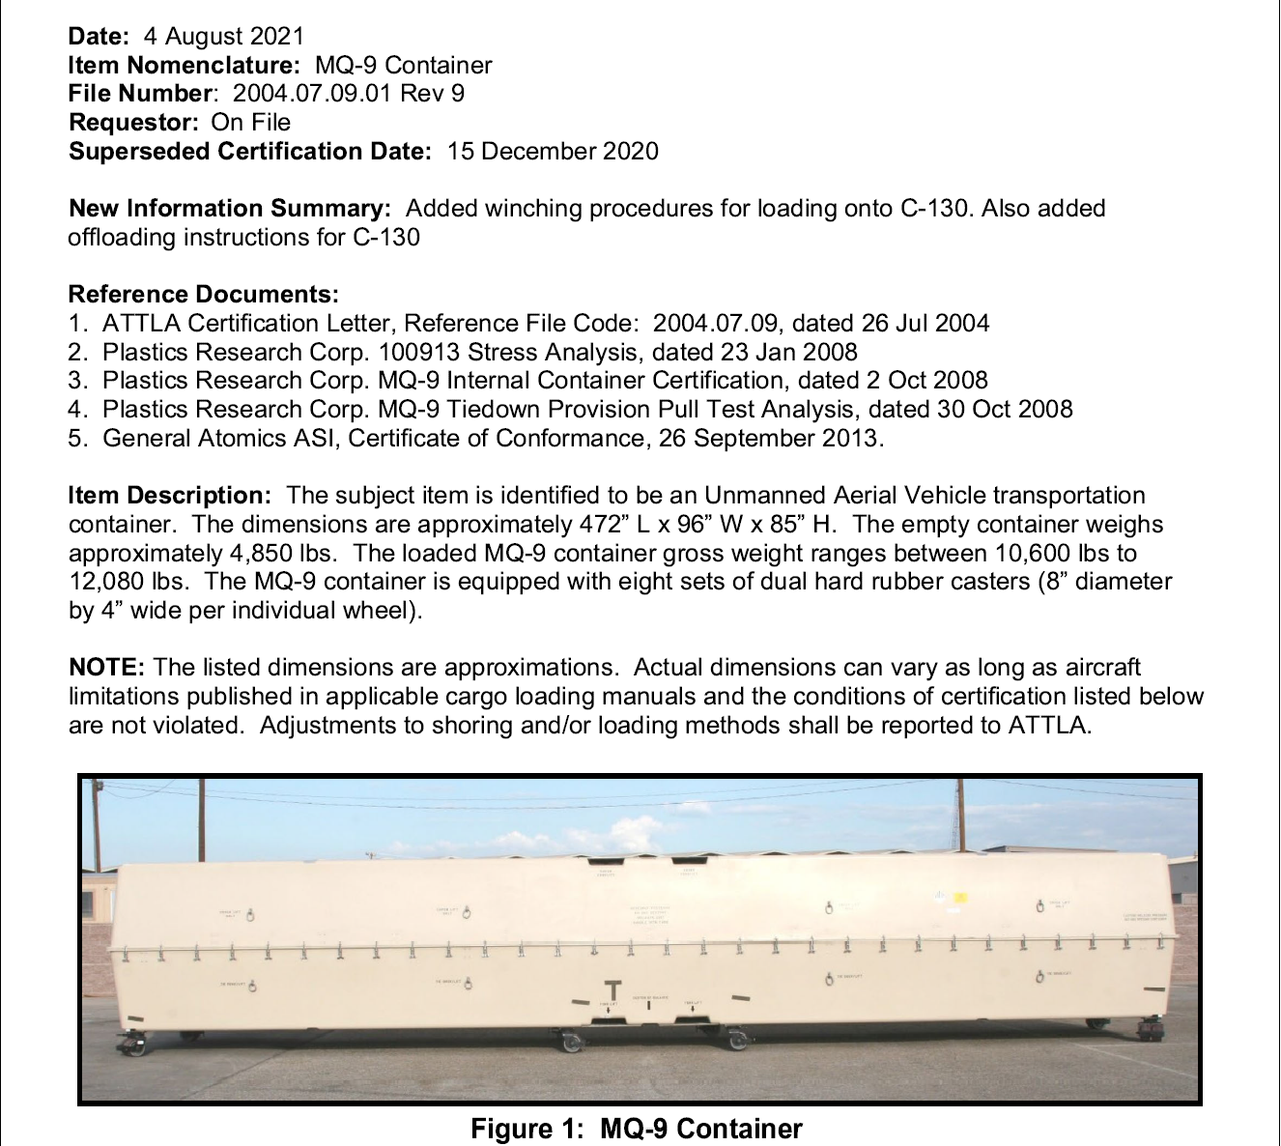
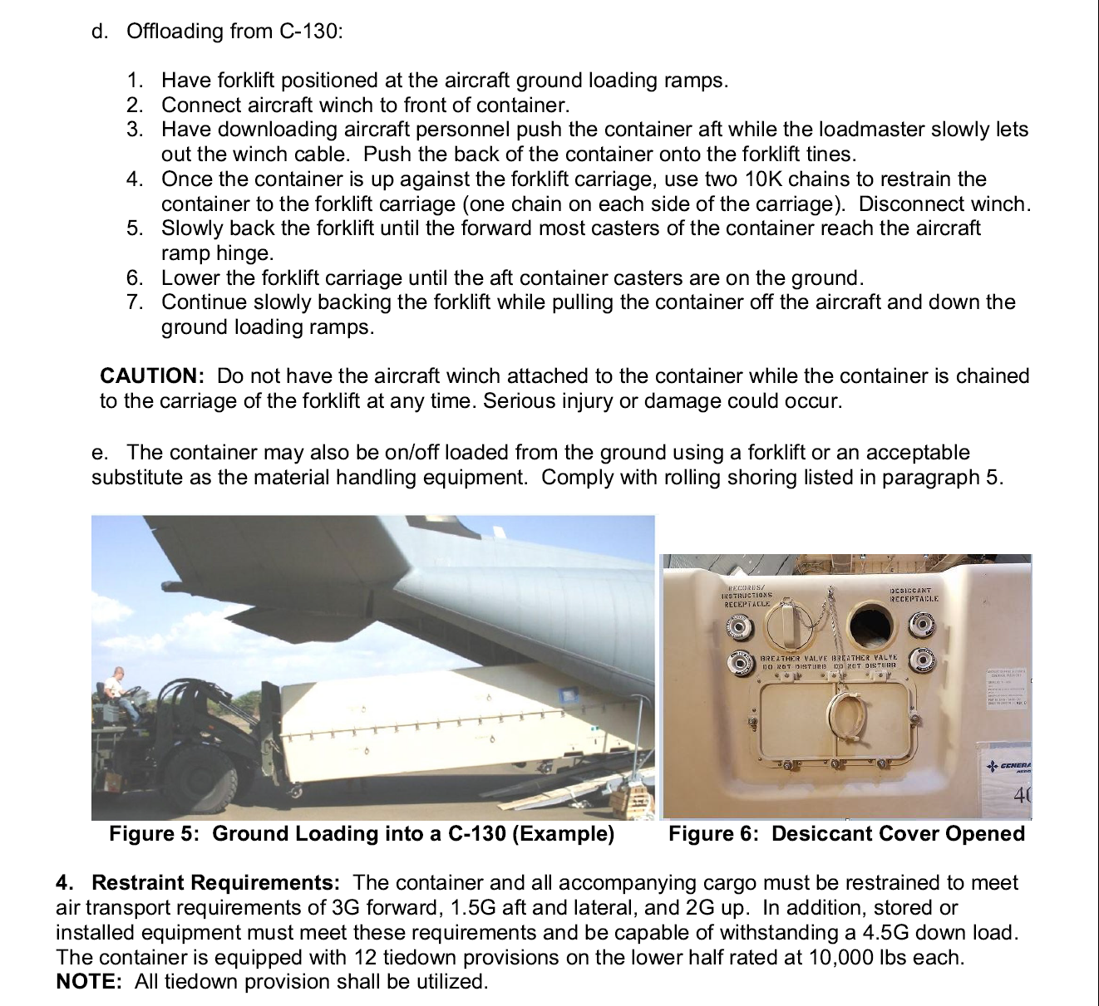

Slide 26
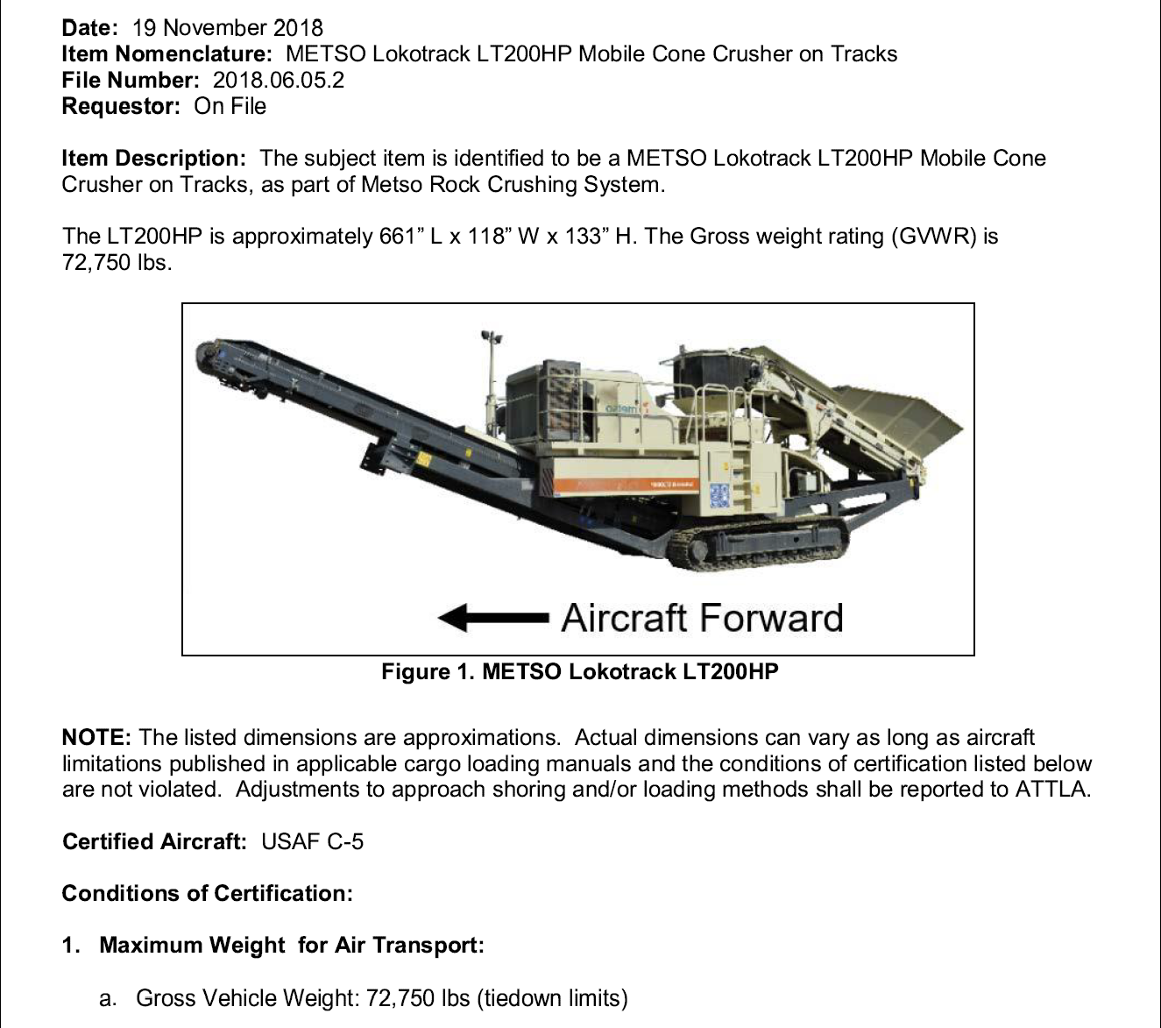
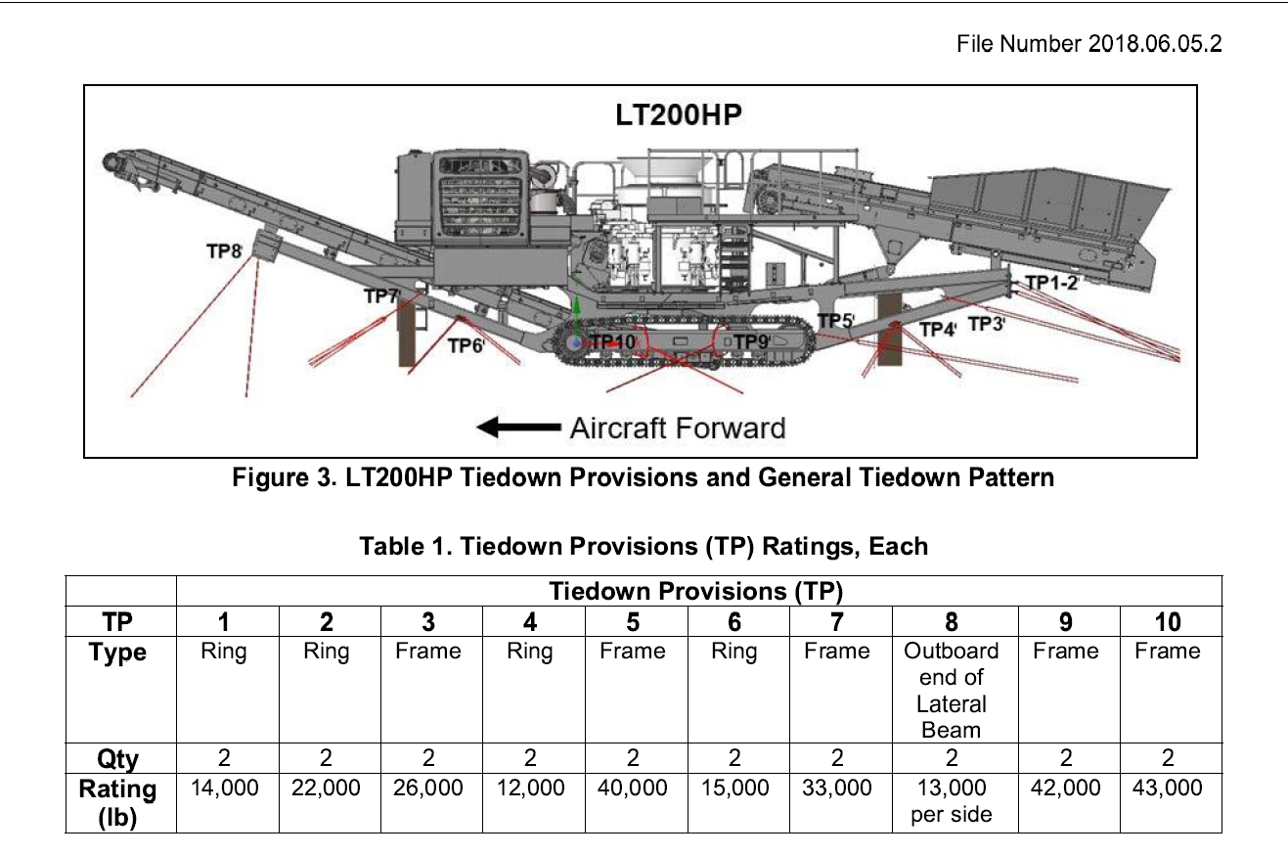

Slide 27
Questions?

Slide 28
SUMMARY
Description of ATTLA Responsibilities
ATTLA Requirements
Shipper’s Responsibilities
ATTLA Letter Overview
Student Activity

