Slide 1
AIRCRAFT LOAD PLANNING
WEIGHT & BALANCE
CAO: 18 October 19

Slide 2
Overview
Terminology
Weight and Balance Theories
Load Planning

Slide 3
TERMINOLOGY

Slide 4
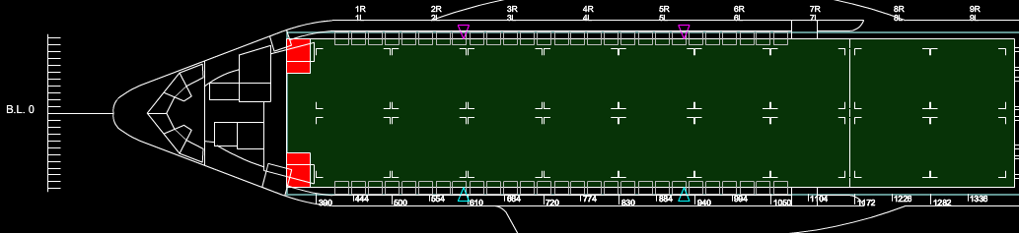
Reference Datum Line (RDL)
Imaginary vertical plane at or near the nose of the aircraft

Slide 5
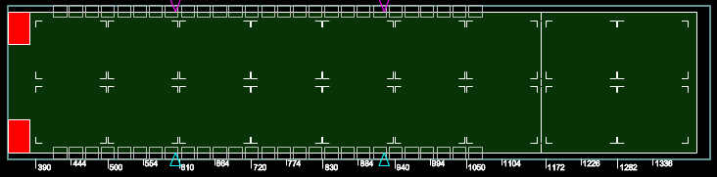
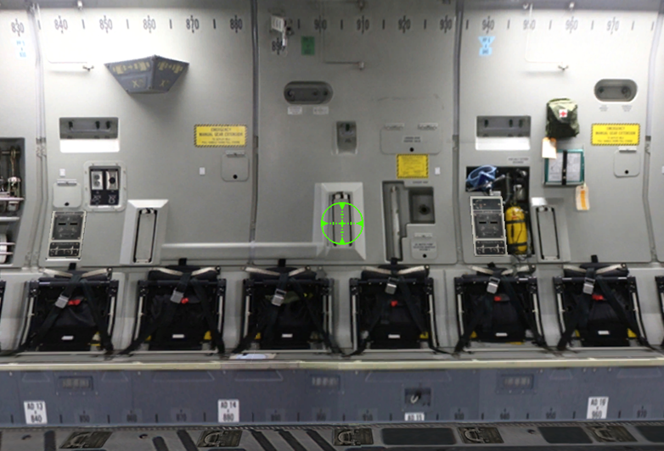
Fuselage Station (FS)
Imaginary plane, perpendicular to the longitudinal axis of the aircraft
Measured in inches from the RDL

Slide 6
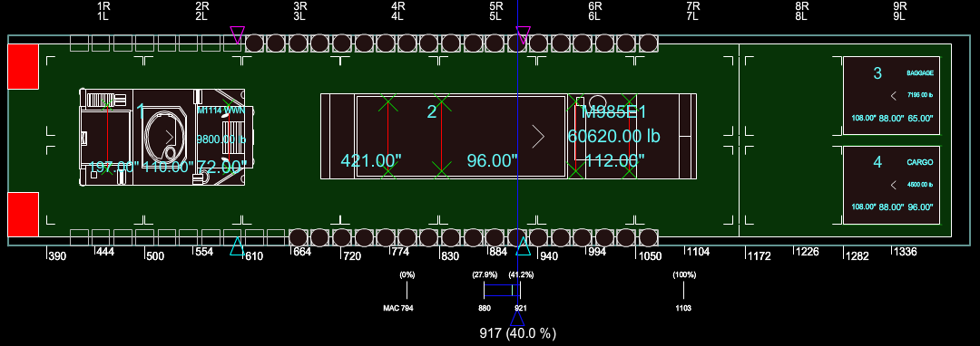
Center of Gravity (CG)
The point at which an aircraft balances.
This point is measured in inches from the RDL.
CG and % of MAC are interchangeable terms

Slide 7
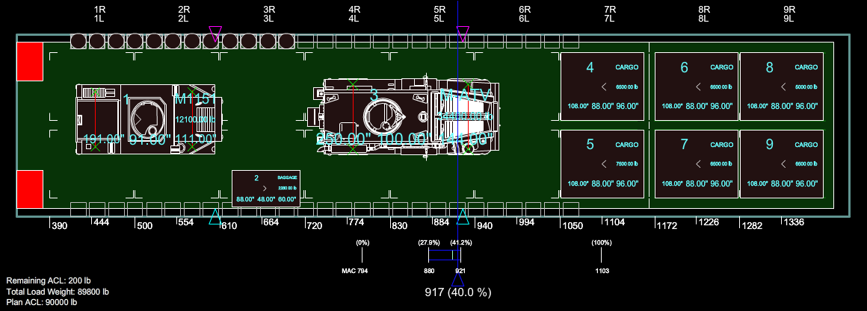
Gross Weight (GW)
The total weight of all cargo, passengers, and baggage
Displayed as “Total Load Weight” in bottom left corner of the Airload Viewer

Slide 8
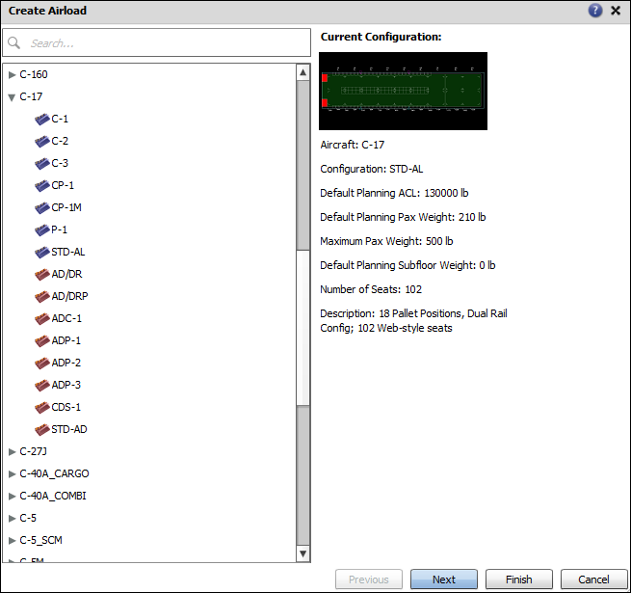
Allowable Cabin Load (ACL)
The maximum planning weight of cargo that may be transported on a specific mission
Standard planning ACLs
C-130 25,000 lbs.
C-130J 40,000 lbs.
C-17 130,000 lbs.
C-5 M 150,000 lbs.
Notes:
Air Force Pamphlet 10-1403 provides standard planning ACLs

Slide 9
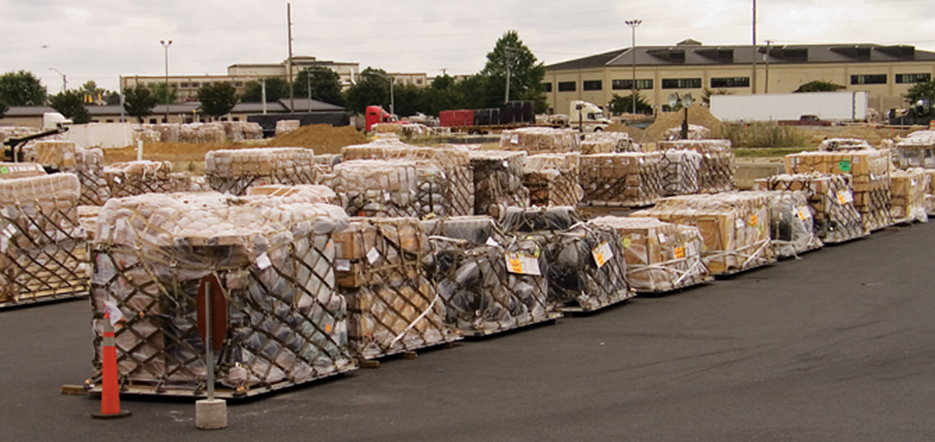
Bulk
Items that fit within the usable dimensions of a single 463L pallet
Notes:
463L Dimensions 108” x 88” x 2.25”
Usable Dimensions 104” x 84”

Slide 10
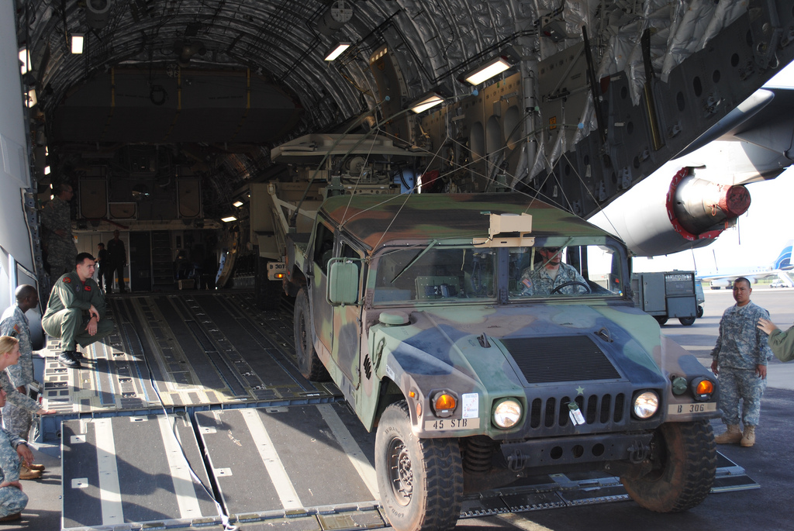
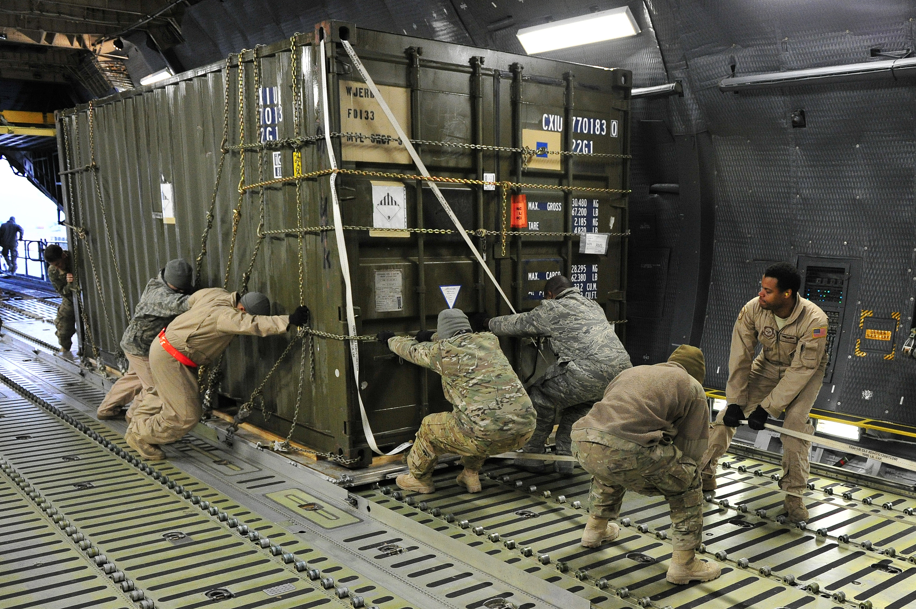
Oversize
Items larger than the usable dimensions of a single 463L pallet

Slide 11

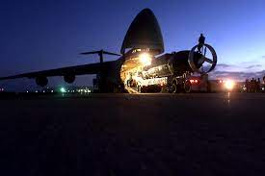
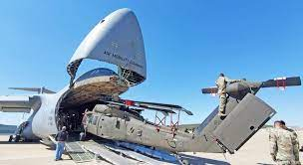

Outsize
Items larger than oversize and can ONLY be airlifted on C-5 or C-17 aircraft

Slide 12
WEIGHT
AND
BALANCE THEORIES

Slide 13
Heavy Cargo
Pyramid Method
Heavy cargo centered with lighter cargo placed out (Recommended method)
Light
Cargo
Light
Cargo
Cargo Load
500
lbs
1000
lbs
2500
lbs
5000
lbs
2500
lbs
1000
lbs
500
lbs
C/B

Slide 14
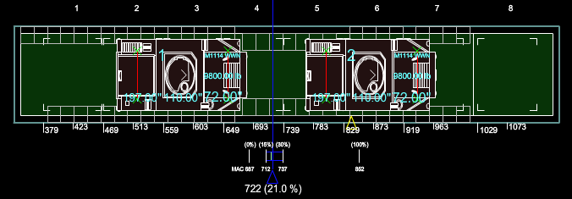
50/50 Method
50% of the cargo is placed on either side of the optimum load CG
1000 lbs.
1000 lbs.
Cargo Load
C/B

Slide 15
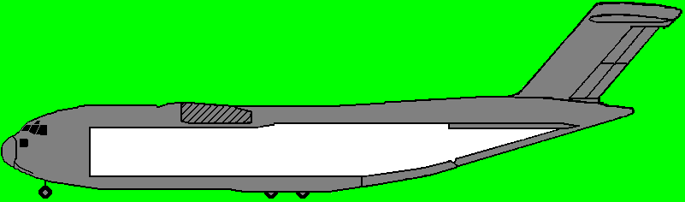


EFFECTS of ADDING CARGO
When cargo is added, the Aircraft CG moves toward the added weight.

Slide 16
EFFECTS of ADDING CARGO
When cargo is added, the Aircraft CG moves toward the added weight.

Slide 17
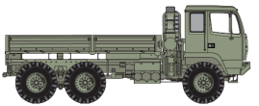
LOAD SHIFT
The aircraft’s CG moves with the cargo
Moving heavy items has a significant change
Moving light items has a minimal change

Slide 18
LOAD PLANNING

Slide 19
Load planning is the process of determining the number and type of aircraft required to transport your units cargo

Slide 20
Key responsibilities for load planners
DTR Part III, Appendix V
Aircraft will be loaded to maximum capacity using the ACL, aircraft load specifications, and passenger limits
Compute weight and balance to ensure fuel efficiency and safety of flight
Be familiar with proper pallet build up and aircraft contour restrictions
Be familiar with hazardous material compatibility
Covered in HAZMAT classes (not air load planners)
Notes:
HAZMAT classes go in depth on preparing/certifying hazardous materials.
Load planners must have familiarity with hazardous materials to ensure they are not mixing incompatible cargo on an aircraft.

Slide 21
5 STEPS
Identify Equipment/Personnel for Airlift
Reference ATTLA Certs for applicable equipment
Place equipment on aircraft(s)
Adhere to aircraft limitations
Optimize Aircraft CG

Slide 22
5 STEPS
Step 1. Identify Equipment / Personnel for airlift
Option 1 - Equipment Files
TC-AIMS II (USA & USN)
SSDM (USMC)
LOGMOD/GATES (USAF)
Option 2 – Pull from JECD Library
Notes:
For this class we give you the equipment files, in real world operations you may utilize one or both options.

Slide 23
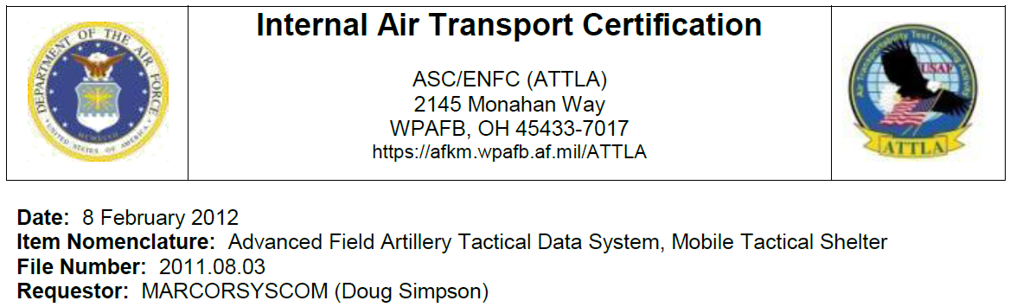
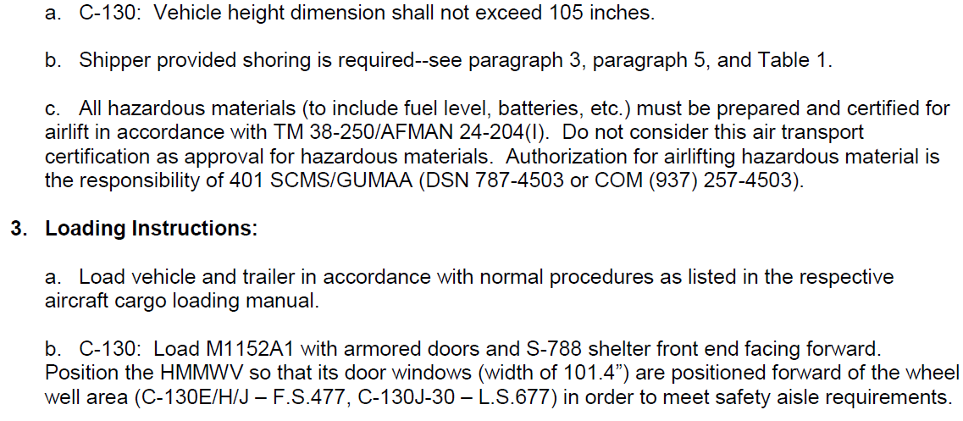
5 STEPS
Step 2. Reference ATTLA Certs for applicable equipment
Equipment Prep Instructions
Aircraft Loading Instructions

Slide 24
5 STEPS
Step 3. Start placing equipment on aircraft
“Pyramid” method or “50/50” method

Slide 25
5 STEPS
Step 4. Adhere to ALL aircraft limitations
Rolling Stock
Ease of on-load/off-load (backed in to aircraft)
Note: unless stated differently in ATTLA cert letter.
ICODES automatically places vehicle in the right direction
Trailers loaded on same aircraft and associated/behind Prime Movers
Pallets
Loaded aft of all rolling stock and passengers
Aircraft contour restrictions
Baggage
Pallet require for 20+ personnel (10+ for KC-10)
Loaded last / first off
Passengers
Must be 30 inches forward of netted palletized cargo
Adjacent to cargo restriction (cargo width) for C-130 & C-17

Slide 26
5 STEPS
Step 5. Optimize Aircraft CG
Each Airframe has a specific Optimal CG
Load Shift Principals
Moving heavy items – Significant Change
Moving light items – Minimal Change

Slide 27
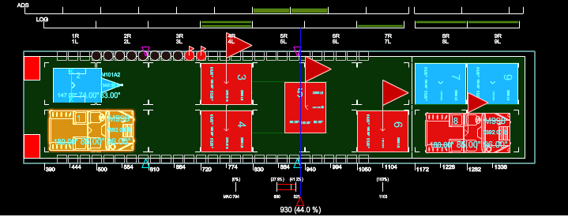
What’s wrong with this picture?
Notes:
Prime mover not connected to vehicle.
Passengers within 30” of a pallet.
Improper mix of logistics/aerial delivery pallets.
Vehicle behind pallets.
Vehicle must face forward on the ramp so filler cap is on the high side of ramp.
C/G out of range.

Slide 28
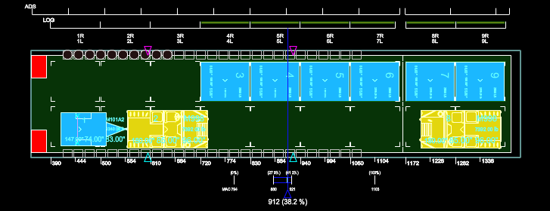
Solution 1:
Advantages
Offload will be very quick
Floor loaded cargo space
Tie-down of vehicles
CG, optimized
Disadvantages
Seats lost next to LRS pallets
LRS pallets can take longer to upload and download

Slide 29
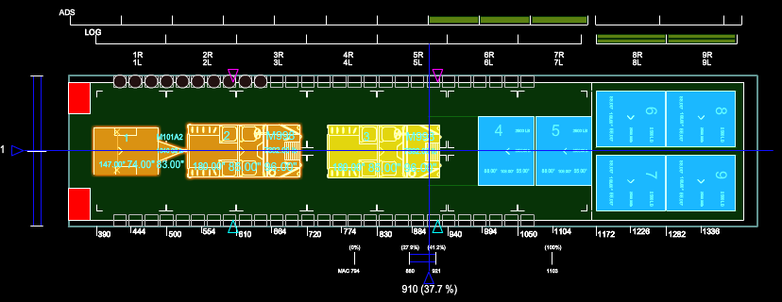
Solution 2:
Advantages
Maximized seat availability
Much easier to marshal vehicles
Optimized CG
Disadvantages
Configuration will take longer
Lost space for floor loaded cargo

Slide 30
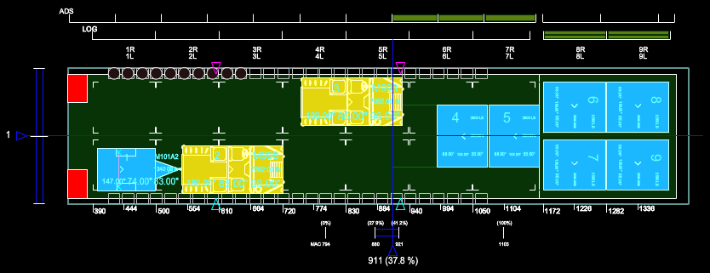
Do not correct this way:
There is no reason to offset these vehicles:
You decrease your passenger seat availability.
Offset cargo has no effect on your C/G.

Slide 31
QUESTIONS?

Slide 32
Summary
Terminology
Weight and Balance Theories
Load Planning

