Slide 1
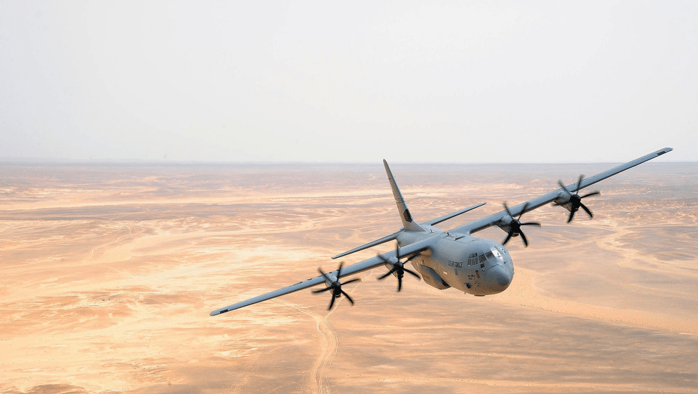
C-130 J & H CHARACTERISTICS

Slide 2
OVERVIEW
Cargo Compartment Limitations
Pallet Considerations
Passenger Considerations
C-130H Differences
Load Planning Factors
JALP

Slide 3
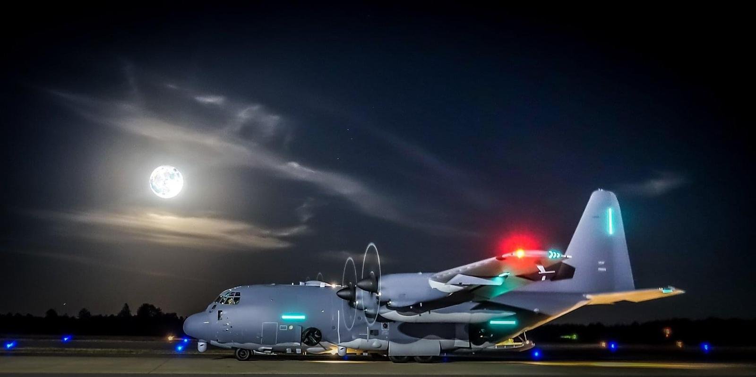
Tactical Airlift vs
Strategic Airlift
JALP
Notes:
Explain tactical airlift

Slide 4
COMPARTMENT LIMITATIONS
JALP

Slide 5
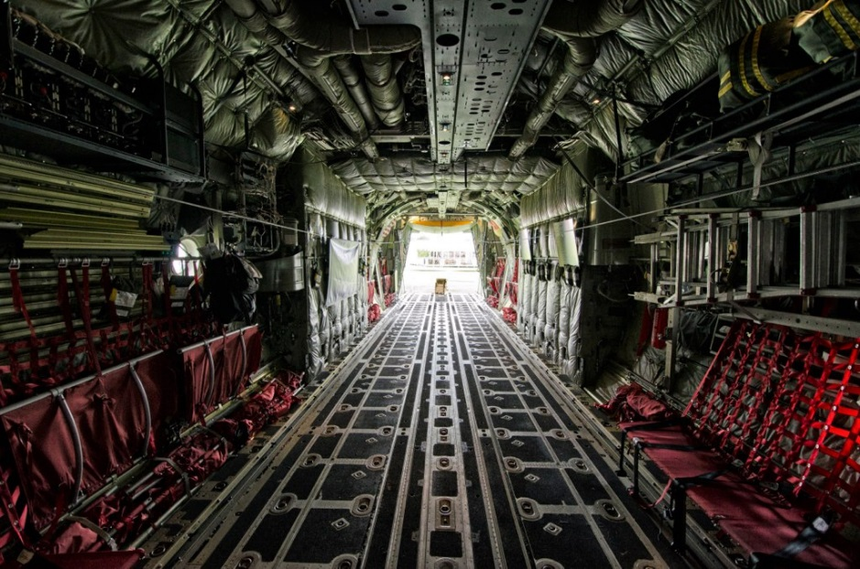
Cargo Floor
  Length – 796” (779” usable)
  Width – 123 (105” usable)
  Height – 108”
Aircraft Ramp
  Length – 127”
  Width – 123” (105” usable)
  Height – 80”
JALP
Cargo over 102” requires special loading procedures; contact your AMCU for guidance
Notes:
Cargo over 102” requires special loading procedures; contact your AMCU for guidance

Slide 6
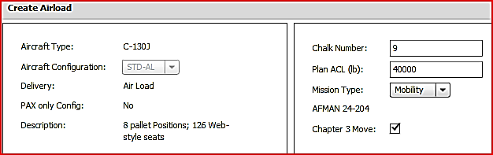
JALP
Notes:
Higher ACLs are possible but only after coordination with your affiliated AMCU or in accordance with the Operation Order

Slide 7
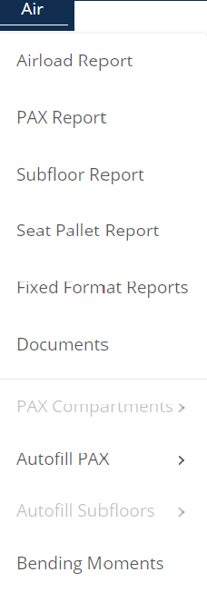
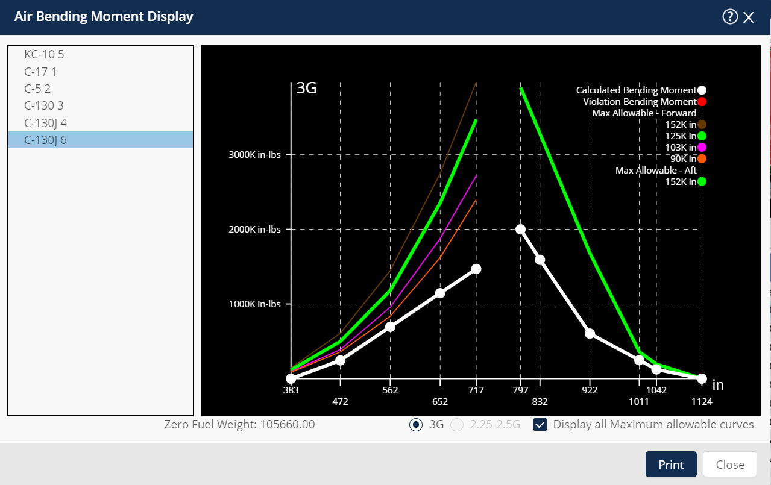
BENDING MOMENTS
(C-130J Only)
Aircraft Commander has final authority to accept/reject any or all of the cargo if the planned load is not within bending moment limits
JALP
Notes:
Use 3.0G if operating in a combat area with hostilities, or tactical maneuvers are planned. Otherwise use 2.5G/2.25G (program defaults to 3.0G)
Bending moment limitation only applies to C- 130J-30

Slide 8
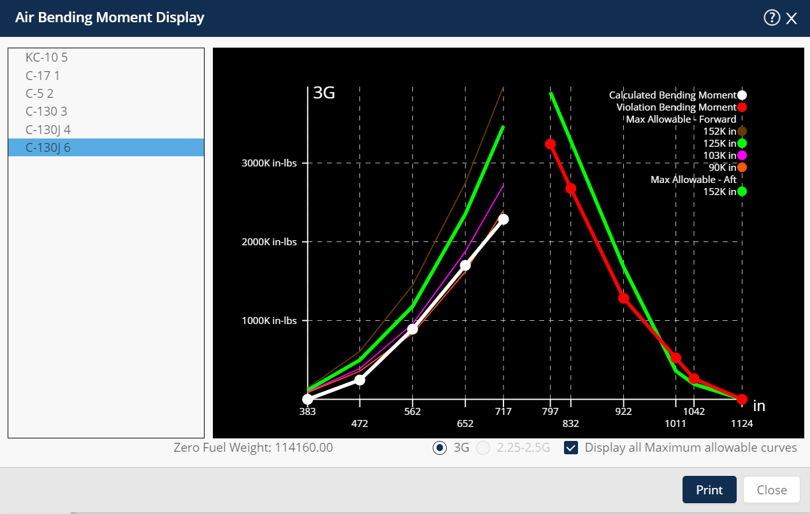
Within Limits
OUT OF LIMITS
JALP
Notes:
Explain bending moment lines and what that white lines are good, red lines are breaking bending moments.

Slide 9
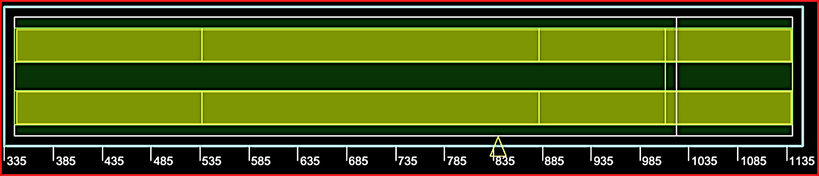
TREADWAY
LIMITATIONS
35” Treadways
Treadways begin 15” left and right of aircraft centerline
35” Treadways
JALP
Notes:
Explain that any axles within 48” must be combined.

Slide 10
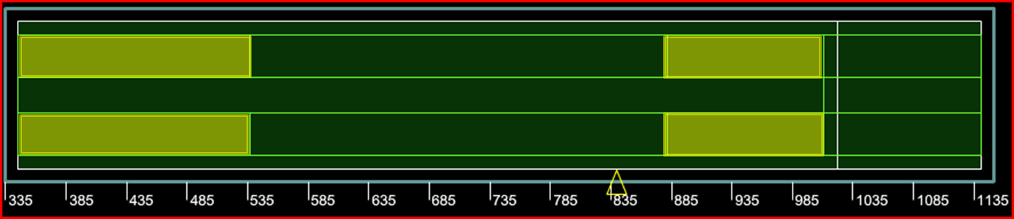
TREADWAY
LIMITATIONS
6,000 lbs Max Axle Weight
FS 345 - 537
FS 882 - 1017
JALP

Slide 11
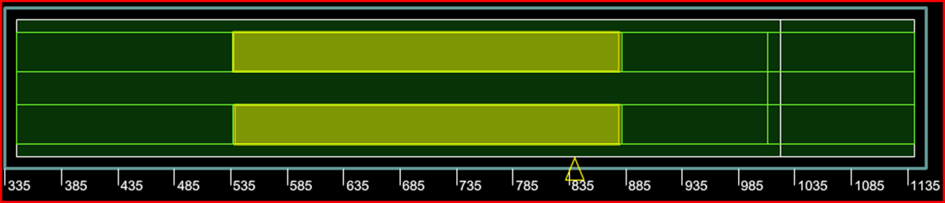
TREADWAY
LIMITATIONS
13,000 lbs Max Axle Weight
FS 537 - 882
JALP

Slide 12
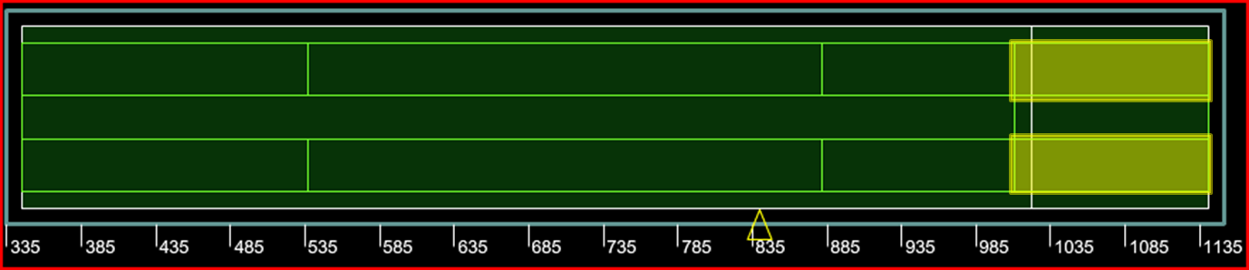
RAMP TREADWAY
LIMITATIONS
Mixed cargo up to 5,000 lbs
(when axle(s) do not exceed
2,500 lbs)
Axle only = 3,500 lbs max
FS 1017 – 1141 (Ramp)
JALP

Slide 13
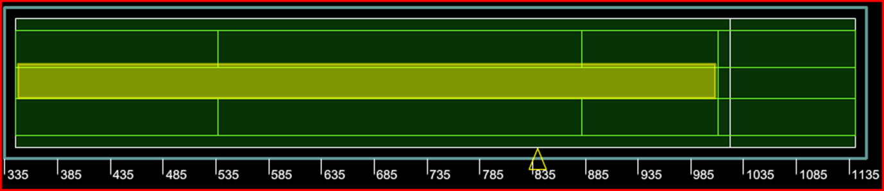
BETWEEN TREADWAY
LIMITATIONS
5,000 lbs Max Axle Weight
2,000 lbs Max Tongue Load
FS 345 - 1017
JALP

Slide 14
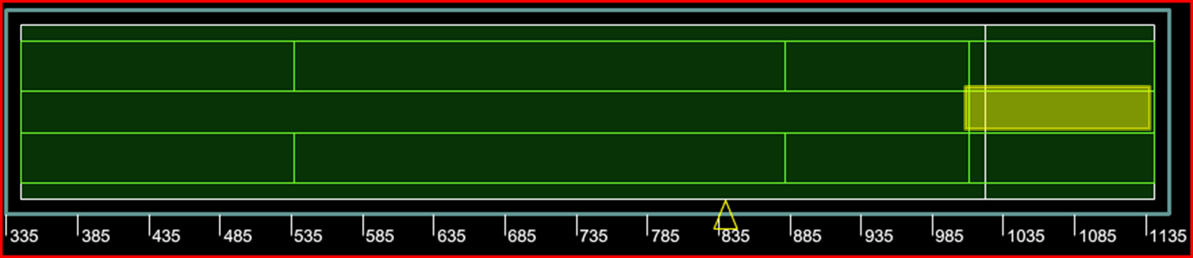
BETWEEN TREADWAY
LIMITATIONS
1,200 lbs Max Axle Weight
450 lbs Max Tongue Load
FS 1025 – 1141 (Ramp)
JALP
P

Slide 15
PALLET CONSIDERATIONS
JALP

Slide 16
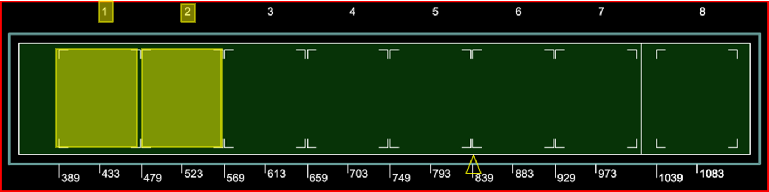
PALLET POSITIONS 1 & 2
Any cargo above 76” up to 96” high must be placed 12” inboard from the edge of the usable surface of the pallet
Note: Contact your AMCU for cargo above 96”
12” Inset
12” Inset
77”-96”
77”-96”
10,355 lbs Max Wt
JALP
12” Inset
12” Inset

Slide 17
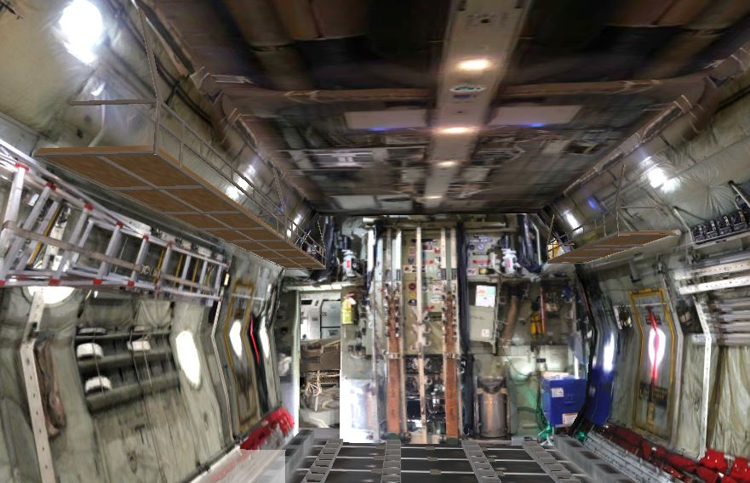
PALLET POSITIONS 1 & 2
JALP
Stowage rack in PP 1 & 2

Slide 18
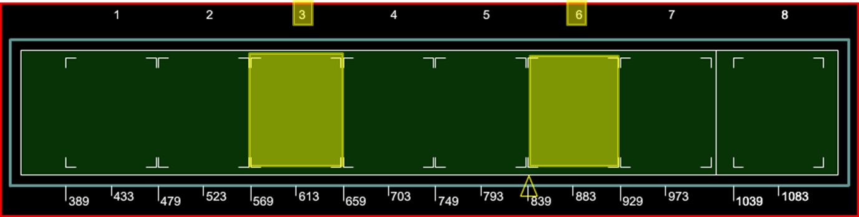
PALLET POSITIONS 3 & 6
10,355 lbs Max Wt
96”
96”
JALP
Note: Contact AMLO or EAGLE or ADACG for cargo above 96”
Notes:
Maximum weight is 10,355 pounds
Cargo may be loaded over the entire usable surface of the pallet up to 96 inches in height.
No setback needed

Slide 19
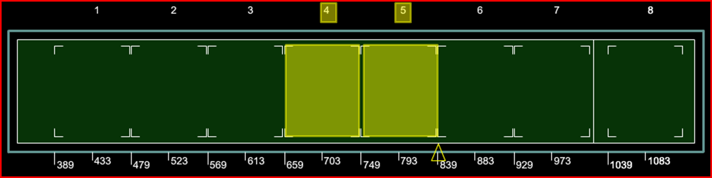
PALLET POSITIONS 4 & 5
10,355 lbs Max Wt
96”
96”
JALP
6” Inset
Cargo must be stacked at least 6 inches in from the edge of the usable surface on one 88-inch side.
Note: Contact your AMCU for cargo above 96”
Notes:
Maximum weight is 10,355 pounds
Cargo may be loaded over the entire usable surface of the pallet up to 96 inches in height.
Must have a setback of 6 inches from the edge of the pallet on one 88 inch side for access to wheel well area when combined with the dual rail system (will provide 14 inch aisle way)

Slide 20
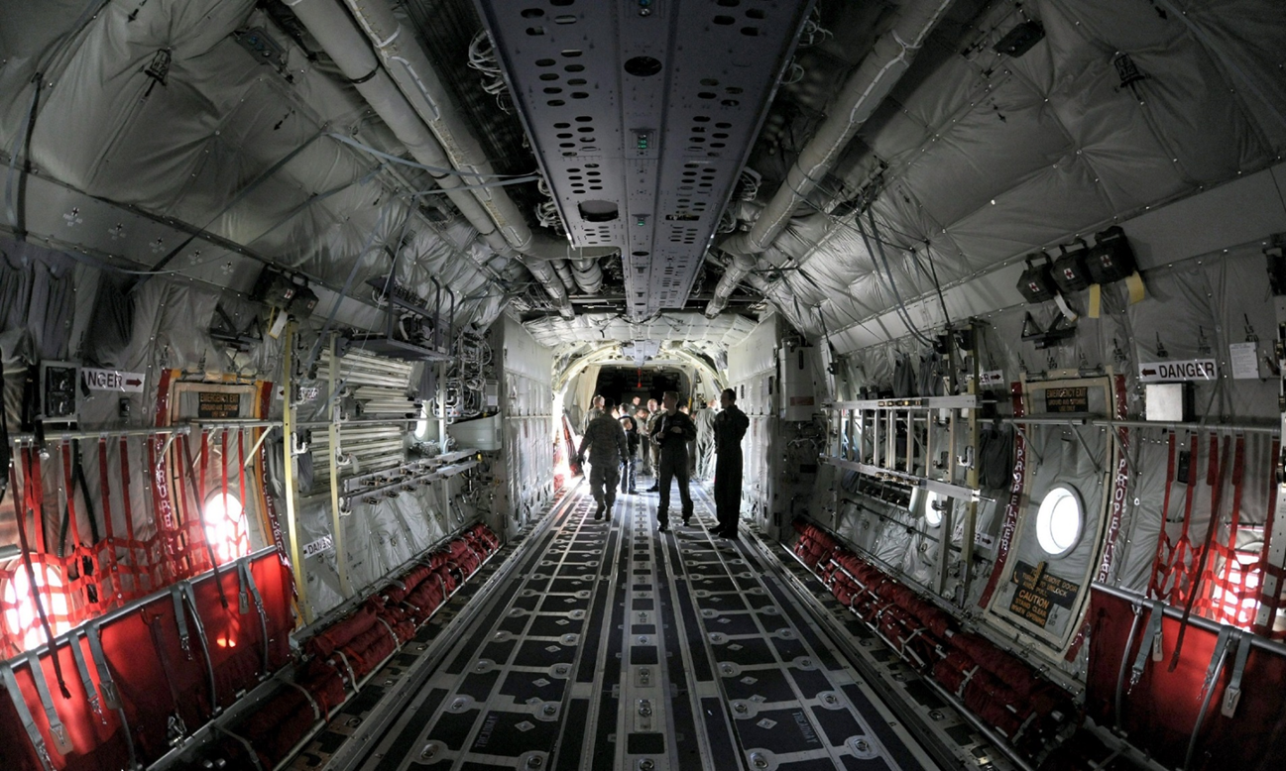
PALLET POSITIONS 4 & 5
JALP

Slide 21
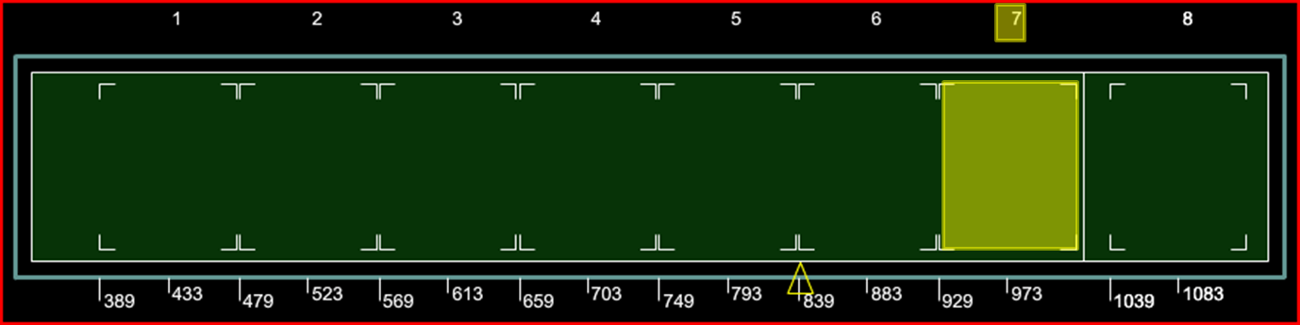
PALLET POSITION 7
8,500 lbs Max Wt
96”
JALP
Notes:
Cargo may be loaded over the entire usable surface of the pallet up to 96 inches in height.

Slide 22
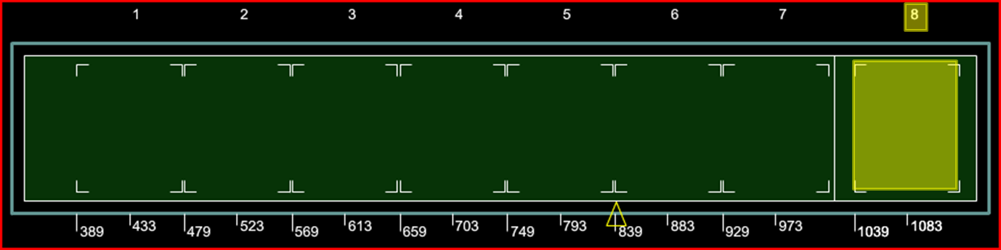
PALLET POSITIONS 8
Cargo must be stacked at least 20 inches in from the edge of the usable surface on one 88-inch side.
20” Inset
5,000 lbs Max Wt
77”
JALP
P
Notes:
Cargo may be stacked up to 77 inches high with a 20 inch set back on the right 88 inch side to give access to rear emergency exits and latrine.
ICODES will not flag pallets over 77 inches (ICODES starts to flag at 81 inches)

Slide 23
PASSENGER CONSIDERATIONS
JALP

Slide 24
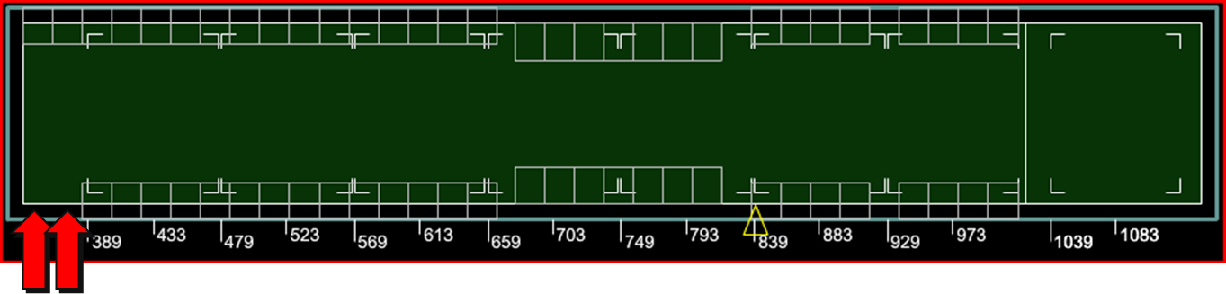
SIDEWALL SEATS
62
Sidewall Seats
60
Available for use
>40
2 LM’s required
JALP
SEATS 1L & 2L AUTOMATICALLY ACCOUNTED FOR
Notes:
48 permanently installed seats, ONLY 46 available for use
14 optionally installed wheel well seats
One loadmaster will always be seated in the cargo compartment; two with 40 or more passengers
These two seats are accounted for (1L & 2L)

Slide 25
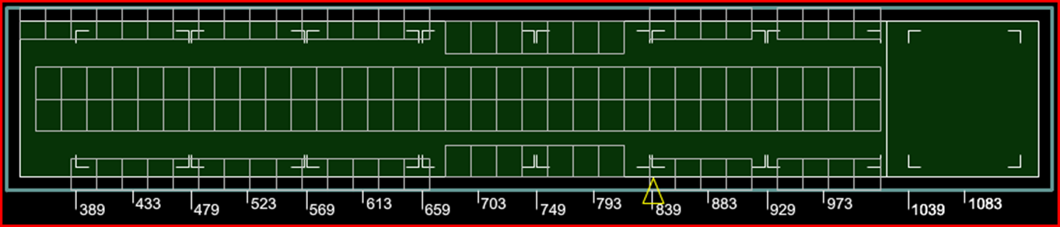
CENTERLINE SEATS
128
126
Available for use
80
Total seats (66 Optionally installed centerline seats)
Max personnel for prolonged over-water flight
JALP
Notes:
66 Optionally installed centerline seats
128 total seats, 126 available for use
Maximum personnel for prolonged over water flights limited to 80 based on life raft capacity (including crew)

Slide 26
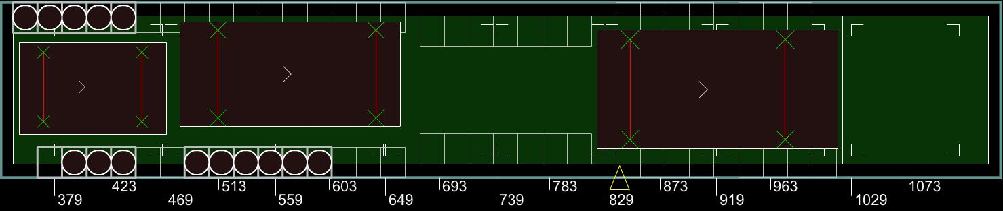
PASSENGERS
NEXT TO CARGO
OUTSIDE OF WHEEL WELL AREA
XXXXXXXXXXXXX
XXXXXXXXXXXXX
77”- 96”
≤76”
>96”
JALP
XXXXXXXXXXXXX
Notes:
Cargo width 76 inches or less; centerline cargo and seat passengers on both sides
Cargo width greater than 76 inches up to 96 inches; offset cargo and seat passengers on opposite side (passengers on one side only)
Cargo width greater than 96 inches- no passengers allowed beside cargo
ICODES will not flag these restrictions

Slide 27
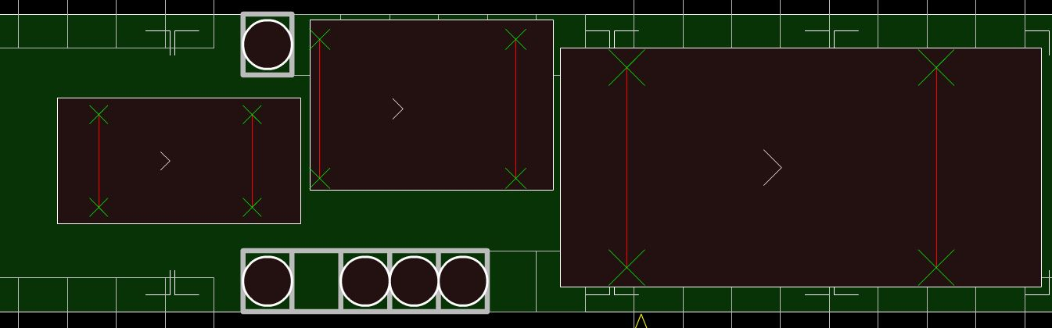
PASSENGERS
NEXT TO CARGO
INSIDE OF WHEEL WELL AREA
XXXXXXXXX
X
53”- 72”
≤52”
>72”
JALP
X
H
Notes:
Cargo width less than 52 inches- centerline cargo and seat passengers on both sides
Cargo width greater than 52 to 72 inches; offset cargo and seat passengers on opposite side (passengers on one side only)
Cargo width greater than 72 inches- no passengers allowed

Slide 28
C-130H DIFFERENCES
JALP

Slide 29
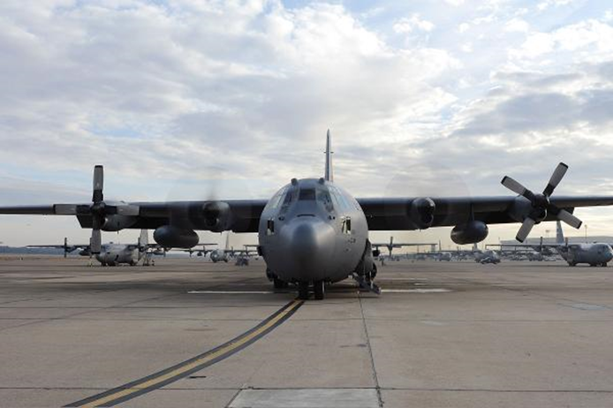
Shorter fuselage holds 6 pallets
4 Blades
JALP
Restrictions/limitations almost identical to C-130J-30

Slide 30
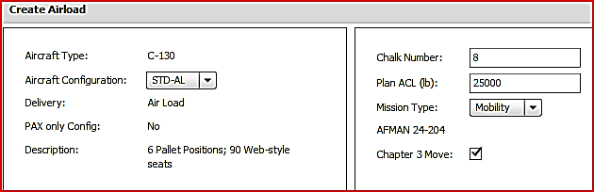
JALP
Notes:
Higher ACLs are possible but only after coordination with your affiliated AMCU or in accordance with the Operation Order

Slide 31
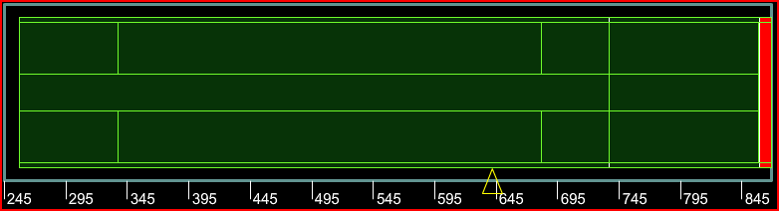
TREADWAY LIMITATIONS
Same restrictions (different FS start/stop)
6,000
13,000
6,000
3500
Max Axle Weight 1,200
Max Tongue load 450
Max Axle Weight 5,000 Max Tongue load 2,000
6,000
13,000
6,000
3500
JALP
P

Slide 32
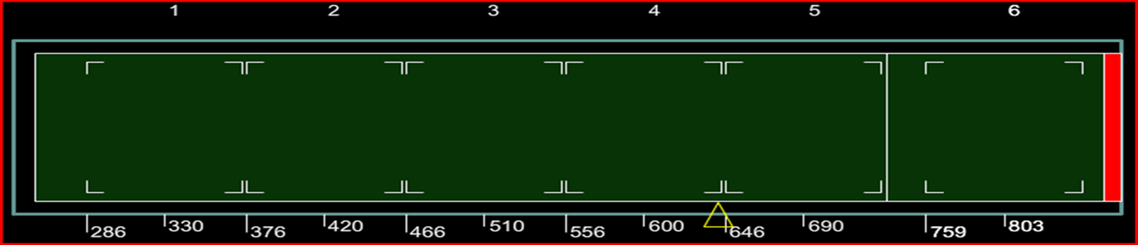
PALLET POSITION 1
Any cargo above 76” up to 96” high must be placed 12” inboard from the edge of the usable surface of the pallet
Note: Contact your AMLO or EAGLE or ADACG for cargo above 96”
12” Inset
77”- 96”
76”
10,355 lbs Max Wt
JALP
12” Inset
Notes:
Maximum weight is 10,355 pound
Cargo may be loaded over the entire usable surface up to 76”
Any cargo above 76 inches up to 96 inches cargo must be placed 12 inches inboard from the edge of the usable surface of the pallet to accommodate storage racks which can be located on the left, right or both sides of the fuselage.

Slide 33
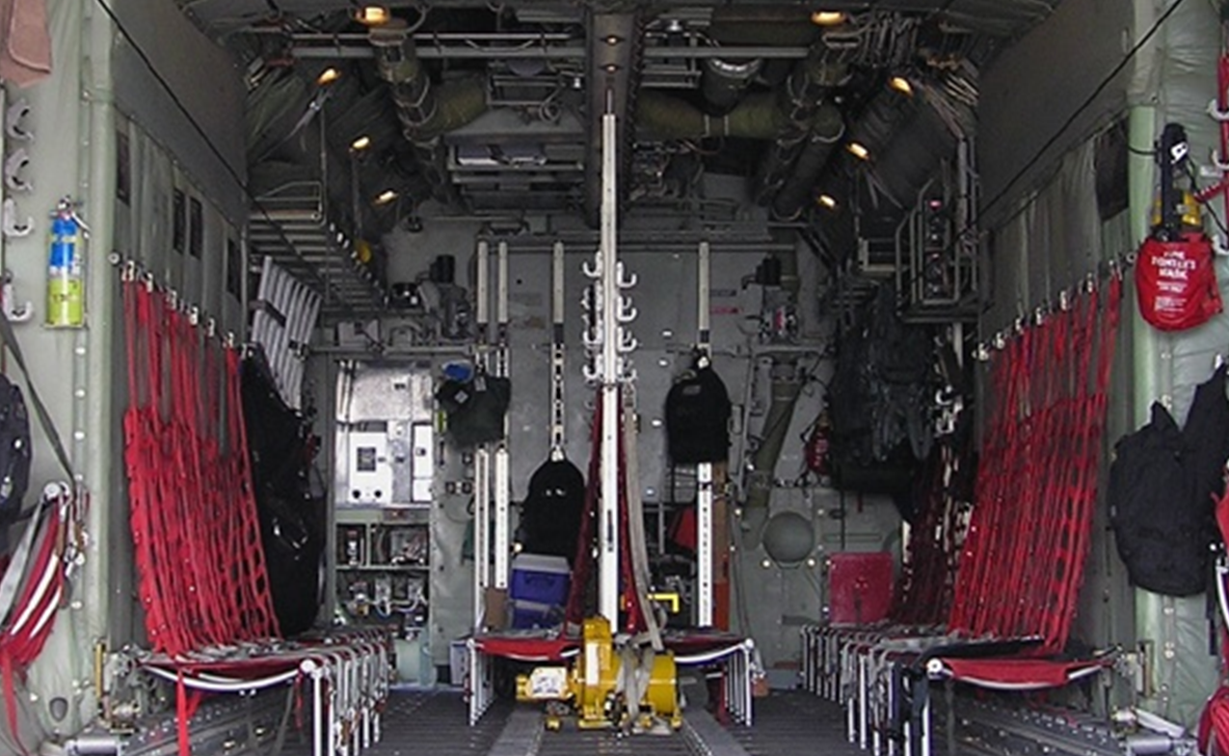

PALLET POSITION 1
JALP

Slide 34
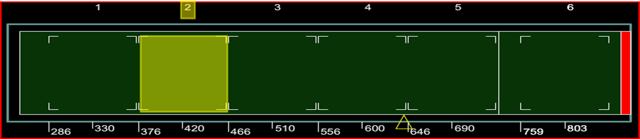
PALLET POSITION 2
96”
10,355 lbs Max Wt
JALP
Note: Contact your AMCU for cargo above 96”
Notes:
Maximum weight is 10,355 pounds
Cargo may be loaded over the entire usable surface of the pallet up to 96 inches in height.
No setback needed

Slide 35
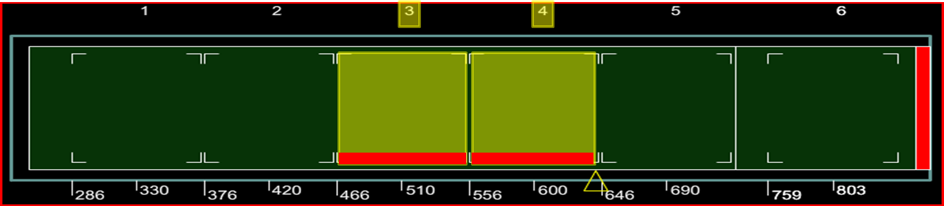
PALLET POSITIONS 3 & 4
Cargo must be stacked at least 6 inches in from the edge of the usable surface on one 88-inch side.
96”
96”
10,355 lbs Max Wt
JALP
6” Inset
Notes:
Maximum weight is 10,355 pounds
Cargo may be loaded over the entire usable surface of the pallet up to 96 inches in height.
Must have a setback of 6 inches from the edge of the pallet on one 88 inch side for access to wheel well area when combined with the dual rail system (will provide 14 inch aisl way)

Slide 36
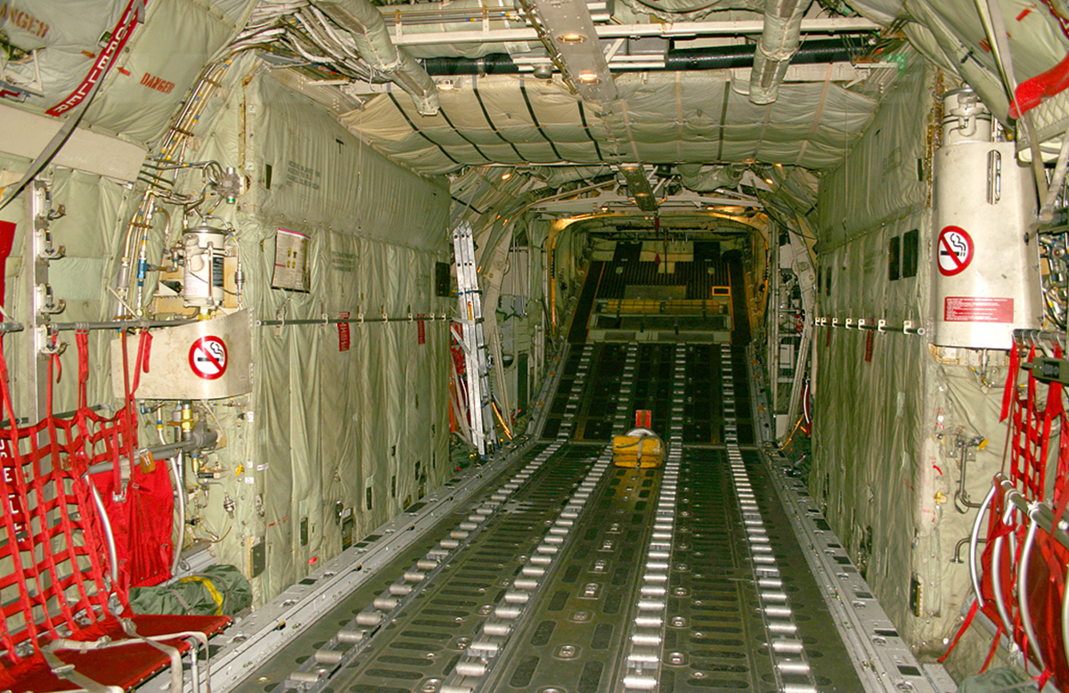
PALLET POSITIONS 3 & 4
JALP

Slide 37
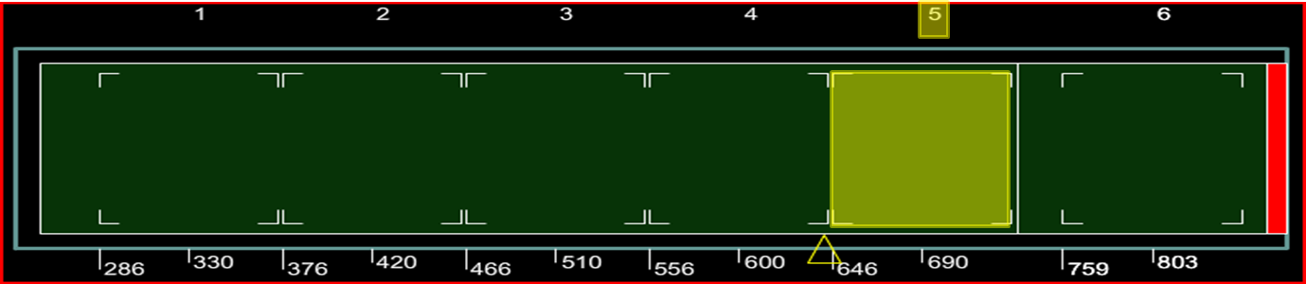
PALLET POSITIONS 5
8,500 lbs Max Wt
96”
JALP
Notes:
Maximum weight is 8,500 pounds
Cargo may be loaded over the entire usable surface of the pallet up to 96 inches in height.

Slide 38
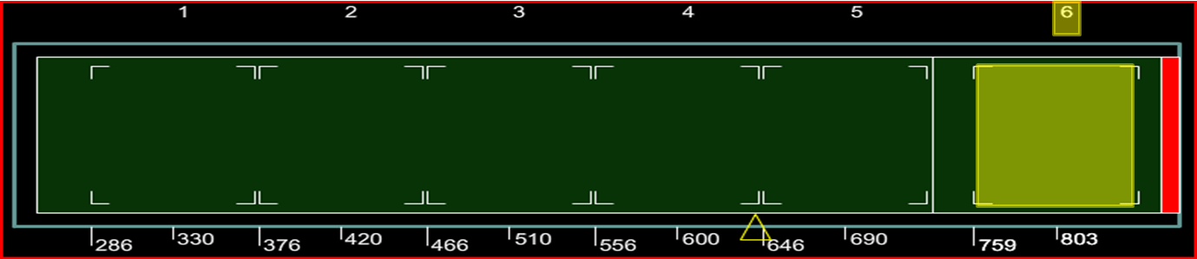
PALLET POSITIONS 6
Cargo must be stacked at least 20 inches in from the edge of the usable surface on one 88-inch side.
20” Inset
4,664 lbs Max Wt
76”
JALP
P
Notes:
Maximum weight is 4,664 pounds
Cargo may be stacked up to 76 inches high with a 20 inch set back on one 88 inch side to give access to rear emergency exits and latrine.
ICODES will not flag pallets over 76 inches (ICODES does not flag until 81 inches)

Slide 39
PASSENGER CONSIDERATIONS
JALP

Slide 40
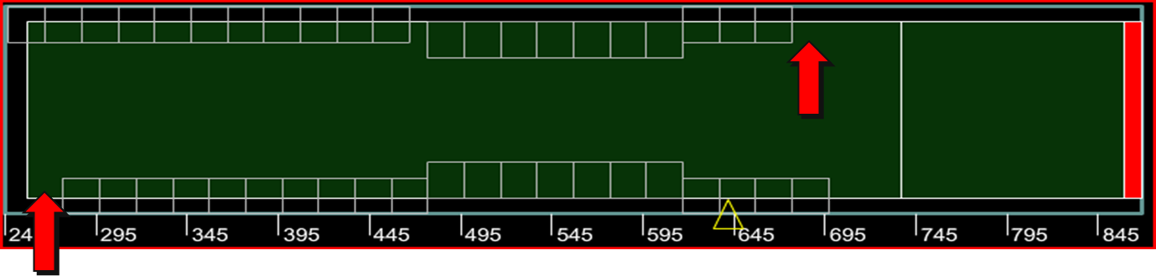
SIDEWALL SEATS
44
Sidewall Seats
42
Available for use
>40
2 LM’s required
14 OPTIONAL WHEEL WELL SEATS
JALP
Seats 1L & 15R automatically accounted for
Notes:
30 permanently installed seats, ONLY 28 available for use
14 optionally installed wheel well seats
One loadmaster will always be seated in the cargo compartment; two with 40 or more passengers
These two seats are accounted for (1L & 15R)

Slide 41
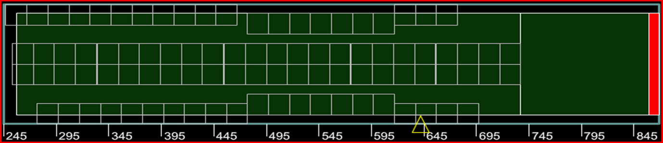
CENTERLINE SEATS
92
90
Available for use
80
Total seats (48 Optionally installed centerline seats)
Max personnel for prolonged over-water flight
JALP
Notes:
48 Optionally installed centerline seats
92 total seats, 90 available for use
Maximum personnel for prolonged over water flights limited to 80 based on life raft capacity (including crew)

Slide 42
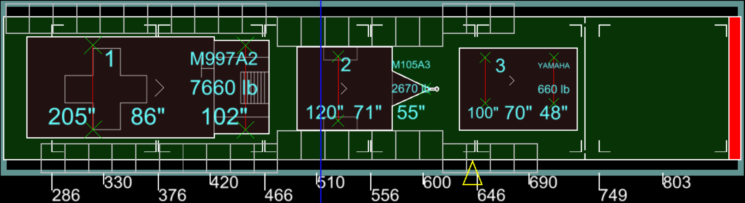
PASSENGERS NEXT TO CARGO
Same passenger next to cargo restrictions as C-130J-30
JALP
L
Notes:
Cargo width less than 52 inches- centerline cargo and seat passengers on both sides
Cargo width greater than 52 to 72 inches; offset cargo and seat passengers on opposite side (passengers on one side only)
Cargo width greater than 72 inches-no passengers allowed
ICODES will not flag these restrictions

Slide 43
LOAD PLANNING CONFIGURATIONS
JALP

Slide 44
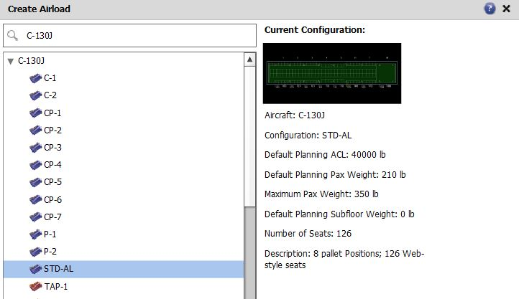
Use STD-AL for all variants
AFI 11-2C-130 Vol. 3 Addenda A contains all configuration descriptions
JALP

Slide 45
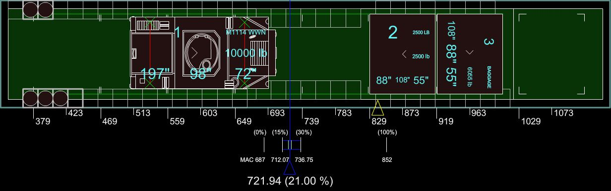
C-130 J or H
OPTIMAL CG
Applies to both C-130J-30 and C130H
JALP
21% +/- 1%
V
Notes:
Mission planners will manage aviation fuel as a limit commodity and precious resource
Fuel optimization will be considered throughout all phases of mission planning
Load and maintain aircraft at an optimum CG
21% plus or minus 1% of MAC is the optimal CG for C-130H/J

Slide 46
QUESTIONS?
JALP

Slide 47
SUMMARY
Cargo Compartment Limitations
Pallet Considerations
Passenger Considerations
C-130H Differences
Load Planning Factors
JALP

