Slide 2
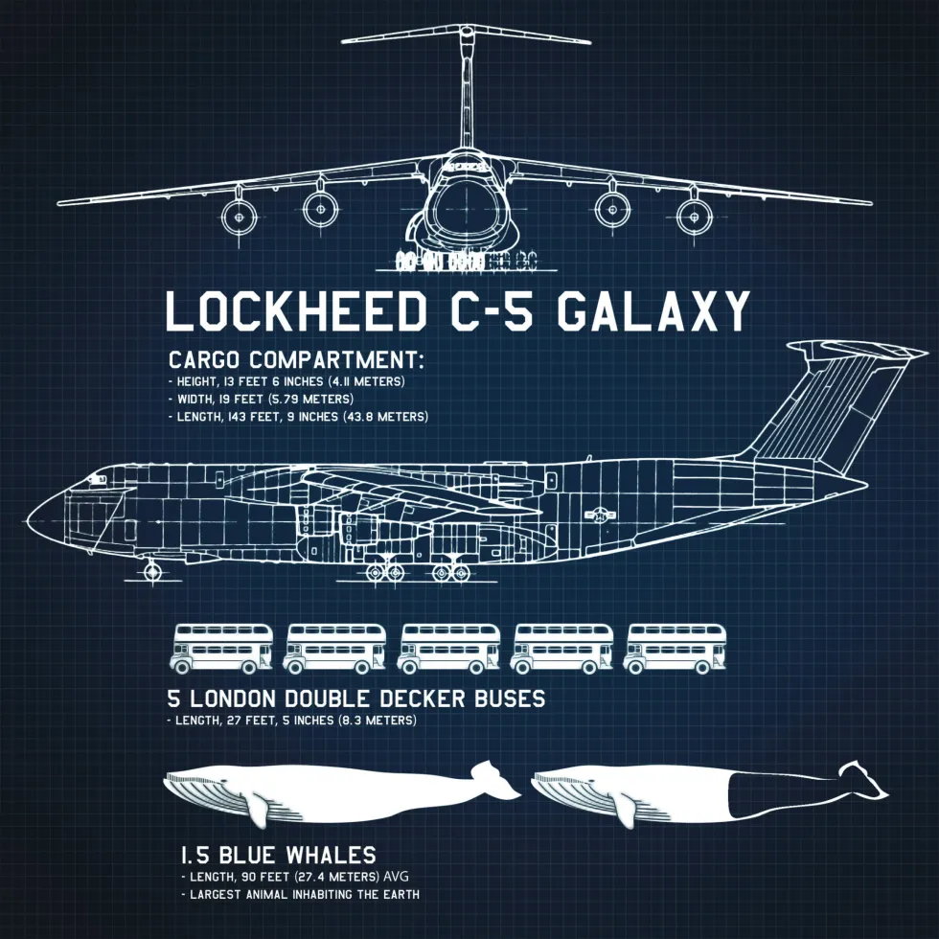

Slide 3
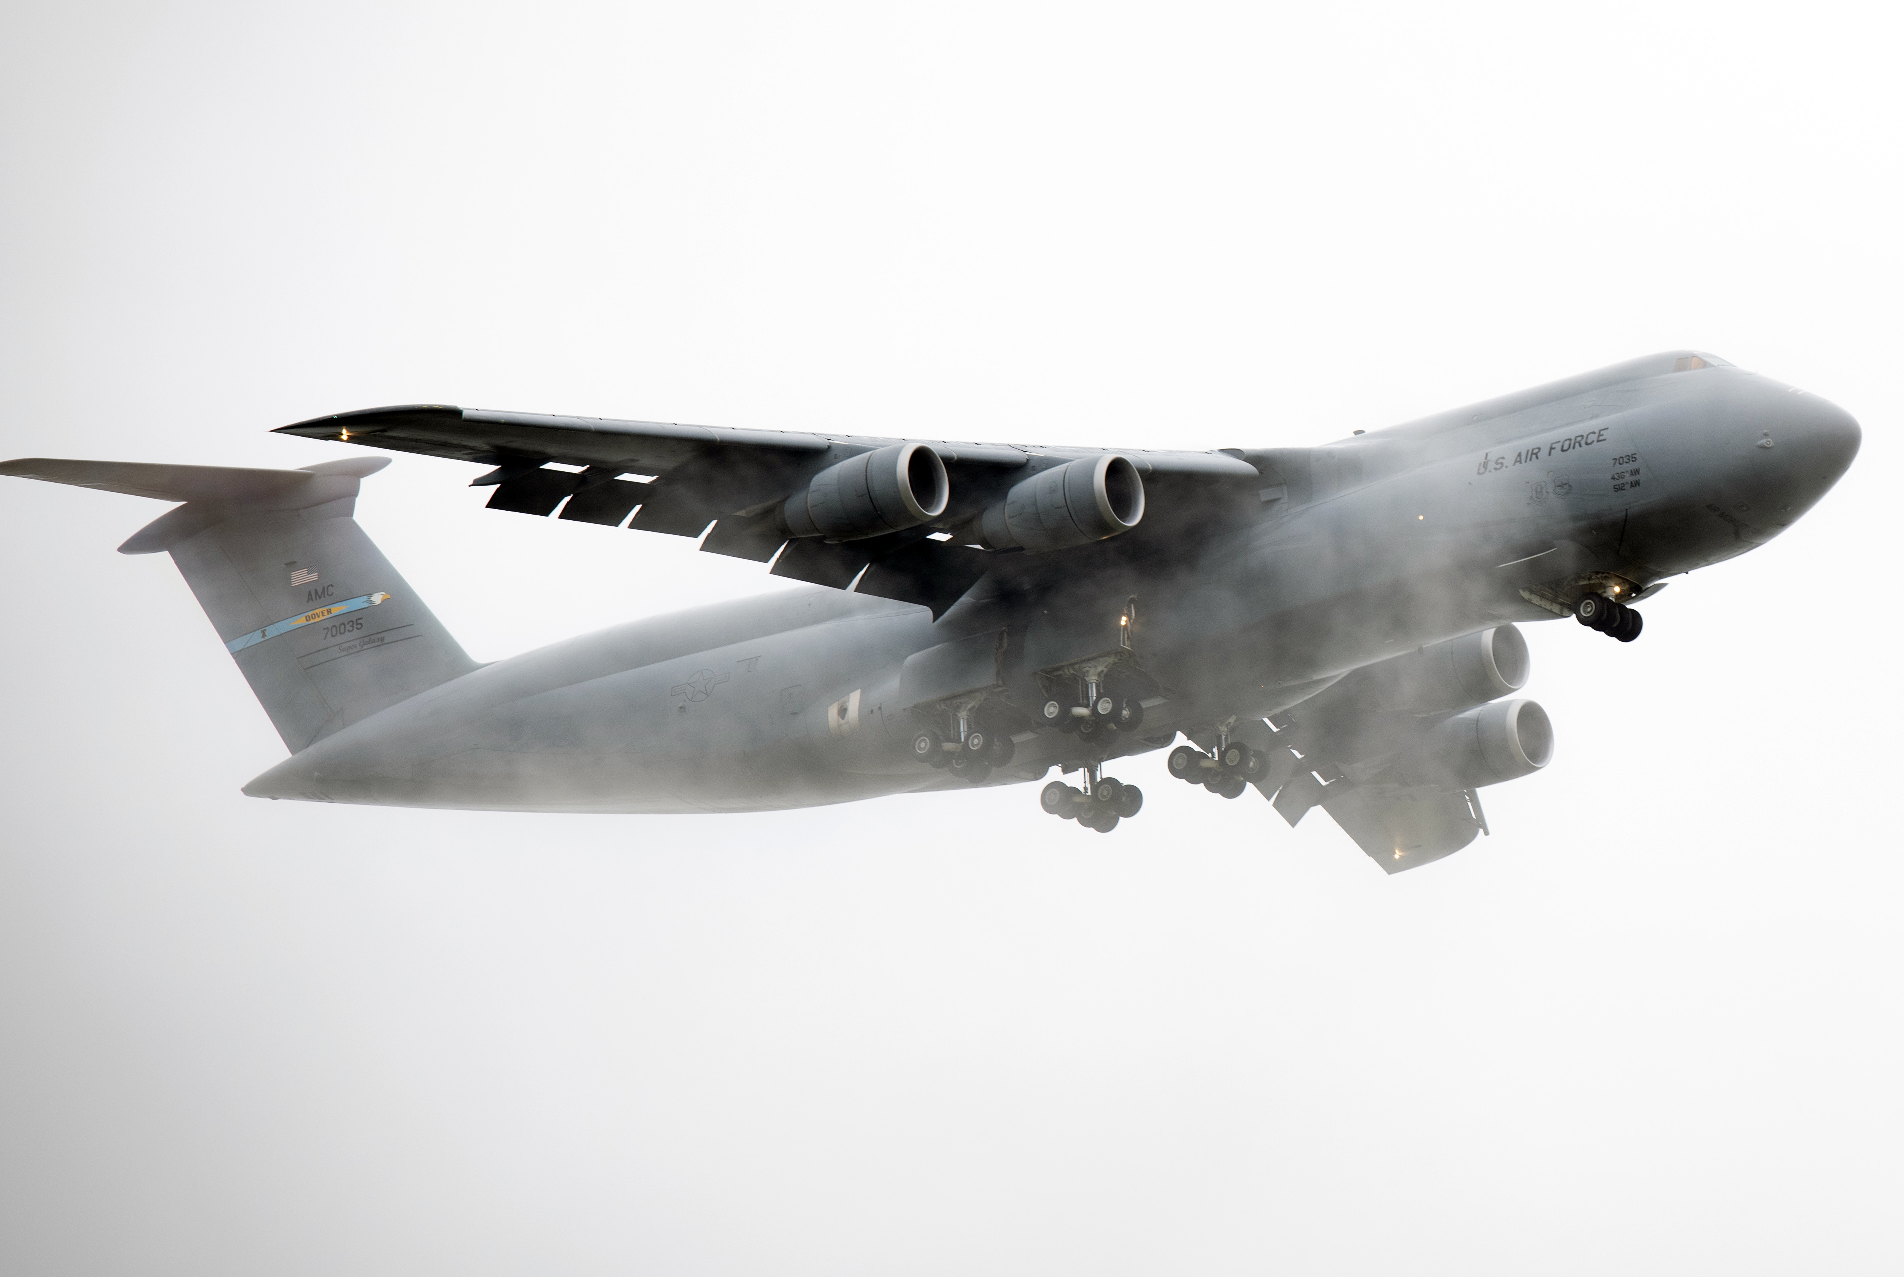
C-5M CHARACTERISTICS

Slide 4

OVERVIEW
Cargo Compartment Limitations
Pallet Considerations
Passenger Considerations
Load Planning Factors

Slide 5

CARGO COMPARTMENT LIMITATIONS
JALP

Slide 6


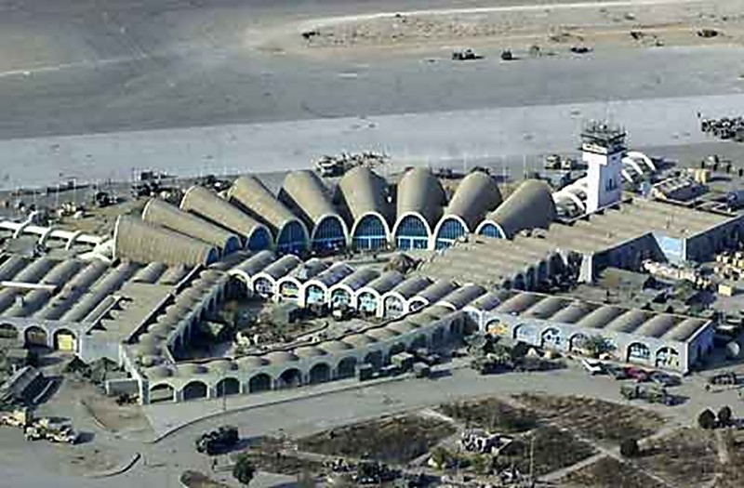
C-5M SUPER GALAXY
Cargo Compartment Limitations
Inter-Theater Airlift (Strategic) of Outsized Cargo
JALP

Slide 7

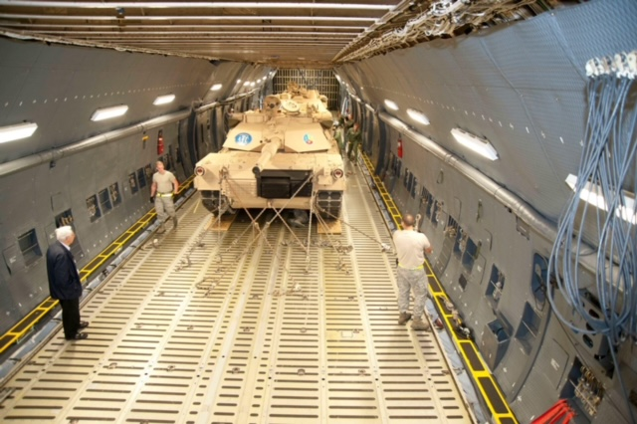
USABLE CARGO DIMENSION
Length of Cargo Floor- 1736”
MAX Width - 228”
MAX Height - 162”
JALP

Slide 8
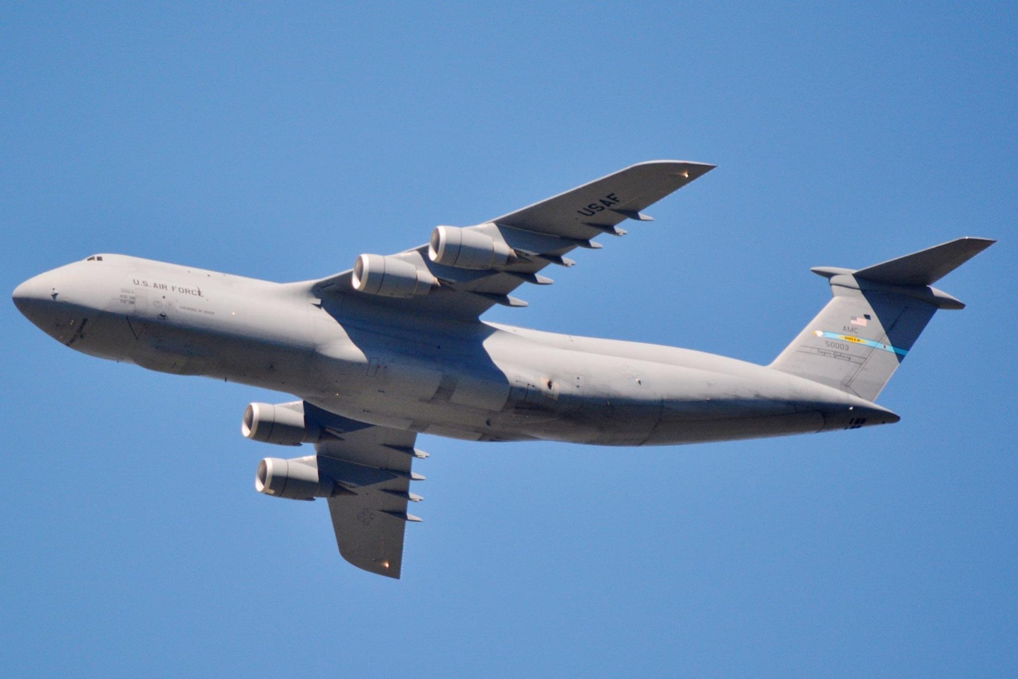
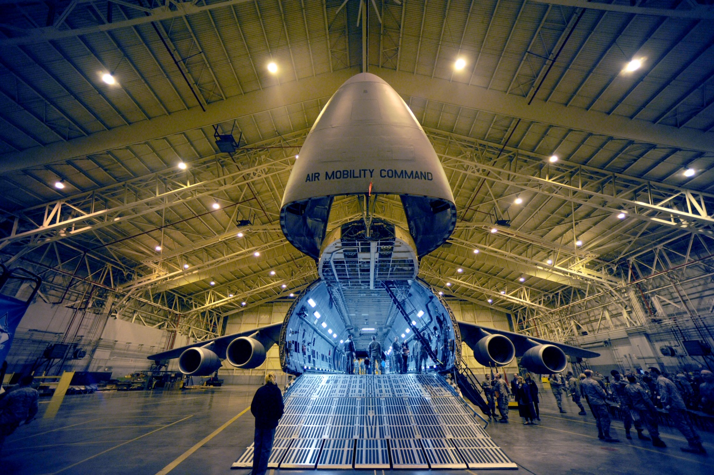
FORWARD RAMP
Length – 122”
Width – 228”
Forward Ramp

Slide 9
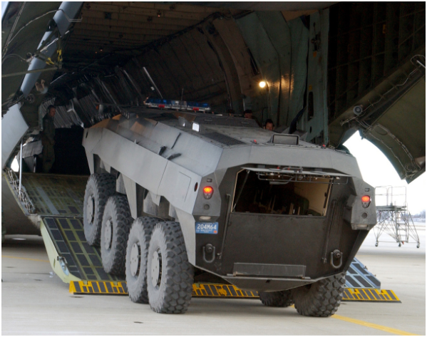
AFT RAMP
Length – 155”
Width – 228”
AFT RAMP
JALP

Slide 10
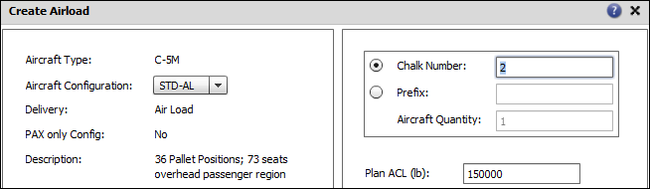
Weight Considerations
Allowable Cabin Load (ACL)
JALP

Slide 11
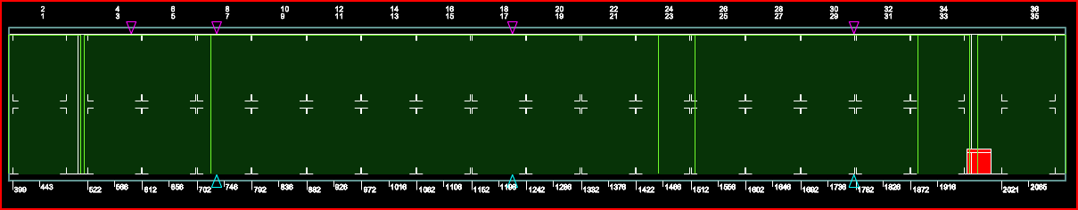
Rolling Stock Limitations/Weight Restrictions
3,600 lbs in any 20” length (FWD/AFT Ramps)
FS 395 – 517 FS 1971 - 2131
JALP

Slide 12
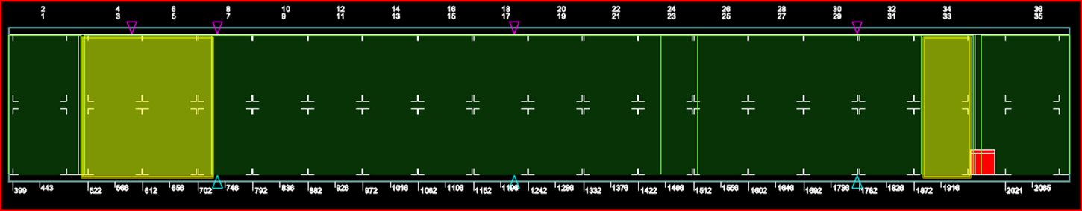
Rolling Stock Limitations/Weight Restrictions
20,000 lbs in any 40” length
FS 517 – 724 FS 1884 - 1971
JALP

Slide 13
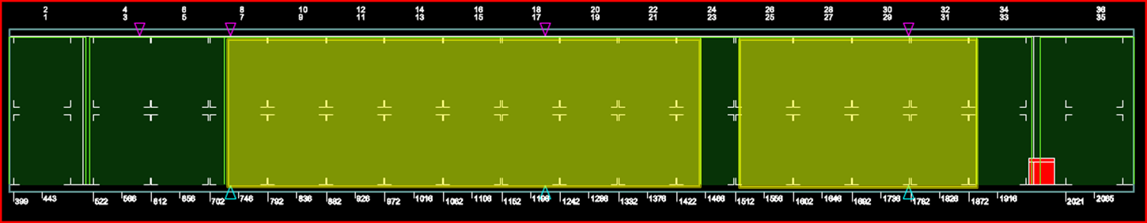
Rolling Stock Limitations/Weight Restrictions
36,000 lbs in any 40” length
FS 724 – 1458 FS 1518 - 1884
JALP

Slide 14
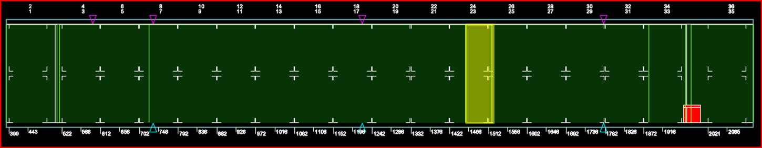
Rolling Stock Limitations/Weight Restrictions
*Track Vehicles Excluded
*25,000 lbs max weight
(Side-by-side/Multiple axles/Concentrated cargo)
FS 1458-1518
JALP

Slide 15

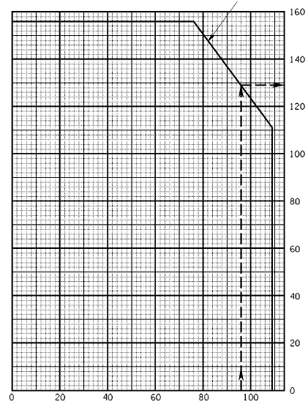
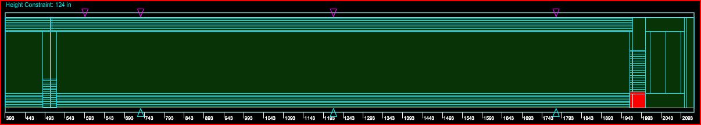
Height Restrictions
114”
Ref: T.O 1C-5M-9
No Load Zone
FWD Ladders
AFT Ladders
JALP

Slide 16
PALLET CONSIDERATIONS
JALP

Slide 17
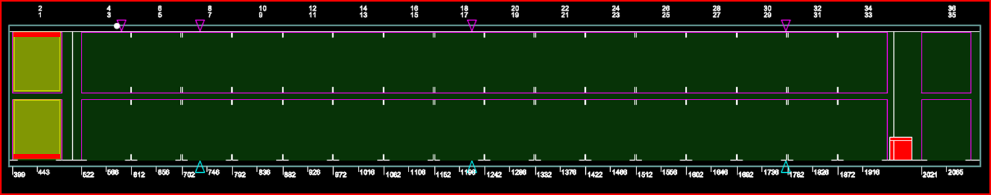
Forward Ramp Positions 1 & 2
96”
Max WT of 7,500 lbs ea in 1 & 2
96”
14” Aisle Ways
JALP

Slide 18
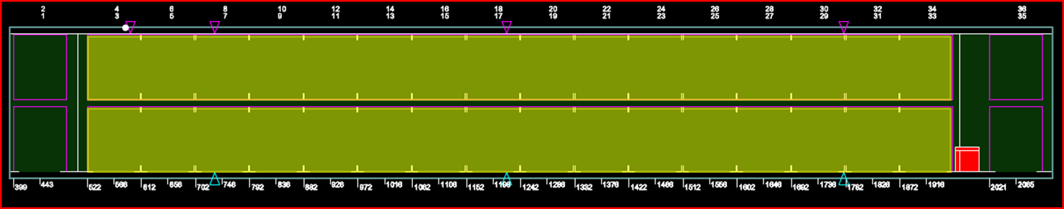
Main Cabin Floor Positions 3-34
10,355 lbs Max Pallet Wt
JALP
Notes:
Check -9 Sec 4 for position 33/34 restrictions for vertical CG.

Slide 19
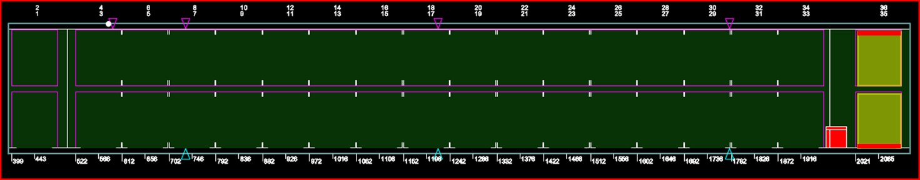
Aft Ramp Positions 35 & 36
Max WT of 7,500 lbs ea in 35 & 36
70”
14” Aisle Ways
70”
JALP

Slide 20
PASSENGER CONSIDERATIONS
JALP

Slide 21
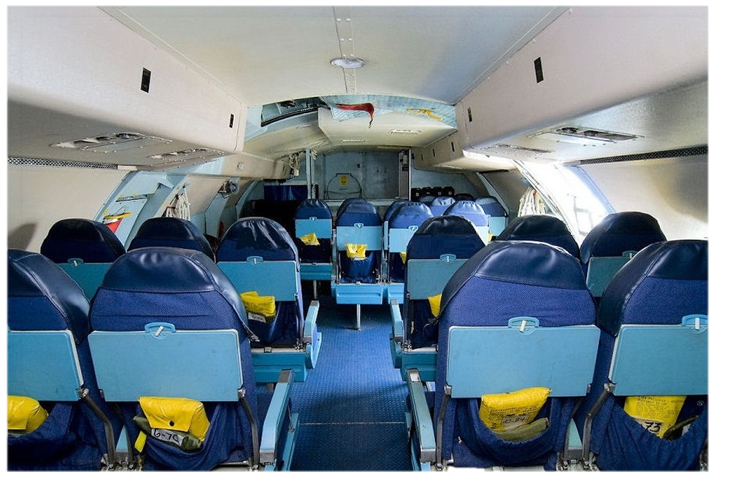
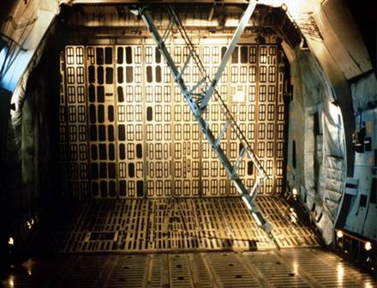
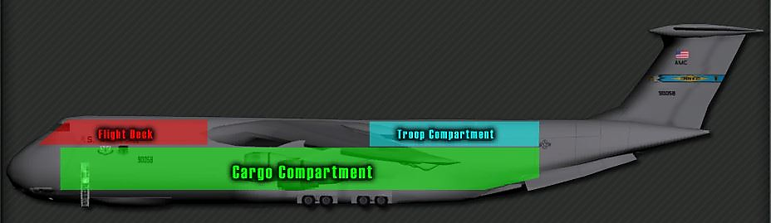
Passenger Considerations
FACING AFT OF THE AIRCRAFT
-73 SEATS
STEEP INCLINE/DECLINE STIARS
JALP
Notes:
Use picture from old slide

Slide 22
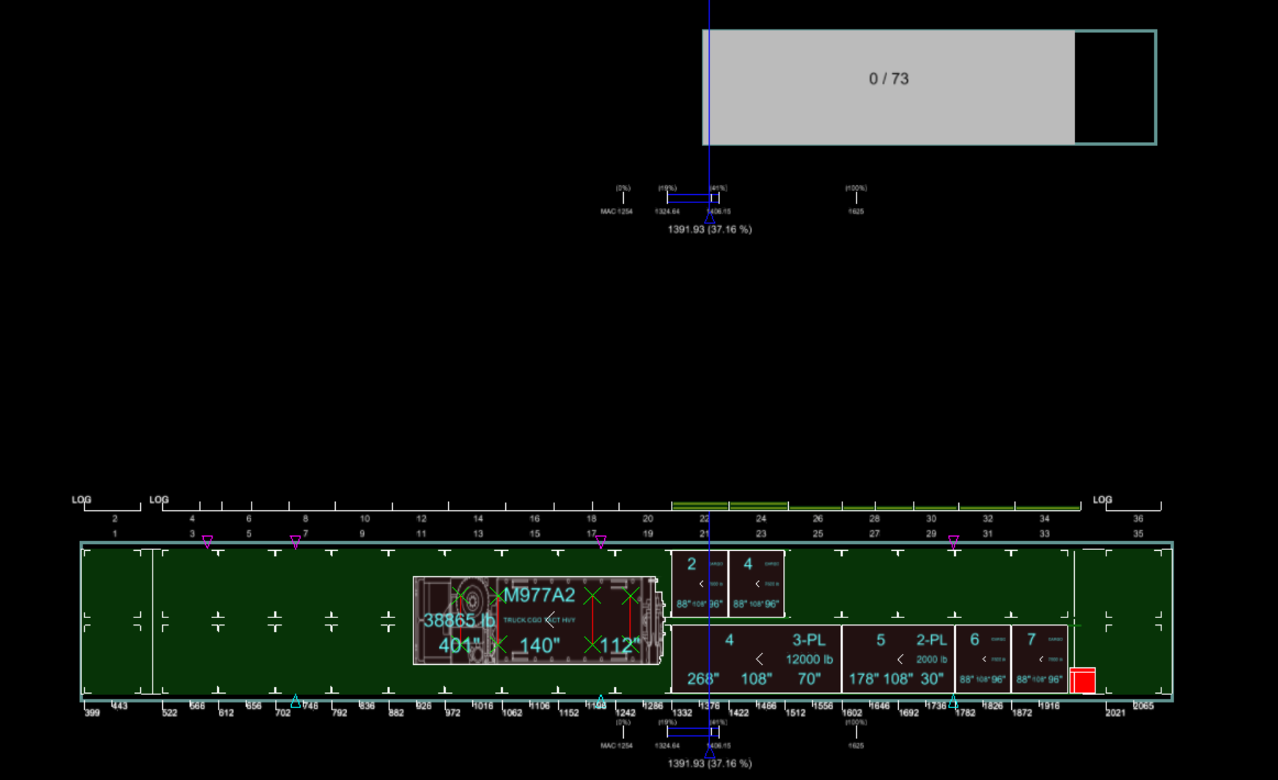
TROOP COMPARTMENT
Separate Compartments
JALP

Slide 23
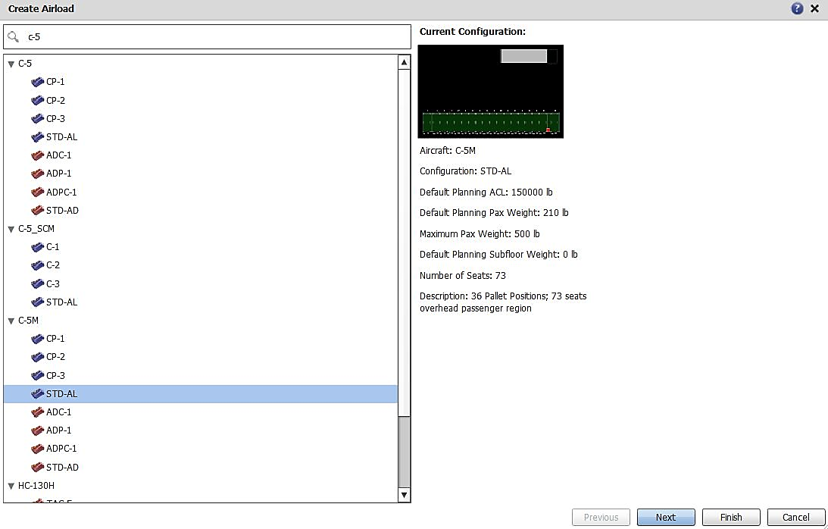
ICODES CONFIGURATIONS
C-5 Galaxy
Vs
C-5M Super Galaxy
Newer Engines/increased ACL
Ref: AFI 11-2C-5 Vol 3 Addenda A
JALP

Slide 24
LOAD PLANNING FACTORS
JALP

Slide 25
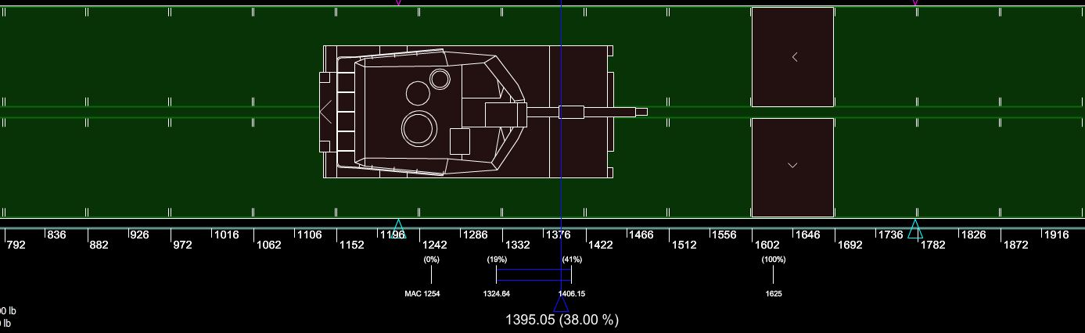
LOAD PLANNING FACTORS
OPTIMAL CG
38% (36% w/o pax & bags) +/- 1%
Fuel Management & Optimization
EXAMPLE
JALP

Slide 26

QUESTIONS?
JALP

Slide 27
QUESTIONS?

Slide 28
SUMMARY
Cargo Compartment Limitations
Pallet Considerations
Passenger Considerations
Load Planning Factors
JALP
Notes:
Cargo Limitations
What is the ACL for the C-5M? (150,000)
What height are we limited to when loading cargo near the side walls? (114”)
Pallet Considerations
How tall can you build pallets on the AFT ramp of the C-5M? (70”)
What is the max pallet weight allowed on the FORWARD & AFT ramps? (7,500)
On the FORWARD & AFT ramp, how much inset do I need and why? (14” & ramp locking pins)
Passenger Considerations
How many passengers can fit in the Troop compartment? (73)
Are the crew compartment and troop compartment connected? (No)
Loading Planning Factors
What is the optimal CG range for the C-5M? (38% +/-1%)

