Slide 1
FINAL DAY
Notes:
Attention: Many of us know how to do our job, but how many of us actually know where to locate the reference on a particular subject. When an Army Colonel is in your face saying that you’re holding up his process because you won’t build up his pallets, and it’s not your job to build them. You should be able to reference your responsibilities.
Motivation: Situations like this happen all too often. By not understanding the deploying unit’s responsibilities, and where to reference them, we sometimes become over zealous in our efforts to accomplish the mission. It is imperative that you have a clear understanding of referencing your responsibilities and the mobility forces responsibilities. It’s this understanding that will eliminate confusion and lighten your workload.

Slide 2
GRADUATION - FOR THE E’S: 3 COLLEGE CREDITS - 2 YEARS FORM 9

Slide 3

SOE:
FEEDBACK
CAPSTONE
CLEANUP
GRADUATION
Notes:
Attention: Many of us know how to do our job, but how many of us actually know where to locate the reference on a particular subject. When an Army Colonel is in your face saying that you’re holding up his process because you won’t build up his pallets, and it’s not your job to build them. You should be able to reference your responsibilities.
Motivation: Situations like this happen all too often. By not understanding the deploying unit’s responsibilities, and where to reference them, we sometimes become over zealous in our efforts to accomplish the mission. It is imperative that you have a clear understanding of referencing your responsibilities and the mobility forces responsibilities. It’s this understanding that will eliminate confusion and lighten your workload.

Slide 4
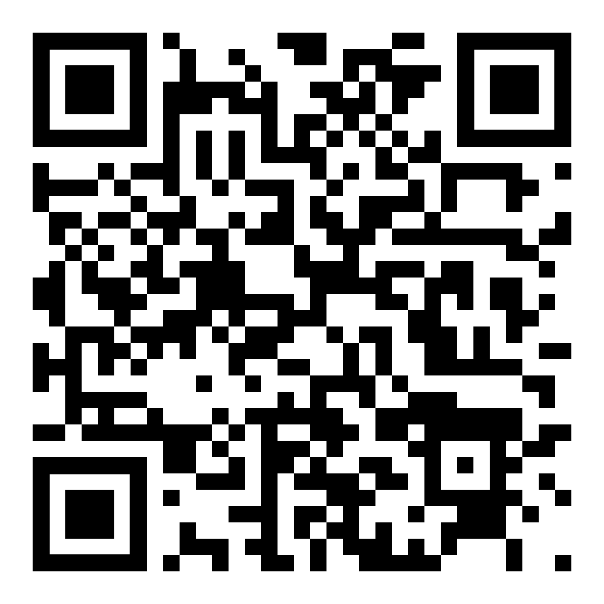
LEVEL 3 FEEDBACK
GO TO GOOGLE AND TYPE “USAF EC SURVEY”
REQUIRED INFO:
COURSE: JALP
CLASS ID NUMBER: 23E
LOCATION: EOS
TRAINED BY: 423 TRS/TRANSPORTATION
GRADUATION DATE: 03/31/2023
CHECK THE FOLLOWING BOXES:
Used Training Equipment / Simulator
Participated in Field Activities / Class Exercises
INSTRUCTORS:
TSGT JONATHAN RIERA
TSGT JAVIER HERNANDEZ

Slide 5
5 MINUTE BREAK

Slide 6
CLOSE BOOK TEST
*REMOVE ALL NOTES FROM DESK AREA*
Go to: B.SOCRATIVE/STUDENT Type JALPC for room Type Last Name, First Name
Complete Test and Leave Room
Until Directed to come back!

Slide 7
CLOSE BOOK TEST
*REMOVE ALL NOTES FROM DESK AREA*
1 hour TEST
START: 0845
FINISH: 0945

Slide 8
5 MINUTE BREAK

Slide 9
CAPSTONE
TIME LIMIT 3 HOURS
NO INSTRUCTOR or ANY ASSIST FROM OTHER STUDENTS
OPEN BOOK
TIME START: 0935
TIME END: 1235

Slide 10
5 MINUTE BREAK

Slide 11
*CLEANUP*

Slide 12
CONGRATULATIONS CLASS 2023C

