Slide 1

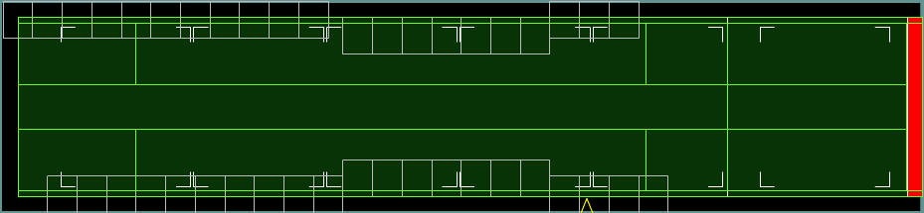
C-130 CHARACTERISTICS
Passenger Considerations
Outside Wheel Wells:
Up to 76” = Both Sides
77” to 96” = One Side Only
Greater than 96” = No Pax
Inside Wheel Wells:
Up to 52” = Both Sides
53” to 72” = One Side Only
Greater than 72” = No Pax
Max Over Land - 90
Max Over Water - 80 (Life Raft Capacity)
28 Sidewall Seats
14 Wheel Well Seats
48 Centerline Seats
NOTE: Sidewall seats 1L and 15R are not visible in ICODES (reserved for aircrew)
Max Takeoff Weight: 155,000 lbs.
Basic Operating Weight: 84,000 lbs.
Planning ACL: 25,000 lbs.
Optimum Zero Fuel CG: 20-22%
Most seats deploy as a set of two(2). Seat sets are bolded when passengers occupy one of the seats.
NOTE: Ensure NO cargo overlaps deployed seats.
Pallet Position #1
Max Wt: 10,355 lbs
Max Ht 96”
Note: 12” inset on one or both 88” sides about 76” height
Pallet Position #2
Max Wt: 10,355 lbs
Max Ht 96”
Pallet Position #3
Max Wt: 10,355 lbs
Max Ht 96”
Note: 6” inset one 88” side for safety aisle
Pallet Position #4
Max Wt: 10,355 lbs
Max Ht 96”
Note: 6” inset one 88” side for safety aisle
Pallet Position #5
Max Wt: 8,500 lbs
Max Ht 96”
Pallet Position #6
Max Wt: 4,664 lbs
Max Ht 76”
Note: 20” inset on one side for safety aisle
**Items with heights of 102’ to 108” WILL have special loading procedures. Reference ATTLA Certification Letter when load planning.
Outside the Treads
NO Axles
Treadway
35” Wide
Starts 15” right of centerline
Between the Treads
Treadway
35 “ Wide
Starts 15” left of centerline
Outside the Treads
NO Axles
Treadways:
6,000 lbs Axle
Treadways:
6,000 lbs Axle
Treadways:
2,500 lbs. Axles**
2,501 – 3,500 lbs. Axle * / **
*Nothing else loaded on Ramp
**Limited to 4,664 lbs. total
Between the Treads:
1,200 lbs. Axle
450 lbs. Tongue
Treadways:
13,000 lbs Axle
337
682
257
Between the Treads:
5,000 lbs Axle
2,000 lbs Tongue
737
869

Slide 2
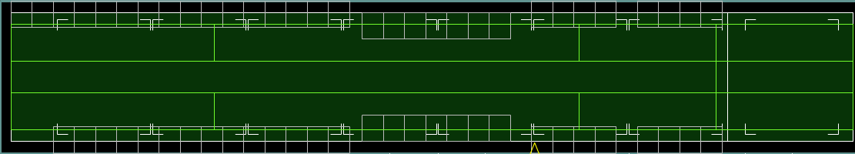
C-130J-30 CHARACTERISTICS
Passenger Considerations
Outside Wheel Wells:
Up to 76” = Both Sides
77” to 96” = One Side Only
Greater than 96” = No Pax
Inside Wheel Wells:
Up to 52” = Both Sides
53” to 72” = One Side Only
Greater than 72” = No Pax
Max Takeoff Weight: 164,000 lbs.
Basic Operating Weight: 89,000 lbs.
Planning ACL: 40,000 lbs.
Optimum Zero Fuel CG: 20-22%
Max Over Land - 126
Max Over Water - 80
46 Sidewall Seats
14 Wheel Well Seats
66 Centerline Seats
NOTE: Sidewall seats 1L and 2L are not visible in ICODES (reserved for aircrew)
Most seats deploy as a set of two(2). Seat sets are bolded when passengers occupy one of the seats.
NOTE: Ensure NO cargo overlaps deployed seats.
**Items with heights of 102’ to 108” have special loading procedures. Reference ATTLA Certification Letter when load planning.
PP #1
Max Wt 10,355 lbs
Max Ht 96”
Note: 12” inset on one/both 88” sides about 76” height
PP #2
Max Wt 10,355 lbs
Max Ht 96”
Note: 12” inset maybe needed on one/both 88” sides about 76” ht
PP #3
Max Wt: 10,355 lbs
Max Ht 96”
PP #4
Max Wt 10,355 lbs
Max Ht 96”
Note: 6” inset on right 88” side for safety aisle
PP #5
Max Wt 10,355 lbs
Max Ht 96”
Note: 6” inset on right 88” side for safety aisle
PP #6
Max Wt: 10,355 lbs
Max Ht 96”
PP #7
Max Wt 8,500 lbs
Max Ht 96”
PP #8
Max Wt 5,000 lbs
Max Ht 77”
Note: 20” inset on right side for safety aisle
Outside the Treads
NO Axles
Treadway
35” Wide
Starts 15” right of centerline
Between the Treads
Treadway
35” Wide
Starts 15” left of centerline
Treadways:
2,500 lbs. Axles**
2,501 – 3,500 lbs Axle * / **
*Nothing else load’d on Ramp
**Limited to 5,000 lbs. total
Between the Treads:
1,200 lbs. Axle
450 lbs. Tongue
Outside the Treads
NO Axles
Treadways:
6,000 lbs Axle
Treadways:
13,000 lbs Axle
Treadways:
6,000 lbs Axle
537
882
345
Between the Treads:
5,000 lbs Axle
2,000 lbs Tongue
1017
1133

Slide 3
C-130J(S) CHARACTERISTICS
Passenger Considerations
Most seats deploy as a set of two(2). Seat sets are bolded when passengers occupy one of the seats.
NOTE: Ensure NO cargo overlaps deployed seats.
Maximum Takeoff Weight: 164,000 lbs.
Basic Operating Weight: 84,000 lbs.
Planning ACL: 40,000 lbs.
Optimum Zero Fuel CG: 20-22%
Max Over Land - 90
Max Over Water - 80 (Life Raft Capacity)
28 Sidewall Seats
14 Wheel Well Seats
48 Centerline Seats
NOTE: Sidewall seats 1L and 15R are not visible in ICODES (reserved for aircrew)
Outside Wheel Wells:
Up to 76” = Both Sides
77” to 96” = One Side Only
Greater than 96” = No Pax
Inside Wheel Wells:
Up to 52” = Both Sides
53” to 72” = One Side Only
Greater than 72” = No Pax
Pallet Position #1
Max Wt: 10,355 lbs
Max Ht 96”
Note: 12” inset on one or both 88” sides about 76” height
Pallet Position #2
Max Wt: 10,355 lbs
Max Ht 96”
Note: 12” inset maybe needed on one or both 88” sides about 76” height
Pallet Position #3
Max Wt: 10,355 lbs
Max Ht 96”
Note: 6” inset on right 88” side for safety aisle
Pallet Position #4
Max Wt: 10,355 lbs
Max Ht 96”
Note: 6” inset on right 88” side for safety aisle
Pallet Position #5
Max Wt: 8,500 lbs
Max Ht 96"
Pallet Position #6
Max Wt: 5,000 lbs
Max Ht 77”
Note: 20” inset on right side for safety aisle
Outside the Treads
NO Axles
Treadway
35” Wide
Starts 15” right of centerline
Between the Treads
Treadway
35 “ Wide
tarts 15” left of centerline
Outside the Treads
NO Axles
Treadways:
6,000 lbs Axle
Treadways:
13,000 lbs Axle
Treadways:
6,000 lbs Axle
337
682
257
Between the Treads:
5,000 lbs Axle
2,000 lbs Tongue
737
869

Slide 4
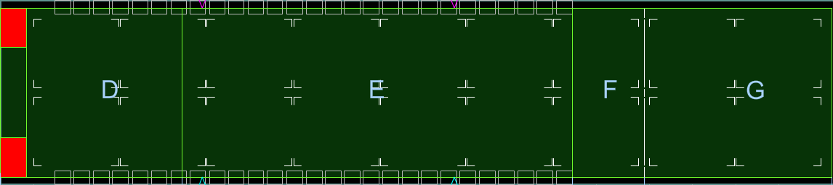
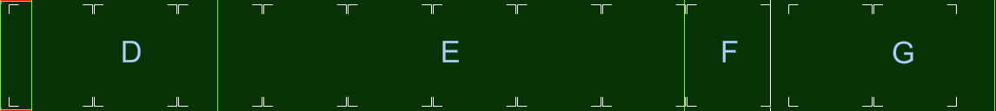
C-17 CHARACTERISTICS
Max Takeoff Weight: 585,000 lbs.
Basic Operating Weight: 284,945 lbs.
Planning ACL: 130,000 lbs.
Optimum Zero Fuel CG: 40% = ZFW less than 400K
39% = ZFW between 400K - 425K
38% = ZFW between 425K - 447K
Passenger Considerations
53 Sidewall Seats
48 Centerline Seats
NOTE: Sidewall seats adjacent to cargo extending past +/- 85 inches of aircraft centerline will NOT be used
Logistic Rail System (LRS) Pallet Positions 1R/L-9R/L Loaded on 88” width basis
All Pallets
Max Weight: 10,355 lbs
Max Height: 96”
Aerial Delivery System (ADS) Pallet Positions 1-11 Loaded on 108” width basis
**Items with heights of 148’ to 162” WILL have special loading procedures. Reference ATTLA Certification Letter when load planning.
Compartment F
Maximum Wt: 35,000 lbs
Maximum Axle:
27,000 lbs
(+/- 8” center)
22,000 lbs
(Side-by-Side)
Tracked Vehicles Beside Single Axle Restrictions
Compartments D, F and G:
Compartment E:
Compartment D Floor Limits
Maximum Weight: 72,000 lbs
Maximum Axle:
27,000 lbs (+/- 8 inches of centerline)
22,000 lbs (Side-by-Side)
Compartment E Floor Limits
Maximum Weight: 170,900 lbs
Maximum Axle:
36,000 lbs (+/- 8 inches of centerline)
27,000 lbs (Side-by-Side)
Compartment G Floor Limits
Maximum Weight: 40,000 lbs
Maximum Axle:
27,000 lbs (+/- 8 inches of centerline)
22,000 lbs (Side-by-Side)
Tracked Vehicle Wt | Max Single Axle Wt
35,000 lbs or less | 16,000 lbs
35,001 - 65,000 lbs | 11,000 lbs
347
578
1074
1165
1403
Tracked Vehicle Wt | Max Single Axle Wt
35,000 lbs or less | 24,000 lbs
35,001 - 65,000 lbs | 22,000 lbs

Slide 5
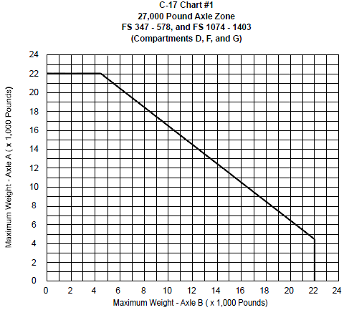
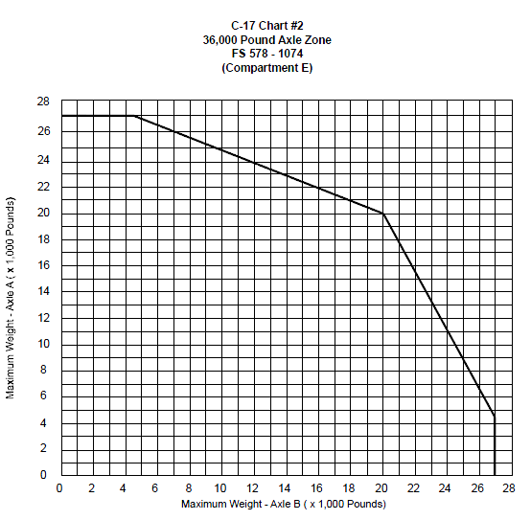

C-17 Side-By-Side Axle Charts

Slide 6

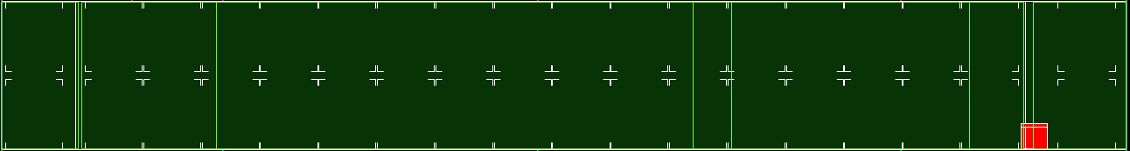
C-5 CHARACTERISTICS
Max Takeoff Weight: 837,000 lbs. (C-5M)
Basic Operating Weight: 384,000 lbs. (C-5M)
Planning ACL: 150,000 lbs. (C-5M)
Optimum Zero Fuel CG: 38%
Passenger Considerations
Troop compartment is located above the aft end of the cargo compartment. A maximum of 73 rear facing seats are available for use.
PP 1 &2
Max Wt
7,500 lbs
Max Ht 96”
Note:
14” Aisleway one 88” side
Pallet Position (PP) 2-34
Max Weight (Wt)
10,355 lbs
Max Height (Ht) 96”
PP 35 &36
Max Wt
7,500 lbs
Max Ht 70”
Note:
14” Aisleway one 88” side
Height Restrictions
Items over 114 inches must be inset.
Use “Height Constraint” in ICODES to maximize aircraft space.
156”
114”
162”
228”
*Cross section of C-5 Cargo Compartment
Maximum Weight
3,600 lbs in any 20” Length
Maximum Weight
20,000 lbs
in any 40” Length
Maximum Weight
36,000 lbs in any 40” Length
Maximum Weight
36,000 lbs in any 40” Length
Maximum Weight
20,000 lbs in any 40” Length
Maximum Weight
3,600 lbs in any 20” Length
**Items with heights of 114’ to 162” WILL have special loading procedures. Reference ATTLA Certification Letter when load planning.
Maximum Wt: 25,000 lbs
Excludes Tracked Vehicles
395
517
724
1458
1518
1884
1971
2131

