Slide 1
ICODES Computer Based Training (CBT)
Preliminary Architectural Design
May 2017

Slide 2
Computer Based Training (CBT) Requirement
Problem: ICODES users require computer systems’ training to meet sustainment training requirements for accomplishment of their unit move and load planning tasks.
Training is localized to formal school instruction; however, the widening base of system proficiencies impacts their ability to conduct targeted training packages.
CBT is necessary to ensure proficiency in rote-based system functions so that formal schools can orient training on processes and procedures vice "button pushing" and "system navigation.“
Solution: Incorporate a CBT layer in ICODES that guides students through key functional sequences by allowing them to:
Read textual instruction on the usage of an ICODES component.
Watch the performance of instructional sequences in the ICODES component.
Practice the instructional sequences using the ICODES component.
Evaluate their proficiency the instructional sequence for an ICODES component.

Slide 3
Phased Development Plan
ICODES CBT is implemented in a phased progression. Each phase delivers working CBT software with increased interactivity, realism, and instructional coverage, as follows.
Phase 1: Guided Tutorial Training
Establishes the components of the training environment.
Establishes the training structure and technical frameworks.
Establishes an initial baseline of training instruction.
Phase 2: Interactive Monitored Training
Implements mechanisms for CBT to monitor user actions in ICODES applications.
Employs monitoring to interactively guide students through training exercises.
Enhances the baseline instruction to exploit new capabilities and expand coverage.
Phase 3: Simulated Actors and Artifact Evaluation
Implements simulated external system interfaces and users.
Implements mechanisms for analysis of student-created data artifacts.
Enhances instruction to exploit new capabilities and complete functional coverage.

Slide 4

Phase 1: Make ICE for Guided Tutorial Training
Learning Management System
(LMS)
SSDM
Establish the ICODES Computer Based Training (CBT) environment (ICE).
ICE is a production deployment of ICODES components that is optimized for training and isolated from operational capabilities.
ICE supports Enterprise and Satellite deployments.
ICE contains and may be employed by a SCORM-compliant LMS.
Establish the Training Framework:
Trainings consists of a pretest, video, practice exercise, and evaluation exercise.
Trainings instruct function sequences in SSDM, SLP, and CB.
Trainings are utilized in the LMS, but exercises are performed in SSDM, SLP, or CB.
Establish a Baseline of Training Instruction.
Initial Trainings cover some key functional sequences in each application.
Initial Trainings serve to develop and validate the Training framework.
SLP
Trainings
Pretest
Video
Practice Exercise
Evaluation Exercise
Post Test
CB
CIW
Admin
Data
Cleanser
Conveyance
Repository
Information
Repository
…
Notes:
SCORM (Shareable Content Object Reference Model) is a set of technical standards for e-learning software products. SCORM tells programmers how to write their code so that it can “play well” with other e-learning software. It is the de facto industry standard for e-learning interoperability. Specifically, SCORM governs how online learning content and Learning Management Systems (LMSs) communicate with each other. SCORM does not speak to instructional design or any other pedagogical concern — it is purely a technical standard.

Slide 5



Phase 2: Bake PIE for Interactive Monitoring
Develop the Player for ICODES Exercises (PIE).
PIE implements mechanisms to monitor user action (e.g., menu and button clicks) in SSDM, SLP, and CB.
PIE is launched in a web browser tab from web links for exercises displayed in the LMS Trainings.
PIE is launched preloaded with the exercise function graphs.
PIE launches the corresponding ICODES application with data initialized to the exercise start state.
PIE reacts to user actions in ICODES by displaying next steps or indicating poor selections, for example.
PIE gathers metrics for students to evaluate their performance in navigating ICODES.
Enhance the Training Instruction Baseline.
Enhanced Trainings include exercise function graphs that capture the navigation through application menus, tabs, windows, and buttons to accomplish the associated functional sequence.
Enhanced Trainings expand the baseline to cover additional functional sequences.
SSDM
Observes
Player
for
ICODES
Exercises
(PIE)
Exercise Data Start States
Launches
SLP
Launches
Launches
Plays
Exercise Data Start States
CB
Exercises
Scenario Data Start State
Function Graph
Textbook Data Artifact Results
Exercise Data Start States

Slide 6
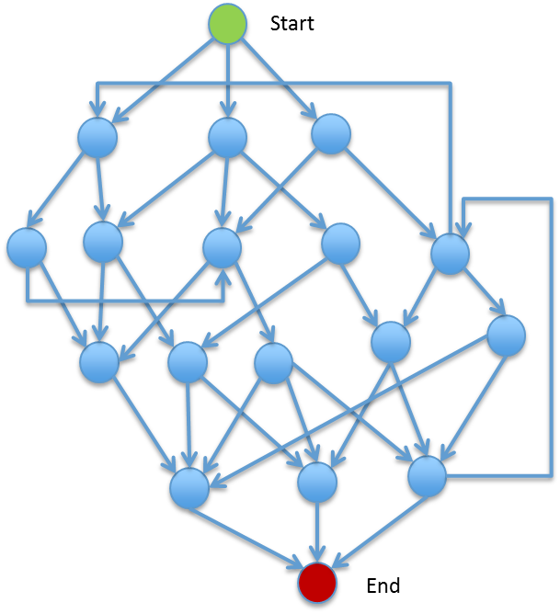
Exercise Graphs
SSDM Workflow
CBT Training Exercise
Exercise Function Graphs
Configure Settings
Create Event
Build UDL
Update Event
Plan Missions
Request Transportation

Slide 7
Create SSDM Event Function Graph Example
B
Best Choice
Start
Primary Tab menu
Event Manager menu item
G
Good Choice
Event Manager tab
B
G
O
Ok Choice
Automatic Choice
B
B
A
Event Details
Events menu
Create New Event menu item
Event Details
Events table
Edit Name
B
G
O
Event Details
Events table
Edit Start Date
Event Details
Events table
Edit End Date
G
B
G
B
B
G
Event Details
Events table
Edit End Date
Event Details
Events table
Edit Name
Event Details
Events table
Edit Start Date
Event Details
Events table
Edit Name
Event Details
Events table
Edit End Date
Event Details
Events table
Edit Start Date
B
B
B
B
B
B
Event Details
Events table
Edit Start Date
Event Details
Events table
Edit End Date
Event Details
Events table
Edit Name
Event Details
Events table
Edit Start Date
A
A
A
A
End

Slide 8


Phase 3: Add CREAM for More Realism & Data Artifact Evaluation
Develop the Case-based Result of Exercise Analyzer (CREAM), using MARVEL technologies
CREAM adds simulated actors to provide a more realistic and dynamic training experience.
Simulated External System interfaces mimic real world external system APIs and behavior.
Simulated collaborators mimic other users operating in the context of a training exercise.
CREAM adds a case base of exercise solutions to provide for analysis of the data artifacts produced in an exercise.
Finalize the Enhanced Training Data Sets
Finalized Trainings exploit the simulated actors and case-based artifact analysis.
Finalized Trainings provide full coverage of the principal functions in SSDM, SLP, and CB.
SSDM
Interface
Interface
Simulated
External
System
Interface
Scenario Data Sets
Simulated
Collaborators
Interface
SLP
Interface
Simulated
External
System
Interface
Scenario Data Sets
Simulated
Collaborators
Interface
CB
Interface
Simulated
External
System
Interface
Case-based
Result of Exercise Analyzer
using MARVEL
(CREAM)
Scenario Data Sets
MARVEL

Slide 9


Composite Solution
ICE
CREAM
& PIE
Putting it all together …
Simulated
Collaborators
Interface
Interface
Simulated
External
System
Interface
LMS
Feedback
ICODES
App
PIE
Event
Tracker
Event Listener
Pretest
Video
Practice Exercise
Evaluation Exercise
Post Test
Launches
CREAM
Launches
Exercise Data
Start State
Textbook
Data
Artifacts
Employs
Students take tests and watch videos in the LMS.
The LMS launches the PIE for students to perform exercises.
The PIE is preloaded with exercise function graphs to train and evaluate student actions.
The PIE launches the associated ICODES App.
The PIE catches mouse events from the ICODES App to track progress through the graph.
ICODES applications are preloaded with the data start state for an exercise.
Students perform exercises in ICODES as guided and evaluated by the PIE.
An Event Listener is incorporated into the ICODES Apps.
ICODES applications may interact with simulated external systems and users.
Textbook solutions are stored in the CREAM to support analysis of resulting data artifacts (e.g., a Air Load Plan or PAX Manifest).
Notes:
Students, assignments, grades, certificates, and awards-badges and such are all part of the LMS.

Slide 10
Questions? Comments?

Slide 11
Composite Solution
ICE
CREAM
& PIE
Simulated
Collaborators
Interface
Interface
Simulated
External
System
Interface
LMS
Feedback
ICODES
App
PIE
Event
Tracker
Event Listener
Pretest
Video
Practice Exercise
Evaluation Exercise
Post Test
Launches
CREAM
Launches
Exercise Data
Start State
Textbook
Data
Artifacts
Employs
Students take tests and watch videos in the LMS.
The LMS launches the PIE for students to perform exercises.
The PIE is preloaded with exercise function graphs to train and evaluate student actions.
The PIE launches the associated ICODES App.
The PIE catches mouse events from the ICODES App to track progress through the graph.
ICODES applications are preloaded with the data start state for an exercise.
Students perform exercises in ICODES as guided and evaluated by the PIE.
An Event Listener is incorporated into the ICODES Apps.
ICODES applications may interact with simulated external systems and users.
Textbook solutions are stored in the CREAM to support analysis of resulting data artifacts (e.g., a Air Load Plan or PAX Manifest).
Notes:
Students, assignments, grades, certificates, and awards-badges and such are all part of the LMS.

