Slide 1


C-17 Characteristics
JALP

Slide 2
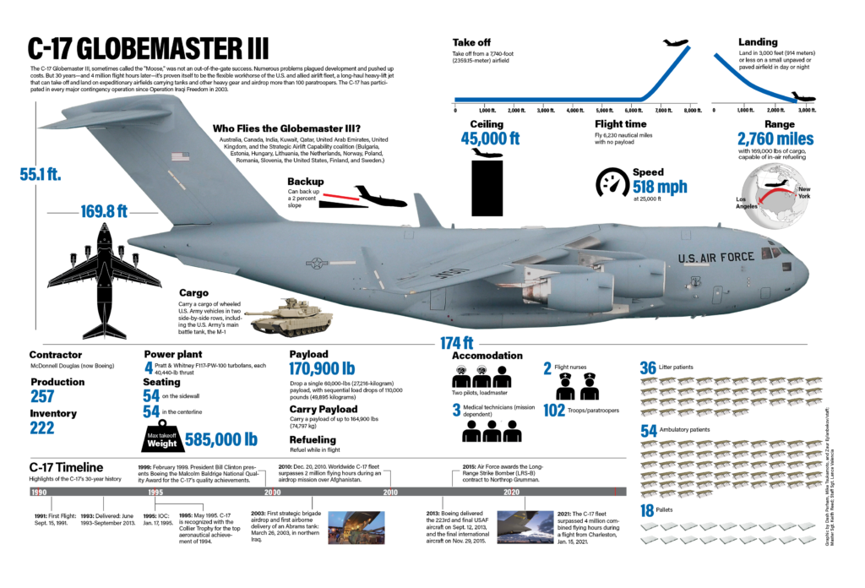
JALP

Slide 3
OVERVIEW
Cargo Compartment Limitations
Pallet Considerations
Passenger Considerations
Load Planning Factors
JALP

Slide 4

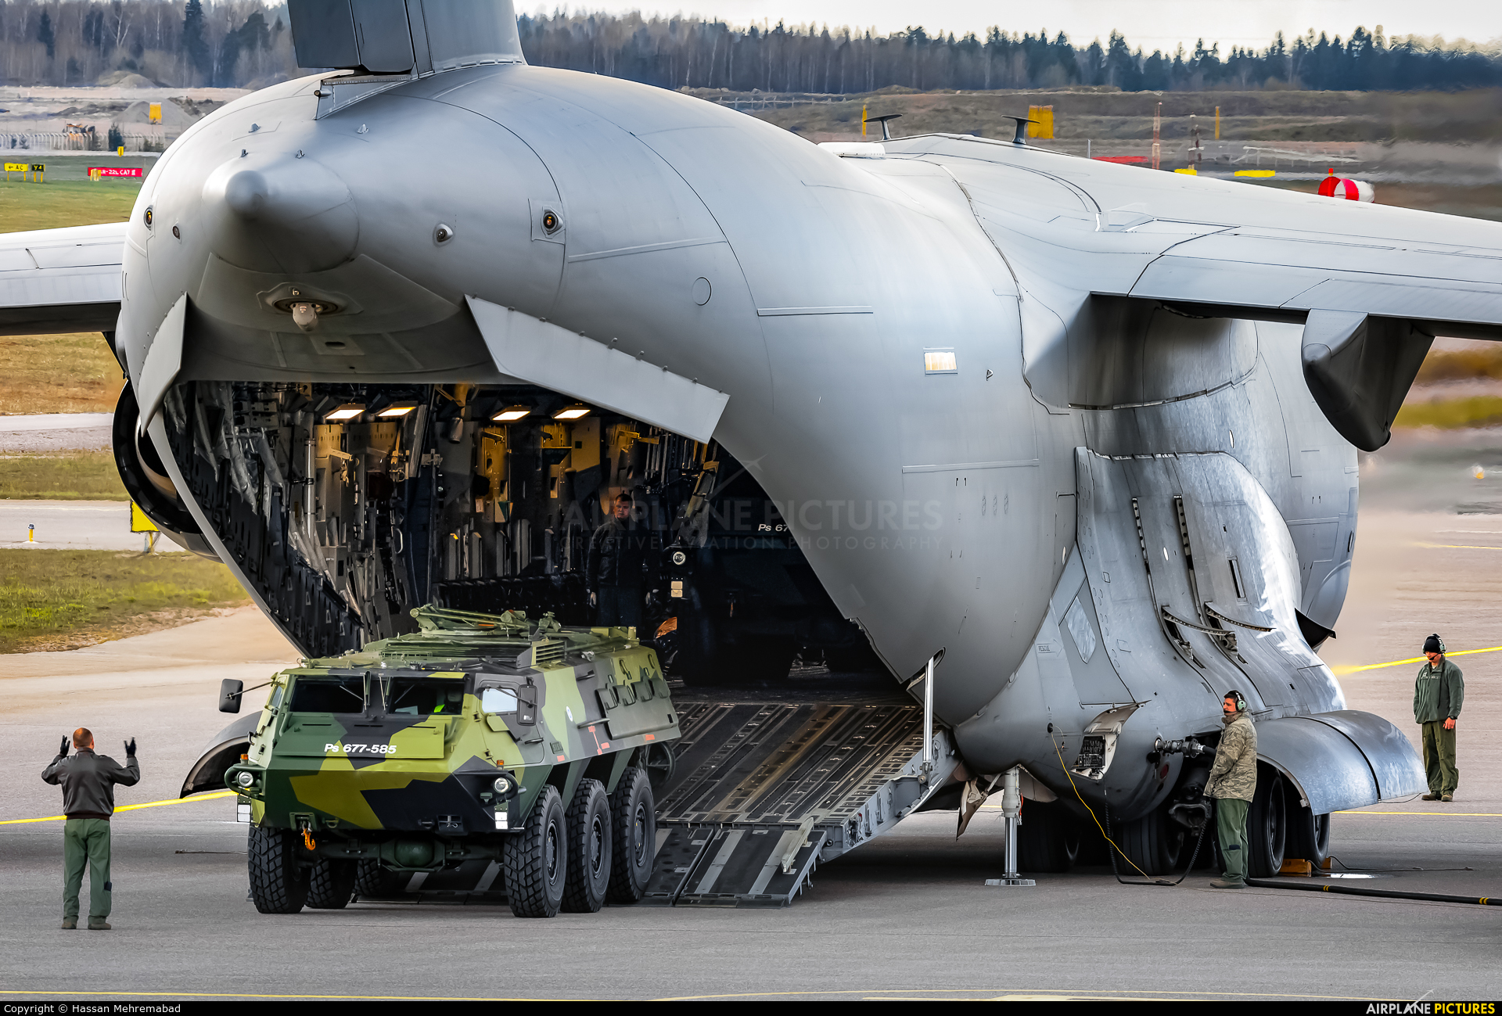
JALP
Capable of tactical (intra-theater) and strategic (inter-theater) airlift
All mission equipment onboard aircraft
Capable of being reconfigured in flight
C

Slide 5
CARGO COMPARTMENT LIMITATIONS
JALP

Slide 6
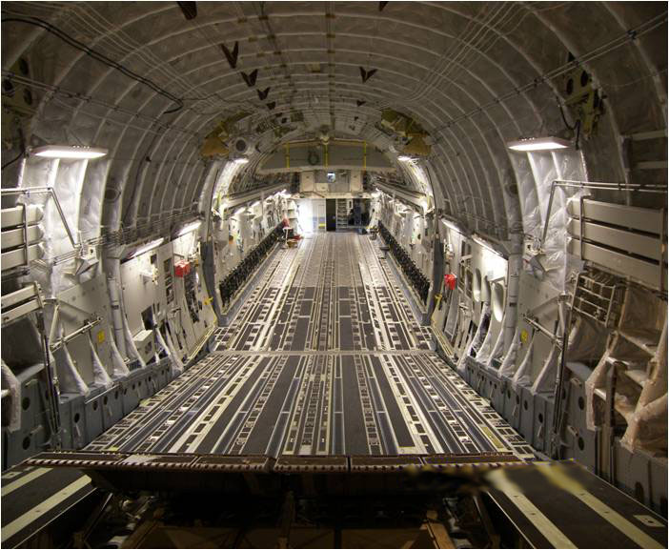
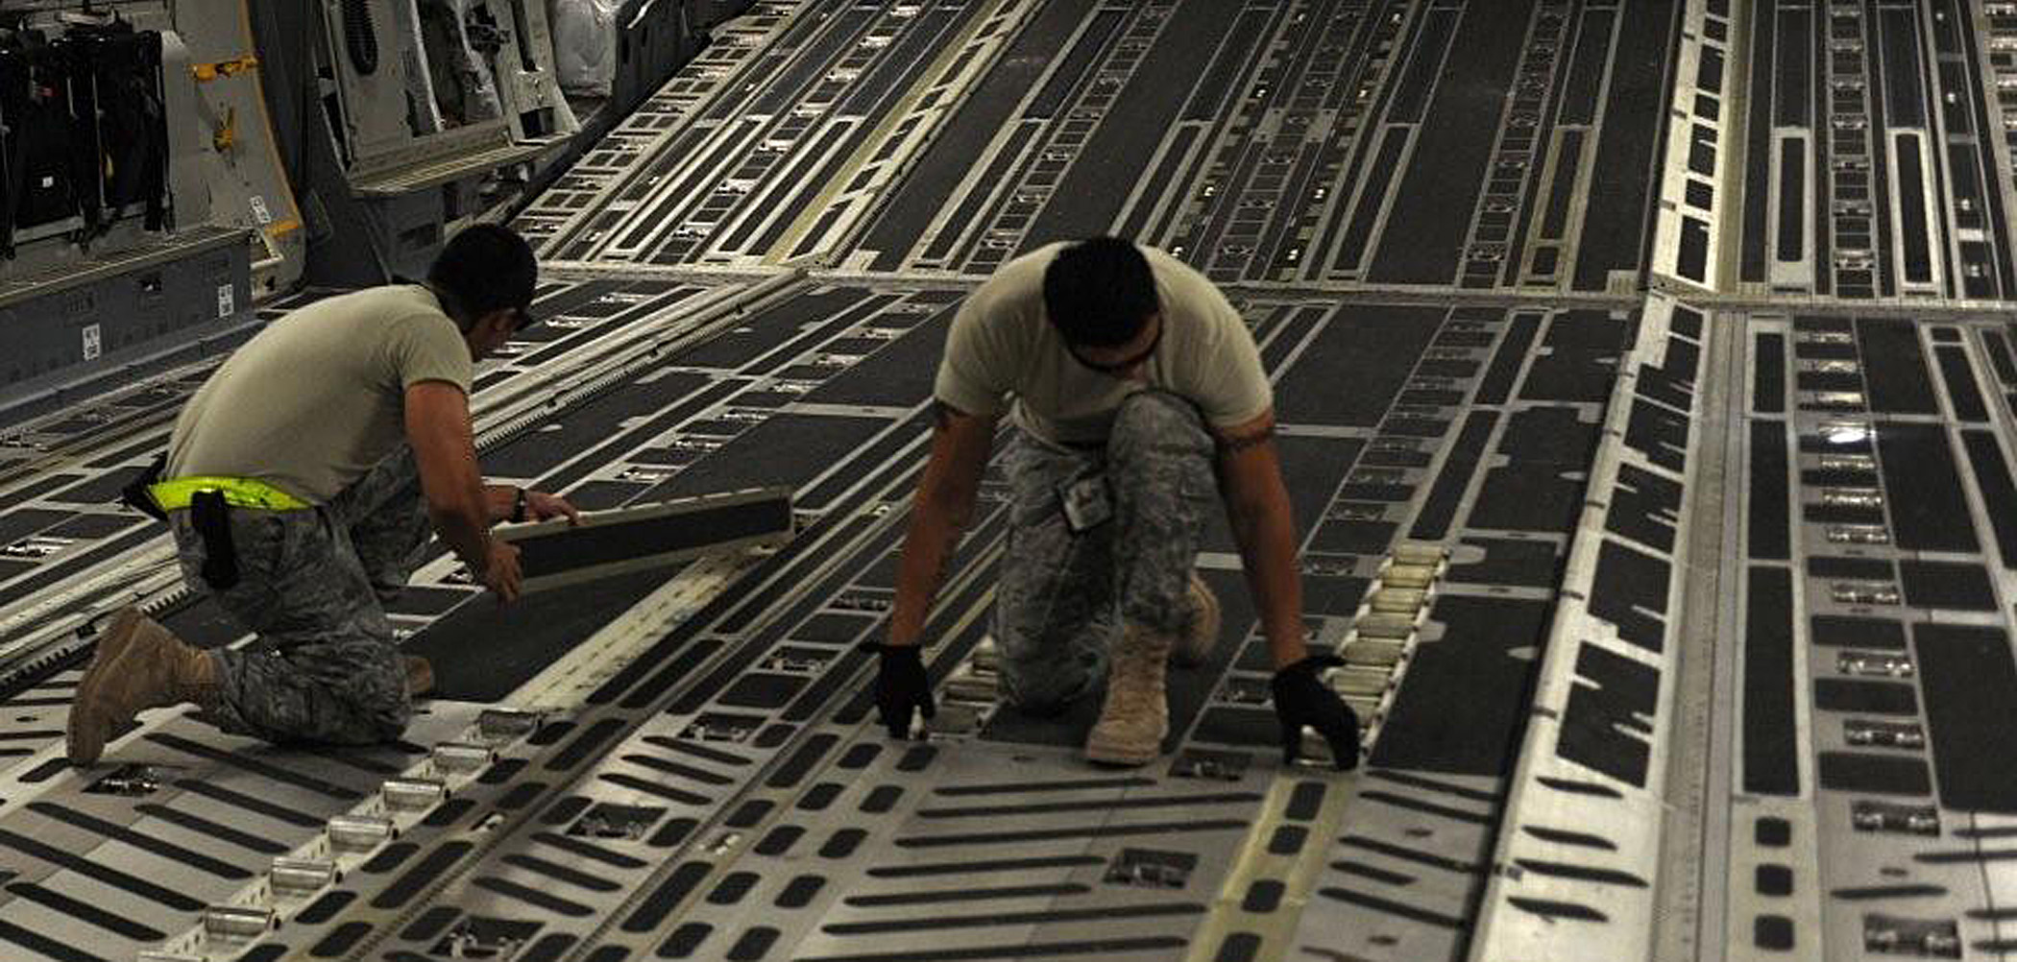
Cargo Floor
Length: 818”
Cargo floor width: 213”
2” above floor width: 216”
Cargo Ramp
Length: 238”
Width: 216”
JALP
Notes:
Added all text from reserves EN

Slide 7
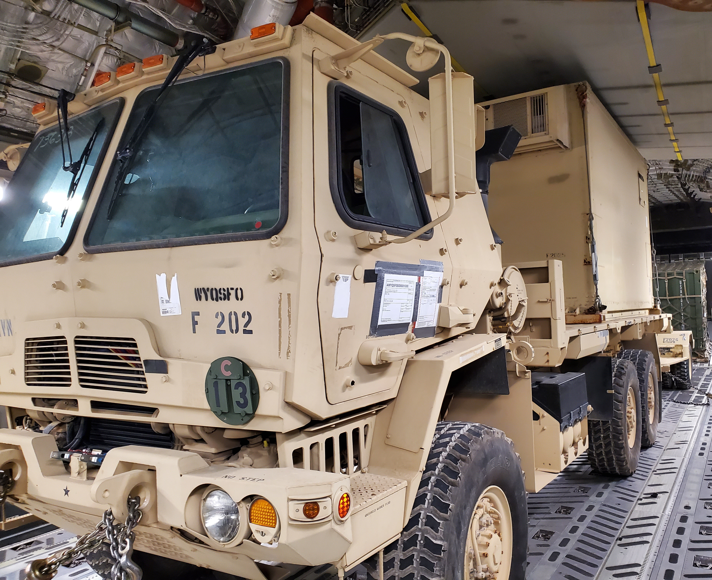
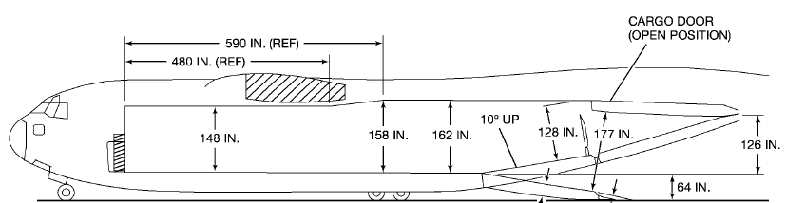
Height: Variable
FS 347- 827: 148”
FS 827- 937: 158”
FS 937- 1165: 162”
JALP

Slide 8
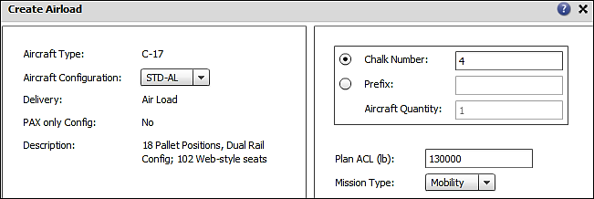
JALP
Notes:
Planning ACL - up to 130,000 pounds
Higher ACLs are possible but only after coordination with your affiliated AMCU or in accordance with the Operation Order

Slide 9
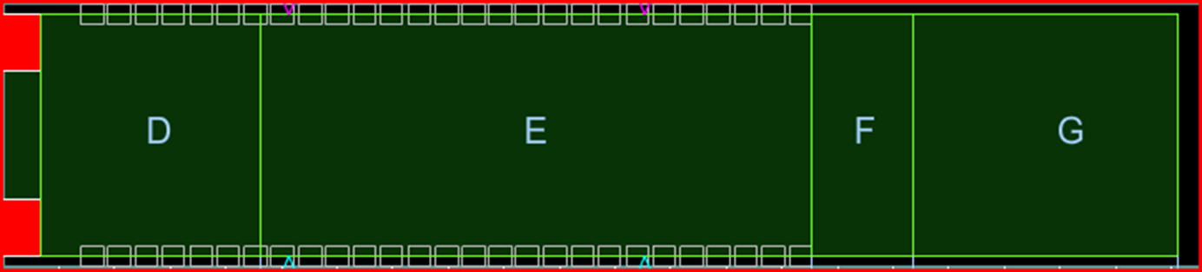
C-17 Cargo Compartment
FRONT
REAR
72,000
Total Wt.
170,900
Total Wt.
35,000
Total Wt.
40,000
Total Wt.
JALP
V

Slide 10
Single Axle Weight Limitations
COMPARTMENTS D,F, AND G
MAX single axle weight: 27,000lbs
Vehicle C/L must be within +/- 8in of aircraft C/L: 22,001-27,000lbs
Side by side loading allowed: 22,000lbs or less
COMPARTMENT E
MAX single axle weight: 36,000lbs
Vehicle C/L must be within +/- 8in of aircraft C/L: 27,001-36,000lbs
Side by side loading allowed: 27,000lbs or less
JALP

Slide 11
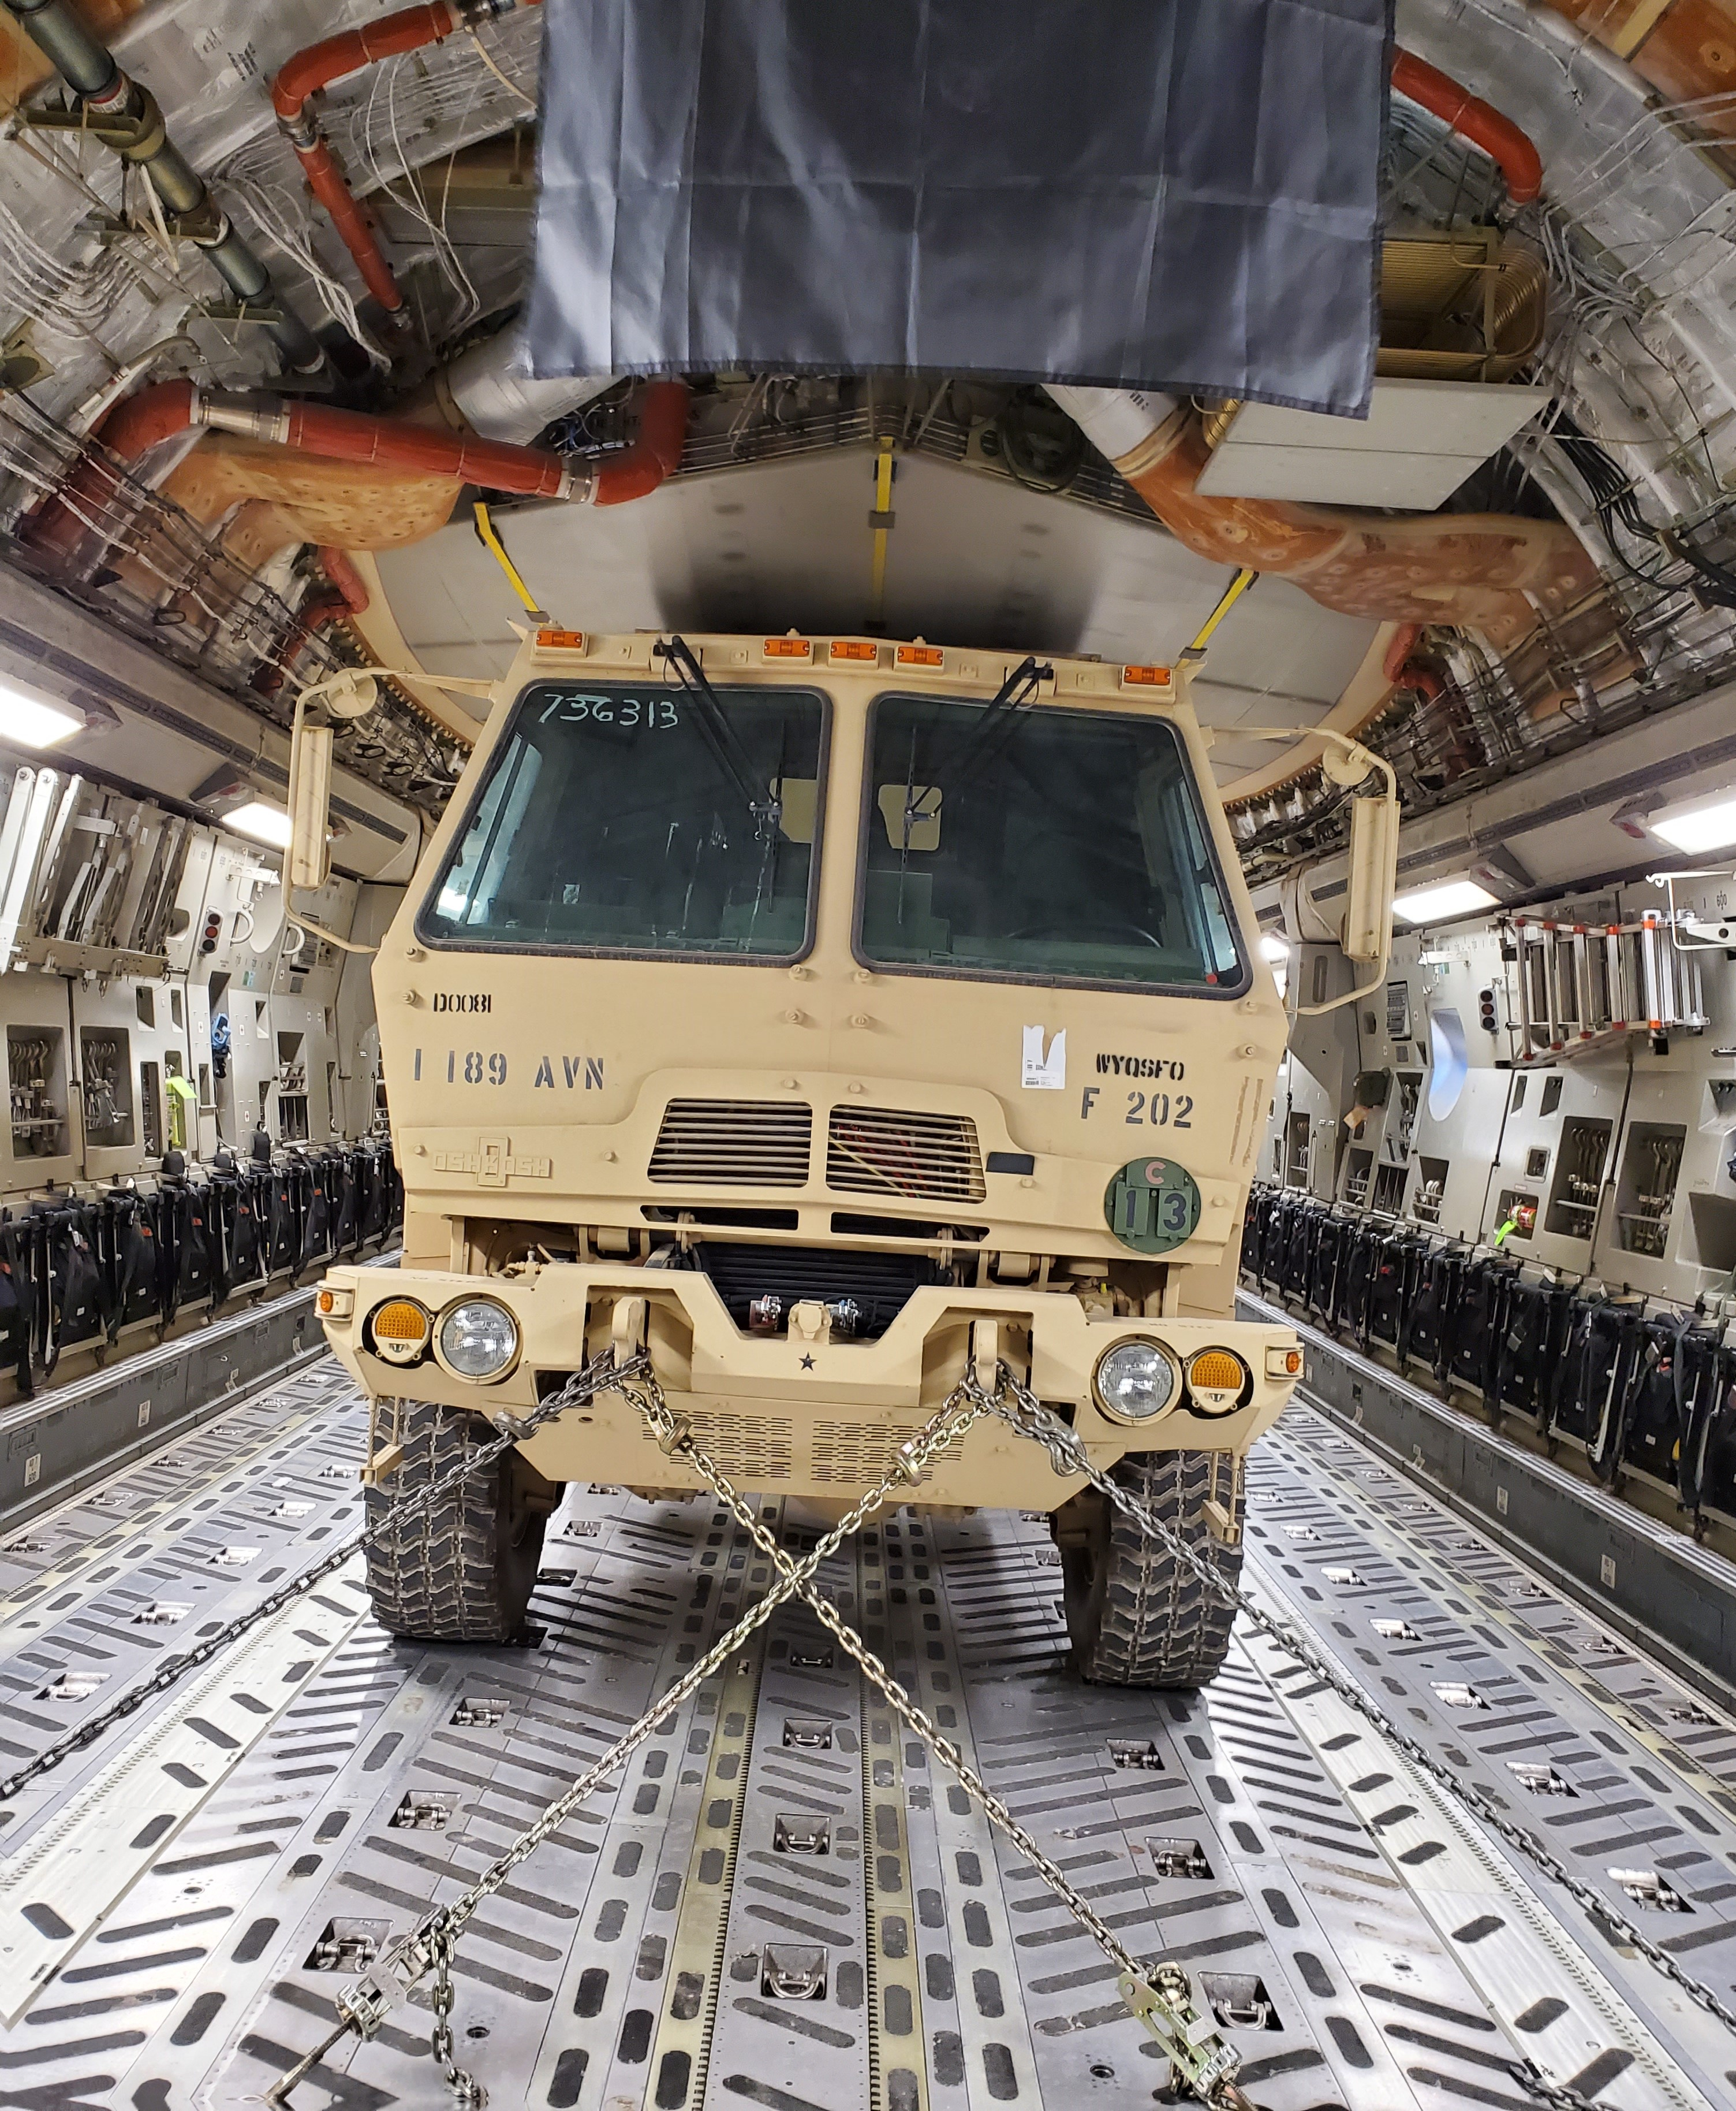
SINGLE AXLE LIMITATIONS
COMPARTMENTS | SIDE BY SIDE AXLE CHART | VEHICLE CENTERLINE MUST BE WITHIN +/-8 IN.OF AIRCRAFT C/L | MAX AXLE WT.
D/F/G | ≤22,000 LBS = D/F/G CHART | 22,001-27,000 LBS | 27,000 LBS
E | ≤27,000 LBS = E CHART | 27,001-36,000 LBS | 36,000 LBS

Slide 12
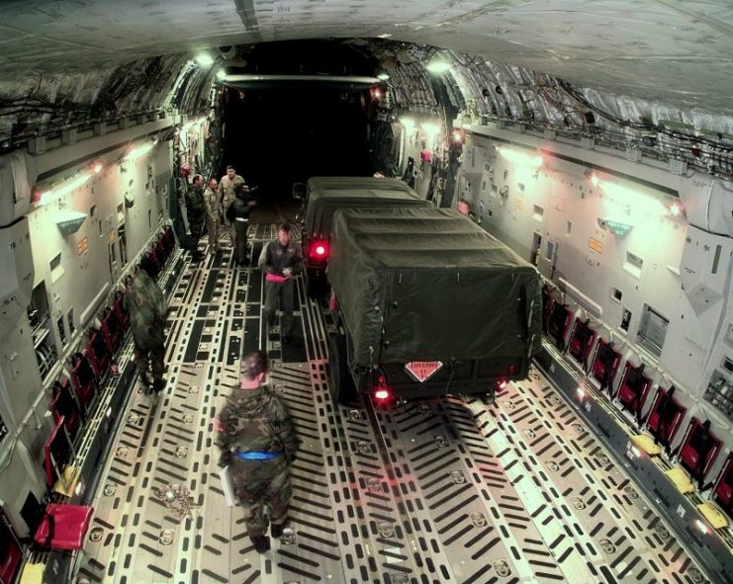
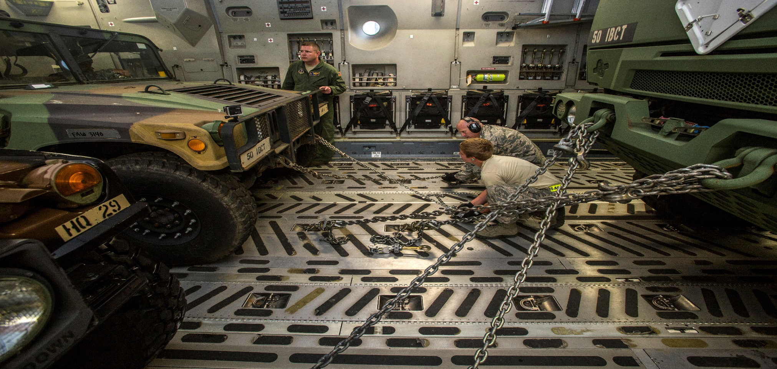
AXLE LIMITATIONS
4 ft aft
4 ft forward
JALP
“8 FOOT ZONE”

Slide 13
TWO different situations for applying the 8 FOOT ZONE
SIDE BY SIDE LOADING
CENTERLINE LOADING
JALP

Slide 14
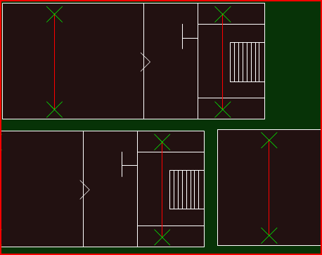
SIDE BY SIDE LOADING
Axle Limitations
14,000
Applies to an 8 foot zone that extends 4 feet forward and 4 feet aft of the center of the “heaviest” single axle in that zone.
6,000
6,000
12,000 lb
JALP
If two or more single axles fall within the 8 foot zone
Axles will be treated as one axle.
Total weight shall not exceed axle chart limits

Slide 15
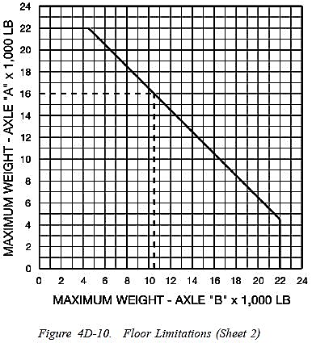

SIDE BY SIDE
AXLE LIMITATIONS
Compartments D/F/G
Axle A weight determines the maximum allowable weight of Axle B
Located in 1C-17A-9
CANNOT BE USED TO LOAD OTHER AIRCRAFT!!!
JALP

Slide 16
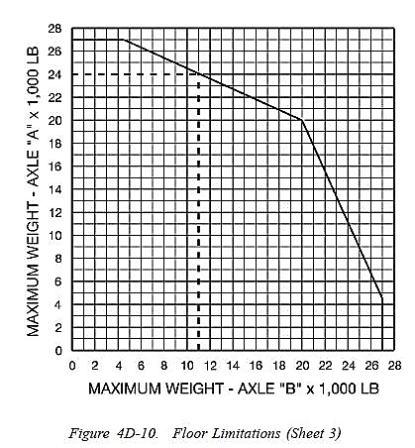

SIDE BY SIDE AXLE LIMITATIONS
Compartment E
Axle A weight determines the maximum allowable weight of Axle B
JALP

Slide 17
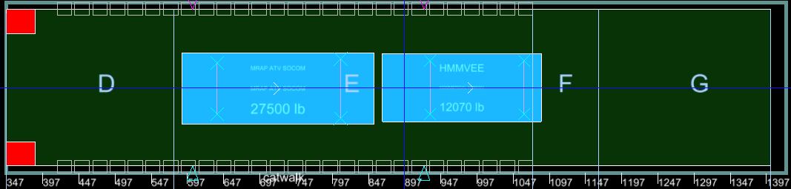
CENTERLINE LOADING
8 Foot Zone applies to vehicles loaded centerline
Use single axle compartment limitations
JALP

Slide 18
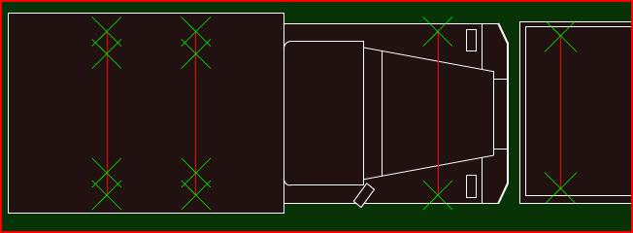
AXLE PROBLEM #1
Where can the 27,500 lbs axle go?
8,000
27,500
It must go in compartment “E” (FS 578-1074)
27,500 lb. axle must be within +/- 8” of aircraft centerline
Since 8,000 lb. axle is within 8’ zone; MUST add axles weights together
8,000 + 27,500 = 35,500 (Does not exceed 36,000 lb. limit)
JALP
Notes:
Explain why the axle can not go in Compartments D/F/G

Slide 19
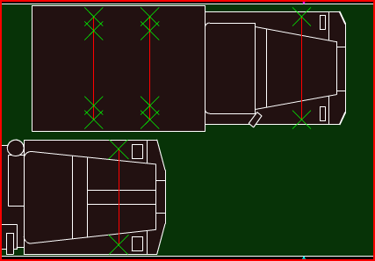
AXLE PROBLEM #2
Can these vehicles be loaded into D compartment?
9000
9000
18,500
JALP

Slide 20
C-17 Chart #1
27,000 Pound Axle Zone
FS 347 - 578, and FS 1074 - 1403
(Compartments D, F, and G)
24
22
20
18
16
14
12
10
8
6
4
2
0
0
2
4
6
8
10
12
14
16
18
20
22
24
Maximum Weight - Axle B ( x 1,000 Pounds)

Slide 21
C-17 Chart #2
36,000 Pound Axle Zone
FS 578 - 1074
(Compartment E)
28
26
24
22
20
18
16
14
12
10
8
6
4
2
0
0
2
4
6
8
10
12
14
16
18
20
22
24
26
28
Maximum Weight - Axle B ( x 1,000 Pounds)

Slide 22
AXLE PROBLEM #3
9000
7000
6000
JALP

Slide 24
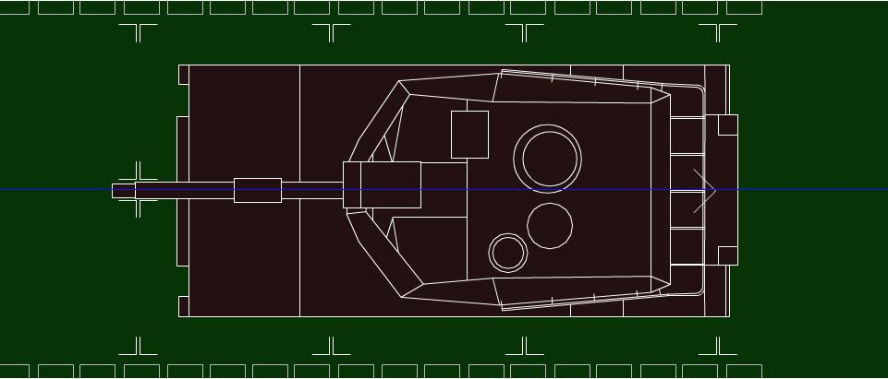
WHEELED/TRACKED VEHICLES
8”
>65,000
8”
JALP

Slide 25
TRACKED VEHICLE LIMITATIONS
COMPARTMENTS | TRACKED VEHICLE WT | MAX AXLE WT NEXT TO TRACKED VEHICLE
D/F/G | ≤ 35,000 LBS | 16,000 LBS
D/F/G | 35,001-65,000 LBS | 11,000
COMPARTMENTS | TRACKED VEHICLE WT | MAX AXLE WT NEXT TO TRACKED VEHICLE
E | ≤ 35,000 LBS | 24,000 LBS
E | 35,001-65,000 LBS | 22,000 LBS
JALP
P
Notes:
Compartments D,F,G (27,000 lb. zones)
Tracked vehicle weighing 35,000 lbs. or less, the max axle next to it can be 16,000 lbs. (8 foot zone restrictions still apply)
Tracked vehicle weighs 35,001 - 65,000 lbs., the max axle next to it can be 11,000 lbs. (8 foot zone restrictions still apply)
Compartment E (36,000 lb. zone)
Tracked vehicle weighing 35,000 lbs. or less, the max axle next to it can be 24,000 lbs. (8 foot zone restrictions still apply)
Tracked vehicle weighing 35,001 - 65,000 lbs., the max axle next to it can be 22,000 lbs. (8 foot zone restrictions still apply)

Slide 26
PALLET CONSIDERATIONS
JALP

Slide 27
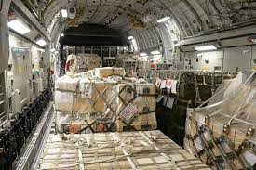
All pallets can weigh 10,355 lbs per pallet position
Max height of 96”
JALP
Notes:
All pallet positions can accommodate pal lets to a weight of 10,355 pounds
All pallet positions can accommodate pallets to a height of 96 inches

Slide 28
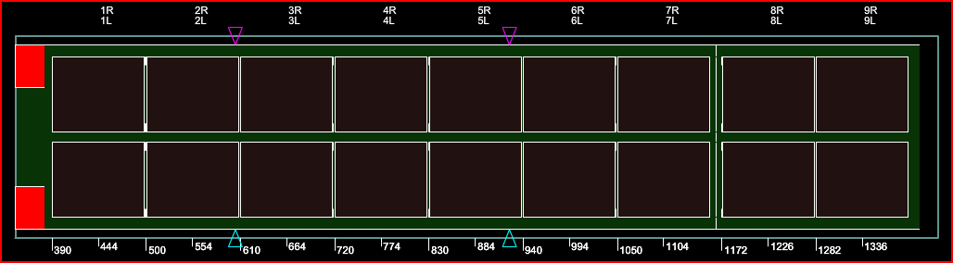
LOGISTICAL RAIL SYSTEM (LOG)
1
3
5
7
9
11
13
15
17
2
4
6
8
10
12
14
16
18
JALP
Notes:
The Logistics system can carry 18 pallets loaded on 88” width bias
14 pallets on the main floor and 4 pallets on the ramp
Can you have a chalk with 18 pallets loaded in this configuration?
(No, because 2 passengers are required per chalk)

Slide 29
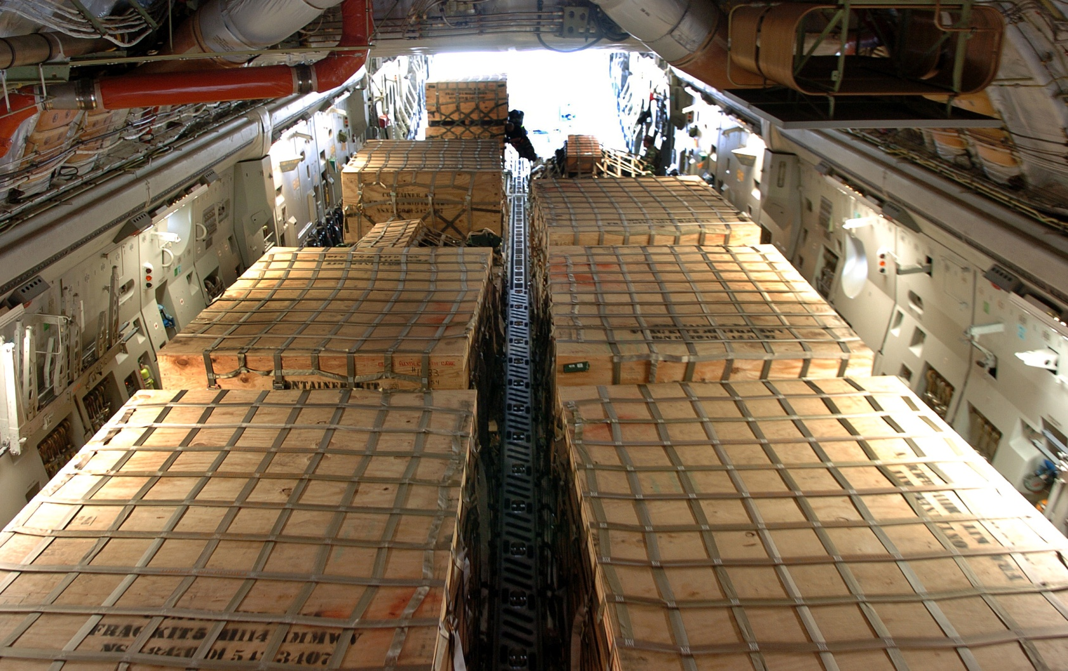
JALP

Slide 30
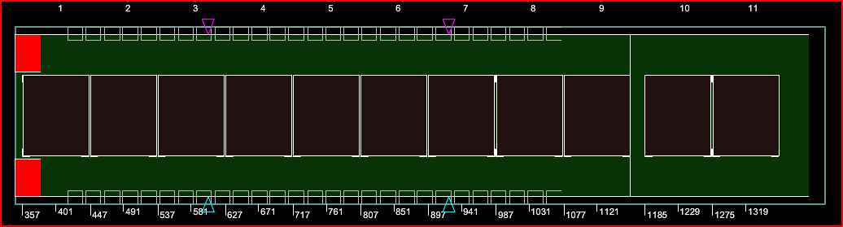
AERIAL DELIVERY SYSTEM (ADS)
1
2
3
4
5
6
7
8
9
10
11
JALP
Notes:
ADS system can carry 11 pallets loaded on 108” width bias
Allows for greater flexibility in the compromise between palletized cargo and troop/passenger seating

Slide 31
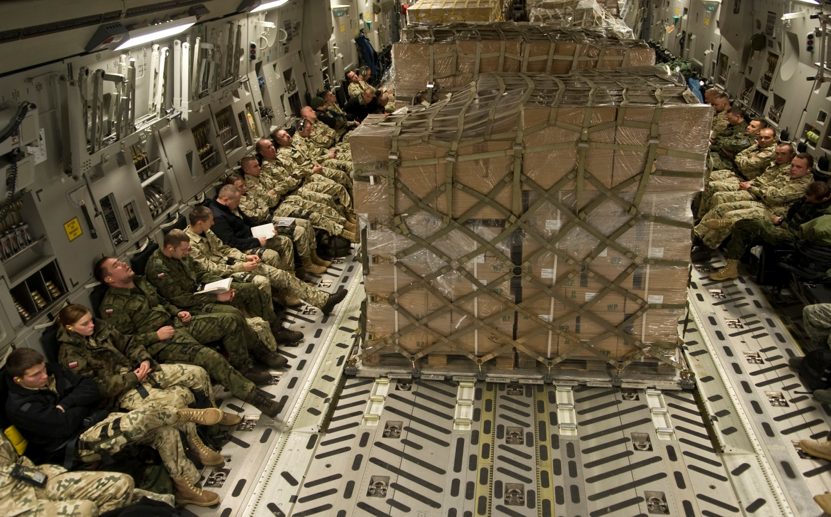
JALP

Slide 32
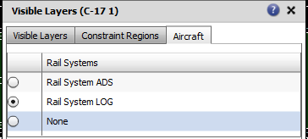
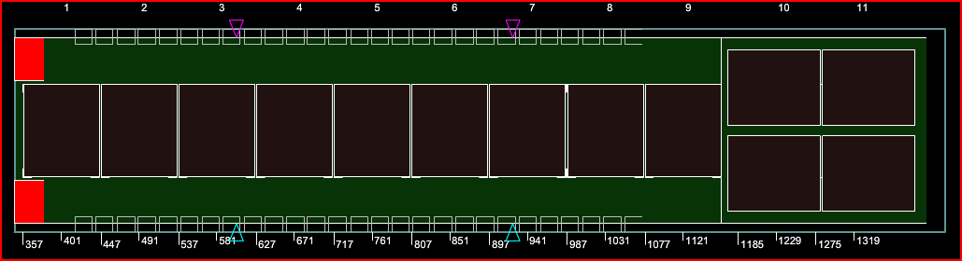
COMBINATION
LOG & ADS
JALP
Notes:
Pallet restraint system allows for a mixture of both the logistics and aerial delivery systems
Allows for greater flexibility in the compromise between palletized cargo and troop/ passenger seating

Slide 33
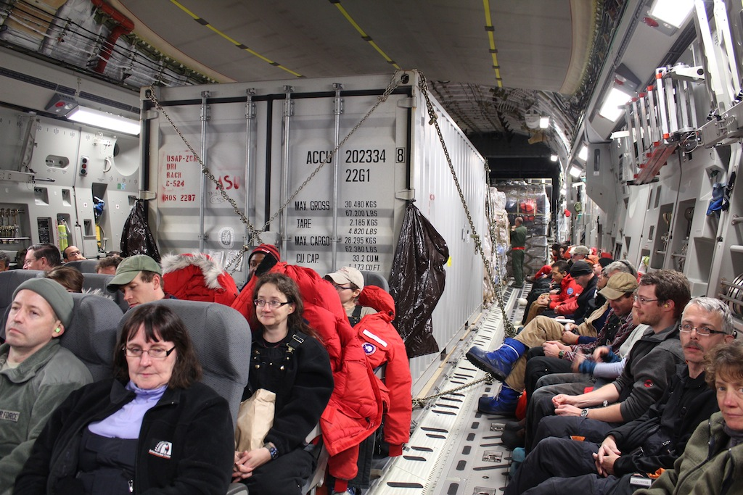
JALP
P

Slide 34
PASSENGER CONSIDERATIONS
JALP

Slide 35
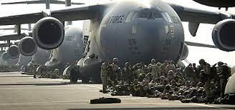
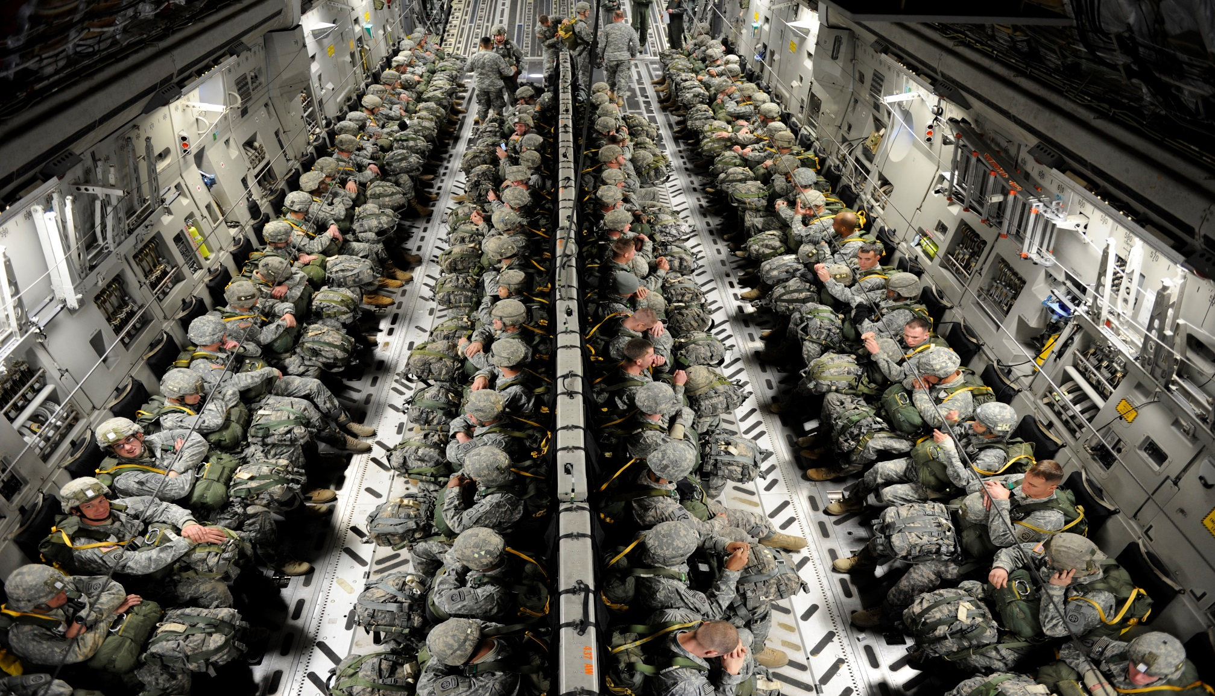
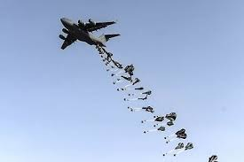
JALP

Slide 36
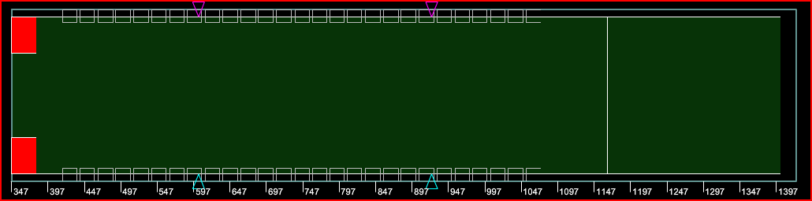
54
Permanently installed sidewall Seats
53
Available for use
>40
2 LM’s required
JALP

Slide 37
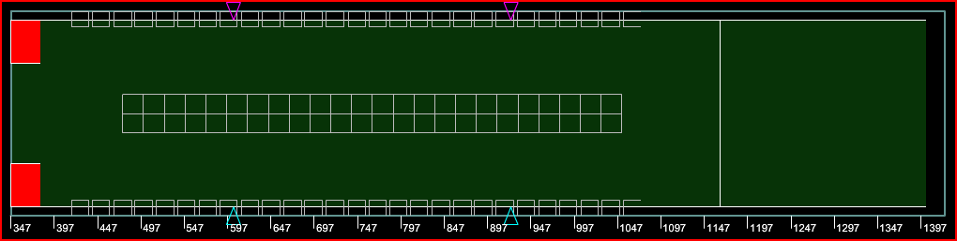
102
101
Total seats (48 Optionally installed centerline seats)
Available for use
JALP
Notes:
Centerline seats are setup in sets of 6 seats (3left/3right).
Centerline seats are not conducive to large cargo movements because 1 set can take up 3 to 4 pallet positions

Slide 38
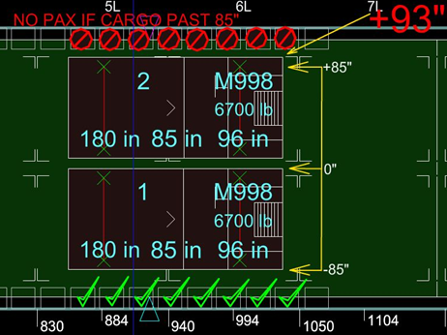
PASSENGERS
NEXT TO CARGO
If bulk cargo and/or vehicles are loaded on the main cargo floor, sidewall seats adjacent to cargo extending +/- 85” of aircraft centerline will not be used
Passengers cannot be loaded next to logistics pallet positions
JALP
ICODES WILL NOT FLAG THIS RESTRICTION
L
Notes:
If bulk cargo and/or vehicles are loaded on the main cargo floor, sidewall seats adjacent to cargo extending past +/- 85 inches of air craft centerline will not be used
If the vehicle width is greater than 85” wide, it must be offset L/R of centerline to utilize the seats for passengers. If it cannot be offset, passenger seats WILL NOT be used.
Explain to students this is a high failure item.
Optional: Explain line tool and how it can be used to give students a visual aid on the 85” line throughout the cargo compartment

Slide 39
LOAD PLANNING CONFIGURATIONS
JALP

Slide 40
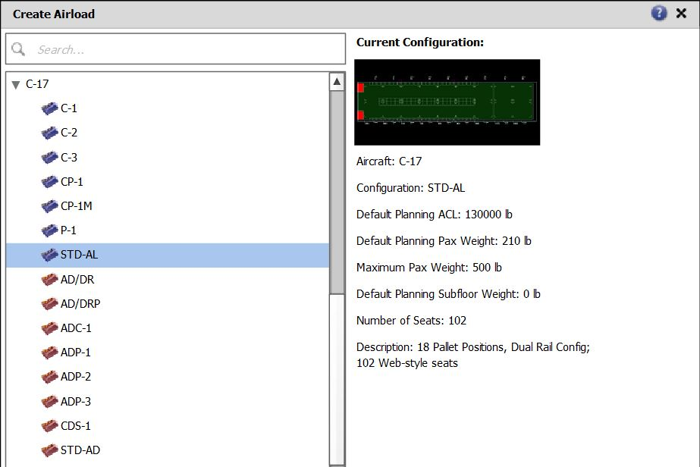
Use STD-AL
AFI 11-2C-17 Vol. 3 Addenda A contains all configuration descriptions
JALP
Notes:
ICODES has 15 different configurations for the C-17
AFI 11-2C-17 Vol. 3 Addenda A contains all configuration descriptions.

Slide 41
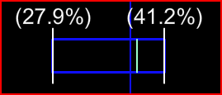
The C-17’s optimal CG is based on combined weight of aircraft + cargo.
Less than 400K = 40% +/- 1% MAC
400K to 425K = 39% +/- 1% MAC
425K to 447K = 38% +/- 1% MAC
MAC: A mathematical calculation that shows where the center of gravity is over the wing often expressed as a percentage on larger aircraft
JALP
V
Notes:
Explain that for this class the weights meet the 400K-425K range and will use 39% +/- 1%

Slide 42
QUESTIONS?
JALP

Slide 43
SUMMARY
Cargo Compartment Limitations
Pallet Considerations
Passenger Considerations
Load Planning Factors
JALP

