Slide 1
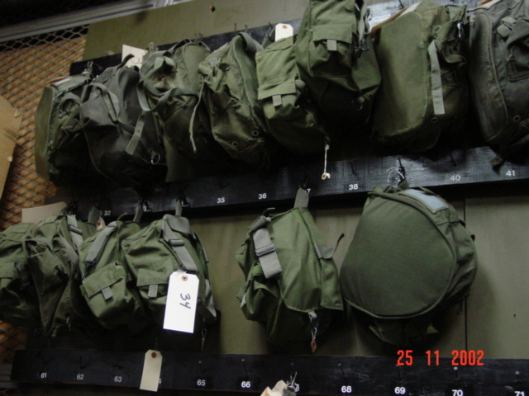
CBRN Program

Slide 2
Terminal Learning Objective
Action: Maintain accountability of unit CBRN defense equipment
Condition: In a classroom environment, and given a Modified Table of Organization and Equipment (MTOE), AR 710-2, DA PAM 710-2-1, DA Form 2062, DA Form 3161, and DA Form 3749.
Standards: Maintain accountability of unit CBRN defense equipment by identifying unit's authorized CBRN equipment using the unit's MTOE, preparing hand receipt documents (DA Form 3749, DA Form 2062, and DA Form 3161), performing CBRN equipment inventories, and issuing CBRN room equipment to unit personnel.

Slide 3
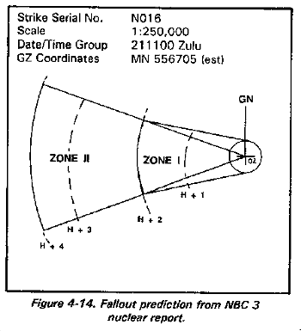
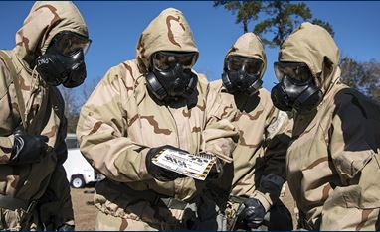
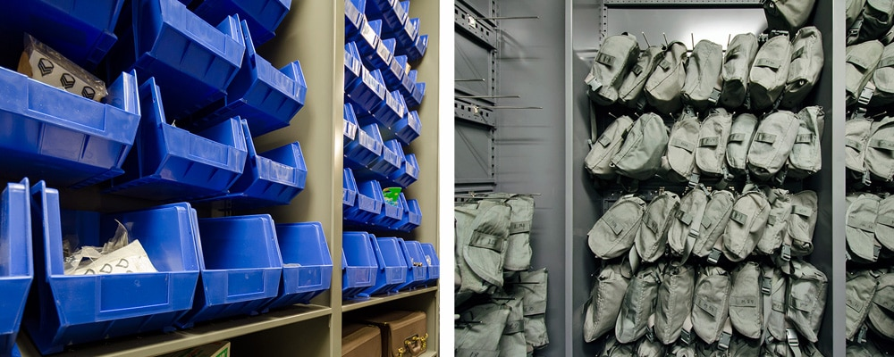
CBRN Program
ATP 3-11.36 Roles and Responsibilities of a Company CBRN NCO/Officer
pg I-21 CBRN Section core functions
A Company CBRN NCO or Officer plays a vital role in
maintaining unit readiness for CBRN threats.
Their main job is to ensure the unit is trained, equipped, and
capable of operating in a CBRN environment.
1. Training and Education
Develop and conduct CBRN training for the company (mask confidence, decontamination procedures, MOPP gear donning/doffing, etc.).
Conduct annual CBRN training and ensure that training
is documented.
Keep soldiers informed on CBRN threat awareness, updates to doctrine, and emerging technologies.

Slide 4
CBRN Program
2. Readiness and Equipment
Manage and maintain CBRN equipment accountability
(masks, filters, JSLIST suits, detection and decon gear).
Ensure equipment is serviceable and calibrated.
Oversee mask fit-testing and mask inspections.
3. Planning and Advising
Advise the Company Commander on CBRN readiness and
risk.
Provide input for unit SOPs and contingency plans related to CBRN defense.

Slide 5
CBRN Program
4. Incident Response and Preparedness
Coordinate and lead CBRN response actions during exercises
or real-world events.
Establish and maintain unit decontamination sites (operational DECON) during operations or training.
Liaise with Battalion or Brigade-level CBRN officers for
higher-level support and integration.
Advises the Commander of CBRN attacks and the impact.
Receive CBRN 3 & 5 reports and plot the information.

Slide 6
CBRN Program
5. Integration and Coordination
Act as the CBRN liaison with battalion-level CBRN personnel.
Support CBRN operations during field exercises, ensuring
proper implementation of CBRN protocols.
Coordinate with maintenance and supply personnel for proper storage and transport of CBRN gear.

Slide 7
CBRN Program
6. Documentation and Reporting
Maintain accurate CBRN training records, equipment
inventory, and inspection logs.
Reports CBRN equipment status to the Battalion CBRN
NCO/Officer. (CDE Report)
A Company CBRN NCO/Officer is a subject matter expert in the defense against chemical, biological, radiological, and nuclear threats.
Their job involves training, equipment management, planning,
and operational readiness, making them an essential part of any unit's mission success and survivability in CBRN-contaminated environments.

Slide 8
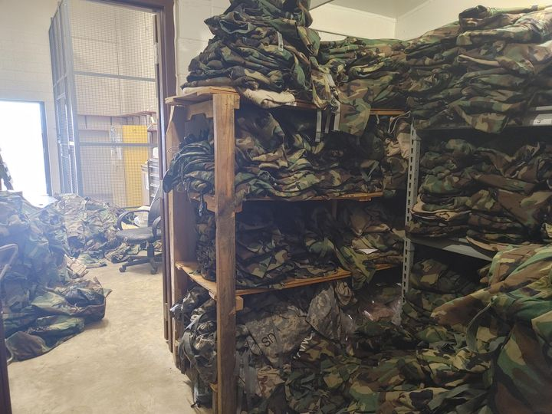
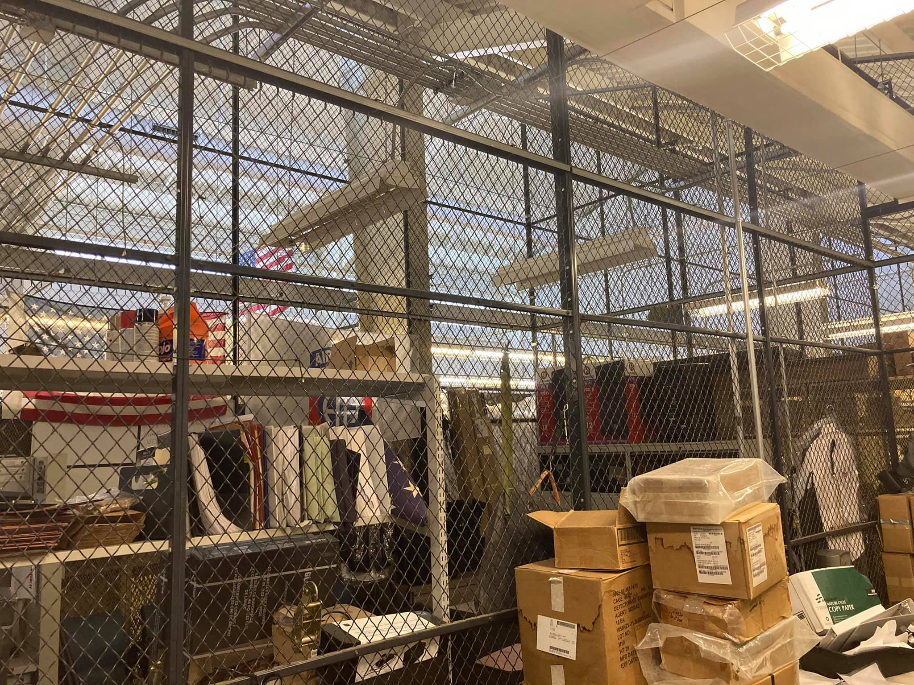
CBRN CAGE
Maintaining a CBRN cage/room is a critical responsibility for the CBRN NCO or officer at the unit level. It's where all sensitive and specialized CBRN equipment is stored, maintained, and managed.
Where to begin?

Slide 9
Getting Organized
1: Inventory. Get your hand receipts in order and take control of the keys.
2: Sub hand receipt equipment where applicable.
3: Issue masks to soldiers.
4: Review all maintenance records for the equipment. Ensure its properly documented and then turn in anything that needs to get serviced.
5: In processing procedures.
6: DATA: shelf life expiration and calibration dates, mask/JSLIST size, CDE Report, training dates etc.
7: Review previous inspection results. (CBRN cage requirements, what you need to improve and sustain)

Slide 10
Check for CBRN Equipment Accountability and for Shortages
Check and compare CBRN equipment on hand against property book/hand receipt. Complete inventory with the Sub-Hand-receipt Holder.
Compare the Property Book and the Hand Receipt against the MTOE.
Report any equipment shortages, missing or damaged items, to the Commander.
Shortage annex: This is what was missing when you took over.
4. Order equipment shortages.

Slide 11
Modification Table of Organization Equipment (MTOE)
The MTOE is the document that authorizes all personnel and equipment assigned to a particular unit
MTOEs are broken down into three sections:
Organization
Personnel
Equipment
Notes:
Insure students under stand MTOE tells them what equipment each PLT gets
As a CBRN NCO you are the only one authorize to store the equipment but the equipment belongs to the PLT.

Slide 13
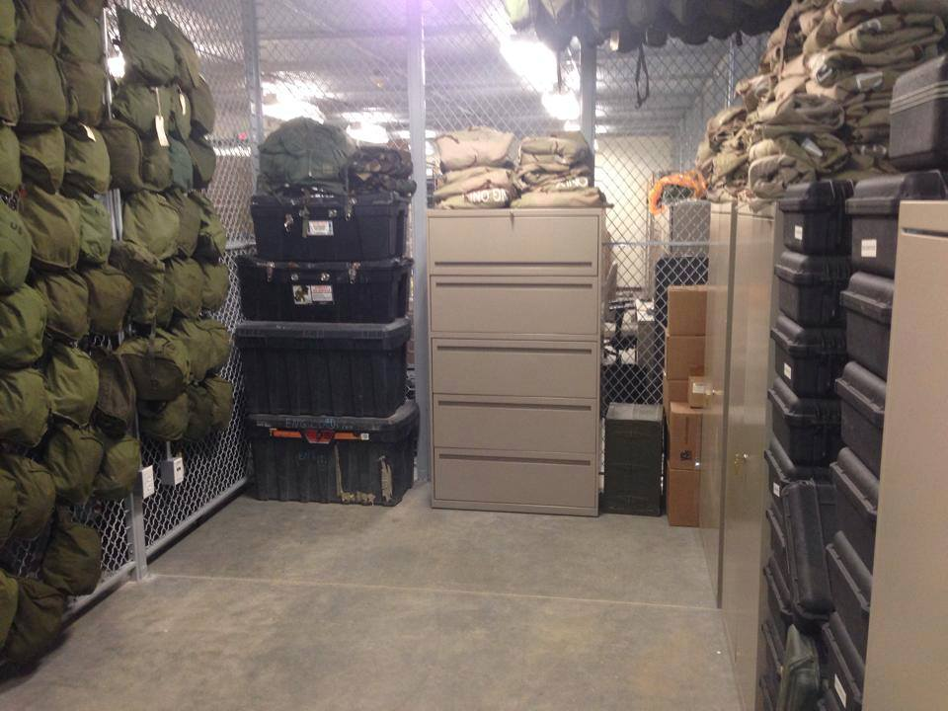
Unit Inventories
AN INVENTORY IS THE PHYSICAL COUNT OF SUPPLIES AND EQUIPMENT ON HAND IN A UNIT
Notes:
Never sign a hand receipt with out doing an inventory

Slide 14
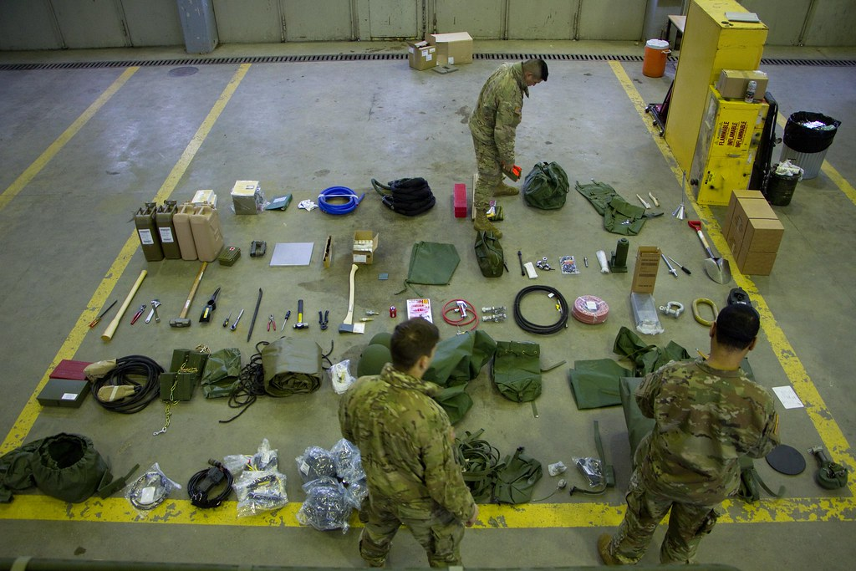
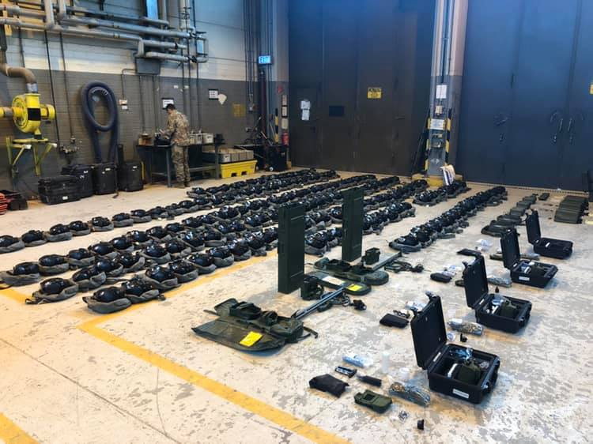
Inventory Procedures
CHECK ALL ITEMS FOR MATCH
CHECK CONDITION OF PROPERTY
CHECK ITEM FOR COMPLETENESS IAW TM
ENSURE YOU PHYSICALLY SEE THE ITEM
VERIFY SERIAL NUMBERS
VERIFY EXISTENCE OF ALL ITEMS TURNED IN FOR MAINTENANCE (DOCUMENTATION)
Notes:
You can not be ordered to sign a hand receipt without an inventory first

Slide 15
Accountability of Equipment
DA Form 3749 (Equipment Receipt)
DA Form 2062 (Permanent Hand Receipt)
DA Form 3161 (Request for issue or turn
in/Temporary Hand Receipt)

Slide 16
DA Form 3749
Purpose:
Use DA Form 3749 (Equipment Receipt) to assign responsibility for property that is issued to the same person for brief recurring periods
Examples are the individually assigned protective masks, assigned chemical agent detectors, and Radiac equipment
**Good for 24HRS
Notes:
Can be used when issuing equipment to PLT for PMCS

Slide 17
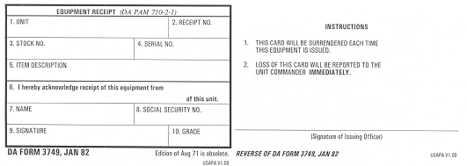
DA Form 3749
HQ Co 82nd Chem. BN
BP-1
4240-01-370-3822
Chem.-Bio Mask: Field, M40A1
CDR HQ Co. CBRN Rm
Joe, GI
300-22-5689
HARRINGTON, STEVE CPT
GI Joe
E-2

Slide 18
DA Form 2062
Purpose:
Use DA Form 2062 to record the issue of property book and durable items
Prepare the form in two copies
The signature of the person on a hand receipt establishes direct responsibility for the issued items
**Update every 6 months
Notes:
Must be updated every 6 months which is a good time to have all mask sanitized.

Slide 19
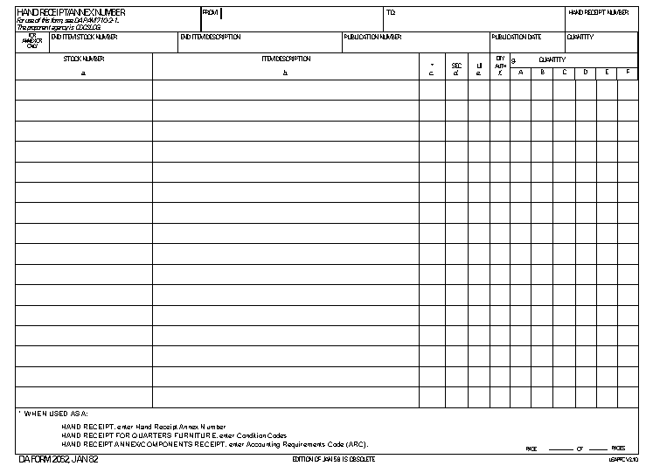
DA Form 2062
CDR HQ Co. CBRN Rm
HENDERSON, DUSTIN SFC
HQ 14
4240-01-370-3822
Chem.-Bio Mask: Field, M40A1
ea
1
1
1
8415-01-137-1704
Battle Dress Overgarment size: MDM
st
1
1
1
8415-01-033-3519
Gloves, CM Protective W/inserts size: LRG
st
1
1
1
8412-01-321-2659
Bag, CBRN Storage
ea
1
1
Notes:
You can use the same HR multiple times. This is an example where there CBRN Bag was not included when the HR was first signed. Now a bag is included so it was signed for. Talk about filling the gap between the signature and the last number to prevent adding additional items after a HR is signed.

Slide 20
DA Form 3161
Purpose:
Use DA Form 3161 for issue and turn-in transactions
between the Property Book Office and the hand receipt holder
(Also known as a change document)
The form is also used for issue and turn-in transactions between the hand receipt holder and the sub-hand receipt holder
Notes:
Allows keep this form until you sign over the CBRN room. The equipment might still be on the property book when you conduct the change over inventory.

Slide 21
DA Form 3161
Prepare the form in two copies
The person who issues or turns in the item keeps the original
The person receiving the property keeps the second copy

Slide 22
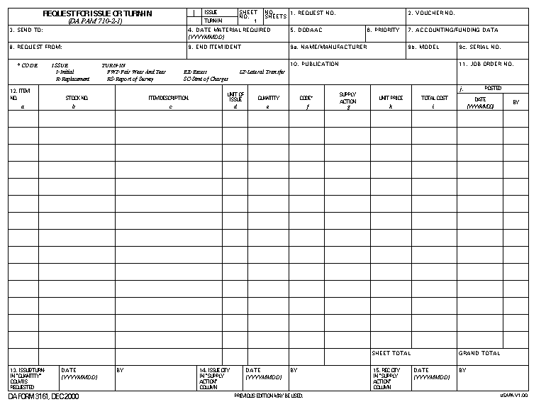
DA Form 3161
X
1
DLA, Ft Leonard Wood
2001/01/03
DODAAC
HQ Co. 82nd Chem BN
DETECTOR UNIT
BATTEL
M22
Y14-D-000237
ALARM, CHEM AGT AUTO:
M22; Y14-M-000314
1
EX
1
6665-01-438-6963
EA
LAST ITEM
PVT BYERS
RECIVERS
SIGNATURE
20100228
SIGNATURE
20100228

Slide 23
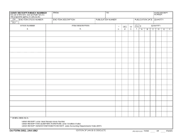
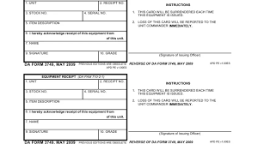
CBRN cages work one of two ways
1: You hold on to all equipment and sign it out for training, or it's hand-receipted down to the platoons or individual Soldier. If your XO or commander gives you a choice, it is highly recommend signing down masks and chemical detectors.
Have a binder for each platoon/sections 2062s for issued masks and equipment.
You keep the 2062s until the mask or equipment is turned in.
2: If you have to hang on to everything, work with the XO to make mask cards (DA Form 3749) for the masks. It will make life so much easier if there is a mass draw.

Slide 24
CBRN Program
Maintain CBRN Equipment (Inventory)
CBRN Cage

Slide 25
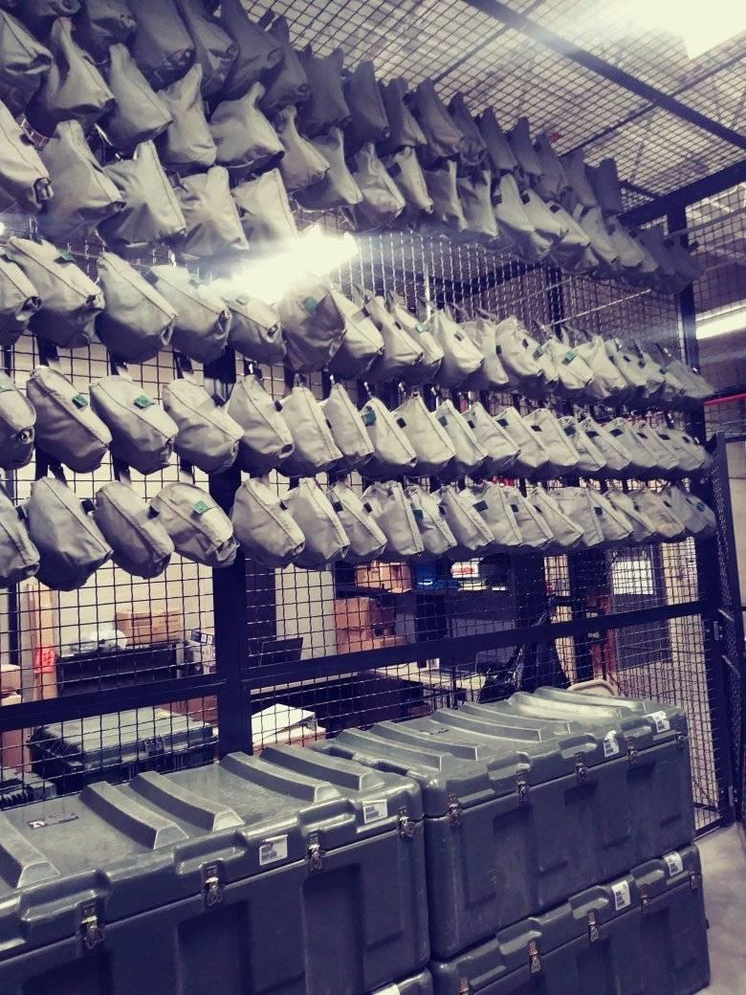
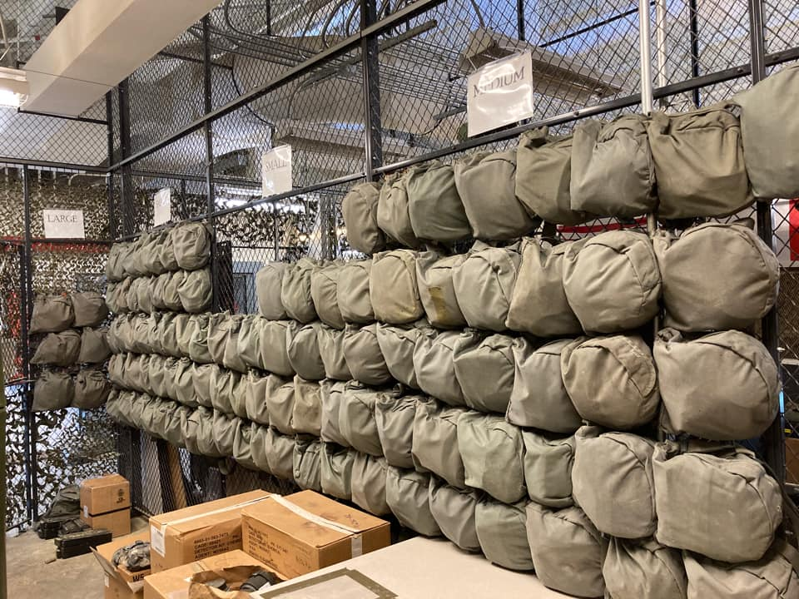
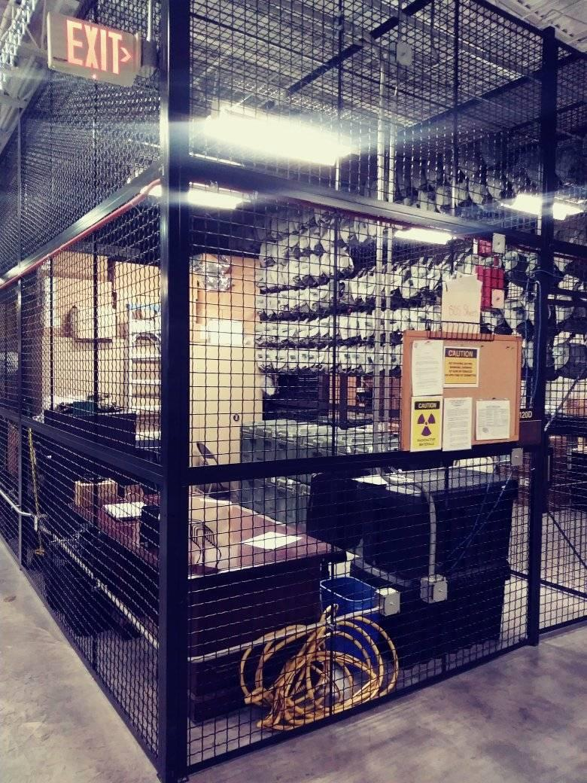
CBRN CAGE
How you set up your cage/room is up to you. The more organized you are the easier it will be to manage your program.
CRF 10 states that storing radioactive equipment requires strict access. Nobody else should have the keys.

Slide 26
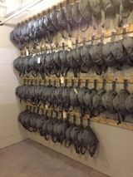
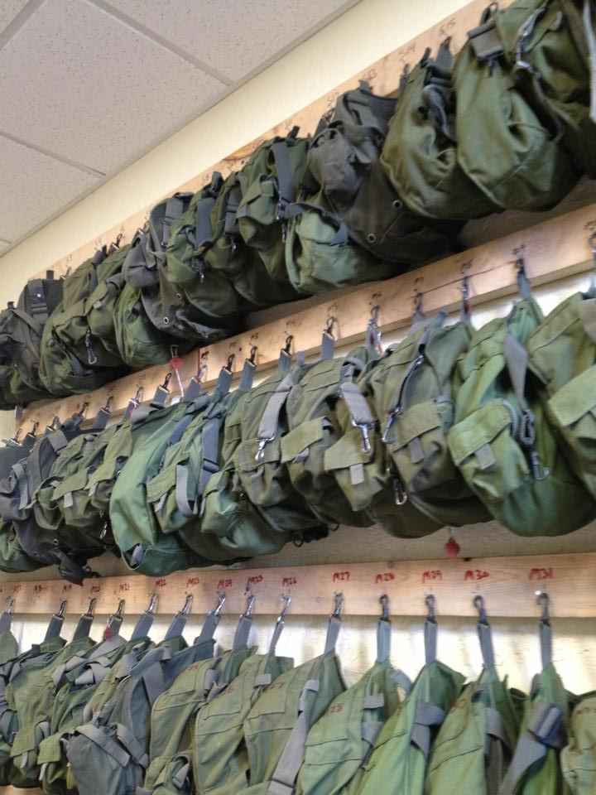
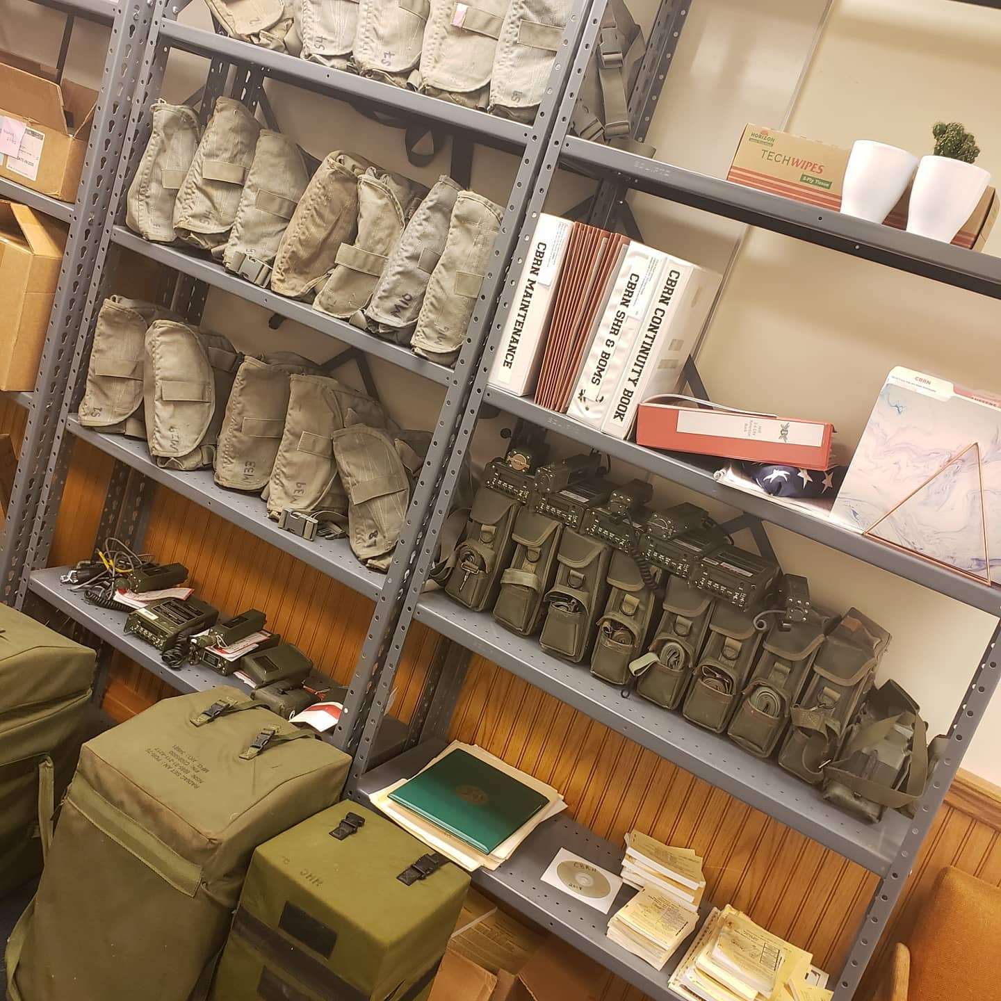
CBRN CAGE
Masks should be organized and off the ground.
Marked and identified for accountability (mask #, size).
Storing similar items together makes it easier for inventory control.
Safety Data Sheets for material in your cage that requires them need to be on hand/file.

Slide 27
CBRN CAGE
Use clearly labeled bins, shelving, or containers—labels should include NSNs, quantities, and expiration dates if applicable.
Use color-coded tags or bins for expired, unserviceable, or pending-inspection gear.
Create an itemized layout diagram or shelf inventory for quick access.

Slide 28
CBRN Program
Maintain CBRN Equipment (Inventory)
CBRN Cage
Storage of Hazardous Materials

Slide 29
Storage of Unit CBRN Hazardous Material
Battery Storage and Safety
Store new batteries in original packaging for ease of visual inspection so swelling or leakage can be detected early.
Inspect Lithium batteries for bulging, cracks, leakage. Don’t use suspect batteries.
Do not accumulate used batteries, dispose of them on a regular basis.
Keep different types of batteries separated from each other, and other chemicals. (Lithium/Alkaline)
Keep in a cool, dry, well ventilated area,
Notes:
Batteries leak. Do not leave them in your equipment.
Battery type: Lithium and Alkalyne. Choose one. Do not mix them because they react to each other.
Lithium batteries react to water. Will combust.
Store in a dry place.
AAs, AAAs, and 9 volts are need for the CBRN room. Keep them on order with supply.
Wear PPE when dealing with bad batteries..gloves.

Slide 30
Storage of Unit CBRN Hazardous Material
Decontaminants
In storage, keep Reactive Skin Decontamination Lotion (RSDL) separate from High Test Hypochlorite (HTH) and Supertropical Bleach (STB). Maintain a barrier between them (i.e. a wall; or by storing them in separate containers or rooms).
The Safety Data Sheet (SDS) for RSDL states:
“The RSDL when combined with some commonly used decontamination materials, i.e., solid powdered High Test Hypochlorite (HTH) (a.k.a calcium hypochlorite) or solid powdered Super Tropical Bleach (STB), causes spontaneous combustion.
Should RSDL be used on the same decontamination line as either of these products, care must be taken to keep them apart.
Do not discard RSDL packaging and sponge into containers that contain or have contained solid undiluted HTH or Super Tropical Bleach.”
Notes:
Safety data sheets will tell you what chemicals respond to other chemicals.
Some chemicals do not play well with others.
RSDL and STB powder can spontaneously combust.
Make sure you look at proper storage procedures.

Slide 31
Storage of Unit CBRN Hazardous Material
Equipment Containing a Radioactive Source
After determining what equipment contains a radioactive source, proper storage must be met in accordance with AR 710-3, AR 385-11, and TB 43-0197
Proper storage requirements are:
Do not store equipment with different isotopes on the same shelf. For example, equipment containing Americium 241 (AM241) is stored on a different shelf than equipment containing Nickle 63 (NI 63).
No mixing equipment containing a radioactive source (i.e. ICAM) with equipment used to detect or monitor for radiation (i.e. AN/VDR-2 Probe/Thorium 232)
Ensuring that equipment containing a radioactive source are contained in a fire retardant container (i.e. metal wall locker, or metal foot locker)
Ensuring that equipment containing a radioactive source are kept secure within a two lock system (i.e. inside a locked cabinet that is inside a locked storage area)
Notes:
AN/VDR2 is a minor source. Don't really have equipment with RAD sources anymore.

Slide 32

Storage of Unit CBRN Hazardous Material
Equipment Containing a Radioactive Source (Cont.)
NRC Form 3
A “CAUTION Radioactive Materials” sign is required on the entrance to areas where equipment containing a radioactive source are stored. Nuclear Regulatory Commission (NRC) Form 3 “NOTICE TO EMPLOYEES” must also be posted on the entrance or next to it.

Slide 33
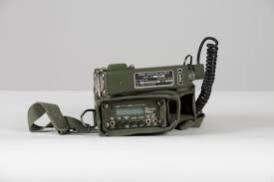
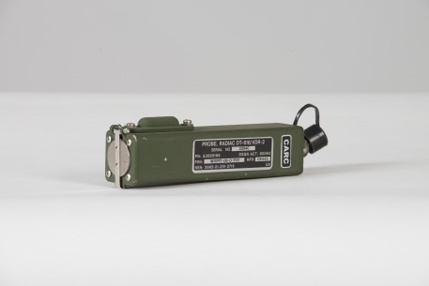
Recovery of a Radioactive Source
Stop all activity surrounding the immediate accident site.
Notify Higher Headquarters, the supporting Radiation Safety Officer (RSO) and the supporting TMDE activity. 3. Clear personnel from the immediate accident area and cordon it off.
Notes:
You need to immediately call the post RAD Officer for further guidance.

Slide 34
CBRN Program
Maintain CBRN Equipment (Inventory)
CBRN Cage
Storage of Hazardous Materials
CBRN Equipment Maintenance Management

Slide 35
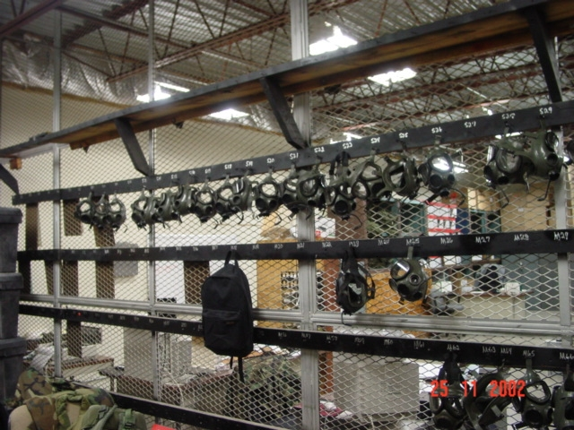
Unit CBRN Equipment Maintenance Management

Slide 36
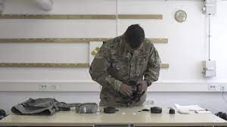
Maintainer Maintenance
Equipment Responsibilities:
Performing organizational maintenance
Turn-in of unserviceable CBRN equipment
Ensuring equipment is calibrated
At the organizational/unit level the Maintainer for CBRN equipment is the Company CBRN Specialist/NCO.

Slide 37
Supervising CBRN Equipment PMCS
The persons having primary responsibility for supervising Operator Maintenance on unit CBRN Defense Equipment are Section and Squad leaders NOT CBRN NCO.
The unit CBRN NCO is responsible for supervising the unit’s Soldier’s as they perform Semi-Annual Mask PMCS, IAW the mask’s Field Maintenance TM; submitting DA Form 2407 to request higher level maintenance support; and maintaining a bench stock of authorized repair parts/supply items necessary to support Operator and Organizational (Field) Maintenance.
Here are some items to check when supervising CBRN Equipment PMCS:
The correct TM is used and Soldiers are following the TM’s PMCS steps.
The PMCS is documented on DA Form 2404 (5988-E).
Any faults found are corrected immediately (if authorized and possible), and if not, are recorded on the DA Form 2404 (5988-E) for future correction, or higher level maintenance action.

Slide 38
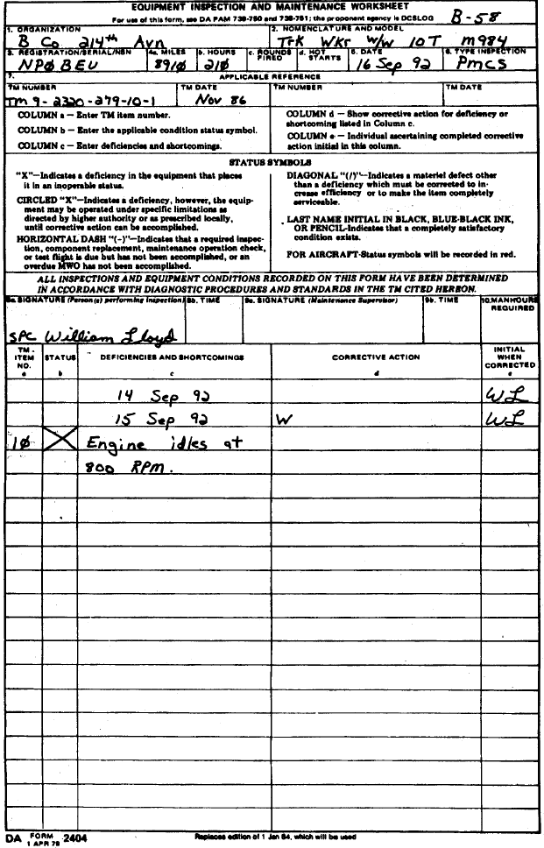
Maintenance Forms DA Form 5988-E/DA Form 2404
Date: 20000101
EQUIPMENT MAINTENANCE AND DA FORM 5988
-
INSPECTION WORKSHEET
E
W8MK3
---------------------------------------------------
EQUIPMENT DATA
-------------------------------------------------
ADMIN NUM: HQ6
EQUIP SERIAL NUM: 1234567
EQUIP MODEL: M998
REGISTRATION NUM: NGOQ90
EQUIP NOUN: TRK UT
TYPE INSP: D
EQUIP NSN: 2320
-
01
-
107
-
7155
CURRENT READING: M 001000
NUMBER
DATE
CHANGE NUMBER
PUBLICATION: TM 9
-
2320
-
280
-
PUBLICATION: TM 9
10
01/96
00
-
2320
-
280
-
20
-
1
01/96
00
INSPECTORS LIC # :
TIME:
SIGNATURE:
TIME:
----------------------------------------------------
PARTS REQUESTED
-----------------------------------------------
QTY
STATUS
DATE
FAULT DOC NUM NIIN NOUN DUE/REC DATE
COMP PRI DLC
--------------------------------------------------
MAINTENANCE FAULTS
--------------------------------------------
ITEM FAULT FAULT FAULT
CORRECTIVE OPER
NUM DATE STATUS DESCRIPTION
ACTION
HRS LIC #
0001
20000101
-
BRAKE TEST DUE 01
-
JAN
-
01
-------------------------
------
------
0002 20000101
-
ANTIFREEZE
-
50 DUE 01
-
JAN
-
01
-------------------------
------
------
0003 20000101
-
ALKALINITY BLUE DUE 01
-
JAN
-
01
-------------------------
------
-------
0009 20000101
-
LUP 001000 / 004000
-------------------------
------
-------
0010 20000101
-
ANNUAL GAGING DUE 01
-
JAN
-
01
-------------------------
------
-------
0011 20000101
-
HI
-
LO RES DUE 01
-
JUL
-
01
------------------------
------
-------
0012 20000101
-
LUB JOB DUE 01
-
JAN
-
01
------------------------
------
-------
0013 20000101
-
CRANE INSPECTION DUE 01
-
JAN01
------------------------
------
-------
0014 20000101
-
TOW VER DUE 01
-
JUL
-
01
-------------------------
-----
--------

Slide 39



Calibration Requirements
Turning in Test, Measurement, and Diagnostic Equipment (TMDE) for Calibration
First: Check the DA label for last calibration date. If the label is gone check with TMD. They will have a record of the last calibration.
Second: Make appointment by phone or in person with the appropriate maintenance support activity (TMDE)
Third: Complete PMCS and record on DA Form-5988-E
Fourth: Turn in equipment on appointment day
AN/VDR-2 Radiac set; every 3 years
AN/PDR-75 Radiac set; every 2 years
AN/UDR-13/14 Radiac set; every 3 years
M41 Protection Assessment Test System (PATS);
every 18 months or every 1,000 hours of use
Notes:
There is no more wipe testing.
The piece of equipment should be turned in within 6 months of calibration.
It is up to you to track and manage that.
If the piece of equipment does not have the validation sticker (DA Label 80), the calibration is voided.
This will be a hit during your inspection.

Slide 40
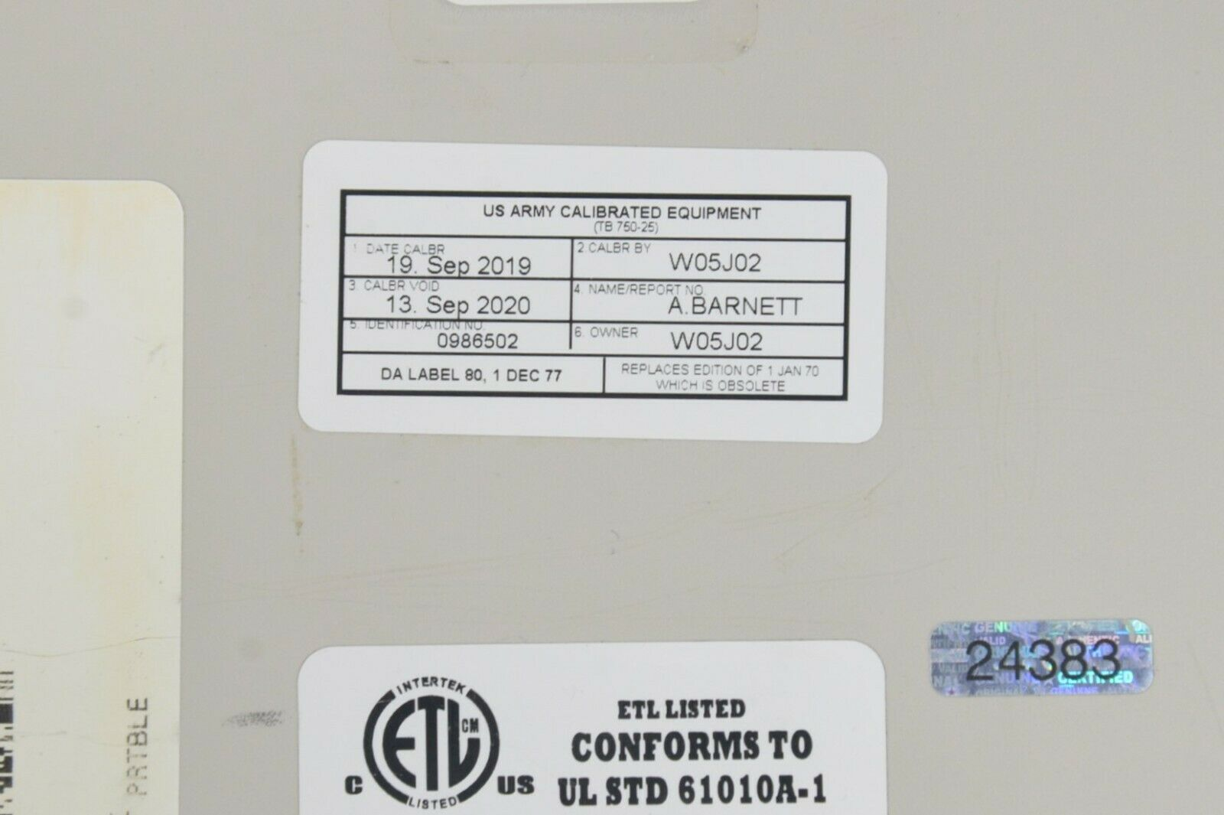
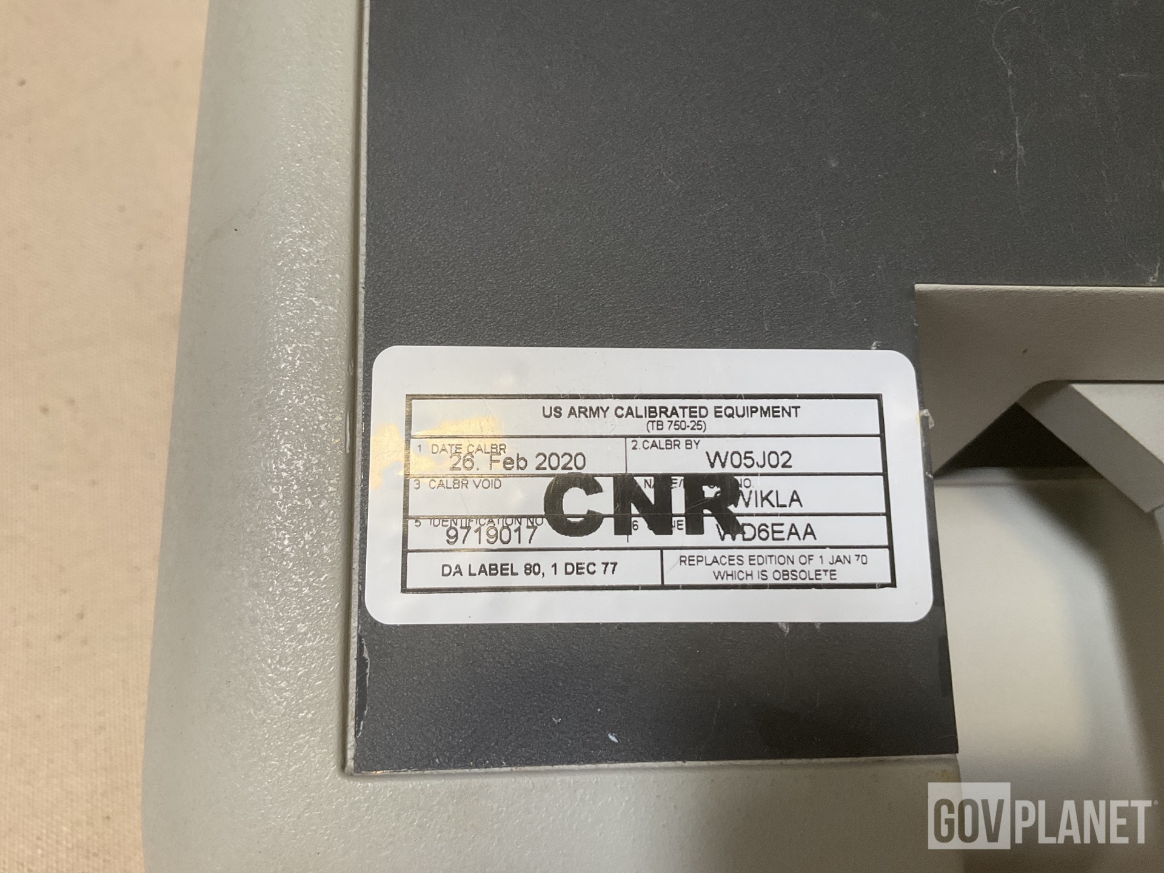
Calibration Requirements
Labeling of TMD Equipment
A DA Label 80 is placed on all calibrated and non-calibrated TMD equipment IAW AR 750-43
All TMD equipment not requiring calibration will have a DA Label 80 placed on them with the letters “CNR” printed across it (Calibration Not Required)
Notes:
This is the validation sticker.

Slide 41
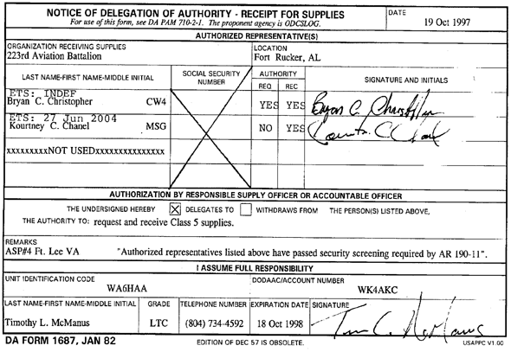
Calibration Requirements
DA Form 1687 (a.k.a. Signature Card) for Equipment Turn-in
To be authorized to turn-in CBRN equipment to a supporting repair or TMDE activity, you must be on a Signature Card on file at the supporting activity.

Slide 42
CBRN Program
Maintain CBRN Equipment (Inventory)
CBRN Cage
Storage of Hazardous Materials
CBRN Equipment Maintenance Management
Soldier In Processing (Assign Protective Mask)

Slide 43
In Processing
The gathering of required information as outlined by unit CBRN SOP (support IPE SISBL issue for deployment):
1. Name
2. Duty position/platoon
3. Type Mask required/ M50/ Aviator/ Tankers
4. Optical inserts requirement, Y or N
5. JSLIST size
6. Boot size
7. Glove size
8. Exemption from CS exposure. If yes, reason
Notes:
Inprocessing sheets are on the CBRN Disk
Different tracking charts are already made and can be found on the disk

Slide 44
Mask Chart/Database
All Soldier that in-process must be fitted for a protective mask using M41 PATS. The mask is issued IAW SOP. You must maintain a mask assignment chart/database:
- Admin Number/mask number
- Mask type
- Mask size
- Mask lot number
- Date mask was sanitized
- Canister or filter lot number/date installed
- Date fitted using the M41 PATS
Notes:
Must make sure to keep the tracking chart up to date. Always have a working copy.

Slide 45
Example PROTECTIVE MASK ROSTER
UNIT
MASK
ADMIN
NO.#
NAME/
RANK
MASK
CANISTER/FILTER
INSERTS
INSTALLED/
ORDERED
DATE
DATE
CLEANED/
SANITIZED
SIZE
TYPE
LOT #
FIT/TEST
DATE
DATE
INSTALLED
LOT #
1
Pinnock SFC
SML
M40A1
EBH65473
14 JUL 09
28 JUN 09
ELZ749736
15 JUL 09
N/A
2
Jackson MAJ
SML
M40A1
EBH65473
14 JUL 09
28 JUN 09
ELZ749736
15 JUL 09
28 Feb 2010
3
Pryce PFC
SML
M40A1
EBH65473
14 JUL 09
28 JUN 09
ELZ749736
15 JUL 09
N/A
4
SML
M42A1
EZH65486
28 JUN 09
ELZ749736
15 JUL 09
N/A
5
Hayden SGT
SML
M42A1
EZH65486
14 JUL 09
28 JUN 09
ELZ749736
15 JUL 09
24 NOV 09
6
MED
M40A1
M2W8756
28 JUN 09
ELZ749736
15 JUL 09
N/A
7
Stultz SPC
MED
M40A1
M2W8756
14 JUL 09
28 JUN 09
ELZ749736
15 JUL 09
N/A
8
Chamberlain PFC
MED
M40A1
M2W8756
14 JUL 09
28 JUN 09
ELZ749736
15 JUL 09
Installed
9
MED
M40A1
M2W8756
28 JUN 09
ELZ749736
15 JUL 09
N/A
10
Biggs COL
MED
M40A1
M2W8756
14 JUL 09
28 JUN 09
ELZ749736
15 JUL 09
N/A
11
Epps SGT
MED
M40A1
M2W8756
14 JUL 09
28 JUN 09
ELZ749736
15 JUL 09
N/A
12
Granger SSG
MED
M42A1
M2L9338
14 JUL 09
28 JUN 09
ELZ749736
15 JUL 09
Installed
13
MED
M42A1
M2L9339
28 JUN 09
ELZ749736
15 JUL 09
N/A
14
LRG
M40A1
SLR8759
28 JUN 09
ELZ749736
15 JUL 09
N/A
15
Bryant SFC
LRG
M40A1
SLR8759
14 JUL 09
28 JUN 09
ELZ749736
15 JUL 09
Installed
16
Ettinger CW4
LRG
M42A1
SMG4856
14 JUL 09
28 JUN 09
ELZ749736
15 JUL 09
N/A
Notes:
Just an example. Use the chart that best works for you.

Slide 46
CBRN Program
Maintain CBRN Equipment (Inventory)
CBRN Cage
Storage of Hazardous Materials
CBRN Equipment Maintenance Management
Soldier In Processing (Assign Protective Mask)
Optical Insert Program AR 40-63

Slide 47
Optical Insert Program, AR 40-63
- It is best to maintain your optical insert chart separate from your mask chart. Use tabs if using an excell spreadsheet.
- When incorporated with the mask chart, the information is limited.
- All Soldiers requiring glasses should have inserts installed in their protective mask.
- When in-processing Soldiers check for the following to update chart as necessary
Optical Inserts Requirement
Are they on hand
If not on hand/ Date ordered
Follow up on inserts on order
- Soldiers receiving new glasses should also have their inserts changed.
- Ensure optical inserts are removed from mask and returned to Soldiers when out-processing.
Notes:
Not your job to make optical appointments for soldiers.
Must track when inserts are put on order and when you have installed them

Slide 48
EXAMPLE
OPTICAL INSERT CHART
DATES
MASK #
NAME
SECTION
INSTALLED/
REMARKS
MASK TYPE
& SIZE
SCREENED
ORDERED
1
2
JACKSON MAJ S3 NORD HALL 10 JUN 09 13 JUN 09 ON ORDER M40A1/SML
3
4
5
HAYDEN SGT DECON 21 JUN 09 15 JUL 09 M42A1/SML
6
7
8
CHAMBERLAIN PFC SUPPLY 15 JUL 09 15 JUL 09 M40A1/MED
9
10
11
12
GRANGER SSG CHEM BIO 14 JUN 09 2 JUL 09 M42A1/MED
13
14
15
BRYANT SFC SMOKE 14 JUL 09 14 JUL 09 M4OA1/LRG

Slide 49
CBRN Program
Maintain CBRN Equipment (Inventory)
CBRN Cage
Storage of Hazardous Materials
CBRN Equipment Maintenance Management
Soldier In Processing (Assign Protective Mask)
Optical Insert Program AR 40-63
Individual Protective Equipment
Standardized Individual Soldiers Basic Load

Slide 50
IPE SISBL Issue
For Soldiers stationed in Korea getting an issue of Individual Protective Equipment (IPE) Standardized Individual Soldiers Basic Load (SISBL) will be a part of in-processing much like in-processing CIF.
CONUS installations have this “wartime” stock stored in warehouses and will get the issue before deployment IAW with their deployment orders.
Notes:
This information should be part of your in processing.
Must have total number of JLIST needed for your company

Slide 51
CBRN Program
Maintain CBRN Equipment (Inventory)
CBRN Cage
Storage of Hazardous Materials
CBRN Equipment Maintenance Management
Soldier In Processing (Assign Protective Mask)
Optical Insert Program AR 40-63
Individual Protective Equipment
Standardized Individual Soldiers Basic Load
CBRN Defense Equipment Reporting

Slide 52
CBRN Defense Equipment Reporting
A report that tracks the status, inventory, serviceability, and accountability of a unit’s CBRN
gear.
Ensures CBRN readiness and compliance with Army regulations and mission requirements.
CDE report reflects items authorized for units according to its MTOE.
Report is sent to higher.
Battalions report Companies/Brigade reports Battalions.

Slide 53
Sections of a CBRN CDE Report
Date was prepared
Unit
Unit identification code
Unit Modification Table Of Equipment (MTOE) Number
MTOE date
Number of personnel authorized to the unit
Number of personnel assigned to the unit
Equipment identification column

Slide 54
SECTIONS OF A CBRN CDE REPORT
Column showing equipment line number
Column showing equipment required
Column showing equipment authorized
Column showing equipment on hand
Column showing equipment on order
Column showing equipment serviceability
Calibration column indicating the DATES, calibration was last done and next due date

Slide 55
CBRN CDE REPORT Heading
Notes:
Is due monthly. You can get it from your BN CBRN NCO.
All the equipment info you can get off of your MTOE.
If the report spreadsheet is formatted correctly, if you put a zero in the on hand section, it should auto populate how much it will cost to purchase the equipment and get the unit at 100% on hand.

Slide 56
CBRN CDE REPORT CLOSING
Notes:
This gets turned in to Div by the BDE Cbrn NCO.
You will turn it in to your BN CBRN NCO.
Usually these are due at the end of the month.

Slide 57
CBRN Program
Maintain CBRN Equipment (Inventory)
CBRN Cage
Storage of Hazardous Materials
CBRN Equipment Maintenance Management
Soldier In Processing (Assign Protective Mask)
Optical Insert Program AR 40-63
Individual Protective Equipment
Standardized Individual Soldiers Basic Load
CBRN Defense Equipment Reporting
CBRN Shelf Life Program

Slide 58
CBRN Shelf Life Program
A Shelf Life/Quality Surveillance Program monitors the expiration, extension, and replacement of shelf-life CBRN items to prevent equipment failure during training or operations.
All shelf life items must be inspected every 90 days IAW AR 702-18
Storage area temperature must be controllable
Storage area has limited access
Storage area does not leak or have utility line or pipes that can cause unexpected damage and lead to failure.
Notes:
You need to keep track of things that expire.
There are trackers that can help you with tracking when it is time to turn in expired items.
You turn in expired items on camp funston.
You turn in expired items and then reorder new stock.

Slide 59
Example of Shelf Life Items
ITEM NSN SHELF LIFE CLASS SUPPLY
BATTERY, BA 3030 6135-00-835-7210 4 YEARS IX
BATTERY, BA 3090 6135-00-900-2139 3 YEARS IX
BATTERY, CAM 5800 6665-99-760-9742 5 YEARS IX
BTRY, LITH BA5590/U 6135-01-036-3495 5 YEARS IX
BTRY, M8A1 BA 3517/U 6135-00-450-3528 4 YEARS IX
CANISTER, C2A1 4240-01-361-1319 SEE SB 3-30-2 IX
CANISTER, FILTER M10A1 4240-00-127-7186 SEE SB 3-30-2 IX
CONFIDENCE, EX KIT 6665-01-382-7081 5 YEARS IX
DECON KIT, M291 6850-01-276-1905 5 YEARS II
DECON KIT, M295 6805-01-357-8456 5 YEARS II
DECON STB, 50 LBS 6850-00-297-6653 5 YEARS II
DECON, M13 DAP 4230-01-133-4124 2 YEARS II
GLOVES, CML PROT 8415-01-033-3517 15 YEARS II
OVERSHOES 8430-01-049-0878 15 YEARS II
HELMET, COVER CML 6415-01-111-9028 15 YEARS II
HOOD, CB MASK M7 4240-00-021-8695 15 YEARS II
HOOD, QUICK DOFF 4240-01-376-3152 5 YEARS II

Slide 60
Example of Shelf-Life Monitoring Chart
NOMENCLATURE
AND
NSN
QUANTITY
LOT
NUMBER
DATE
PRODUCTION OF PACKED
ITEMS
EXPIRATION/
DISCARD
DATE
TEST
DATE
LOCATION
STORED/
ISSUED
BATTERY, BA 3030
6135-00-835-7210
N/A
13 APR 00
12 APR 04
CBRN Cage
Shelf 2
2 EA
13 MAR 03
Notes:
Some trackers will turn colors to let you know when an item will expire.

Slide 61
CBRN Program
Maintain CBRN Equipment (Inventory)
CBRN Cage
Storage of Hazardous Materials
CBRN Equipment Maintenance Management
Soldier In Processing (Assign Protective Mask)
Optical Insert Program AR 40-63
Individual Protective Equipment
Standardized Individual Soldiers Basic Load
CBRN Defense Equipment Reporting
CBRN Shelf Life Program
CBRN Inspection Checklist

Slide 62
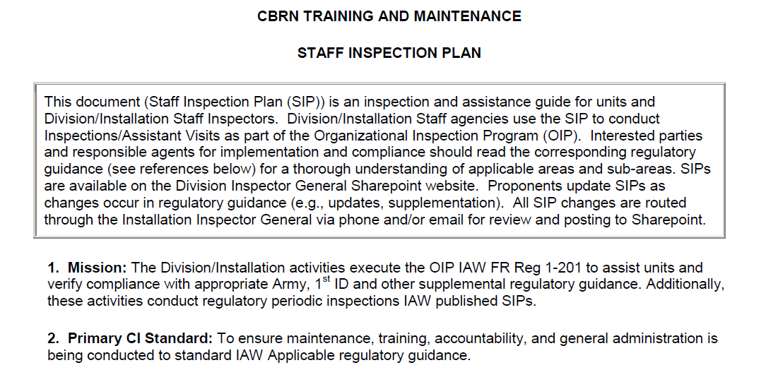
Inspection Checklist

Slide 63
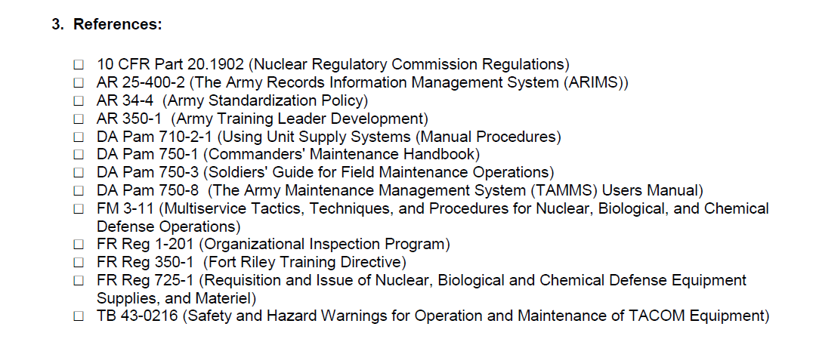
Inspection Checklist

Slide 64
Inspection Checklist
This will be broken down by Brigade, Battalion, and Company

Slide 65
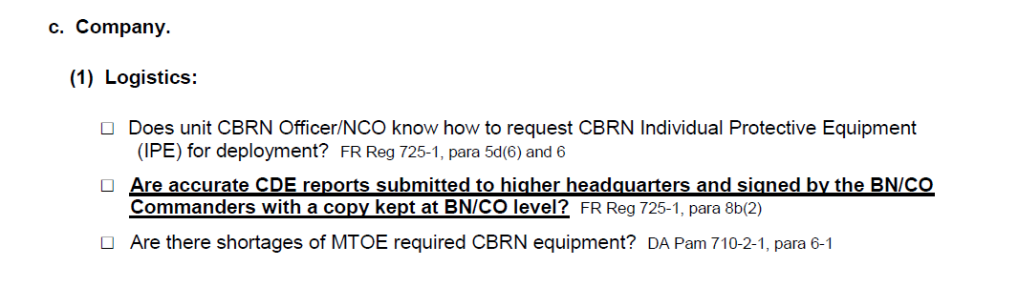
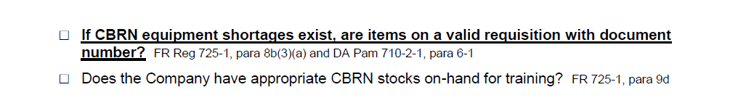
Inspection Checklist
Monthly CDE report
Inventory

Slide 66
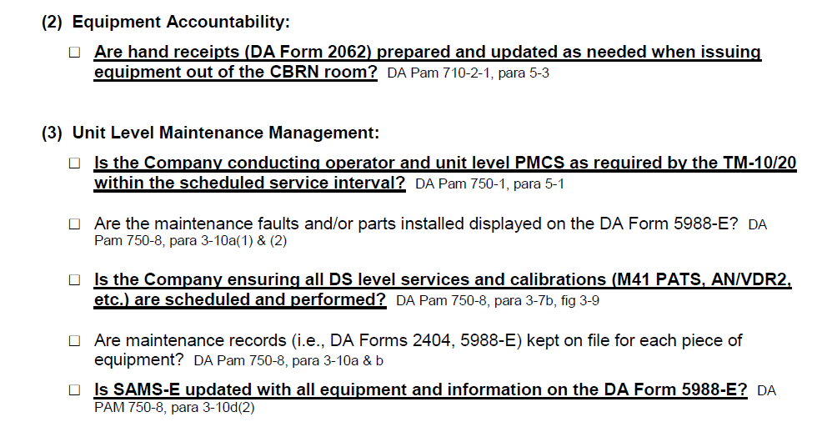
Inspection Checklist
_______
_____________

Slide 67
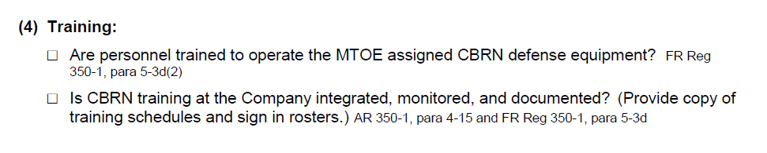
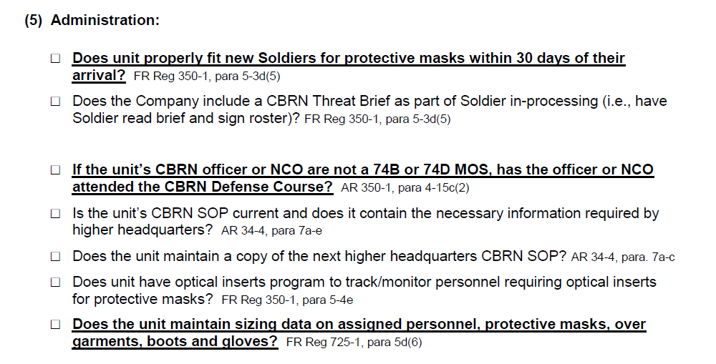
Inspection Checklist
____
_______
Fit test/M41 PATs
Orders/SOP
In-processing/Data Trackers

Slide 68
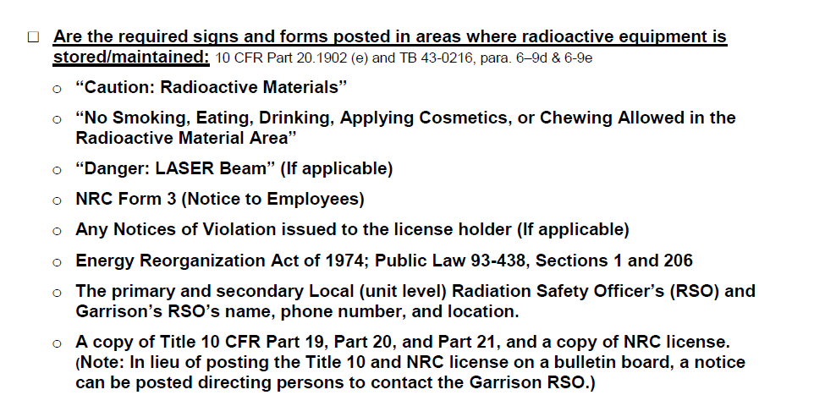
Inspection Checklist

Slide 69
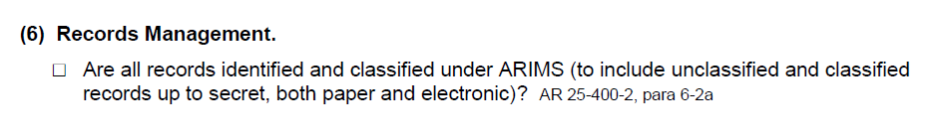
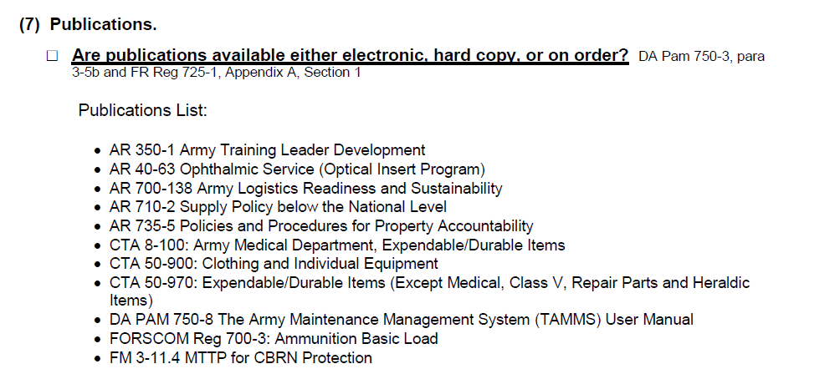
Inspection Checklist

Slide 70
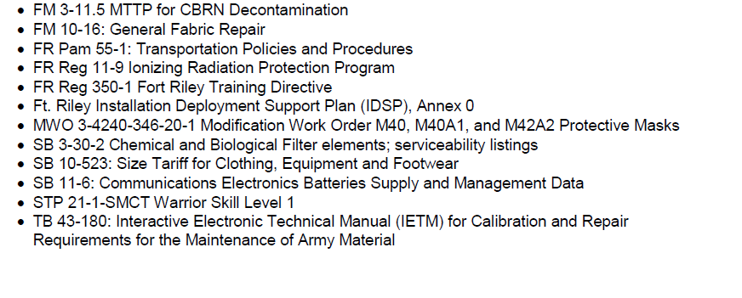
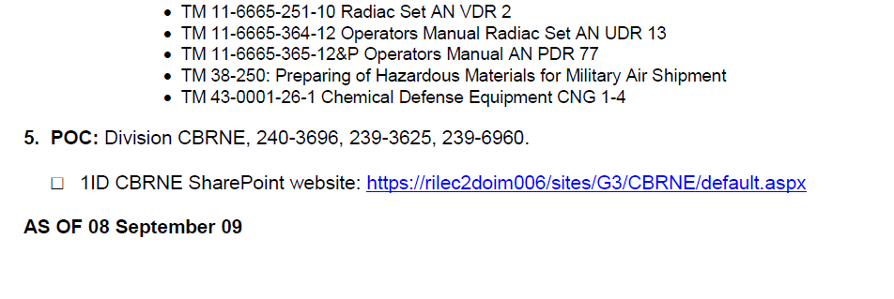
Inspection Checklist

Slide 71
Never sign a hand receipt without doing an inventory
You cannot be ordered to sign a hand receipt without doing an inventory first
Things to remember

Slide 72
SUMMARY
Inventory CBRN equipment
Prepare and maintain Hand receipts
DATA tracking/In-processing
Equipment maintenance
Training
Inspection Checklist is the guide for your CBRN Room Program

