Slide 1
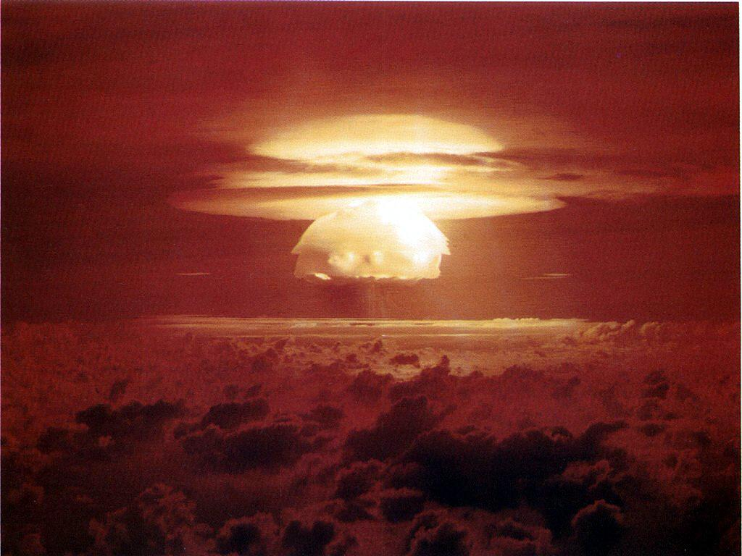
CBRN Warning and Reporting
System

Slide 2
Terminal Learning Objective
ACTION: Use the CBRN Warning and Reporting System
CONDITIONS: In a training environment and given CBRN attack scenarios, Chemical Downwind Message (CDM), CBRN 3 CHEM Report, CBRN 5 CHEM Report, CBRNWRS (GTA 03-06-008), FM 3-11.3, 1:50,000 military map, Coordinate Scale and Protractor (GTA 05-02-012), permanent markers, map overlay, scissors, and transparent tape.
STANDARDS: Use CBRNWRS by interpreting a Chemical Downwind Message (CDM) to include identifying the date/time group (DTG) each line item (WM, XM, and YM) is valid from and to, and what each digit or groups of digits in a particular line (WM, XM, or YM) indicates (i.e. wind direction, wind speed, and other meteorological data); preparing a CBRN 1 Report, utilizing the format in GTA 03-06-008, and containing all mandatory line items; preparing a CBRN 4 Report, utilizing the format in GTA 03-06-008, and containing all mandatory line items; plotting a CBRN 3 and CBRN 5 Report on map overlay material with all mandatory marginal information placed on the overlay, and the overlay positioned on a military map that matches the marginal information identified on the overlay.

Slide 3
LESSON ADMINISTRATIVE DATA
SAFETY REQUIREMENTS: No major considerations.
RISK ASSESSMENT LEVEL: Low
ENVIRONMENTAL CONSIDERATIONS: No major considerations
Assessment: Student's will be performance tested on plotting CBRN 3 and 5. The lesson as a whole will be tested on the Technical CBRN Advise Assessment (031-DCX01) in which the student must get a minimum of 70%.

Slide 4
CBRNWRS Formats
The formats are made up of letters from the alphabet.
Each letter has a specific meaning based on whether or not the report deals with chemical, biological, or nuclear contamination.

Slide 5
CBRN Reports IAW FM 3-11.3 And GTA 03-06-008
CBRN 1 (Observer’s Report)
CBRN 2 (Evaluated Data)
CBRN 3 (Immediate Warning)
CBRN 4 (Recon, Monitoring, & Survey)
CBRN 5 (Actual Contamination)
CBRN 6 (Detailed Information)

Slide 6
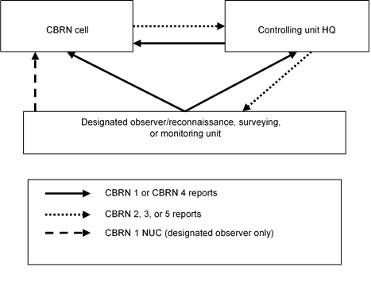
CBRN WRS Flow

Slide 7
Check On Learning
What CBRN report is the Observers Report?
The CBRN 1 Report.
What is the difference between the CBRN 3 and CBRN 5 reports?
The CBRN 3 report is for predicted contamination and the CBRN 5 report is for actual contamination.
Who is responsible for initiating the CBRNWRS?
The Units

Slide 8
CBRN 1 REPORT
Most widely used report.
Observing unit uses it to provide CBRN attack data.
All units must be familiar with report.
Battalion and higher forward reports.
Consolidated report sent for multiple attacks in same area.
If attack is based upon alarm signal without an indication of attack, then inform higher and verify with detector kits before sending CBRN 1.

Slide 9
SALUTE REPORT
After initial reaction to a suspected attack, notify higher headquarters with a SPOT or SALUTE report.
SIZE
ACTIVITY
LOCATION
UNIT
TIME
EQUIPMENT
Submit CBRN 1 report after gathering required data

Slide 10
CBRN 1 REPORT Mandatory Lines
Nuclear - B, D, G, and H.
Chemical - B, D, G, I and MR.
Biological – B, D, F, G, I and MR.
Radiological-B, D, G, IR, and MR
You will send all data in a single, complete CBRN 1 Report.

Slide 11
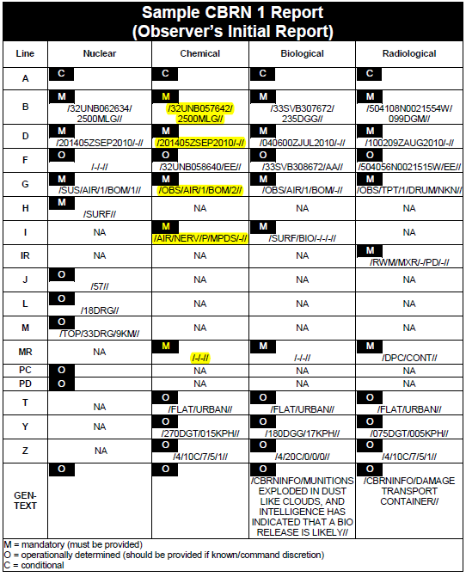

Slide 12
EXAMPLE CBRN1 REPORT
B Co, 84th Chemical BN
CBRN 1 Chemical Report
Precedence: Flash (initial)
NOTE: all reports after initial have IMMEDIATE precedence.
B WB87456415/ 90 Deg
D 030900LAPR2009/030930LAPR2009
G SUS/Missile/3
I Airburst/NERVE/ G /NP/MPDS
MR Liquid

Slide 13
Check On Learning
What is the purpose of the CBRN 1 Report?
Used to provide immediate attack information from the observer
What is the most widely used report?
CBRN 1
What information does a SALUTE report provide?
Size, Activity, Location, Unit, Time, Equipment

Slide 14
Practical Exercise
Prepare an CBRN 1 Report

Slide 15
UNCLASSIFIED
PE-CBRN1-Scenario
“You are assigned to Bravo Company, 47th Transportation Battalion. Today’s date at 0900 while on security at FOB Stryker located in a flat urban area you observed 2 missile explosions in the air 270 deg magnetic from your location WB65057310. After the airburst, you noticed a white mist settling over the area of attack. It lasted for 10 minutes. The S4’s driver approached from the north, and her vehicle’s M9 Paper has turned red. Testing with M8 paper indicated the agent to be VX, nerve. The JCAD Alarms are sounding, indicating presence of ‘Nerve’ agent. This is the first use of chemical weapons in the area of operations.”
a. Submit an CBRN 1 report
UNCLASSIFIED

Slide 16
PE-CBRN 1 Report Results
B Co, 47th Trans Bn
CBRN 1 Chemical Report
Flash (initial)
B WB65057310/ 270 deg
D 080900LSEP2009/080910LSEP2009 (10 Min duration)
G OBS/Missile/2
I Air/NERV/VX/P/MPDS
MR Liquid

Slide 17
Check on Learning
Question: What is a CBRN 1 report?
Answer: Observers report
Question: Which lines must always be reported in a CBRN 1 Chemical report?
Answer: B, D, G, I, MR
Question: After a unit completes an CBRN 1 report, to whom is it reported?
Answer: Next higher headquarters

Slide 18
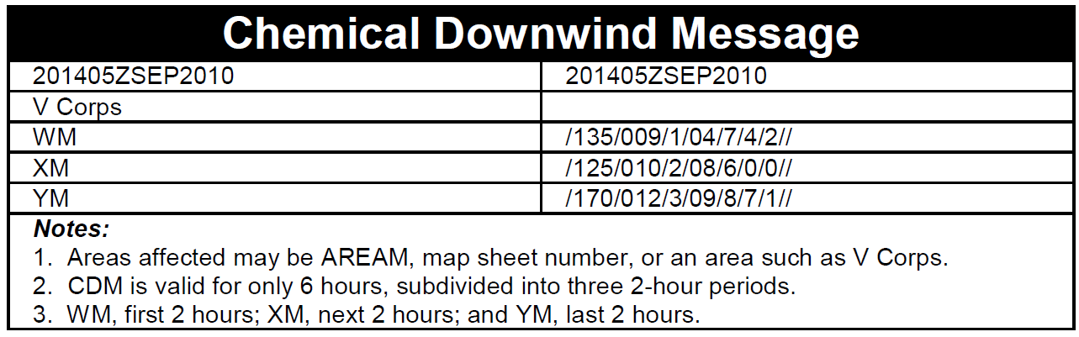
CDM Line Information
(Received)
(Effective)
(Area affected)
(1405-1605)
(1605-1805)
(1805-2005)

Slide 19
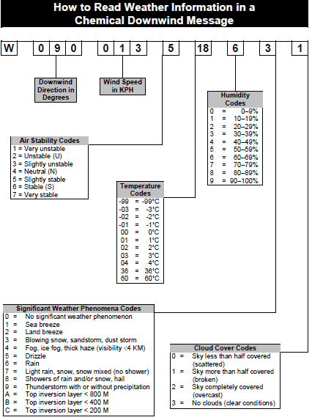

Slide 20
Check on Learning
Question: How long is the CDM valid for?
Answer: 6 hours
Question: How long is line YM valid for?
Answer: 2 hours
Question: What does the number 7 mean in this example of the CDM?
015/035/7/24/4/5/1
Answer: Air Stability (Very Stable)

Slide 21
Check on Learning
Question: What is the wind speed according to this line of the CDM? 015/035/7/24/4/5/1
Answer: 35 KPH
Question: What is the wind direction according to this line of the CDM? 015/035/7/24/4/5/1
Answer: 015 degrees
Question: If WM is valid from 0600 to 0800, what time frame will YM be valid for?
Answer: 1000-1200

Slide 22
CBRN3 REPORT
Sent to all affected units.
Re-evaluated every 2 hours based on the CDM
Division CBRNC uses CBRN 2 Reports and weather to predict downwind hazard area.
Prediction is safe-sided to ensure a militarily significant hazard will not exist outside of predicted area.
Line items A, D, F, I, MR,PA, PX are mandatory lines

Slide 23
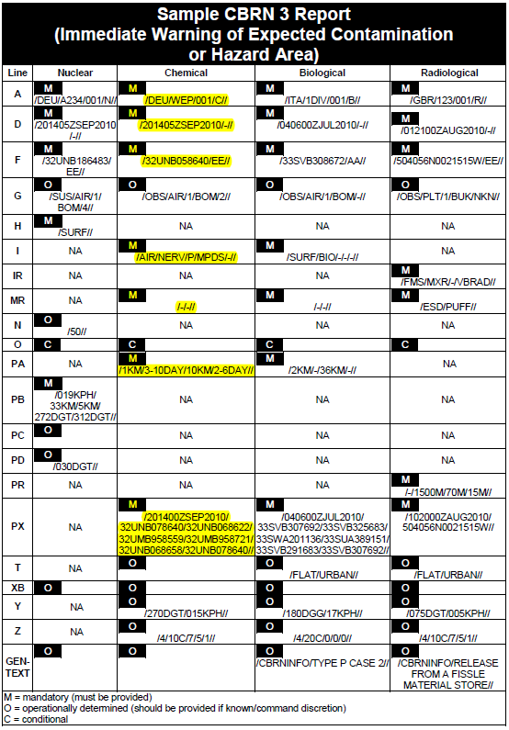

Slide 24
Example CBRN 3 Report
CBRN 3 Chemical Report
A C002
D 200945ZMAR2009 / 201000ZMAR2009
F LB126874 AA
I NERVE, V, (P)
MR Liquid
PA IN AA 2 - 4 DAYS, IN HA 1-2 DAYS
PX LB556751/LB559754/LB632774/LB610794/LB558747//
Y 270/015//
Z 5/18/6/4/0//

Slide 25
Plot CBRN 3 Report
Steps for plotting CBRN 3 Report
Plot Line Foxtrot on Map
Plot Line PX [5 coordinates (fan plot) or 010 (circle plot)]
Complete Attack Area Circle Radius
Connect Remaining Coordinates
Include Marginal Data
Plot two grid reference points on the overlay
Brief Your Supervisor

Slide 26

PLOTTING DEMONSTRATION
PX
PX
130 /12 kph
F
o
PX
DOWNWIND DIRECTION
PX
PX

Slide 27
PLOTTING DEMONSTRATION
LINE PX 010
F

Slide 28
MARGINAL DATA CBRN 3
Must Include:
Line A (Strike Serial #)
Line D (Date/Time of Attack)
Line F (Location of Attack)
Line I (Type of Agent)
Map Name and Series
Map Scale

Slide 29
46
45
44
44
.
43
17
42
41
40
39
GN
38
.
37
.
36
o
35
.
90 /11 kph
34
33
A- Strike SN
D- D/T Attack
F- Loc of Attack
I- Agent
Map Name
Map Series
Map scale
32
31
30
29
.
28
27
27
26
26
25
05
24
06
23
22
02 03 04 05 06 07 08 09 10 11 12 13 14 15 16 17 18 19 20

Slide 30
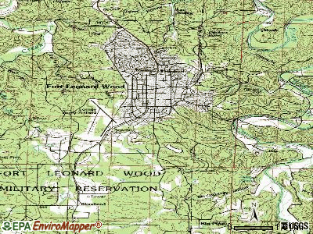
44
.
17
7th Cm Co
2/3 ADA
.
2/10 Inf Bn
GN
84th Cm Bn
.
.
.
o
90 /11 kph
A- Strike SN
D- D/T Attack
F- Loc of Attack
I- Agent
Map Name
Map Series
Map scale
3/10 Inf Bn
3rd Cm Bde
703rd MSB
27
1/48 Inf Bn
.
26
05
06

Slide 31
Check on Learning
Question: How Often is the CBRN 3 re-evaluated?
Answer: Every two hours, based on the CDM.
Question: Why is the CBRN 3 safe-sided?
Answer: To ensure a significant military hazard does not exist outside the predicted area.
Question: Why are grid reference points placed on the overlay?
Answer: To ensure you place the overlay on the map correctly

Slide 32
Learning Step/Activity 6
Practical Exercise
Plot a CBRN 3 Report

Slide 33
PE-PLOT CBRN 3 REPORT
CBRN 3 Chemical Report
C111
D. 250900LMAR2013
WB69008100
Nerve, V, Air, P
MR. Liquid
PA. Attack Area 2-4 days; Hazard Area 1-2 days
PX. WB68458187/WB68008075/WB69558185/WB71606855/WB81807815
Y. 135/012
Z. 4/15/6/-/2//

Slide 34
PE- Plot a CBRN 3 Report #2
CBRN 3 Chemical Report
C112
D. 141800ZFEB2011
WB74807730
Nerve, V, Air, P
MR Liquid
PA. Attack Area 2-4 days; Hazard Area 1-2 days
PX. 010
Y. 090/007
Z. 4/15/6/-/2//

Slide 35
Check on Learning
Question: If you have 010 on line PX of a CBRN 3 what type of plot do you have?
Answer: Circle plot
Question: What is the first step in plotting a CBRN 3 report?
Answer: Plot Foxtrot on the map or overlay
Question: What is the size of the Attack Area circle around Foxtrot?
Answer: 2 km radius

Slide 36
CBRN 4 Report
Compiled by recon and survey teams at the source of contamination.
Used to create CBRN 5 Reports.
Sent when a unit encounters an agent during its mission.
Lines Q, R, and S are required for Nuclear
Lines IR, Q,R, and S are required for Radiological
Lines I, Q, and S are required for Chemical and Biological.

Slide 37
Prepare CBRN 4 Report
Prepare a CBRN 4 Report
Follow format in GTA 03-06-008
Submit completed CBRN 4 report using any means possible

Slide 38
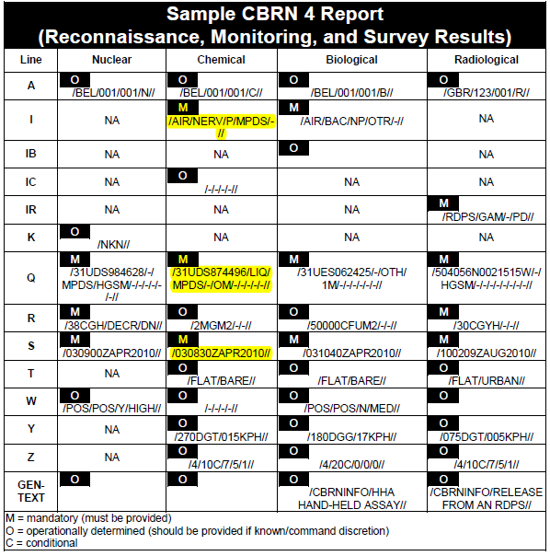

Slide 39
Example of a CBRN 4 Report
LINE CHEMICAL
I Air, Nerve, G, NP, MPDS
Q LB200300, Air
S 170610ZJAN2013
Repeat lines I, Q, and S as often as needed
Line Q must include type of sample (e.g., air, vapor, liquid, solid)

Slide 40
Check on Learning
Question: Who submits the CBRN 4 report?
Answer: Recon and Survey Team
Question: What are the CBRN 4 reports used for?
Answer: Used to create the CBRN 5 report
Question: What format is followed to create the CBRN 4 report?
Answer: GTA 03-06-008

Slide 41
CBRN 5 Report
Provides boundaries of actual contamination.
Best sent as an overlay or fax.
Sent after completion of decon missions.
First and last coordinates are the same.
Lines A, I, O, and XA are the required lines for Chemical and Biological reports
Lines A, O and XA are required for Nuclear
Lines A, IR, O, and XA are required for Radiological

Slide 42
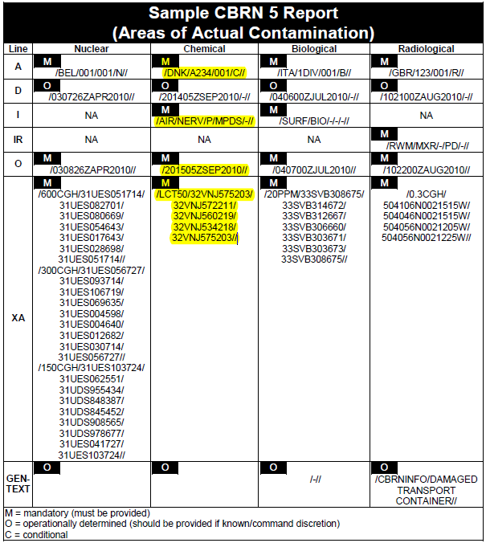

Slide 43
CBRN 5 Report
LINE CHEMICAL
A C112
I Nerve, V, P, Air
O 201005ZJAN2013
XA ND206991/ND201576/ND200787/
ND206991

Slide 44
Steps to Plot CBRN 5 Report
Plot an CBRN 5 Report Steps
Plot coordinates from line XA
Connect these points with a smooth, yellow curved line; shade area lightly in yellow
Write marginal data
Plot two grid reference points on the overlay
Brief supervisor as required

Slide 45
CBRN 5 (Example Plot)
Points plotted from line XA of the CBRN 5 report
XA
XA
XA
XA
XA
XA
XA
XA
XA
XA
XA

Slide 46
MARGINAL DATA CBRN 5
Must Include:
Line A (Strike Serial #)
Line D (Date/Time of Attack)
Line I (Type of Agent)
Line O (Date/Time of Contour Line)
Map Name and Series
Map Scale

Slide 47
44
2/10 Inf Bn
17
2/3 ADA
7th Cm Co
3rd Cm Bde
.
703rd MSB
84th Cm Bn
.
.
.
.
.
.
A- Strike SN
D- D/T Attack
I- Agent
O-D/T Contour line
Map Name
Map Series
Map scale
3/10 Inf Bn
.
.
.
.
1/48 Inf Bn
27
26
05
06

Slide 48
Check on Learning
Question: What is the purpose of the CBRN 5 Report?
Answer: Provides boundaries of actual contamination
Question: What line in the CBRN 5 Report shows the actual contaminated area boundary coordinates?
Answer: XA
Question: When plotted on the map overlay, what color is used to indicate area with chemical contamination?
Answer: Yellow

Slide 49
Learning Step/Activity 9
Practical Exercise #3
Plot a CBRN 5 Report

Slide 50
PE –Plot a CBRN 5 Report
LINE CHEMICAL
A C201
D 030900LJUN2011
I Nerve, V, Air Burst, P
O 061005MAR09L
XA WB68258155 / WB68058105 / WB68208020 / WB68787975 / WB70007970 / WB70708020 / WB71378055 / WB71008120 / WB70058155 / WB69108185 / WB68258155

Slide 51
Check on Learning
Question: When preparing a CBRN 5 Report, What CBRN reports are used to supply individual coordinates of contaminated areas?
Answer: CBRN 4
Question: Which is the preferred method of distributing the CBRN 5 chemical report?
Answer: Fax or Overlay
Question: What format is followed when preparing a CBRN 4 report?
Answer: GTA 03-06-008
Question: What is unique about the first and last coordinates given on line XA of the CBRN 5 report?
Answer: They are the same

Slide 52
Summary
CBRN Reports Overview
Preparing CBRN 1 Report
Preparing CBRN 4 Report
Interpreting CDM
Plotting CBRN 3 Report
Plotting CBRN 5 Report

Slide 53
Performance test
Plot CBRN 3
Plot CBRN 5

