Slide 1
CBRN Warning and Reporting System (CBRNWRS)
FM 3-11.3, Chap 3, pg III-7
GTA 03-06-008
Standardized System
Six Reports

Slide 2
CBRN Warning and Reporting System (CBRNWRS)
CBRN-1: Observers Report
CBRN-2: Evaluated Data
CBRN-3: Immediate Warning of Expected Contamination
CBRN-4: Survey and Monitoring Data
CBRN-5: Actual Contamination
CBRN-6: Detailed Information on Attacks

Slide 3
Prepare and Submit CBRN 1 Chemical Report
CBRN 1 Report
Observers Report or Initial Use Report
Gives basic and follow up data about the CBRN attack.
Sent by Platoons and Companies to BN HQ or by Designated Observers to Division CBRN Centers (CBRNC)

Slide 4
CBRN 1 REPORT
The CBRNWRS is the primary means of warning units of an actual or predicted contamination hazard.
Allows units to determine protective measures and plan operations.
Units use info to take action

Slide 5
CBRN 1 REPORT
The CBRN 1 report is the most widely used of the six CBRNWRS reports.

Slide 6
CBRN 1 REPORT
Control party and leaders must be familiar with the CBRN 1 Report and the information in it.
Commands must consolidate reports and decide which CBRN 1 report to forward.
This reduces the number of reports to a manageable level.

Slide 7
CBRN 1 REPORT
The unit CBRNC is responsible for ensuring the report is in the correct format.
This report must be prepared quickly and accurately.
CBRN 1 Reports are not routinely passed to CORPS or higher CBRNC except for initial use report.

Slide 8
CBRN 1 REPORT
Precedence
FLASH
IMMEDIATE
Routine
The first NBC-1 Chemical Report of an attack in the theater is sent FLASH!

Slide 9
CBRN 1 REPORT
Types of CBRN 1 Reports:
Initial – first report sent with basic info
Subsequent- any follow-up report for a given attack

Slide 10
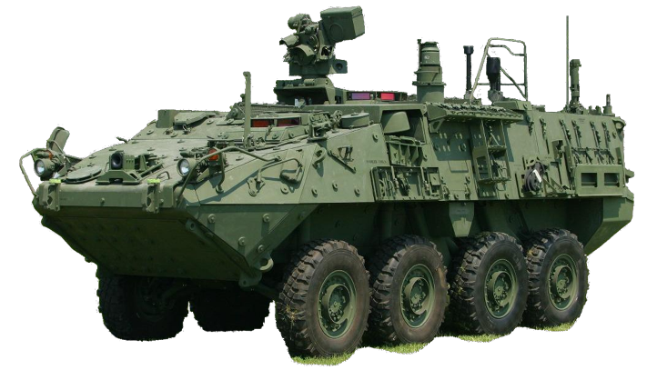
CBRN 1 REPORT Designated Observers
Only those units with the equipment to make the most accurate observations meet the criteria to become designated observers.
STRYKER NBCRV

Slide 11
CBRN 1 REPORT
Formatting Lines
Mandatory lines
Operationally Determined lines
Conditional lines
D / 210615ZJUL2010 / 210655ZJUL2010 //
(D – date/time start and end of attack)
FM 3-11.3, Chap 3, pg III-7
Table III-2, Table III-3 and Table III-4

Slide 12
CBRN 1 REPORT
Procedures to prepare a CBRN 1 Report
Fill out required information:
Line B-(M) Location of Observer ,use grid coordinates or place name and direction to attack – B/14SPJ645208/45DGG//
Line D- (M) Date-time group of the attack ,specify Local or Zulu time – D/210615ZJUL2009//
Line F- (O) Location of attack or event – F/14SPJ620210/EE//

Slide 13
CBRN 1 REPORT
Procedures to prepare a CBRN 1 Report
Line G- ( ) Delivery and Quantity Information – G/OBS/AIR/1/BOM/UNK//
Line I- ( )Release Information – I/SURF/NERV/P/MPDS//
GENTEXT (O) – Additional Info/Remarks
M
M

Slide 14
Sample Report
From:
To:
Precedence:
Security Classification:
DTG Sent:
Category of Report:
A Co, 1/1 AV
HQ 1/1 AV
FLASH
FOUO
210615ZJUL2009
Initial

Slide 15
Sample Report
B-Position of observer Direction of Attack:
D- DTG of attack (and end):
F-Location of Attack:
G-Delivery and Quantity Information:
I-Release Information:
T-Terrain/Topography and Vegetation Description:
B/14SPJ640123/090DGG//
D/210602ZJUL2009//
F/14SPJ638129/EE//
G/OBS/AIR/1/BOM/1//
I/SURF/-/NP/-//
T/FLAT/WOODS//

Slide 16
Sample Report
Sample reports are located in Appendix E of FM 3-11.3
NBC Report Templates are located in Appendix L (Reproducible Example Forms) of FM 3-11.3

Slide 17
CBRN 1 REPORT
Submit CBRN 1 Report to next higher echelon IAW unit SOP. SOP directs who sends the report.
All units submit the CBRN 1 Report to their higher HQs.
All units make observation, record the data in
proper format, and use the info for their own operational planning.

Slide 18
CBRN 1 REPORT
Designated Observers will submit directly to Division CBRN Center first, then send the report through their normal chain.
Do not “split up” reports
Consolidate multiple reports, then send only one to next level

Slide 19
Questions? >Practical Exercise<

Slide 20
PREPARE A CHEMICAL DOWNWIND HAZARD PREDICTION

Slide 21
Prepare a Chemical Downwind Hazard Prediction
All Hazard Predictions…
1. Are an approximation
2. Are Safe-Sided
3. Provide info to CDRs for planning
4. Anyone can do one!

Slide 22
Prepare a Chemical Downwind Hazard Prediction
Types of Hazard Prediction:
First, go to:
FM 3-11.3, Appendix E, page E-7, Table E-1

Slide 23
Prepare a Chemical Downwind Hazard Prediction
Type A Attacks
Type A attacks are Non-Persistent
Air contaminating agents
Ground bursting munitions

Slide 24
Prepare a Chemical Downwind Hazard Prediction
Type B Attacks
Type B attacks are Persistent
Ground contaminating agents
Air bursting munitions and Spray

Slide 25
Prepare a Chemical Downwind Hazard Prediction
Type C Attacks
Unobserved attacks
Usually found during recon or surveys
Any windspeed, case is N/A

Slide 26
Prepare a Chemical Downwind Hazard Prediction
Information needed to make a Simplified Prediction
a. A CBRN 1 or CBRN 2 Chemical Report.
AND
b. Chemical Downwind Message (CDM)
The CDM is valid for 6 Hours!
OR: A CBRN-2 with Lines Y and Z

Slide 27
ZM/210530ZAPR2008/210600ZAPR2008/211200ZAPR2008// V CORP WM/075/016/4/35/6/0/0// XM/080/014/4/37/6/0/0// YM/127/026/2/19/8/9/2// (Sample CDM in Appx D, pg D-32)
SAMPLE REPORT CHEMICAL DOWNWIND MESSAGE

Slide 28
PLOT A CBRN 3 REPORT
Purpose and importance of a CBRN 3 Report:
The CBRN 3 Report is a prediction, a plot
The CBRN 2 reports are used to create the CBRN 3 Report.
Each unit plots the CBRN 3 and disseminates the report
The Report warns commanders

Slide 29
PLOT AN CBRN 3 REPORT
Prepare a CBRN 3 Chemical Report:
The CBRN 3 plot will override any previous simplified prediction done with the CBRN 2 and CDM
It is an Immediate Warning of Expected Contamination

Slide 30
CBRN 3 REPORT
The Report may include the following line items:
A - Strike Serial Number (M)
D - Date Time group for start/end of attack (M)
F - Location of area attacked (M)
G – Delivery/Quantity Info (O)
I – Release Info (M)

Slide 31
CBRN 3 REPORT
The Report may include the following line items:
O – Reference Date/Time (O)
PA – Atack Area Radius, Downwind Distance, Hazard Duration (M)
PX – Weather Period, Hazard Area Coordinates (M)
XB – Predicted Contour Info (C)
Y, Z, GENTEXT are all optional

Slide 32
CBRN 3 REPORT
Sample NBC 3 Reports (Type A, case 2)
A/US/A23/001/C//
D/271647ZAPR2011//
F/32UPG560750/AA//
I/SURF/NERV/NP//
PA/01KM/-/10KM/-//
PX/271600ZAPR2011/
32UPG674791/
32UPG557759/
32UPG550752/
32UPG552742/
32UPG638657//

Slide 33
CBRN 3 REPORT
Sample NBC 3 Reports (Type B, case 1)
A/US/A23/001/C//
D/271630ZAPR2010//
F/33UUB206300/AA//
I/AIR/NERV/P//
PA/01KM/2-4DAY/10KM/1-2DAY//
PX/271600ZAPR2011//

Slide 34
CBRN 3 REPORT
Questions?
Practical Exercise

