Slide 1
CBRN RECONNAISSANCE
FM 3-11.19

Slide 2
CBRN RECONNAISSANCE
Contamination Avoidance Measure
Provides CDRs with info for their AO
5 Tasks:
Detection, Identification, Marking, Reporting, Sampling

Slide 3
CBRN RECONNAISSANCE
Chemical Surveys:
Required when the CDR needs info on the size of a contaminated area
When tasked by higher HQs
Prime interest is determining how large the contaminated area is

Slide 4
CBRN RECONNAISSANCE
Time is a major factor
Primary concern are areas with persistent agents
The majority of the testing done will be with M8 detection paper.

Slide 5
CBRN RECONNAISSANCE
May also use:
M256A1 Sampler Packet
ICAM
JCAD
Helps confirm and/or verify results

Slide 6
CBRN RECONNAISSANCE
Survey Tasks:
Locate Boundaries
Emplace Markers
Determine Intensities
Report

Slide 7
CBRN RECONNAISSANCE
Considerations:
What is the Agent?
Is there a mixture of agents?
How much time is available?
Two Types of Surveys:
Complete and Incomplete

Slide 8
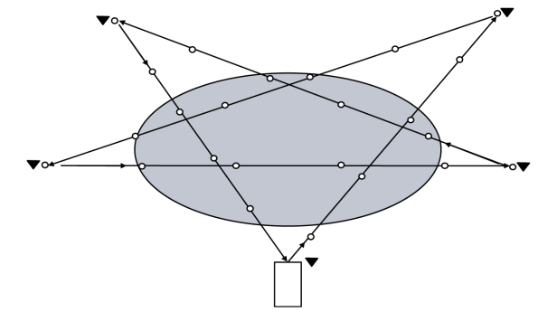
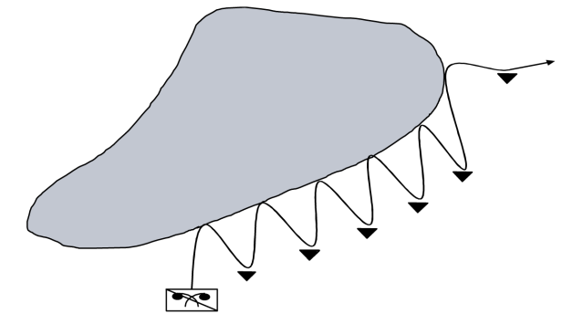
CBRN RECONNAISSANCE
SurveyTechniques:
Nearside – Farside
Box
Star
Bounce-and-Bypass

Slide 9
CBRN RECONNAISSANCE
Results can determine bypass options
Informs units to avoid
Can also be used to find clean areas within the contaminated area.

Slide 10
CBRN RECONNAISSANCE
Marking Contaminated Areas:
Signs used are standard NATO
Ensure the marker is facing away from the contaminated area.

Slide 11
CBRN RECONNAISSANCE
Required information on markers:
Agent name if known
Date/Time agent was detected

Slide 12
CBRN RECONNAISSANCE
Attach the marker to objects, such as trees or poles
Easily visible from all probable routes
Place adjacent markers so they are in sight of each other

Slide 13
CBRN RECONNAISSANCE
Recording and Reporting:
Use chemical survey data form to record (FM 3-11.3, App L, page L-4)
Information that must be included:
Location and Time of Test
Type of detector
Agent

Slide 14
CBRN RECONNAISSANCE
Survey data sheet can be hand carried and passed on
Or use CBRN-4 report to send up fast

Slide 15
CBRN RECONNAISSANCE
CBRN 4 Chemical Report information:
Precedence (normally IMMEDIATE)
Date/Time
Security Classification
From
To
Type of Report
see FM 3-11.3, App E, pg E-53 and App L, pg L-19

Slide 16
CBRN RECONNAISSANCE
CBRN 4 lines:
Line A – Strike serial number (O)
Line I – Release Info (M)
Line Q – Location of detection/Sample Type/Method of Detection (M)

Slide 17
CBRN RECONNAISSANCE
Line R – Level of contamination (O)
Line S – Date/Time of detection (M)
Line W – Sensor Info (O)
Line Y – Wind direction/speed (O)

Slide 18
CBRN RECONNAISSANCE
Line Z – Weather Info (O)
GENTEXT – Remarks/additional info (O)
_________________________________________________________________
Always include
India, Quebec, Sierra
On CBRN 4 Report

Slide 19
CBRN RECONNAISSANCE
Sample Report:
CBRN – 4 Chemical Report
IMMEDIATE
I/UNK/NERV/P//
Q/27JMN419273/LIQ/MSVY//
S/231015ZMAR2011//

Slide 20
EXERCISE
You are the leader of a chemical survey team. Your team went to the following locations at the times indicated on 14 March 2002. (All times are ZULU time).At each location testing was done with M8 paper as well as M256 Kit Sampler Packets. V Nerve agent was detected and identified at each location. Using this data, format a CBRN-4 Chemical Report.
Location Time
NB 400305 0815
NB 411309 0840
NB 421311 0905
NB 429319 0930
NB 432325 0955

Slide 21
EXERCISE
CBRN 4 Chemical Report IMMEDIATE
H Nerve, V
Q NB400305, Liquid, air
S 140815Z
H Nerve, V
Q NB411309, Liquid, Air
S 140840Z
H Nerve, V
Q NB421311, Liquid, Air
S 140905Z
H Nerve, V
Q NB429319, Liquid, Air
S 140930Z
H Nerve, V
Q NB432325, Liquid, Air
S 140955Z

Slide 22
CBRN RECONNAISSANCE
Survey teams prepare and submit CBRN 4 to the control party.
Control parties forward survey data to the CBRNC.

Slide 23
CBRN RECONNAISSANCE
CBRNC consolidates info from CBRN 4
That Info becomes the CBRN 5 Report
The CBRN 5 is sent to all units

Slide 24
I/AIR/NERV/P// CBRN – 5 Report
Q/14SNB400305/LIQ/MSVY//
S/140815ZMAR2011// A/US/012/001/C//
D/140325ZMAR2011//
I/AIR/NERV/P// I/NERV/P//
Q/14SNB411309/LIQ/MSVY// O/140930ZMAR2011//
S/140840ZMAR2011// XA/-/14SNB400305/
14SNB411309/
I/AIR/NERV/P// 14SNB421311/
Q/14SNB421311/LIQ/MSVY// 14SNB429319//
S/140905ZMAR2011//
I/AIR/NERV/P//
Q/14SNB429319/LIQ/MSVY//
S/140930ZMAR2011//

Slide 25
CBRN- 4 Report
I/AIR/NERV/P// CBRN – 5 Report
Q/14SNB400305/LIQ/MSVY//
S/140815ZMAR2011// A/US/012/001/C//
D/140325ZMAR2011//
I/AIR/NERV/P// I/NERV/P//
Q/14SNB411309/LIQ/MSVY// O/140930ZMAR2011//
S/140840ZMAR2011// XA/-/14SNB400305/
14SNB411309/
I/AIR/NERV/P// 14SNB421311/
Q/14SNB421311/LIQ/MSVY// 14SNB429319//
S/140905ZMAR2011//
I/AIR/NERV/P//
Q/14SNB429319/LIQ/MSVY//
S/140930ZMAR2011//

Slide 26
CBRN RECONNAISSANCE
Plotting the CBRN 5
Lines in a CBRN 5:
A- Strike Serial Number (M)
D- Date/time of attack (O)
I- Release Info (M)

Slide 27
CBRN RECONNAISSANCE
O - Reference time (M)
XA - Area of actual contamination (M)
GENTEXT – Remarks/Additional Info (O)

Slide 28
CBRN RECONNAISSANCE
Marginal information that should be recorded on the CBRN 5 report overlay once plotted.
a. Unit (that completed survey)
b. Line Alpha
c. Line Delta

Slide 29
CBRN RECONNAISSANCE
d. Line India
e. Line Oscar
f. Grid reference points
g. Date and time prepared

Slide 30
CBRN RECONNAISSANCE
A properly plotted CBRN 5 Chemical Report
CBRN 5 CHEMICAL
Immediate
A/US/C001/001/C//
D/030930ZMAR2011//
I/-/NERV/P//
O/031345ZMAR2011//
XA/-/14SEG574826/14SEG579822/14SEG584824/
14SEG584832/14SEG582839/14SEG577843/
14SEG571841/14SEG567837/14SEG568834/
14SEG573830/14SEG574826//

Slide 31
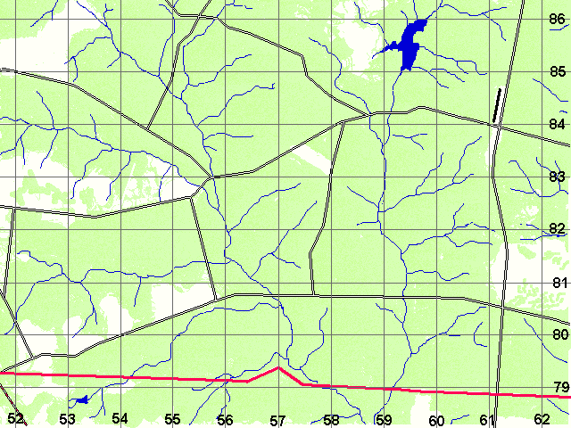
CBRN 5 CHEMICAL REPORT
CBRN 5 CHEMICAL
Immediate
A/C001/001/C//
D/030930ZMAR2011//
I/-/NERV/P//
O/031345ZMAR2011//
XA/-/14SEG574826/
14SEG579822/
14SEG584824/
14SEG584832/
14SEG582839/
14SEG577843/
14SEG571841/
14SEG567837/
14SEG568834/
14SEG573830/
14SEG574826//
All Points Must Be Plotted
Connect with ONLY ONE, SMOOTH, FLOWING line
86
52
1 ID
A/C001/001/C// D/030930ZMAR2011//
I/-/NERV/P//
O/031345ZMAR2011//
Map Scale: 1:50,000
Prepared 031410ZMAR2011
Valid through 251930Z
62
79

Slide 32
CBRN 5 CHEMICAL REPORT
86
52
1 ID
A/C001/001/C// D/030930ZMAR2011//
I/-/NERV/P//
O/031345ZMAR2011//
Map Scale: 1:50,000
Prepared 031410ZMAR2011
Valid through 251930Z
62
79

Slide 33
CBRN RECONNAISSANCE
CONTOUR LINES.
A line representing an imaginary line on the ground.
It’s a boundary
Contour lines are either open or closed.

Slide 34
CBRN RECONNAISSANCE
Closed contour lines form a complete circle.
First and Last grid coordinates will be the same.
Example Line XA AY 123456 First
AY 145621
AY 123456 Last

Slide 35
CBRN RECONNAISSANCE
Open: The first and last grid coordinates will be different.
Occurs when survey personnel encounter some type of obstacle or area that cannot be surveyed.
Example: Line XA: AY 123456 First
AY 123462
AY 156234
AY 162345 Last

Slide 36
CBRN RECONNAISSANCE
QUESTIONS?

Slide 37
CBRN DECONTAMINATION
FM 3-11.5

Slide 38
Identify forms and hazards of contamination
Characteristics of Contamination:
Forms of contamination:
Vapors
Liquids
Aerosols
Solids

Slide 39
Identify forms and hazards of contamination
Vapors/Gases –
Either directly on the target or upwind
Affected by the weather
Can cover large areas.

Slide 40
Identify forms and hazards of contamination
Liquids –
Generally delivered in a mist or rain that falls to the ground.
Can be in aerosol form
Viscosity differs greatly – thin to thick

Slide 41
Identify forms and hazards of contamination
Aerosols –
Liquid or solid particles suspended in the air.
Behave much like vapors.

Slide 42
Identify forms and hazards of contamination
Solids –
Include nuclear fallout and dusty agents
Can be in aerosol form

Slide 43
Identify forms and hazards of contamination
Contamination hazards
Transfer – Pick it up and move it from one surface to another.

Slide 44
Identify forms and hazards of contamination
Spread –
Spread contamination around on the same surface and you increase the size of the contaminated area.

Slide 45
Identify forms and hazards of contamination
Desorption –
Liquid contamination will absorbs into porous surfaces.
Then it begins to desorb or give off gas

Slide 46
Identify forms and hazards of contamination
Vapor/Aerosols –
Can be carried through the air
Will disperse rapidly so there is no need to decon.

Slide 47
Identify forms and hazards of contamination
Methods of contamination detection:
M4 JCAD
Chemical Agent Monitor (ICAM)
AN/VDR2 RADIAC Set

Slide 48
Identify forms and hazards of contamination
M256A1 Chemical Agent Detector Kit
M8 Detector Paper
M9 Detector Paper

Slide 49
Identify the purpose of decontamination
Purpose of Decontamination:
Decontamination is a permanent solution to contamination. It is the removal, destruction or neutralization of contamination.

Slide 50
Decontamination
Principles of decontamination
Decontaminate as soon as possible
Makes decon easier
Gets you out of MOPP sooner
If you wait, you might die

Slide 51
Decontamination
Decon only what is necessary
You have limited resources
Don’t squander them on unnecessary items

Slide 52
Decontamination
Decontaminate by Priority
CDRs determine what gets deconned first to last
Put in SOP
Priorities set at all levels (Co, Bn, Bde…)

Slide 53
Decontamination
Limited Area
Begin decon where the contamination occurs
Allows decon to begin earlier
Limits spread and transfer

Slide 54
Describe decontamination levels
Decontamination Procedures
Levels of Decontamination:
IMMEDIATE DECON
OPERATIONAL DECON
THOROUGH DECON

Slide 55
Describe decontamination levels
There are three Immediate Decon techniques:
skin decon
personal wipe down, and
operator wipe down.
FM 3-11.5, Chap III

Slide 56
Describe decontamination levels
Skin decontamination –
Life saving procedure
Use M291 SDK or RSDL
MUST begin within 1 minute

Slide 57
Describe decontamination levels
Personal Wipe Down –
Removes or neutralizes contamination on hood, mask, gloves and weapon.
Use M295 IEDK
Do within 15 minutes
Use CAM or M8 paper to check

Slide 58
Describe decontamination levels
Operator Wipe Down –
Decon controls, handles, steps, seats, etc
Determine areas with M8 and CAM
Do within 15 minutes
Use M13, M100, STB

Slide 59
Describe decontamination levels
OPERATIONAL DECON –
Sustains operations
Reduces contact hazard and limits spread
Reduces the duration of wearing MOPP
FM 3-11.5, Chap IV

Slide 60
Describe decontamination levels
OPERATIONAL DECONTAMINATION
MOPP Gear Exchange
and
Vehicle Washdown
MOPP Gear Exchange and Vehicle Washdown best within 6 hours

Slide 61
Describe decontamination levels
OPERATIONAL DECONTAMINATION is performed in 3 Phases
Preparation -
Starts with the decision to decon
Ends with site ready for decon

Slide 62
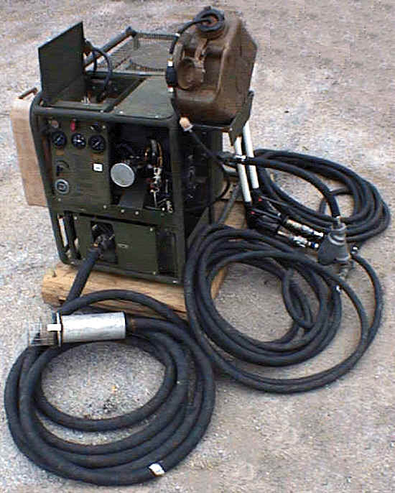
Describe decontamination levels
Coordination includes:
ID link up point
Who will provide the PDDE (Power Driven Decon Equipment)
Number of vehicles and people
Site selection is done by the controlling HQ.

Slide 63
Describe decontamination levels
Site may have been designated in the operation order (OPORD)
Selected based on the current METT-TC.

Slide 64
Describe decontamination levels
Linkup includes:
Establish security
Positioning marshalling areas Camouflaging removal points
Controlling traffic
Ensuring unit supply has replacement MOPP gear.

Slide 65
Describe decontamination levels
Execution:
Starts with establishing positive control
Ends with processing the last vehicle and soldier

Slide 66
Describe decontamination levels
Assistant driver leaves vehicle and goes to the MOPP gear exchange point
Contaminated unit provides security.
Vehicles get 2-3 min washdown
Remaining crew to MOPP gear exchange after washdown

Slide 67
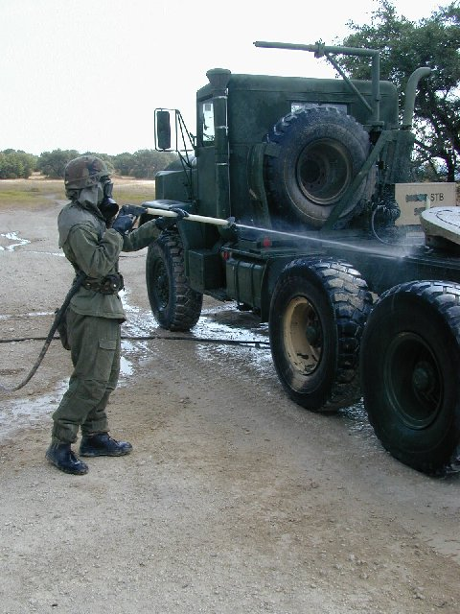
Describe decontamination levels
Vehicle Washdown
Unsupported
Contaminated unit uses it’s own equipment
Supported
Uses organic equip or support from a chem company.

Slide 68
Describe decontamination levels
MOPP Gear Exchange –
Buddy
Triple-Buddy
Individual
Should be done in 6 hours
Squad size element best

Slide 69
Describe decontamination levels
Video
MOPP GEAR EXCHANGE

Slide 70

Describe decontamination levels

Slide 71
Describe decontamination levels
When the squad or crew has finished:
Remount vehicles
Moves to an after decon AA
Await further instructions
Moves to next battle position.

Slide 72
Describe decontamination levels
Site Clearance:
Cleanup
Marking
Reporting
METT-TC dictates cleanup

Slide 73
Describe decontamination levels
Contaminated waste may be stored, buried, or burned
Site is marked and reported

Slide 74
Describe decontamination levels
Contaminated unit is responsible for the decon of its soldiers and equipment.
BN TOC coordinates the operational decon

Slide 75
Describe decontamination levels
THOROUGH DECONTAMINATION:
Detailed Equipment Decon (DED)
and
Detailed Troop Decon (DTD).
FM 3-11.5, Chap V

Slide 76
Describe decontamination levels
THOROUGH DECON –
Reduce or eliminate the need for protective clothing
Carried out with assistance from chem units
Reduce contamination to the lowest possible level.

Slide 77
Describe decontamination levels
They restore combat power by removing nearly all contamination from unit and individual equipment so that troops can operate safely for extended periods at reduced MOPP levels.

Slide 78
Describe decontamination levels
Combat support services (CSS):
Replenish combat stocks
Refit equipment
Replace personnel
and equipment as required.

Slide 79
Describe decontamination levels
Thorough decon performed in 3 phases
Preparation –
Subordinate units review their higher HQ’s decon plan
The decon unit determines support needed
Execution – Decon operations begin

Slide 80
Describe decontamination levels
Site Clearance –
Decon area is closed
All vehicles and personnel have been processed

Slide 81
Questions? For Now…

Slide 82
DECONTAMINATES FM 3-11.5, App C

Slide 83
Describe decontamination levels
Video
M100 Decon System

Slide 84
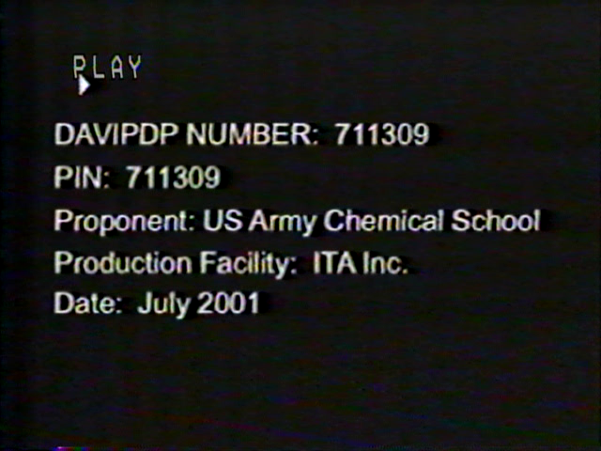
Describe decontamination levels

Slide 85
Describe use of decontaminants
Natural Decontaminants:
Weathering/Aging –
Works through evaporation and decomposition
Effects dependent on persistency, climate and type of surface.

Slide 86
Describe use of decontaminants
Earth (cover,seal) –
Do not disturb
Can mix in STB
Can increase persistency
Monitor

Slide 87
Describe use of decontaminants
Fire –
Rapid, simple and effective
For non-mission essential items
Do not use fire if it reveals your location

Slide 88
Describe use of decontaminants
Water –
Removes fallout and bio agents
Ineffective on some chem
Heat/Add soap increases effectiveness
Runoff may contaminate

Slide 89
Describe use of decontaminants
Soil –
Depends on composition
Can be an absorbant
Can increase vapor hazard
Soil becomes contaminated

Slide 90
Describe use of decontaminants
Standard decontaminants-
STB–
Neutralizes Agents
Corrosive
High Chlorine content
Can be exothermic

Slide 91
Describe use of decontaminants
High-Test Bleach (HTH) –
Neutralizes agents
Corrosive
Can be exothermic
Higher chlorine than STB

Slide 92
Describe use of decontaminants
Reactive Sorbent Powder–
Alluminium Oxide + Activated Carbon
M100 SDS
Neutralizes agents
Absorbant

Slide 93
Describe use of decontaminants
Miscellaneous decontaminants:
Soap –
Can neutralize some agents
Good for personnel
Runoff can be contaminated

Slide 94
Describe use of decontaminants
Caustic Soda (sodium hydroxide/lye) –
Neutralizes G agents on contact
Exothermic
Mist/vapors toxic
Burns skin

Slide 95
Describe use of decontaminants
Washing Soda (sodium carbonate) –
Recommended for G agents
Limited effectiveness on others

Slide 96
Describe use of decontaminants
Ammonia/Ammonia Hydroxide–
Effective for several agents
Acts slower than caustic soda

Slide 97
Describe use of decontaminants
See FM 3-11.5, App C
Standard Decontaminates – Table C-6
Misc/Non-Standard - Table C-7
Natural - Table C-8

Slide 98
Describe use of decontaminants
Radiological contamination –
Fallout – remove, seal, take away
Radiation – cannot decon
Biological Contamination-
STB, bleach, lye sanitizers

Slide 99
QUESTIONS?
About any CBRN topic since day 1?

