Slide 1
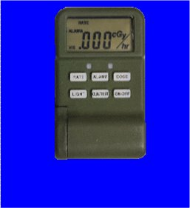
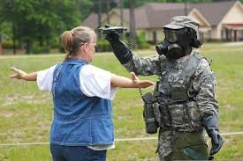
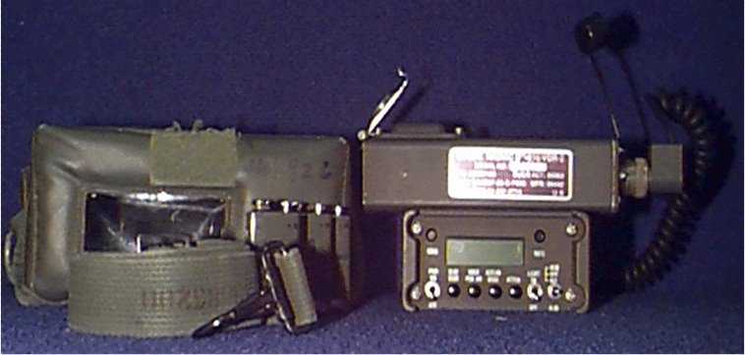
Radiological instruments

Slide 2
An/vdr-2 radiac set

Slide 3
An/vdr-2 description
Used to locate and measure gamma and detect beta radiation.
Lightweight, battery operated, and self testing.

Slide 4
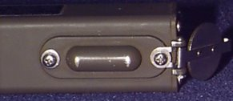
An/vdr-2
The high range detector contains 1 nanocurie of Thorium 232, and controlled disposal is required in accordance with AR 385-11.
Do not hold probe by the high range detector because potential biological (human tissue damage) hazard may exist.
When attaching probe to radiac meter, ensure that power switch is off. Damage may occur.
High Range Detector

Slide 5
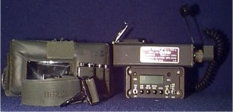
An/vdr-2 components
Pouch
Probe
Strap
Radiac meter
NOTE: Radiac meter and Probe are serialized and must be kept together as a set.

Slide 6
An/vdr-2 capabilities
Detects, measures, and displays gamma dose rates from .01Gy/hr to 100 Gy/hr. (Gray)
Detects, and displays beta dose-rates from .01 Gy/hr to 5cGy/hr. (Centigray)
Measures, stores, & displays accumulated dose (total dose) from .01 Gy to 9.99Gy.
__________
___________
Dose Rate: How much radiation one can expect to absorb in 1 hour. Useful for assessing immediate danger
Total Dose: How much total radiation one has absorbed. Important for tracking exposure against safety limits (OEG)

Slide 7
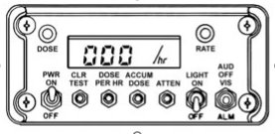
An/vdr-2 features
Liquid Crystal Display (LCD)
Vehicle Mountable: Can be used as a portable or vehicle-mounted system.
Display Functions:
Shows dose rate and accumulated dose values.
Displays battery condition, test information, and fault indicators.
Alarms:
Equipped with audible and visual alarms.
Independent preset levels for both dose rate and accumulated dose.
Alarms activate when preset radiation thresholds are exceeded.
Based on Operation Exposure Guidance (OEG)
Turnback Dose Rate

Slide 8
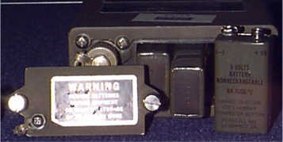
An/vdr-2 power sources
Main Power:
Uses three 9-volt batteries.
Provides approximately 100 hours of operating time under normal conditions.
Vehicle Power:
Can also operate from 24 VDC vehicle power using the appropriate power cable connection.
When battery life reaches about 10 hours remaining, the dose rate unit “/hr” on
the LCD will flash continuously.
Flashing will continue until batteries are fully depleted.
Will retain memory 5 min. after batteries are removed.

Slide 9
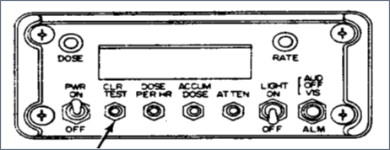
An/vdr-2 controls and indicators
Dose and Dose Rate Lights
Power On/Off
Alarm Switch

Slide 10
An/vdr-2 controls and indicators
Accumulated Dose
Light
Clear Test
Dose Per Hour
Attenuation

Slide 11
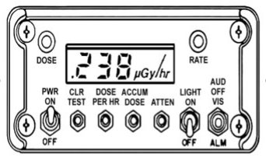
An/vdr-2 features
Decimal indicators - decimal points between numbers.
Digits (Numeral Segments) - The main numeric display is made up of illuminated segments that show the current dose rate or accumulated dose.
Dose units - The instrument automatically displays the correct
radiation unit based on the detected level:
μGy (microgray) for very low radiation levels.
cGy (centigray) for moderate levels.
Gy (gray) for high radiation levels.

Slide 12
Preoperational Test Procedures
Preoperational tests are performed to ensure the RADIAC set is operating correctly before a mission. The set is self-testing during operation and tests are performed automatically.
Operator performs this task before the AN/VDR - 2 is to be used.
1. Set Power to on.
2. Set ALM to AUD.
0.00 _{uGy}
55.5_{uGy}
3. Press & hold CLR/TEST button until alarm sounds for two seconds, then release.
11.1 _{uGy}
666 _{uGy}
4. Set ALM to Off, then VIS, the Dose & Rate Lights
will come on.
222 _{uGy}
77.7 _{uGy}
.333 _{uGy}
888 _{uGy}
5. Once the segment test is complete the unit will automatically go
through the Unit/Digit Test & Electrical Test.
4.44 _{uGy}
999 _{uGy}
6. Once You See the Flashing “9”, Press the CLR/TEST Button
7. The Tests are Complete
If all tests are ok, you will see a flashing “9”.
If there is a fault, you will see a flashing “1-8”.

Slide 13
Purpose of Preoperational test
Ensures the radiac meter and probe are fully operational.
Confirms battery condition and power connections.
Verifies that display indicators, alarms, and measurement functions are working correctly.
Identifies any fault codes or malfunctions before exposure to a radiation environment.

Slide 14
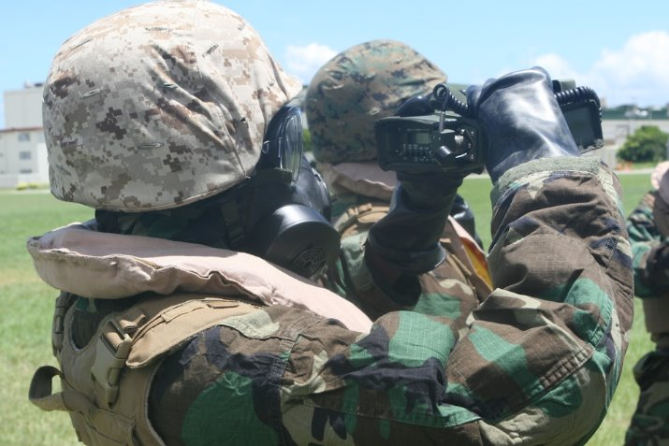
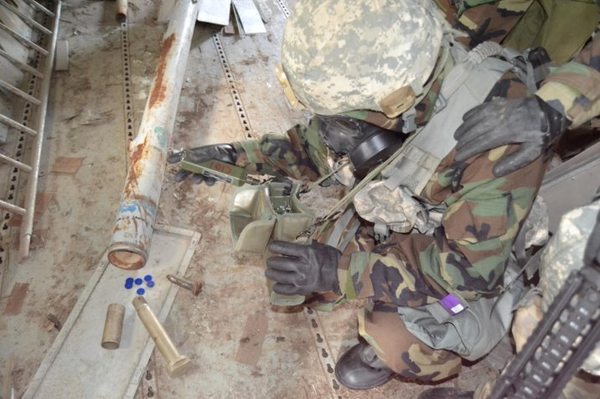
Equipment application
There are two methods used to locate radiological contamination:
Monitoring - is performed to determine the presence and intensity of residual radiation (It helps determine if radiation is present and measures its level).
Surveying – are conducted to find the extent (area) and intensity (strength) of contamination.

Slide 15
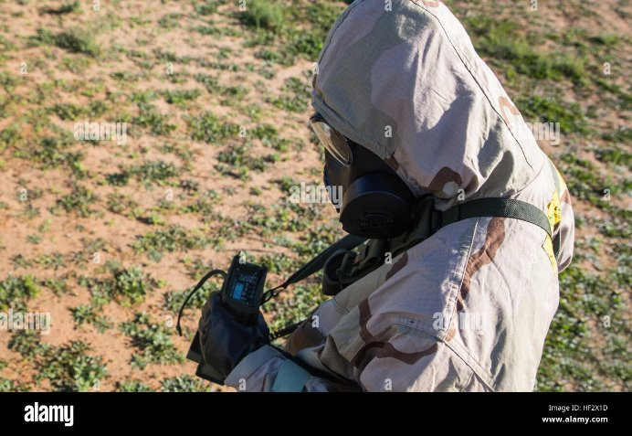
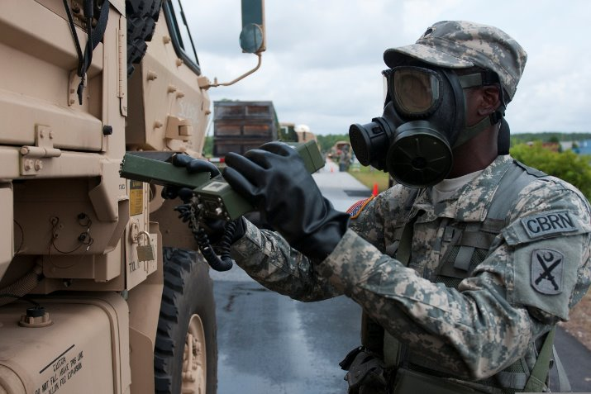
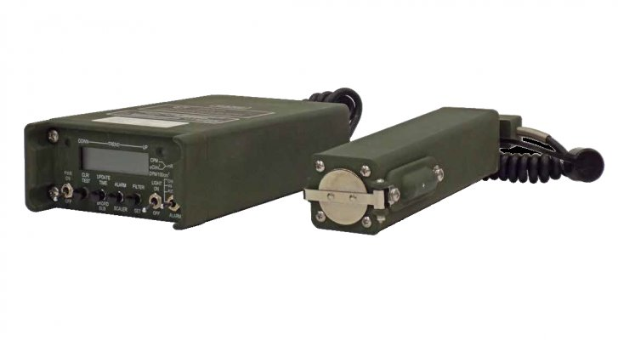
An/vdr-2 gamma survey
In both survey and monitoring modes, the operator wears the VDR-2 radiac meter in its carrying pouch with the power switch turned on.
The probe can either: be carried inside the pouch, or held in the hand, depending on the operator’s preference or mission needs.
The probe cover must be closed when measuring Gamma Radiation.
keeping the cover closed, the VDR-2 only measures Gamma radiation without interference from beta radiation.
Probe cover "Beta Shield"

Slide 16
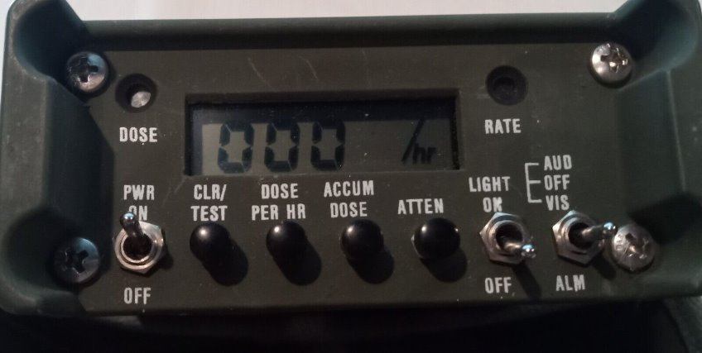
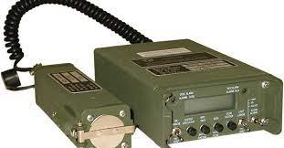
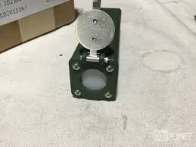
An/vdr-2 beta monitoring
When monitoring for Beta Radiation the probe must be hand held, and the probe cover open to allow beta particles to enter. Position the probe close to surfaces or suspected contamination areas.
When monitoring for Beta Radiation, the audible alarm set points should be used. This allows the operator to pay attention to the positioning of the probe rather than watching the visual display.
Set the alarm just above the background level.

Slide 17
Employment gamma survey
1: Positioning: Stand in the open, at least 10 meters away from large objects that could affect the reading.
Avoid shielding objects like buildings, vehicles, power lines, and trees.
2: Hold the radiac set at waist height.
The probe can either Remain in the pouch, or be handheld, depending on preference.
The strap is placed around the shoulder.
3: Slowly turn 360 degrees (a full circle) at a steady speed to detect radiation from all directions.
4: Record the highest reading displayed during the full turn. This represents the maximum gamma dose rate at that survey location.

Slide 18
monitoring
Contamination: Before something can be considered contaminated, a reading equal to or higher than twice the background must be obtained.
Any reading below the background reading, you may consider not contaminated.
Determine the background reading: Turn your back to or walk away from the suspected contamination.
Open Beta shield on the end of probe to allow detection of beta particles.
Observe reading for 5 to 10 seconds; record highest reading.
Multiply reading by 2; this is your background reading.
Any reading below this background threshold can be considered not contaminated.
Readings equal to or above this value indicate contamination and require further monitoring

Slide 19
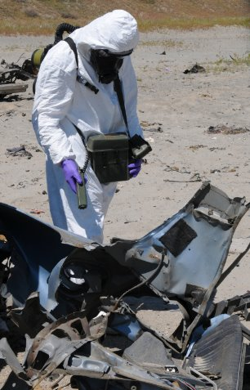
Monitoring equipment & supplies for beta & gamma
1: Take a Background Reading:
Open the Beta shield on the probe.
Take a background reading away from the suspected contamination area.
Record the background reading for reference.
2: Monitor the Suspected Surface:
Leave the shield open (to detect Beta and Gamma radiation).
Hold the probe approximately 1 inch from the surface.
Hold the probe perpendicular (at a 90-degree angle) to the surface and move the probe slowly across the surface — about 2 inches per second.

Slide 20
Monitoring equipment & supplies for beta & gamma
3: Evaluate the Reading:
Continuously observe the radiac meter display or listen for the audible alarm.
If the reading is higher than twice the background reading, contamination is
present.
4: Report the Results:
Accurately record your findings.
Report contamination locations, levels, and any actions taken.

Slide 21
Identifying types of radiation
What type of contamination:
Your background reading is .2 uGy/hr (microgray); multiply by .2 which gives you .4 uGy/hr.
Your open shield reading is .3 uGy/hr and the closed shield reading is .3 uGy/hr.
Both readings were not twice the background
No Contamination Present

Slide 22
Identifying types of radiation
What type of contamination:
Your background reading is .2 uGy/hr (microgray) X 2 is .4 uGy/hr.
Your open shield reading is 2.5 uGy/hr which is more than twice the background reading.
The closed shield reading is .2 uGy/hr.
It is not twice the background reading.
Beta contamination only
Since the open shield reading is above twice the background but the closed shield reading is below, the contamination is beta radiation only.

Slide 23
Identifying types of radiation
What type of contamination:
Your background reading indicates .2 uGy/hr. (microgray)
Your open beta shield reading indicates .8 uGy/hr. This reading does indicate twice the background.
Your closed shield reading indicates .8 uGy/hr. The reading is at least twice the background reading.
The readings are identical so there is no beta radiation.
Gamma contamination only
No Beta radiation is present (if Beta were present, the open shield reading would be higher than the closed shield reading).

Slide 24
Identifying types of radiation
What type of contamination:
Your background reading is .2 uGy/hr (microgray) x 2 is .4 uGy/hr.
Your open shield reading is 3.4 uGy/hr which is more than twice the background reading.
The closed shield reading is 2.2 uGy/hr.
It is also twice the background.
Beta & Gamma contamination
If the open reading is higher than the closed reading, the difference is caused by beta radiation, meaning beta + gamma contamination. Both are twice the background.

Slide 25

Monitoring personnel
a. Take a background reading; note the reading.
b. Have the person to be monitored stand straight with feet apart, arms extended sideward with palms up and fingers straight.
c. Hold the probe about one inch away while passing it overboth hands (with palms up) and arms; then repeat with palms turned down.
d. Pass the probe over the entire front of the body, starting at the top of the head;
check hair, forehead, nose, lips, neckline, torso, knees, and ankles. Pay particular
attention to hairy and oily portions of the body (these can trap radioactive particles).

Slide 26
Monitoring personnel
e. Repeat the process from head to ankles over the back of the individual. Monitor the sole of each foot (contamination often collects there).
f. If a reading on any portion of the individual's body is twice the background or higher, contamination is present. The reading and the portion of the body that is contaminated should be recorded using the correct unit of measurement.
g. Inform your supervisor of the contamination and have the individual await further instructions.

Slide 27
An/vdr-2
AN/VDR 2 PE

Slide 28
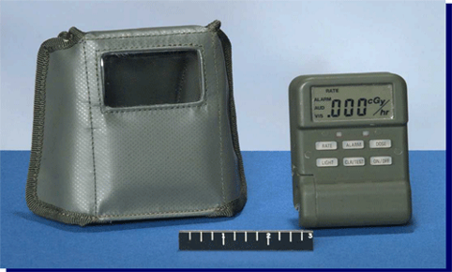
An/udr-13 & an/udr-14 radiac sets

Slide 29
Capabilities, characteristics & features
Detects total neutron and gamma radiation dose (total dose) and gamma dose rate.
Consists of 2 components; the Radiacmeter and carrying case.
Are miniaturized Radiac meters that can be carried in Soldiers’ pockets or in a case worn on a belt or load bearing equipment.
UDR-13/14 is a Unit Dosimeter.
Provides continuous monitoring and alerts an individual if radiation dose readings exceed unhealthy levels of radiation exposure. Based on operational exposure Guidance (OEG)
Total Dose: How much total radiation one has absorbed. Important for tracking exposure against safety limits (OEG)
Dose Rate: How much radiation one can expect to absorb in 1 hour. Useful for assessing immediate danger

Slide 30
Capabilities, characteristics & features
Gamma Dose Rate 0.001 to 999 cGy/hr 0.001 μGy/hr to 999 cGy/hr
Total Dose (Gamma/Neutron) 0.001 to 999 cGy 0.001 μGy to 999 cGy
Radiation Types Detected Gamma and Neutron Gamma and Neutron
The AN/UDR-13 is calibrated in centigray (cGy) units — suitable for higher dose environments.
The AN/UDR-14 adds microgray (μGy) precision, offering greater sensitivity for detecting very low-level radiation exposure.
Both sets feature a pre-settable Alarm and a Sleep Mode.
Both models serve as unit dosimeters to monitor and alert personnel of potential radiation hazards.
Centigray
Microgray

Slide 31
Capabilities, characteristics & features
Each powered by 4 “AAA” (1.5 volt) dry cell batteries
AN/UDR-13
Battery Life is 100 hours in Normal Operation Mode
Battery Life is 2000 hours in Sleep [SLP] Mode
AN/UDR-14
Battery Life is 100 hours in Normal Operation Mode
Battery Life is 1000 hours in Sleep [SLP] Mode
Both the AN/UDR-13 and AN/UDR-14 will always turn on in the Dose Rate Mode.

Slide 32
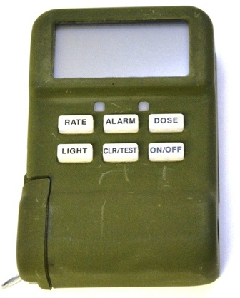
CONTROLS AND INDICATORS
LCD
Rate Alarm Light
Dose Alarm Light
RATE button
ALARM button
DOSE button
LIGHT button
CLR/TEST button
ON/OFF button
Notes:
This is your battery life for normal perations and Sleep mode

Slide 33

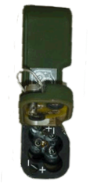

batteries
Clean and remove moisture and/or dirt on the outer surface of the radiac and soft case
Inspect battery cover gasket
Inspect battery contacts for corrosion

Slide 34
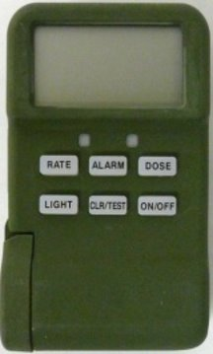
batteries
If "BAT" should appear in the upper left corner, it means the batteries have 600 minutes or less of life remaining.
In the Rate Mode, press "CLR/TEST" button to get the approximate battery life in minutes. Replace the batteries as needed.

Slide 35

Preoperational test
To start the preoperational test, Press and hold CLR/TEST button until a complete display appears, then release.
It will begin an internal test that will end with a blinking "9"
Following sequence of numbers are displayed:
● .000 µGy ● 66.6 cGy
1.11 µGy ● 777 cGy
22.2 µGy ● 88.8 Gy
333 µGy ● 999 Gy
.444 cGy ● 000
5.55 cGy ● 9 (Blinking)
If a flashing “8” or a flashing “L” appears on the
display, refer to the troubleshooting procedures.

Slide 36
RATE/DOSE MODE
Rate Mode
RATE
ALARM
AUD .455 ^{cGy}/hr
VIS
_________
Example Display

Slide 37
RATE/DOSE MODE
Dose Mode
DOSE
ALARM
AUD .665^{cGy}/hr
VIS
_________
Example Display

Slide 38
Start preoperational test
1) Press " On/Off " button to turn on.
2) Press and hold " Clr/Test " button for five seconds.
3) It will begin internal test which will end with a blinking "9 "
4) To turn off: Hold " on/off "

Slide 39

Sleep mode
While in rate mode hold " rate " + " on/off " for two seconds.
SLP will be displayed then --- then sleep.
This will show you a rate in five minute intervals.
This conserves batteries
2) To return to rate mode hold the " on/off " button then release.

Slide 40
Dose/rate modes
Switch between Dose/Rate Modes
Push Rate or Dose to switch modes.
Set Alarm audio/Visual
1: Press Rate + Alarm - numbers flash
2: Press alarm to cycle through Audio/Visual
You can cycle through flashing numbers pushing CLR/Test 6 times.

Slide 41
Set rate alarm numbers
1: Press Rate + Alarm - Numbers Flash
2: Press clear test once - decimal flashes
To move decimal, push rate.
3: Press Clear Test - Digit Flashes
Rate - Cycles through 0-9.
4: Press Clear Test - Next digit flashes.
Rate - Cycles through 0-9.
5: Press Clear test - Next digit flashes.
Rate - Cycles through 0-9.
6: CLR/Test cycles through flashing #'s

Slide 42
AN/UDR-13 &14
To turn off: Hold "on/off"
OFF
---
Example Displays

Slide 43
Udr 13/14
UDR 13/14 PE

Slide 44
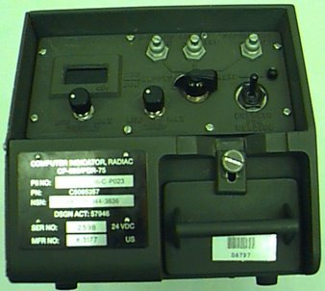
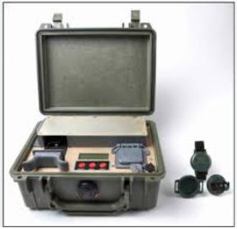
An/pdr 75

Slide 45
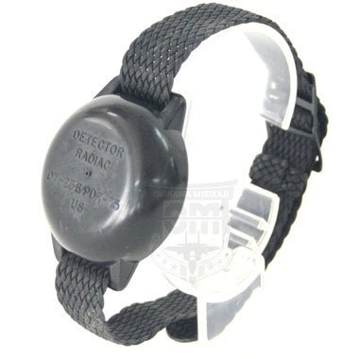
An/pdr 75
The AN/PDR-75 Radiac Set is a tactical instrument that records total dose.
CP-696/PDR-75 (Reader) - measures neutron and gamma radiation dose absorbed by the Radiac Detector
DT-236A/P (wrist watch).

Slide 46
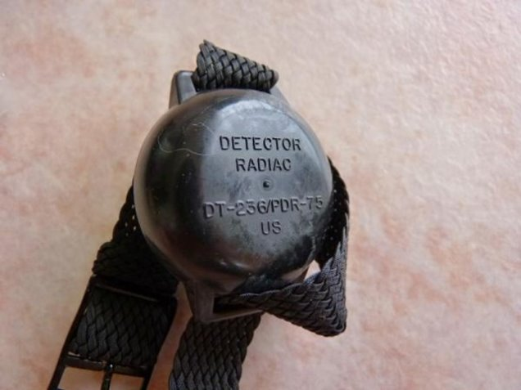
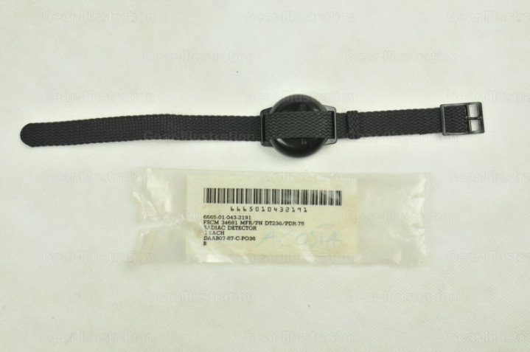
Dosimeter capabilities
Records any combination of neutron & Gamma total doses from 0 to 999 cGy.
The wrist watch will be issued to all soldiers.
Each person wears the wrist dosimeter on the outside of their garment

Slide 47
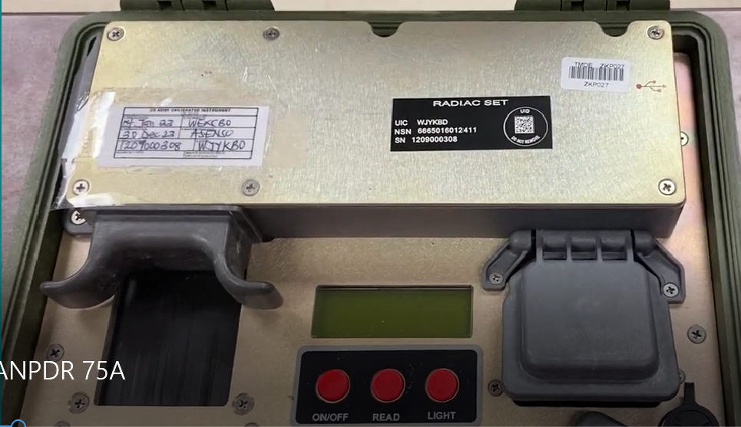
AN/PDR-75
Front Panel
Display
Drawer
Battery Cover
On/Off
Read

Slide 48
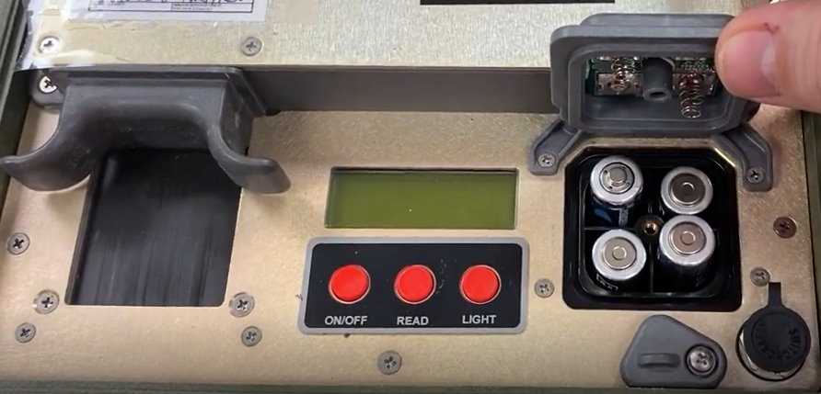
An/pdr-75
Install four AA Batteries
Close and lock the battery cover

Slide 49
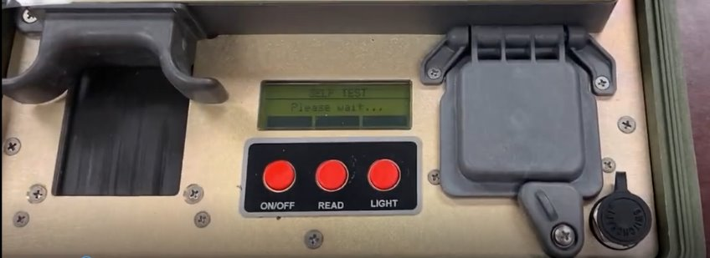
An/pdr-75
The AN/PDR - 75 will turn on and conduct a self-test.
It will walk you through step by step what to do. Just follow the instructions.

Slide 50
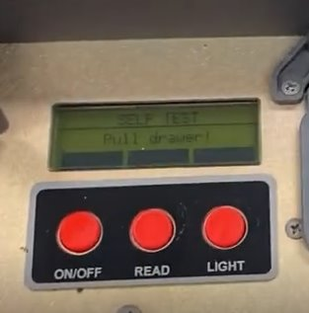
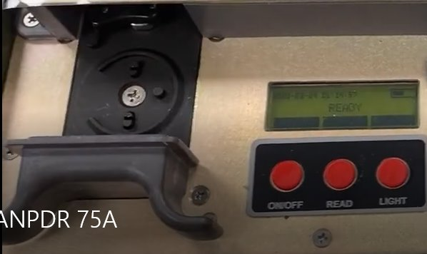
An/pdr-75
Display reads open the drawer
Open the drawer

Slide 51
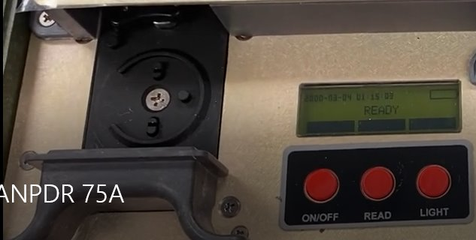
An/pdr-75
Do not have the drawer open and read the Dosimeter at the same time.
You could damage your eyes due to the ultra violet lightsource or you can damage the equipment.

Slide 52
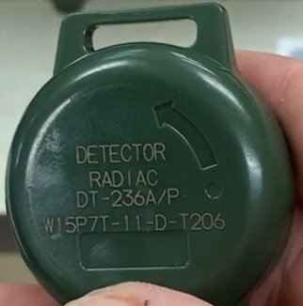
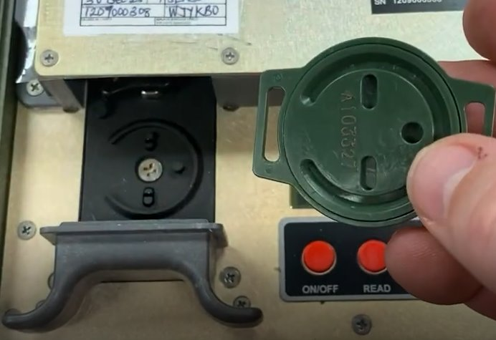
An/pdr-75
Make sure you are using DT-236A/P. The old versions are not compatible.
Before you can put in the machine, line up the grooves with the drawer.

Slide 53
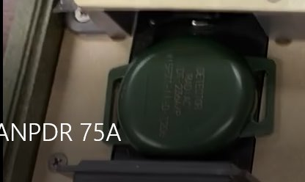
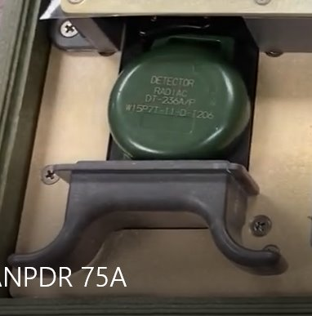
An/pdr-75
Push in place.
Lightly turn counter clock wise to lock it in.

Slide 54
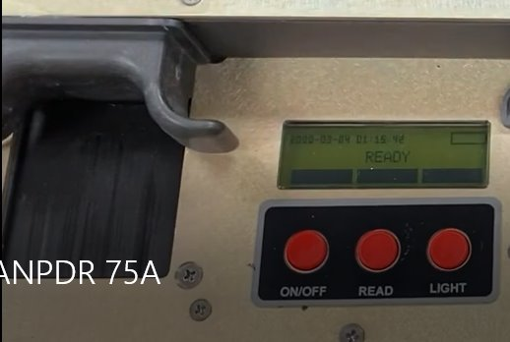
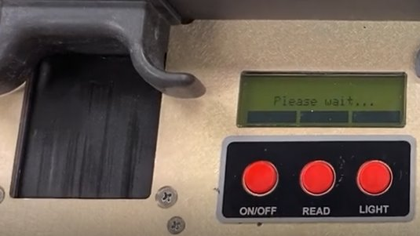
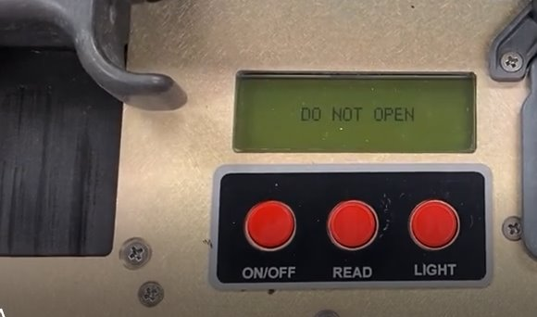
An/pdr-75
Close drawer.
When display reads ready push the read button.
It will go through its functioning

Slide 55
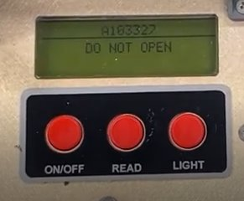
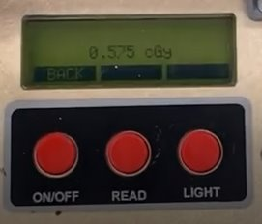
An/pdr-75
It will give you the dosimeter number that it is reading from. That number corresponds to the soldier the dosimeter is assigned to.
After it completes its calculations it will give the reading measured.
Keep Soldiers readings for your records in order to keep track of exposure status.

Slide 56
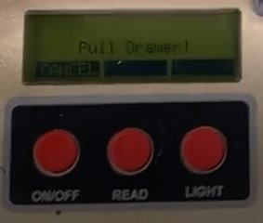
An/pdr-75
Hit the on/off button.
It will tell you to pull the drawer.
Remove dosimeter by turning clockwise.
Continue with readings or turn off by pushing the on/off button.

