Slide 1
Radiological Monitoring and Survey Operations
Notes:
Radiation monitoring is reported using CBRN 4 nuclear reports.

Slide 2
Radiological Monitoring
Mission
Nuclear fallout may contaminate a large portion of the battlefield. To operate and survive in this environment, contamination must be:
Located: Use radiac detectors to detect and measure radiation levels.
Mark contaminated areas.
Reported: Nuclear 4 reports.
Avoided, if possible
Impact on Mission Planning:
Radioactive contamination requires commanders to reassess how to accomplish the mission using available resources.
Commanders must adapt based on the level of contamination present.
Notes:
Locate Contamination
Use tactical radiac instruments (e.g., AN/VDR-2, AN/PDR-77, AN/PDR-75) to detect and measure radiation levels.
Mark contaminated areas with standard CBRN markers (yellow triangle with “ATOM” and dose rate/date/time).
Radiation monitoring is reported using CBRN 4 nuclear reports.

Slide 3
Radiological Monitoring
Commander’s Options (In Order of Preference):
1. Conduct the Mission in a Clean Area:
The commander should first determine if the mission can be completed while completely avoiding contaminated areas.
This is the preferred option to minimize exposure and maintain combat effectiveness.
2. Conduct the Mission in a Contaminated Area with Increased Resources:
If contamination cannot be avoided, perform the mission using:
A higher risk level (accepting increased radiation exposure).
More soldiers and greater resources to complete the mission faster, minimizing time spent in the hazardous environment.
Notes:
Radiation monitoring is reported using CBRN 4 nuclear reports.

Slide 4
Radiological Monitoring
Mission
Commander’s Options (In Order of Preference):
3. Delay the Mission to Allow for Natural Radioactive Decay:
If additional resources are unavailable or faster completion is not feasible:
Delay the mission start time.
Allow natural radioactive decay to reduce radiation levels.
You can conduct the mission in the same amount of time with the same
number of soldiers, but with less exposure.
Minimize time in contaminated areas, maximize shielding, and maximize distance from the source.
Notes:
Radiation monitoring is reported using CBRN 4 nuclear reports.

Slide 5
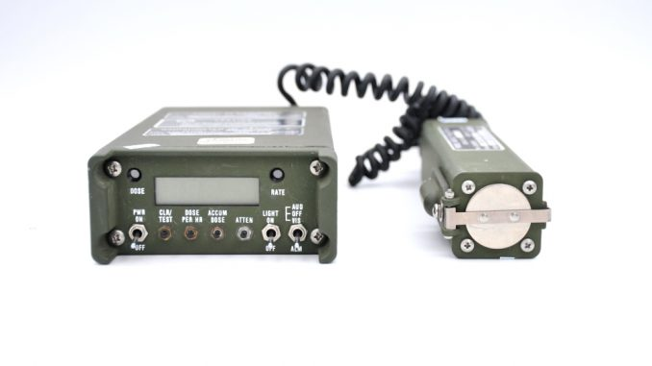
Radiological Monitoring
Radiological monitoring is done to detect and measure residual radiation in an area. It helps determine if the environment is safe and alerts the unit to new contamination.
Types of Monitoring
Periodic Monitoring
Purpose: To check the unit area regularly for radiation.
Confirms the area is safe.
Warns if fallout or contamination arrives.
When to Start:
After the first use of nuclear weapons in theater.
When ordered by higher headquarters.
When the unit stops continuous monitoring.
How to Perform:
Take readings with an AN/VDR-2 Radiacmeter at least once every hour.
Units may require more frequent checks based on their SOP.
Notes:
Performed while in a stationary position.

Slide 6
Radiological Monitoring
Types of Monitoring
Continuous monitoring means constant surveillance for radiation in the unit’s area or position. It is usually done using the indirect technique (from inside a vehicle or shelter). The frequency of readings depends on the situation and the unit’s SOP.
When to Start Continuous Monitoring
Begin continuous monitoring when:
A nuclear detonation is seen, heard, or reported nearby.
An NBC 3 (Nuclear) report places the unit in Zone I or II.
A dose rate of 1 cGyph or higher is found during periodic monitoring.
Ordered by the unit commander.
The unit is moving or on patrol in a possible fallout area.
When to Return to Periodic Monitoring
When the unshielded dose rate drops below 1 cGyph, or
When ordered by the commander.
Notes:
Performed while in a stationary position.

Slide 7
Radiological Monitoring Direct/Indirect
Direct monitoring is the simplest and most accurate way to measure radiation. It uses a radiacmeter to take an unshielded (outside) dose rate reading.
Use Direct Monitoring When:
Checking for the initial arrival of fallout.
Operating in low dose rate areas.
Taking an unshielded (outside) dose rate for transmission or correlation factors.
Verifying if a new position is contaminated.
Moving on foot through a contaminated area.
​

Slide 8
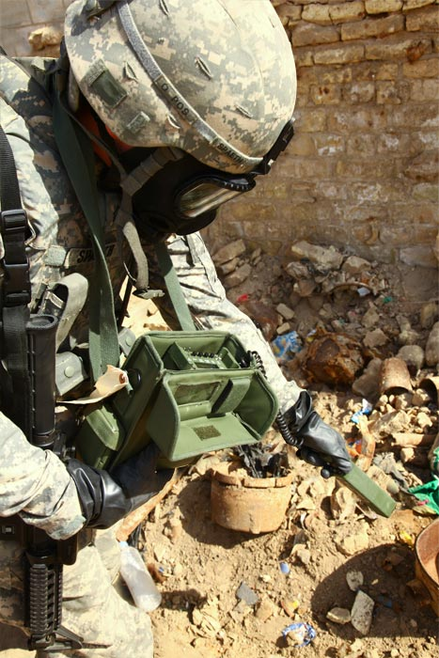
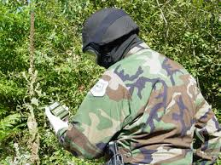
Unshielded (outside) Dose Rate Measurement
1: Hold the instrument (VDR-2 or UDR-13) waist high or about 1 meter off the ground.
2: Rotate your body 360° to scan the area evenly.
3: Record the highest reading observed — this is the unshielded dose rate.
ide) dose rate by standing with the VDR-2 or UDR-13 held waist high or 1 meter off the ground and rotating your body 360 degrees. ​
​
The highest reading observed is recorded​

Slide 9
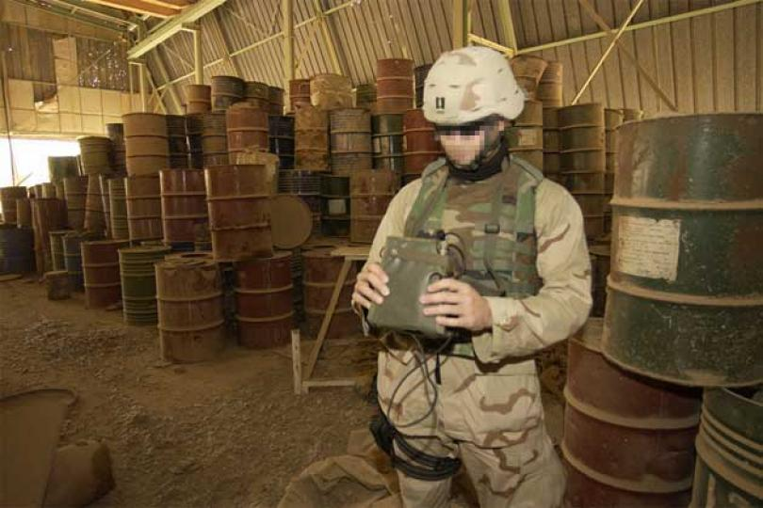
Indirect Monitoring Technique:
Indirect monitoring is done inside shelters or vehicles. This allows the unit to measure radiation levels and still keep exposure to a minimum.
Safest method, but more complicated. At least one outside reading is necessary to determine the correlation factor. (convert an ID to OD)
Done inside shelters or vehicles.
Keeps exposures to a minimum.
Preferred technique in a contaminated area.
vehicles. ​

Slide 10
Supervise Radiation Monitoring
1. Determine whether to use periodic or continuous monitoring.
2. Select a central point in your area where operators will take readings.
Locate the grids on the map.
3. Ensure the operators perform PMCS radiac set.
4. Determine whether operators should use the direct (outside dose) or
indirect (inside dose) technique while monitoring.
Notes:
Radiation monitoring is reported using CBRN 4 nuclear reports.

Slide 11
Supervise Radiation Monitoring
5. Direct the operators on how often to take readings.
6. Make sure the operators have a means of recording locations, readings and time. (Nuclear Data Sheet)
7. Spot check the operators. Periodically verify readings and procedures to ensure accuracy.
8. Send up the data.
NOTE: Use the Nuclear Data Sheet samples provided in the back of FM 3-11.3.
Always maintain a backup radiacmeter and extra Nuclear Data Sheets in case equipment fails or contamination spreads
Notes:
Radiation monitoring is reported using CBRN 4 nuclear reports.

Slide 12
Use DA Form 1971-R or 1971-1-R (producible forms from FM 3-11.3, Appendix L).
Forms Purpose
1971-R (Point Technique / Monitoring)
Record radiation readings at individual points.
Use for Periodic or Continuous Monitoring.
1971-1-R (Route or Course Leg Technique)
Record data collected along a route or area.
Applicable for ground or aerial radiological surveys.
Both forms serve as the official record for reporting radiation intensity, location, and time.

Slide 13
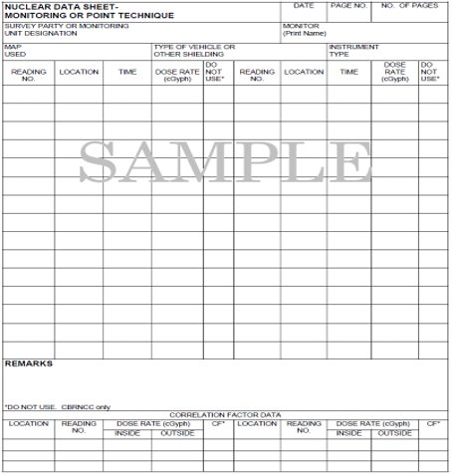
This form is located in FM 3-11.3, App L

Slide 14
Nuclear Data Sheet for Radiological Monitoring
Prepare Monitoring or Point Technique Data Sheet
Steps to Complete the Data Sheet
1: Technique Type
Record either “Monitoring” or “Point Technique”.
Draw a line through the one that doesn’t apply.
2: Date
Enter the date the data was taken.
3: Page Number
Record the page number and total number of pages.
4: Unit / Survey Party
Enter the survey party or monitoring unit designation.
Indicate “Survey Party” or “Monitoring” (line through the one that doesn’t apply).
Notes:
Point. The team travels to a point and takes one reading for that location.
Route: The team takes dose rate readings inside the vehicle at selected intervals between checkpoints along a route.

Slide 15
Nuclear Data Sheet for Radiological Monitoring
Prepare Monitoring or Point Technique Data Sheet
Steps to Complete the Data Sheet
5: Operator Name
Record the name of the Soldier conducting the monitoring.
6: Map Information
Record the map title, sheet designation, and map scale used.
7: Vehicle / Shielding
Record the type of vehicle or shielding used (if any).
Line through the one that doesn’t apply if not used.
8: Instrument Used
Record the type of instrument used to take the dose rate readings.
Notes:
Point. The team travels to a point and takes one reading for that location.
Route: The team takes dose rate readings inside the vehicle at selected intervals between checkpoints along a route.

Slide 16
Nuclear Data Sheet for Radiological Monitoring
Prepare Monitoring or Point Technique Data Sheet
Steps to Complete the Data Sheet
9: Radiation Readings
For each reading, record:
Reading number
Location (grid coordinates)
Time (local or Zulu)
Dose rate (cGyph)
Notes:
Point. The team travels to a point and takes one reading for that location.
Route: The team takes dose rate readings inside the vehicle at selected intervals between checkpoints along a route.

Slide 17
Nuclear Data Sheet for Radiological Monitoring
Prepare Monitoring or Point Technique Data Sheet
Additional Data and Correlation Factor (CF) Instructions
1: Use Extra Sheets as Needed
Add additional data sheets if the form runs out of space.
2: Record Extra Information
Include any information useful to the control party, e.g., Time of Burst (TOB).
3: Indirect Technique / Shielded Readings
If readings are taken from inside a vehicle or shielded position, include Correlation Factor (CF) data.
Notes:
Point. The team travels to a point and takes one reading for that location.
Route: The team takes dose rate readings inside the vehicle at selected intervals between checkpoints along a route.

Slide 18
Nuclear Data Sheet for Radiological Monitoring
Prepare Monitoring or Point Technique Data Sheet
Additional Data and Correlation Factor (CF) Instructions
4: Correlation Factor Data to Record
Location of the reading
Reading numbers (#1, #2, etc.)
Inside (shielded) dose rate (cGyph)
Outside (unshielded) dose rate (cGyph)
5: Submission
Submit completed sheet(s) to the unit’s control party.
Notes:
Point. The team travels to a point and takes one reading for that location.
Route: The team takes dose rate readings inside the vehicle at selected intervals between checkpoints along a route.

Slide 19
NUCLEAR DATA SHEET-
MONITORING OF POINT TECHNIQUE
DATE
PAGE NO.
NO. OF PAGES
For use of this form, see FM 3-3-1; the proponent agency is TRADOC
5 Nov XX
1
27
SURVEY PARTY OR MONITORING
UNIT DESIGNATION
MONITOR
(Print name)
SPC James, Richard
A1H57
MAP
USED
PELL CITY, 3741,
1/50,000
TYPE OF VEHICLE OR
OTHER SHIELDING
BUNKER
INSTRUMENT
TYPE
AN/VDR-2
Notes:
Correlation factors are required to convert inside dose rate readings to outside dose rate readings. They are calculated using the following formula: Outside Dose (OD) divided by Inside Dose (ID) = CF
Correlation factors are always greater than 1.00 and are rounded to the nearest hundredth.

Slide 20
Nuclear Data Sheet for Radiological Monitoring
READING
NO.
LOCATION
TIME
DOSE RATE
(cGyph)
DO
NOT
USE*
READING
NO.
LOCATION
TIME
DOSE RATE
(cGyph)
DO
NOT
USE*
1
AY17649732
0830
0
16
AY17649732
1105
54
2
0900
0
17
“ “
1110
47
3
0930
0
18
“ “
1115
25
4
1000
4
19
“ “
1120
18
5
1010
10
20
“ “
1125
17
6
1015
17
21
“ “
1130
16
7
1020
31
22
“ “
1135
15
8
1025
45
23
“ “
1140
14
9
1030
53
24
AY17649732
1145
14
10
1035
62
25
11
1040
69
26
12
1045
78
27
13
1050
78
28
14
1055
76
29
15
AY17649732
1100
67
30
REMARKS
All Times Zulu
* DO NOT USE. For control party only

Slide 21
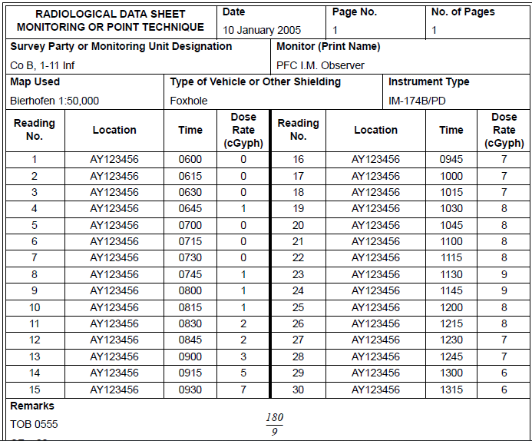
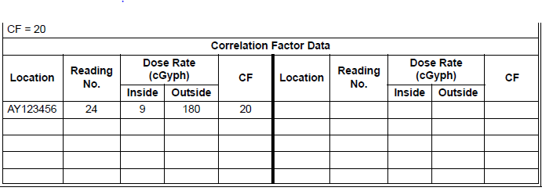
Notes:
Correlation factors are required to convert inside dose rate readings to outside dose rate readings. They are calculated using the following formula: Outside Dose (OD) divided by Inside Dose (ID) = CF
Correlation factors are always greater than 1.00 and are rounded to the nearest hundredth.

Slide 22
Radiological Surveys
A survey is performed by a group comprised of a defense team and one ormore survey teams.
The survey team, organized within the company/troop/battery NBC team,consists of a monitor and necessary support and security personnel.
Purpose: Determine the extent of contamination when routine monitoring does not provide a complete picture.
When to Conduct a Survey:
Only after fallout has ended.
Conducted only when directed by the CBRN CELL.
Goal: Provide accurate information on how widespread contamination is in order to support mission planning and force protection.

Slide 23
Radiological Surveys – Ground Survey (Route Technique)
Purpose: Take dose-rate readings during a ground survey along a route.
Who Performs: Mounted personnel in survey vehicles.
Technique:
Readings are taken inside the vehicle (shielded).
Convert readings to outside (unshielded) dose rates using a correlation factor (CF).
Speed & Intervals:
Average survey speed: 15 mph.
Take readings at selected intervals along the designated route.
At least one reading must be taken outside the vehicle for reference.

Slide 24
Radiological Surveys – Ground Survey (Point Technique)
Purpose: Measure radiation at a specific point of operational concern.
Technique:
Move directly to the point.
Take readings using either:
Direct monitoring (outside/unshielded), or
Indirect monitoring (inside/shielded).
When to Use:
When a specific location needs evaluation for contamination.

Slide 25
Plan a Radiological Survey
Equipment Requirements:
Radiacmeter (AN-VDR 2, AN-PDR 77) for measuring dose rates (How much radiation one can
expect to absorb in 1 Hr).
Dosimeter, (UDR-13, UDR-14) for purposes of radiation exposure control.
Nuclear Radiation Data Sheet (DA Form 19-71R used for recording information collected during
the survey.
Watch to determine the time when survey readings are taken.
Communications equipment necessary for rapid reporting is required.
Maps of the land areas to be surveyed must be available to the survey team.
Vehicles that have high radiation shielding characteristics (high correlation factors)

Slide 26
CBRN 4 Nuclear Report
When any unit detects Radiation Hazards through monitoring, survey or reconnaissance, this information is reported using an CBRN 4 Nuclear Report.,

Slide 27
CBRN 5 Nuclear Report
Actual Contamination​
​
Comes down from Div ​
​
It’s a Plot!​

Slide 28
CBRN 5 Nuclear Report
Line Items:​
​
Alfa: Strike serial number (O)​
Delta: Date/Time of detonation (O)
​
Oscar: Reference date/time (M)​
XrayA: Actual Contour (M)​

Slide 29
CBRN 5 Nuclear Report
XA/ Dose rate /grid coordinates//
1000 cGY/ hr contour line (red)
300 cGY/hr (green)
100 cGY/hr (blue)
20 cGY/hr (black)
XA and set 2 is repeatable up to 50 times!
They show radiation hazard zones based on dose rates.
Commanders can see where it's safer and where it’s too dangerous to operate.
Helps plan movement routes, mission timing, and protect troops.

Slide 30
CBRN 5 Nuclear Report
NBC-5 Nuclear Report
Immediate
A/US/G29/006/N//
D/241540ZMAR2011//
O/241640ZMAR2011//
XA/100CGH/14SNB343255/14SNB339230/14SNB321228//
XA/20CGH/14SNB291235/14SNB287230/
14SNB279226//
Contour lines are color coded and by dose reading
Contour lines are always open or closed

Slide 31
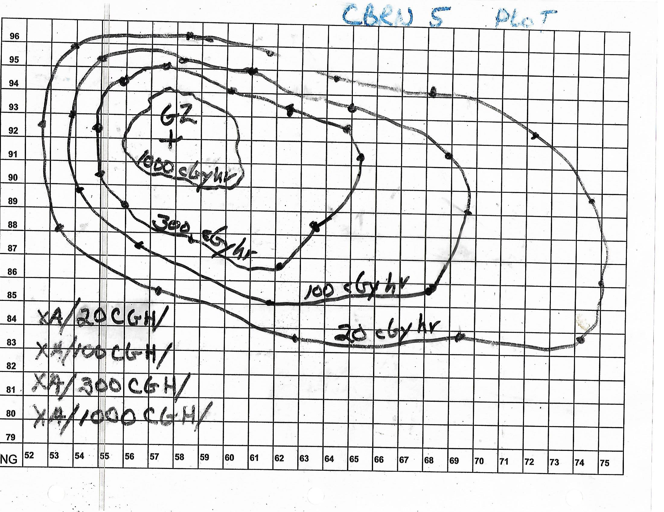
CBRN 5 Nuclear Report
oring, survey or reconnaissance, this information is reported using an CBRN 4 Report.
Red
Green
Blue
Black

Slide 32
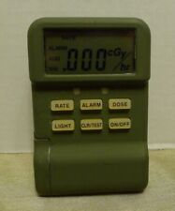
Collect And Report Total Radiation Dose
The dose rate of radiation does not directly determine whether or not personnel become casualties. Casualties depend on total dose received.
This total dose determines potential casualties, mission impact, and protective actions required.
Starts with the dosimeters (AN/UDR-13) assigned to platoons.
Getting the dose rates and reporting Exposures.
Used in conjunction with the Operational Exposure Guidance
Notes:
This total dose determines potential casualties, mission impact, and protective actions required.

Slide 33
Collect And Report Total Radiation Dose
1: Start with Assigned Dosimeters
Each individual or team carries a personal or tactical dosimeter, such as the AN/UDR-13 or AN/UDR-14.
These devices record both dose rate and accumulated total dose.
2: Unit Control
Each platoon or team leader maintains oversight of dosimeter readings.
Readings are collected periodically or at mission completion, whichever comes first.
3: Record & Report
Record the current total dose from each dosimeter.
Compile data at platoon → company → battalion levels.
Notes:
This total dose determines potential casualties, mission impact, and protective actions required.

Slide 34
Collect And Report Total Radiation Dose
Operational Exposure Guidance (OEG)
OEG is a command tool that allows commanders to:
Control radiation exposure among personnel.
Maintain mission effectiveness by selecting units with the lowest accumulated or projected dose.
Minimize casualties and long-term radiation effects.

Slide 35
Collect And Report Total Radiation Dose
Integration with Total Dose Reporting
1: Collect dosimeter data from units.
2: Compile total accumulated doses for each unit.
3: Compare doses to OEG thresholds for:
Routine operations
Critical operations
Lifesaving or essential missions
4: Commander decision-making:
Select units with the lowest exposure for current missions.
Rotate or pull higher-dose units out of high-radiation zones.
Adjust mission timelines to stay within OEG limits.

Slide 36
Criteria for Establishing OEG
1: Mission Type
Offensive vs. Defensive:
Offensive operations may require higher exposure risk if mission success is critical.
Defensive or routine operations aim to minimize exposure.
2: Higher Command Guidance
Directives from brigade, division, or higher HQ on acceptable exposure levels,
mission priorities, or protective measures.
3: Recommendations from Leaders
Platoon leader, platoon sergeant, squad leader provide ground-level insight:
Current operational status
Observed environmental hazards

Slide 37
Criteria for Establishing OEG
4: Future Operations / Cumulative Exposure
Consider planned missions that could increase total dose.
Factor in cumulative exposure to avoid exceeding safe limits.
5: Medical Advice
Unit surgeon or medical officer reviews health status of previously exposed personnel.
Provides guidance to adjust OEG based on actual effects of radiation observed in the unit.
6: Degrees of Risk
Use a risk chart to define acceptable exposure levels:
Low Risk → routine operations
Moderate Risk → mission-essential operations
High Risk → lifesaving or critical operations only

Slide 38
Criteria for Establishing OEG
7: Radiation Exposure Status (RES) of Unit
Each unit’s current total dose (measured by dosimeters).
Helps commanders prioritize low-exposure units for high-risk missions.
1: Collect total dose data from each unit’s dosimeters.
2: Consider mission type and guidance from higher command.
3: Consult leaders and medical personnel about unit readiness.
4: Use risk charts and current RES to select units.
5: Set OEG limits for the mission.
6: Update OEG as mission progresses or as more dose data becomes available.
OEG is not fixed—it’s dynamic. Commanders weigh mission requirements, cumulative radiation
exposure, health status, and operational guidance to balance mission success with personnel safety.

Slide 39
Degrees of risk: Affects of radiation exposure on combat personnel
Degree of Risk Concept
Is defined in percentages of either casualties or performance degradation.
Based on total acute dose

Slide 40
Degrees of risk: Affects of radiation exposure on combat personnel
A measure of how radiation exposure affects combat personnel, expressed as a percentage of expected casualties or performance degradation.
1: Based on Total Acute Dose
Total radiation absorbed over a short period (acute dose) determines risk.
2: Effects Considered
Casualties: Probability that personnel will suffer radiation sickness or incapacitation.
Performance degradation: Reduced physical or cognitive effectiveness, even if personnel are not immediately sick.

Slide 41
Degrees of risk: Affects of radiation exposure on combat personnel
Degree of Risk Total Acute Dose (cGy) Expected Effects
Negligible >0 but <75 Acceptable for operating in a contaminated area.
Will not cause casualties.
Maximum 2.5% nuisance effect
(minor fatigue, temporary discomfort)
Moderate >75 but <125 Generally will not cause casualties.
Up to 5% nuisance effect
(slight performance degradation)
Emergency >125 Increased risk of performance degradation.
Casualties possible under prolonged exposure.
Nuisance effects = minor symptoms (fatigue, mild nausea, temporary reduced efficiency).
These thresholds are used by commanders with OEG to decide:
Which units can operate in contaminated areas
How long personnel can remain in the area
When to rotate, evacuate, or provide medical monitoring

Slide 42
Radiation Exposure Status
Tracked continuously during operations where radiation is a threat.
RES tracks the total amount of radiation that a unit or individual has received, and how much more exposure they can safely take before suffering serious effects.
It helps commanders manage mission risk and prevent radiation injuries.
Determines who is available for future missions and who must be rested or evacuated.
Commanders must balance: mission urgency vs. health risk to soldiers.
Updated often: usually with daily radiation monitoring reports.

Slide 43
Radiation Exposure Status
Categories of Radiation Exposure Status:
Radiation Status Category Total Cumulative Dose
RES 0 No previous exposure
RES 1 Greater than 0, less than or equal to 75 cGy
RES 2 Greater than 75, less than or equal to 125cGy
RES 3 Greater than 125 cGy

Slide 44
Radiation Exposure Status
Categories of Radiation Exposure Status:
Radiation Status Category
RES 0 Full use in any mission.
RES 1 Full use in any mission.
RES 2 Use cautiously; limit high-risk tasks.
RES 3
Use only if absolutely necessary; expect degraded performance.

Slide 45
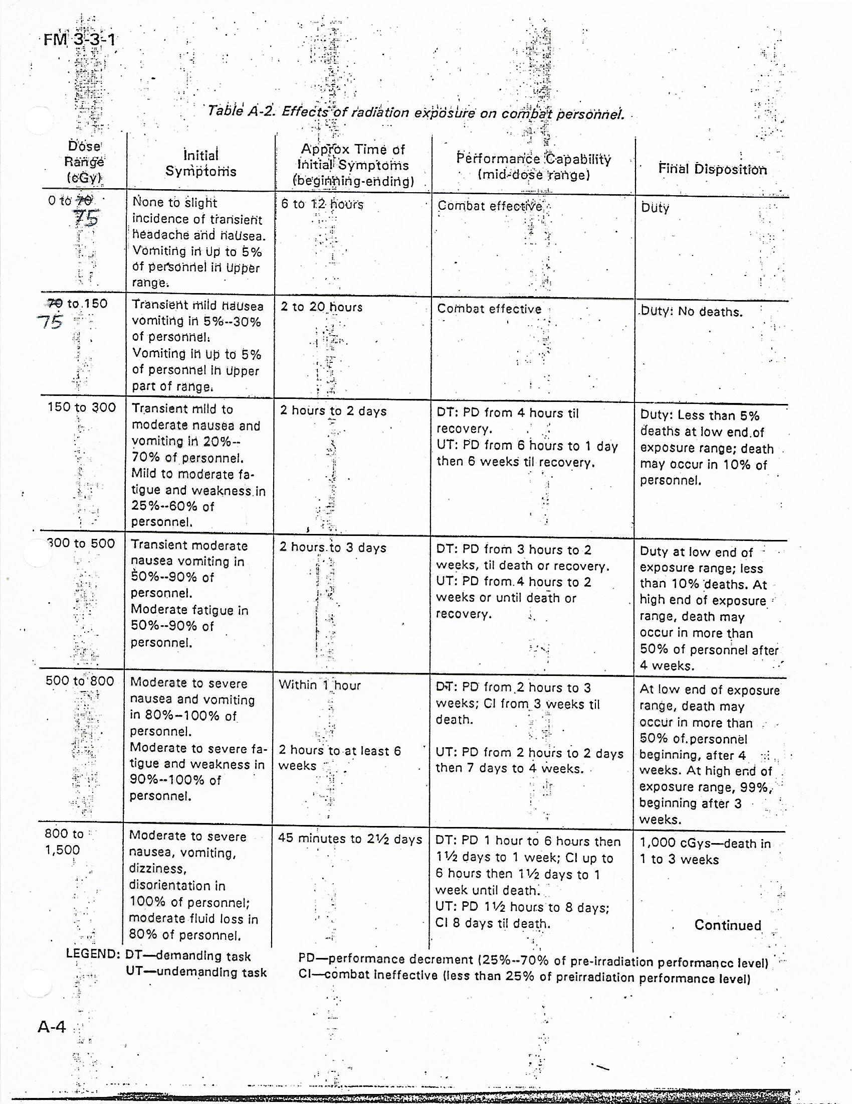
Degrees of risk: Affects of radiation exposure on combat personnel

Slide 46
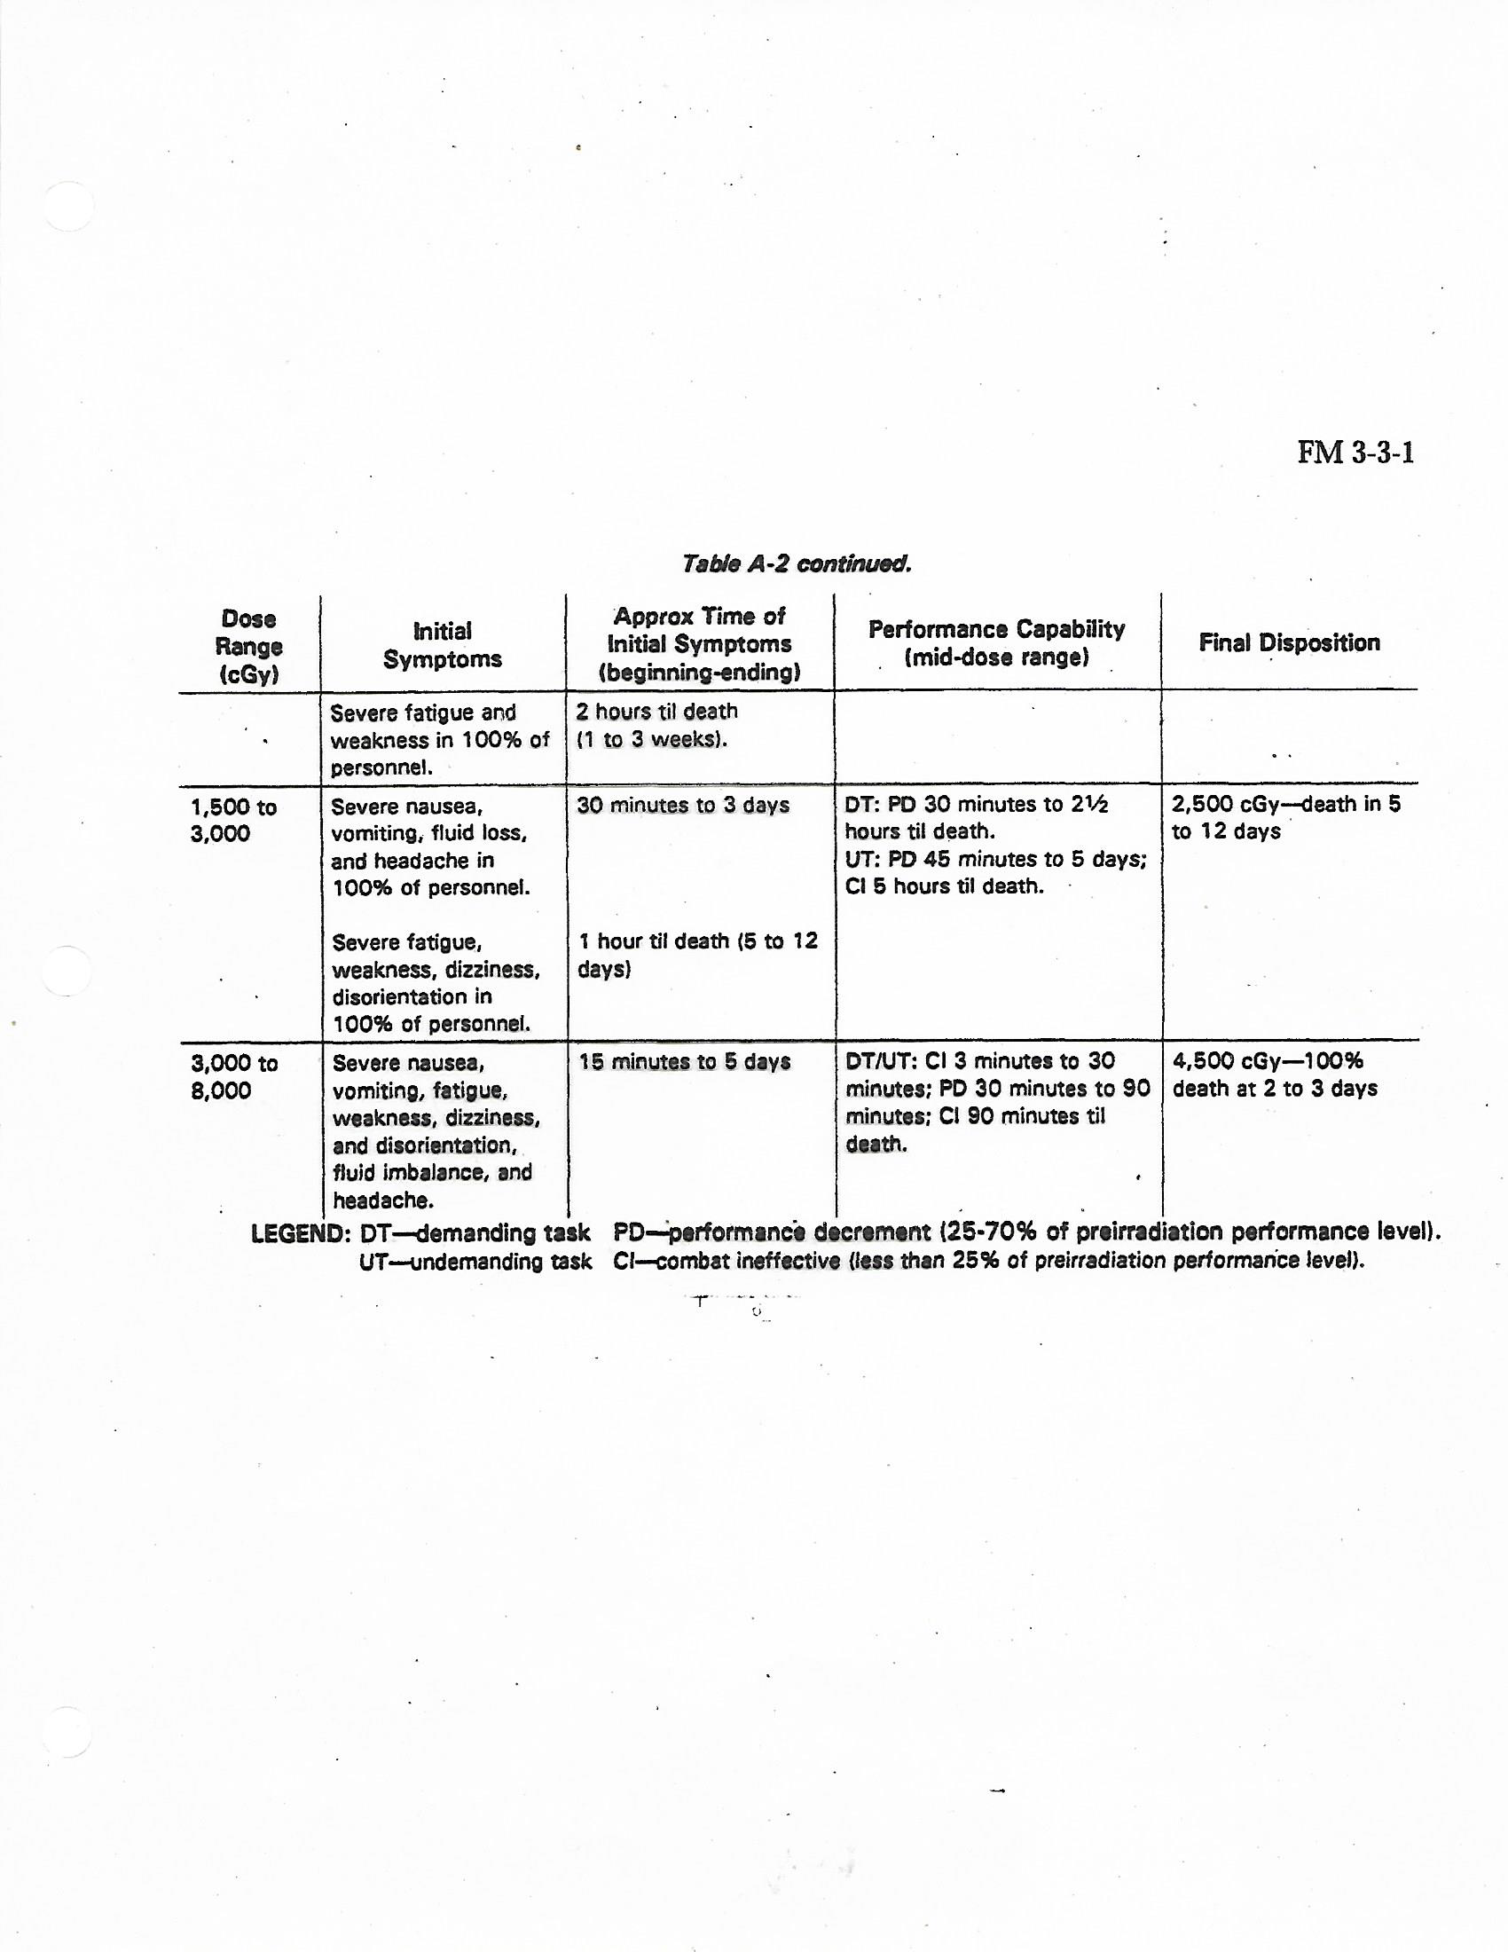
Degrees of risk: Affects of radiation exposure on combat personnel

Slide 47
RES Category PE

Slide 48
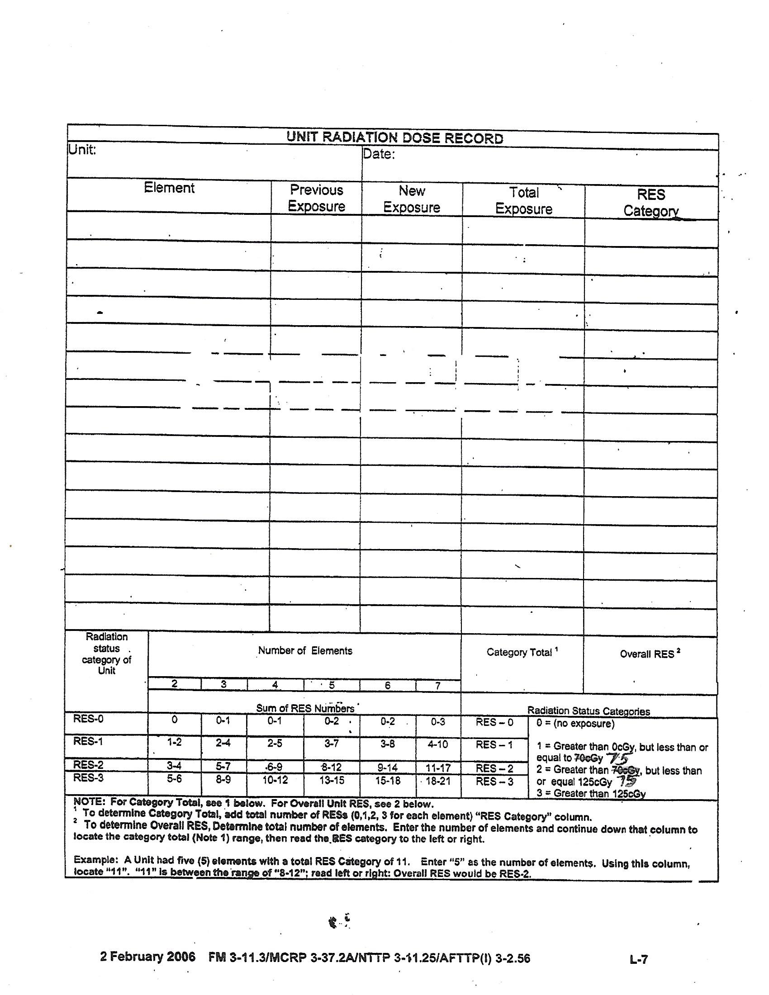
1: Input Elements.
2: Add the total of each Dosimeter reading of each section for the new exposure number.
3: Divide the new exposure number by the number of readings taken for an average. This is the total exposure.
(always a whole number. Round up or down as needed)
4. RES Category. Is based off the total exposure number.
Sum of RES Catagories
5. Number of elements is seven.
6. Follow the collumn down until you find the range that your sum of RES catagories falls into.
Number of elements
7. Follow the row to the left or right end for the overal RES for the unit.
RES Catagory
8. Overall RES.

Slide 49
Protection measures
Controlling Exposures :
1. Delay entry time
2. Increase shielding - Sandbag vehicles, tops, floors and sides.
3. Select routes with lower dose rates and fastest route of travel.

Slide 50
Protection measures
Use of OEG / RES
Fallout predictions Survey
Computation of turn back dose and dose rates:
OEG used to calculate turn back dose and dose rates
Computations help enforce commander’s OEG
Turn back dose (Dtb): OEG divided by 2

Slide 51
Terms for Dose and Total Dose calculations
Transmission Factors
TF is the measurement of the degree of protection or shielding afforded
to a soldier by a structure, vehicle or fortification.
Will always be less than 1
TFs can be calculated for all types of protection.
TF = ID / OD
ID = OD x TF
OD = ID/TF

Slide 52
Terms for Dose and Total Dose calculations
Correlation Factor
Purpose of Correlation Factors:
Correlation factors are used to convert inside dose rates to outside dose rates and vice versa.

Slide 53
Terms for Dose and Total Dose calculations
CF = Outside Dose(OD) / Inside Dose (ID) ​
OD = ID x CF​
ID = OD / CF​
CF’s are always greater than 1
and are rounded to the nearest hundredth.​

Slide 54
Terms for Dose and Total Dose calculations
CALCULATE DOSE RATE
Values and Terminology for fallout/induced:
1. R1 - dose rate taken one hour after the burst (The dose rate at H+1)
2. Rt - dose rate taken any time other than H+1
3. t – time (H+2, H+5, H+0.5, etc)

Slide 55
Terms for Dose and Total Dose calculations
Working problems.
Figuring out word problems
Extracting information
Finding known values
Determining values to “plug in”

Slide 56
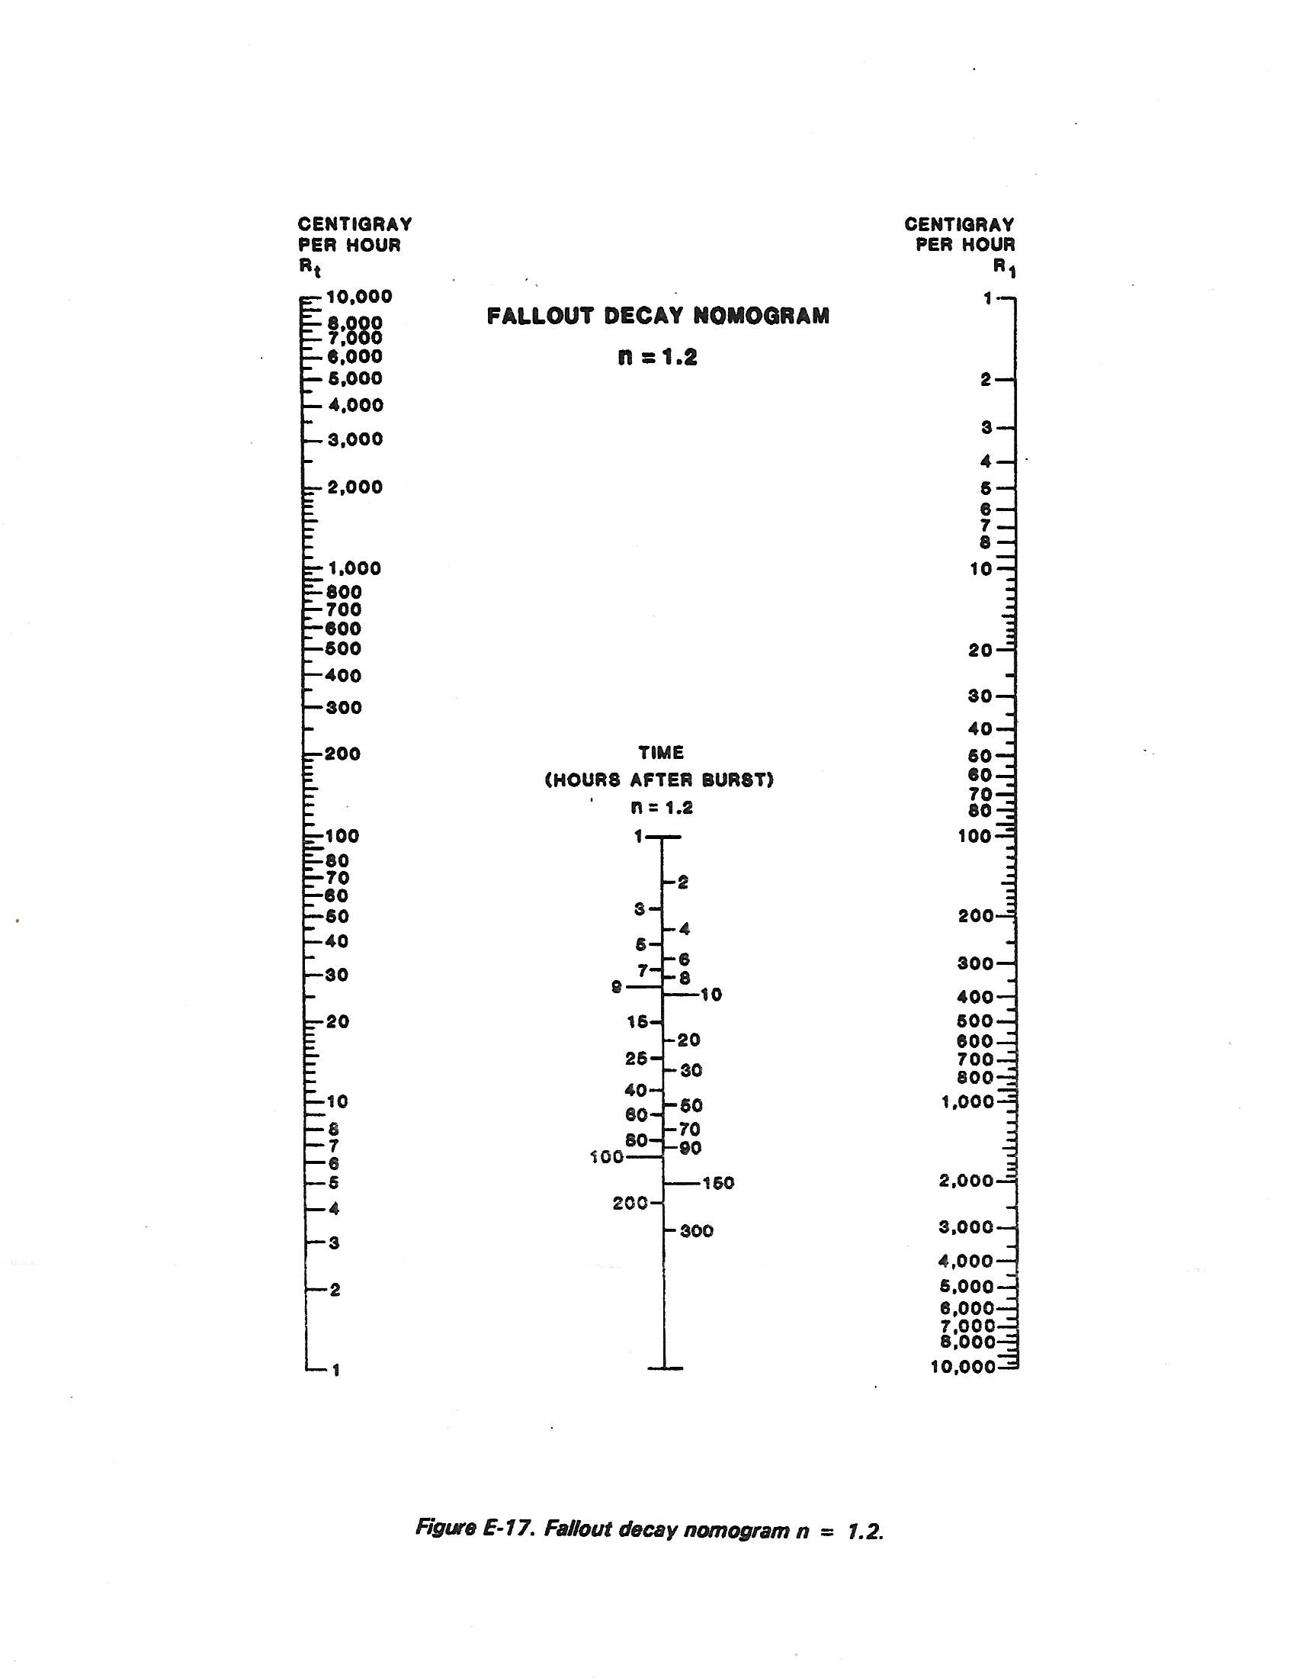
Total Dose Practical Exercise 1
Rt - dose rate taken any time other than H+1
How much radiation one can expect to absorb in 1 hour
R1 - dose rate taken one hour after the burst (The dose rate at H+1)
what is given in the equation? what is being asked?
Work direction
1: Line up the hairline on the value 175 cGy in the R1 column.
Line up the other end of the hairline on the value 50 cGy in the Rt column.
Time - the time you took a Dose rate
2: The center scale is time.
3: Read the time where the hairline crosses the Time (hours after Burst), scale. That is your answer.
Time:
3 Hrs
50 cGy
175 cGy
Example:
R1 = 175 CGy/hr
Time =
Rt = 50 cGy/hr
3

Slide 57
CALCULATE DOSE RATE
Practical Exercise

Slide 58
Calculate Total dose
Calculate Total dose.
Terminology of values:
D – total dose (in cGy)
R1 – dose rate taken one hour after the burst (the dose rate at H+1)
Ts – time of stay (in hours)
Te – time of entry – hours after burst (H+1, H+3, H+12, etc)
How much total radiation one has absorbed

Slide 59
Calculate Total dose
Rt – dose rate taken at any other time than H+1 (ex: 55 cGy/hr at H+3)
TF – transmission factor
Calculate the Total Dose!

Slide 60
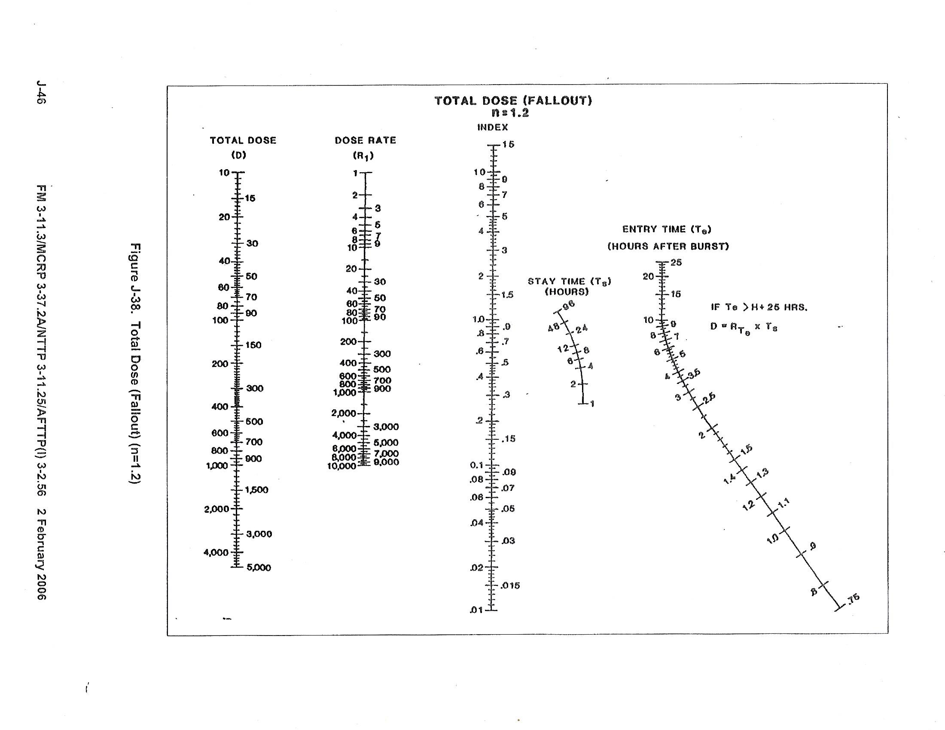
R1 - dose rate taken one hour after the burst (The dose rate at H+1)
Need a D & R1 in order to solve for Te, or Ts.
Need a Te & Ts in order to solve for R1 or D.
How much total radiation one has absorbed
D – total dose (in cGy)
Not used
When you have an Rt & T
Use Fallout Nomogram to get R1. Then use Total dose Nomogram to finish problem.
Work direction
The side that you have both info in the equation is the side you start on
25 cGy
Ts – Time of stay
(in hours)
Te – Time of entry after burst
(H+1, H+2, H+12 etc)
what is given in the equation? what is being asked?
H+10
1: Line up the hairline on the value 25 cGy in the D column.
350 cGy
If Te is after H=25, use formula to get dose
2: Also line up the hairline on the value 350 cGy in the R1 column.
3: Pin hairline in the index column. Pivot hairline to begin working the other side of the nomogram..
1.4 or 1.5
4: Line up the hairline on the value H+10 in the Te column.
Pin hairline
3: Read the time where the hairline crosses the Time Ts, scale. That is your answer.
Example:
D = 25 CGy/hr
R1 = 350 cGy/hr
Te = H+10
Ts =
1.4 or 1.5

Slide 61
CALCULATE TOTAL DOSE
Practical Exercise

