Slide 1
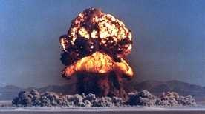
NUCLEAR WEAPONS EFFECTS

Slide 2
NUCLEAR WEAPONS EFFECTS
July 16, 1945
Notes:
This is the date of the first atomic test, Trinity. White Sands, New Mexico. Next slide is video of that test.

Slide 3
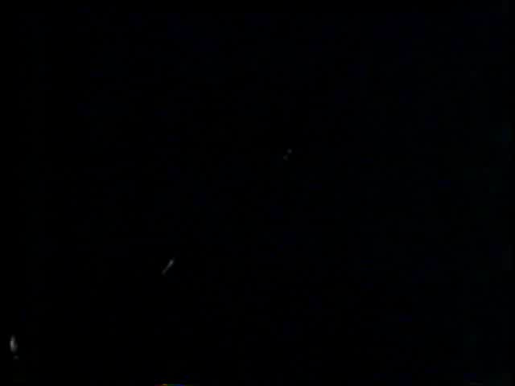
NUCLEAR WEAPONS EFFECTS

Slide 4
NUCLEAR WEAPONS EFFECTS
Weight : 47 tons
Notes:
Trivia: What weighs 47 tons, is located on this post and relates to this class. Answer: the Atomic cannon located on top the hill across from Marshall Airfield. & cannons like this exist. One is here at FR, one is at Ft Sill, one is at the Smithsonium in DC and others are around the world. Next slide shows cannon in action.

Slide 5
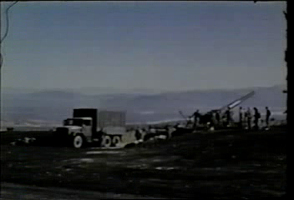
NUCLEAR WEAPONS EFFECTS

Slide 6
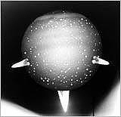
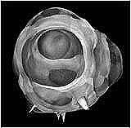
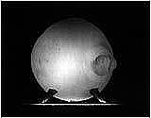
NUCLEAR WEAPONS EFFECTS
The Fireballs
Notes:
This slide not shown

Slide 7
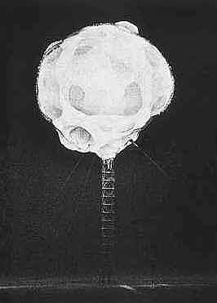
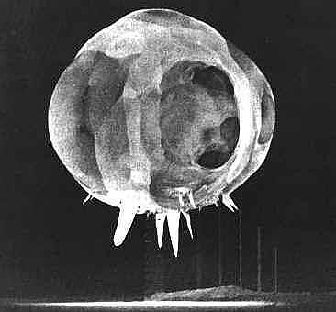
NUCLEAR WEAPONS EFFECTS
Notes:
This slide not shown

Slide 8
NUCLEAR WEAPONS EFFECTS
The Flash
Notes:
The next two slides show video of the intensity of a nuclear flash. The first slide and vid is real time, the next one is frame by frame to illustrate how far out the heat and light go.

Slide 9
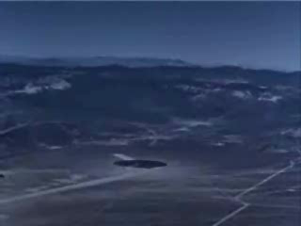
NUCLEAR WEAPONS EFFECTS

Slide 10
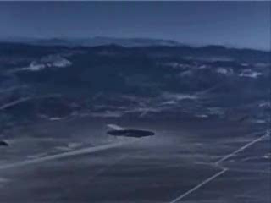
NUCLEAR WEAPONS EFFECTS

Slide 11
Notes:
This slide is another view of the Trinity fireball

Slide 12
NUCLEAR WEAPONS EFFECTS
Largest Ever
Notes:
Next slide is the largest. 50 megatons. Done by the russians

Slide 13
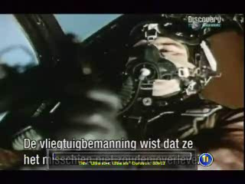

Slide 14
Characteristics and Effects of Nuclear Weapons
DIFFERENCES in EXPLOSIONS.
CONVENTIONAL:
Fast chemical reaction
Creates heat, blast, light
NUCLEAR:
Nuclear reaction, mass is converted to energy
Creates intense heat, blast, light
Creates nuclear radiation
Creates Electro-magnetic pulse

Slide 15
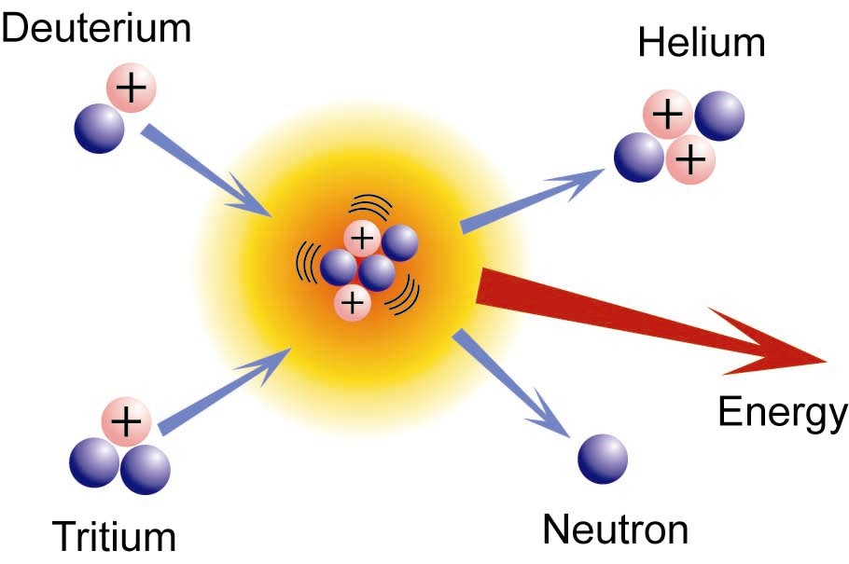
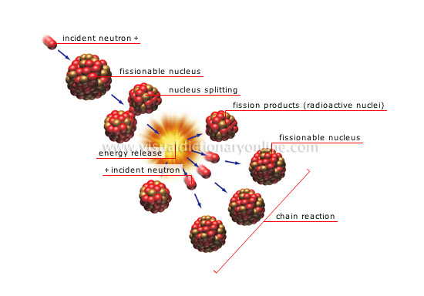
Characteristics and Effects of Nuclear Weapons
Fission
splits atoms
Fusion joins the atoms. Thermo –Nuclear reaction

Slide 16
Characteristics and Effects of Nuclear Weapons
How big is it?
Yield
Kiloton (KT): Thousand TONS of TNT.
Megaton (MT): Million TONS of TNT.
HIROSHIMA: 12.5 KT(12.5 thousand tons/TNT)
NAGASAKI: 22 KT (22 thousand tons/TNT)

Slide 17
Characteristics and Effects of Nuclear Weapons
Types of Bursts:
Airburst:
Clean white cloud.
Blast effects much stronger than surface bursts.
Does not produce fallout.
GZ is below point of detonation on ground
Fireball doesn’t touch ground

Slide 18
Characteristics and Effects of Nuclear Weapons
Surface Burst:
Dark mushroom cloud with a dark dirty stem
Produces fallout
Fireball touches earth
Point of detonation is not always on the ground

Slide 19
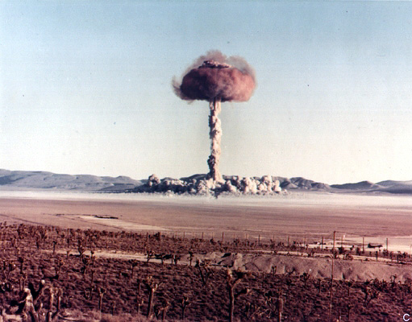
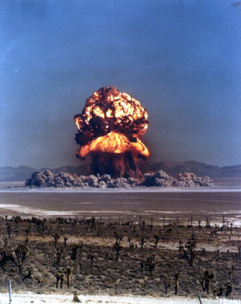
Characteristics and Effects of Nuclear Weapons

Slide 20
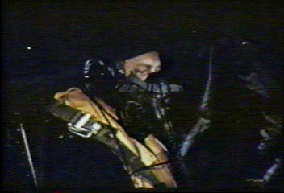

Slide 21
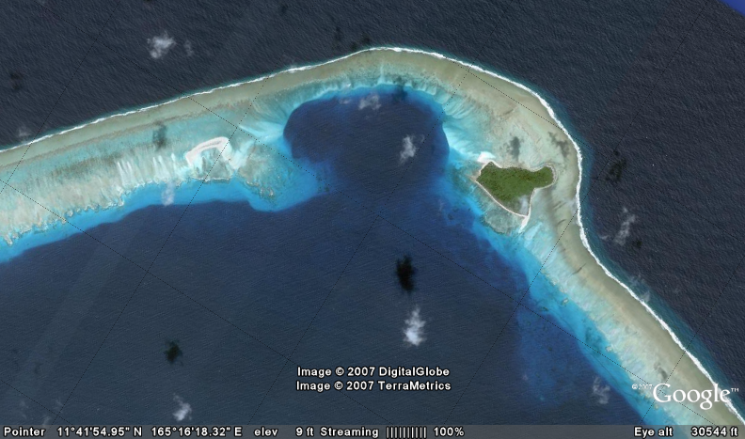
NUCLEAR WEAPONS EFFECTS
Notes:
10.2 megaton blast on the bikini islands and the resulting crater. More than one mile wide and 300 feet deep.

Slide 22
Characteristics and Effects of Nuclear Weapons
Subsurface Burst:
underground or water.
Causes earthquake effects and cratering.
If fireball breaks the plane of the earths surface, it’s no longer a subsurface burst.
Ground zero location is directly above the point of detonation on the earth’s surface.

Slide 23
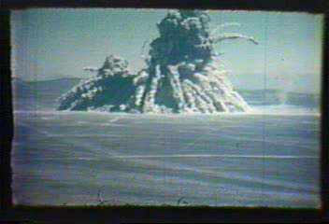
Notes:
Subsurface burst that results in a surface burst when the fireball breaks through the earth.

Slide 24
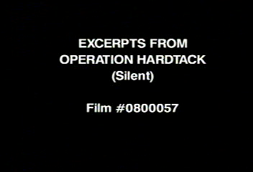

Slide 25
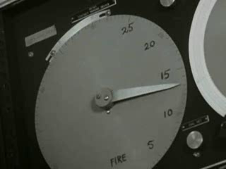
Notes:
Subsurface burst in lagoon. 90 feet deep.

Slide 26
Characteristics and Effects of Nuclear Weapons
Distribution of Energy.
Blast (or shock) = 50%
Thermal radiation (heat and light) = 35%
Total Nuclear radiation = 14%
(4% - initial, 10% residual)
Electromagnetic Pulse (EMP) = 1%

Slide 27
Characteristics and Effects of Nuclear Weapons
Blast Effects (50%)
Produces a concussive shock wave in all directions
Overpressure: Crushing effect. Normal pressure exceeded (14.7 PSI).
Dynamic Pressure: the shock “wave” 600- 1000 mph wind out. 50-75 mph back.

Slide 28
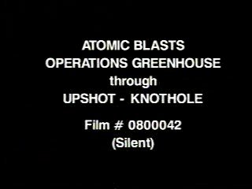
Notes:
Video of representative fireballs. Watch the shock wave hit the ground from the last detonation, Climax.

Slide 29
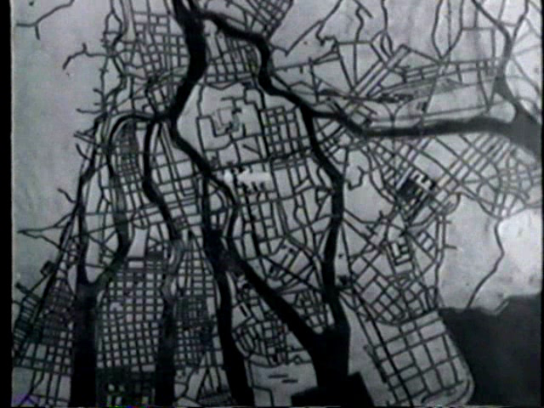
Notes:
Damage to Hiroshima. Notice the guy standing at ground zero and the buildings that remain. They are completely gutted from the blast wave.

Slide 30
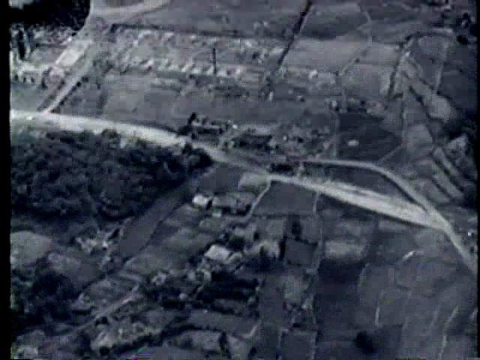
Notes:
Damage to Nagasaki.

Slide 31
Characteristics and Effects of Nuclear Weapons
Thermal Radiation Effects (35% heat and light).
Effects on Personnel:
1st, 2nd and 3rd degree burns.
Eye damage, temporary to permanent blindness.

Slide 32
Characteristics and Effects of Nuclear Weapons
Effects on Material:
Instant fire with combustable/flammable material
Explosions
Fire Storms

Slide 33
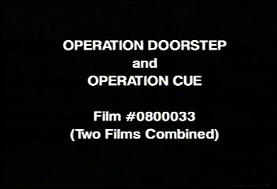
Notes:
Notice the “thermal pulse” in this vid. It heats up the outside of the house and catches it on fire long before the blast wave reaches it.

Slide 34
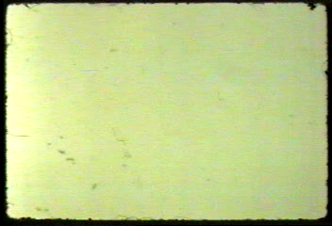

Slide 35
Characteristics and Effects of Nuclear Weapons
Total Nuclear Radiation (14%):
1. Initial Radiation (4%)-
Occurs during the first minute
Creates Gamma and Neutron Radiation.

Slide 36
Characteristics and Effects of Nuclear Weapons
Gamma Radiation –
Pure energy, no mass, no weight
highly penetrating
damage living tissue
Neutron Radiation –
Make things radioactive
Then they emit gamma and beta

Slide 37
Characteristics and Effects of Nuclear Weapons
2. Residual Radiation(10%):
Present after the first minute
Includes alpha, beta and gamma radiation
Fallout

Slide 38
Characteristics and Effects of Nuclear Weapons
Alpha Radiation-
Particulate radiation
limited penetrating powers
High internal hazard
Beta Radiation-
Some penetrating powers
Can cause burns

Slide 39


Slide 40
Characteristics and Effects of Nuclear Weapons
Radiation Protection
Gamma- limit exposure, stay back, shelter
Time, Distance, Shielding
Alpha/Beta – cover mouth and nose

Slide 41
Characteristics and Effects of Nuclear Weapons
Electromagnetic Pulse (EMP, 1%)
High intensity surge
Long range
Damages electronics

Slide 42
Characteristics and Effects of Nuclear Weapons
Protection from EMP:
Disconnect cables and antenna.
Place equipment in storage cases.
Use mission essential equipment only.
Ground equipment.
.

Slide 43
Characteristics and Effects of Nuclear Weapons
Preattack:
Find shelter
Secure equipment
Cover skin
Protect electronics
Follow your SOP

Slide 44
Characteristics and Effects of Nuclear Weapons
During-attack
Drop face down/feet towards blast
Close eyes
Protect skin
Stay down

Slide 45
Characteristics and Effects of Nuclear Weapons
During-attack
Stay calm
Check injuries
Inside Shelters:
Stay away from windows/doors
Face down in center of room

Slide 46
Characteristics and Effects of Nuclear Weapons
Postattack
Report the attack
Assess casualties
Check for radiation
Decon
Prepare for fallout

Slide 47
Characteristics and Effects of Nuclear Weapons
QUESTIONS?

