Slide 1
NUCLEAR REPORTS
FM 3-11.3, App G

Slide 2
CBRN1 NUCLEAR REPORT
Used by the observing unit to provide CBRN attack data to higher headquarters.

Slide 3
CBRN1 NUCLEAR REPORT
Types Of Observers Gathering Information:
They are designated observer, aerial designated observer and the non-designated observer.
App g, pg G-6

Slide 4
DESIGNATED OBSERVERS
Selected by the Division CBRNC
They provide the essential data for hazard locations and damage assessment
The CBRNC specifies precedence and primary and alternate means of forwarding data.
Observers report the first nuclear burst in the theater with a flash precedence.

Slide 5
SELECTION OF UNITS
Designated Ground-Based observers
Selected based on the following factors:
Location
Commo
Mission (present/ future)
Training & experience
Anticipated reliability of data
Possession of organic angle measuring equipment

Slide 6
DESIGNATED UNITS
Field Artillery
Air Defense Artillery
Engineers

Slide 7
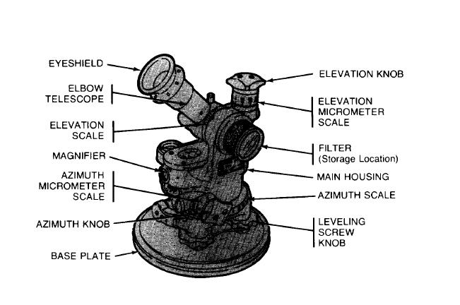
ANGLE MEASURING EQUIPMENT
M2 Aiming Circle – Cloud angles up and down

Slide 8
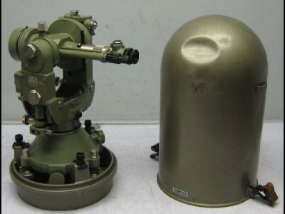
ANGLE MEASURING EQUIPMENT
BC Periscope - Cloud angles up and down (M65 or M43)
Theodolite – Horizontal and vertical angles (T16 or T2)

Slide 9
ANGLE MEASURING EQUIPMENT
Pocket transit (M2)
Radar
Lensatic Compass
M2 Aiming Circle is preferred because it is set to grid north and measures in mils.

Slide 10
AERIAL DESIGNATED OBSERVER
Aviators have the advantage of height
May be able to see and report the location of ground zero
They also may see and estimate crater width

Slide 11
NON- DESIGNATED OBSERVERS
Non-Designated Observers:
Will record nuclear attacks in the prescribed format.
Will not send a report unless asked to do so.
They will gather information for their own use.

Slide 12
CBRN 1 NUCLEAR REPORT
Sample report pg G-10, Template pg L-11
Report Information:
From/To
Precedence
Sec Class
DTG Sent
Category (Initial/Follow up)

Slide 13
CBRN 1 NUCLEAR REPORT
B/ Position of Observer/Direction to Attack (M)
D/ Date -Time of Detonation (M)
F/ Location of Area Attacked (O) (Ground Zero)
G/ Delivery Info (M)
H/ Type of Burst (M) (Surface, Air)
J/ Flash to Bang Time in seconds (O)
(hint: This Info in GTA 03-06-08!)

Slide 14
CBRN 1 NUCLEAR REPORT
L/ Cloud Width at H+5 min (O)
M/ Stabilized Cloud Top or Bottom Angle or Cloud Top or Bottom height at H+10 min
(hint: This Info in GTA 03-06-08!)

Slide 15
CBRN 1 NUCLEAR REPORT
NBC-1 Nuclear Report
FLASH
B/ 14SNB123456/087DGG//
D/211520ZMAR2011//
G/OBS/UNK/-/UNK/-//
H/SURF//
J/78//

Slide 16
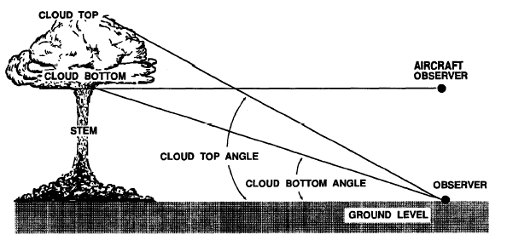
CBRN 1 NUCLEAR REPORT

Slide 17
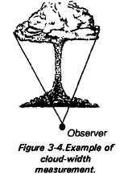
CBRN 1 NUCLEAR REPORT

Slide 18
METHODS OF LOCATING GROUND ZERO
Use the information from the CBRN 1
Intersection (2 or more azimuths)
Polar Plot

Slide 19
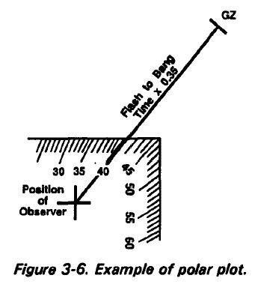
METHODS OF LOCATING GROUND ZERO
LINE J X 0.35 =
Distance to Ground
Zero (DGZ) in Km

Slide 20
CALCULATE NUCLEAR WEAPONS YIELD
Needed for downwind predictions
Use info from NBC-1 Nuclear Report

Slide 21
WEAPONS YIELD MEASUREMENTS
Yield can be determined by using the following measurements:
1. L – Cloud Width at H+5 min
or
2. M – Cloud Top or Bottom Angle at H+10 min
AND
3. J – Flash to Bang Time
or
4. Distance to Ground Zero

Slide 22
SIMPLIFIED FALLOUT PREDICTION

Slide 23
PREPARATION OF SIMPLIFIED FALLOUT PREDICTION
For Simplified Predictions you need:
A CBRN 2 Nuclear Report
Effective Downwind Message
(Good for 6 hours)

Slide 24
EFFECTIVE DOWNWIND MESSAGE
ZULUM/ Date-Time winds observed/ Date-Time effective/Date-Time expires
Remaining lines provide data for the 7 preselected yield groups
Sample report on pg D-31, FM 3-11.3

Slide 25
Effective Downwind Message
ZULUM/231030ZMAR2011/
231200ZMAR2011/231800ZMAR2011
AM/009/-/-/-//
BM/-/240/015/6//
CM/-/220/015/-//
DM/-/210/015/-//
EM/-/235/010/-//
FM/-/245/014/-//
GM/-/225/020/-//

Slide 26
EFFECTIVE DOWNWIND MESSAGE
AM over 0 thru 2 KT
BM over 2 thru 5 KT
CM over 5 thru 30 KT
DM over 30 thru 100 KT
EM over 100 thru 300 KT
FM over 300KT thru 1MT
GM over 1 thru 3 MT

Slide 27
M5A2 AREA PREDICTOR
Semi-Transparent flexible
Scaled 1/50,000 or 1/250,000
Azimuth dial, center represents ground zero.
2 radial lines, 40 degrees apart, STANDARD
Marked in kilometers

Slide 28
M5A2 AREA PREDICTOR
Semicircles (A, B, C, D, E, F) representing cloud radius for pre-selected yield groups (2, 5, 30, 100, 300kt, and 1MT)
Nomogram, Downwind Distance Zone of Immediate Concern

Slide 29
TYPE OF SIMPLIFIED FALLOUT PREDICTION
1. Normal Case – 6 Digits EDM line
2. Expanded Case – 9 Digits EDM line
3. Circular Case – 3 Digits EDM line

Slide 30
CBRN 2 (NUC) REPORT
A/US/B14/003/N//
D/231400ZMAR2010//
F/25RPA550612/EE//
G/SUS/MSL/1/BOM/1//
H/SURF//
N/20KT//

Slide 31
PREPARATION OF SIMPLIFIED FALLOUT PREDICTION
Practical Exercise

Slide 32
PREPARATION OF SIMPLIFIED FALLOUT PREDICTION
Significance of zones :
Zone 1 is the zone of Immediate Operational Concern.
Areas where exposed, unprotected personnel may receive doses of 125 cGy
FM 3-11.3, pg G-23

Slide 33
PREPARATION OF SIMPLIFIED FALLOUT PREDICTION
Zone II
The zone of secondary hazard.
Total dose received by exposed unprotected personnel is not expected to reach 125 cGy within 4 hrs after the arrival of fallout
May receive a total dose of 75 cGy

Slide 34
PREPARATION OF SIMPLIFIED FALLOUT PREDICTION
Outside the predicted area:
Exposed, unprotected may receive a total dose that does not reach 50 cGy in the first day after actual arrival of fallout.
The total dose for an infinite time of stay outside the predicted area should not reach 125 cGy.

Slide 35
PREPARATION OF SIMPLIFIED FALLOUT PREDICTION
Arrival of fallout:
Commander needs to know
Use info to plan and avoid it

Slide 36
PREPARATION OF SIMPLIFIED FALLOUT PREDICTION
Calculating ETA for fallout:
Step 1. Measure the distance from the given location to GZ.
Step 2. Determine the effective wind speed from the EDM.

Slide 37
PREPARATION OF SIMPLIFIED FALLOUT PREDICTION
Step 3. Then divide the distance from ground zero by the effective wind speed.
Time of arrival(hr) = distance from GZ(km)
Effective wind speed (kmph)

Slide 38
PREPARATION OF SIMPLIFIED FALLOUT PREDICTION
3 Rules For Fallout:
Rule 1. Fallout may arrive as early as one-half of the estimated time of arrival (ETA).
Rule 2. If fallout has not arrived by twice the ETA or H+12 (whichever is earliest) fallout is not expected to fall on that location.

Slide 39
PREPARATION OF SIMPLIFIED FALLOUT PREDICTION
Rule 3. Fallout may not cover the entire predicted area.
Protection from fallout: When a unit is in an area predicted to receive fallout, it must take action to reduce the potential threat. These actions must be listed in the unit SOP.

Slide 40
CBRN 3 NUCLEAR REPORT

Slide 41
PLOT AN CBRN 3 NUCLEAR REPORT
Plot a CBRN 3 Nuclear Report.
The CBRN 3 nuclear report is needed to plot a detailed fallout prediction.
Immediate Warning of Expected Contamination resulting from a nuclear detonation.

Slide 42
CBRN-3 (NUCLEAR REPORT)
A/US/B29/001/N//
D/211000ZMAR2011//
F/14SNB355255/EE//
PB/015KPH/010KM/02KM/
150DGG/210DGG//

Slide 43
PLOT A CBRN 3 NUCLEAR REPORT
Line Items on NBC-3 Nuclear Report
ALFA - Strike serial number
DELTA - date/time of attack (L or Z)
FOXTROT - location of area attacked (ground zero)

Slide 44
PLOT AN CBRN 3 NUCLEAR REPORT
PAPAB - Effective wind speed,
Downwind distance of zone 1,
Stabilized cloud radius,
Direction measured clockwise from grid north to the left radial line,
Direction measured clockwise from grid north to the right radial line

Slide 45
PLOT AN CBRN 3 NUCLEAR REPORT
Types of CBRN 3 Nuclear Reports (2 cases)
Standard case:
PB has w/s,Z1,Cloud Radius, L & R radial lines
PB/012KPH/018KM/02KM/040DGG/080DGG//
Special case:
PB has only a Z1 distance
PB/-/004km/-/-/-//

Slide 46
PLOT AN CBRN 3 NUCLEAR REPORT
Practical Exercise

