Slide 1
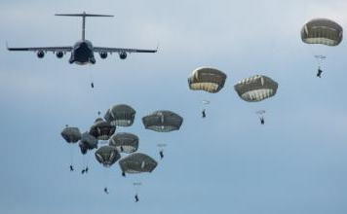
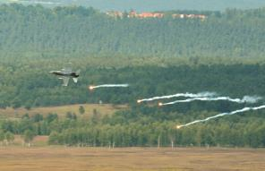
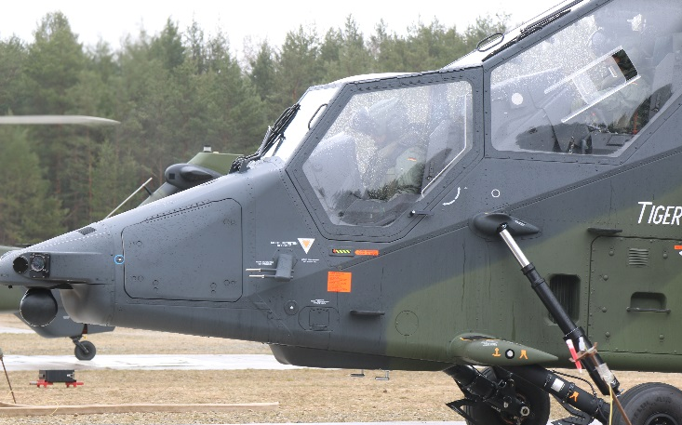
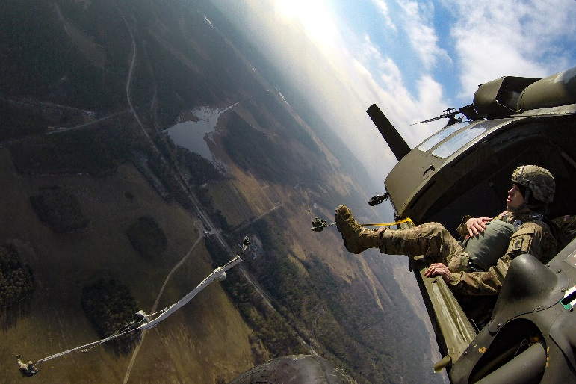
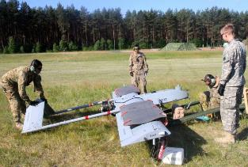
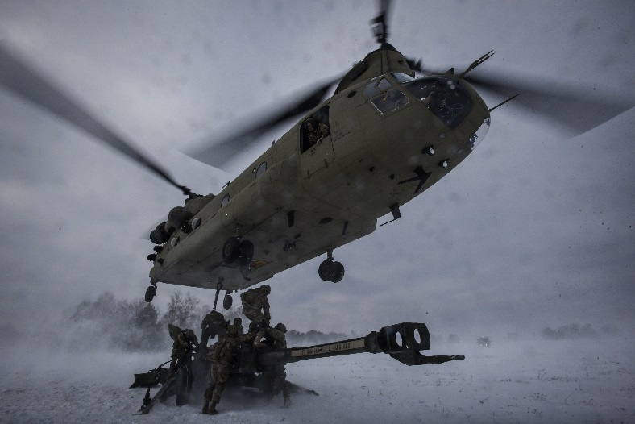
GTA REDLINE BRIEF – SUAS
7th ARMY TRAINING COMMAND
GRAFENWOEHR TRAINING AREA
WORLD’S GREATEST TRAINING AREA
GTA Aviation Branch
475-7941
09641837941
Notes:
Hello and welcome to the GTA Range Operations Capabilities Brief. I am CPT Brian Middleton, Chief of Operations at the Grafenwoehr Training Area. Today I will be giving you a short overview of the Grafenwohr Training Area, some of its Ranges, and other capabilities.
FDO reviewed on 08/04/2025 for JMTG-U course.

Slide 2
AGENDA
References
Airspace Overview
Scheduling
Redline Briefing
Restrictions
Airborne Operations
GTA ROZ / Airspace Deconfliction
SNAP ROZ
Bunker DZ / Balli UAS Facility
No-Fly Areas
Communication
Lost Comms / Link
GTA AVN Incident Reporting
Emergency
COTS SUAS Quick Reference Card
Questions

Slide 3
REFERENCES
Memorandum of Agreement: Small Unmanned Aerial System Operations within the Grafenwoehr Training Area, 1 June 2024.
Grafenwoehr Training Area Range Operations (GTA-RO) Standard Operating Procedure, 1 August 2023.
Army Regulation 385-63, Range Safety, 30 January 2012.
Department of the Army Pamphlet 385-63, Range Safety, 16 April 2014.

Slide 4
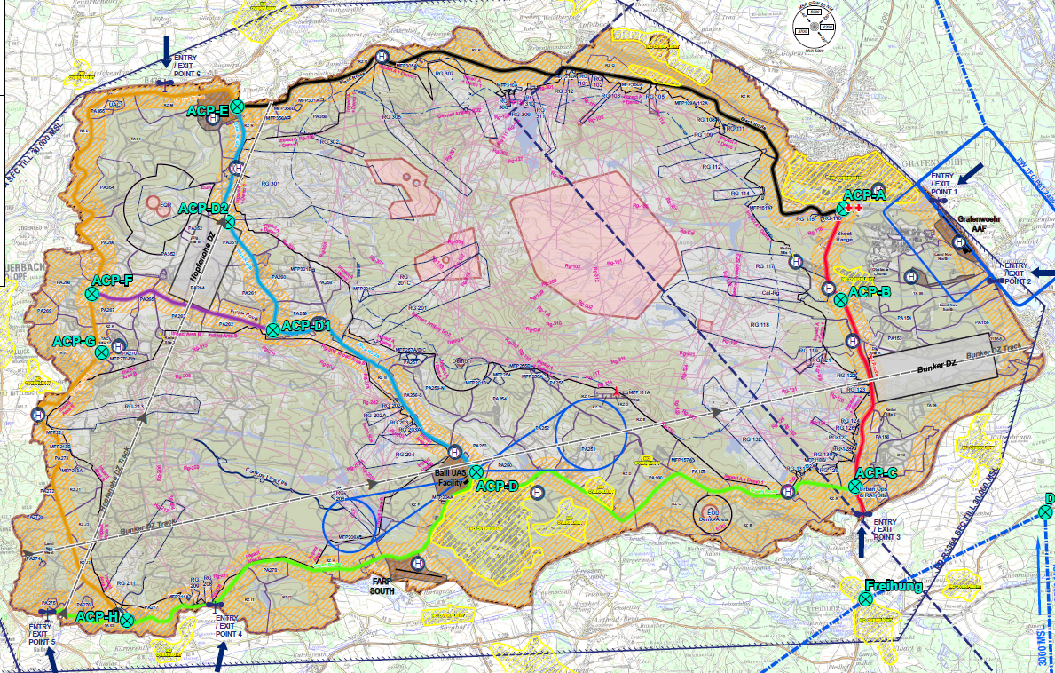
GRAFENWOER TRAINING AREA
Notes:
Europe Deutschland-Restricted Area (ED-R) 136 extends from the surface to 30,000 feet mean sea level (MSL). Sector A is for all rotary-wing, fixed-wing, and Unmanned Aircraft Systems (UAS) operations. Sector B is extended airspace to the west of Sector A from surface to 10,000 feet MSL and is primarily for fixed-wing platforms performing airborne operations and Close Air Support (CAS) missions. Sector C is above Sector B from 10,000 to 30,000 feet MSL and is primarily for high-performance CAS platforms. Sector A is permanently active with Sectors B and C activated and deactivated by the Airspace Usage Plan.
Grafenwoehr Air Traffic Control Services (ATCS) maintains Local Flying Rules for areas outside ED-R 136. The Local Flying Rules include Maintenance Test Flight Areas. Contact Aviation Branch or Grafenwoehr ATCS for Local Flying Rules.
The only approved flight following agency is provided by Grafenwoehr Army Radar Approach Control (ARAC), call sign henceforth referred to as “Graf Radio”.
Current maps, HLZ diagrams, SOPs, and range diagrams are available by contacting the Aviation Branch. US military units may also log in to:
https://armyrangemapper.eur.army.mil/tapin
Search for “GTA Range Operations” and click on “Training Resources” then “Resource Library.”

Slide 5
SCHEDULING
Unless pre-approved per the GTA SOP, all operations require coordination with Aviation Live Fire Branch 21 days prior.
  usarmy.bavaria.7atc-gta.list.gta-avn-branch@army.mil
There are no free training areas within GTA due to hunting, range maintenance, and German Forestry operations.
Graf Radio will not be used for aviation training that can be accomplished in other training areas within GTA.
Recreational airspace usage (e.g. model rockets, model airplanes, commercial off the self SUAS, etc…) is prohibited.
Notes:
Rotary Wing: Flights entering and exiting the established Entry/Exit (E/E) Points and remaining on the Admin Route for the duration of the flight are authorized when Graf Radio is operational. There are no free training areas within GTA. Due to hunting, range maintenance, and German Forestry operations, all flights operating outside of the Admin Route or the landing zones authorized in paragraph 1-5 c must be coordinated with GTA Aviation Branch, DSN 475-7941 or usarmy.bavaria.7atc-gta.list.gta-avn-branch@mail.mil, NLT 14 days prior to the event.
Fixed Wing: Operations must be scheduled NLT 21 days prior to the event through the 7TH Army Center Air Force Liaison Office (7ATC ALO), DSN 475-6108, or the Aviation Branch.
UAS: All UAS operations must be scheduled NLT 21 days prior to the event through the Aviation Branch. See Chapter 5 for further details on scheduling UAS land and airspace.
GAAF usage and PPRs will be in accordance with DOD Flight Information Publication (FLIPs). Due to noise avoidance considerations, GAAF will not be used for aviation training that can be accomplished in other training areas within GTA.
VAAF usage will be scheduled through GAAF Base Operations, but Aviation Branch must be notified of any air activities. VAAF will not be used for non-aviation training without approval from the 7th ATC Commanding General.
Ground units requesting non-organic aviation asset support must submit an Air Mission Request and concept of the operation overlay through their Brigade Aviation Element for submission to the United States Army Europe (USAREUR) G-3 Air 60 day prior to training.
Non-military use of ED-R 136 requires special approval. Agencies desiring to enter ED-R 136 may contact Aviation Branch NLT 21 days prior to coordinate.
Recreational airspace usage (e.g. model rockets, model airplanes, drones, quad copters) is prohibited. Individuals may pursue a waiver to this by contacting Aviation Branch.
Weather balloons (less than 500g) can be released on GTA. Units must contact GAAF Base Operations 1 hour prior to launch and Graf Radio 15 minutes prior to launch. See Table 1-3 for frequencies and phone numbers.

Slide 6
REDLINE BRIEFING
Requirements to fly in GTA (ED-R 136):
  Must have an Aircrew Procedures Guide (APG) REDLINE Brief prior to operating in ED-R 136. Operators are required to validate their REDLINE briefing with the GTA firing desk prior to entering the airspace.
  Unit must submit a memorandum signed by briefer on file with GTA Aviation Branch. Briefs are valid for 365 calendar days.
  RSO/OIC must have a copy of the current map, GTA SOP, and Daily Range Bulletin during operations.
    https://armyeitaas.sharepoint-mil.us/:f:/r/teams/GTARangeOperations/Shared%20Documents/General/03.%20Range%20Bulletins?csf=1&web=1&e=8SqnJ6
Notes:
Regardless of aircraft type, all pilots and UAS operators must obtain an Aircrew Procedures Guide (APG) REDLINE briefing prior to operating within ED-R 136. REDLINE briefings are valid for 120 calendar days. The GTA Air Traffic and Airspace (AT&A) Officer is the only default authorized briefer.
After a local REDLINE Brief is conducted for SP’s, units will submit a Memorandum for Record listing all locally briefed pilots and UAS operators. The memorandum will be signed by the briefer and submitted to the Aviation Branch prior to conducting training within ED-R 136. Example memorandums can be found in Appendix A.
Self-briefing (i.e., reviewing the REDLINE Brief at Base Operations) is not authorized. Only the approved unit representative or the GTA AT&A may give the REDLINE Briefing.
All Aviators, UAS Operators, and Range OICs must have a current copy of and be familiar with the Daily Range Bulletin. Range Bulletins are published NLT 72 hours prior to the training day and will be utilized when conducting final mission planning. Graf Radio will receive any subsequent updates from Aviation Branch and will brief aircrews any changes amendments as needed.
The Daily Range Bulletin is the final authorization for aviation operations outside of the Admin Route and those facilities listed in paragraph 1-5 (Admin Route flights will not be listed on the bulletin). Supported ground units may coordinate for aviation operations, but Aviators and UAS Operators are ultimately responsible to ensure their operations are listed on the bulletin. In the event a flight is not listed, contact Aviation Branch prior to operations to request approval.
Units must comply with all requirements/restrictions in GTA SOP 1 and SOP 4. Violations will result in loss of flight privileges within ED-R 136

Slide 7
REDLINE BRIEFING
Flights may operate only when Graf Radio is open
  Normal Graf Radio hours are 0800-2300L Monday-Friday.
  UAS flights outside of these hours require an extension memo for Graf Radio hours. This extension memo must be submitted through the Aviation Live Fire Branch for approval from the RMA.
  With Graf Radio open, we have the potential to operate 24 hours a day, 365 days a year.
Notes:
Regardless of aircraft type, all pilots and UAS operators must obtain an Aircrew Procedures Guide (APG) REDLINE briefing prior to operating within ED-R 136. REDLINE briefings are valid for 120 calendar days. The GTA Air Traffic and Airspace (AT&A) Officer is the only default authorized briefer.
After a local REDLINE Brief is conducted for SP’s, units will submit a Memorandum for Record listing all locally briefed pilots and UAS operators. The memorandum will be signed by the briefer and submitted to the Aviation Branch prior to conducting training within ED-R 136. Example memorandums can be found in Appendix A.
Self-briefing (i.e., reviewing the REDLINE Brief at Base Operations) is not authorized. Only the approved unit representative or the GTA AT&A may give the REDLINE Briefing.
All Aviators, UAS Operators, and Range OICs must have a current copy of and be familiar with the Daily Range Bulletin. Range Bulletins are published NLT 72 hours prior to the training day and will be utilized when conducting final mission planning. Graf Radio will receive any subsequent updates from Aviation Branch and will brief aircrews any changes amendments as needed.
The Daily Range Bulletin is the final authorization for aviation operations outside of the Admin Route and those facilities listed in paragraph 1-5 (Admin Route flights will not be listed on the bulletin). Supported ground units may coordinate for aviation operations, but Aviators and UAS Operators are ultimately responsible to ensure their operations are listed on the bulletin. In the event a flight is not listed, contact Aviation Branch prior to operations to request approval.
Units must comply with all requirements/restrictions in GTA SOP 1 and SOP 4. Violations will result in loss of flight privileges within ED-R 136

Slide 8
REDLINE BRIEFING
Violations of Redline Brief
Any Violation of procedures within GTA results in loss of flight privileges within EDR-136 for 14 days. Once APG privileges are removed, the aviators must be re-briefed by Aviation Branch for re-certification before reentering EDR-136. IAW SOP #1, violations also require a GTA to submit Command Incident Report (CIR) to 7ATC.
Violations within EDR-136 will be considered violations of restricted airspace and will be reported by an OHR or filed as violations to AFOD.

Slide 9
RESTRICTIONS
Surface to 500 FT AGL.
Maintain 300m from helicopter routes / Tank Trail.
Maintain 300m from training area boundary lines.
Will not operate beyond 1.5KM of the control station and will remain within line of sight.
Exceptions to these restrictions will need to be approved by the Aviation Live Fire Branch.
Notes:
Rotary Wing: Flights entering and exiting the established Entry/Exit (E/E) Points and remaining on the Admin Route for the duration of the flight are authorized when Graf Radio is operational. There are no free training areas within GTA. Due to hunting, range maintenance, and German Forestry operations, all flights operating outside of the Admin Route or the landing zones authorized in paragraph 1-5 must be coordinated with GTA Aviation Branch, DSN 475-7941, NLT 14 days prior to the event.
Fixed Wing: Operations must be scheduled NLT 14 days prior to the event through the 7TH Army Center Air Force Liaison Office (7ATC ALO), DSN 475-6108, or the Aviation Branch.
UAS: All UAS operations must be scheduled NLT 14 days prior to the event through the Aviation Branch.
Tactical UAS (TUAS) Shadow and Hunter systems need only reserve the land required for launch and recovery. Reservations for Vilseck Army Airfield (VAAF) and the CW2 Ed Balli UAS Facility (Balli Strip) will be through Grafenwoehr Army Airfield (GAAF) Operations.
Aviation Branch will approve/assign keypads and altitudes for TUAS operations and notify Graf Radio for visibility and real-time de-confliction.
Land being utilized for small UAS (SUAS) operations must be reserved, occupied, and cleared in accordance with GTA SOP 1.
SUAS operations will schedule land through the Range Facility Management Support System (RFMSS) IAW GTA SOP 1. Recommend units contact Aviation Branch prior to scheduling, as not all areas support SUAS operations.
GAAF usage and PPRs will be in accordance with DOD Flight Information Publication (FLIPs). Due to noise avoidance considerations, GAAF will not be used for aviation training that can be accomplished in other training areas within GTA.
VAAF usage will be scheduled through GAAF Base Operations, but Aviation Branch must be notified of any air activities. VAAF will not be used for non-aviation training without approval from the 7th ATC Commanding General.
Ground units requesting non-organic aviation asset support must submit an Air Mission Request and concept of the operation overlay through their Brigade Aviation Element for submission to the United States Army Europe (USAREUR) G-3 Air 60 day prior to training.
Non-military use of ED-R 136 requires special approval. Agencies desiring to enter ED-R 136 may contact Aviation Branch NLT 14 days prior to coordinate.
Recreational airspace usage (e.g. model rockets, model airplanes, drones, quad copters) is prohibited. Individuals may pursue a waiver to this by contacting Aviation Branch.

Slide 10
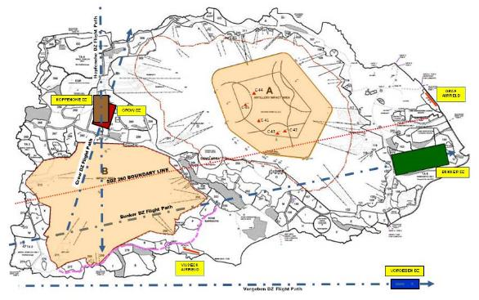
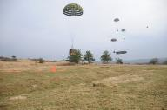
AIRBORNE OPS
The activation of Bunker DZ may effect your training by placing all ranges within GTA to “dry status” until airborne operations complete.
This is only for Fixed Wing Airborne Operations.
Rotary Wing Airborne Operations have no effect on UAS operations.
1
2
Notes:
In addition to Air weapons training the GTA has 3 on Drop zones and 1 available in the Maneuver rights area.
On average we do 2-3 air drops on the GTA primarily from units based on Ramstein AB.

Slide 11
GTA ROZ / AIRSPACE DECONFLICTION
CUI
ROZ Utilization and Airspace deconfliction.
🡺 When a ROZ begins and ceases to be utilized, the OIC for the ROZ Request must notify GTA Range hotline and ARAC:
  Firing Desk:
◆ +49 (0) 9641 70 526 1200
    DSN: 526-1200
    FM: 60.000
  ARAC:
◆ +49 (0) 9641 70 526 8333
(alt: 8334)
    DSN: 526-8333 (alt: 8334)
    FM: 33.225
🡺 Failure to report usage will result in a non- usage flag from Range at a minimum, and an unintended AVN safety incident in the worst case.
Lost link-UAS.
🡺 If there’s a lost link for signal for (S)UAS, and the location of the aircraft is either unknown or known to have exited their ROZ, the operator must immediately notify GTA Range hotline and ARAC:
  Firing Desk:
◆ +49 (0) 9641 70 526 1200
    DSN: 526-1200
    FM: 60.000
  ARAC:
◆ +49 (0) 9641 70 526 8333
(alt. 8334)
    DSN: 526-8333 (alt: 8334)
    FM: 33.225
🡺 Failure to report lost link could result in property loss at minimum, and an unintended
AVN safety incident in the worst case.
A ROZ is defined as a Restricted Operating Zone and incorporates both crewed and non-crewed aviation platform usage.
CUI

Slide 12
SNAP ROZ
These are quick turn on ROZs for Unit Training events, familiarization training, certification or currency flights that do not fall within the 21-day window.
The breakdown of these ROZs are as follows:
  173D: BUNKER DZ / TA06
  2CR: PA252 / PA251
  7ATC: BALLI UAS CENTER (BALLI AIRSPACE) / RZ F
  RAF UNITS: TA04
Non tenant units and multinational partners can use any of the available Snap ROZs as well.
Notes:
Rotary Wing: Flights entering and exiting the established Entry/Exit (E/E) Points and remaining on the Admin Route for the duration of the flight are authorized when Graf Radio is operational. There are no free training areas within GTA. Due to hunting, range maintenance, and German Forestry operations, all flights operating outside of the Admin Route or the landing zones authorized in paragraph 1-5 must be coordinated with GTA Aviation Branch, DSN 475-7941, NLT 14 days prior to the event.
Fixed Wing: Operations must be scheduled NLT 14 days prior to the event through the 7TH Army Center Air Force Liaison Office (7ATC ALO), DSN 475-6108, or the Aviation Branch.
UAS: All UAS operations must be scheduled NLT 14 days prior to the event through the Aviation Branch.
Tactical UAS (TUAS) Shadow and Hunter systems need only reserve the land required for launch and recovery. Reservations for Vilseck Army Airfield (VAAF) and the CW2 Ed Balli UAS Facility (Balli Strip) will be through Grafenwoehr Army Airfield (GAAF) Operations.
Aviation Branch will approve/assign keypads and altitudes for TUAS operations and notify Graf Radio for visibility and real-time de-confliction.
Land being utilized for small UAS (SUAS) operations must be reserved, occupied, and cleared in accordance with GTA SOP 1.
SUAS operations will schedule land through the Range Facility Management Support System (RFMSS) IAW GTA SOP 1. Recommend units contact Aviation Branch prior to scheduling, as not all areas support SUAS operations.
GAAF usage and PPRs will be in accordance with DOD Flight Information Publication (FLIPs). Due to noise avoidance considerations, GAAF will not be used for aviation training that can be accomplished in other training areas within GTA.
VAAF usage will be scheduled through GAAF Base Operations, but Aviation Branch must be notified of any air activities. VAAF will not be used for non-aviation training without approval from the 7th ATC Commanding General.
Ground units requesting non-organic aviation asset support must submit an Air Mission Request and concept of the operation overlay through their Brigade Aviation Element for submission to the United States Army Europe (USAREUR) G-3 Air 60 day prior to training.
Non-military use of ED-R 136 requires special approval. Agencies desiring to enter ED-R 136 may contact Aviation Branch NLT 14 days prior to coordinate.
Recreational airspace usage (e.g. model rockets, model airplanes, drones, quad copters) is prohibited. Individuals may pursue a waiver to this by contacting Aviation Branch.

Slide 13
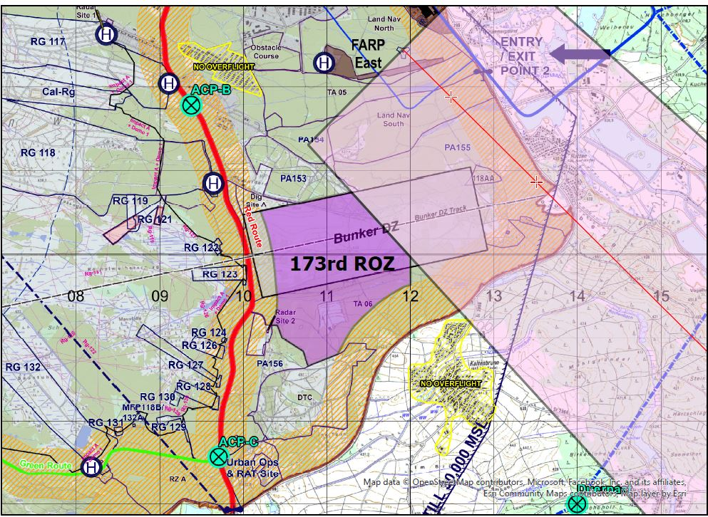
BUNKER DZ
The entirety of Bunker DZ is not permitted for Snap ROZ UAS operations.
Units will not fly outside the specified ROZ boundaries on Bunker DZ due to potential conflicts with approach procedures with GAAF and the risk of crossing into the Class Delta Airspace.
Notes:
In addition to Air weapons training the GTA has 3 on Drop zones and 1 available in the Maneuver rights area.
On average we do 2-3 air drops on the GTA primarily from units based on Ramstein AB.

Slide 14
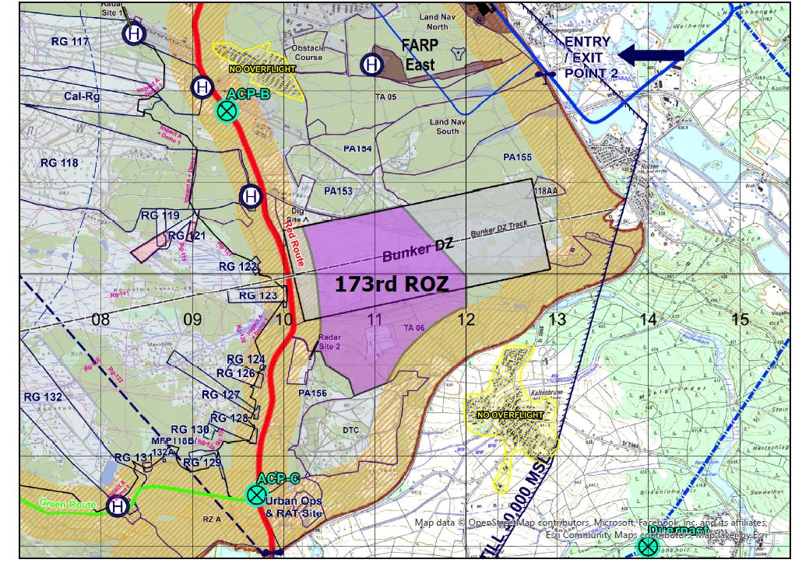
BUNKER DZ
Return to home point with be placed in the vicinity of 32UQA106770624.
During an aircraft emergency or Medical Evacuation (MEDEVAC), Graf Radio will notify UAS operator for UAS to go flat pitched (placed on the ground) to deconflict with the emergency situation.
At no time will a
UAS operate during an emergency without authorization from Firing Desk.
Notes:
In addition to Air weapons training the GTA has 3 on Drop zones and 1 available in the Maneuver rights area.
On average we do 2-3 air drops on the GTA primarily from units based on Ramstein AB.

Slide 15
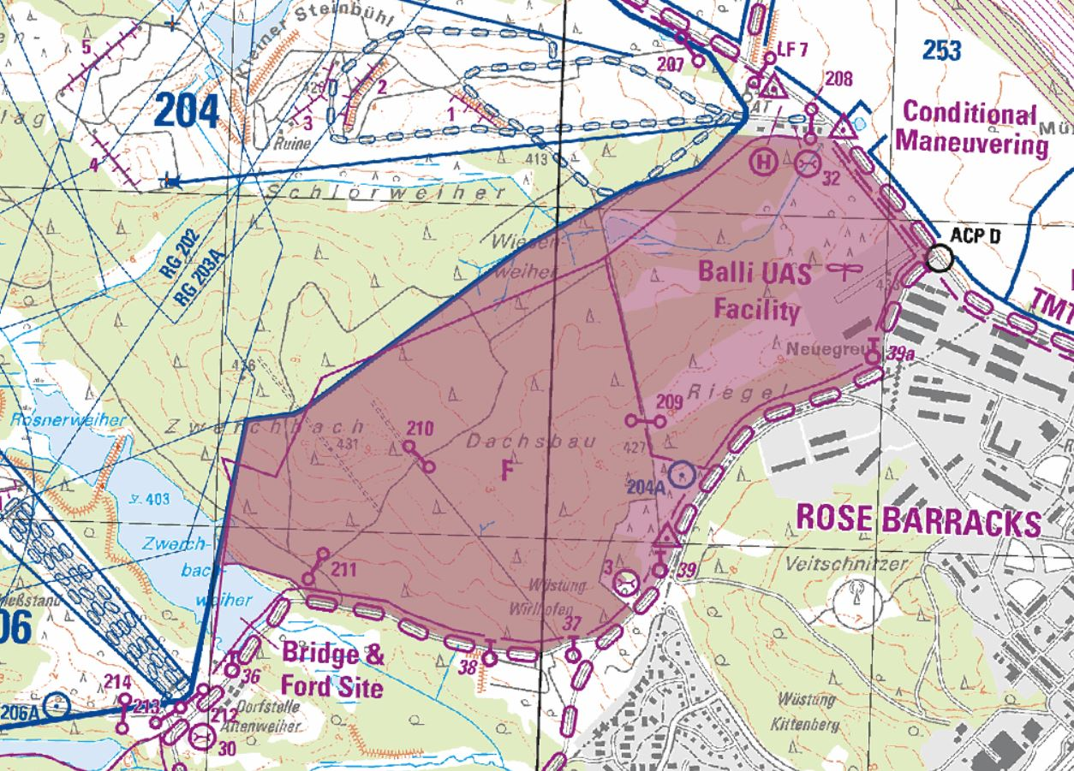
BALLI UAS FACILITY
Balli UAS Facility will have dedicated airspace above Balli AAF and Rendezvous Zone (RZ) F on GTA to operate at or below 500’ AGL.
Operators will contact GRAF Radio and the Firing Desk prior to launching from the paved areas of the facility to ensure there is no conflict with rotary wing traffic on the aviation route.
Notes:
In addition to Air weapons training the GTA has 3 on Drop zones and 1 available in the Maneuver rights area.
On average we do 2-3 air drops on the GTA primarily from units based on Ramstein AB.

Slide 16
BALLI UAS FACILITY
While operating in the Balli AAF and RZ F airspace, operators will ensure the UAS is not flying within 300 meters of the tank trail without prior coordination with the firing desk and Graf Radio.
UAS Operator is solely responsible to ensure their UAS remains 1NM clear of all aircraft operating at or below 1000FT AGL.
Notes:
In addition to Air weapons training the GTA has 3 on Drop zones and 1 available in the Maneuver rights area.
On average we do 2-3 air drops on the GTA primarily from units based on Ramstein AB.

Slide 17
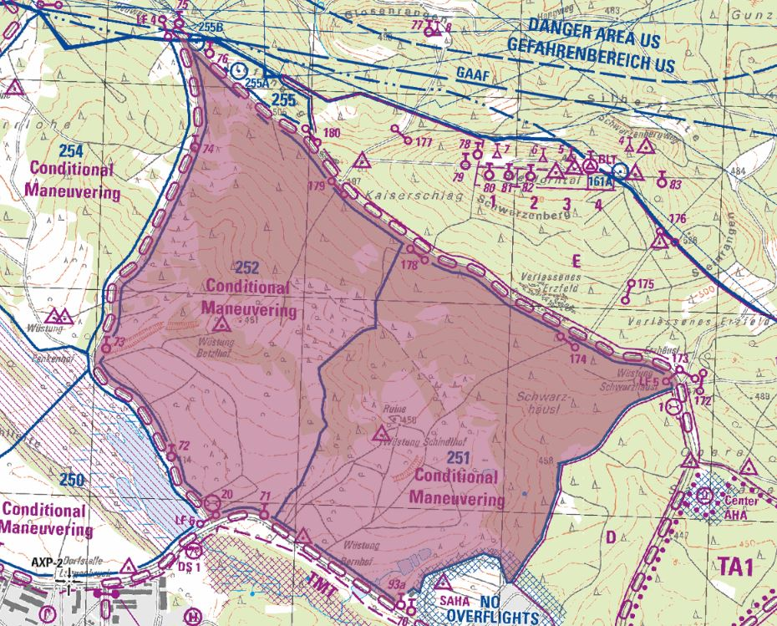
2CR SNAP ROZ
Notes:
In addition to Air weapons training the GTA has 3 on Drop zones and 1 available in the Maneuver rights area.
On average we do 2-3 air drops on the GTA primarily from units based on Ramstein AB.

Slide 18
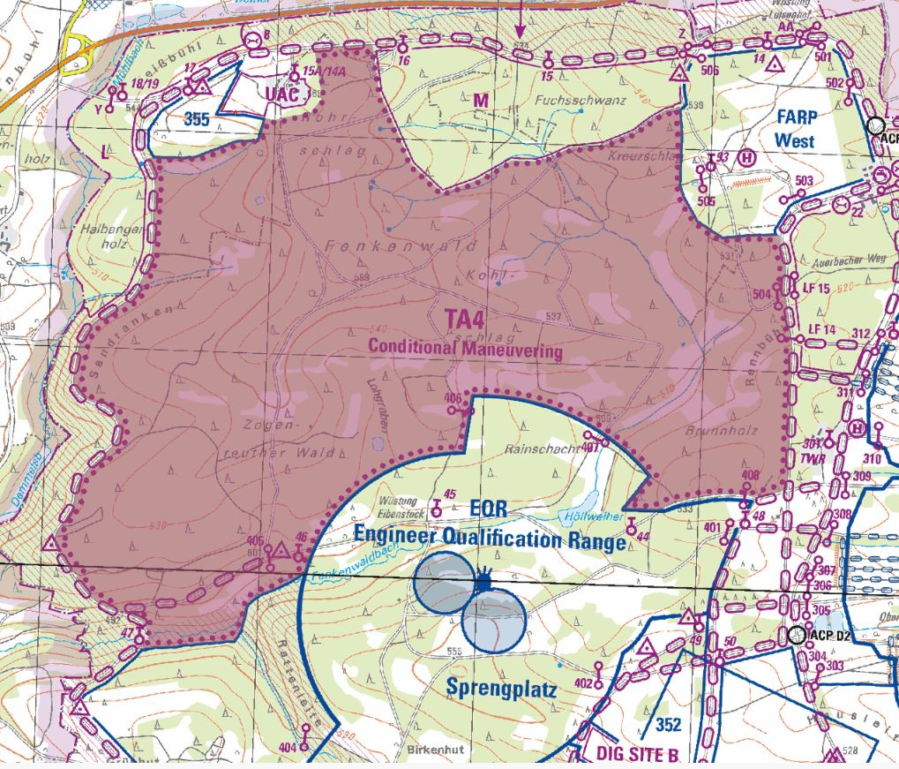
RAF SNAP ROZ
Notes:
In addition to Air weapons training the GTA has 3 on Drop zones and 1 available in the Maneuver rights area.
On average we do 2-3 air drops on the GTA primarily from units based on Ramstein AB.

Slide 19
NO-FLY AREAS
The following areas are No-Fly areas within the ED-R 136 from surface to 1,000FT AGL:
  Ammunition Storage Point (ASP) (center point QA 0330 0275)
  Northern Ammunition Holding Area (NAHA) (center point QA 0510 1280)
  Southern Ammunition Holding Area (SAHA) (center point QA 0400 0350)
  PA 160 Ammunition Holding Area (AHA) (center point QA 0500 0410)
Notes:
1-6. No-Fly Areas
The following areas are No-Fly areas within the ED-R 136 from surface to 1,000 feet AGL:
Ammunition Storage Point (ASP) (center point QA 0330 0275)
Northern Ammunition Holding Area (NAHA) (center point QA 0510 1280)
Southern Ammunition Holding Area (SAHA) (center point QA 0400 0350)
PA 160 Ammunition Holding Area (AHA) (center point QA 0500 0410)
The training area has multiple environmentally sensitive areas that will not be over flown less than 500 feet AGL. Aviation Branch will notify the unit of these areas when approving off route flights.
All populated areas outside GTA but within ED-R 136 will not be over-flown at altitudes less than 1,000 feet AGL.

Slide 20
COMMUNICATION
Initial Contact:
  Request permission 15 minutes prior to launch/recovery operations.
  Aircraft identification, location, and telephonic contact information.
  Direction of departure/recovery.
  Requested operating area(s) and altitude.
For Snap ROZs initial coordination must be made with the firing desk, in advance of the UAS launch time.
Notes:
The only approved flight following agency is Graf Radio. Aircraft will monitor Graf Radio and the Range Ops Firing Desk (FM 60.0) when operating in the training area, outside of a ROZ or live fire range.
Initial Contact - Rotary Wing. On initial contact, aircraft will provide Graf Radio with:
Aircraft call sign and five digit tail number
Number and type of aircraft in flight
Number of personnel on board
Location
Destination
Any other pertinent information (Code or VIP on board, approved non-standard flight route, etc.)
Initial Contact - UAS.
Request permission 15 minutes prior to launch/recovery operations
On initial contact, operators will provide Graf Radio with:
Aircraft identification, location, and telephonic contact information (landline or cellphone)
Direction of departure/recovery
Requested operating area (Killbox/Keypad(s))
Requested block altitudes
GTA has a published air-to-air frequency, but there is no requirement to monitor it. Aviation Branch has the authority to mandate its use on a case by case basis.
NOTE
The GTA Firing Desk is not authorized to flight-follow aircraft within ED-R 136. Aviators/UAS operators may contact the Firing Desk if unable
to communicate with Graf Radio during an emergency.
Operating when Graf Radio is closed requires approval from Aviation Branch and a Battalion Commander-approved memorandum (or a DD Form 2977 with a Medium residual risk that addresses operations without flight following). During these times utilize Graf Radio frequency VHF 139.40 as a CTAF and check in and out with the Firing Desk. See paragraph 1-10a for normal hours of operation.
GTA’s MEDEVAC support unit is the only unit pre-approved to operate outside of Graf Radio’s hours.
The controlling agency for ED-R 136 is the GTA AT&A Officer, delegated to Graf Radio. Graf Radio is the only approval authority for ED-R entry and exit. Graf Radio is the only flight-following agency for GTA during day or night operations.
All ACPs are mandatory reporting points to Graf Radio. Aircraft will also report arrival at ranges or training areas.
Aircraft will contact Graf Radio with an “operations normal” call every 30 minutes or as requested by Graf Radio while established within a training area.

Slide 21
COMMUNICATION
The only approved flight following agency is provided by Grafenwoehr Army Radar Approach Control (ARAC), call sign “Graf Radio”.
The Firing Desk is not authorized to flight-follow aircraft. Aviators/UAS operators may contact the Firing Desk if unable to communicate with Graf Radio during an emergency.
Graf Radio and the Firing Desk will be notified 15 minutes prior to any Launch/Recovery Operations.
Operators will contact Graf Radio with an “operations normal” call every 30 minutes or as requested by Graf Radio while established within a training area.
Notes:
The only approved flight following agency is Graf Radio. Aircraft will monitor Graf Radio and the Range Ops Firing Desk (FM 60.0) when operating in the training area, outside of a ROZ or live fire range.
Initial Contact - Rotary Wing. On initial contact, aircraft will provide Graf Radio with:
Aircraft call sign and five digit tail number
Number and type of aircraft in flight
Number of personnel on board
Location
Destination
Any other pertinent information (Code or VIP on board, approved non-standard flight route, etc.)
Initial Contact - UAS.
Request permission 15 minutes prior to launch/recovery operations
On initial contact, operators will provide Graf Radio with:
Aircraft identification, location, and telephonic contact information (landline or cellphone)
Direction of departure/recovery
Requested operating area (Killbox/Keypad(s))
Requested block altitudes
NOTE
The GTA Firing Desk is not authorized to flight-follow aircraft within ED-R 136. Aviators/UAS operators may contact the Firing Desk if unable
to communicate with Graf Radio during an emergency.
Operating when Graf Radio is closed requires approval from Aviation Branch and a Battalion Commander-approved memorandum (or a DD Form 2977 with a Medium residual risk that addresses operations without flight following). During these times utilize Graf Radio frequency VHF 139.4 as a CTAF and check in and out with the Firing Desk FM 60.00. See paragraph 1-10a for normal hours of operation.
GTA’s MEDEVAC support unit is the only unit pre-approved to operate outside of Graf Radio’s hours.
The controlling agency for ED-R 136 is the GTA AT&A Officer, delegated to Graf Radio. Graf Radio is the only approval authority for ED-R entry and exit. Graf Radio is the only flight-following agency for GTA during day or night operations.
All ACPs are mandatory reporting points to Graf Radio. Aircraft will also report arrival at ranges or training areas.
Aircraft will contact Graf Radio with an “operations normal” call every 30 minutes or as requested by Graf Radio while established within a training area.

Slide 22
COMMUNICATION
Station | Primary |  |  | Secondary
 | UHF | VHF | FM | DSN | CIV
Graf Radio | 398.5 | 139.40 | 33.225 | 526-8333/8334 | 09641-70- 526-8333/8334
Range Ops Firing Desk | - | - | 60.0 | 526-1200 | 09641-70-526-1200
MEDEVAC | - | - | 48.0/83.8 | - | -
CTAF/ When Graf Radio is closed | - | 139.40 | - | - | -
Metro | - | 140.3 | - | 526-8307 | -
Notes:
The only approved flight following agency is Graf Radio. Aircraft will monitor Graf Radio and the Range Ops Firing Desk (FM 60.0) when operating in the training area, outside of a ROZ or live fire range.
Initial Contact - Rotary Wing. On initial contact, aircraft will provide Graf Radio with:
Aircraft call sign and five digit tail number
Number and type of aircraft in flight
Number of personnel on board
Location
Destination
Any other pertinent information (Code or VIP on board, approved non-standard flight route, etc.)
Initial Contact - UAS.
Request permission 15 minutes prior to launch/recovery operations
On initial contact, operators will provide Graf Radio with:
Aircraft identification, location, and telephonic contact information (landline or cellphone)
Direction of departure/recovery
Requested operating area (Killbox/Keypad(s))
Requested block altitudes
GTA has a published air-to-air frequency, but there is no requirement to monitor it. Aviation Branch has the authority to mandate its use on a case by case basis.
NOTE
The GTA Firing Desk is not authorized to flight-follow aircraft within ED-R 136. Aviators/UAS operators may contact the Firing Desk if unable
to communicate with Graf Radio during an emergency.
Operating when Graf Radio is closed requires approval from Aviation Branch and a Battalion Commander-approved memorandum (or a DD Form 2977 with a Medium residual risk that addresses operations without flight following). During these times utilize Graf Radio frequency VHF 139.40 as a CTAF and check in and out with the Firing Desk. See paragraph 1-10a for normal hours of operation.
GTA’s MEDEVAC support unit is the only unit pre-approved to operate outside of Graf Radio’s hours.
The controlling agency for ED-R 136 is the GTA AT&A Officer, delegated to Graf Radio. Graf Radio is the only approval authority for ED-R entry and exit. Graf Radio is the only flight-following agency for GTA during day or night operations.
All ACPs are mandatory reporting points to Graf Radio. Aircraft will also report arrival at ranges or training areas.
Aircraft will contact Graf Radio with an “operations normal” call every 30 minutes or as requested by Graf Radio while established within a training area.

Slide 23
LOST COMMS / LINK
In the event of lost communications/or lost link of UAS for more than one minute, the operator will accomplish the following:
a. Return aircraft to authorized landing area and land. For lost link provide the Firing Desk and Graf Radio with the last known position.
b. Notify ground safety officer or OIC of situation.
c. Make a telephone/radio call to Graf Radio and the Firing Desk to advise them of the status of the aircraft.
d. Advise the Firing Desk and Graf Radio once the UAS has landed in the designated area or lands outside of the designated landing area for further assistance.
Notes:
In the event of an emergency, immediate notification of Graf Radio/GAAF Tower, Base Operations, and GTA Range Operations will activate the 7ATC Aviation Pre-Accident Plan.
Emergency operations. Aviators/UAS operators experiencing in-flight emergencies will report the following to Graf Radio:
Identification/Aircraft Type
Nature of the emergency
Location (or last known)
Pilot/Operator intentions
Number of personnel on board
Fuel remaining (hours/minutes)
Ammunition on board
Other pertinent data
In the event of an emergency, immediate notification of Graf Radio/GAAF Tower, Base Operations, and GTA Range Operations will activate the 7ATC Aviation Pre-Accident Plan.
Notify the GTA Range Operations Firing Desk as soon as possible after landing. All accidents must be reported to Range Operations IAW GTA SOP #1. Additionally, per AE Suppl 1 to AR 95-1, any unit involved in a Class A, B, or C aviation accident will immediately notify the USAREUR Watch Officer (537-3192/3186/3189, CIV: 0611-143-537-3189) and submit the AE Form 95-23A within two hours to usarmy.badenwur.usareur.mbx.g33-ops-watch-officer@mail.mil.
Emergency landing areas. Aviators required to perform precautionary or forced landings may choose a landing area as necessary to ensure the safety of occupants and the flight crew. Flight crews should consider the location of active ranges and permanently dudded areas before landing.
Primary. GAAF is the primary emergency recovery location for aircraft requiring adequate maneuver area for run-on or roll-on landings. Depending on the nature of the emergency, aircraft with munitions on board will:
Hover taxi onto the taxiway between parking pads 7 & 11 and continue straight ahead toward the berm west of Pad 99.
Position the aircraft in the center of Pad 99 oriented west.
Aircraft unable to taxi will shut down in place and immediately notify unit to download aircraft.
Alternate. VAAF serves as a secondary recovery location for aircraft requiring run-on or roll-on landings. The bulletin will note if VAAF is occupied with ground operations.
Aviators shall ensure that the runway environment is free of obstructions before landing.
Depending on the nature of the emergency, aircraft with munitions on board will position the aircraft at a heading of 330 degrees and notify unit to download aircraft following shutdown.
Lost Communication. Lost communication procedures will be accomplished IAW the FIH, Army Regulations, applicable ATM, and unit SOPs. In the event of lost communications and/or lost link of UAS for more than one minute, the pilot/UAS operator will accomplish the following:
Cease fire and place armament switches to the safe position.
Return aircraft to authorized landing area and land. For UAS, land the UAS or provide the Firing Desk and Graf Radio with last known location.
Notify OIC/Range Safety Officer (RSO) of the situation.
Contact Graf Radio and the Firing Desk by alternate means to advise them of the status of the aircraft.
Aircraft returning to GAAF under lost communications will follow published DoD procedures. For UAS, notify the Firing Desk and Graf Radio once UAS has landed in the designated area or lands outside of the designated landing area for further assistance.
Inadvertent Instrument Meteorological Conditions (IIMC) Recovery Procedures
IIMC recovery procedures will be accomplished IAW Army Regulations, ATMs, and unit SOPs. The Minimum Sector Altitude for GTA is 3700’ MSL, but the Minimum Vectoring Altitude for ARAC is 5300’ MSL.
Flight procedures are IAW AE Suppl 1 to AR 95-1 and AR 95-1. In addition, aviators must immediately call Graf Radio to declare an emergency. Graf Radio will forward the information to the Firing Desk. The call must include, "Mayday, Mayday, Mayday, call sign, inadvertent IMC, cease fire due to aircraft over the restricted area." This call may be directly from the crew or from the unit/airborne controller supervising the flight.
Aircraft north of the 09 gridline will (once a positive climb is established) turn to the north to exit the concentration of firing and climb to 3700’ MSL, but should continue to 5300’ MSL to receive radar vectors.
Aircraft south of the 09 gridline will (once a positive climb is established) turn to the south to exit the concentration of firing and climb to 3700’ MSL, but should continue to 5300’ MSL to receive radar vectors.
After established in straight-and-level flight, contact the appropriate Grafenwoehr Air Traffic Service (ATS) facility or the local enroute Air Traffic Service Facility if Grafenwoehr ATS is closed. Set transponder to emergency mode (code 7700) after establishing the climb. Units are responsible for establishing a multi-ship procedure for each flight.
The primary recovery airfield is GAAF. Normal operating hours of the Ground Controlled Approach are IAW the DoD FLIP, unless coordination is made with ARAC prior to mission execution.
Ammunition or Weapons Malfunction Procedures
WARNING
Perform all immediate action procedures per the aircraft/weapon operator’s manual.
In the event of a major weapon malfunction, round out of impact, or accidental discharge, the OIC must immediately put the range into a “CEASE FIRE” status. Contact the Firing Desk as soon as the incident occurs and request an investigation. The OIC must quarantine any flight recorder tapes that are available. Have individuals prepared to give the Range Operations representative detailed written statements on the circumstances of the incident. Training can resume once Range Operation’s investigation is complete.
7.62, .50 Caliber, 30mm Cannon (Jam, Runaway Gun)
Keep weapon pointed in a safe direction (downrange, between the limit markers. If necessary, land the aircraft in a safe location, with the weapon oriented downrange.
Clear the weapon/aircraft prior to leaving the range. Malfunctions that cannot be immediately cleared shall be SAFED to the extent possible, and the aircraft shall land at a safe place on the range with the weapon pointed downrange.
Once the weapon has been cleared (or in the event weapon cannot be cleared and no safe place exists to land), return the aircraft to the FARP re-arm pads and orient the weapon toward the berm in front of the pad.
Radio the FARP OIC to provide notification of the malfunction.
2.75” (70mm) Folding Fin Aerial Rockets (FFAR) (Malfunction, Misfires)
Perform hang-fire procedures IAW aircraft TM.
Failure to fire. Inspect for damage and clean/dry rockets and connections. If there is visible damage or if the rocket fails to fire after three attempts, secure the ground safety/foil wrap and notify QASAS for turn-in.
After a failure to fire, the rocket may be transferred to a different tube to validate the cause of the fault, but the three attempt restriction still remains.
Aircraft without an occupied FARP requiring a bermed landing area shall proceed to Pad 99, the bermed pad at GAAF.
Report dangerous or damaged ammunition or damage to aircraft/weapons to the Firing Desk immediately. EOD/LAR support will be initiated by the Firing Desk.

Slide 24
GTA Aviation Incident Reporting
CUI
Crewed Aircraft Incident Reporting on GTA:
🡺Report Immediately to GTA Range Hotline and ARAC:
  Firing Desk:
◆ +49 (0) 9641 70 526 1200
    DSN: 526-1200
    FM: 60.000
  ARAC:
◆ +49 (0) 9641 70 526 8333
(alt: 8334)
    DSN: 526-8333 (alt: 8334)
    FM: 33.225
🡺GTA Range Hotline number is also provided on the range bulletin.
Un-Crewed OTR Aircraft Incident Reporting:
🡺Does this also involve a crewed aircraft?
  Yes, see instructions on left and then continue below.
  No, continue below.
🡺Report to these three:
  CPT Kacey Tyra, 7ATC UAS PM.
    DSN: 314-569-2693
    Cell: +49 (0) 9641 70 569 2693
  CW3 Crystal Hackett, JMTG-U, S3 Air
    DSN: 526-2133
    Cell: +49 (0) 9641 70 526 2133
  Internal unit’s COC.
CUI

Slide 25
EMERGENCY OPERATIONS
In the event of an emergency, immediate notification of Graf Radio/GAAF Tower, Base Operations, and GTA Range Operations will activate the 7ATC Aviation Pre-Accident Plan.
Per AE Suppl 1 to AR 95-1, any unit involved in an aviation accident will immediately notify the USAREUR Watch Officer:
  537-3192/3186/3189, CIV: 0611-143-537-3189
Submit the AE Form 95-23A within two hours to:
  usarmy.badenwur.usareur.mbx.g33-ops-watch-officer@mail.mil
Notes:
In the event of an emergency, immediate notification of Graf Radio/GAAF Tower, Base Operations, and GTA Range Operations will activate the 7ATC Aviation Pre-Accident Plan.
Emergency operations. Aviators/UAS operators experiencing in-flight emergencies will report the following to Graf Radio:
Identification/Aircraft Type
Nature of the emergency
Location (or last known)
Pilot/Operator intentions
Number of personnel on board
Fuel remaining (hours/minutes)
Ammunition on board
Other pertinent data
In the event of an emergency, immediate notification of Graf Radio/GAAF Tower, Base Operations, and GTA Range Operations will activate the 7ATC Aviation Pre-Accident Plan.
Notify the GTA Range Operations Firing Desk as soon as possible after landing. All accidents must be reported to Range Operations IAW GTA SOP #1. Additionally, per AE Suppl 1 to AR 95-1, any unit involved in a Class A, B, or C aviation accident will immediately notify the USAREUR Watch Officer (537-3192/3186/3189, CIV: 0611-143-537-3189) and submit the AE Form 95-23A within two hours to usarmy.badenwur.usareur.mbx.g33-ops-watch-officer@mail.mil.
Emergency landing areas. Aviators required to perform precautionary or forced landings may choose a landing area as necessary to ensure the safety of occupants and the flight crew. Flight crews should consider the location of active ranges and permanently dudded areas before landing.
Primary. GAAF is the primary emergency recovery location for aircraft requiring adequate maneuver area for run-on or roll-on landings. Depending on the nature of the emergency, aircraft with munitions on board will:
Hover taxi onto the taxiway between parking pads 7 & 11 and continue straight ahead toward the berm west of Pad 99.
Position the aircraft in the center of Pad 99 oriented west.
Aircraft unable to taxi will shut down in place and immediately notify unit to download aircraft.
Alternate. VAAF serves as a secondary recovery location for aircraft requiring run-on or roll-on landings. The bulletin will note if VAAF is occupied with ground operations.
Aviators shall ensure that the runway environment is free of obstructions before landing.
Depending on the nature of the emergency, aircraft with munitions on board will position the aircraft at a heading of 330 degrees and notify unit to download aircraft following shutdown.
Lost Communication. Lost communication procedures will be accomplished IAW the FIH, Army Regulations, applicable ATM, and unit SOPs. In the event of lost communications and/or lost link of UAS for more than one minute, the pilot/UAS operator will accomplish the following:
Cease fire and place armament switches to the safe position.
Return aircraft to authorized landing area and land. For UAS, land the UAS or provide the Firing Desk and Graf Radio with last known location.
Notify OIC/Range Safety Officer (RSO) of the situation.
Contact Graf Radio and the Firing Desk by alternate means to advise them of the status of the aircraft.
Aircraft returning to GAAF under lost communications will follow published DoD procedures. For UAS, notify the Firing Desk and Graf Radio once UAS has landed in the designated area or lands outside of the designated landing area for further assistance.
Inadvertent Instrument Meteorological Conditions (IIMC) Recovery Procedures
IIMC recovery procedures will be accomplished IAW Army Regulations, ATMs, and unit SOPs. The Minimum Sector Altitude for GTA is 3700’ MSL, but the Minimum Vectoring Altitude for ARAC is 5300’ MSL.
Flight procedures are IAW AE Suppl 1 to AR 95-1 and AR 95-1. In addition, aviators must immediately call Graf Radio to declare an emergency. Graf Radio will forward the information to the Firing Desk. The call must include, "Mayday, Mayday, Mayday, call sign, inadvertent IMC, cease fire due to aircraft over the restricted area." This call may be directly from the crew or from the unit/airborne controller supervising the flight.
Aircraft north of the 09 gridline will (once a positive climb is established) turn to the north to exit the concentration of firing and climb to 3700’ MSL, but should continue to 5300’ MSL to receive radar vectors.
Aircraft south of the 09 gridline will (once a positive climb is established) turn to the south to exit the concentration of firing and climb to 3700’ MSL, but should continue to 5300’ MSL to receive radar vectors.
After established in straight-and-level flight, contact the appropriate Grafenwoehr Air Traffic Service (ATS) facility or the local enroute Air Traffic Service Facility if Grafenwoehr ATS is closed. Set transponder to emergency mode (code 7700) after establishing the climb. Units are responsible for establishing a multi-ship procedure for each flight.
The primary recovery airfield is GAAF. Normal operating hours of the Ground Controlled Approach are IAW the DoD FLIP, unless coordination is made with ARAC prior to mission execution.
Ammunition or Weapons Malfunction Procedures
WARNING
Perform all immediate action procedures per the aircraft/weapon operator’s manual.
In the event of a major weapon malfunction, round out of impact, or accidental discharge, the OIC must immediately put the range into a “CEASE FIRE” status. Contact the Firing Desk as soon as the incident occurs and request an investigation. The OIC must quarantine any flight recorder tapes that are available. Have individuals prepared to give the Range Operations representative detailed written statements on the circumstances of the incident. Training can resume once Range Operation’s investigation is complete.
7.62, .50 Caliber, 30mm Cannon (Jam, Runaway Gun)
Keep weapon pointed in a safe direction (downrange, between the limit markers. If necessary, land the aircraft in a safe location, with the weapon oriented downrange.
Clear the weapon/aircraft prior to leaving the range. Malfunctions that cannot be immediately cleared shall be SAFED to the extent possible, and the aircraft shall land at a safe place on the range with the weapon pointed downrange.
Once the weapon has been cleared (or in the event weapon cannot be cleared and no safe place exists to land), return the aircraft to the FARP re-arm pads and orient the weapon toward the berm in front of the pad.
Radio the FARP OIC to provide notification of the malfunction.
2.75” (70mm) Folding Fin Aerial Rockets (FFAR) (Malfunction, Misfires)
Perform hang-fire procedures IAW aircraft TM.
Failure to fire. Inspect for damage and clean/dry rockets and connections. If there is visible damage or if the rocket fails to fire after three attempts, secure the ground safety/foil wrap and notify QASAS for turn-in.
After a failure to fire, the rocket may be transferred to a different tube to validate the cause of the fault, but the three attempt restriction still remains.
Aircraft without an occupied FARP requiring a bermed landing area shall proceed to Pad 99, the bermed pad at GAAF.
Report dangerous or damaged ammunition or damage to aircraft/weapons to the Firing Desk immediately. EOD/LAR support will be initiated by the Firing Desk.

Slide 26
COTS SUAS Quick Reference Card
CUI
For US Operators
Emergency Procedures:
(Warning Messages) and procedures to execute.
Battery Voltage - Land safest area immediately.
Video Signal Lost - fly back
to "Home Location" immediately or until reconnection.
Strong Wind Warning - reduce altitude and fly back to "Home Location".
Low Battery - fly back to "Home Location".
Extreme Low Battery - Land safest area immediately.
Lost of GPS - Record UAS’s last known location, attempt to manually fly back to “Home Location”. Contact Range Operations Hotline found in GTA AVN incident reporting instructions Quick Reference Cards.
Pre-Flight Checklist:
Battery, Controller, and Phone are fully charged.
No warning messages.
Temperature is between -5C and 40C.
No precipitation in flight path.
Propellers are fully attached.
"Lens Cover" removed.
Max Altitude set to 160m.
Low Battery Warning Message set to 30%, Extreme Low-15%.
RTH altitude set to 100m or 10m higher than the highest point at range.
If flying tandem with MN partner, verify they have received authorized SUAS qualification training.
CUI

Slide 27
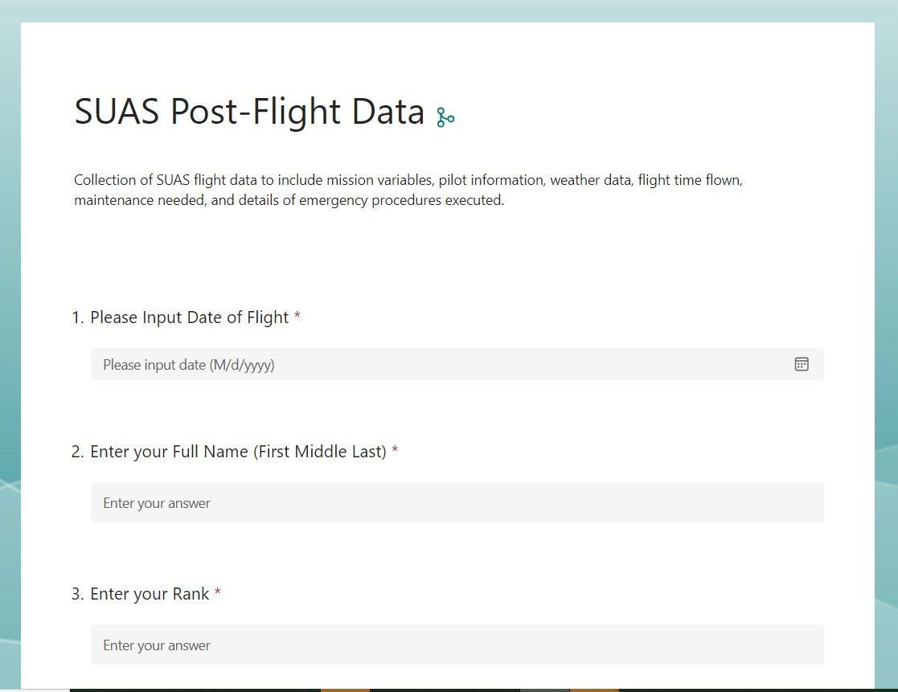
COTS SUAS Quick Reference Card
For US Operators
CUI
Post-Flight Data Form:
https://forms.osi.apps.mil/r/yJRgSpz69W
Post-Flight Checklist:
Battery, Controller, and Phone are fully recharged are placed back in their proper configuration.
Document flight and maintenance
information using provided form: https://forms.osi.apps.mil/r/yJRgSpz69W
Document flight and maintenance information internally through Troop SUASMAN account.
Notify JMTG-U if property is damaged or lost.
Return SUAS to property holder
promptly upon completion of mission.
CUI

Slide 28



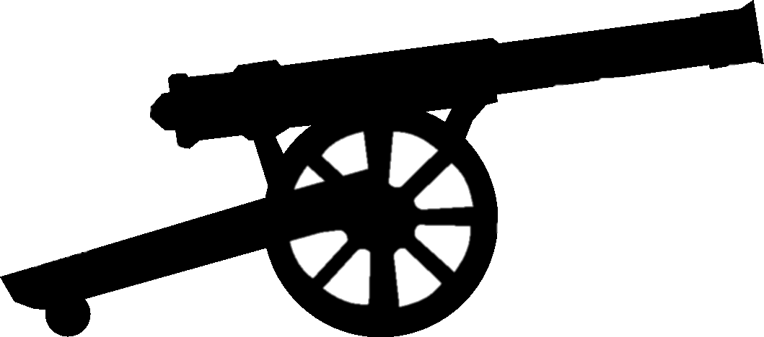
QUESTIONS
Seit 1910
Notes:
Sir Pending your questions.

