Slide 1



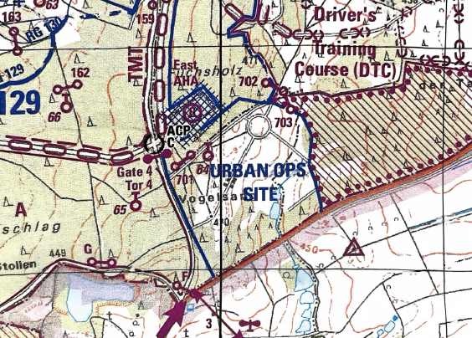
JMTG-U CLC Urban Ops Site ROZ REQUEST
Mission
JMTG-U operators employ sUAS ISO CLC STX/FTX on Urban Ops Site
Key Tasks
STX/FTX and sUAS operations for JMTG-U CLC.
Endstate
CLC successfully maneuver through STX/FTX with sUAS support.
POCs
OIC: CPT Mitchell, Marcus
+1 (731) 415-0402
RSO: 1SG Fugok, William
+1 (615) 268-2928
sUAS MT: SSG Ozier, Kenneth
+1 (731) 212-7199
sUAS FLOWN
Mavic 3 Classics
Loss of Link Point
REQUEST ROZ LIMITS
UPPER LEFT | UPPER RIGHT | BOTTOM LEFT | BOTTOM RIGHT
32U OA 0990 0345 | 32U OA 1020 0380 | 32U OA 1005 0310 | 32U OA 1040 0340
LOSS OF LINK POINT | DATES AND TIMES | MIN/MAX ALT
32U OA 1000 0352 | 29JUL – 2AUG25 0800-1800 DAILY | 0-1000ft AGL

