Slide 1
First Person View (FPV) Drones Overview

Slide 2
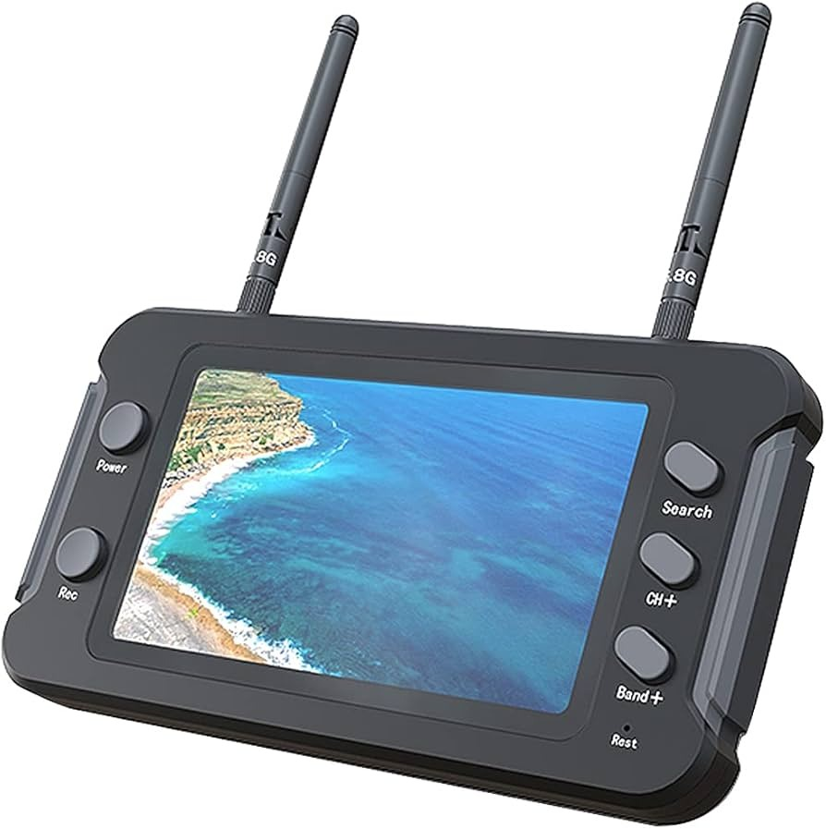
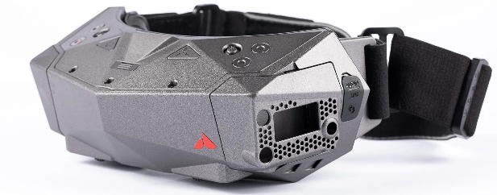
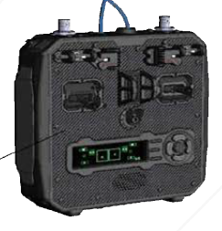
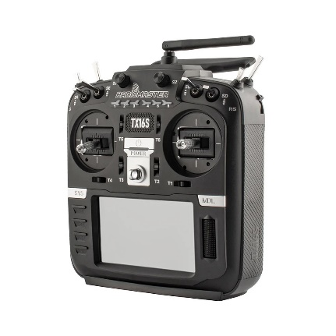
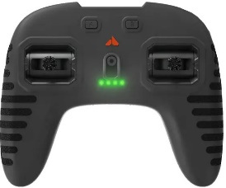
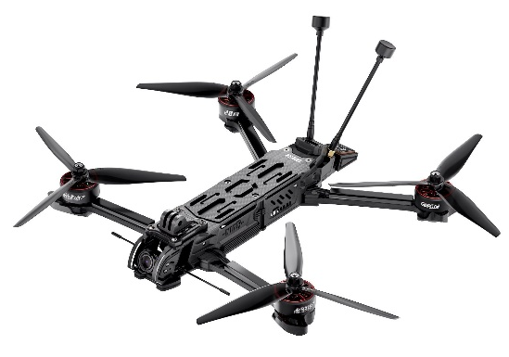
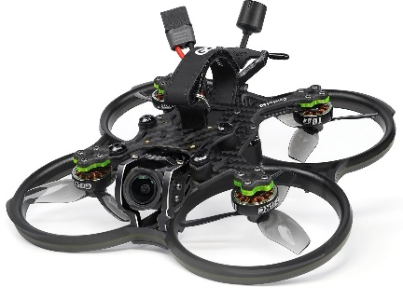
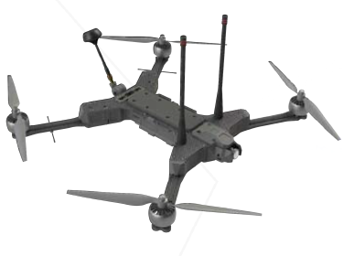
System Components
Goggles / Video Receiver:
Device used by drone operator to observe the live video feed transmitted from the Multirotor
Radio Transmitter:
Device that uses radio signals to transmit commands wirelessly via a pre-determined frequencies to a Radio Receiver integrated into the Multi-rotor’s hardware.
FPV Multirotor:
A fast, agile, and precise battery powered flying machine that is
Controlled remotely by a pilot.
Transmits a live feed from the camera mounted on the front of the aircraft.

Slide 3
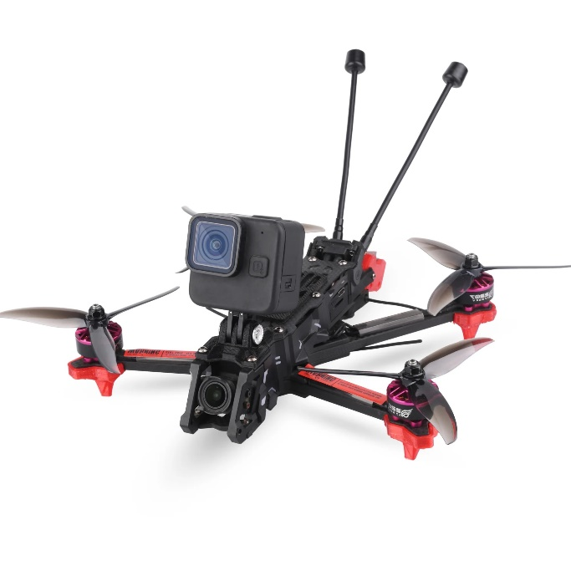
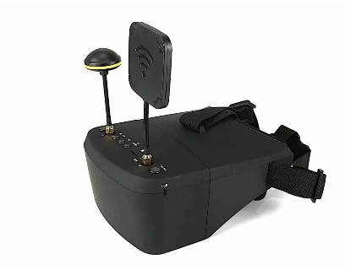
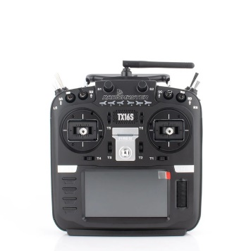
Wireless FPV Drone Communication
Video transmitting on 5.8Ghz from DRONE to OPERATOR
Inputs from Radio transmitting on 2.4Ghz from OPERATOR to DRONE
Feedback from Radio transmitting on 2.4Ghz from DRONE to OPERATOR
Telemetry Display & Operator Inputs

Slide 4
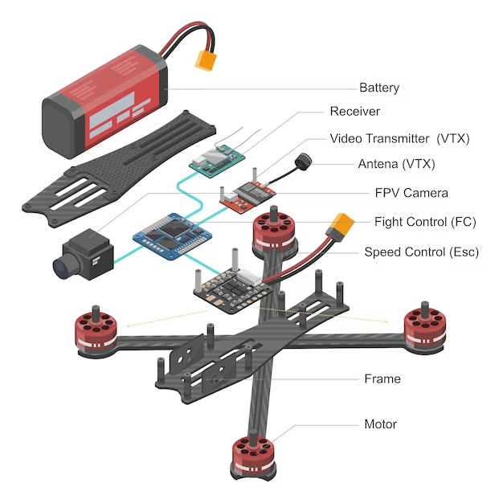
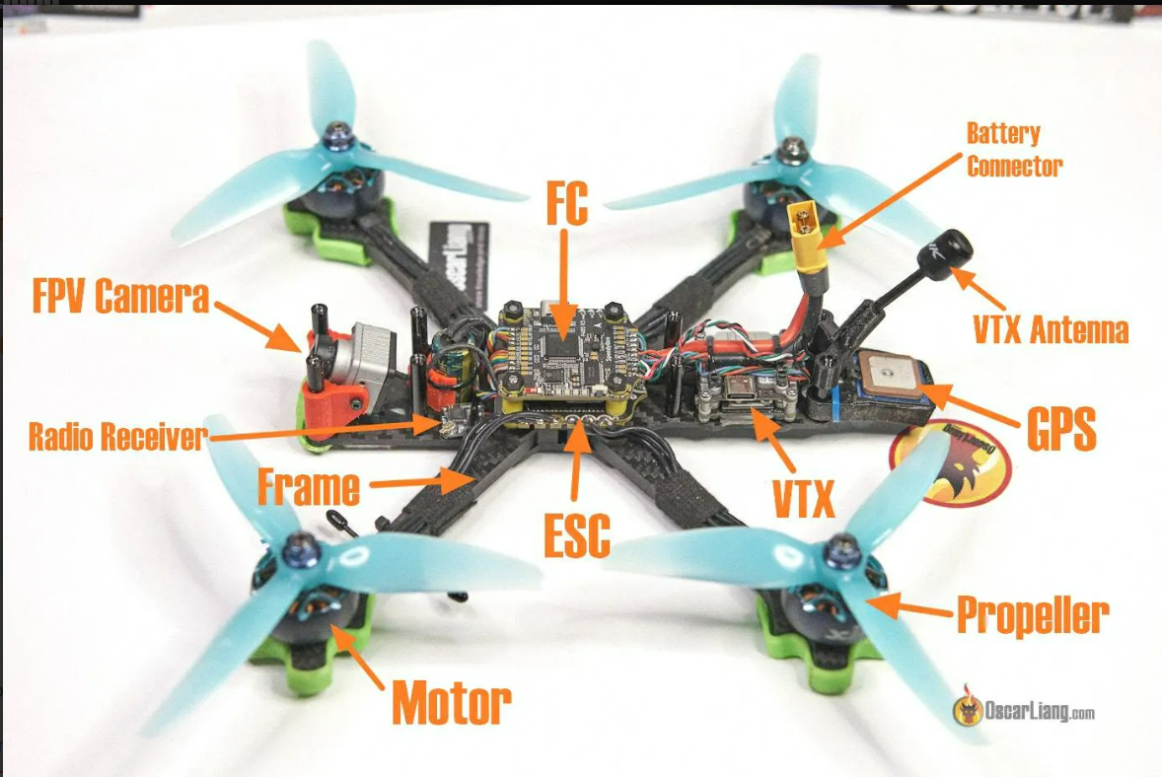
Components of an FPV
Notes:
Here’s how the fpv looks assembled without the top plate and then another picture showing the breakout

Slide 5
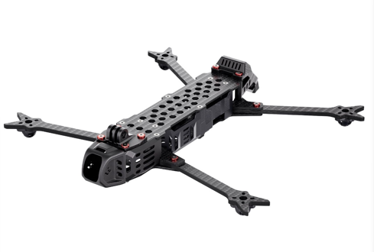
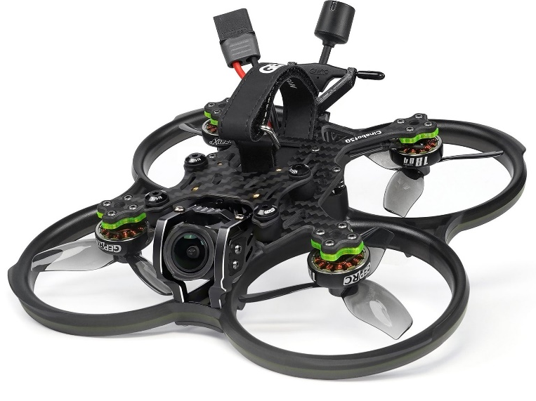
Frames
Thermoplastic:
Cheap, light weight frame material, not as strong as carbon fiber, Ideal for complex parts with minimal load bearing such as antenna mounting brackets.
Carbon Fiber:
Extremely ridged, high tensile strength, low density, material fatigue under flexing cycles best overall material for the frame and motor arms.
Metals:
Steel is strong and dense. Aluminum is relatively strong and much lighter. Titanium has the best properties of both aluminum and steel but is more expensive. Metal is rarely used in FPV drones as a frame material.
Thermoplastic
Carbon Fiber
Thermoplastic
Metal
Thermoplastic

Slide 6
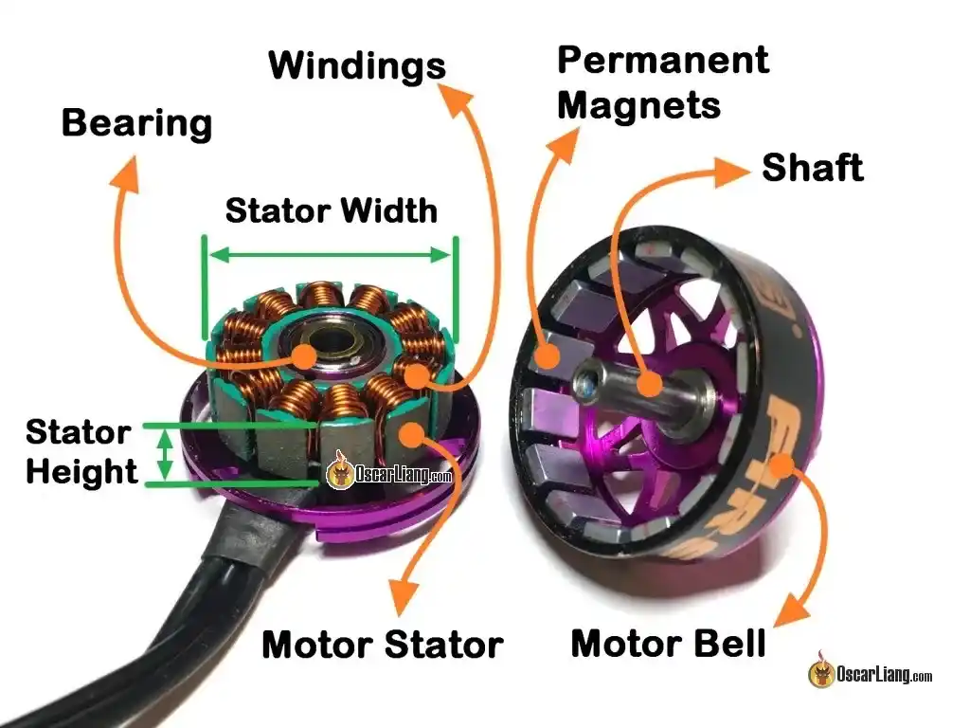
Motors
FPV drones utilize brushless motors almost exclusively due to their high-power output, durability/longevity, and energy efficiency.
These motors operate by sending a series of 3 electrical pulses from the electronic speed controller (ESC) that charge the copper coils (windings).
This action causes the copper windings to become magnetized. This interacts with the permanent magnets in the motor bell causing the motor to spin.
The rate at which these electrical pulses are sent to the motor and the order in which they are sent controls the speed and direction of the motors rotation.
Motors are listed with a “KV” rating. This rating determines how fast the motor will spin in RPM for every volt applied.
EX: a 2004 KV motor is powered using a 4S (16.8 V) battery. By multiplying the KV rating and the battery voltage, you get 33,667.2 RPM.

Slide 7
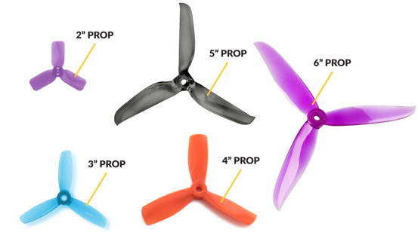

Propellers
Spin – Counterclockwise and Clockwise
Size – Larger diameter propellers will provide increased efficiency but are less responsive and more ‘floaty’
Pitch – the distance a propeller travels during one revolution, measured in inches. Higher pitch equates to more lift and drag.
Blade count - Adding blades increases the surface area and therefore creates more thrust. Adding blades decreases efficiency and puts more strain on the motor. More blades typically results in quieter operation.
Length x Pitch x number of blades (5x3x3 has a diameter of 5 inches, will travel 3 inches per rotation, and has 3 blades)
Pairing propellers to mission / use is critically important to ensure the drone can complete the mission and fly at peak efficiency.
Propeller rotation orientation
Notes:
https://safe.menlosecurity.com/doc/docview/viewer/docNDB62B70D368C2f22474000485ca0e368d63e28533d5da3948f7be058107430111ae33b51800f

Slide 8
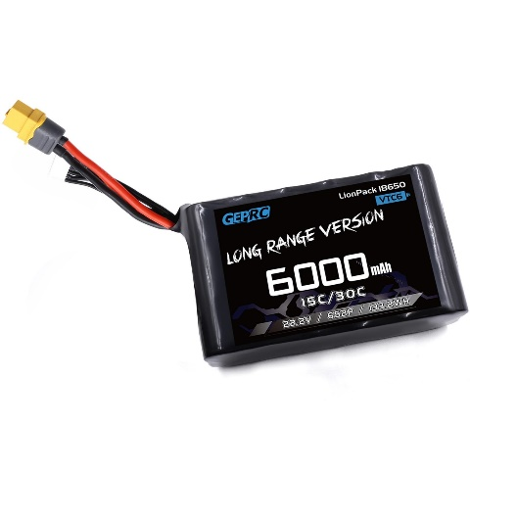
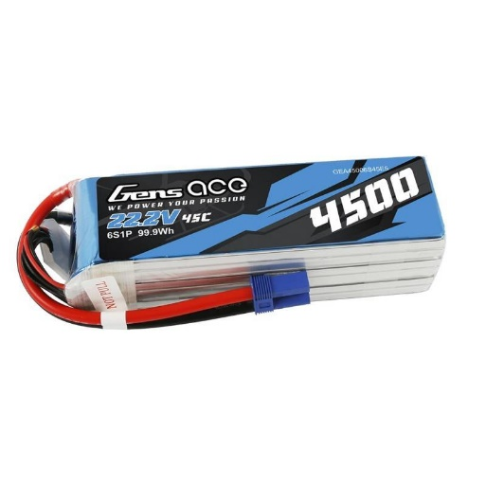
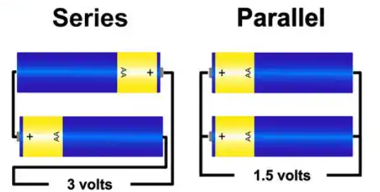
Batteries
Lithium Ion (Li-ion):
3.0-4.2v per cell
Greater energy density (high mAh by weight)
Lower C rating (rate of charge and discharge)
Lithium Polymer (LiPo):
3.5-4.2v per cell
Lower energy density (low mAh by weight)
Higher C rating, results in fast battery charging and peak performance
Number of Cells:
Cells connected in series add voltages
Cells connected in parallel add capacity
Usually either 4s (16.8v max) or 6s (25.2v max)
Li-ion Battery
LiPo Battery
2850 mAh
2850 mAh
2850 mAh
2850 mAh
2850 mAh
5700 mAh

Slide 9


Batteries cont.
Example:
A drone needs to deliver a 1.5 Kg payload of C4 with detonator. The drone itself weighs .65 Kg without a battery. The specifications for the battery are as follows:
6s (22.2 V)
7500 mAh
.95 Kg
What is the flight time of the drone?
If the drone has a cruising speed of 80 KM/h, what is its range if not limited by video / control signal?
C – capacity of the battery [Ah]
D – Discharge limit for battery protection [80%]
AAD – Average Amperage Draw [A]
M – Mass of the Drone and Payload [Kg]
E – Power required to lift 1 Kg of weight [W/Kg]
Conservative value: 170 W/Kg
V – Battery Voltage [V]

Slide 10
Batteries cont.
Exercise:
A drone needs to deliver a 5 Kg payload of C4 with detonator. The drone itself weighs .7 Kg without a battery. The specifications for the battery are as follows:
6s (22.2 V)
8000 mAh
1.1 Kg
What is the flight time of the drone?
If the drone has a cruising speed of 65 KM/h, what is its range if not limited by video / control signal?
C – capacity of the battery [Ah]
D – Discharge limit for battery protection [80%]
AAD – Average Amperage Draw [A]
M – Mass of the Drone and Payload [Kg]
E – Power required to lift 1 Kg of weight [W/Kg]
Conservative value: 170 W/Kg
V – Battery Voltage [V]

Slide 11
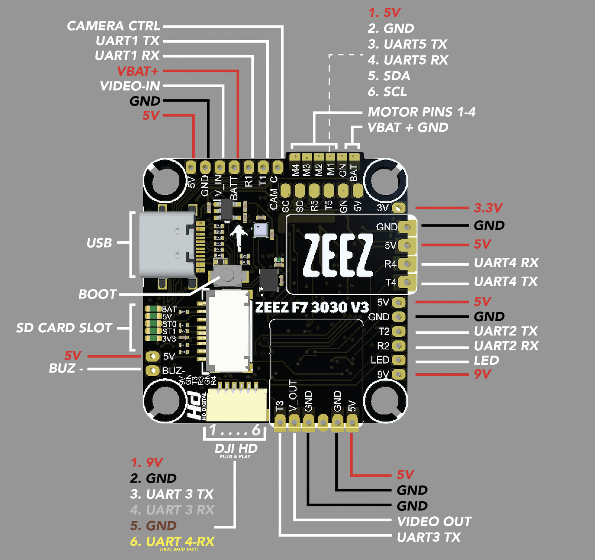
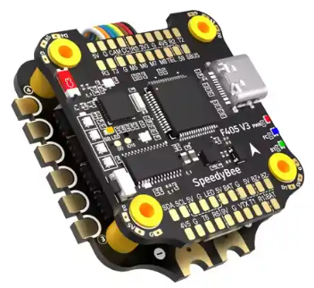
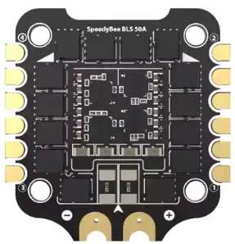
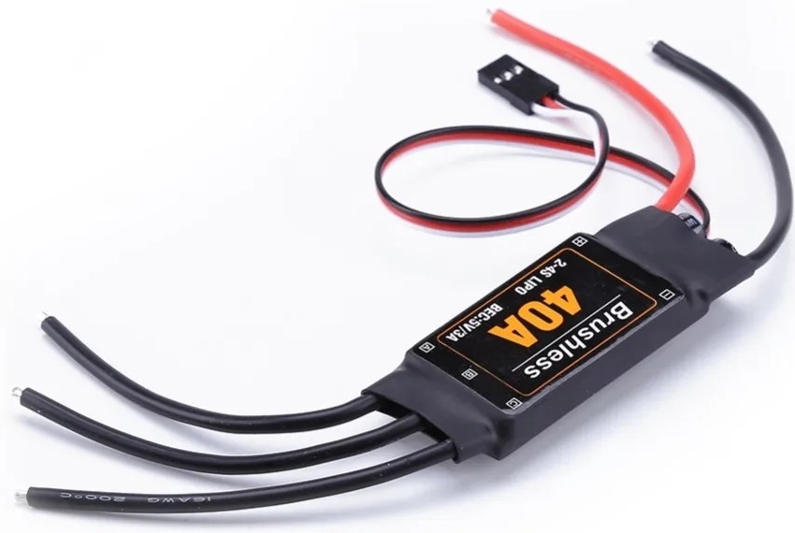
Stack (FC and ESC)
Flight Controller:
A circuit board with sensors to detect the drone's movements/attitude using accelerometers. This is the “brain” of the drone doing the following:
Contains the firmware that makes the drone operable
Receiving commands from the transmitter via a receiver
Controlling the speed and direction of the motors via the ESC
Overlaying data onto an on-screen display (OSD) with in the goggles
Interfaces with other accessories like GPS/Magnetometer Modules.
Electronic Speed Controller:
An ESC is responsible for controlling the speed and direction of motors in an FPV drone. The ESC receives speed signals from the flight controller and amplifies it to drive the brushless motor at the desired speed.

Slide 12
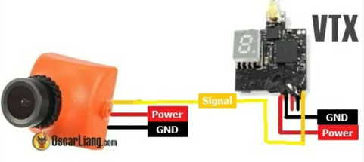
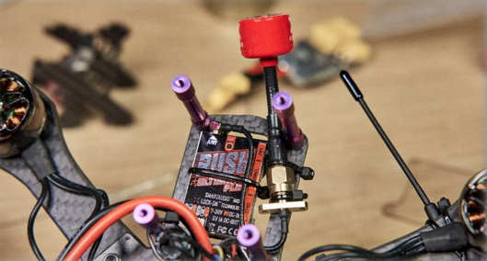
Video Transmitter (VTX)
The Video Transmitter (VTX) is a device that sends video from the FPV camera to a video receiver.
-Two Types:
Analog - works by continuously varying the amplitude or frequency of the wave
Digital - works by taking the video image and coding it into binary to send to the receiver
**Antenna selection is covered in an antenna theory class later in the course

Slide 13
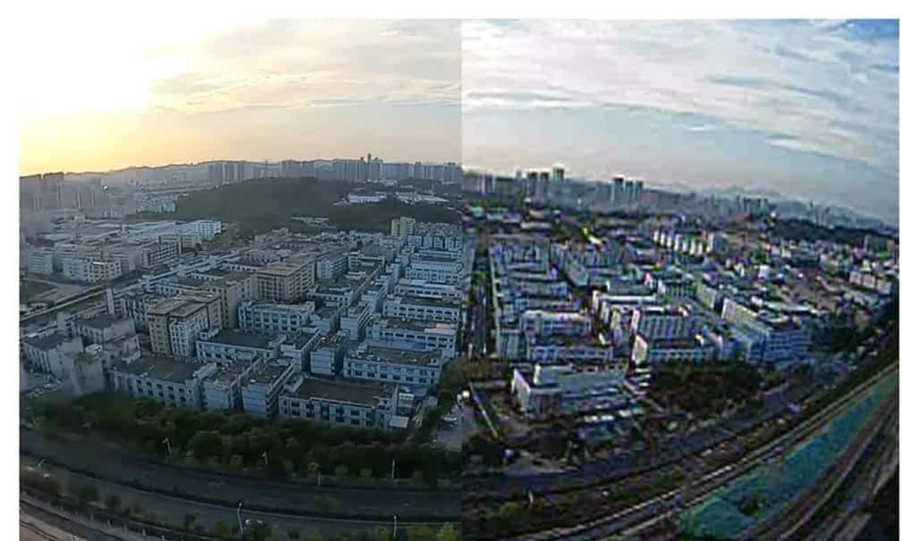
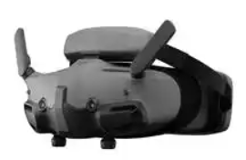
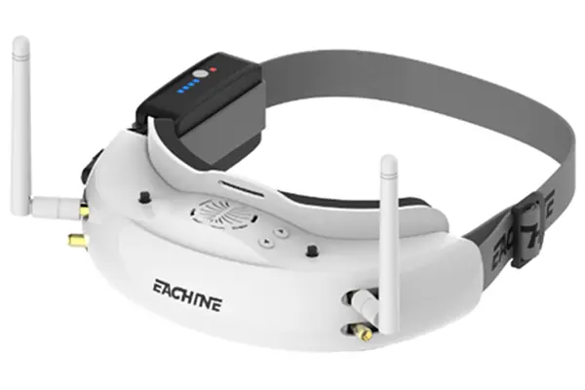
Goggles
Goggles must be paired with the appropriate type of VTX utilized on the drone.
Analog - Currently analog video has lower latency, develops static in the picture that breaks up gradually when the signal gets weaker, and is more difficult to jam. This may change in the future as the technology develops.
Digital – Stays much clearer and will not display any static during the flight. It is significantly easier to jam and will go “black screen” when signal is lost without warning. Digital systems are not cross compatible like analog systems and will require proprietary hardware to work correctly.
Note: DJI digital goggles may only be utilized with DJI systems unless modified to fit an analog receiver.
Digital
Analog
Notes:
https://forum.dji.com/forum.php?mod=viewthread&tid=246779

Slide 14
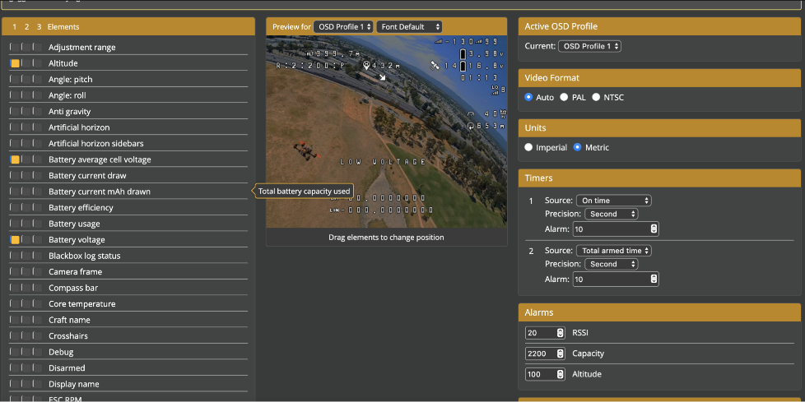
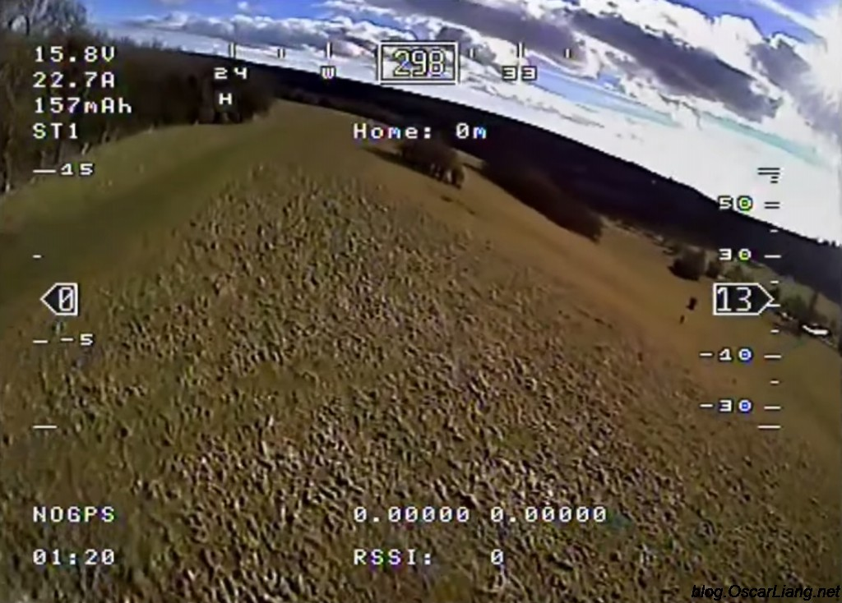
On Screen Display (OSD)
The On Screen Display overlays flight information onto your FPV video feed.
OSD allows you to monitor your quadcopter status and navigate in real-time while flying FPV.
You can display flight data of your choice on your FPV goggles, such as battery voltage, current draw, aircraft attitude, altitude, direction of flight, GPS coordinates, etc.
Extremely useful tool for navigation and mission decision making.

Slide 15
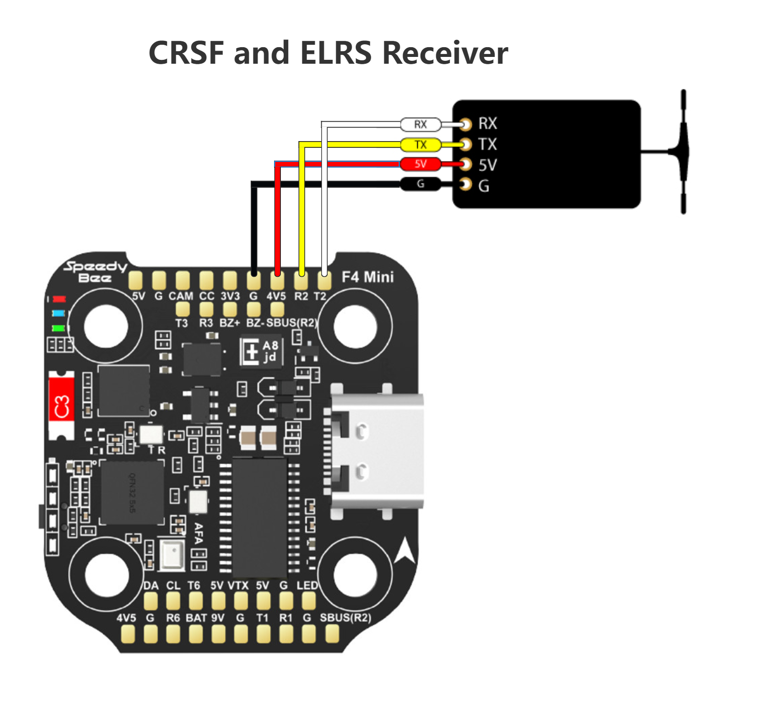
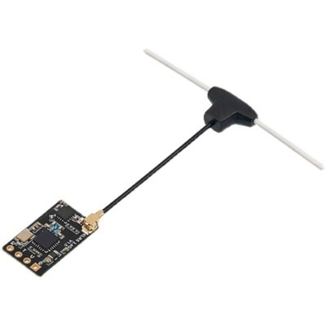
Radio Receiver
Radio Receiver
Circuit board and antenna that receives commands from a radio transmitter and sends the signal to the flight controller. Can also send telemetry data to the radio transmitter utilizing a two-way connection.
Remote Transmitter
Device that uses radio signals to transmit commands wirelessly via a pre-determined frequencies to a radio Receiver integrated into the multirotor hardware.
Precision gimbals allow pilot to provide extremely precise control inputs
Radio transmitters come equipped with an array of switches that you can use to arm your drone, activate flight modes, and perform other functions based on configuration and program of universal asynchronous receiver / transmitters (UARTs).
ExpressLRS (ELRS) - 2.4GHz and 868MHz/915MHz
TBS Crossfire - 868MHz/915MHz
Notes:
Hand the controller to them and let them get that touch with it.
www.expresslrs.org
https://www.team-blacksheep.com/products/prod:crossfire_tx

Slide 16
FPV Flight Modes
Acro – Our primary flight mode, completely manual inputs that require the operator to manually level and orient the drone.
Angle – Auto-levels the drone allowing for easy forward flight with less maneuverability.
Position Hold / Altitude Hold – A GPS enabled flight mode that, like angle mode, allows the aircraft to auto-level with the added benefit of holding its altitude and/or holding its position in 3D space. Requires advanced firmware programming.

Slide 17
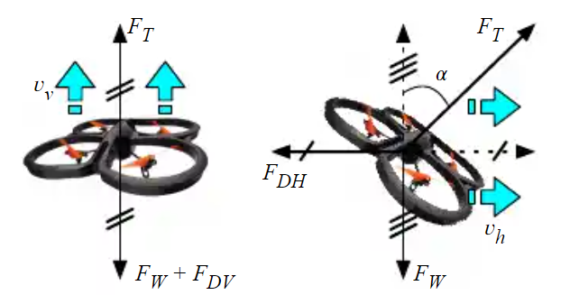
In Flight Forces
Weight - The total weight of the drone and its payload, which pulls down on the drone due to gravity.
Drag - The force caused by disrupted airflow that acts in both the horizontal and vertical directions, opposing the drone's movement.
Thrust - The force produced by the drone's rotating propellers, which opposes the weight and drag to maintain the drone's height and speed.
Lift - The upward force created by the drone's propellers, which opposes gravity.
Torque - The force created by each propeller as it rotates, which is added up with the other three torques to determine the total torque on the quadcopter.
Notes:
Forces acting on a drone. | Download Scientific Diagram (researchgate.net)
Source

Slide 18
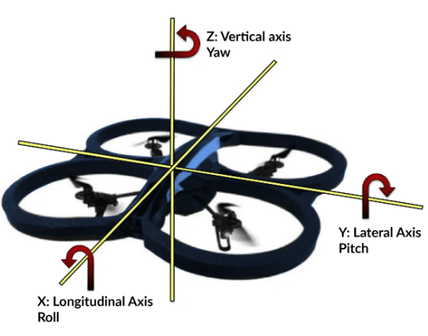
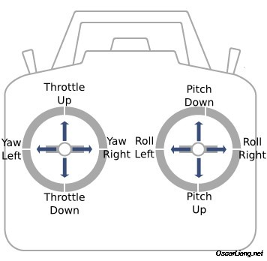
Attitudes and Inputs
Aircraft:
Pitch: Rotation around the axis from wing tip to wing tip of the aircraft
Roll: Rotation around the axis from the nose to tail of the aircraft
Yaw: Rotation around the vertical axis through the aircraft
Radio Controller:
Left Stick: Adjusts total thrust and yaw
Right Stick: Adjusts attitude
Notes:
https://www.google.com/search?sca_esv=5009c1303de011b0&sca_upv=1&q=drone+roll+pitch+yaw&udm=2&fbs=AEQNm0A6bwEop21ehxKWq5cj-cHa02QUie7apaStVTrDAEoT1A_pRBhSGXWPGL0_xk71SHFUmHSJWGPXoD9Kj5_rnHbWKxXBDKIYTLNVNouz_AS-xz-ZPATflliqW6OYoDueccnjkPVzeMNn3wsWVBjrHjDnKz-XPgEqtr1bYTmgd-jdmuZ2Fcl_Bc2RhyP0I0JcZ5RRzCFv&sa=X&ved=2ahUKEwiTh9_lreOIAxXi-AIHHaypC1kQtKgLegQIEhAB&biw=1528&bih=736&dpr=1&safe=active&ssui=on#vhid=79Z_NYMijMCeAM&vssid=mosaic

Slide 19
Simulator Demo

