Slide 1
Weather

Slide 2
Admin Information
Classification: UNCLASSIFIED
Risk Assessment: Low
Safety:
Exits
Fire Extinguisher
Tripping Hazards
Smoking Area
Restrooms

Slide 3
Agenda
Flight Hazards
Winds
Clouds
Cloud Coverage
Temperature
Precipitation
Weather Apps
METAR

Slide 4
Terminal Learning Objectives
Action: Discuss and learn how weather conditions effect sUAS operations and planning.
Condition: In a classroom environment, utilizing a PowerPoint hold discussions on how weather effects sUAS operations planning.
Standard: Fully involved class discussions.

Slide 5
References
TC 3-04.11
AR 95-1

Slide 6
CAUTION!!!
Weather is a factor to consider when planning your flight operation and for the limitations for the sUAS

Slide 7
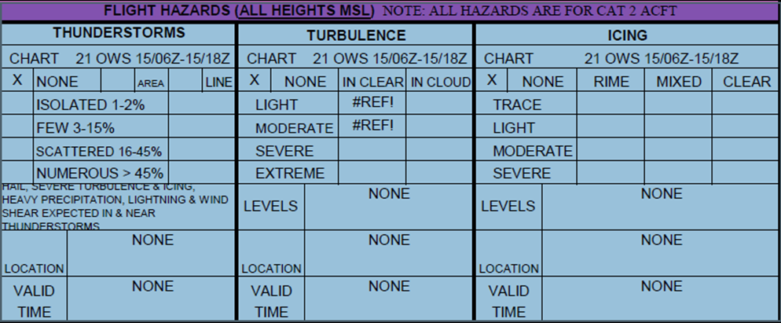
Flight Hazards
Precipitation
Wind
Temperature
Visibility

Slide 8
Winds
Winds are important as they affect takeoff, landing, and cruise flight operations.
Headwind
Against the direction of travel.
Tailwind
Blows in the direction of travel of an object.
Crosswind
Any wind that has a perpendicular component to the line or direction of travel.
Low-level Wind Shear/Microburst
A sudden, drastic change in wind speed and/or direction over a very small area and is dangerous to flight operations.

Slide 9
Clouds
Clouds: Conditions are described by the amount of cloud cover and the height of the base of the cloud above ground level (Ceiling)
Amount of cloud cover: Overcast (OVC), Scattered (SCT), Broken (BKN), and FEW
Ceiling: Expressed in feet above ground level

Slide 10
Cloud Coverage
Few (FEW): 0% - 25%​
Scatter (SCT): 25% - 50% ​
Broken (BKN): 50% - 75%​ (ceiling)
Overcast (OVC): 75% - 100% (ceiling)

Slide 11
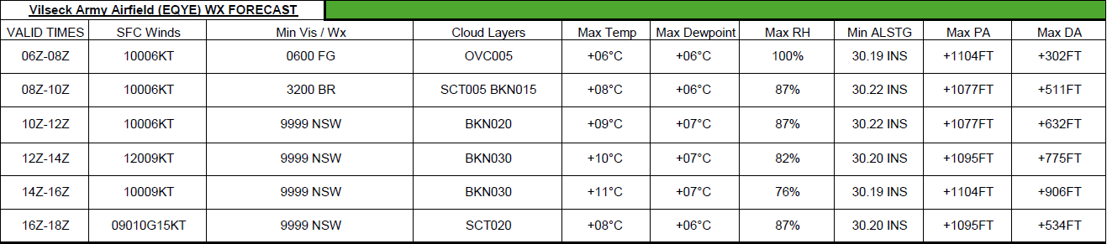

Slide 12
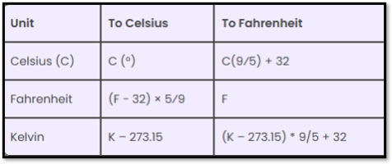
Temperature
Important to the aircrew because it enters the computation of most aircraft performance parameters.​
In aviation, temperature is given in Celsius ​

Slide 13
Precipitation​
Liquid or solid moisture that falls from the atmosphere as rain, freezing rain, drizzle, freezing drizzle, ice pellets, snow, hail, or a combination of these
Depending on the form of precipitation, it can reduce visibility, create icing situations, and affect landing and takeoff lift performance of an aircraft

Slide 14
Weather Apps
METAR
Avia Weather
Aviation Weather

Slide 15
METAR / MEF
Meteorological Aerodrome Report (METAR)
An observation of current surface weather reported in a standard international format
Mission Execution Forecast (MEF)
Predict and assess the execution of aviation missions, taking an account factors like weather, operational readiness, and resource availability.
Can also give weather predictions and conditions at predetermined altitude.

Slide 16
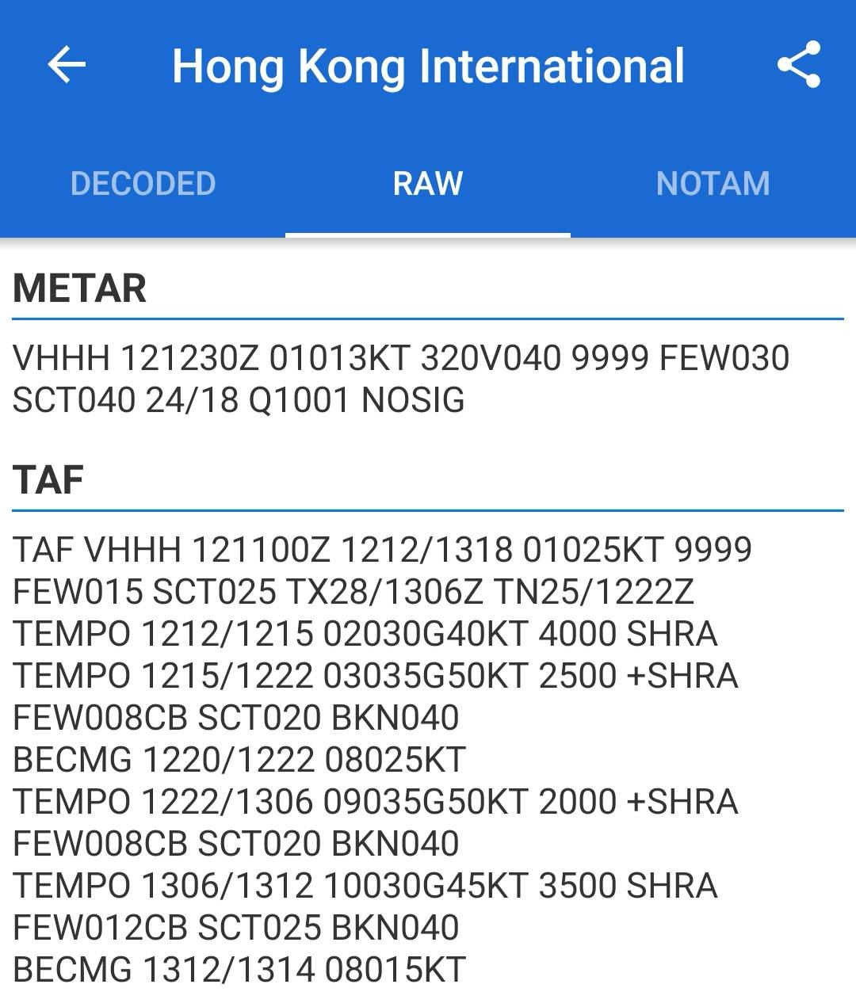
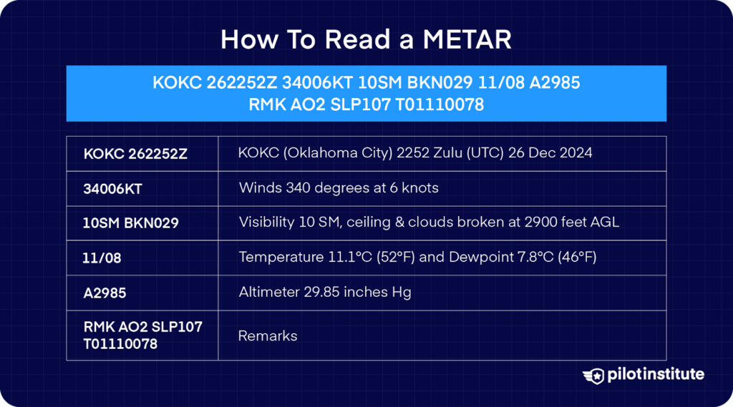
RAW METAR

