Slide 1
Overview of Unmanned Aerial Systems Tactical Level

Slide 2
Agenda
Admin Information
Terminal Learning Objectives
sUAS Influence on the Battlefield
Roles & Types of sUAS
Operational Range & Order of Battle
Types of Ordinance
Target Types
FPV Issues
Videos

Slide 3
Admin Information
Classification: UNCLASSIFIED
Risk Assessment: Low
Safety:
Exits
Fire Extinguisher
Tripping Hazards
Smoking Area
Restrooms

Slide 4
Terminal Learning Objectives
Action: Learn about the impacts and the future of sUAS on the Battlefield.
Condition: In a classroom environment, utilizing classroom discussion and PowerPoint.
Standard: Fully participate in classroom discussions based around sUAS operations within different units and battlefields.

Slide 5
UAS Groups
UA Category | Maximum Gross Takeoff Weight | Normal Operating Altitude (ft) | Airspeed | Representative UAS
Group 1: sUAS (Includes mini and Micro) | 0–20 Pounds | <1,200 above ground level (AGL) | <100 Knots | FPV DJI Mavic 3
Group 2: Small Tactical | 21–55 Pounds | <3,500 AGL | <250 Knots | Lancet 3 Zala Z16
Group 3: Tactical | 56 < 1,320 Pounds | <18,000 mean sea level (MSL)
 |  |  |  | Scan Eagle
Group 4: Strategic or Theater | >1,320 Pounds |  | Any airspeed | Predator
Group 5: Strategic |  | >18,000 MSL |  | Global Hawk
Note: Groups 1, 2, and 3 are sometimes referred to as low, slow, or small UASs
Notes:
Mean sea level is the aircraft's altitude above the average level of the world's oceans
-MSL establishes a consistent reference point across regions and terrain—if you used AGL over a mountain range, for example, you would have to continuously climb and descend to maintain an assigned AGL altitude
-What ATC measures assigned altitudes with
Above ground level is the aircraft's altitude above the earth's surface directly beneath it
-key reference point when flying closer to the ground
-when you're flying at low levels you want to ensure you're clear of obstacles/terrain, AGL becomes important because its value changes based on terrain
-many regulations like minimum safe altitudes are expressed in AGL

Slide 6
Influence of UAS on the Battlefield
Тwo main reasons:
Fast development of UAS
Decrease in number of heavier equipment
UAS
54%
Artillery Aviation Tanks Infantry

Slide 7
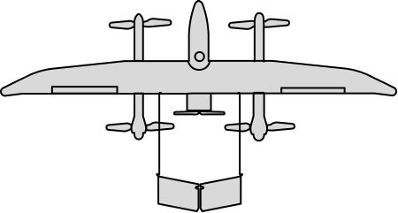
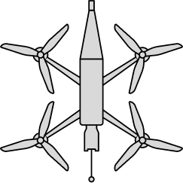
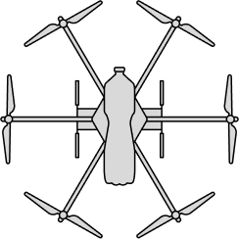
Roles of UAS
Intelligence | Combat | Additional
Command and Control | Striking Moving Targets Bombing Missions | Logistics
Reconnaissance | Remote Mining | Repeater System (commo)
Battle Damage Assessments | Call for Fire Counter-Battery Fire | Countering the Opponent's FPVs
 | Offense/Defense Support | Drone with Electronic Warfare

Slide 8
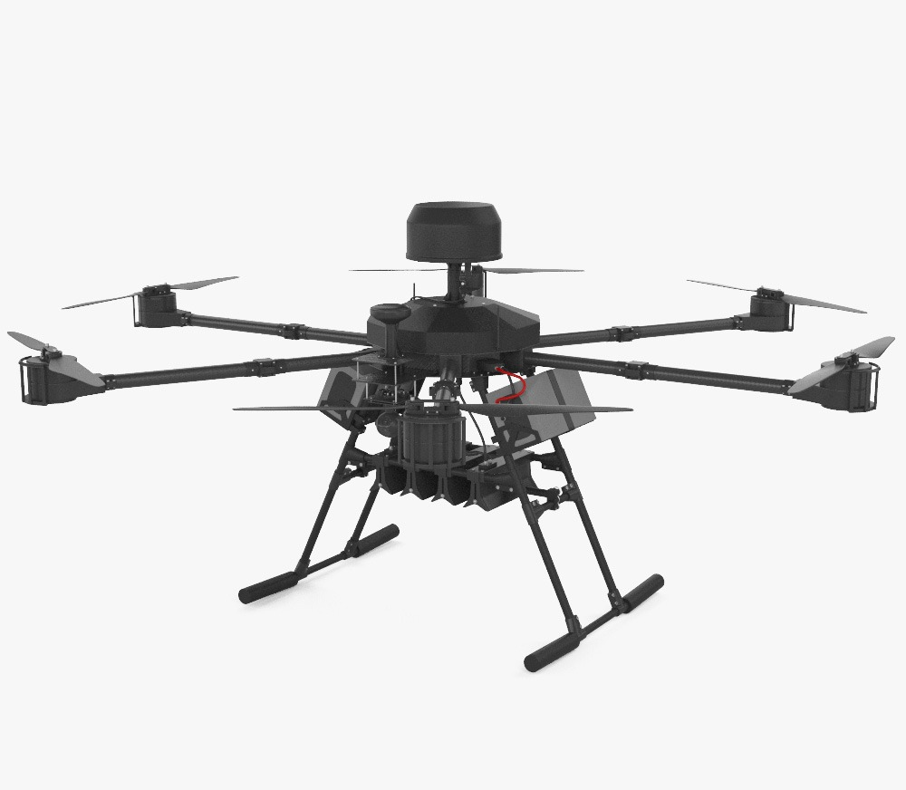
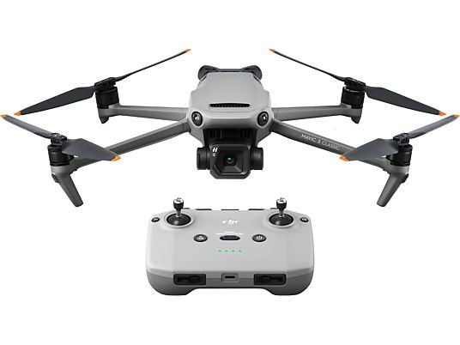
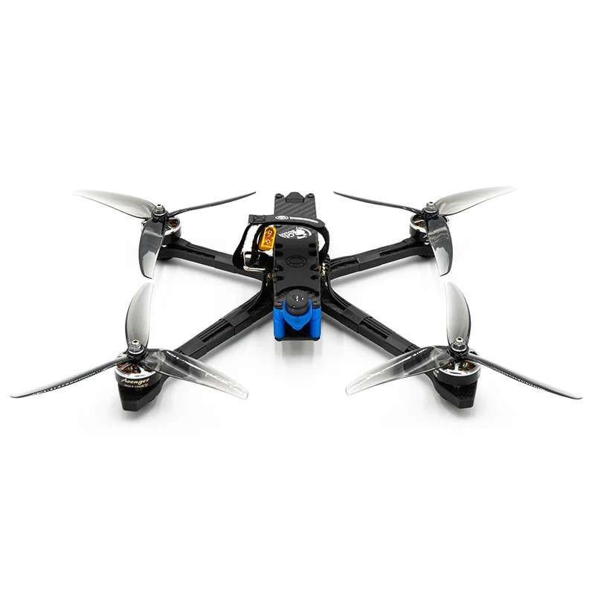
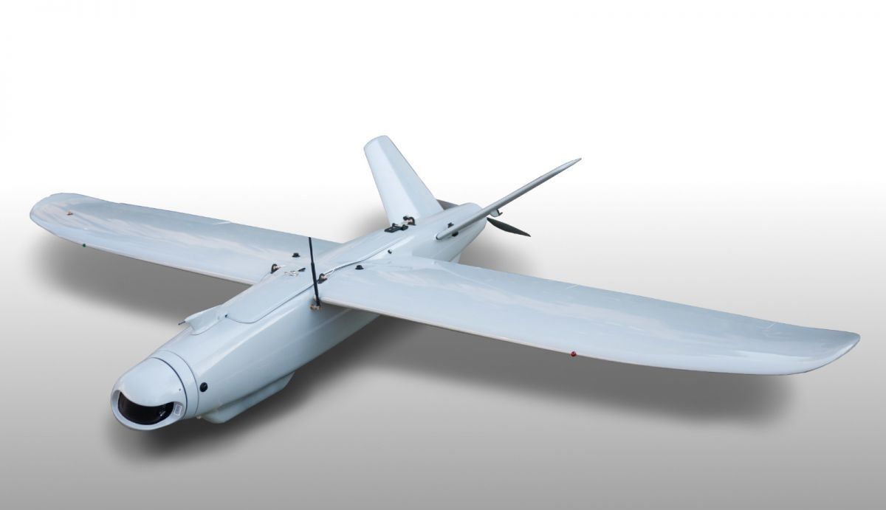
Types of UAS
Commercial
(Mavic 3/3T, Skydio)
FPV
Multirotor Heavy Bomber (Kazhan, Vampire)
Fixed wing UAS (Leleka/Shark)
Type
Mission/ Capability
Recoinassance to 5-6 KM
Striking of moving targets
Striking of planned targets/mining
Recoinassance to 45 KM
Flight Duration
30 min
15-20 min
35 min
2 hours

Slide 9
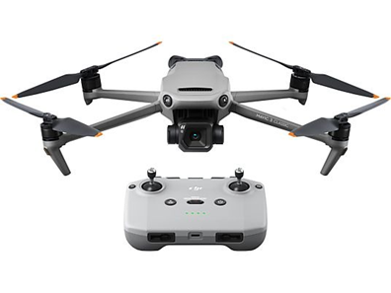
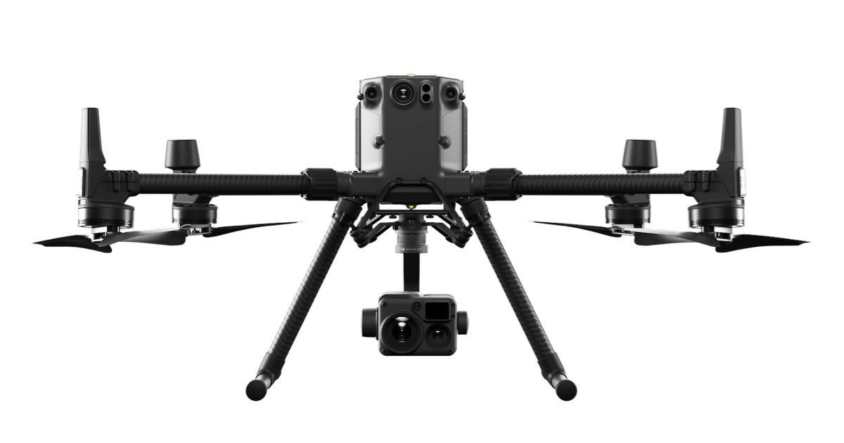
Intelligence, Surveillance, and Reconnaissance
System
DJI Mavic 3/3T
DJI Matrice 30T/300 RTK
Leleka-100
Altitude
100-350 M
500-1000 M
250-1500 M
Crew
2 People
3 People
3-4 People
Operational Range
1-2 KM from front line
3-5 KM from front line
5-50 KM from front line

Slide 10
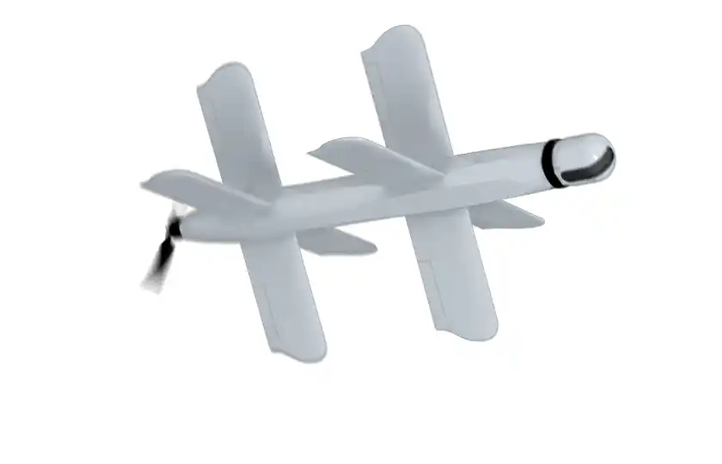
Combat Missions
System
FPV Kamikaze
Vampire
(Baba Yaga)
Lancet-3
Payload Weight
1-2 KG
8-12 KG
3 KG
Crew
2-3 People
3-4 People
2-3 People
Operational Range
2-5 KM from front line
10-15 KM from front line
30-40 KM from front line

Slide 11
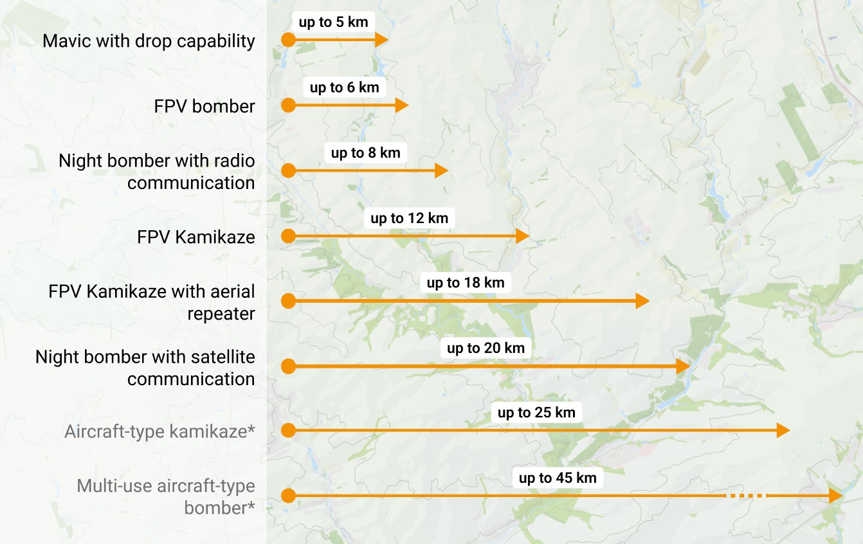
UAS Operational Range Example

Slide 12
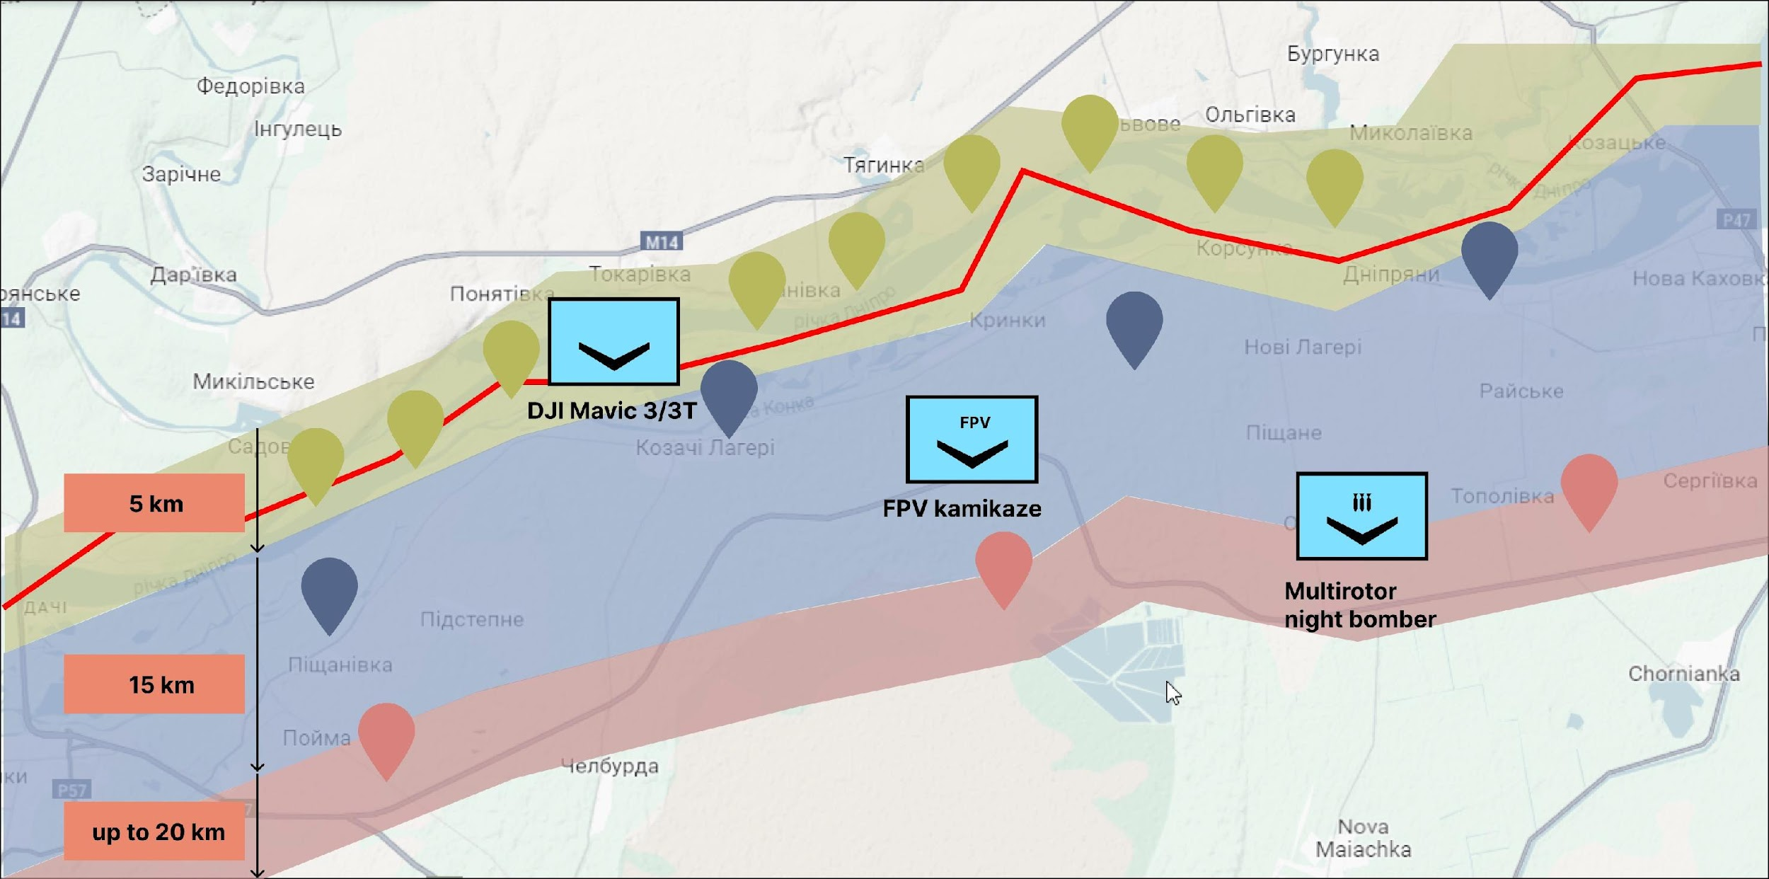
Battle Order of UAS Units

Slide 13

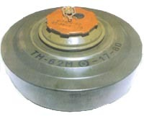
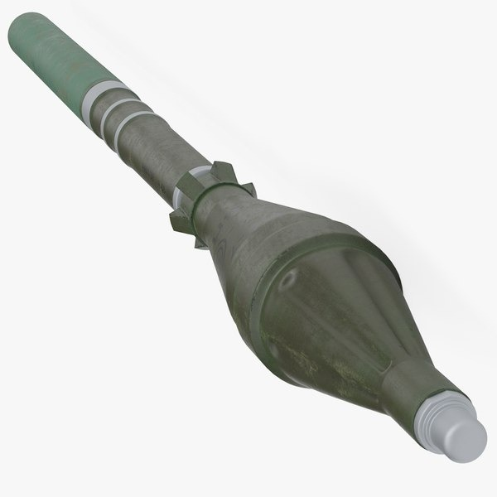
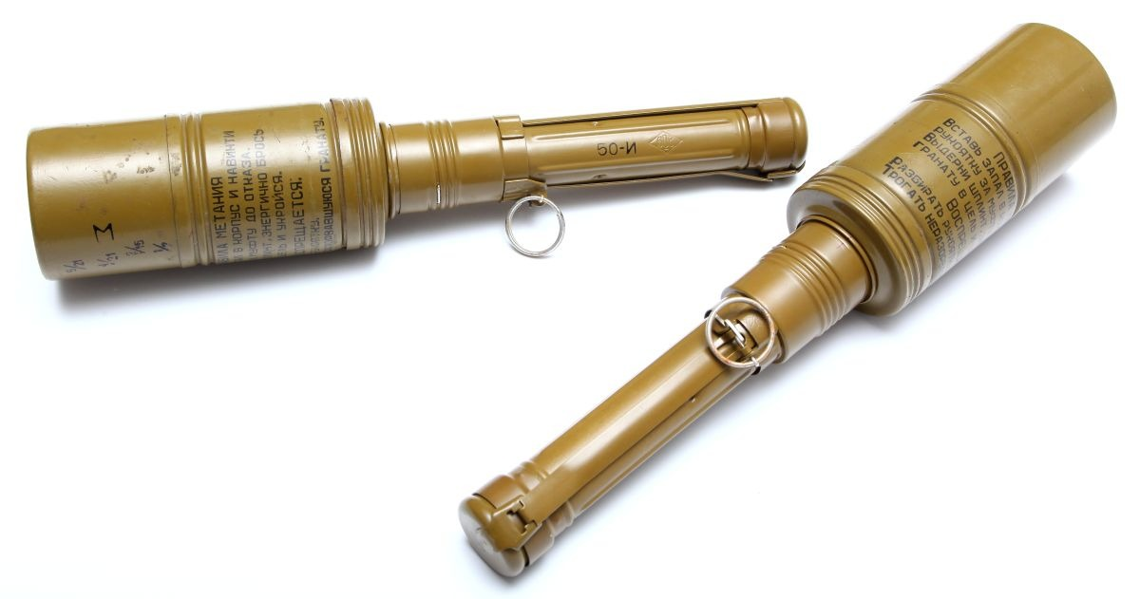

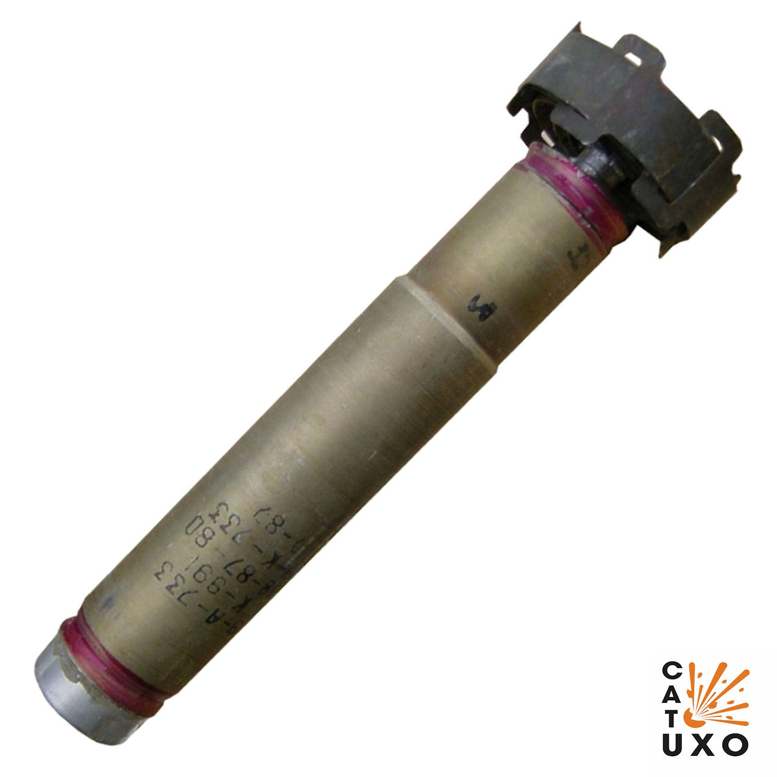
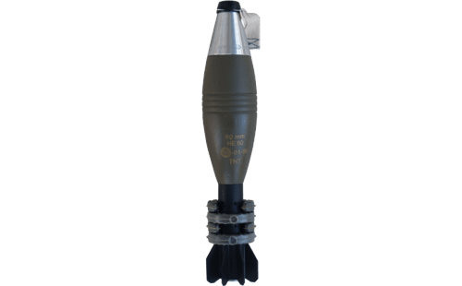
Some Commonly Used Ammunition
TM-62 (anti-tank blast mine)
Mortar Shells (60мм, 82 мм)
PG-7VL (ammunition for handheld anti-tank grenade launcher)
RKG-3 (anti-tank hand grenades)
PTAB (antitank aviation bomb) etc...

Slide 14
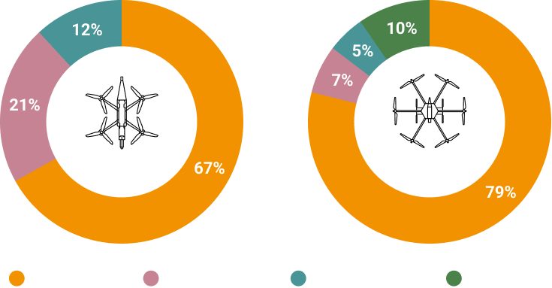
Types of Ammunition Used With S-UAS
Multi-rotor Heavy Bomber
FPV
High-Explosive Ammunition
Shrapnel Ammunition
Thermobaric Ammunition
Mines

Slide 15
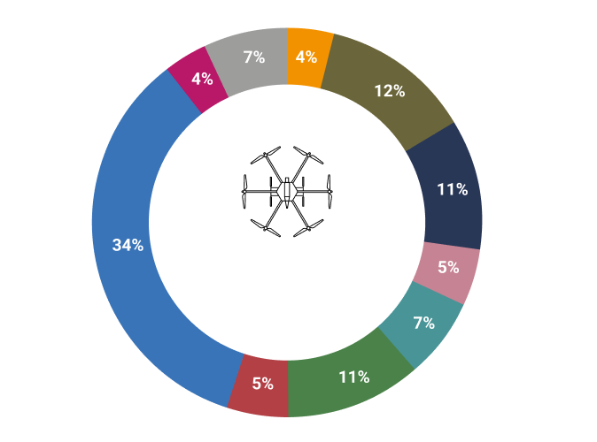
Types of Targets Struck With
Heavy Multi-Rotor UAS
Ammunition Depots
Other Tanks
Armored Fighting Vehicles (AFV)
Cars
Shelters/Dugouts
Multi-rotor Heavy Bomber
Trucks
Intelligence Sensors
Groups of Personnel
Artillery

Slide 16
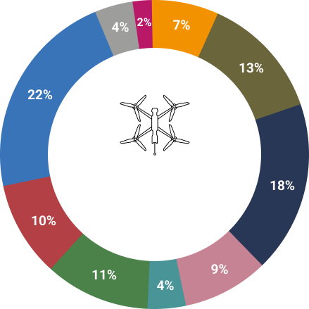
Types of Targets Struck With
FPV UAS
Ammunition Depots
Other
Tanks
Armored Fighting Vehicles (AFV)
Shelters/Dugouts
Cars
FPV
Groups of Personnel
Artillery
Trucks
Intelligence Sensors

Slide 17
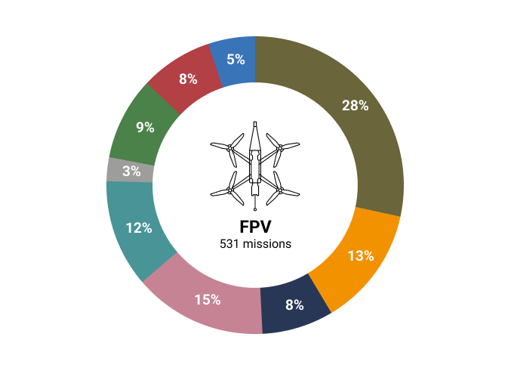
Sources of FPV Issues
Problems with Battery
Loss of Target
Missing the Target
Enemy Downed
Other
Loss of Video Signal
Ammunition Does Not Detonate
Loss of Control Capabilities
Ammunition Detonates Early

Slide 18
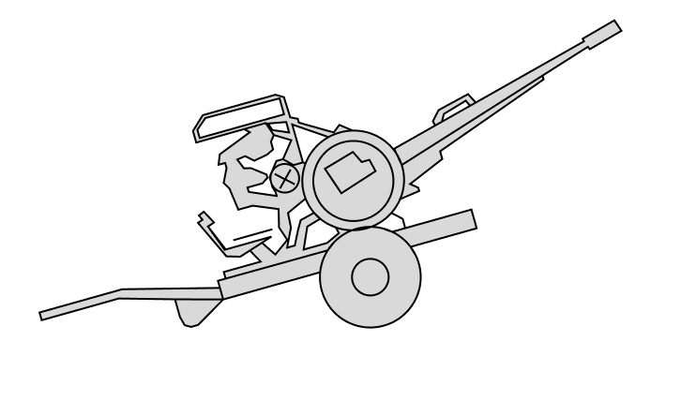
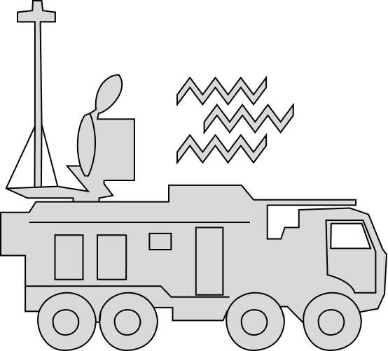
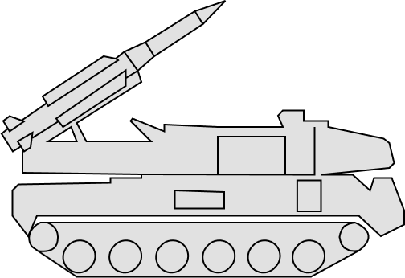
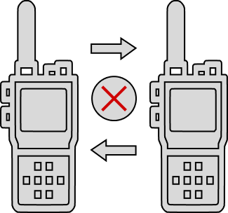

Sources of UAS Loss
SAM
Surface-to-Air Missile System
AA Systems
EW
Electronic Warfare
Friendly Fire
Technical Malfunctions

Slide 19
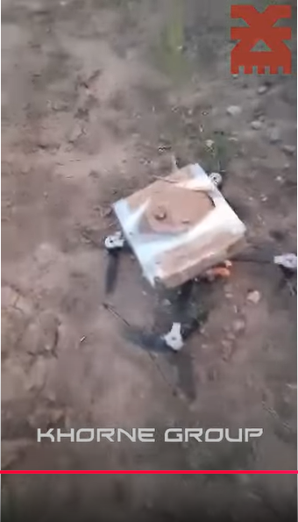
Remote Mine Laying
Ammunition: anti-tank mines.
Distance: Up to 8 km.
Crew: 3-4 people.
Notes:
https://www.youtube.com/watch?v=PwMtdEx1GDU

Slide 20
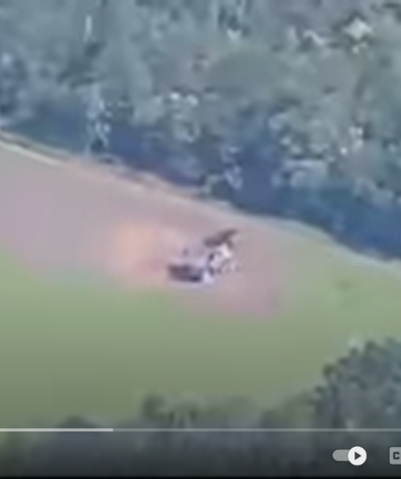
Counter Battery Fire
Ammunition: Mission dependent
Distance: Up to 15 km.
Crew: 2-3 people.
Notes:
https://www.youtube.com/watch?v=ngxqm3vnSgA

Slide 21
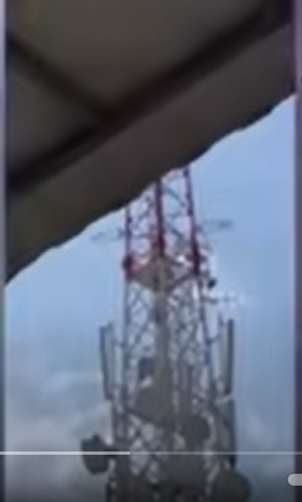
Destruction of Intelligence Sensors
Ammunition: High-explosive, shrapnel
Distance: up to 10 km.
Crew: 2-3 people.
Notes:
https://www.youtube.com/watch?v=HYNECDHdxn4

Slide 22
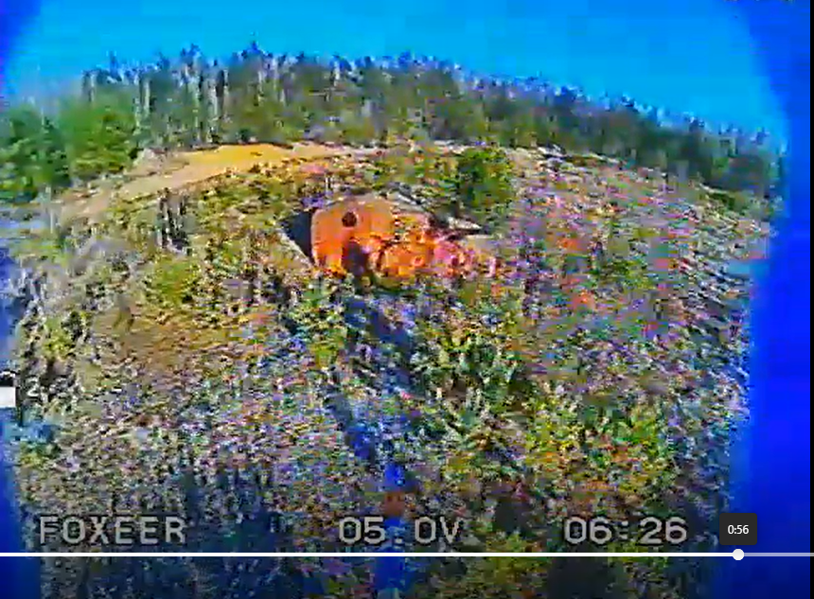
Striking a Moving Target
Ammunition: cumulative.
Distance: Up to 10 km.
Crew: 4-7 people.
Notes:
https://armyeitaas.sharepoint-mil.us/teams/JTMG-UTFBOWIE/_layouts/15/stream.aspx?id=%2Fteams%2FJTMG%2DUTFBOWIE%2FShared%20Documents%2F22%20%2D%20UAS%2F01%5FTeam%5FAdmin%5FFolders%2F08%5FProject%5FSHIV%2FVideos%2FShiv1%2Emp4&referrer=StreamWebApp%2EWeb&referrerScenario=AddressBarCopied%2Eview%2Ee6fb4bc1%2D7886%2D4515%2D9f29%2Dacfd35e32bae

Slide 23
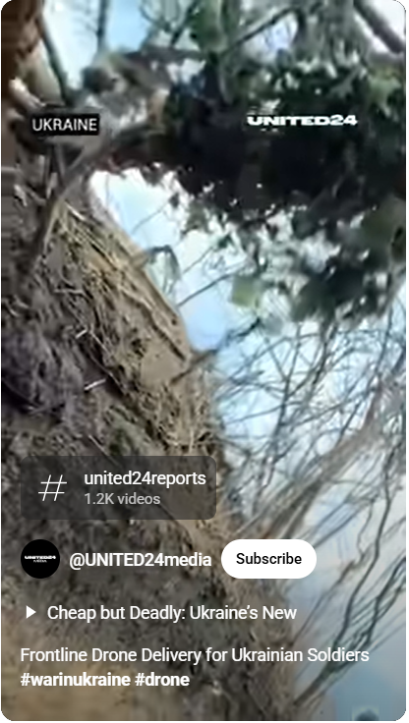
Logistic Resupply
Types: FPV bombers, Multirotor heavy bomber, Mavic 3
Distance: 3-8 km.
Supply: radios, food, munition, etc.
Notes:
https://www.youtube.com/shorts/fJoxS64T5I8

Slide 24
UAS as a Fires Asset
Type | FPV Kamikaze | Bomber (Radio Link) | M777 | Javelin
Weight of munition (payload), KG | 1 (0.5) | 10 (1.6) | 46.9 (10.8) | 15 (~3)
Mobility (1-10) | 8 | 6 | 1 | 5
Rate of fire per 1 hour | 3 | 1 | 120 | 30
Firing range, KM | 6 | 8 | 22.5 | 5
Accuracy (1-10) | 5 | 6 | 1 | 4
Price Per Round/Price Per System (Approximations) | $1,000 | $3,500 | $3,000/$3 Million | $200,000

Slide 25
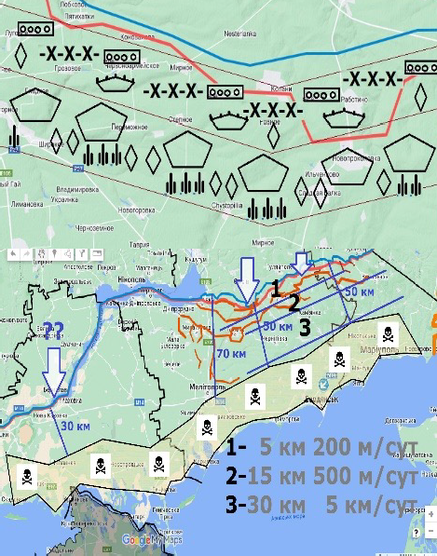
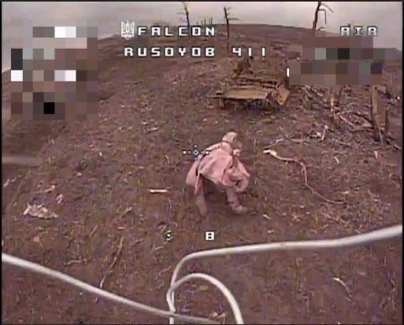
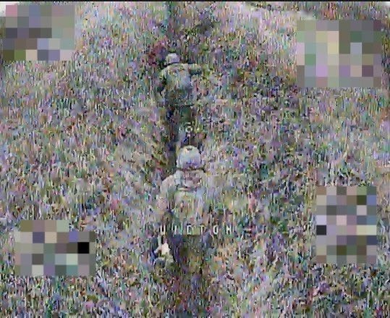
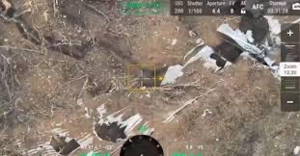
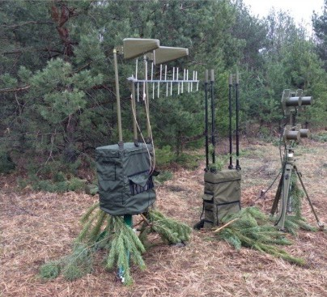
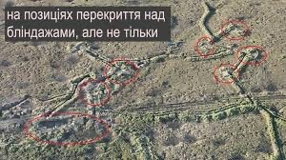
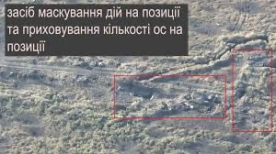
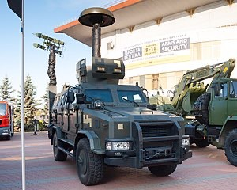
Dynamics of War Under the Influence of UAS
An increased need for logistical line protection
Every infantryman is a target
Changing fortification approach
Fast development of Electronic Warfare
‹#›

Slide 26
Questions?
‹#›

