Slide 1
Tactical Kinetic Drone Employment

Slide 2
References
ATP 3-21.10

Slide 3
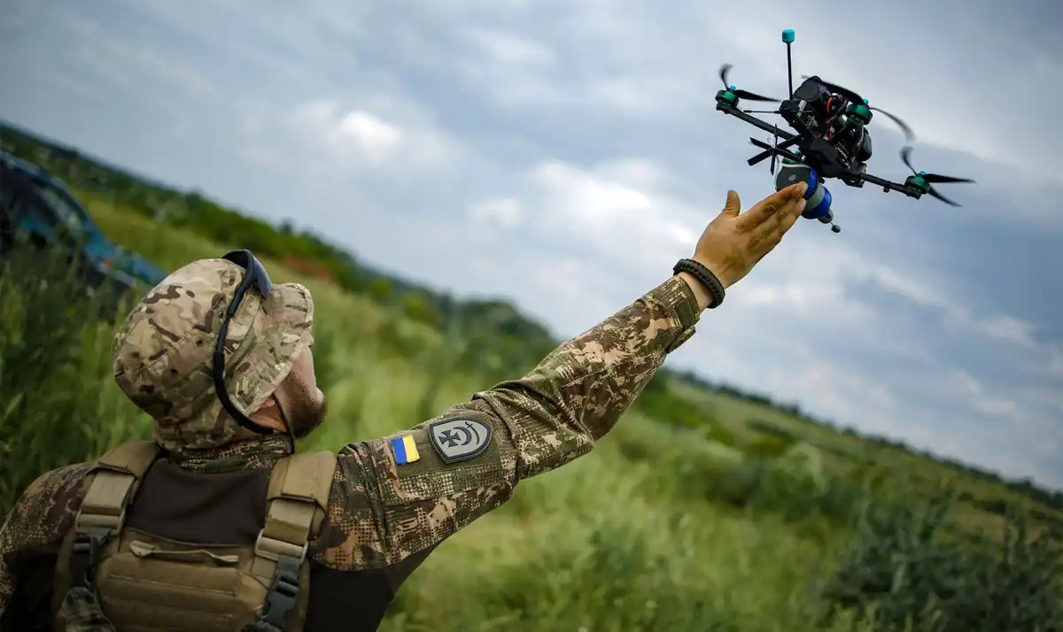
Overview
Team Loadout
Hunter – Killer Concept
Methods of Engagement
Drones as Part of Combined Arms
Special Operations / Missions

Slide 4
Standard Kit for a FPV Team
Drone Backpack/ruck/duffle bag with waterproof cover and waterproof bags.
1 x 5.5mm socket
1x 1.5mm hex driver
1x 2.0 mm hex driver
1x 2.5 mm hex driver
1x tweezers
1x snipers
1x needle nose pliers
1x portable soldering iron
30ft roll solder
1x flux
1x brass sponge
28awg wires
18awg wires
Conformal coating (waterproof electronics)
Controller- 18650 li-ion batteries (no tabs)
2 Ah or larger battery bank
1m USB-C cable
Googles- 2s 7.4v 2500-300mAh lipo batteries with barrel plug (QTY 2 per FPV Drone)
Drone- 6s 22.2v 4000-8000mAh LI-ION (lipo less proffered) with xt60 connector (Min QTY 2 per FPV)
Lipo safe batter bag
Gaffers tape
Electrical tape
Lighter
Multitool
8x small zip ties

Slide 5
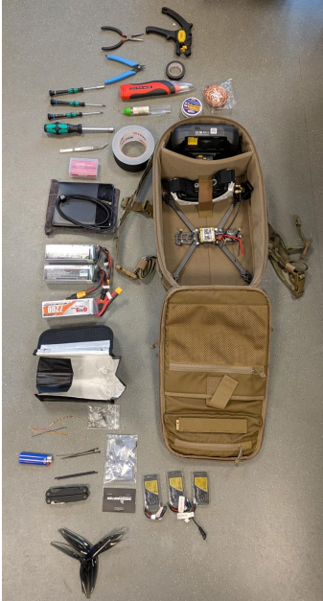
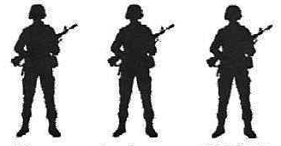
FPV Team
Operator
Spotter
Reserve

Slide 6

Roll of a Spotter
Each FPV operator needs to be paired with a spotter.
This mirrors the current standard for rotor wing aviation where one pilot is on the controls focused on flying and the other pilot is focused on radio communications, navigation, troubleshooting, ect.

Slide 7
Hunter – Killer Concept
Method of organization that matches systems with upgraded optics and a “lower-profile” design with systems that feature increased firepower.

Slide 8
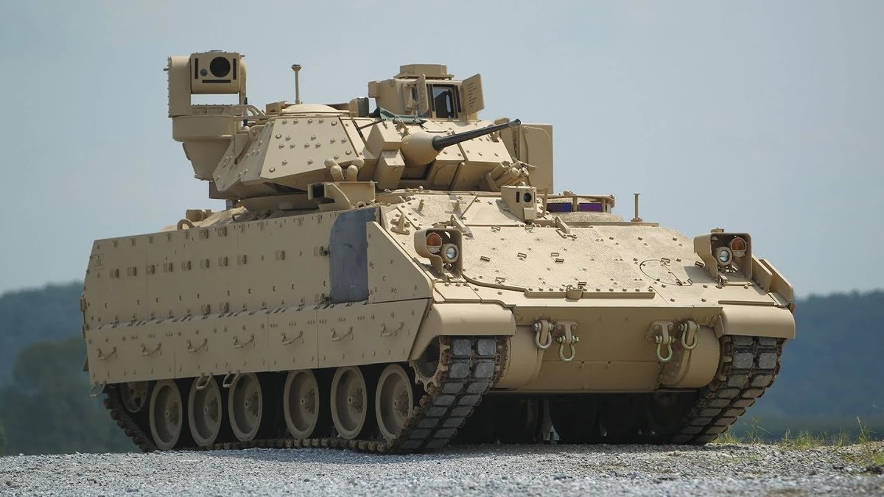
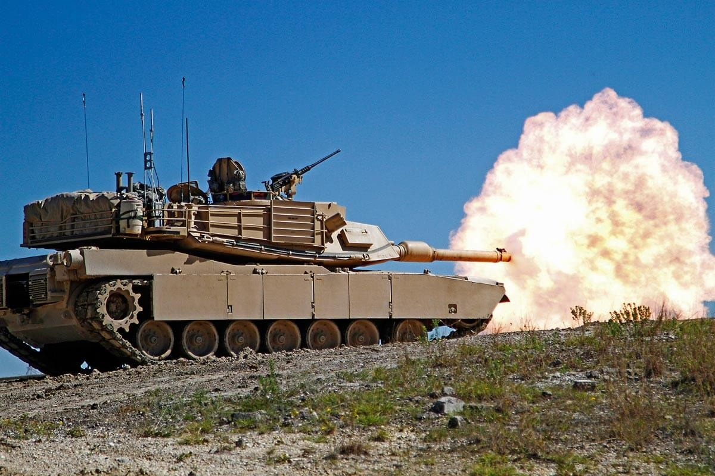
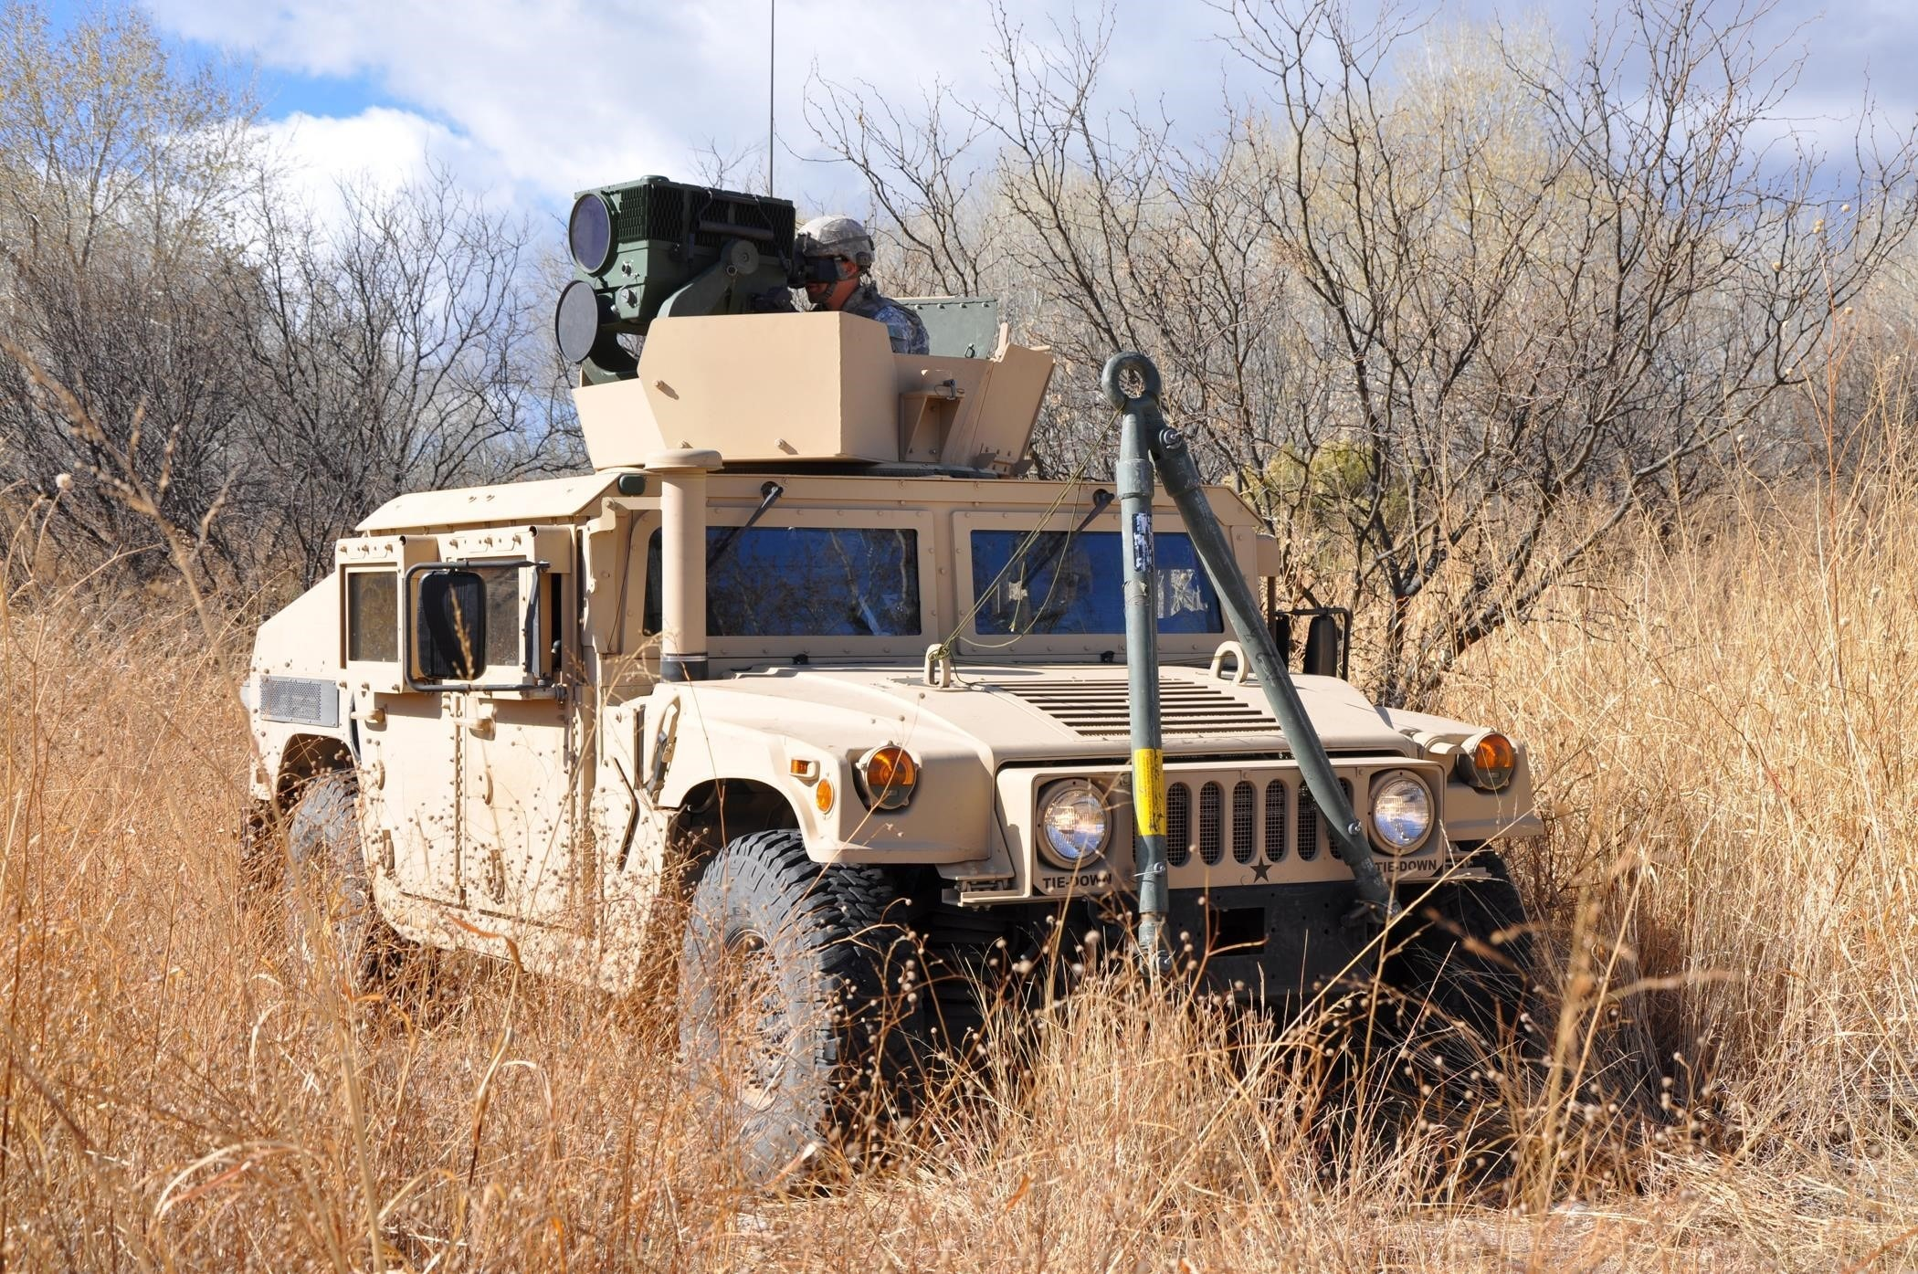
Hunter – Killer Concept

Slide 9
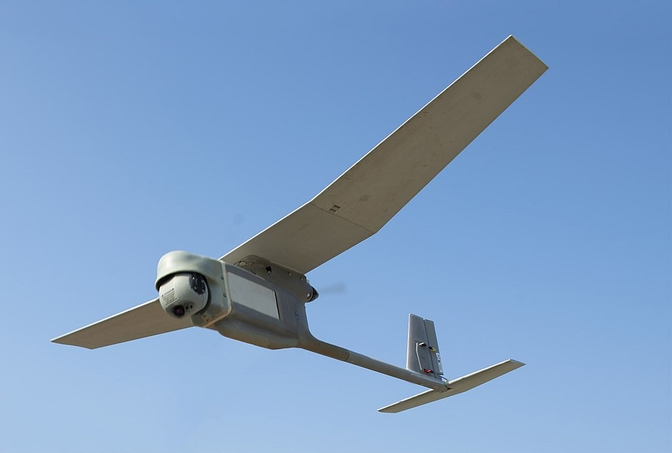
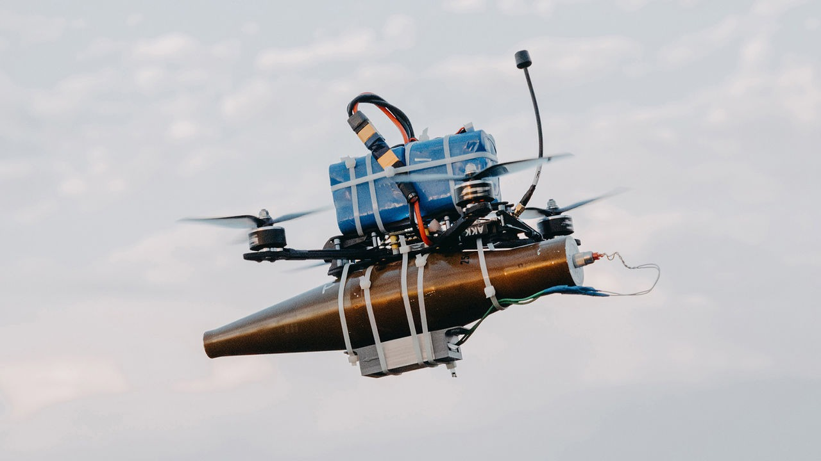
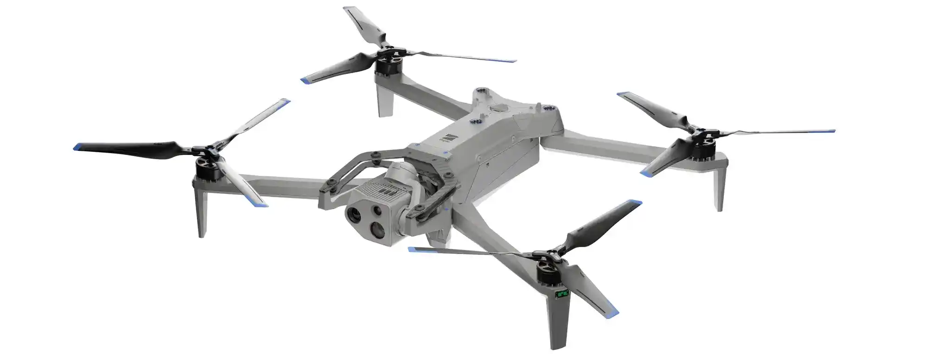
Hunter – Killer Concept

Slide 10
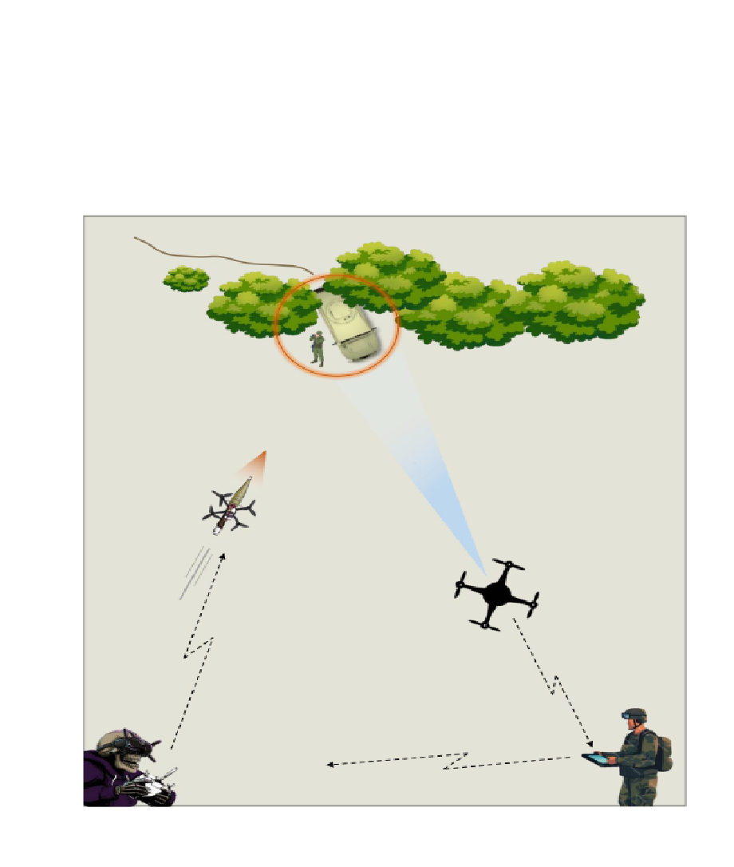
FPV “Killer” Aircraft
Recon “Hunter” Aircraft

Slide 11
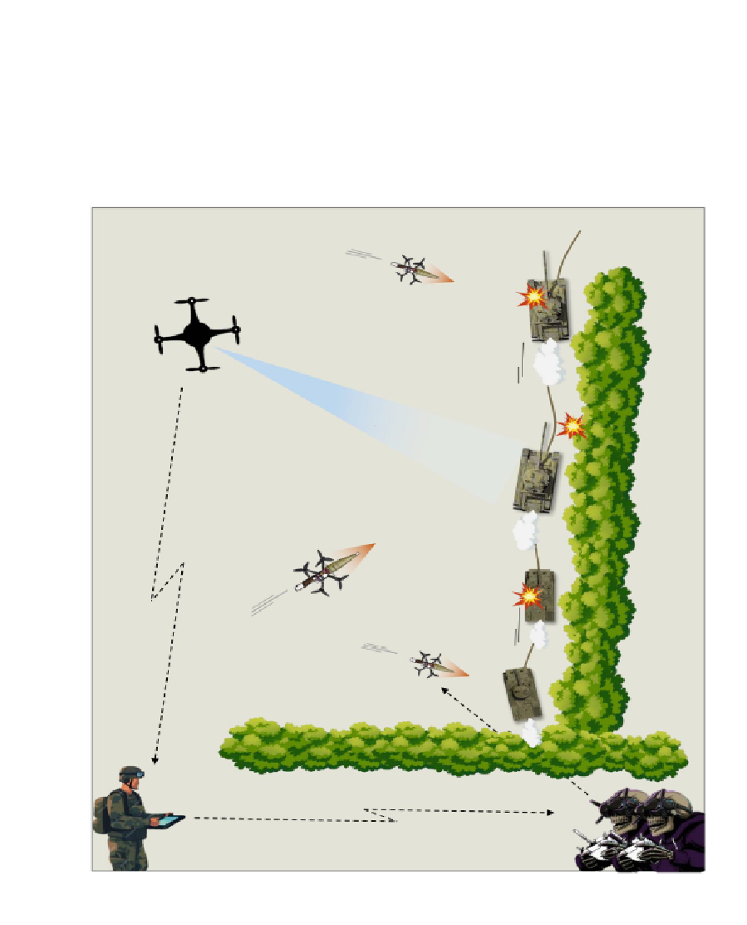

Slide 12
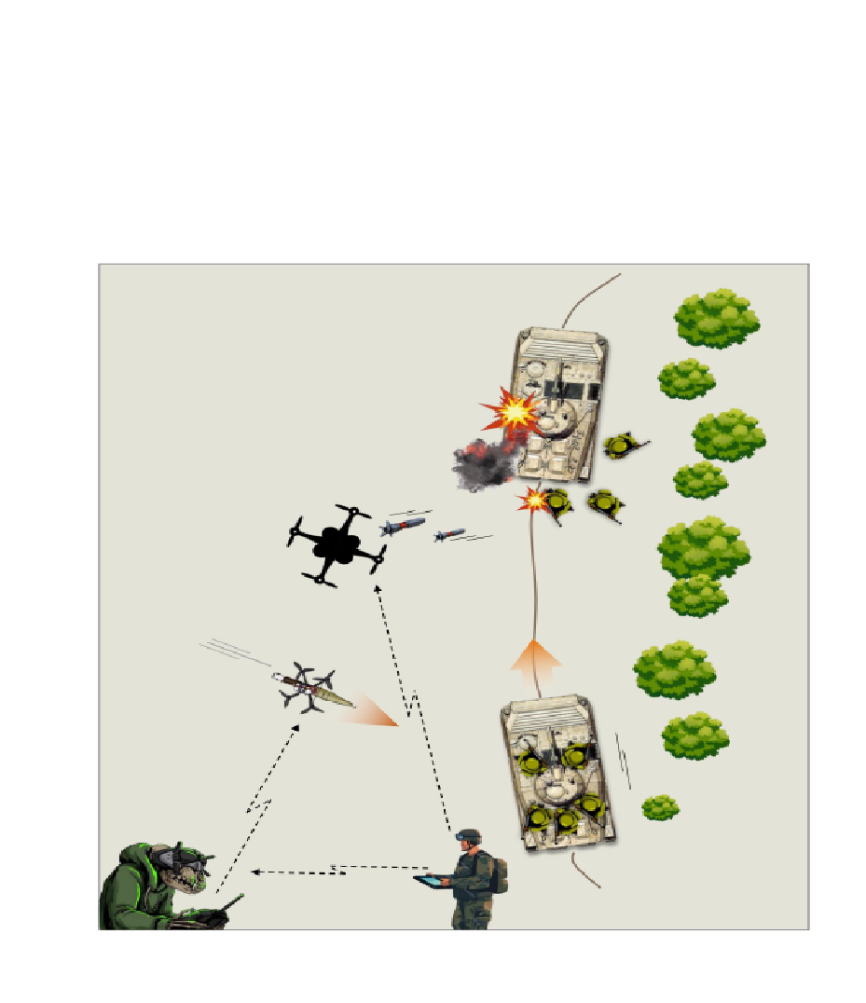
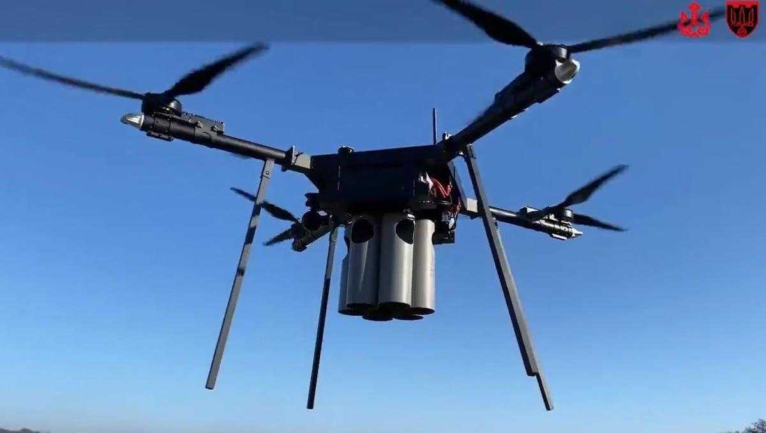
Bomber Aircraft
Heinz 57 heavy bomber with 6 separate droppers.

Slide 13
Methods of Engagement

Slide 14
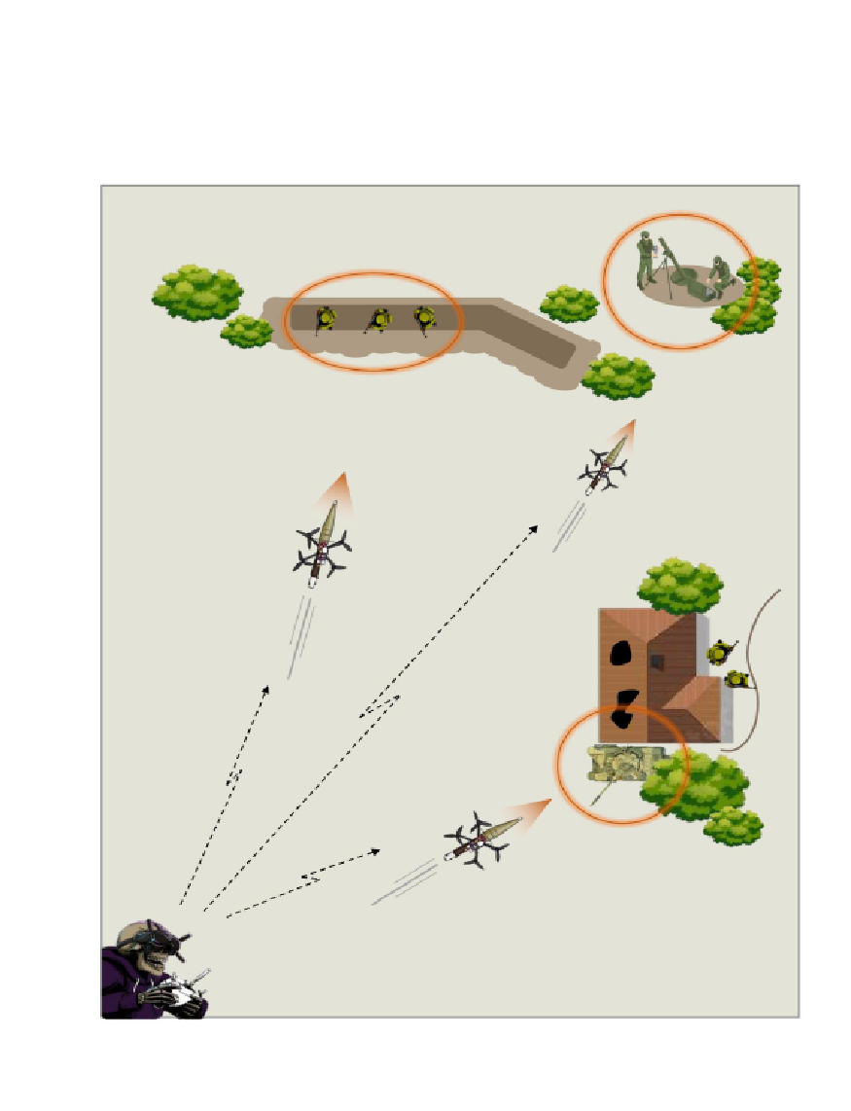
Movement to Contact:
FPV pilots conduct flights to identify and engage targets of opportunity in regions of suspected enemy presence/activity without the aid of recon aircraft.
Notes:
https://www.youtube.com/shorts/cosqPgrg9vE?feature=share

Slide 15
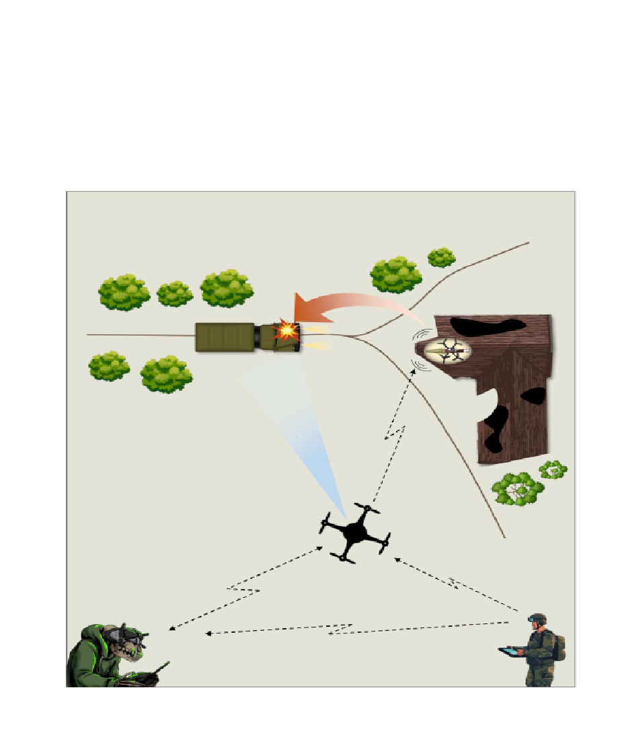
Ambush:
FPV pilots perch drones in positions to observe enemy avenues of approach. Upon identification of enemy entering the kill zone, operators arm their aircraft and engage.
Repeater / Recon Drone
Notes:
https://www.youtube.com/shorts/cwP6P9dfLUM?feature=share

Slide 16
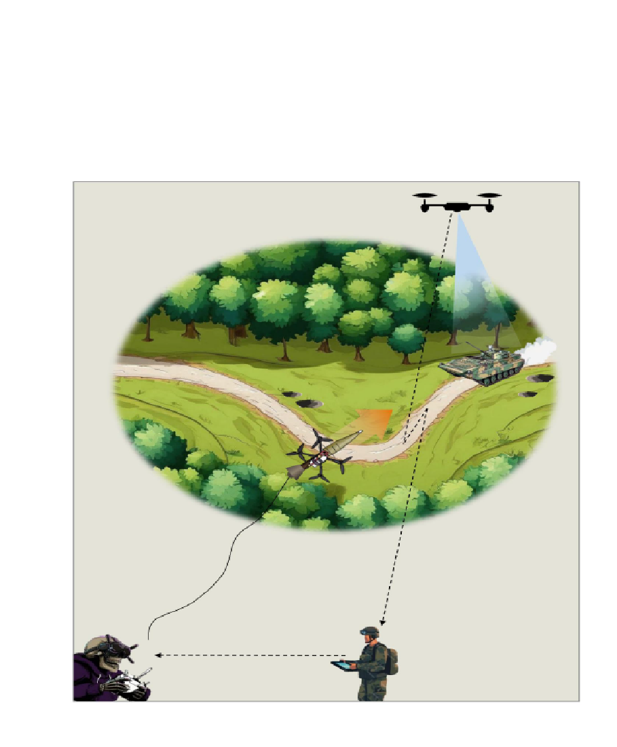
Wire-Attack:
FPV pilots launch fiber-optic enabled FPV drones to attack targets with EW capabilities.
Notes:
https://www.youtube.com/shorts/eITcGuMOEsM?feature=share

Slide 17
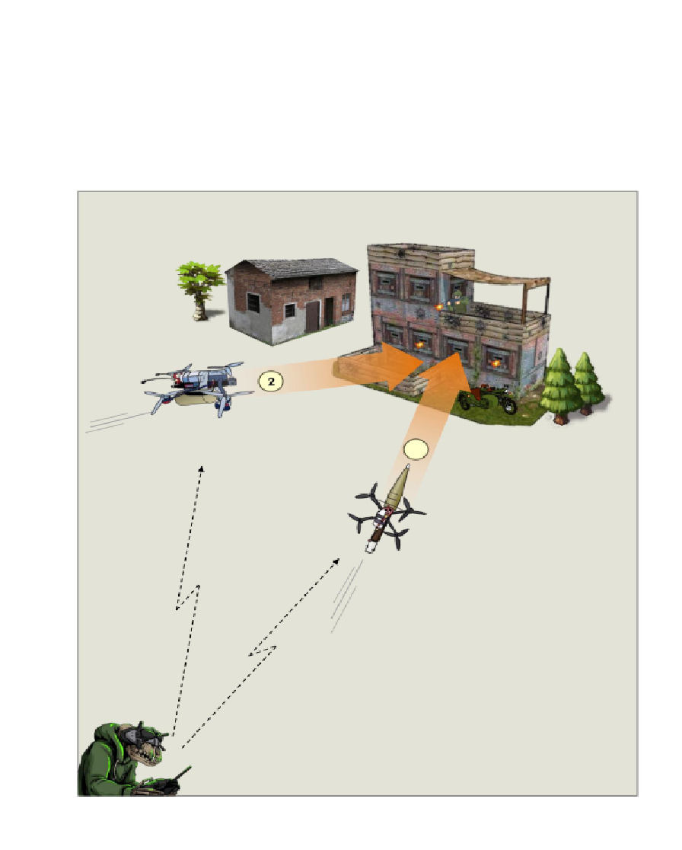
Break and Bake:
FPV drone 1 is armed with an obstacle reducing round designed to penetrate protecting obstacles.
FPV drone 2 is armed with a thermobaric charge that then enters the enemy position and is detonated.
1
Notes:
https://www.youtube.com/shorts/myj0Yz8B0h8?feature=share

Slide 18
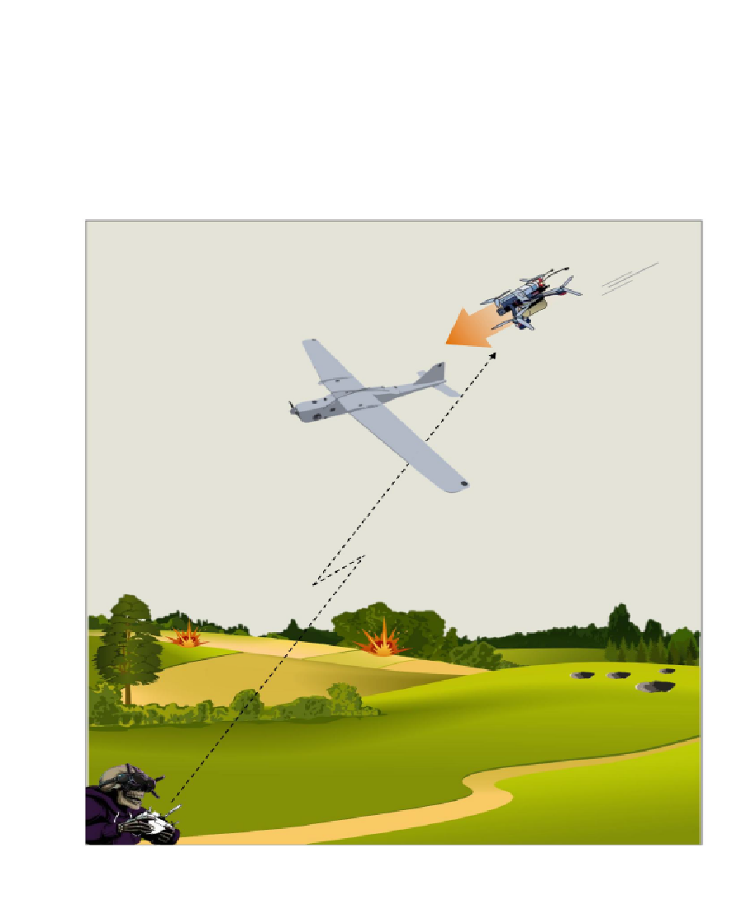
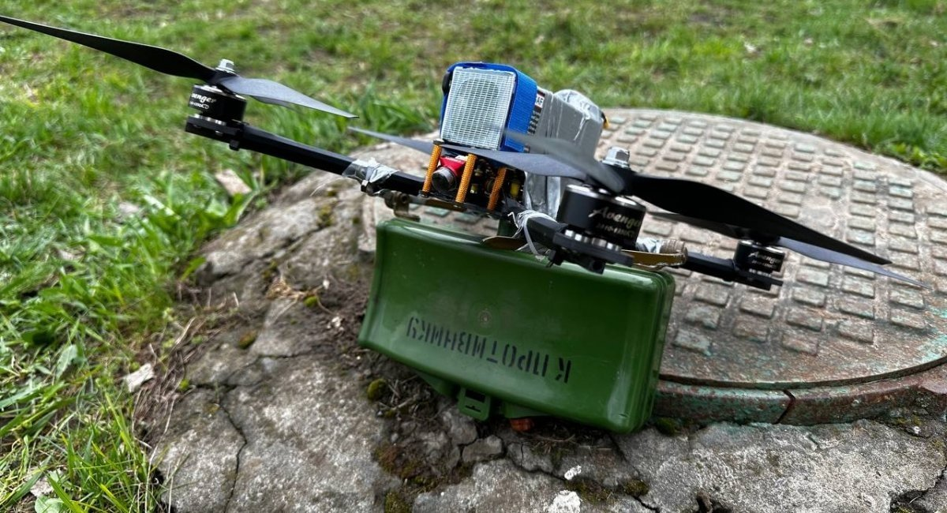
Air Intercept:
FPV pilot identifies and intercepts enemy UAS system or rotary / fixed-wing aircraft.
Notes:
https://www.youtube.com/shorts/WQdtAur-MZI?feature=share

Slide 19
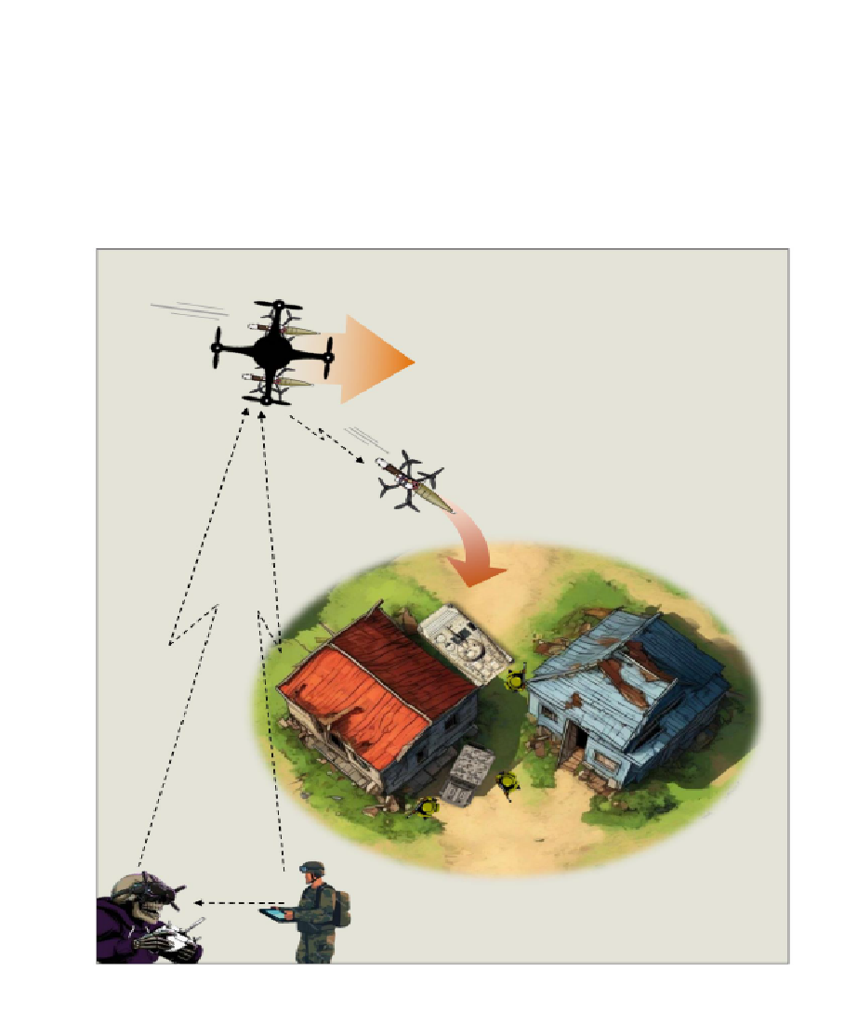
Mothership:
Mothership drone transports multiple FPV drones to an objective. Once in position, the FPV drones are released, and the mothership drone serves are recon and retransition.
Notes:
https://www.youtube.com/shorts/2oJwKZnCl6I?feature=share

Slide 20
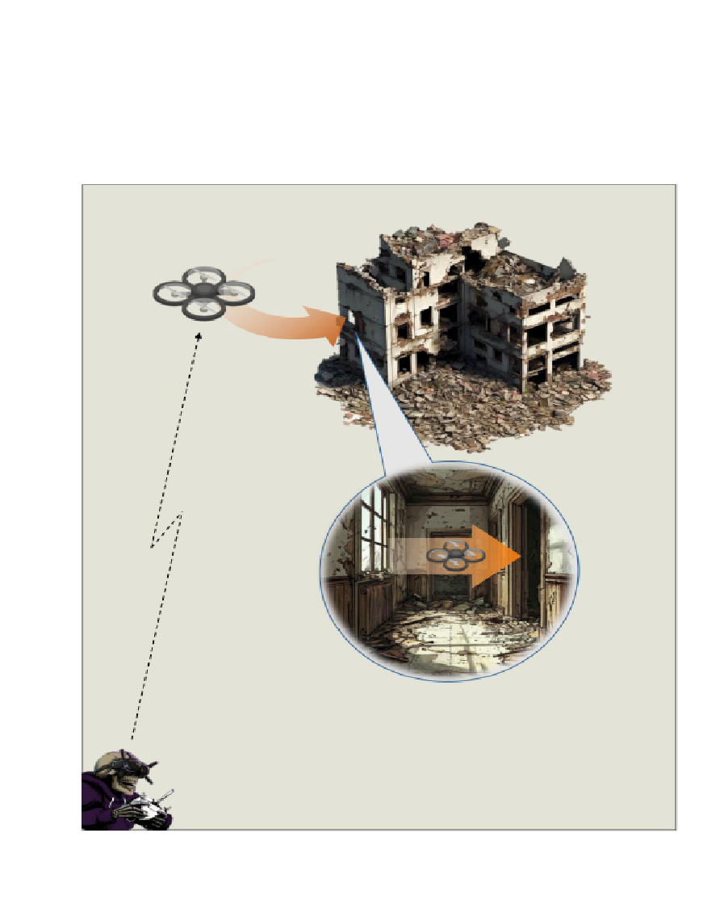
Urban Operations:
Small form factor FPV drones can be utilized to enter and clear buildings in conjunction with Soldiers on ground. This offers early detection and visual clearing of the vast amount of dead-space present in urban environment.
Notes:
https://www.youtube.com/watch?v=q1NvH0Hyp1Q&pp=ygUhSURGIGZwdiBkcm9uZSAgZmluZHMgaGFtYXMgbGVhZGVy

Slide 21
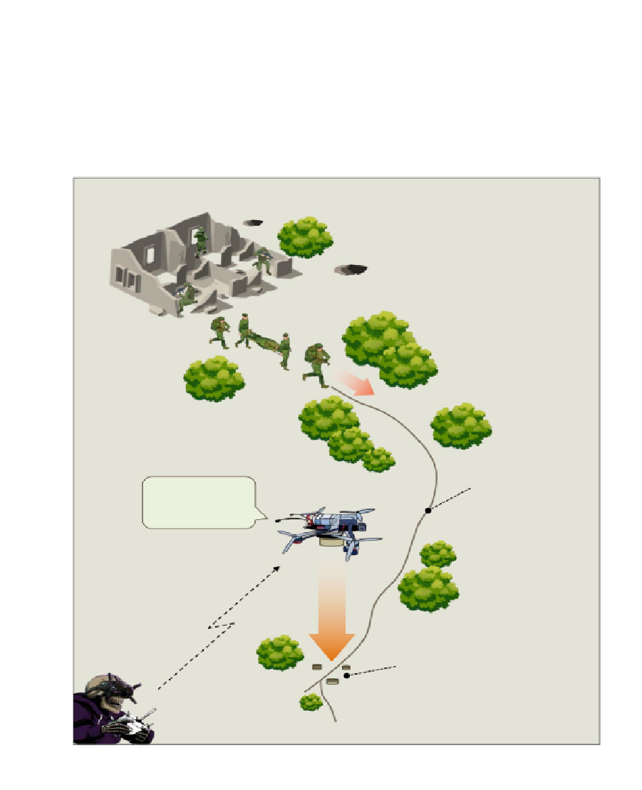
Limited Mine Placement
Notes:
https://youtu.be/RUCndq9WVTk

Slide 22
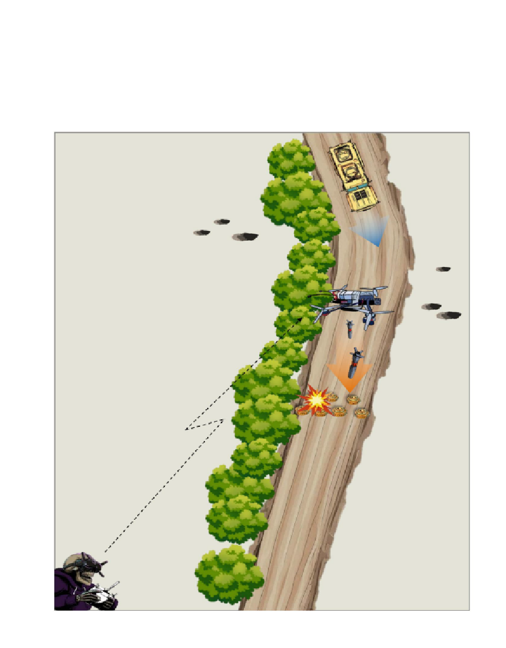
Limited Mine Reducing

Slide 23
Route Planning
Flight Techniques
Launch Site Considerations
Nap-of-the-Earth
During NOE flight, geographical features are used as cover, exploiting valleys and folds in the terrain by flying in, rather than over, them. This keeps the aircraft below enemy air defense radar coverage, avoiding being silhouetted against the sky.
What are issues with this technique?
High(er) Altitude Approach
Flights conducted at the upper-limits of the ROZ utilized to maintain LOS to the aircraft to ensure high fidelity communications. Outranges shortrange EW systems and avoids detection by soldiers and systems through sheer distance.
What are issues with this technique?
Separate from operator/hide-site or adjacent units
Behind cover and concealment
Minimizes exposure
Avoid Open Terrain
Mask EM Signature
LOS for Aircraft C2 at launch
Recovery Site (if applicable)
Same considerations as launch site

Slide 24
Airspace Considerations

Slide 25
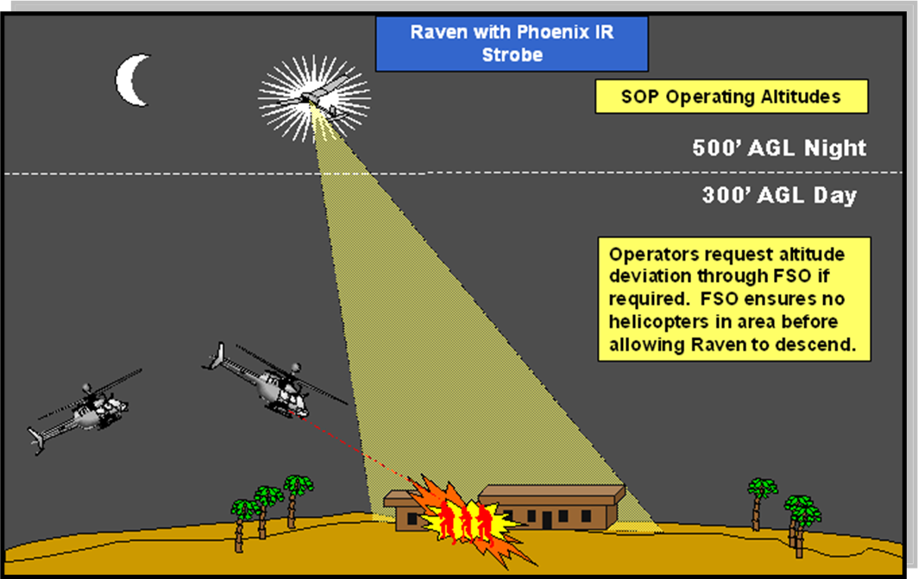
Vertical Separation
Same space and/or time, separated by altitude
Notes:
Fun fact: ATC using vertical separation based on heading. If your heading is 0-179 degree, you fly at an odd thousand's altitude (3,000/5,000/7,000). If your heading is 180-359, then you fly at an even thousand's altitude (4,000/6,000/8,000).

Slide 26
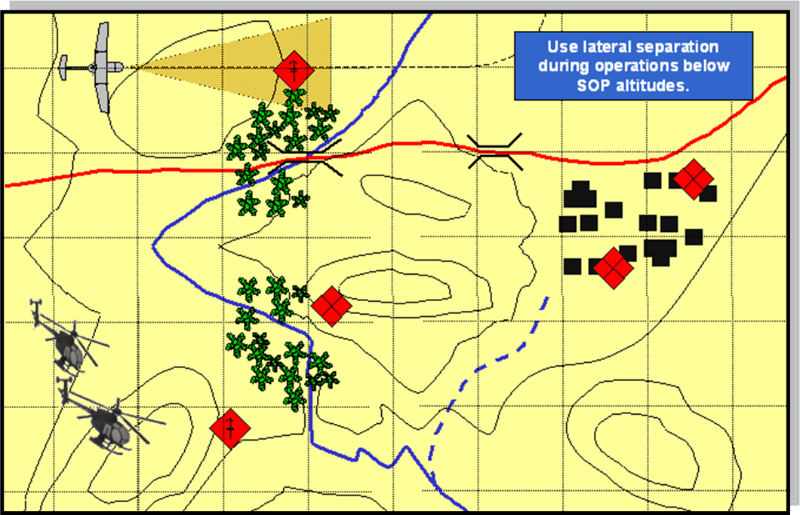
Lateral Separation
Same altitude and/or time, separated by distance/terrain

Slide 27
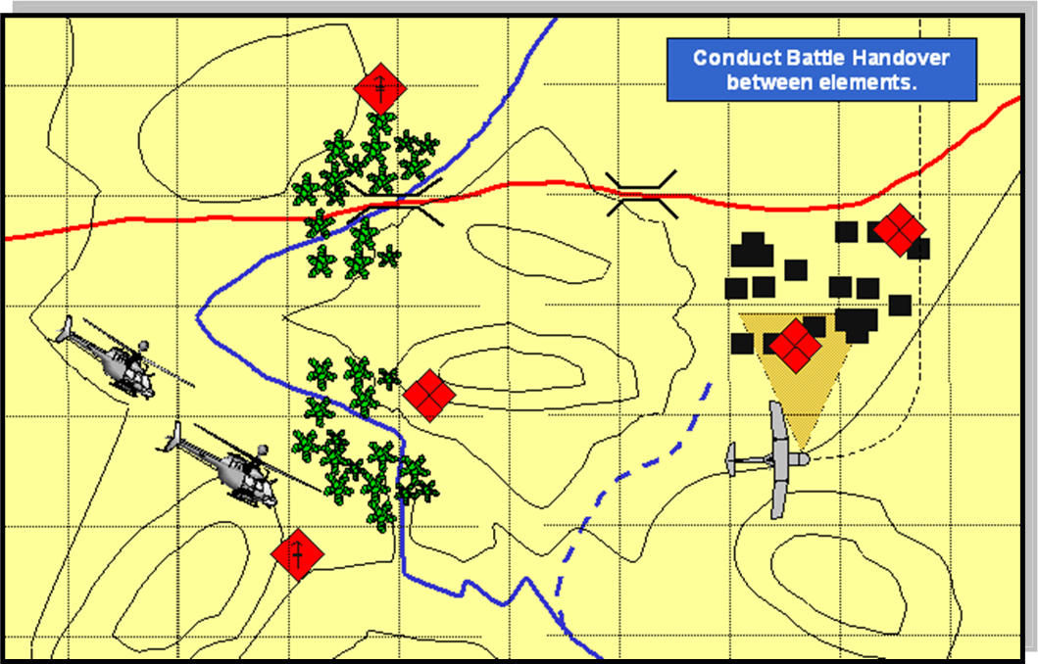
Time Separation
Same altitude and/or space, separated by time

Slide 28

Drones as Part of Combined Arms

Slide 29
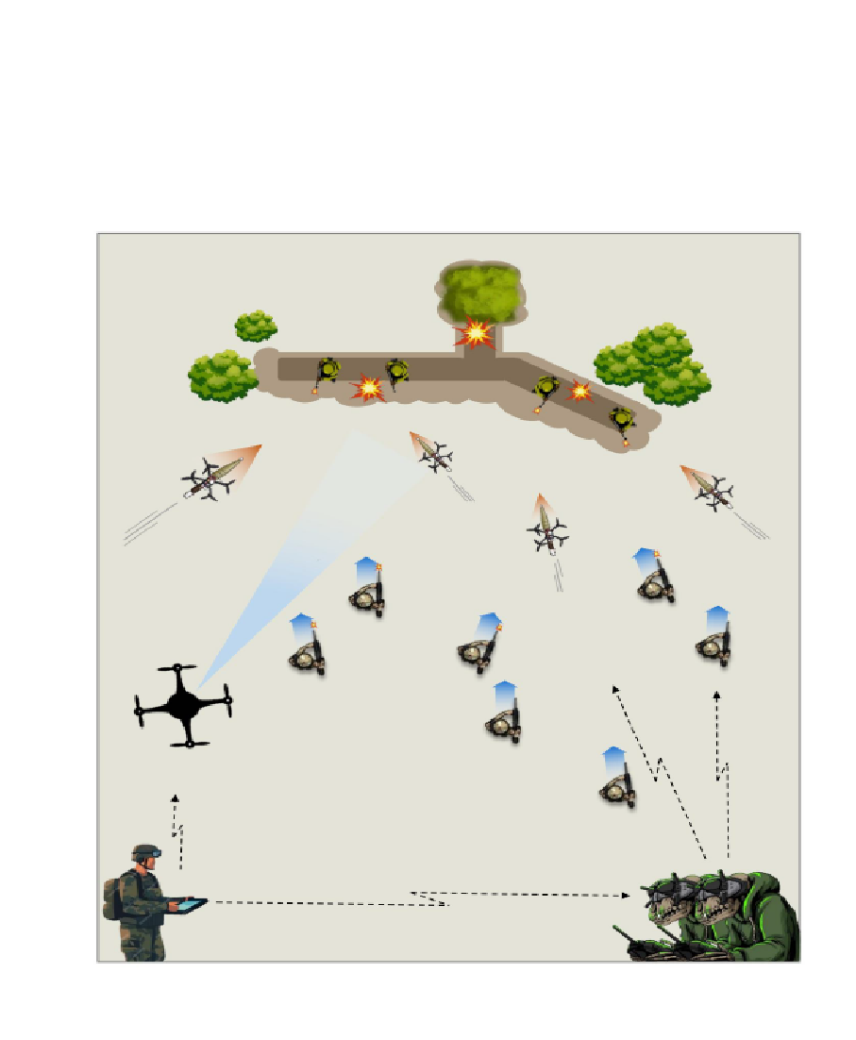
While drones can be useful in accomplishing a myriad of tasks alone, their main purpose is to ENABLE maneuver forces to accomplish their objectives on the battlefield.
This means that they must be integrated as part of the Combined Arms philosophy of maneuver warfare.

Slide 30
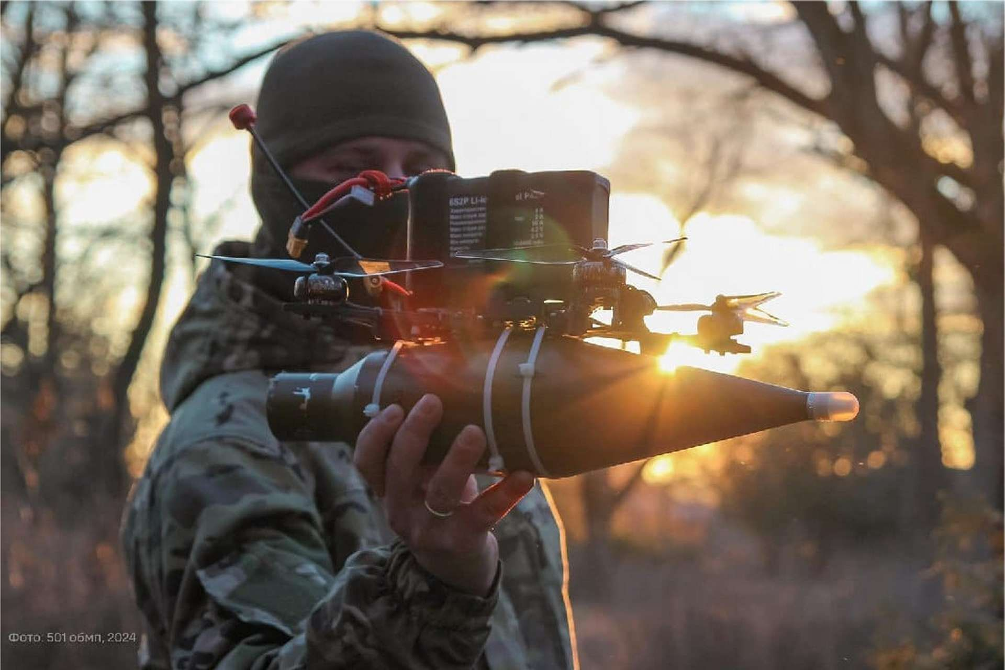
Integration into Offensive Operations
Characteristics of the Offense
Concentration
The massing of overwhelming combat power to achieve a single purpose
Audacity
Bold, simple plans executed with determination.
Tempo
The speed and rhythm of military operations relative to the enemy
Surprise
attacking the enemy at an unexpected time or place, or in an unexpected manner

Slide 31
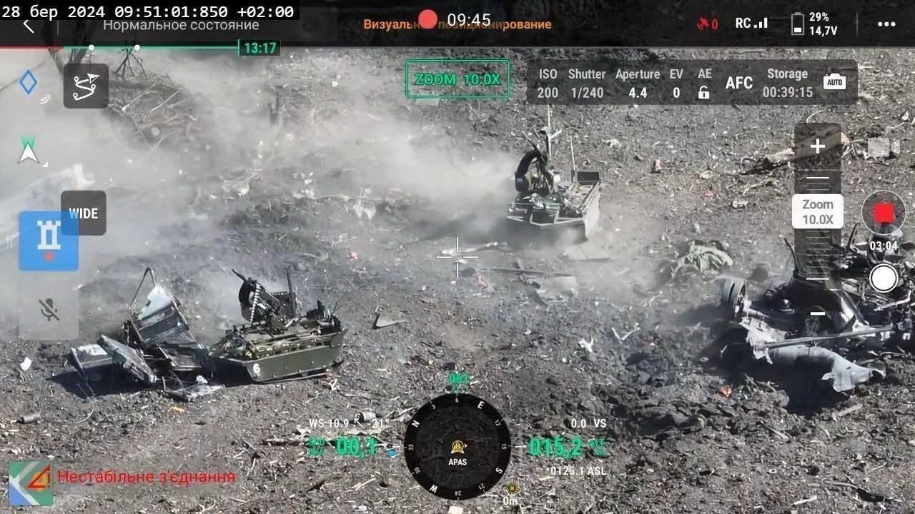
Integration into Breaching
Breaching Steps (SOSRA)
Suppress
Obscure
Secure
Reduce
Assault

Slide 32
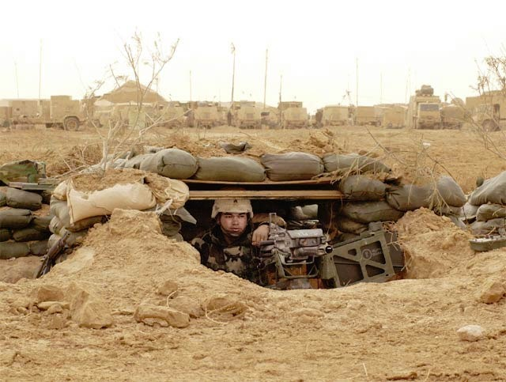
Characteristics of Defensive Operations
Disruption
Flexibility
Maneuver
Mass and Concentration
Operations in Depth
Preparation
Security

Slide 33
Integration into Defensive Operations
Engagement Area Development
Identify likely enemy avenues of approach
Determine the enemy’s likely scheme of maneuver
Determine where to kill the enemy
Plan and integrate obstacles
Emplace weapons systems
Plan and integrate indirect fires
Rehearse the engagement

Slide 34
Limitations
Susceptibility to electronic warfare
Unmanned systems do not replace Soldiers on the ground, especially in urban environments
Limited in payload while still remaining group 1 and 2 sized
Relatively high skill threshold to operate
Requires integration into other warfighting functions to exploit the advantages that FPV drones provide
"If all you have is a hammer, everything looks like a nail.“
-Abraham Maslow

Slide 35
Special Operations / Missions

Slide 36
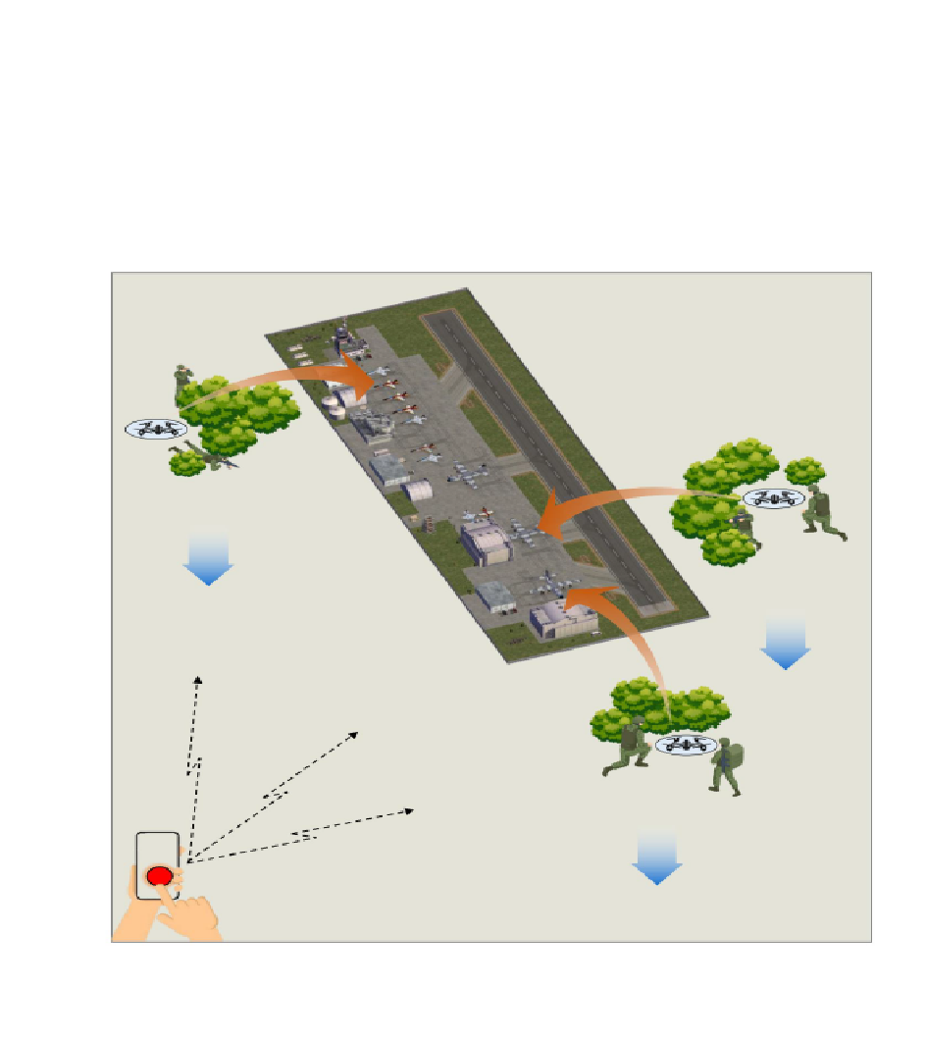
Complex Remote Attacks:
FPV systems are planted in advance or delivered to an unwitting enemy. They are then activated remotely to perform the attack via GSM (global cell network).
Notes:
https://www.youtube.com/shorts/yOdvTSwutLs?feature=share

Slide 37
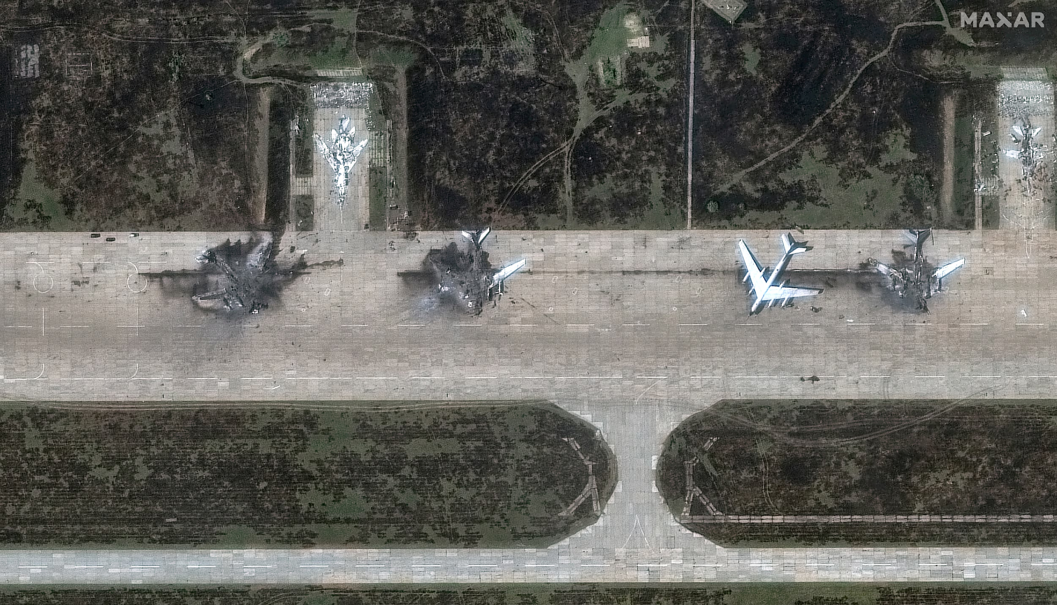
Reference attack on Russian Bomber Fleet by Ukraine 7 June 2025

Slide 38
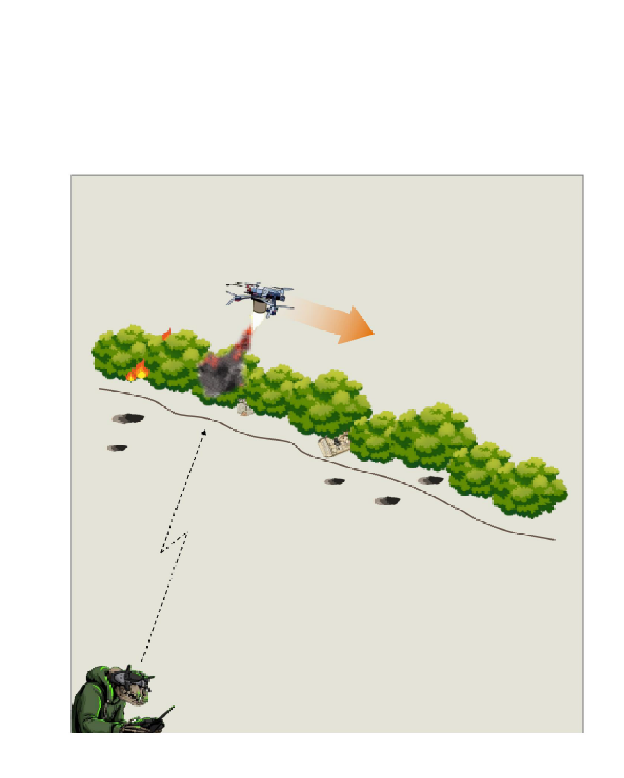
Incendiary Obstacle Reduction:
Thermite based incendiary devices may be attached to drones in order to destroy vegetation and wood based protective obstacles.
Notes:
https://www.youtube.com/shorts/55bWk2gKass?feature=share

Slide 39
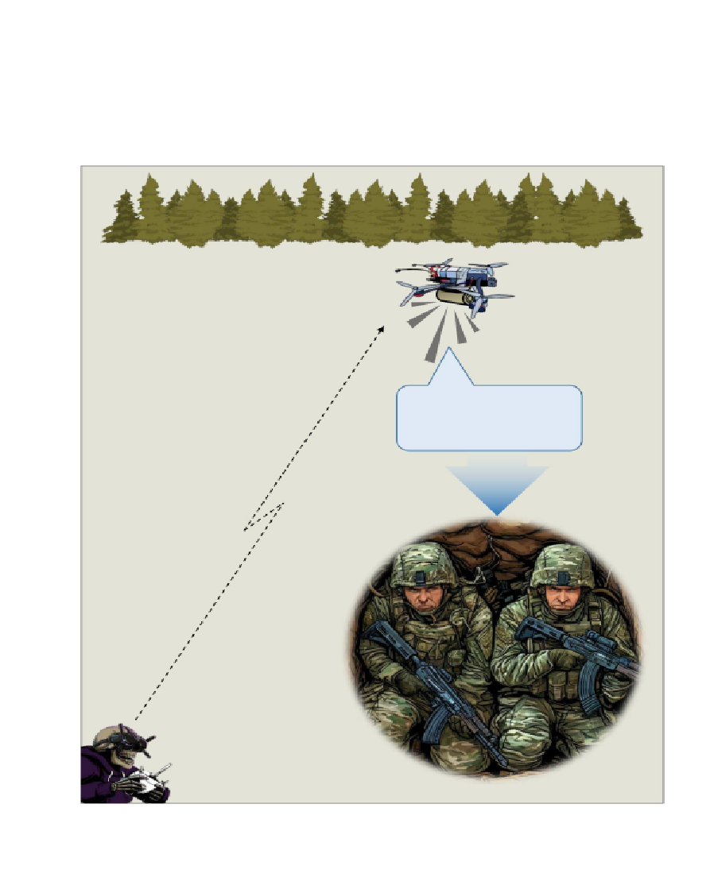
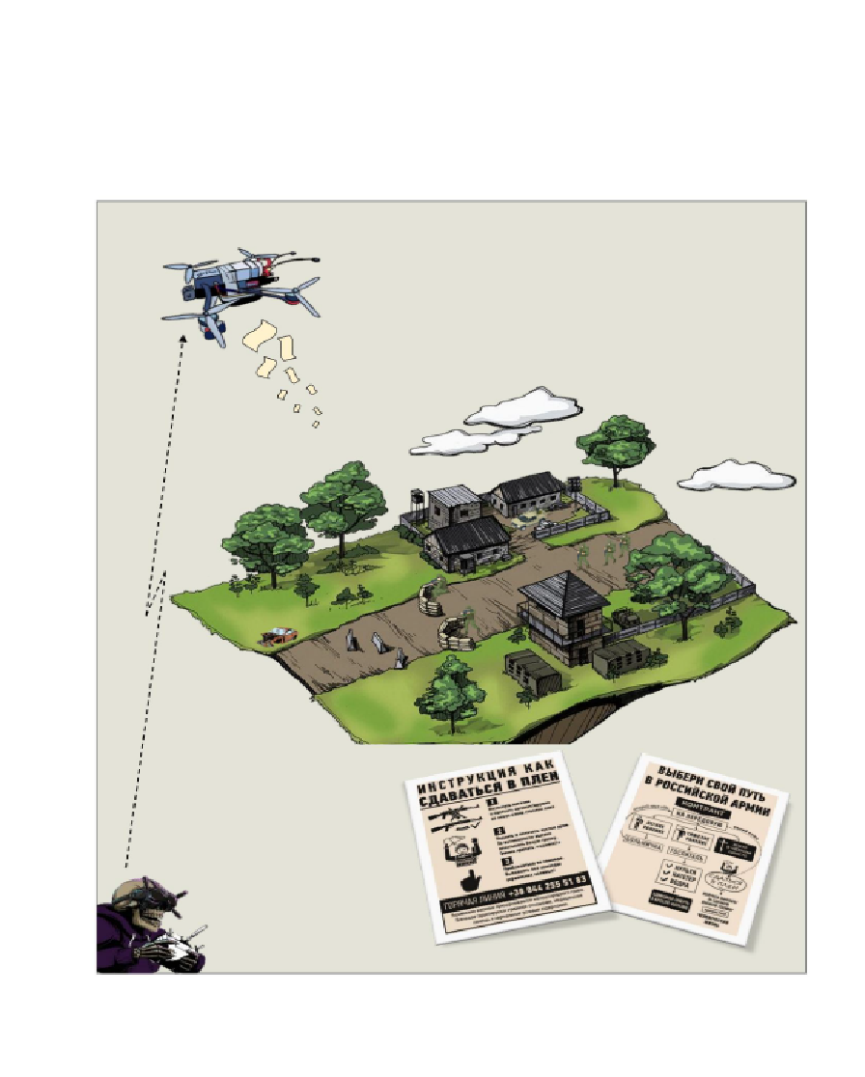
Psychological Operations :
Drones can be utilized to drop leaflets as well as broadcast messages via a PA system to encourage enemy units to surrender.
We're no strangers to love
You know the rules and so do I
A full commitment's what I'm thinkin' of
You wouldn't get this from any other guy

