Slide 1
sUAS FPV Antenna Theory

Slide 2
Fundamentals

Slide 3
Intro
What Is An Antenna:
  The interface between electromagnetic waves propagating through space and electric currents moving through system components
How it works:
  Transmitter: Supplies an amplified electric current to the antenna’s terminals causing the antenna to radiate energy in the form of Electro Magnetic (EM) waves.
  Receiver: Intercepts some of the EM waves, producing an electric current at the receiving antenna. The received electrical current is then carried to and amplified by the receiving device.

Slide 4
What is a Decibel (dB)
A ratio between two signal levels. Primarily used to describe the effect of system components on signal strength.
How does this apply to FPV?
  The total dB in a FPV system includes:
    Antenna Gain(s)
    Transmitter (TX) Power
    Receiver Sensitivity
Maximum range can be described as when the dB reaches 0.
mW (milliwatt) | dBm*
1 | 0
2 | 3
4 | 6
8 | 9
10 | 10
100 | 20
1000 | 30
10000 | 40
*dBm is used to indicate a power level expressed in decibels with 1 mW as a reference point.
Notes:
A power level in watts corresponds with 10 times the log of the power level in watts divided by 1 watt dBw. Recall that dividing logarithms is the same as subtracting the log of the numerator and the log of the denominator. So, 10 times log p watts/1 watt can be rewritten as (10 times log P minus 10 times log 1)dBw. The log of 1 is zero, so 10 times log 1 = 0. The results is (10 log P minus 0)dBw. The result is (10 log P)dBw.
A power level in milliwatts corresponds with 10 times the log of the power level in milliwatts divided by 1 milliwatt. This will result in (10 times log P minus 10 times log 1)dBm. The log of 1 is zero, so 10 times log 1 = 0. Now you have (10 log P minus 0)dBm. The result is (10 log P)dBm.
Both these examples prove that P watts = (10 log P)dBw and P milliwatts = (10 log P)dBm
Instructor Note:
[Source: Math for Sigint, pg.. 12-6]
dBi describes gain compared to isotropic reference antenna
dBd describes gain compared to reference dipole antenna
dBic describes gain compared to reference isotropic circular polarized antenna
https://www.nordicid.com/resources/expert-article/rfid-reader-power-outputs/

Slide 5
FPV Antenna Parts
Element
  Conductive material that transmits and receives electromagnetic waves.
Ground Plane
  Think electrical ground of the device. This is made of conductive metal and if properly tuned it can amplify the signal emitted or received by the element.
Coaxial Cable
  Shielded wire that carries signals between the connector and element without emitting. Primarily used to extend the length of the antenna.
  Not necessary if the antenna is directly connected to the element.
Connector
  Physical connection between the antenna and video transmitter (VTX)/receiver (RX)

Slide 6
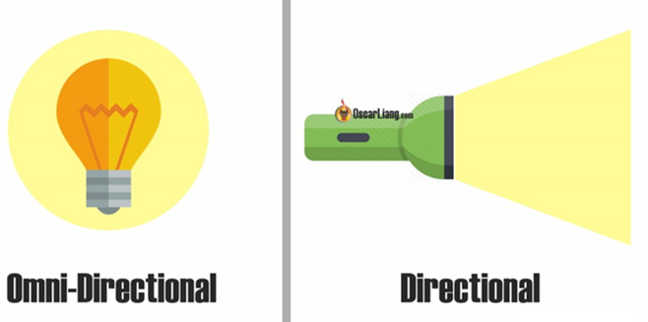
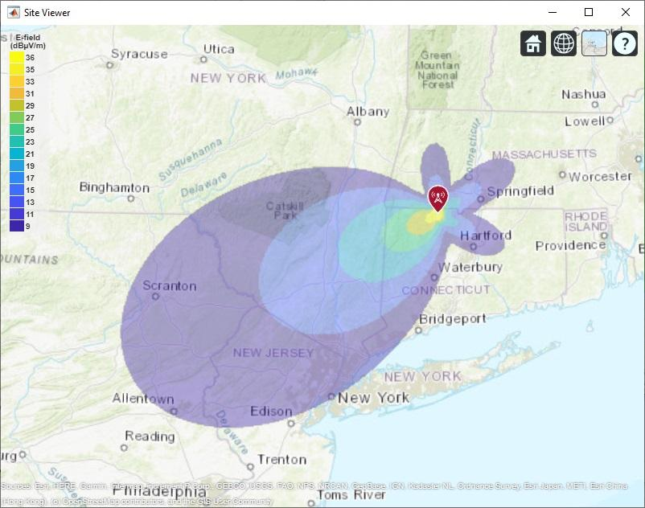
Antenna Directionality
Omni-Directional
  Emit in all directions at equal levels.
Directional
  Focused emittance in a specific direction.
  Emittance in other directions is minimal however, it still occurs.
    These are called “Side or Back Lobes”
In comparison, a directional antenna will reach further than an omni-directional antenna with the same power.

Slide 7
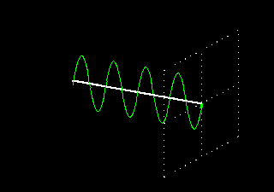
FPV Antenna Polarization
Linearly Polarized Antennas (LP)
  The signal oscillates either horizontally or vertically as it travels

Slide 8
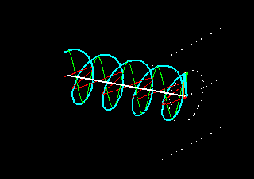
FPV Antenna Polarization
Circularly Polarized Antennas (CP)
  Circular polarization transmits signals on both horizontal and vertical planes.
  The phase shift is 90 degrees and looks like a spinning corkscrew

Slide 9
Circular Polarization
Two Types:
  Left Hand Circular Polarized Antennas (LHCP)
  Right Hand Circular Polarized Antennas (RHCP)
Matching the direction of a circularly polarized antennas is paramount to minimizing signal loss.
Example: If a transmitter (“TX”) utilizes a LHCP antenna the receiver (“RX”) should utilize a LHCP antenna as well.

Slide 10
Why does polarization matter in FPV use?
Due to the variety of use cases for FPV specific antennas, understanding what antenna to use is incredibly important to get the best performance.
In situations where radio frequency (“RF”) is not the most important factor a linearly polarized antenna is chosen due to their lighter, more durable, and smaller design. This allows pilots to increase their range.
Circularly polarized antennas are generally better suited for FPV usage. Linearly polarized antennas require specific antenna alignment to ensure signal reception. With drones rotating on all three axes this becomes difficult to ensure.

Slide 11
LP + CP setup
It is possible to use both antenna polarization types in a setup.
The most common use case for utilizing both LP and CP antennas is for short-range flying where the LP antenna is utilized on the drone itself, and the video receiver utilizes a CP antenna.
Signal loss will occur at almost -3dB (50% power output) which limits range.
  This is still significantly better than utilizing two LP antennas where the maximum reduction in signal is -30dB (0.1% power output).

Slide 12
Antenna Metrics
Antenna Directionality (Gain)
Radiation Pattern
Axial Ratio
Voltage/Standing Wave Ratio (VSWR/SWR)

Slide 13
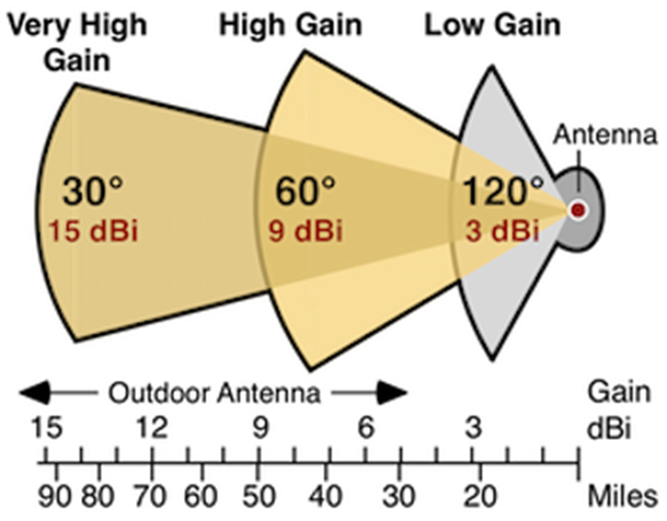
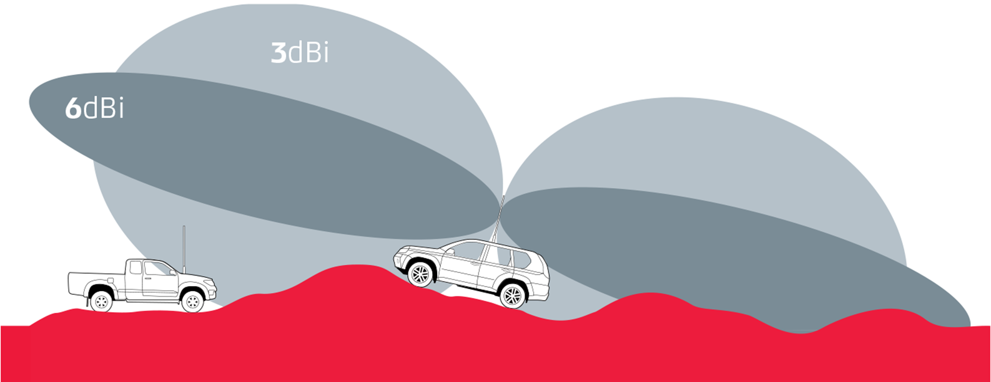
Antenna Directionality (Gain)
A metric to measure how much more power an antenna can radiate in a particular direction compared to a theoretical antenna that radiates completely equally in all directions.
Specified in decibels (dB)
Every 3dB gain you get from your antenna is equivalent to doubling the power of your TX.
  6dB of gain is equivalent to 4x the power of your TX

Slide 14
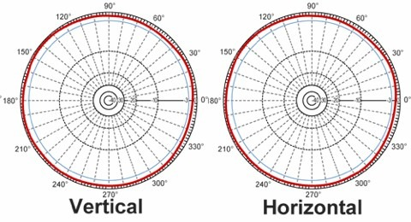
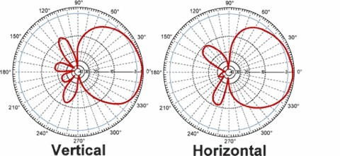
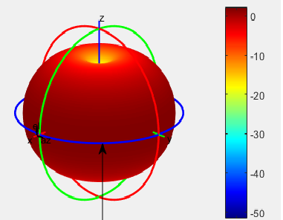
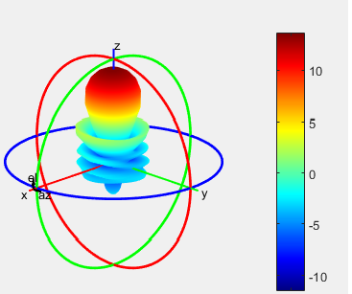
Radiation Pattern
Radiation patterns are normally seen in two charts; one looking down on the antenna, and the other looking at it from the side.
Understanding what is depicted allows the user to identify potential weak spots.
0 dB gain
8 dB of gain

Slide 15
Axial Ratio
No circularly polarized antenna will be perfectly LHCP or RHCP. There will be slight amounts of signal of the other type.
  For example; 90% LHCP and 10% RHCP
The axial ratio is used to measure an antenna properly.
  A perfectly circularly polarized antenna would have an axial ratio of 1.
Specifically, for FPV usage this measures how susceptible an antenna is to multipath interference.
Multipath Interference – form of noise seen in the video feed. It happens when the signal bounces off other objects and is received at the incorrect time (out of phase/phase delay).

Slide 16
Voltage/Standing Wave Ratio (VSWR/SWR)
The ratio of out going energy vs. energy that is reflected back at a transmitter.
Why does this matter?
  For a TX antenna, a high SWR can cause the TX to overheat which could potentially damage the radio.
  For a RX antenna a high SWR can degrade signal reception.
To best utilize an antenna’s SWR rating it is imperative that the user identifies the operating frequency range and does not exceed the power output of the antenna.
Notes:
Train analogy

Slide 17
Common FPV Antennas
 | Omni-directional | Directional
Linear Polarization | Monopole, Dipole | Patch
Circular Polarization | Cloverleaf, Pagoda | Helical, Patch, Crosshair

Slide 18
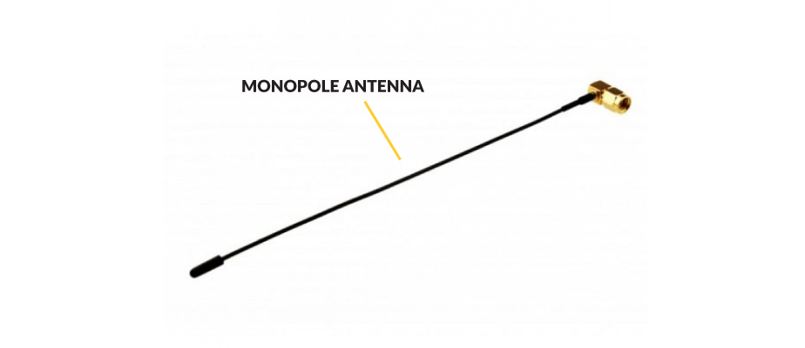
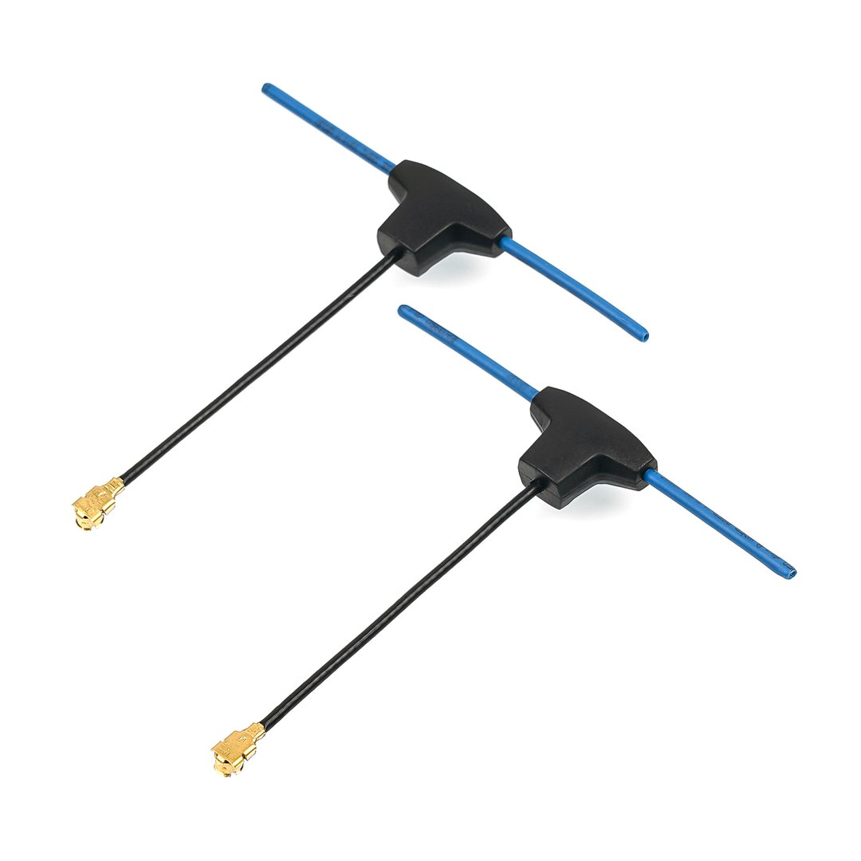
Monopole Antenna
Dipole Antenna
Type:
  Omni-directional Linear Polarization
Application(s):
  Radio control transmitters (TX) and receivers (RX)
Type:
  Omni-directional Linear Polarization
Application(s):
  Radio controlled transmitters (TX) and receivers (RX)
  Video transmitters
Notes:
Simplest form of antenna. Unshielded wire that acts as the antenna element. Length of exposed wire is crucial as it determines the resonant frequency
Resonance = ½ wavelength

Slide 19
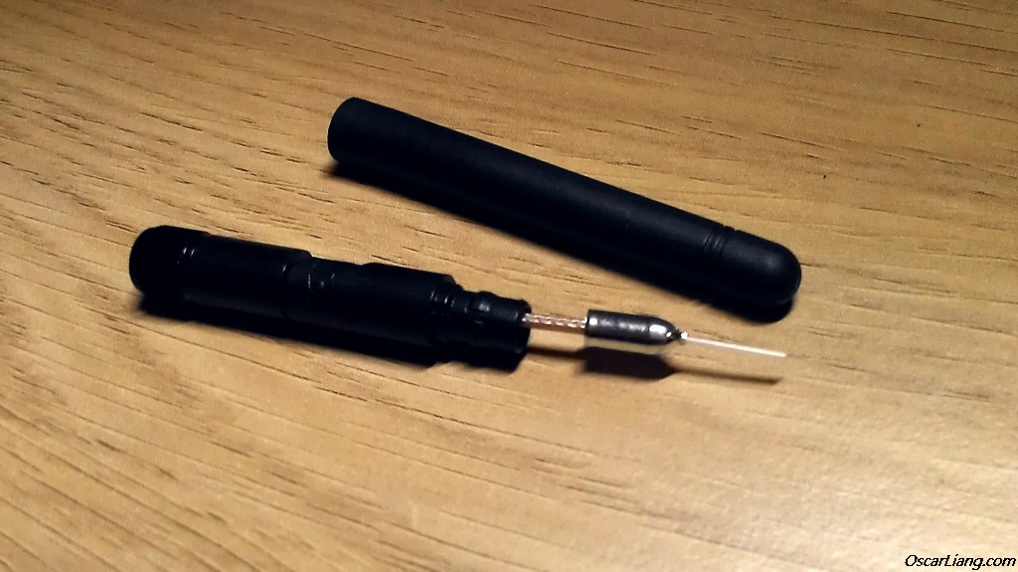
Dipole Antenna
Type:
  Omni-directional Linear Polarization
Application(s):
  Radio controlled transmitters (TX) and receivers (RX)
  Video transmitters
Notes:
A dipole antenna has a simple design, consisting of two equal-length elements that are perpendicular to each other, typically in a straight line. One element is the radiating element, while the other serves as a ground plane. The dipole antenna has slightly higher gain than a monopole antenna at the expense of reduced effectiveness of the antenna’s vertical performance.

Slide 20
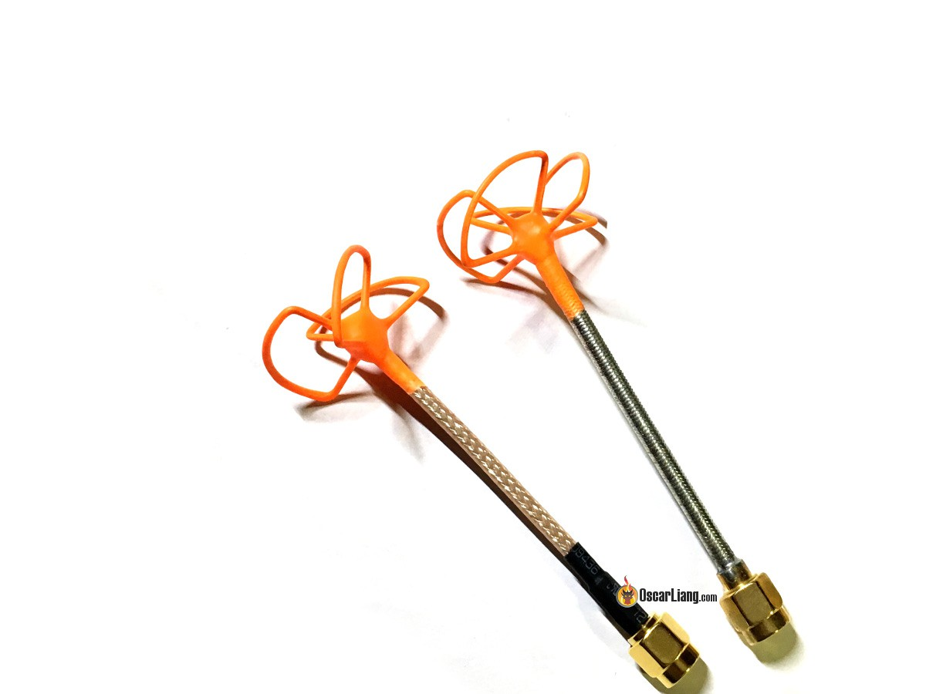
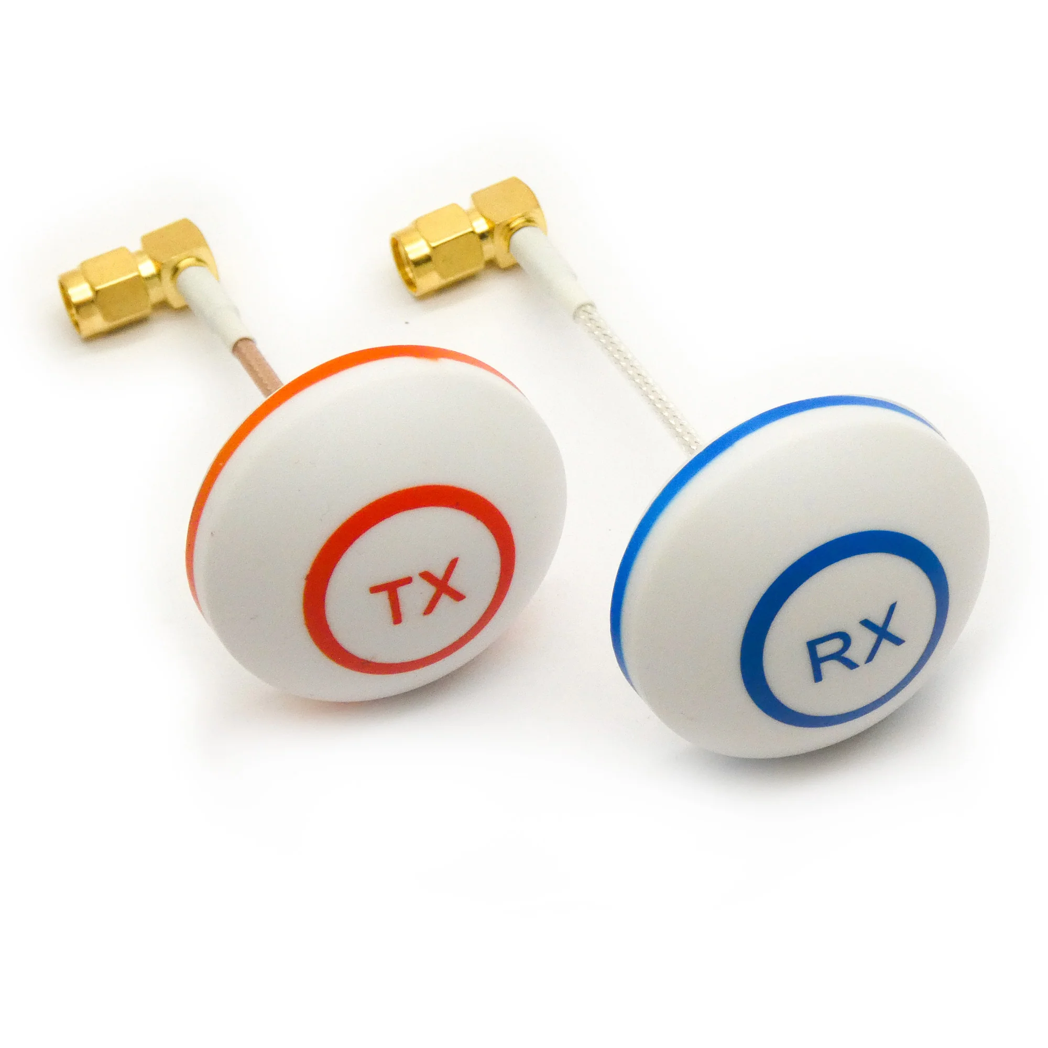
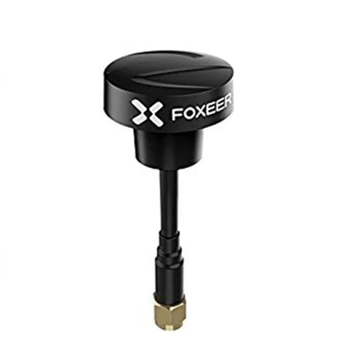
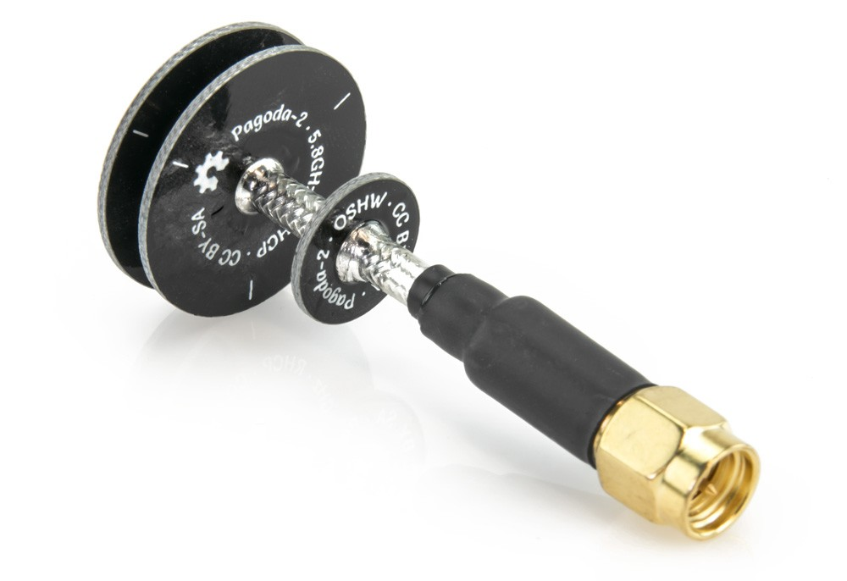
Cloverleaf Antenna
Pagoda Antenna
Type:
  Omni-directional Circular Polarization
Application(s):
  Video transmitter (TX) and receiver (RX) antennas
Type:
  Omni-directional Circular Polarization
Application(s):
  Video transmitter (TX) and receiver (RX) antennas
Notes:
Provide fantastic performance regardless of their orientation relative to one another. They are less susceptible to multi-pathing
Very fragile – normally come in a housing to protect them.

Slide 21
Pagoda Antenna
Type:
  Omni-directional Circular Polarization
Application(s):
  Video transmitter (TX) and receiver (RX) antennas
Notes:
Made out of PCB (circuit boards) they are very durable. Less efficient because they use material that leads to lower RSSI than antennas with identical specs utilizing wires

Slide 22
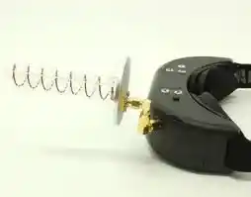
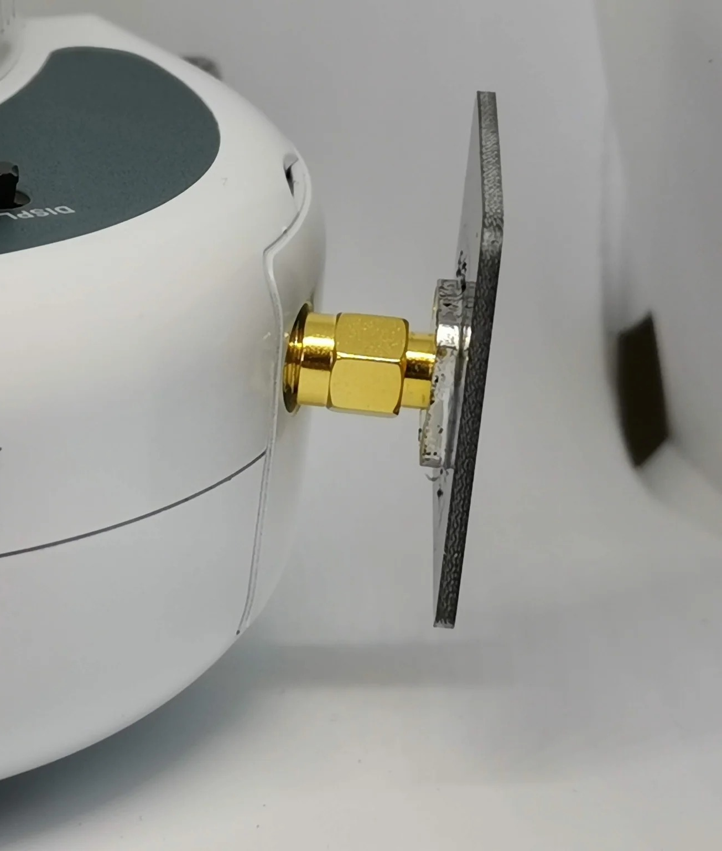
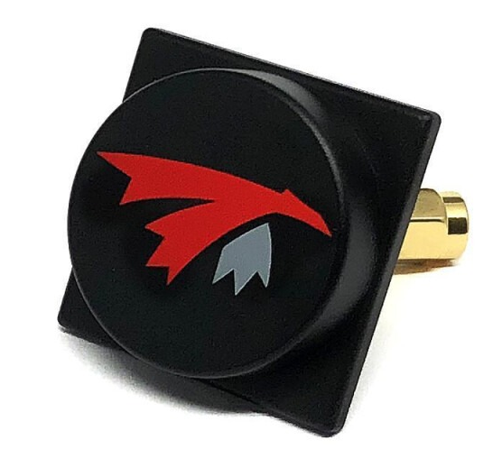
Helical Antenna
Patch Antenna
7-turn 5.8GHz 12dBi helical antenna
Type:
  Directional Circular Polarization
Applications:
  Video receivers (RX)
Type:
  Directional Linear or Circular Polarization
Application:
  Radio control transmitters (TX) and video receivers (RX)
Notes:
The number of turns of coil determines the gain of the antenna. More turns = higher gain

Slide 23
Patch Antenna
Type:
  Directional Linear or Circular Polarization
Application:
  Radio control transmitters (TX) and video receivers (RX)

Slide 24
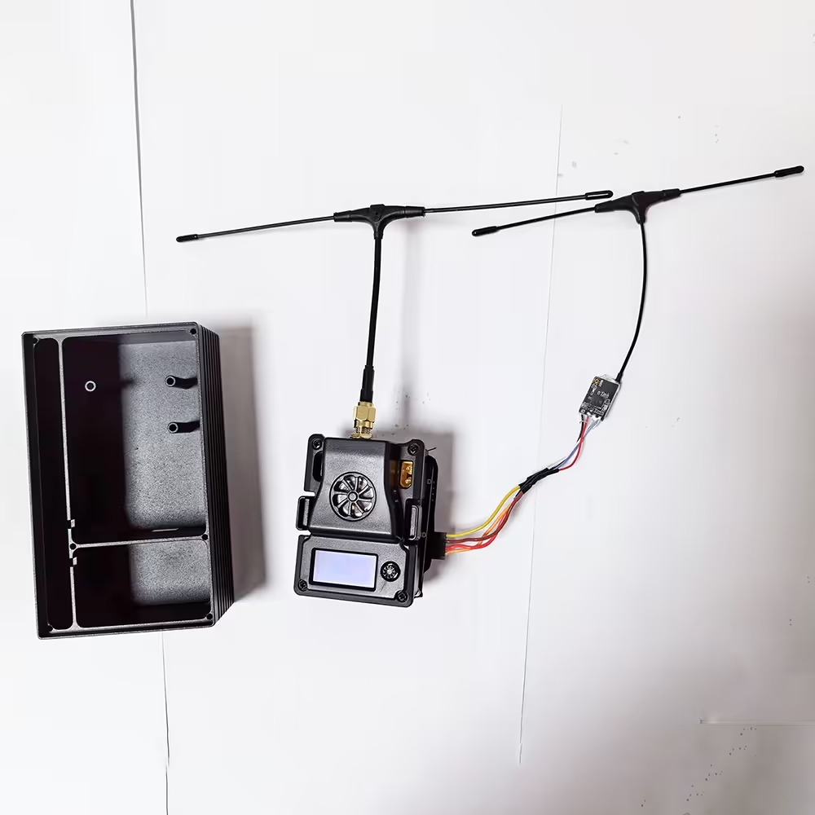
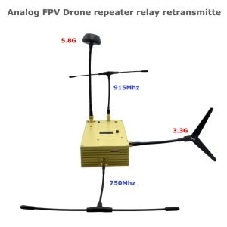
Analog VTX Repeater
Amplifies and retransmits (relays) video signal, effectively extending range of FPV
Ground based or mobile

Slide 25
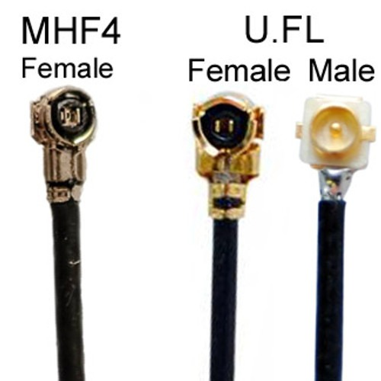
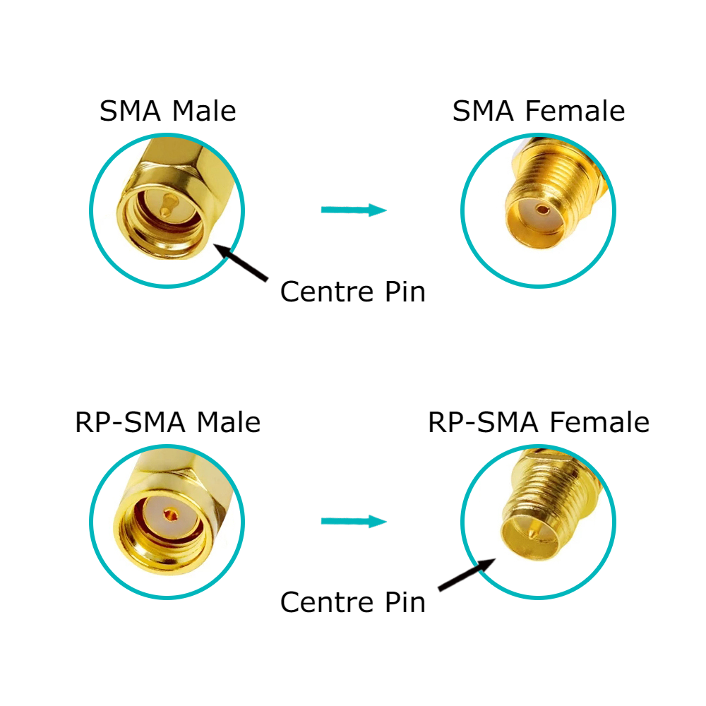
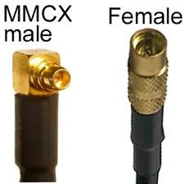
Antenna Connectors
Most common:
  SMA
  RP-SMA
Other options:
  U.FL
    Very lightweight and compact but very fragile
  MMCX
    A balance between SMA and U.FL
    More mating cycles and stronger than U.FL but has a smaller footprint than SMA

Slide 26
Things to Consider
When choosing an antenna for your FPV there are a few non-technical characteristics to consider:
  Durability
    Antennas are mounted externally and therefore are prone to damage
  Weight
    With the trend of drones becoming lighter antenna weight must be taken into consideration
  How the video transmitter (VTX) will be mounted
    Its important to ensure the VTX away from conductive materials.
    What orientation will work best?

Slide 27
Building a Dipole Antenna
Items need for building a Dipole:
Snap Bayonet Neill-Concelman (BNC) Connector
6 to 7 ft. of COAX
100ft quad shield plus pro wire
Wide range receiver AR 8200 (or Uniden)
Yard stick
Solder kit
Wire cutter
Multi-meter
Wooden Dowel
Electrical tape (Lots)
American Wire Gauge (AWG) solid core wire
Wooden 1x2 stick 5ft
Calculator (or the one on your computer)

Slide 28
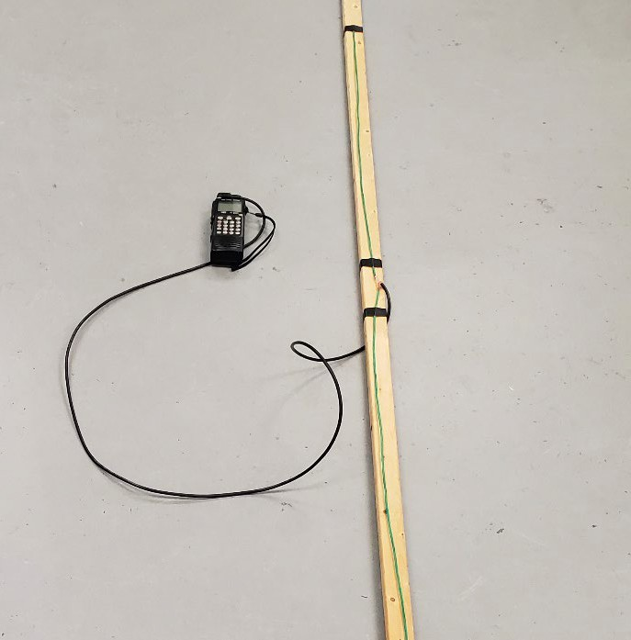

Building a Dipole Antenna Step 1
The Wave Length equation:
  300/ desired Frequency (FM) = X in meters
  X/4
  Write this number down!
1/4th of the wavelength

Slide 29
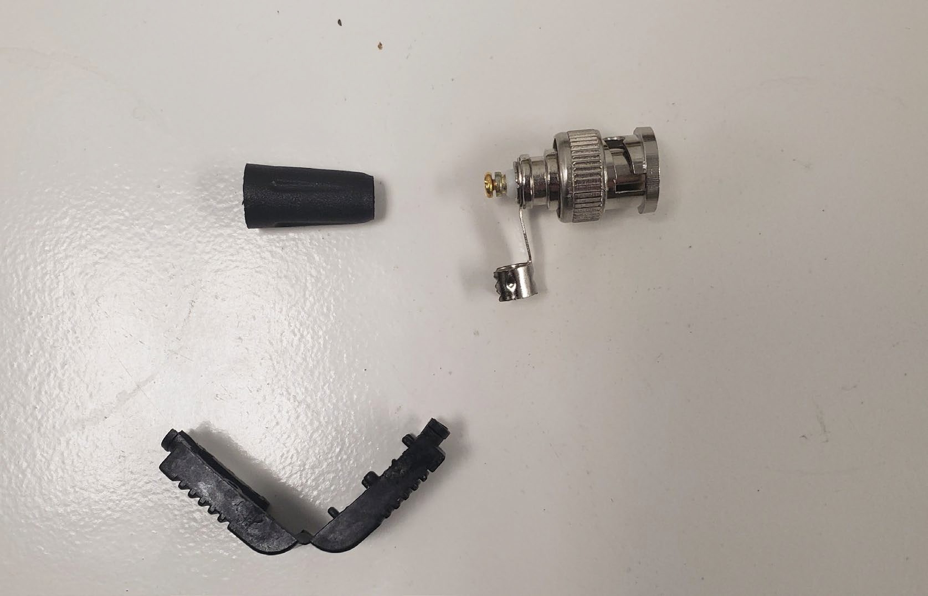
Building a Dipole Antenna Step 2
Have all parts of the BNC connector required for the connection to the coax cable.

Slide 30
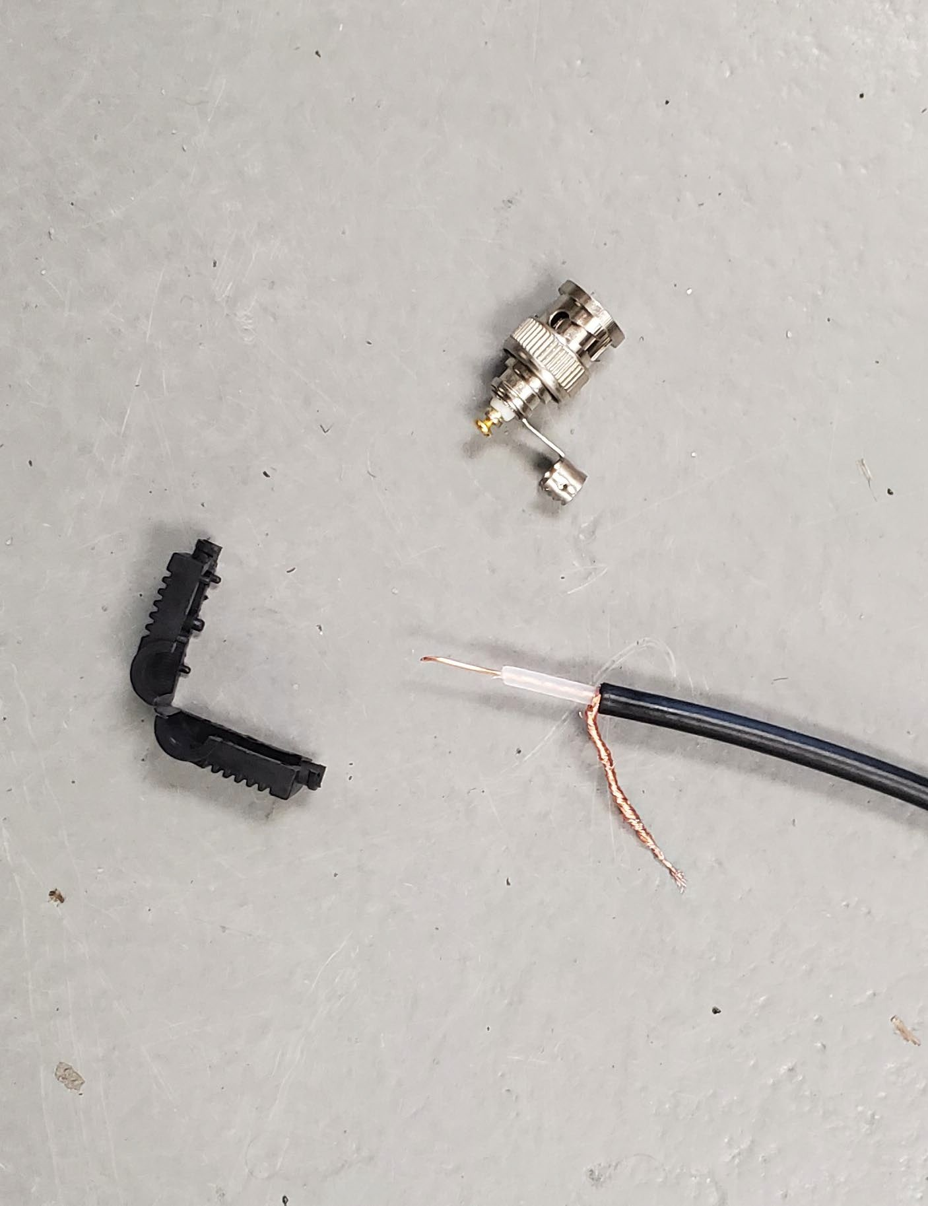
Building a Dipole Antenna Step 3
COAX cable to be stripped for connection of BNC.

Slide 31
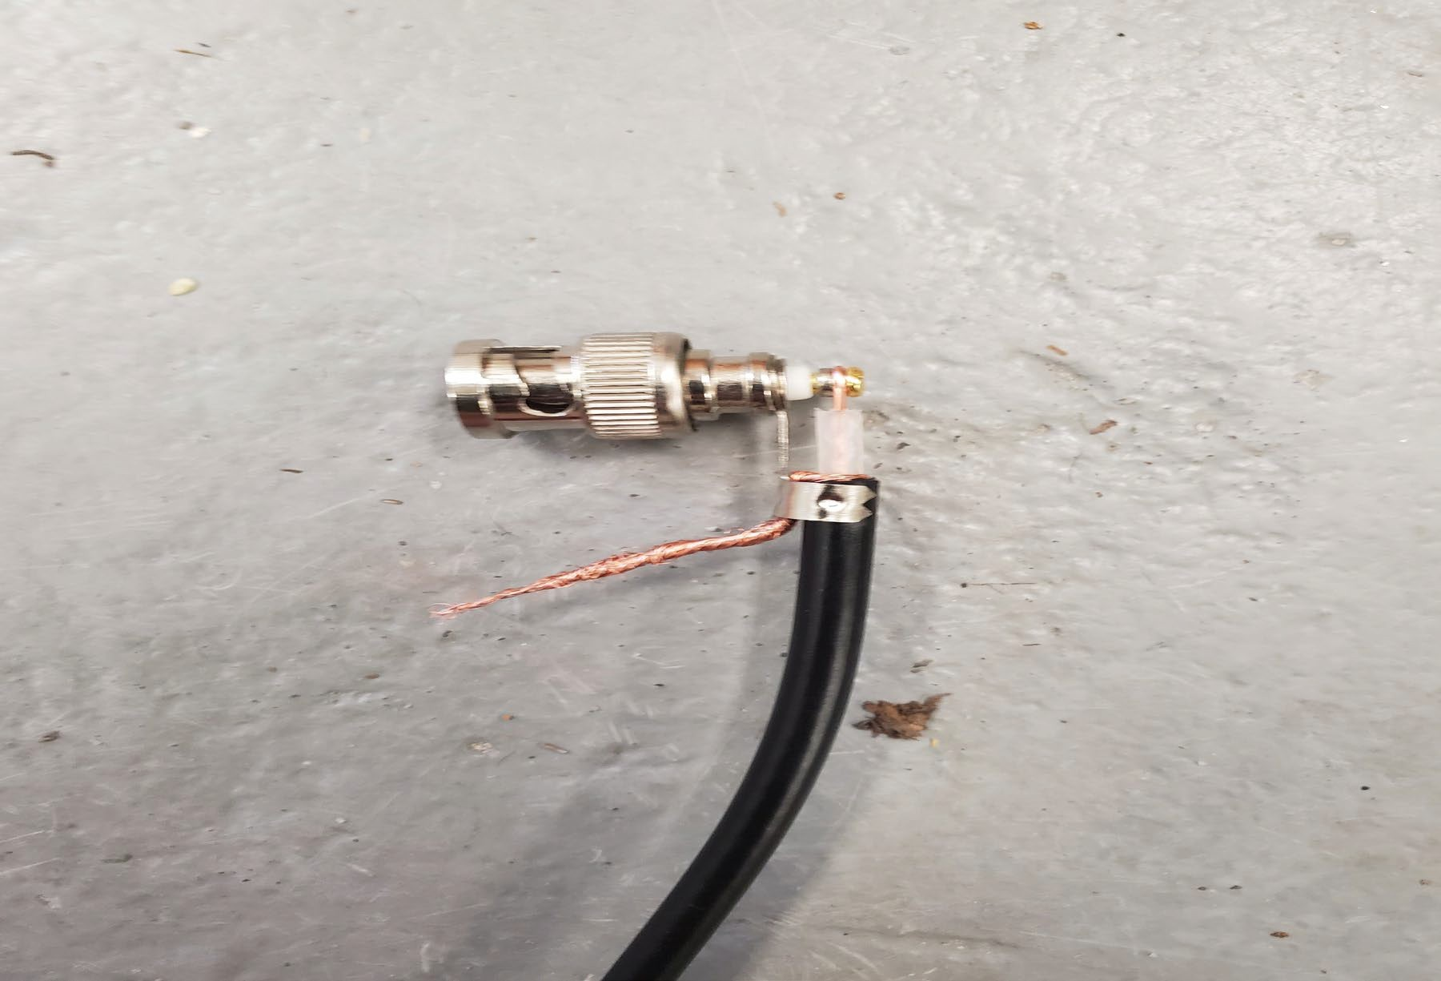
Building a Dipole Antenna Step 4
Connect the BNC connector to the wire.

Slide 32
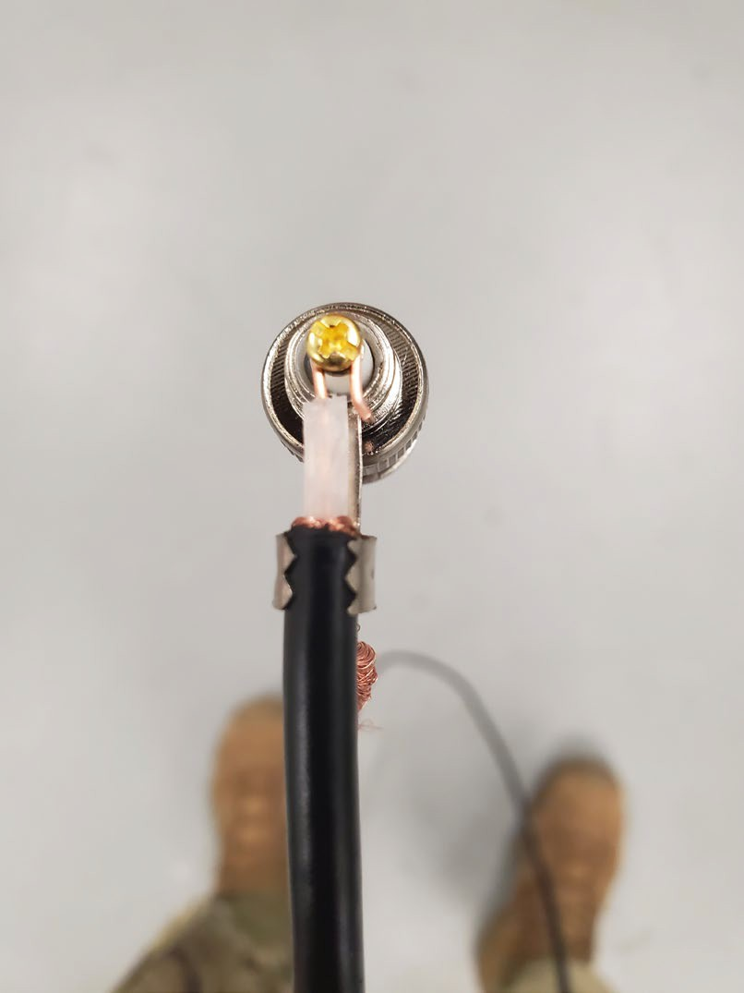
Building a Dipole Antenna Step 5
Remove the additional copper insulator from the BNC connector from
the COAX cable.
Ensure interior wire is bent around the end of the BNC connector.

Slide 33
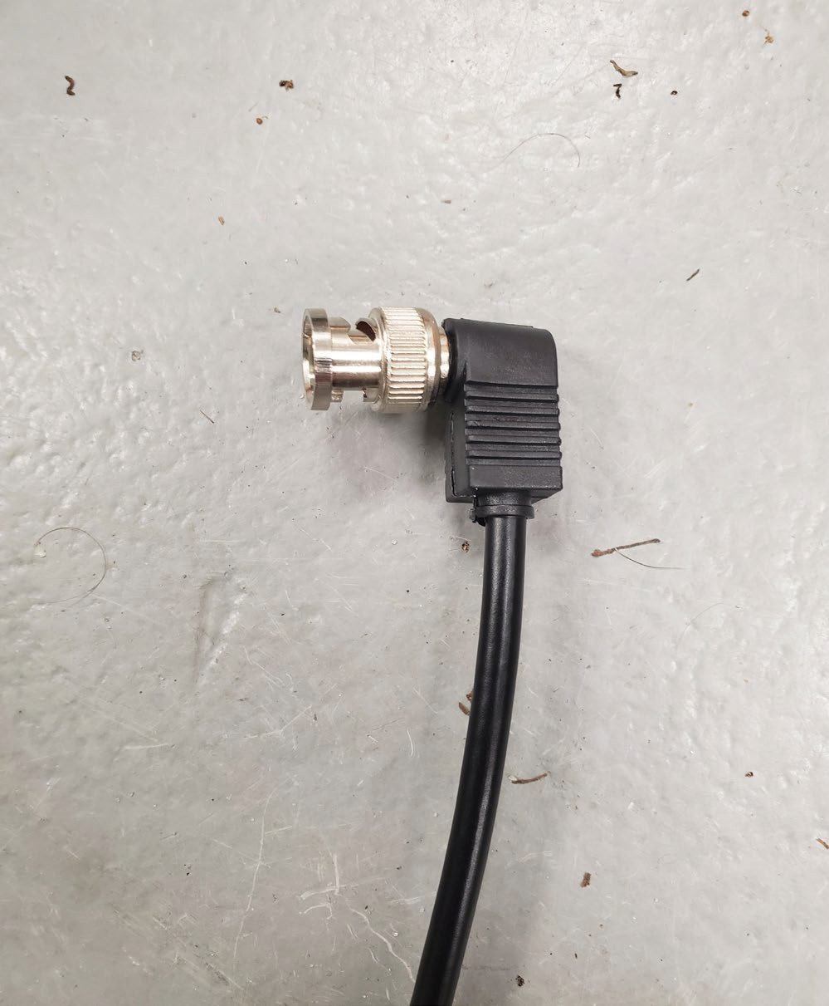
Building a Dipole Antenna Step 6
Attach the Plastic Clamp, from the BNC Connector to around the COAX cable.
Plastic Clamp

Slide 34
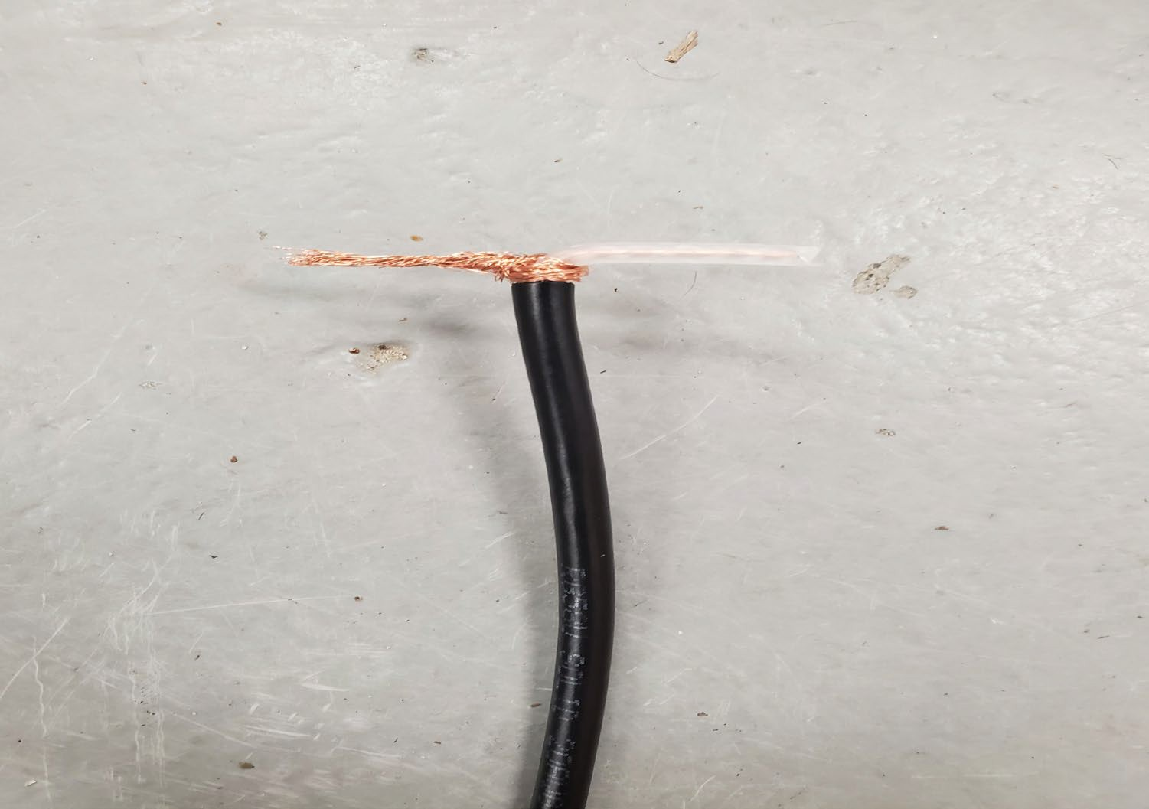
Building a Dipole Antenna Step 7
Split the COAX cable, stripping the copper insulator to become part of the antenna, forming a “T shaped” Dipole Antenna.

Slide 35
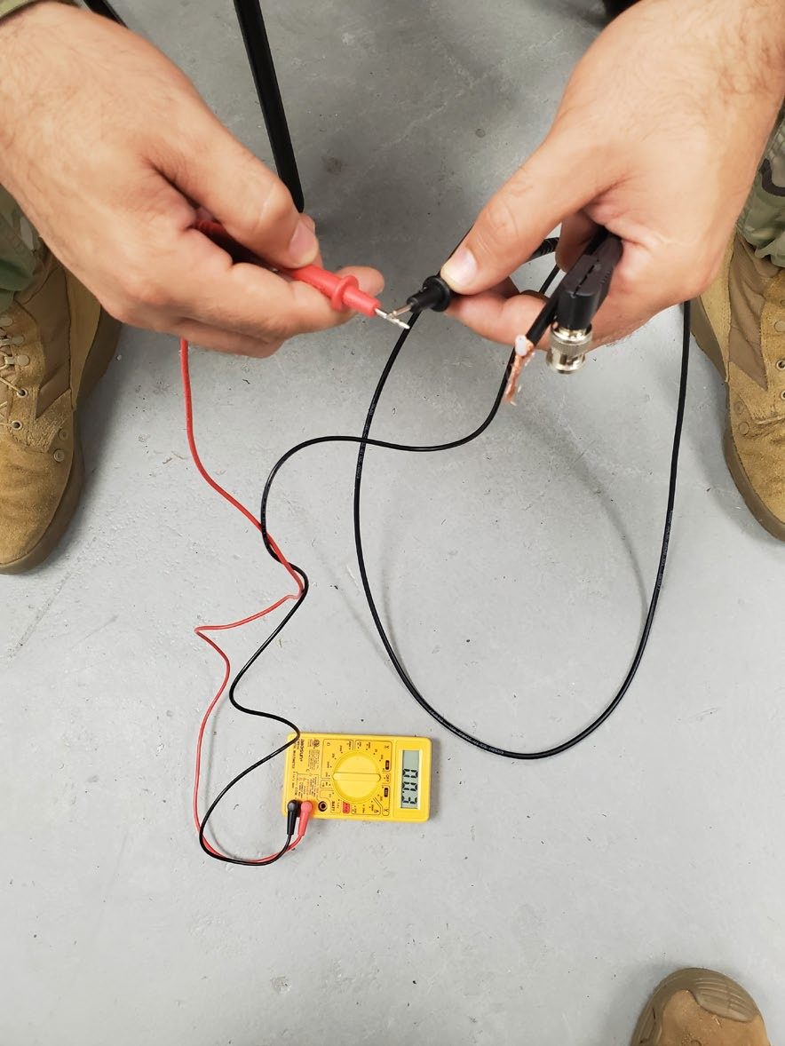
Building a Dipole Antenna Step 8
Establish that the multi-meters measurements are accurate, by testing the unit.

Slide 36
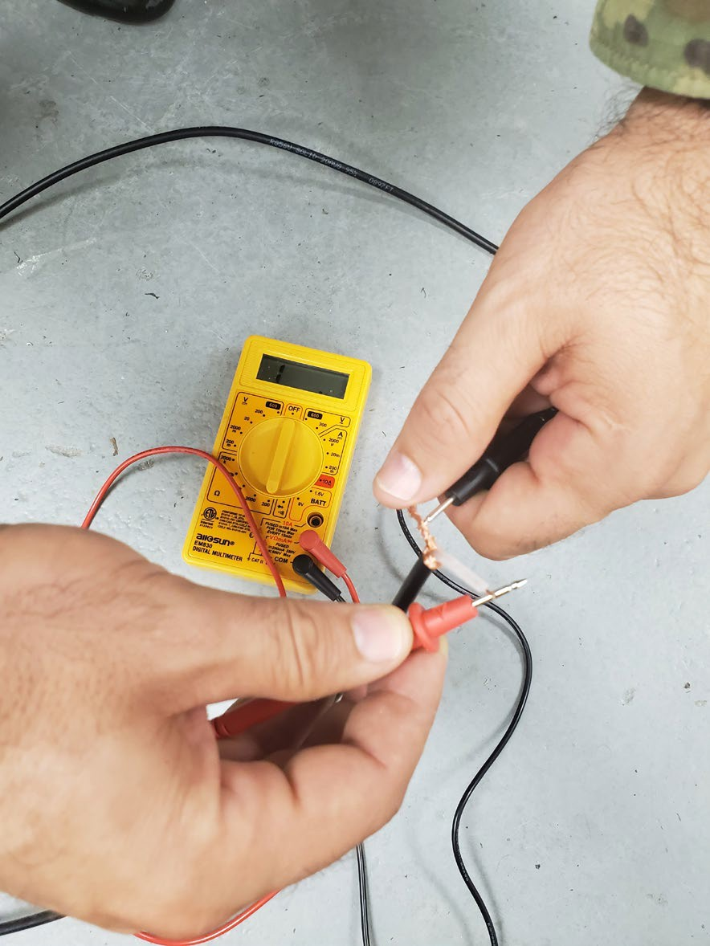
Building a Dipole Antenna Step 9
Test Antennas with multi-meter tool. Connect the black electrode (ground) to the copper RF shielding portion of the antenna. Connect the positive to the solid copper wire portion of the antenna.

Slide 37
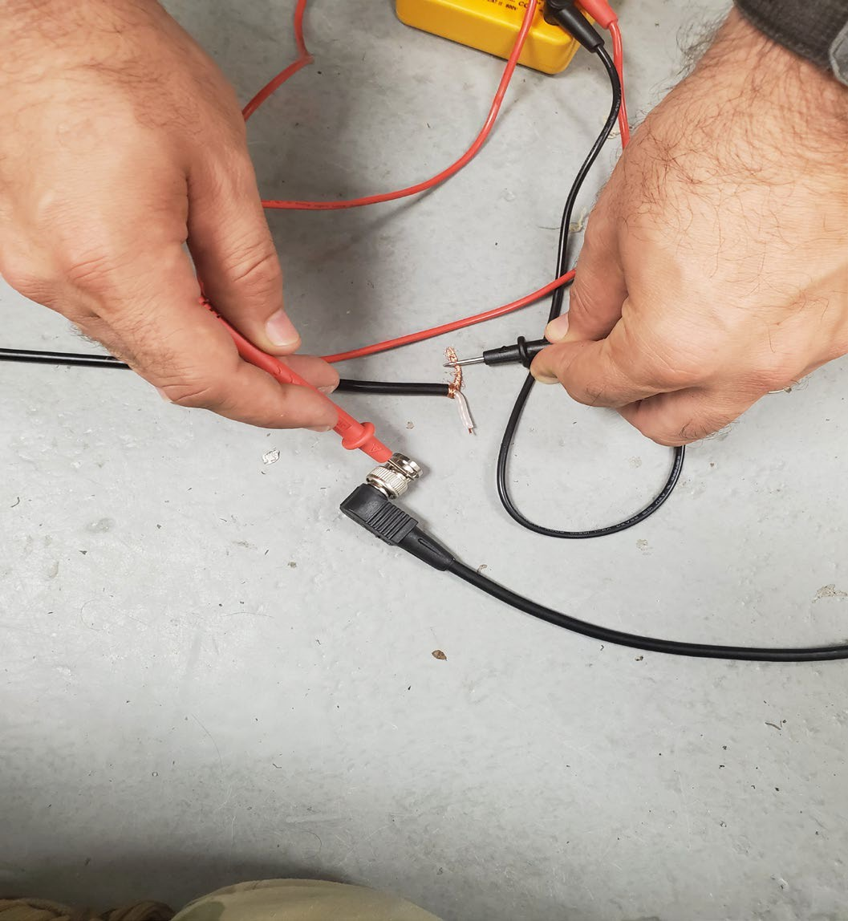
Building a Dipole Antenna Step 10
Continue Testing the continuity of the antenna by connecting the positive electrode with the COAX BNC connector and connecting the ground electrode to the copper shielding.

Slide 38
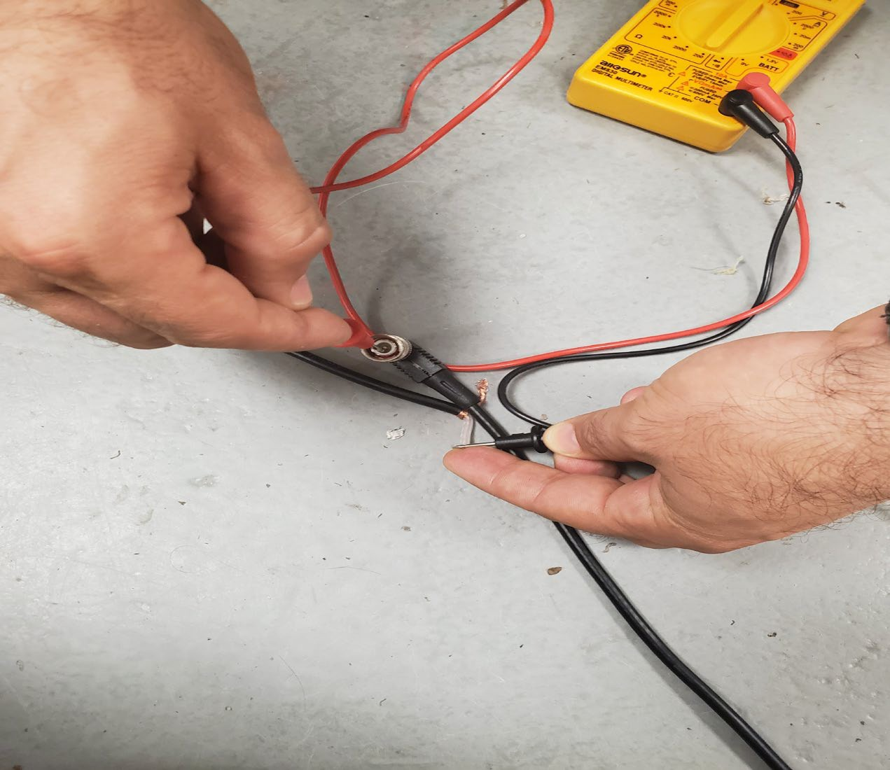
Building a Dipole Antenna Step 11
Connect the multi-meter once again to the opposite components from the last interval of testing.

Slide 39
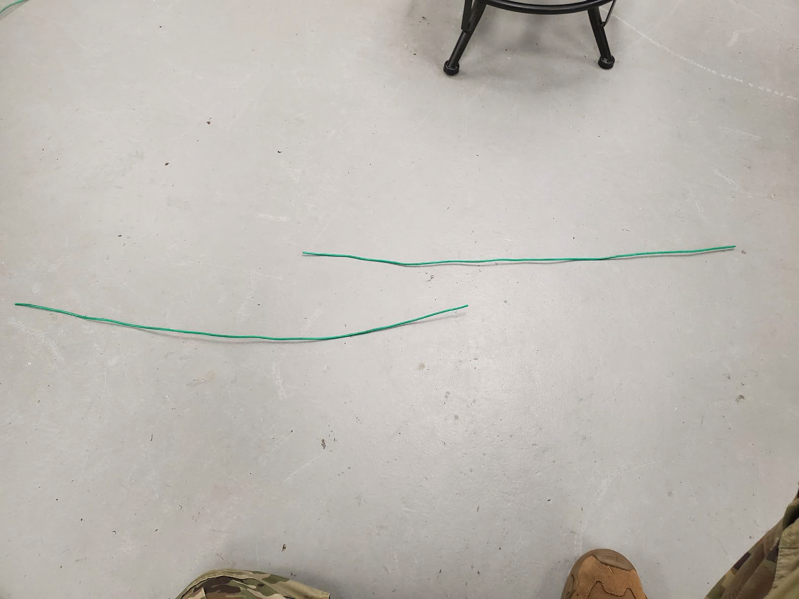
Building a Dipole Antenna Step 12
Once the base components of the antenna have been tested, cut the AWG wire to form the dipole antenna.

Slide 40
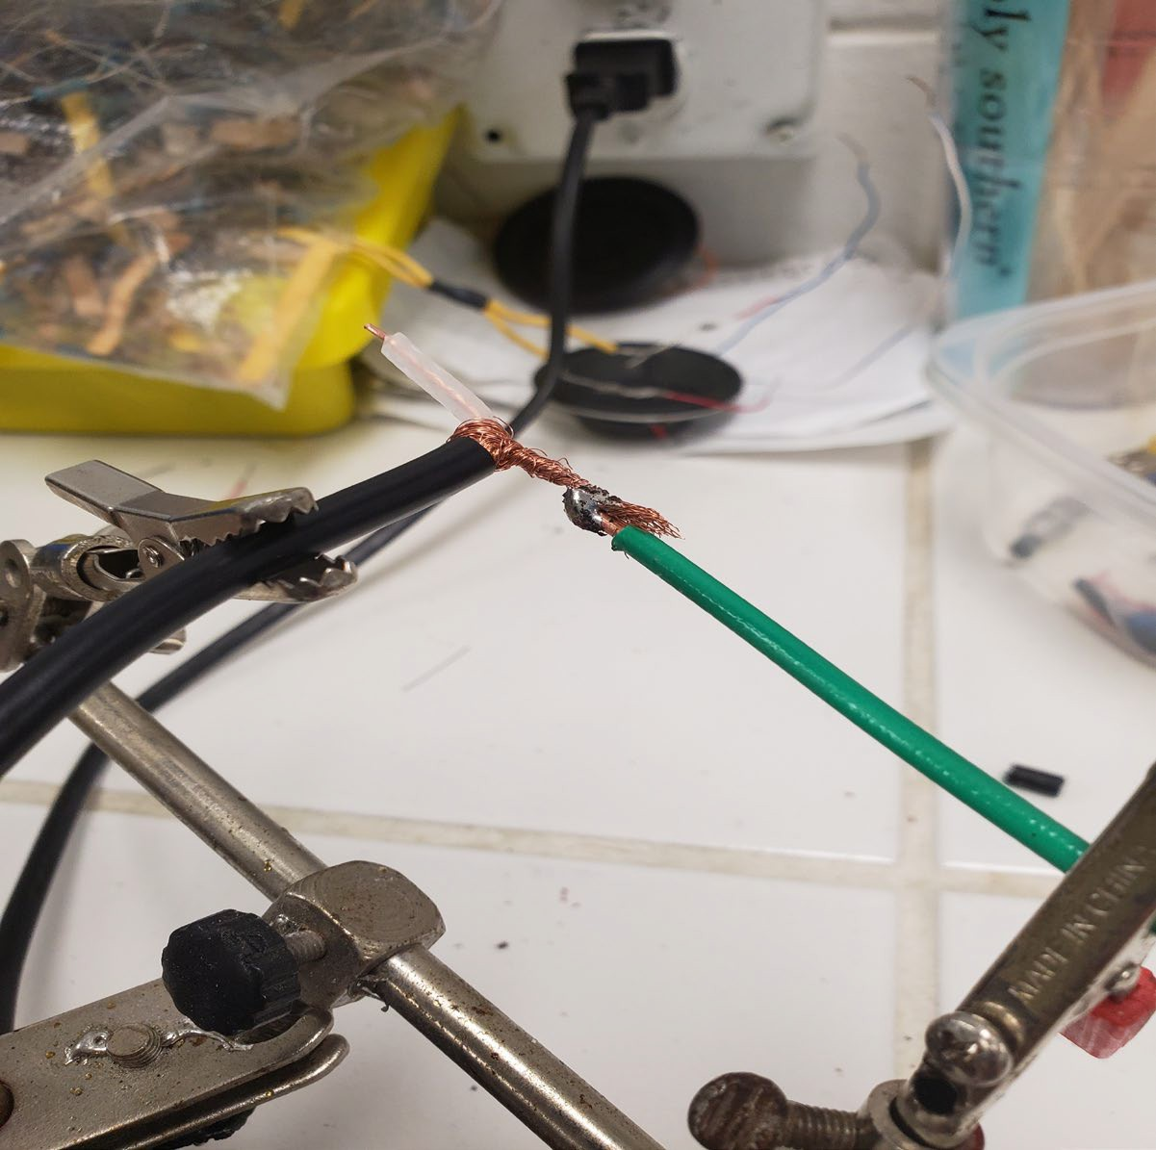
Building a Dipole Antenna Step 13
Begin the soldering process by soldering the first length AWG wire to the copper ground portion of the dipole antenna.

Slide 41
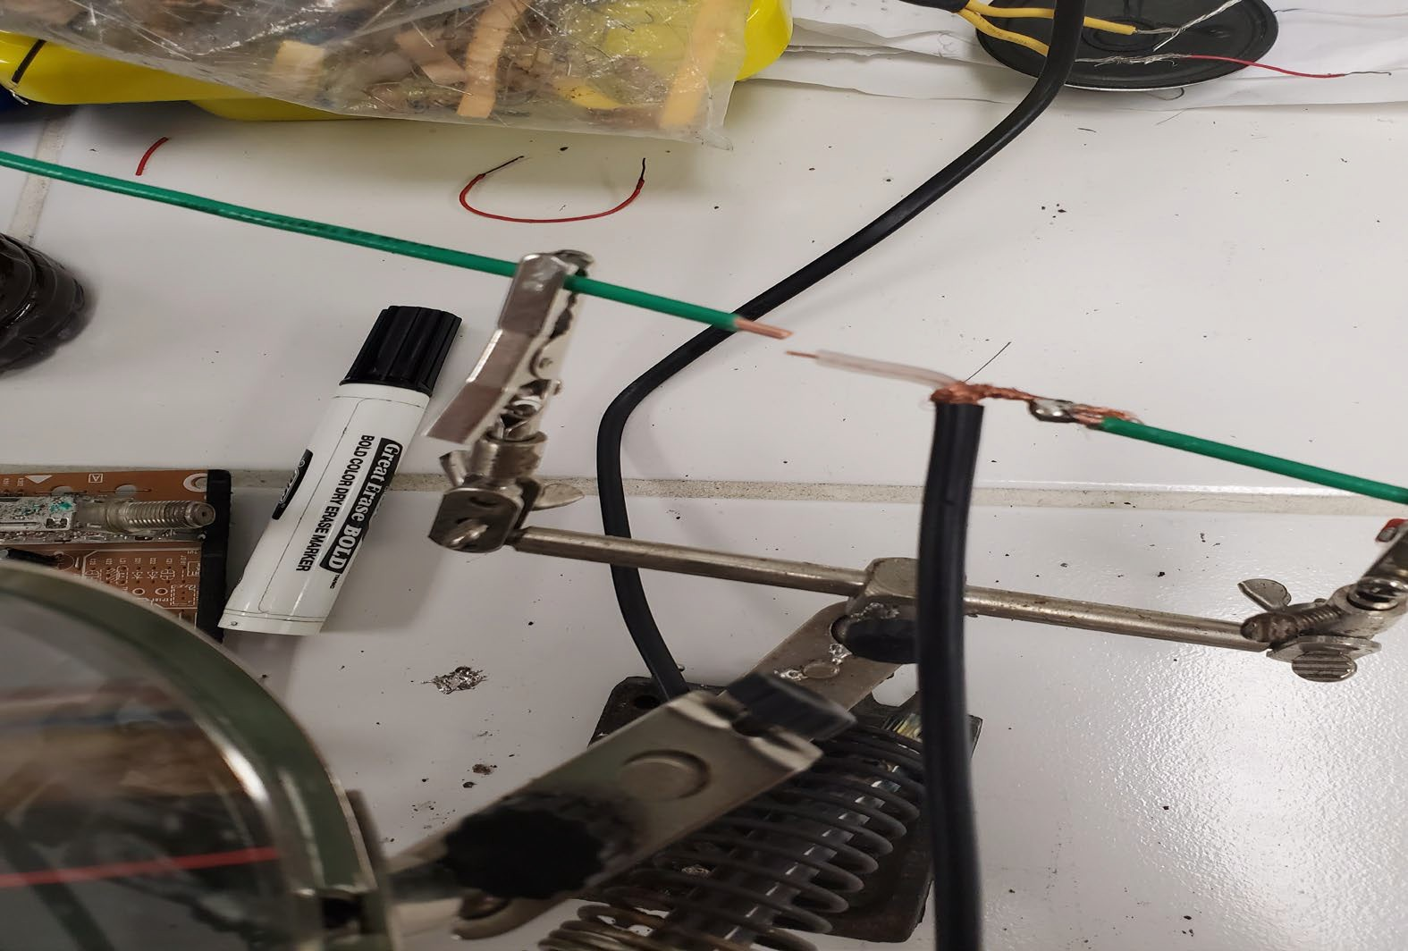
Building a Dipole Antenna Step 14
Once the first AWG wire has been soldered to the antenna, solder the next piece of AWG to the antenna.
Solder the additional length of AWG wire to the copper core portion of the antenna.

Slide 42
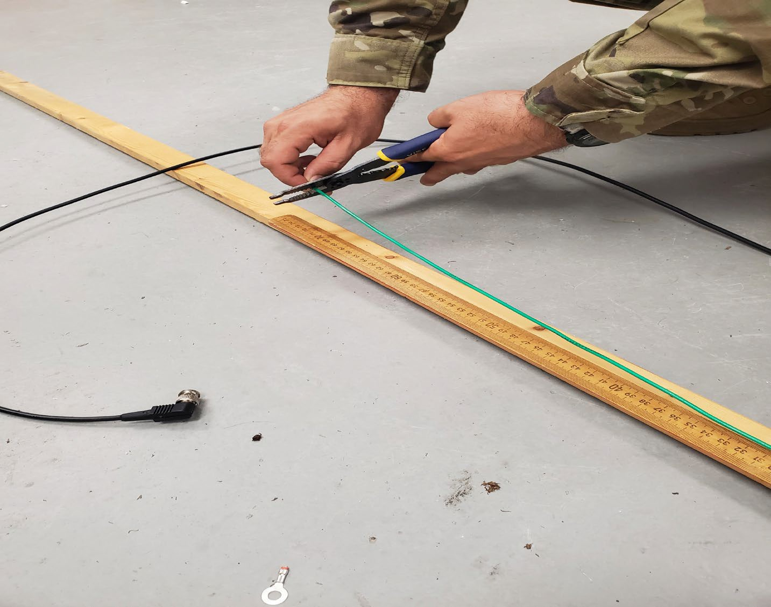
Building a Dipole Antenna Step 15
Measure the extensions of the antenna (AWG wire) to precisely ¼ of their desired frequency wave length. Then cut using the wire cutters.

Slide 43
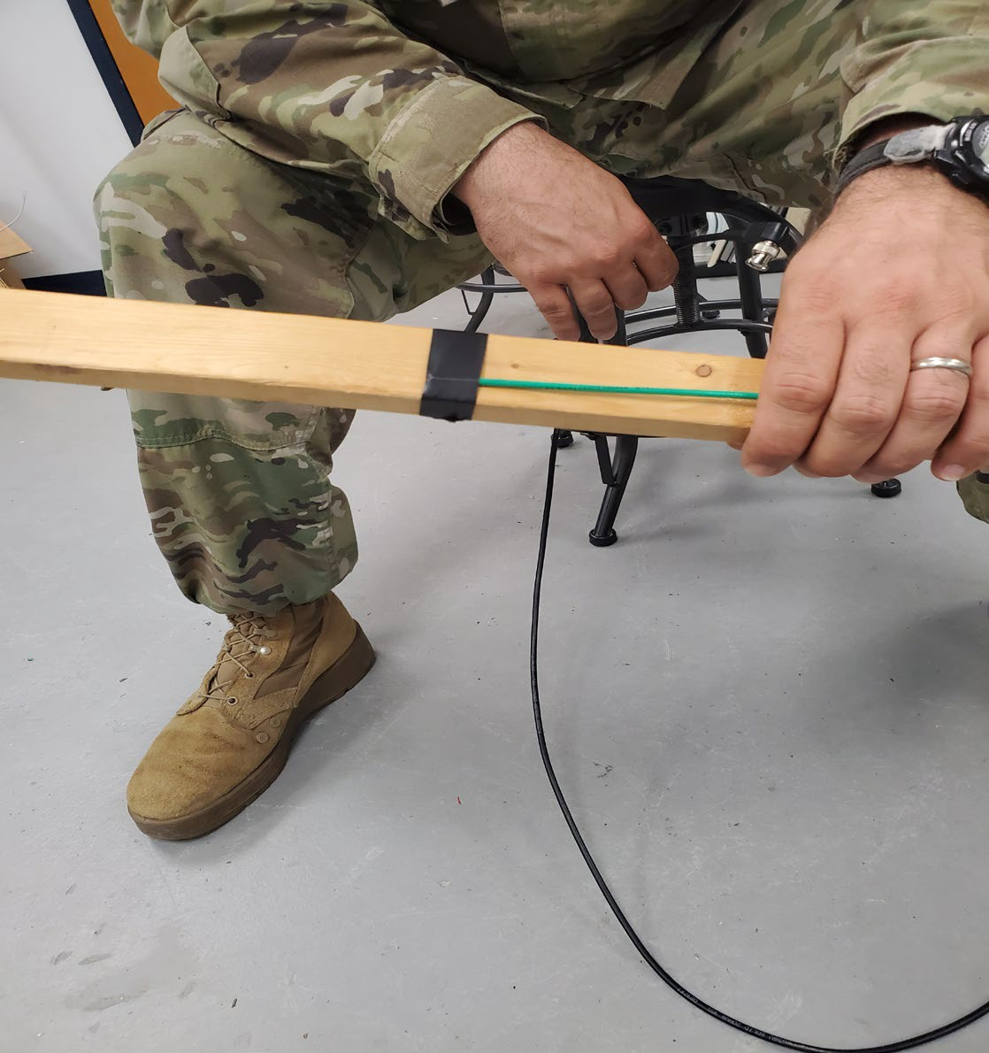
Building a Dipole Antenna Step 16
Once the soldering is complete, tape the opposite non-soldered ends to their wooden 1x2 sticks.

Slide 44
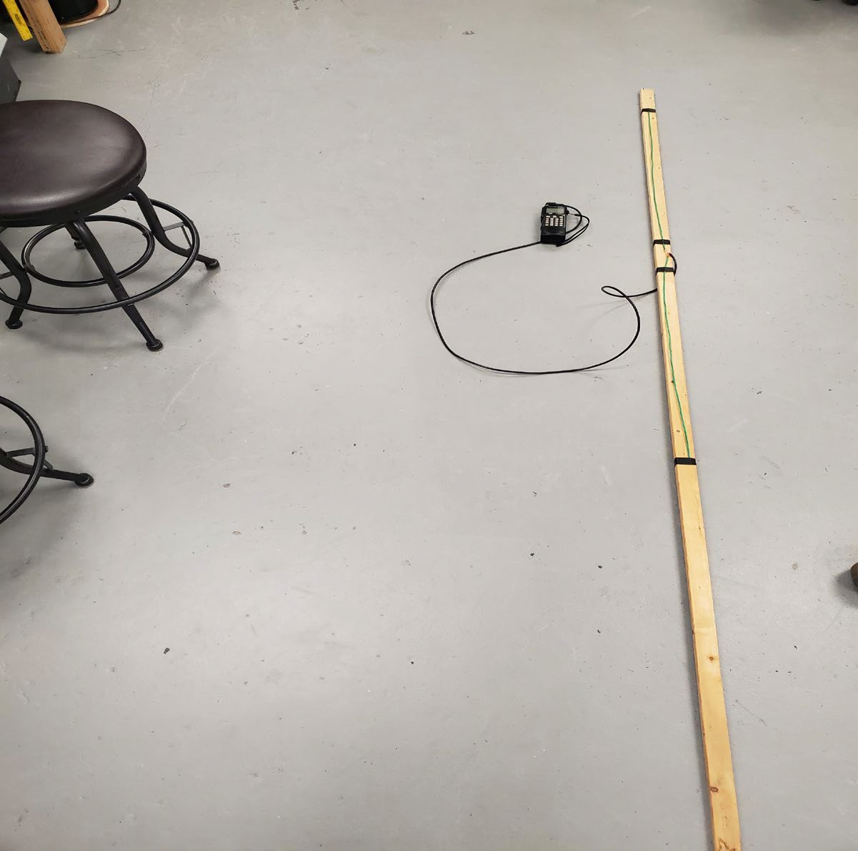
Building a Dipole Antenna Step 17
Connect the BNC connector to The AR8200 Scanner and program the desired FM station frequency. Walk outside and prepare to find your signal.

Slide 45
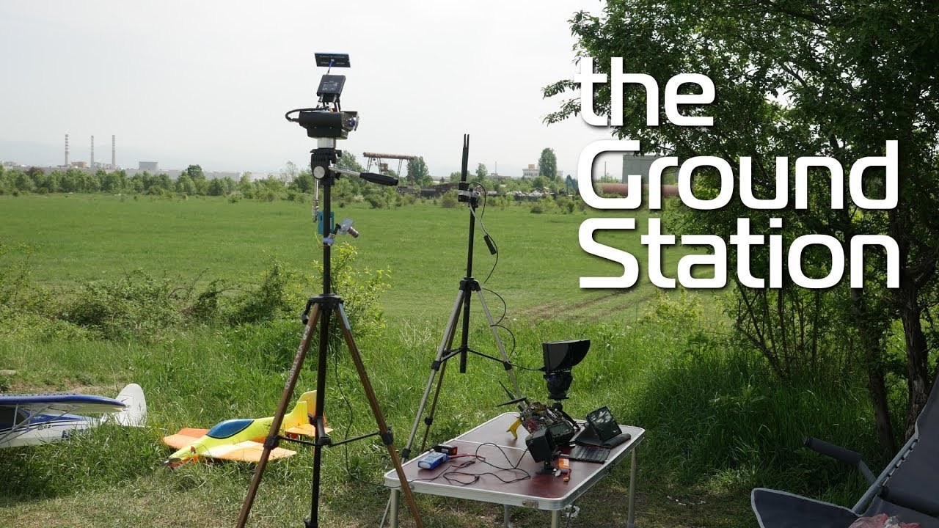
Displaced Antenna
Moves transmitter from operators' location to a different location
Allows for more antenna mounts to provide better reception
Consider cable length and type of cable
  Longer cables create signal loss and reduction in power relative to distance
  High quality data cables provide best transmission of RF signals over distance

Slide 46
References
TC 9-64. Communications-Electronics Fundamentals, Wave
Propagation, Transmission Lines, and Antennas July 04
MCRP 8-10B.11 Antenna Handbook May 16
Antennas and connectors SG v2.0 20-Nov-18
https://www.antenna-theory.com/antennas/monopole.php
https://amateurradiotech.com/antenna-connector-types/
https://www.slideshare.net/slideshow/brkewn-3016-radiodeisng/10582160
https://www.ahsystems.com/articles/antenna-beamwidth.php
https://en.wikipedia.org/wiki/Antenna_(radio)
https://en.wikipedia.org/wiki/Connector
https://ivcan.com/analog-fpv-drone-repeater-vtx-receiver-and-transmitter/

