Slide 1
7” FPV Build

Slide 2
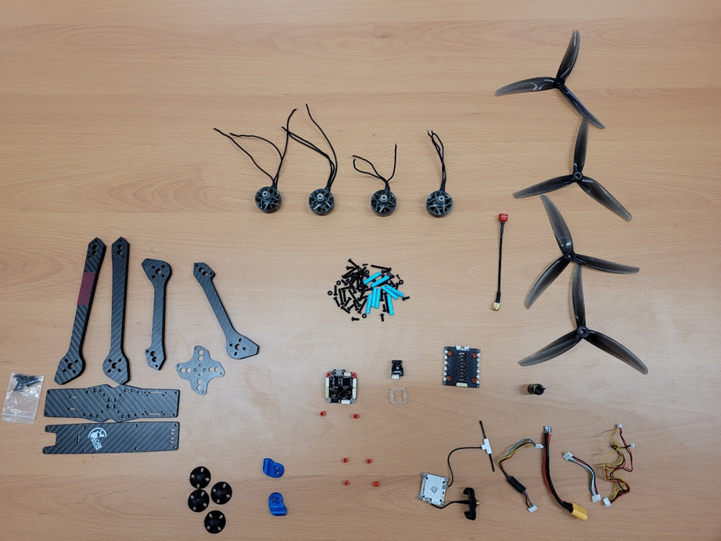
Parts Required
Drone Frame
Hardware
Motors QTY 4
Electronic Speed Controller (ESC)
Power Distribution Board (PDB)
Flight Controller
RC Receiver (RX)
RX Antenna
Camera
Video Transmitter (VTX)
VTX Antenna
Cables (ESC, VTX, Battery)
Capacitor
Propellers QTY 4

Slide 3

Parts Layout

Slide 4
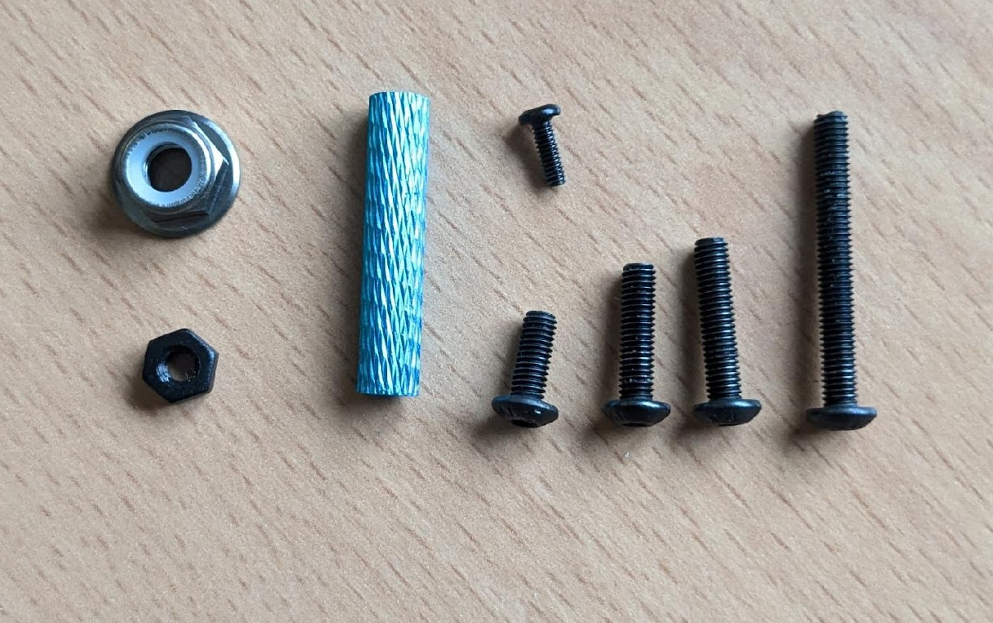
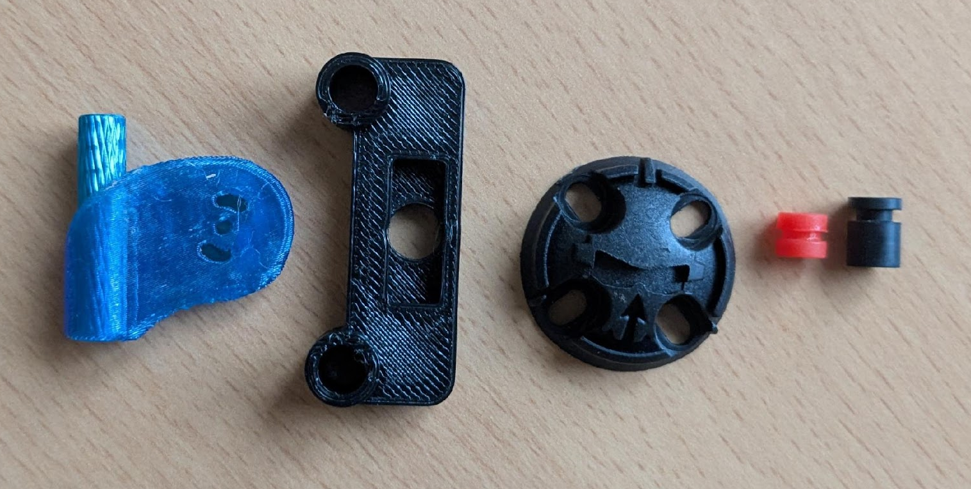
Hardware
Fasteners
  4 – M3 x 25 mm
  8 – M3 x 14 mm
  16 – M3 x 12 mm
  16 – M3 x 8 mm
  8 – M3 Nylon Nuts
  4 – M5 Lock-Nuts
  2 – M2 x 6 mm
  8 – 25 mm Standoffs
  3D Prints/Plastic
    2 – Blue Camera Mounts
    1 – Antenna Mount
    4 – Motor skids
    8 – Gummies

Slide 5
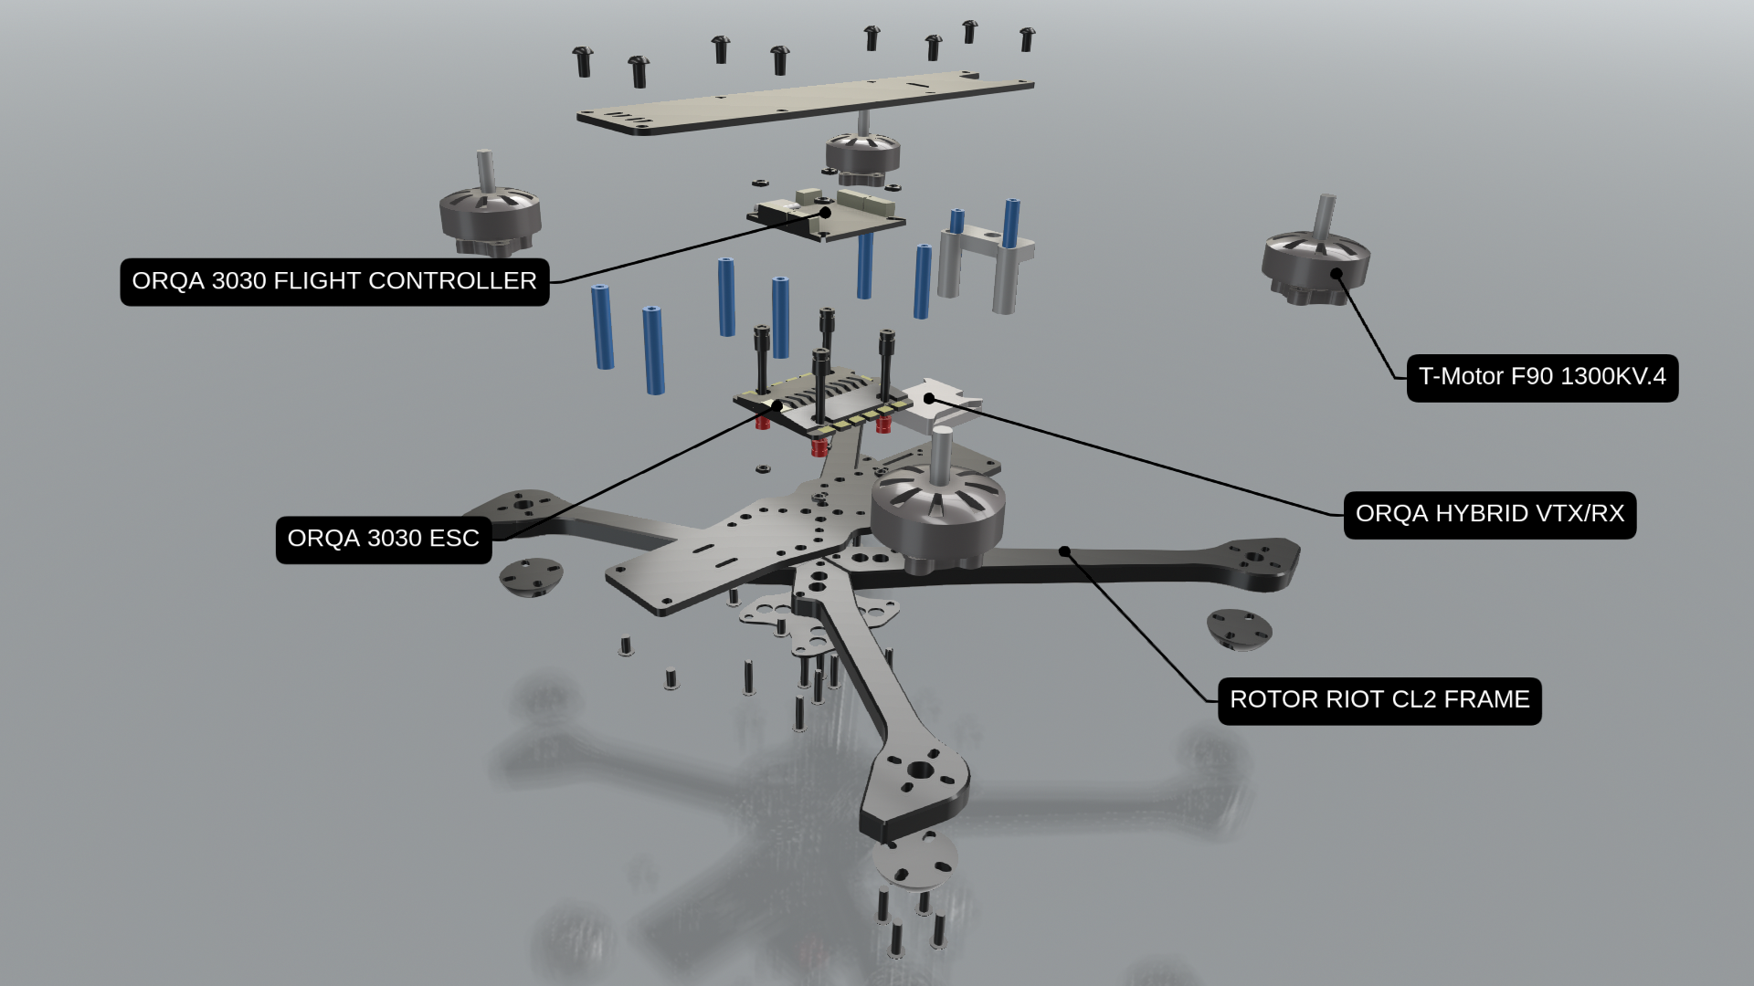

Slide 6
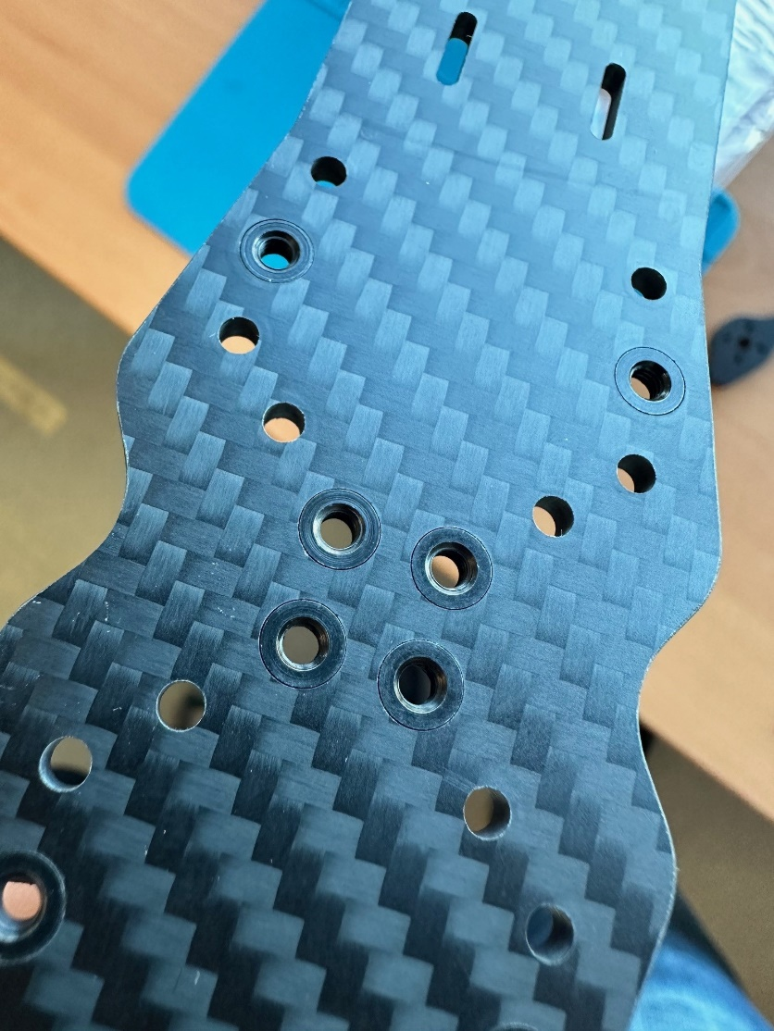
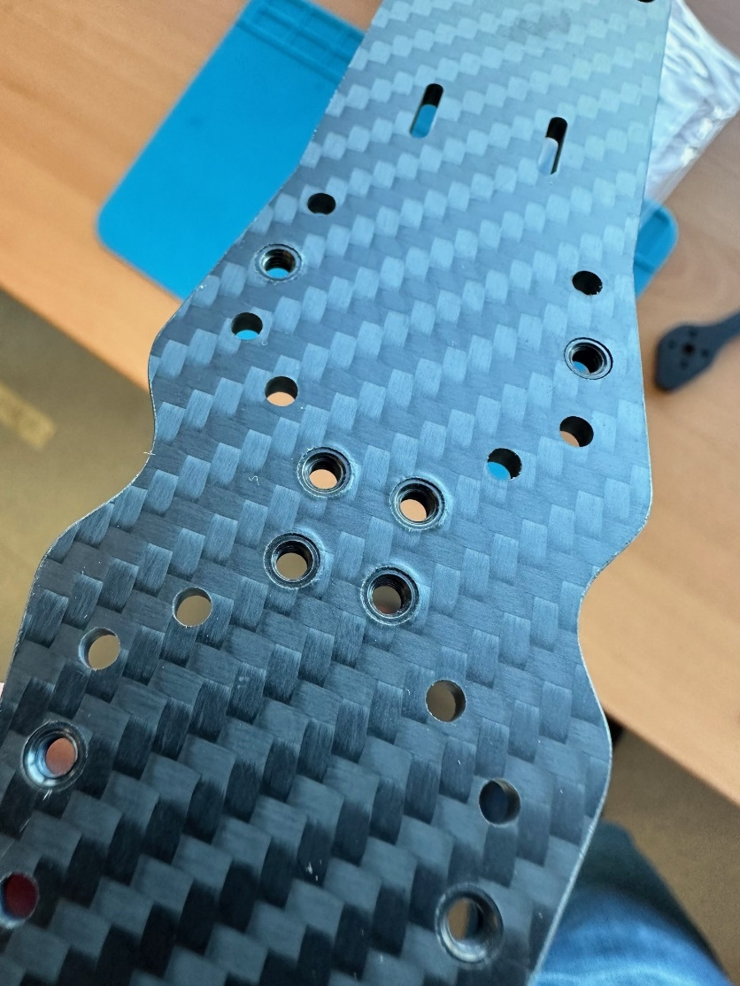
Frame Assembly
Start with identifying the bottom of the frame.
The press-nuts with the lip/flange are on the top side of the lower frame.
TOP
BOTTOM

Slide 7
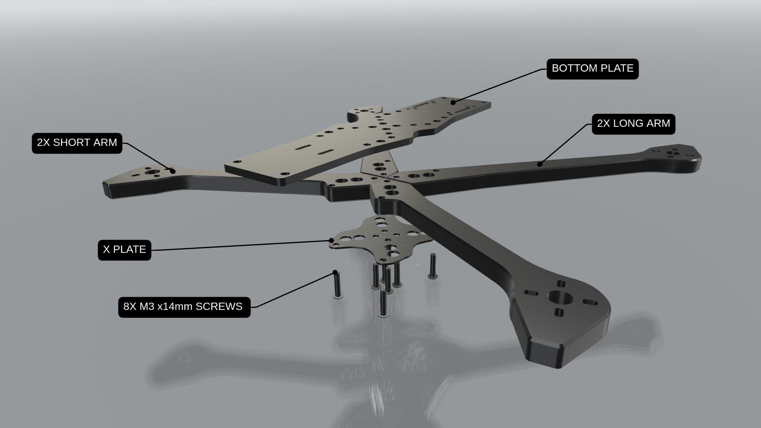
Frame Assembly
When laying out the frame the longer arms go in the rear.
Rear of the bottom plate has longer slots and more holes for the VTX mounting.
The “X” plate sandwiches between the arms and the bottom frame plate.
Each arm receives 2 bolts (M3x14mm) that screw into the press nuts attached to the lower frame.

Slide 8
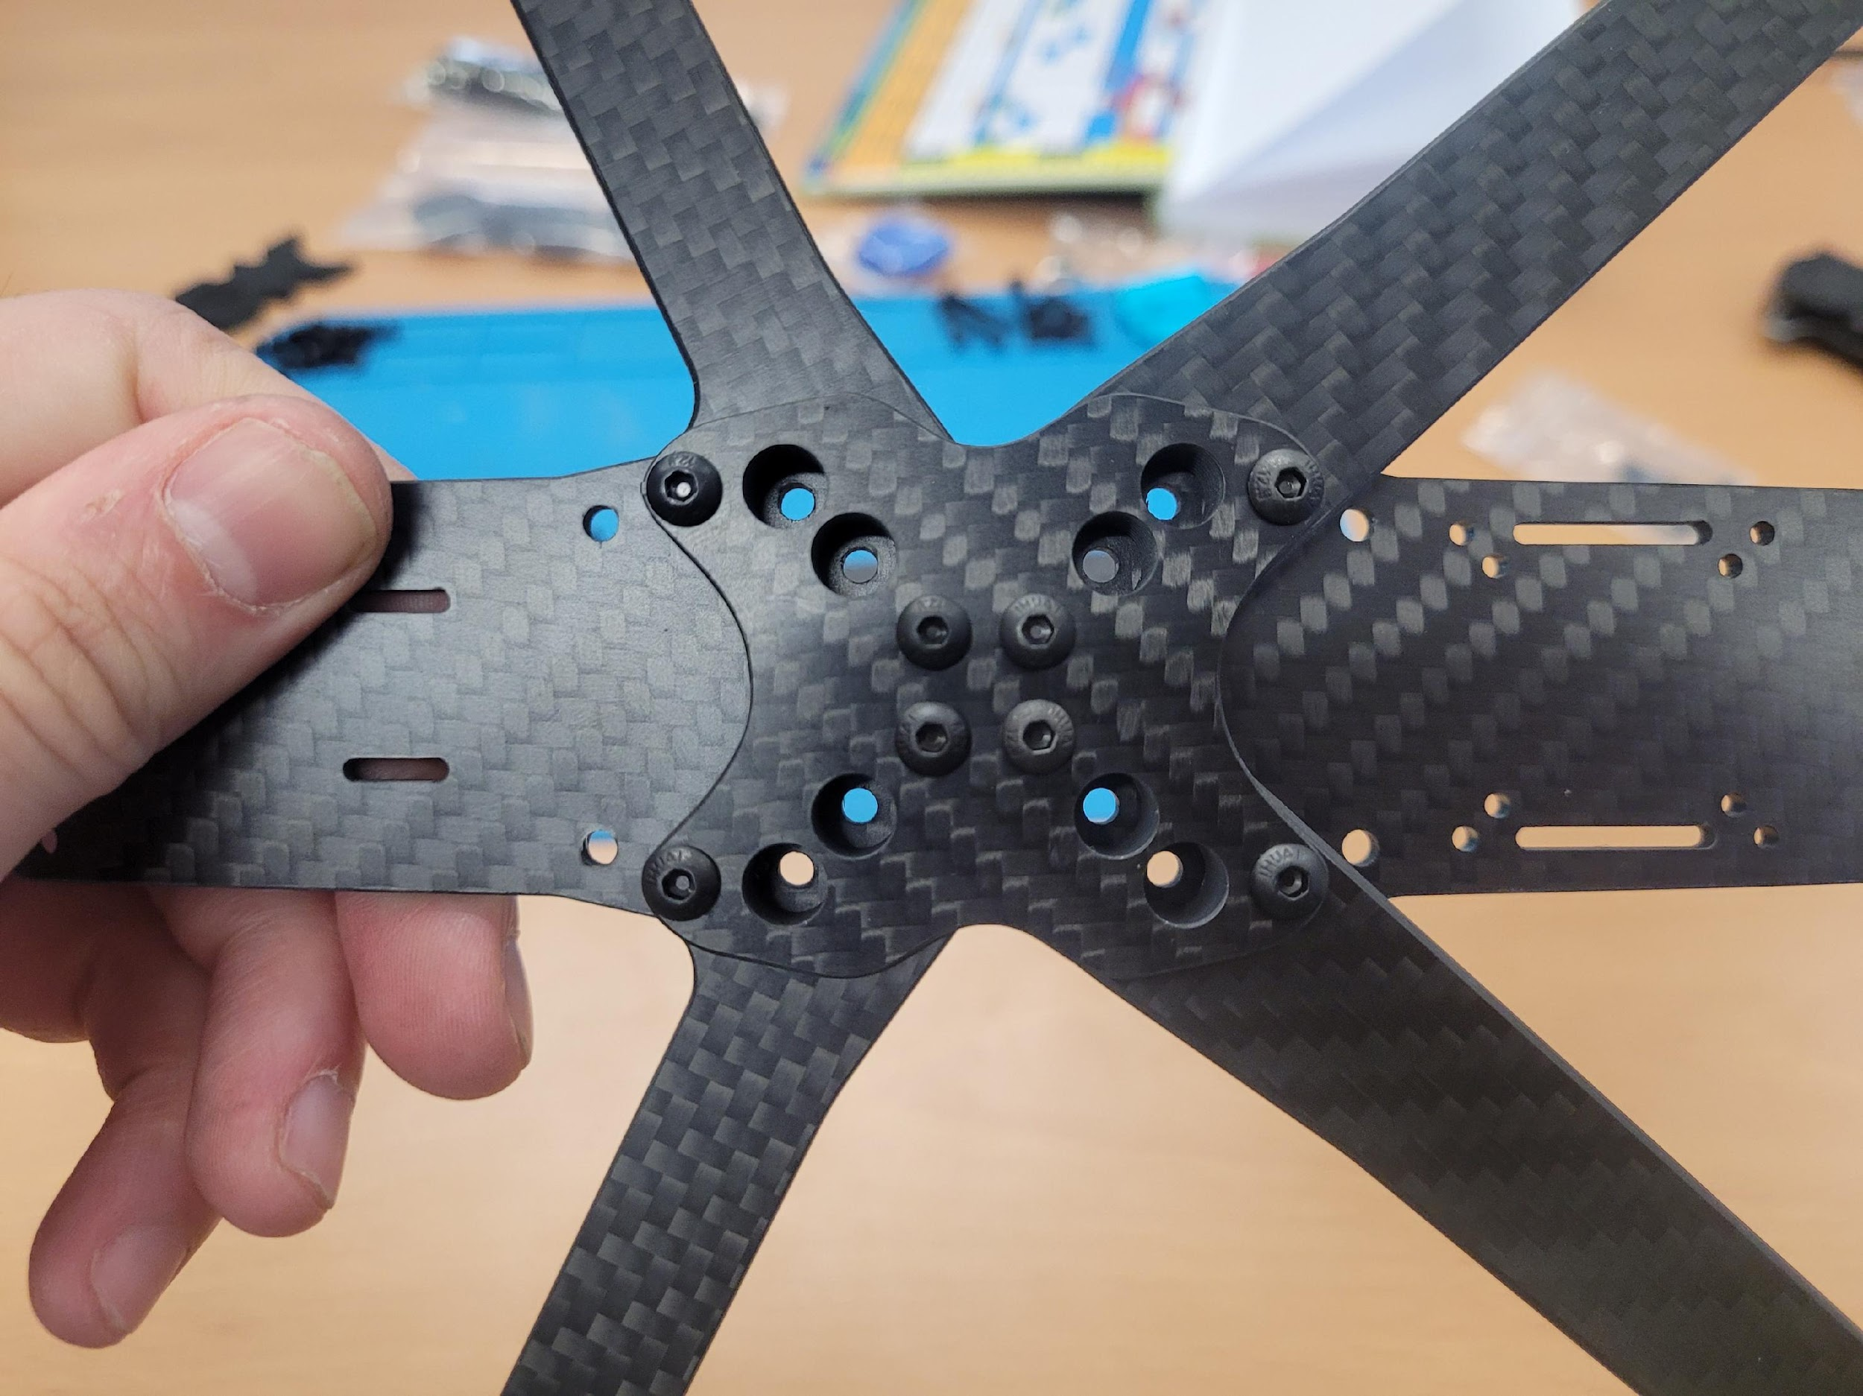
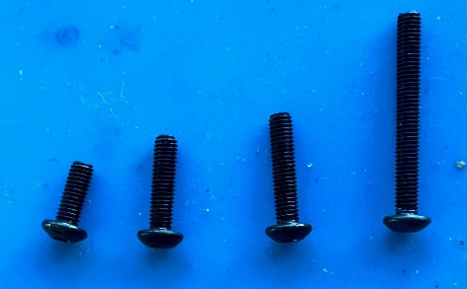
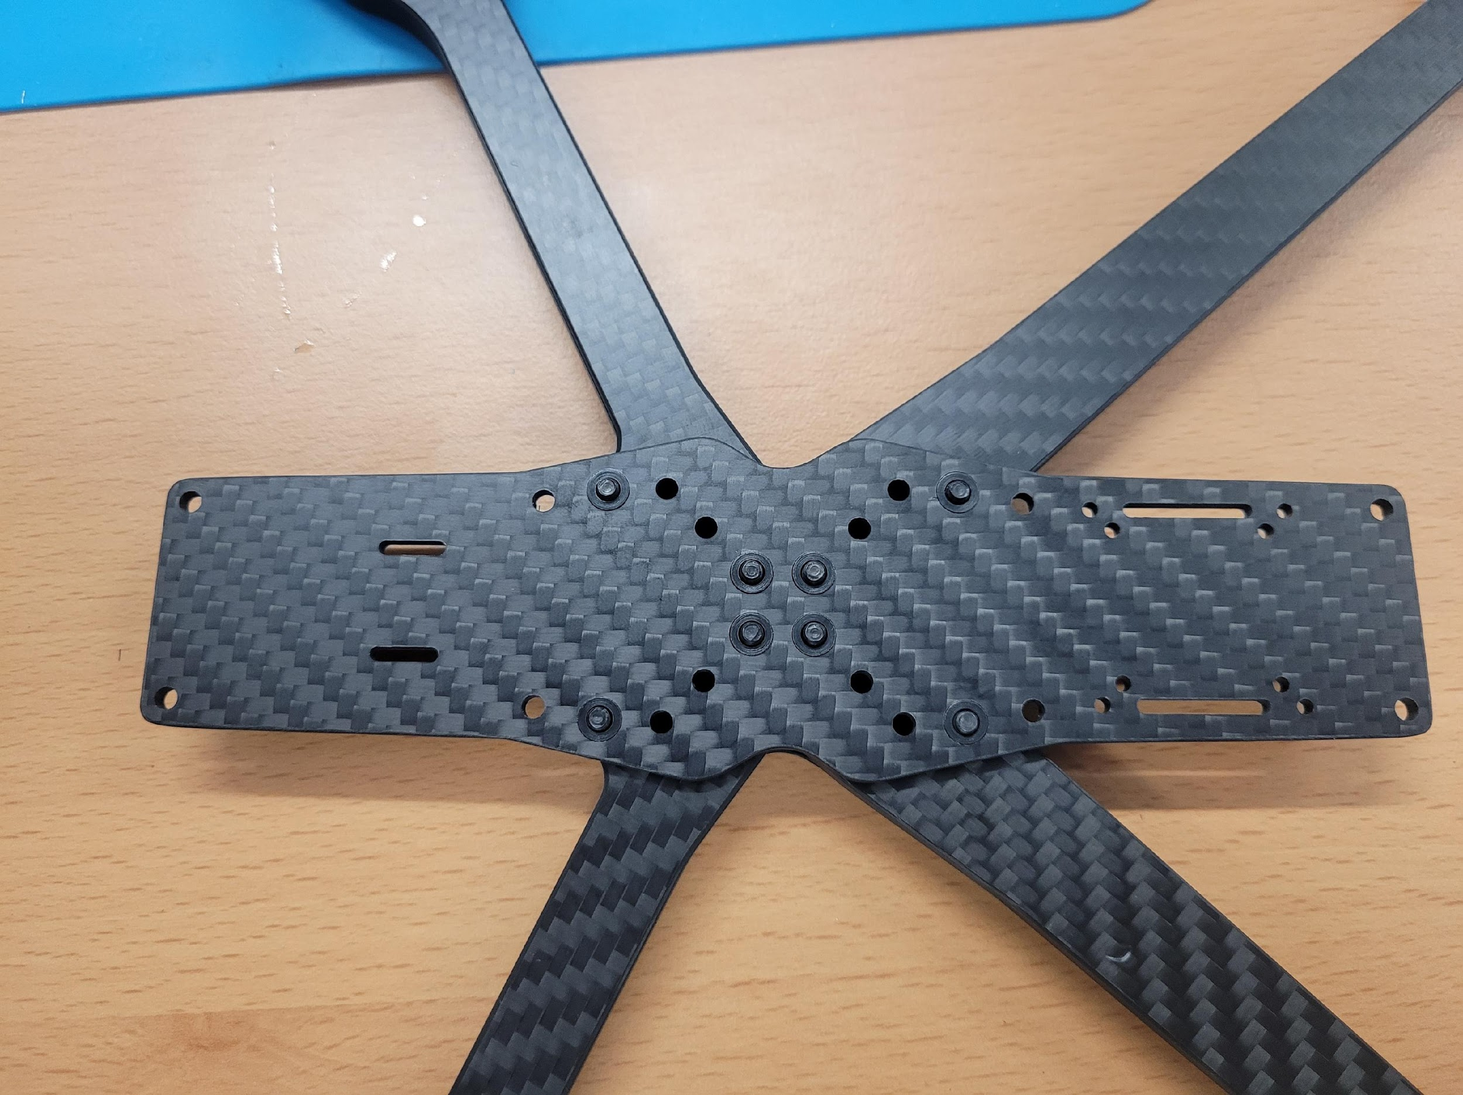
Frame Assembly
M3x14mm
Bottom plate
(from below)
Base plate
(from top)

Slide 9
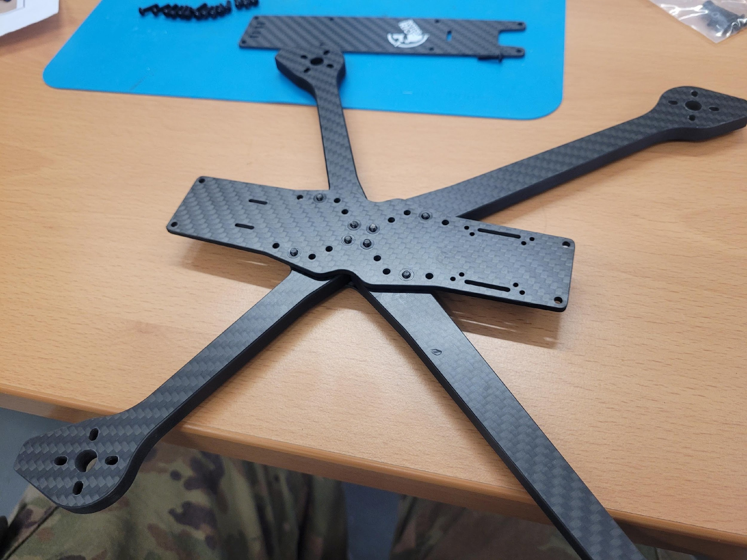
Frame Orientation
FRONT
REAR
camera zip tie slots
VTX zip tie slots
And mount

Slide 10
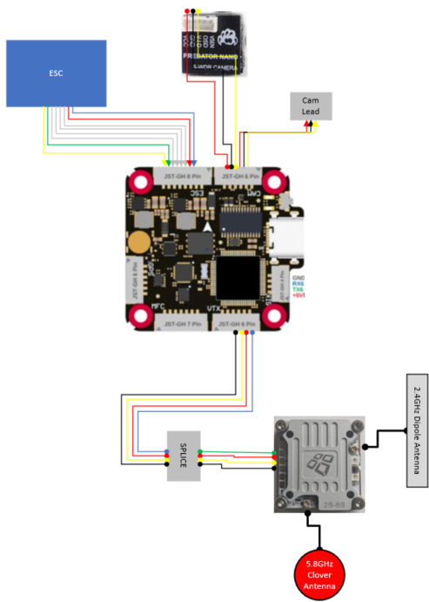
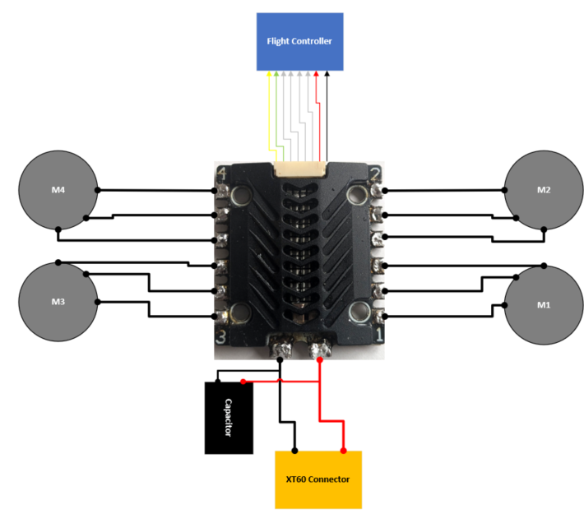
FPV ICD

Slide 11
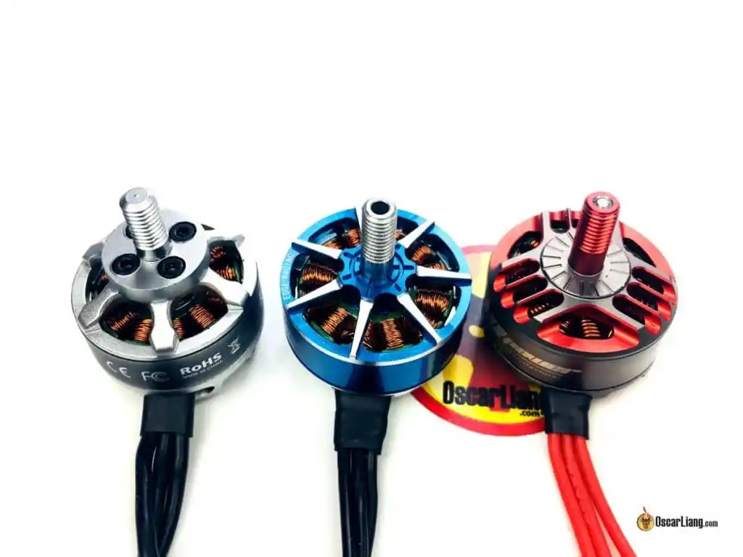
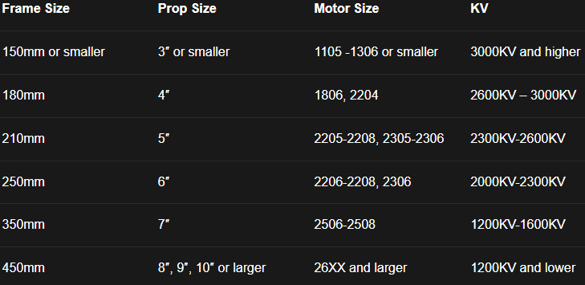
Motors
There are different motors for different flying styles (Freestyle, Long range, racing, and aggressive flying)
7in drones typically used for long range flights so motors efficient at cruising speeds are ideal
  For 6s setups, 1300Kv motors are ideal
  For 4s setups, 1500Kv or higher
Oscar Liang – Motors
Oscar Liang – Combo Table

Slide 12
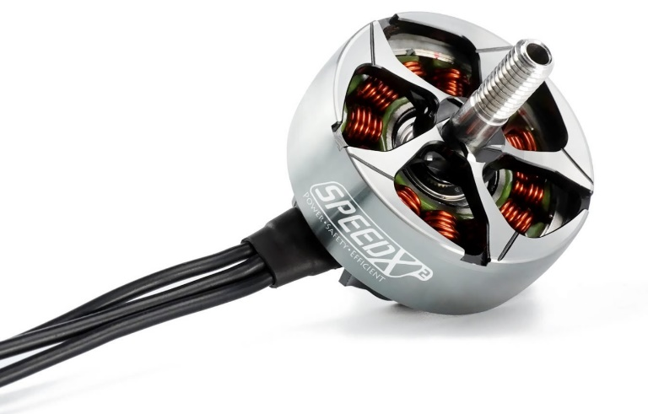
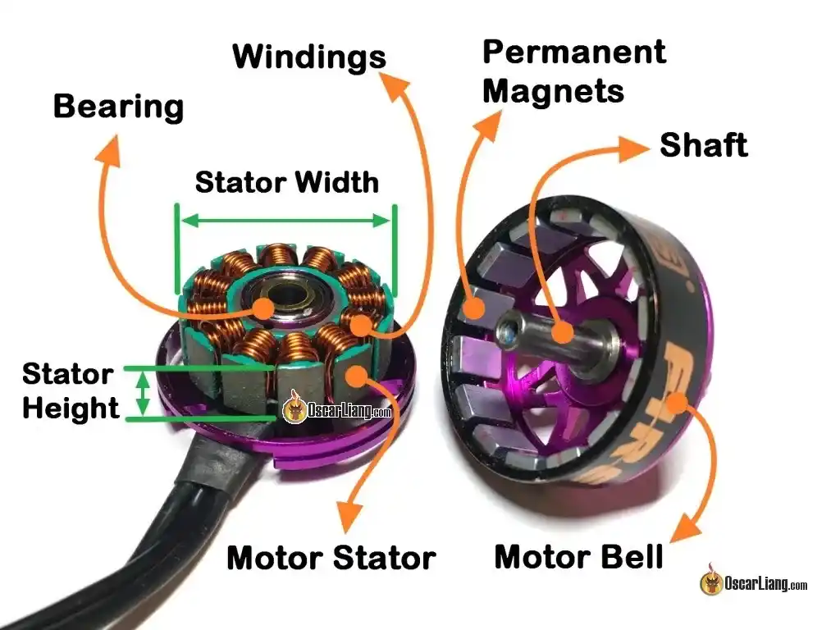
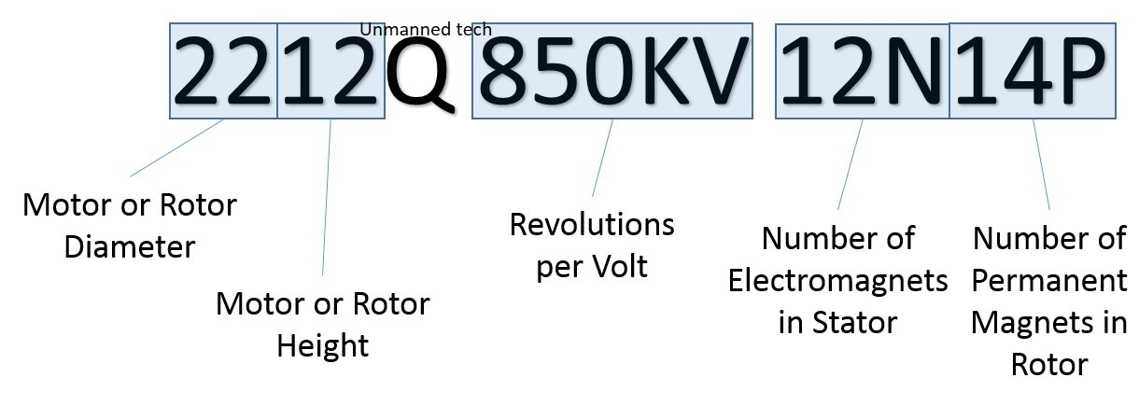
Motors Cont.
Selection Criteria:
Weight – motor
Thrust – Tied to RPM as well as propeller selection
Efficiency – Grams/Watt or Grams/Amp (larger number is better)
Torque and Response – driven by stator volume
This is an example. Not all brushless motors follow the same part numbering. Consult manufacturer’s documentation.

Slide 13
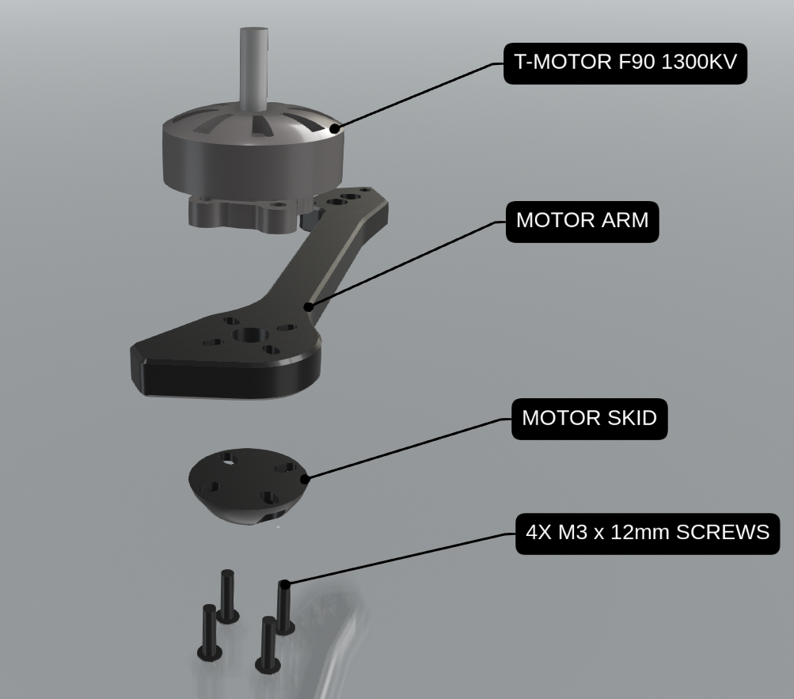
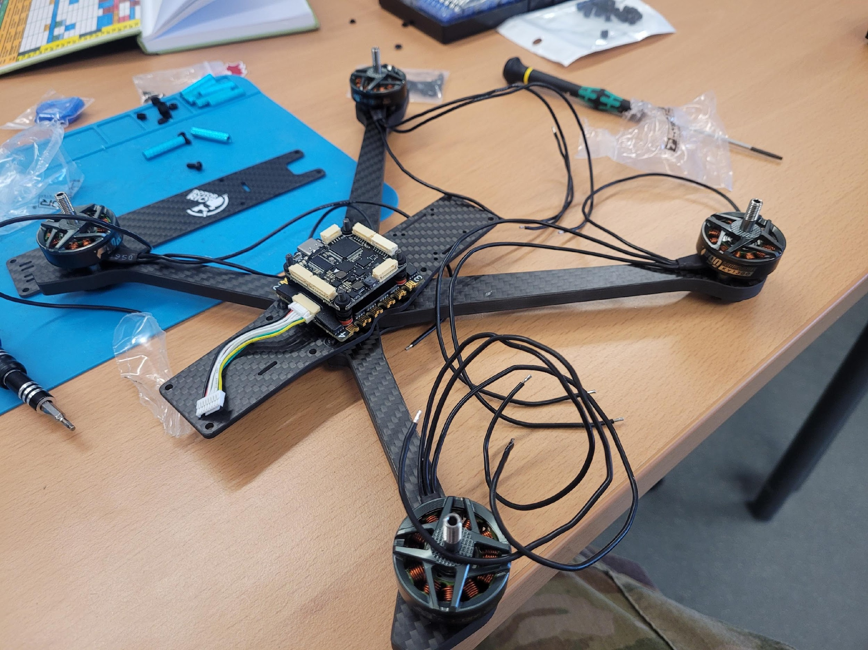
Motor Mounting
M3x12mm
Wire orientation

Slide 14
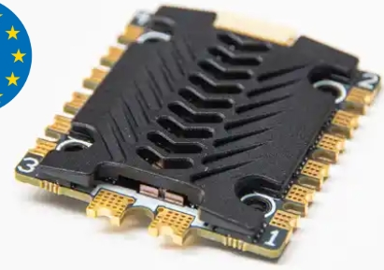
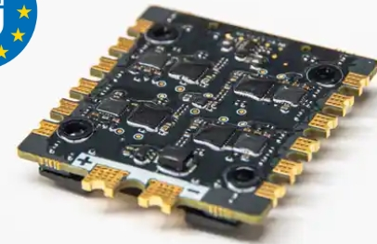
Electronic Speed Controller
Placement – The ESC should be placed with the wire harness connection to the front so the battery pads are to the rear and the heatsink is facing up.
Pressed Washers – The press in washer need to be removed IOT fit the ESC on the stack. Utilize a small screwdriver and put pressure on the inner edge of the washer from the top to the bottom. (refer to the arrow identifying the washer).
Gummies – In place of the washers that are removed, take the red gummies from the FC and place them in the ESC.
FC harness – Utilize the ESC to FC harness that comes with the ESC and plug it into the FC at the ESC port.

Slide 15

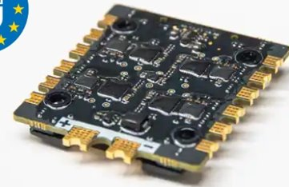
Electronic Speed Controller (ESC)
ESC controls the speed of the motors through signals from the flight controller
Two main types of ESCs; Single ESCs and 4-1 ESCs
  Single ESCs control only one motor (Easier to replace if ESC fails, but make the drone heavier)
  4-1 ESCs control all 4 motors (Standard for modern FPV, compact and light, but if one ESC fails whole board needs to be replaced
Verify voltage and amperage rating of ESC to identify which batteries are compatible

Slide 16
ESC Troubleshooting
Fault | Cues | Fix
ESC Burnout | Physical damage to board Black "soot" near components | Most common fault in ESCs and very rarely fixable Micro soldering skills required, or new ESC
ESC Desync | Drone flipping erratically out of the sky Drone spooling up then ramping power to one motor | Programming in BetaFlight Set motor idle throttle value ESC firmware modification
Motor stuttering/ Refusing to rotate | Clicking or grinding esque noises Erratic motor movement No motor movement in one or more motors | Check wires and solder joints for damage or shorts Re-flash firmware on ESC
ESC does not power up | No response from ESC when battery plugged in No power to FC or rest of drone Error code or rapid beeping from ESC | Visual verification of any damage to ESC or solder joints Verify if ESC is receiving power at all Replace ESC
ESC Firmware Corruption (Bricked) |  | Re-flash firmware and ensure so errors occur during update
Noise Interference | Jittery flight characteristics If analog, wavy interference in picture Random overloading and bottoming out into the ground | Ensure capacitor is the right size for ESC Adjust BetaFlight filters for PID tuning

Slide 17
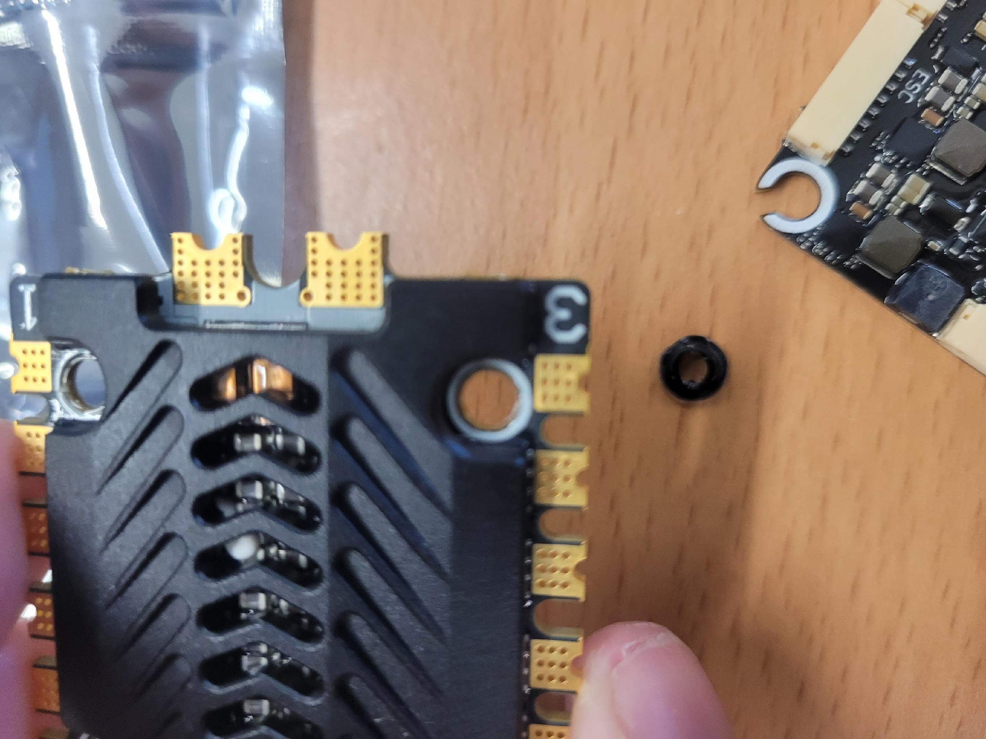
ESC Orientation
ESC: Rear has battery leads
FRONT
REAR

Slide 18
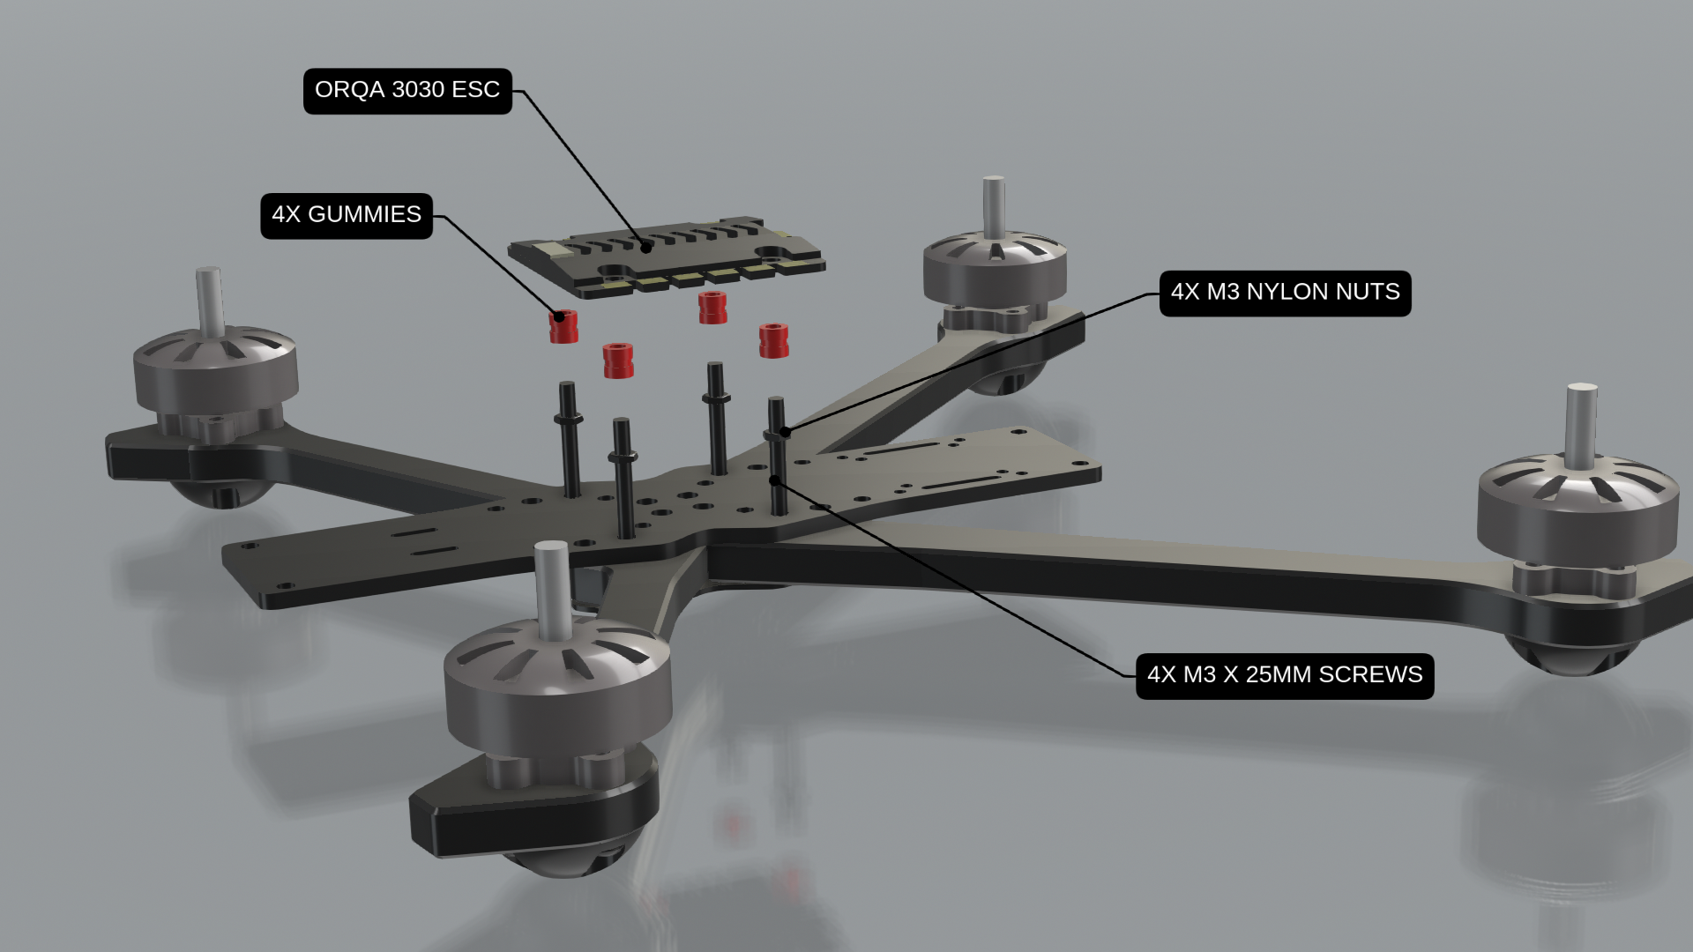
Stack
M3x25mm

Slide 19
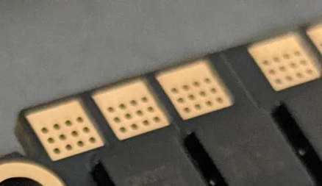
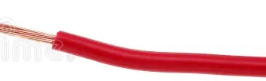
Working with Perforated Pads
Perforation holes
ESC (Side View)
Underhanging solder blob
Insufficient tin
-Add solder
Saturation
-Ready to wire
Oversaturation + gravity
ESC (Side View, upside down)
Flip board and reheat
ESC (Side View)
Righted solder blob, ready to wire

Slide 20
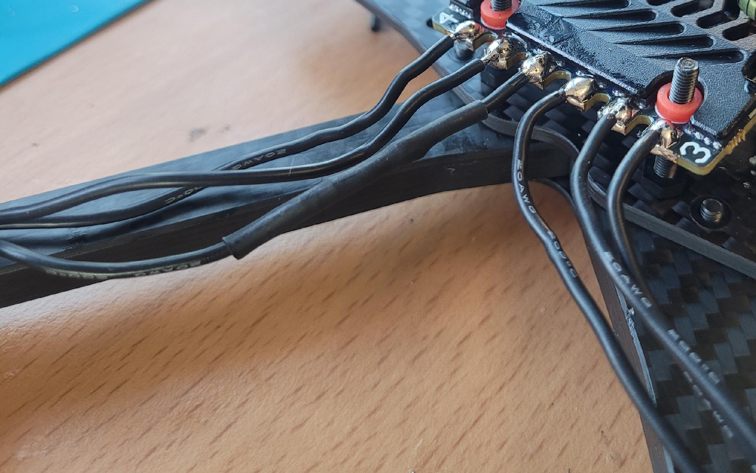
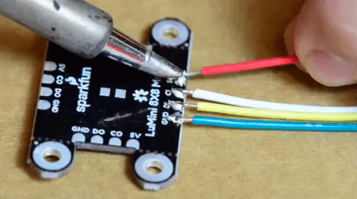
Motor-ESC Soldering
Raise the ESC slightly in case you need to flip the pads upside down (more on next slide).
Tin ESC pads (Flip and tin if you get buildup underneath).
Line up motor wires with three closest ESC pads, make sure you are not soldering to the 2 rear power supply pads.
Cut motor wires to length while flush to the arm.
Strip the wires to double the length of the pad.
Tin the motor wires, then cut to length of the pad.
Press the motor wires into the tinned pad.

Slide 21
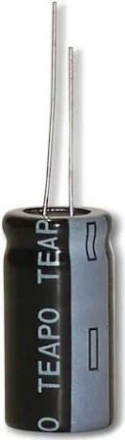
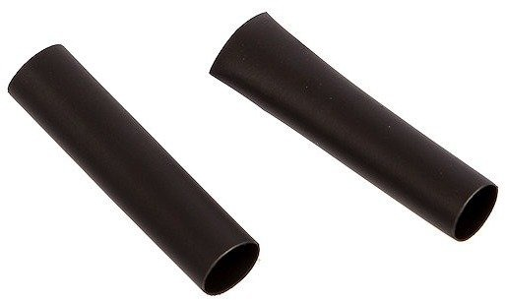
XT60 Pigtail & Capacitor
ESC with positive and negative lead symbols under black cover
Capacitor with heat shrink
Pigtail wired on top of capacitor for clearance
Pigtail with tinned wires

Slide 22
FPV ICD

Slide 23
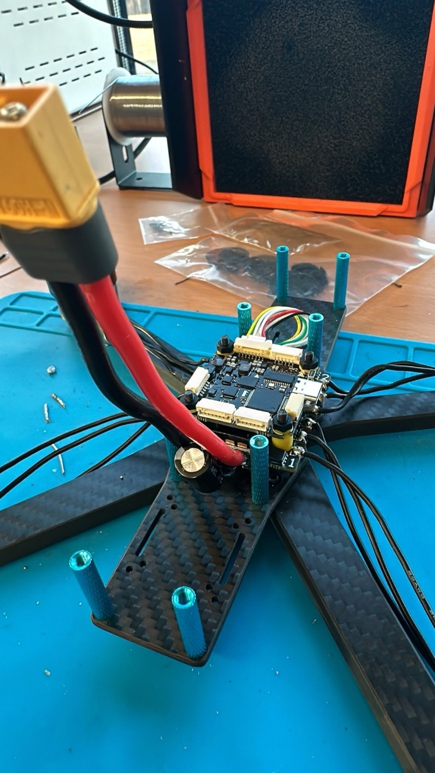
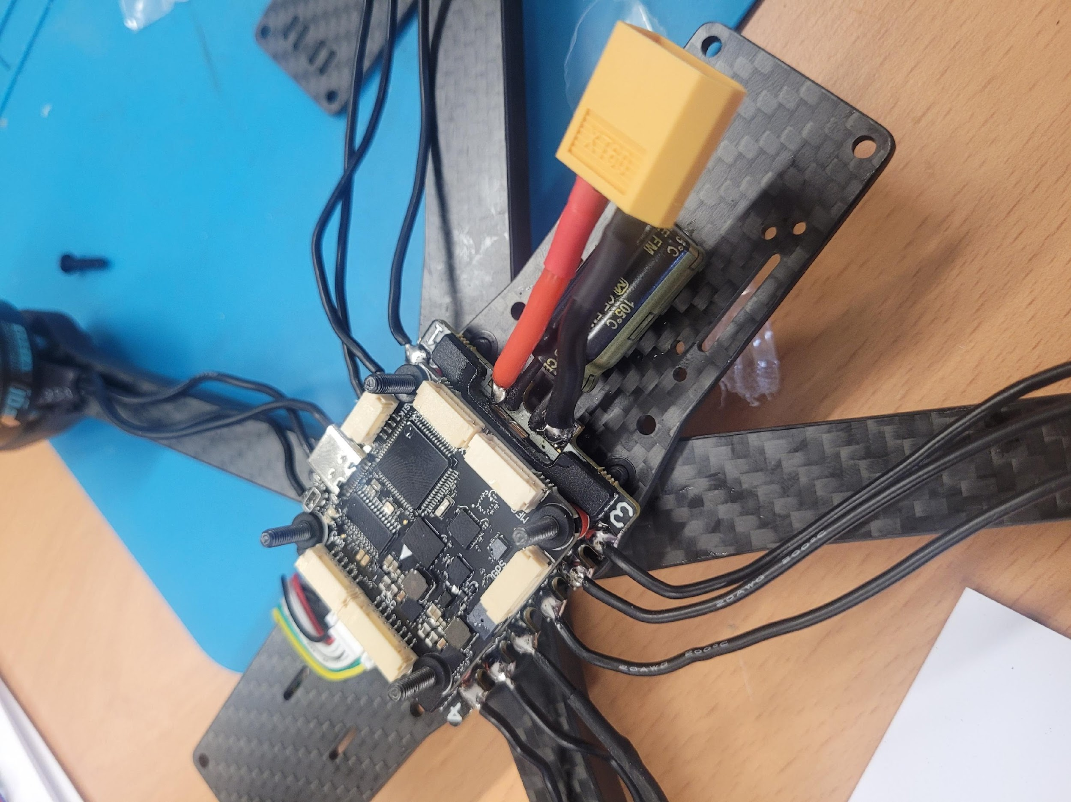
XT60 Pigtail & Capacitor
Capacitor must go on the bottom of pigtail so VTX harness can plug in.

Slide 24
Quality Control Step 1
& Smoke Test

Slide 25
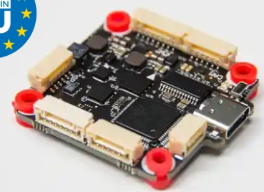
Flight Controller (FC)
"Brain" of the FPV responsible for stabilizing aircraft, ensuring precise flight maneuvers, and providing data to pilot
Two types of FC
  Regular FC, better for larger drones, more robust and durable
  AIO FC (All-in-One FC) FC and ESC on one circuit board, more compact but less robust
Most FCs and ESCs are sold together in a "stack"
It is crucial that the FC is "Soft Mounted" using rubber grommets to reduce vibration

Slide 26
FPV ICD

Slide 27
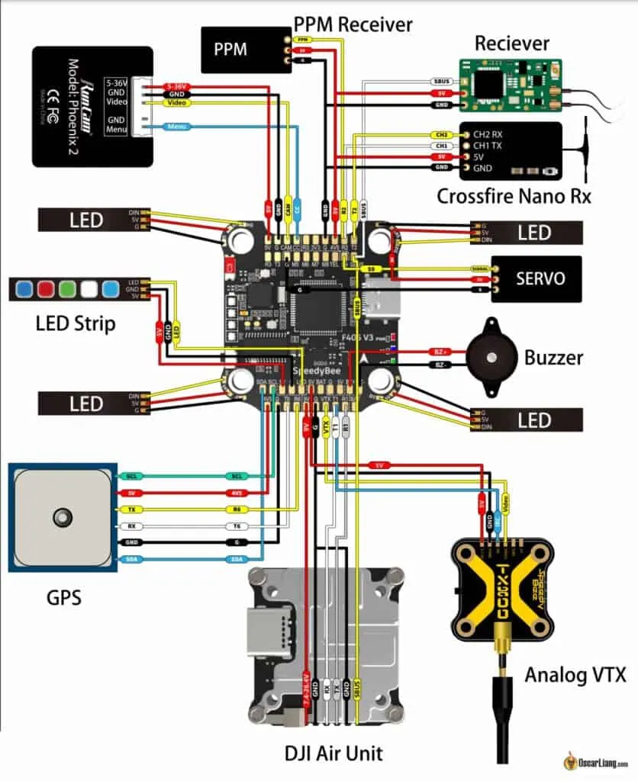
Flight Controller (FC)

Slide 28
FC Troubleshooting
Fault | Cues (Status LEDs) | Fix
Loose Wiring | Low or inconsistent power delivery | Ensure connections are firm and correctly oriented
Red Indicator Light | Steady Red Light Normal power supply No Red Light FC isn't receiving power properly | Inspect power connections for any faults
Blue Indicator Light | Blinking Blue Light Signifies normal operation Solid/No Blue Light Potential malfunction or bricked state | Reflash firmware
Driver Issues | Failure to connect to BetaFlight configurator | Run ImpulseRC Driver Fixer to help resolve issue
Gyro/Accel Issues | Aircraft does not move appropriately in BetaFlight preview Erratic flight | Ensure FC is oriented appropriately in betaflight’s config tab Ensure FC is mounted properly, and all mechanical components are secured

Slide 29
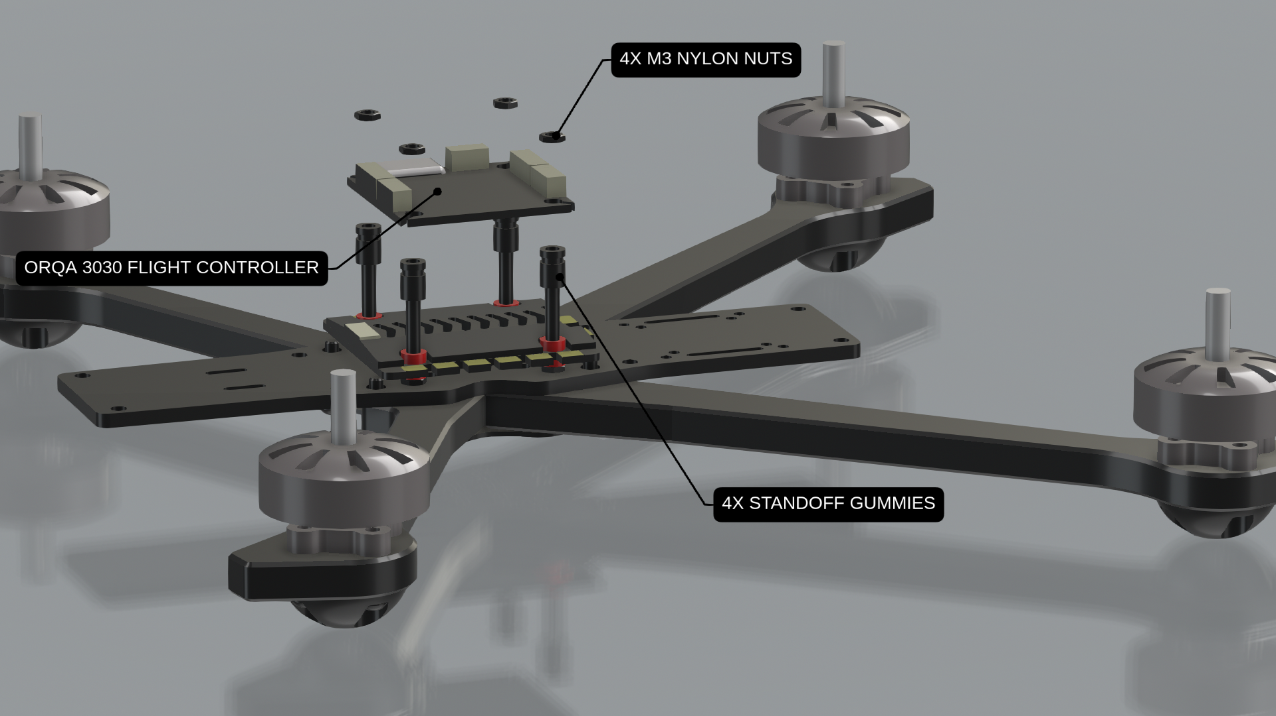
Flight Controller Orientation
FC: Front facing arrow on top
REAR
FRONT

Slide 30
FPV ICD

Slide 31
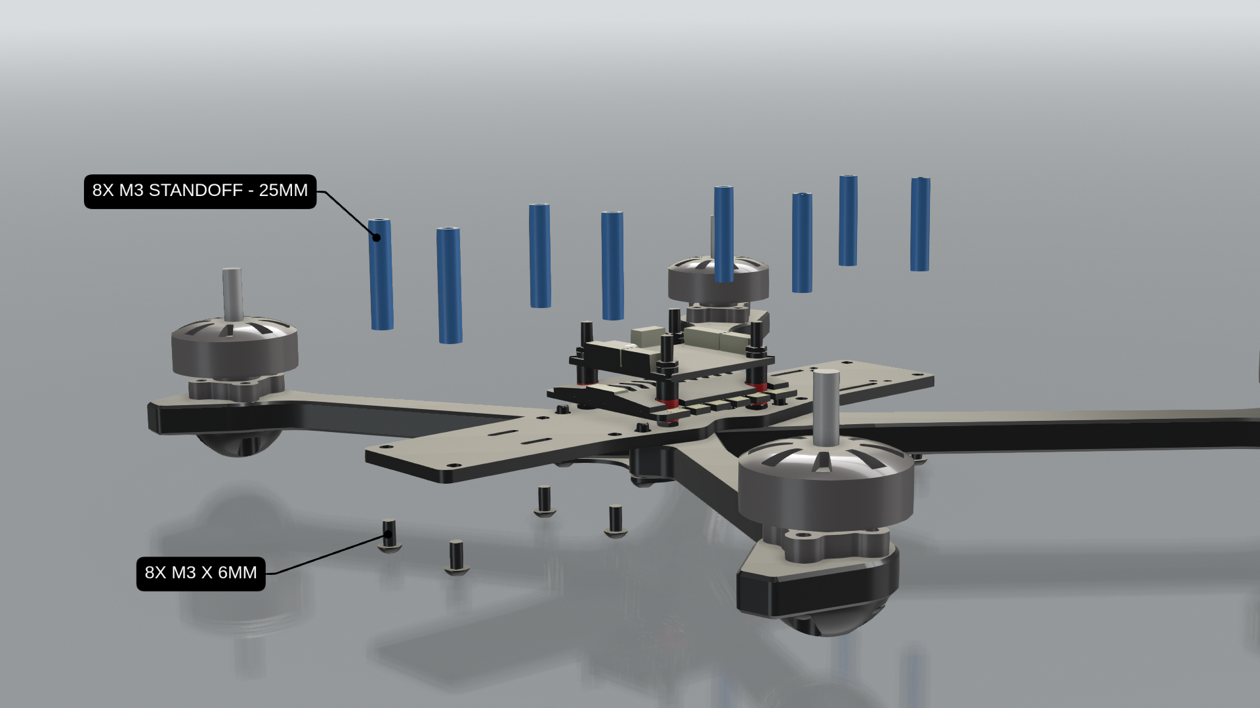
Standoffs
M3x8mm
8

Slide 32
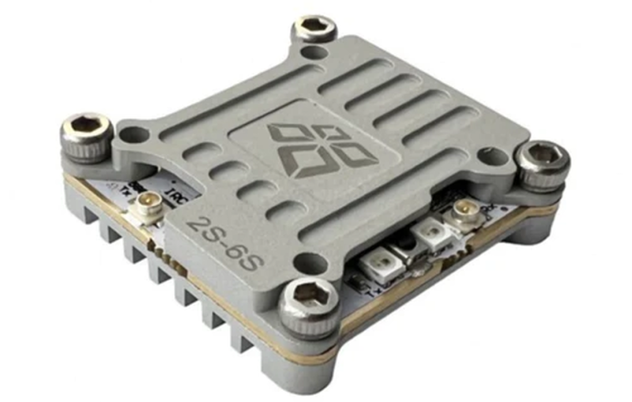
VTX/RX Module
Two types of FPV systems
  Analog (Lower image quality, but more range and lower latency)
  Digital (HD image quality, but higher latency and complete loss of video when experiencing high interference)
Main factors contributing to FPV signal quality is antenna placement, and VTX's accuracy in transmitting intended frequency
In analog systems there are 5 bands with 8 channels each
  A, B, E, F (Fatshark), R (Raceband)

Slide 33
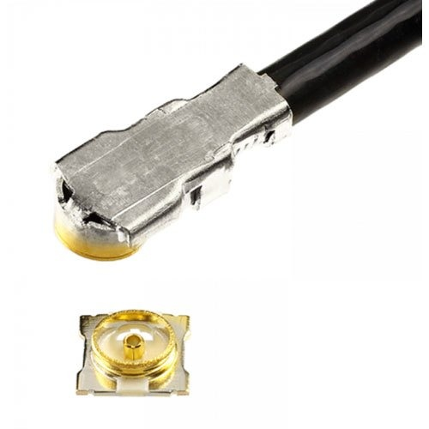
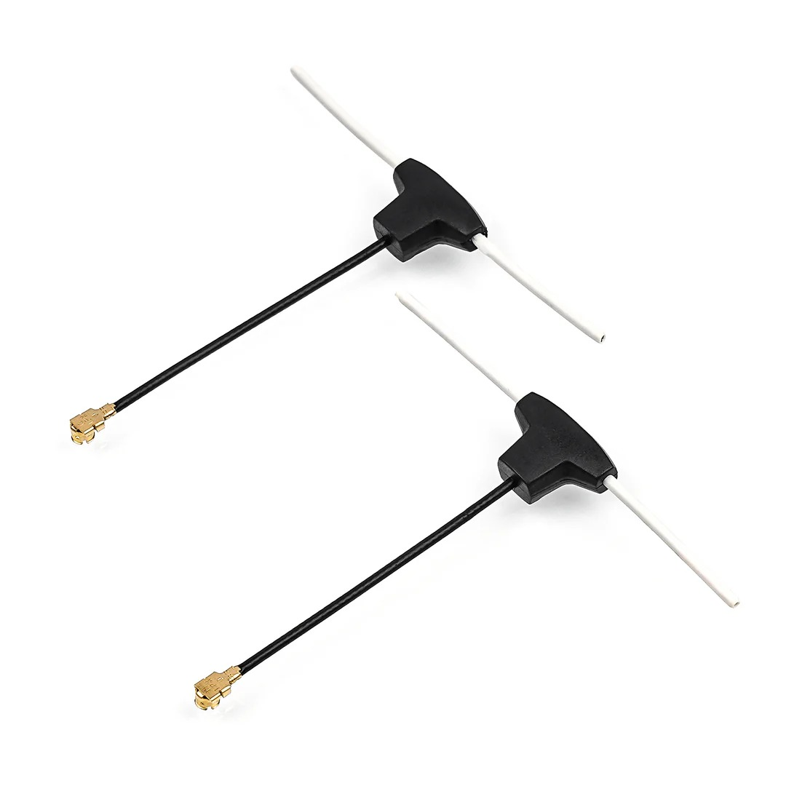
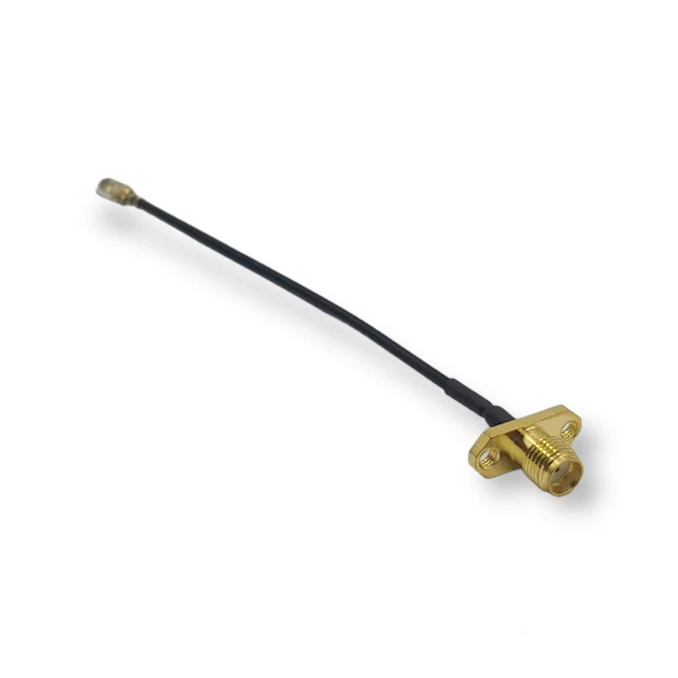
VTX Connections
Soldering pad side
U.Fl locking connectors
Plug side
U.Fl locking connectors
RX
VTX & RX status LEDs
TX
RX Bind Button

Slide 34
VTX Status Lights
VTX(rear light)
RX (front light)
Unbound
Unbound/searching
Bound
Bound/connected
Bound
Not connect
VTX
RX

Slide 35
VTX/RX Troubleshooting
Fault | Cues | Fix
Excessive Electrical Noise | White lines in video | Add low ESR capacitor to XT60 connecters Power camera from VTX
VTX not receiving enough power | Black lines in video | Power VTX directly from battery Check that motor screws aren't too long (Shorting against motor windings)
Mechanical issue (CMOS sensor in camera) | "Jello", wobbly video, in FPV video | Check for loose camera mounts, loose or cracked camera lock nuts, loose camera sensor inside housing
Lost Sync Pulse | Vertically rolling video Horizontal scrolling video | Sync pulse reconstruction More advanced receivers have this capability
Bad/Mismatched Antennas | Poor image quality | Ensure VTX and goggles have matching connecters Match polarization Change video channels
Settings Issue | No Video | Ensure VTX settings are correct in app Ports not set correctly in BetaFlight

Slide 36
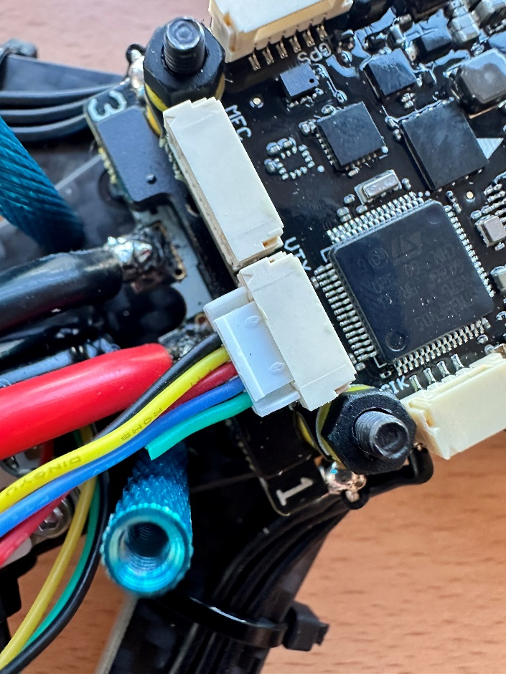
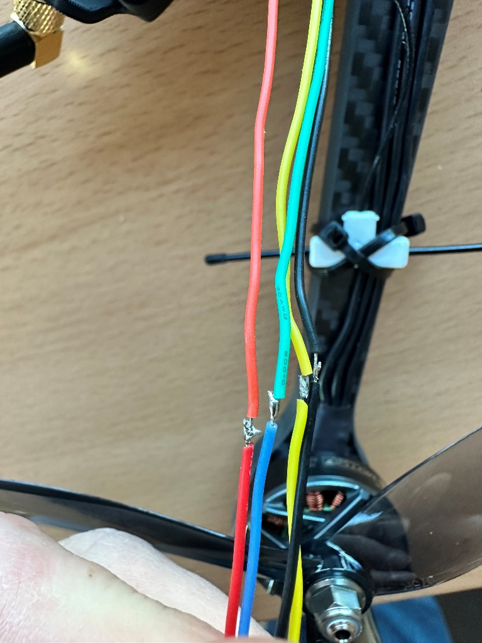
VTX / RX Hybrid
Wiring to VTX harness – utilize the harness that comes with the hybrid VTX/RX and splice it into the harness that comes off the FC VTX port (refer to the picture). Connect the wires as follows:
Black to black
Yellow to yellow
Red to red
Green from VTX/RX to Blue on FC VTX harness

Slide 37
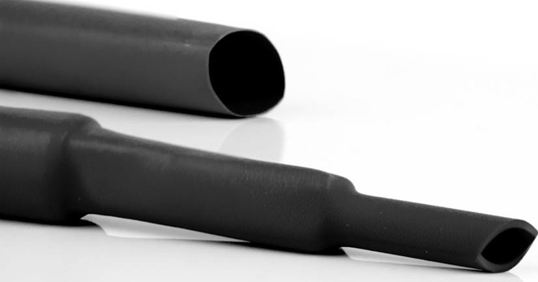
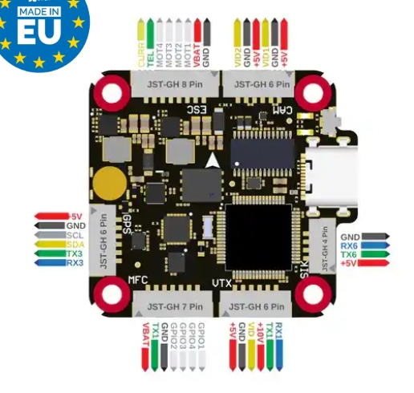

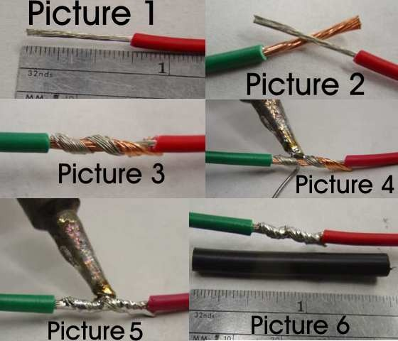
Splicing for VTX/RX Harness
Slide heat shrink on wires
(before connecting)
4. Apply heat shrink over connections
1. Cut wires for harness
3. Splice and tin wires
cut

Slide 38
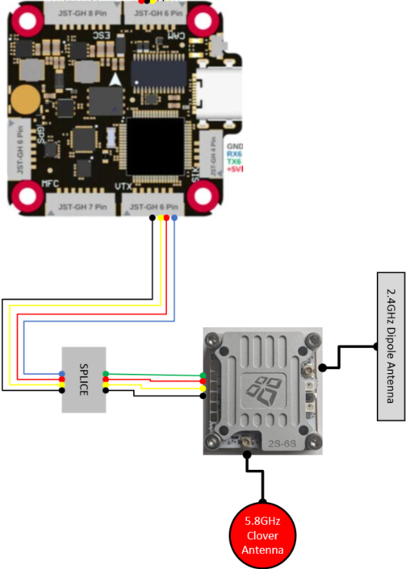
Wiring for VTX/RX

Slide 39
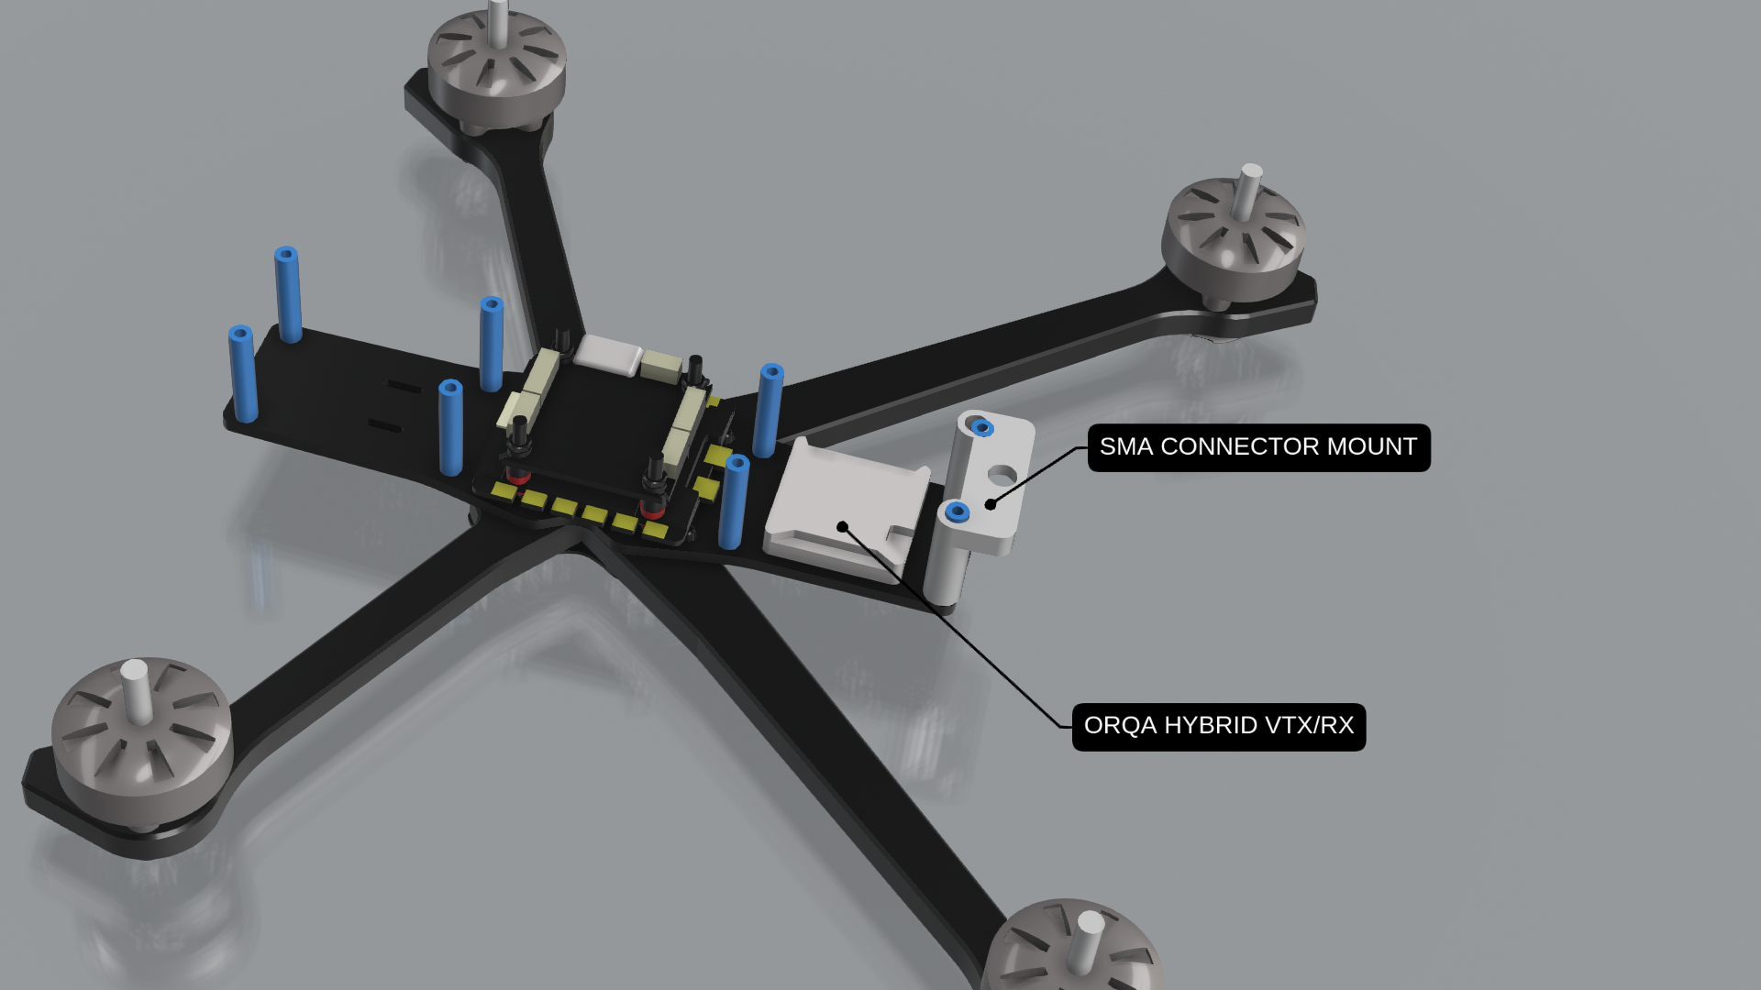
VTX Install

Slide 40
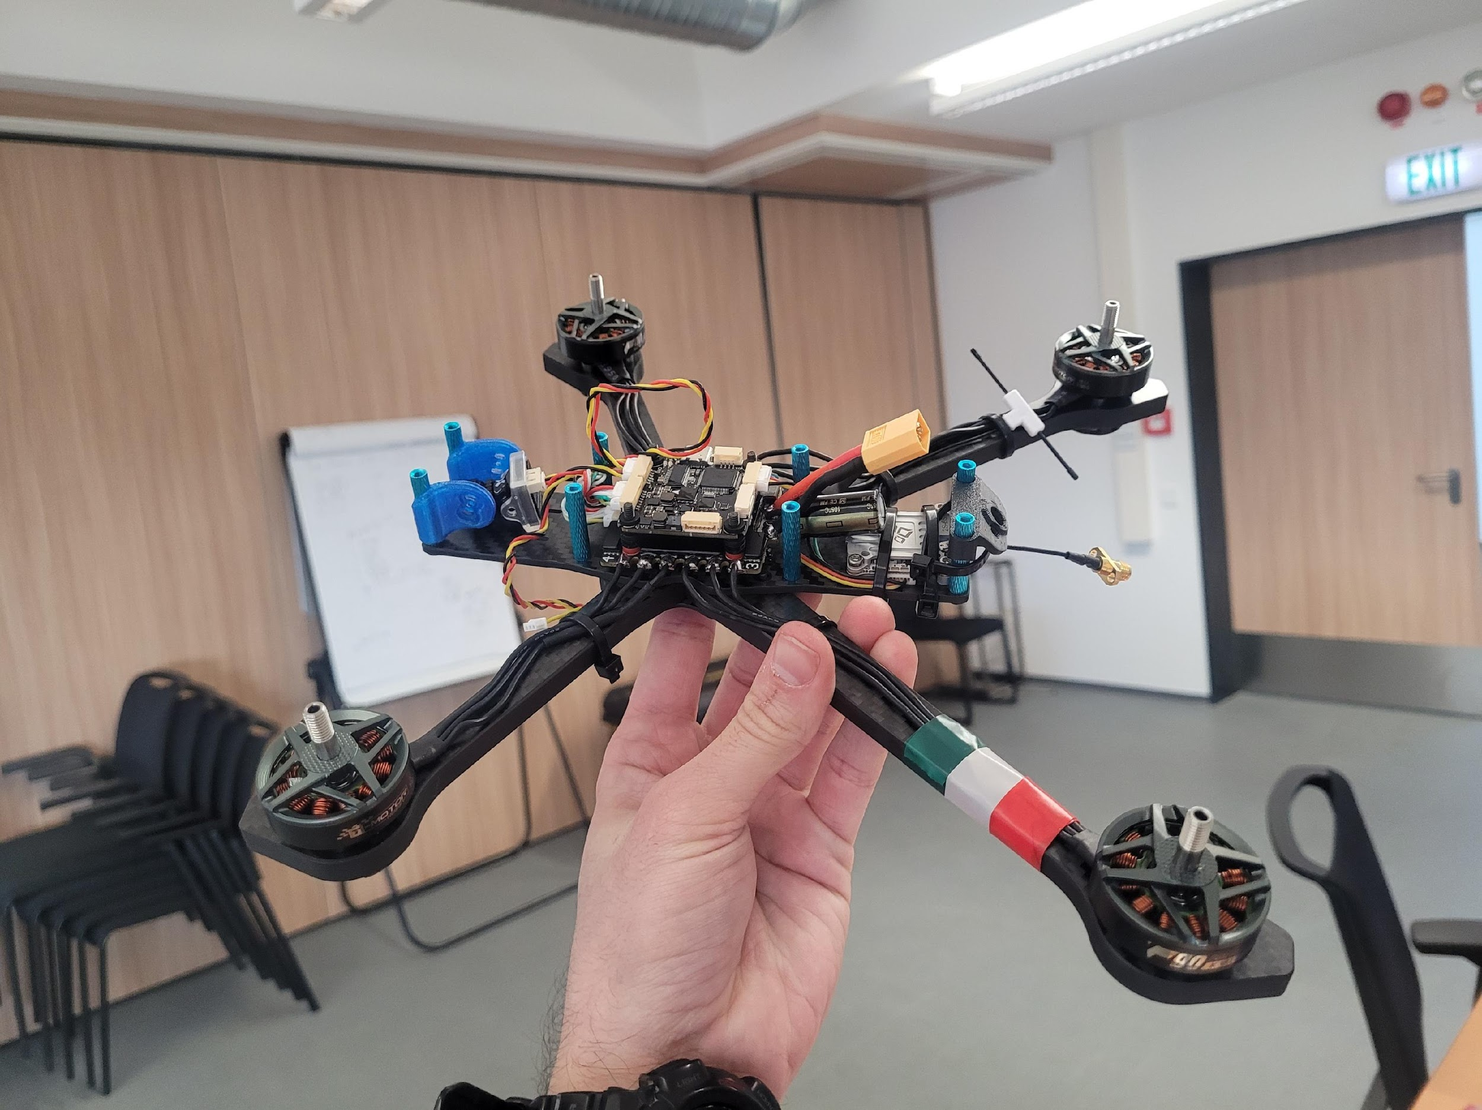
VTX / RX Antenna
Dipole Antenna – zip-tie it to the top of the arm with an “X” on the zip-ties. Make sure the antenna will not rotate into your blades
VTX
SMA Antenna – utilize the 3D printed SMA antenna mount and slide it down the rear standoffs.

Slide 41
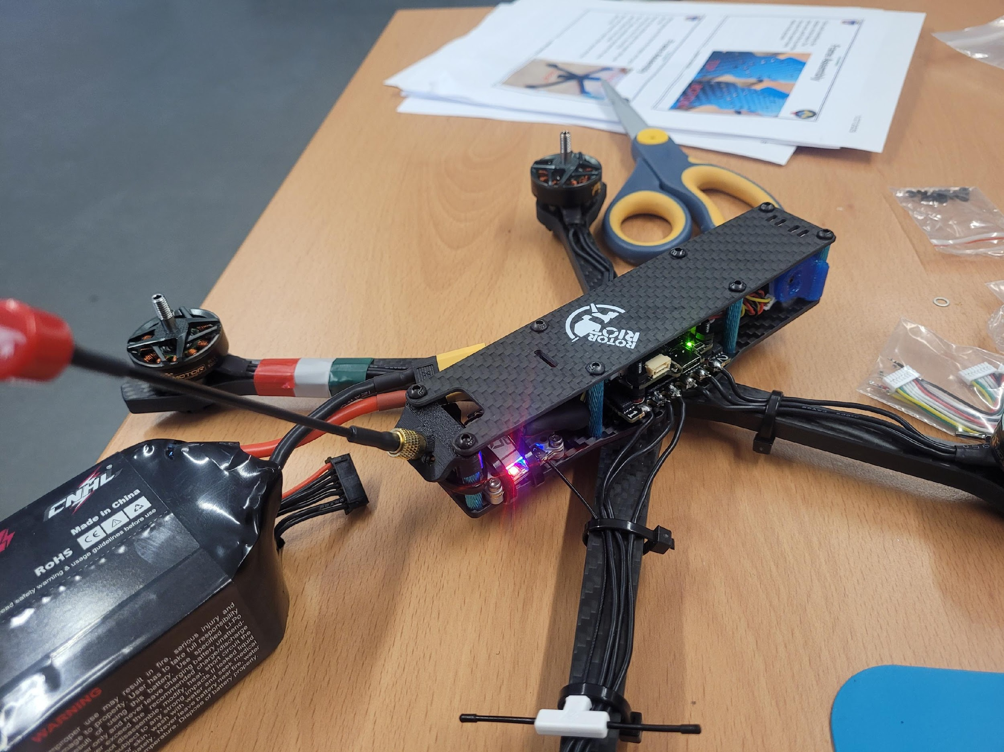
SMA Antenna Extension
Screws on from SMA antenna pushed through 3D printed mount

Slide 42


Camera mount
~15º
Angle from frame
3D print cam mounts

Slide 43


Camera Harness
Identify Harness – Colors are in order from the diagram as a 6 pin harness. One end has 2, 3-pin connectors. No splicing is required for this harness.
Connection – Plug one of the 3-pin connectors directly into the cam as seen in the picture and plug the 6 pin side into the FC on the CAM port.
*Notes:
This harness is quite long, for this project, it’s best to just twist the harness and then loop and secure it as seen in the picture.
  Twisting wire harness creates artificial shielding from interference
If you have a black screen in your goggles, swap the camera cables to the unused end and check your video feed.

Slide 44

Camera plug
When testing your goggles, if you see your OSD, but the video is gray, check you are not plugging in the loose end (video 2) to the camera, then check you have the correct sequence :
Red: VCC
Black BND
Yellow Vid

Slide 45
Quality Control Step 2
& Smoke Test

Slide 46


FPV Batteries
Notes:
C-Rate: percentage of max output that the battery can provide. Lower C-Ratings are typically found in larger batteries and are designed to output stable power.

Slide 47

FPV Batteries
How to charge LIPO Batteries?
  Plug the main lead and the balance connector into the charger
  Set the charger to with the following:
    No more than 4.2 volts per cell
    2S-6S depending on battery
    Amperage – the capacity of the battery
Notes:
Amperage – some batteries are designed to be charged at 2-4 X capacity. Consult the battery’s technical specs to confirm prior to attempting
@ 1X the capacity all dead batteries will take ~1 hr to charge

Slide 48
FPV Batteries
Charger Capabilities
  Multiple Battery Charging
  Max Current
  Charge settings
    Standard Charge for use
    Storage Charge (3.8v per cell)
    Discharge – bleeds battery power for storage

Slide 49
Additional Resources
Quad Part Picker
  A helpful website for ensuring all FPV components you have selected are compatible
Joshua Bardwell
  Great resource for FPV part reviews, how to fly lessons, and troubleshooting components
Oscar Liang
  Great resource for FPV part reviews and troubleshooting components

Slide 50


