Slide 1
BetaFlight & Ghost Programming
Notes:
https://oscarliang.com/soldering-guide/
https://oscarliang.com/soldering-iron-buyers-guide/

Slide 2
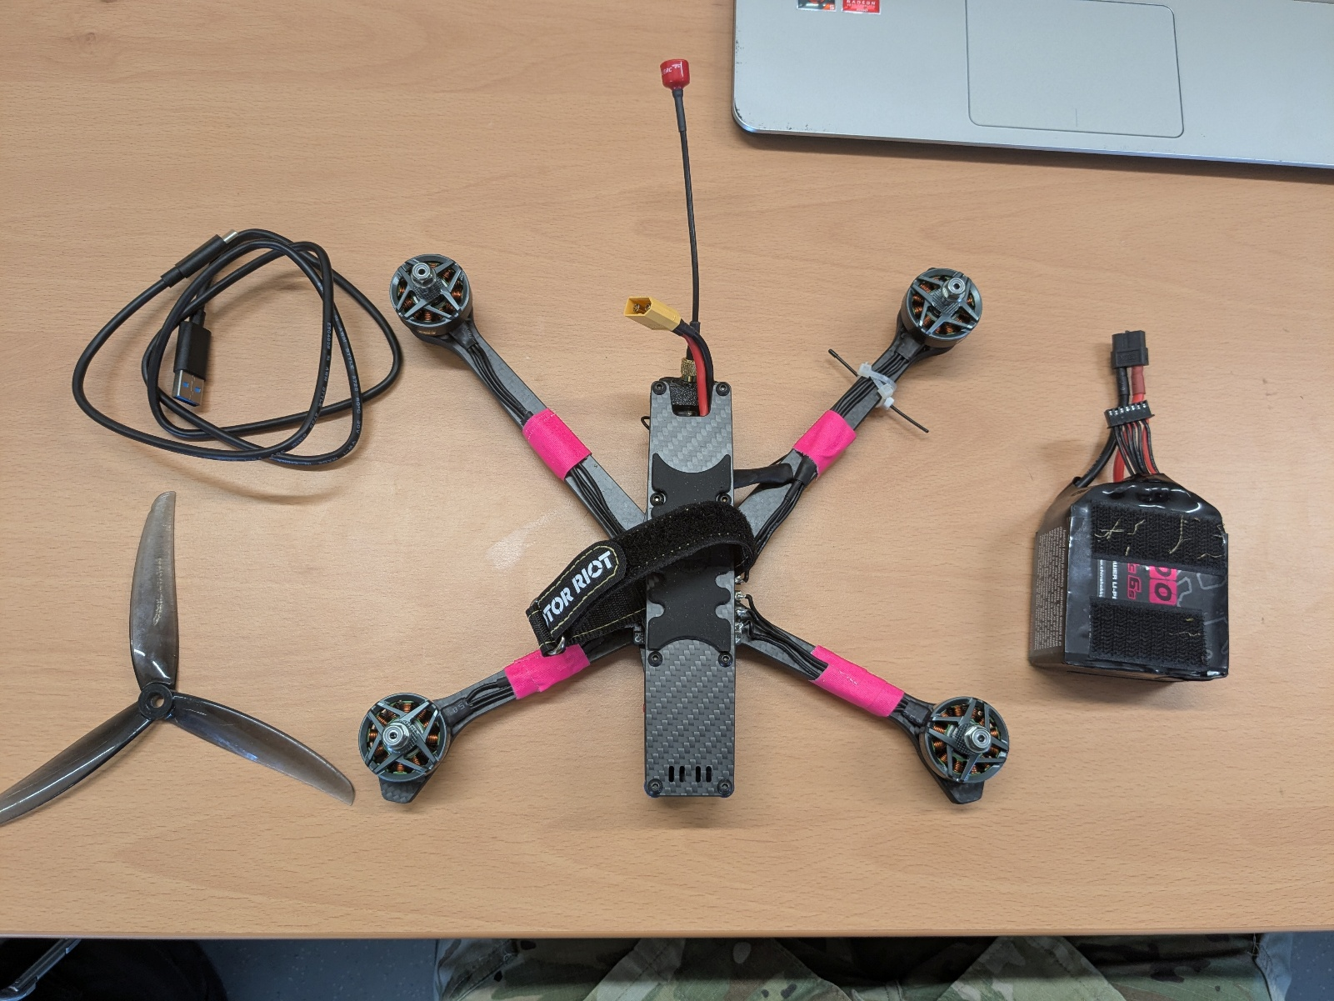
REMOVE PROPS PRIOR TO BETAFLIGHT CONFIGURATION
Required Items:
FPV Drone
Battery (charged)
USB Cable
Controller (Not Shown)
Betaflight Configurator
NOTE: This guide works for this hardware configuration. Refer to your manufacturer’s specifications and the Betaflight wiki if your hardware differs.

Slide 3
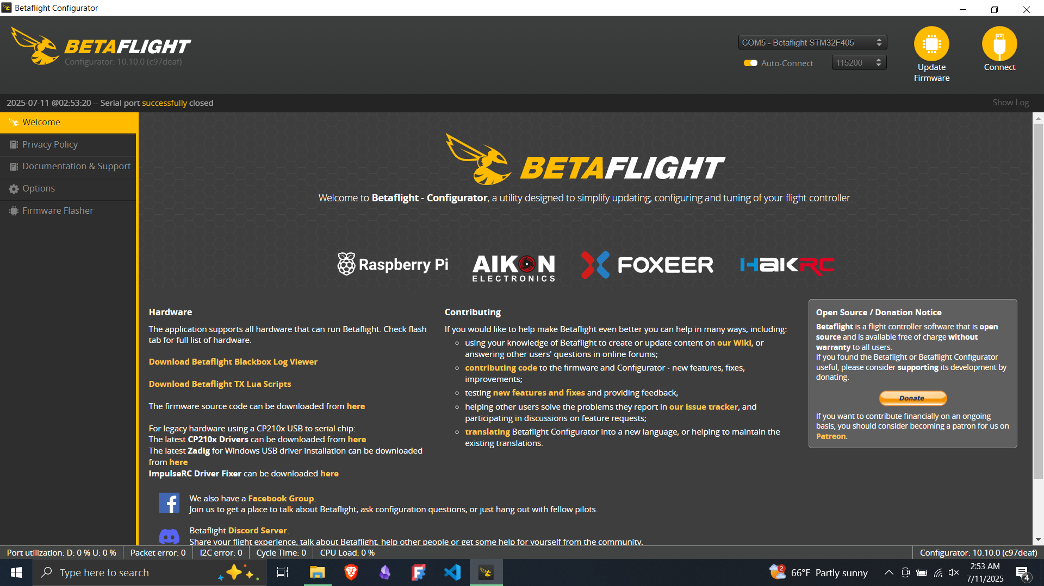
Flight Controller (FC)
Connect FC

Slide 4
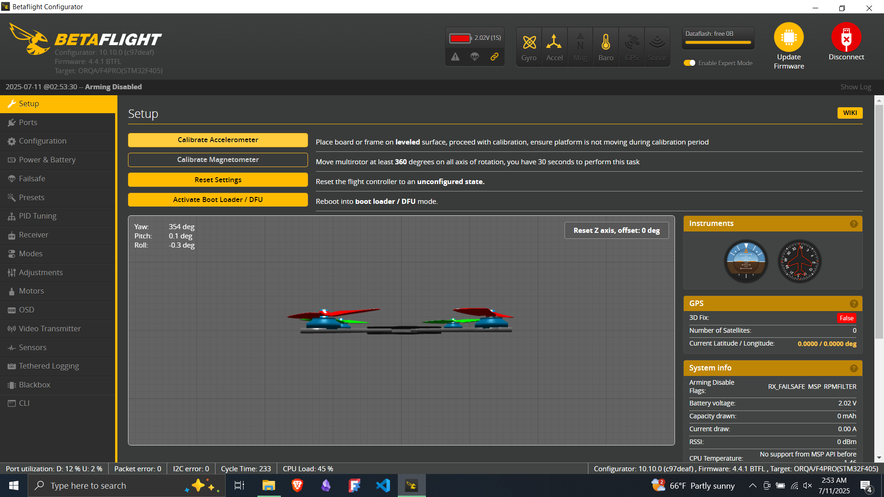
Drone Status
Configuration Tabs
Initial Calibration Options
Detailed Drone Status Data

Slide 5
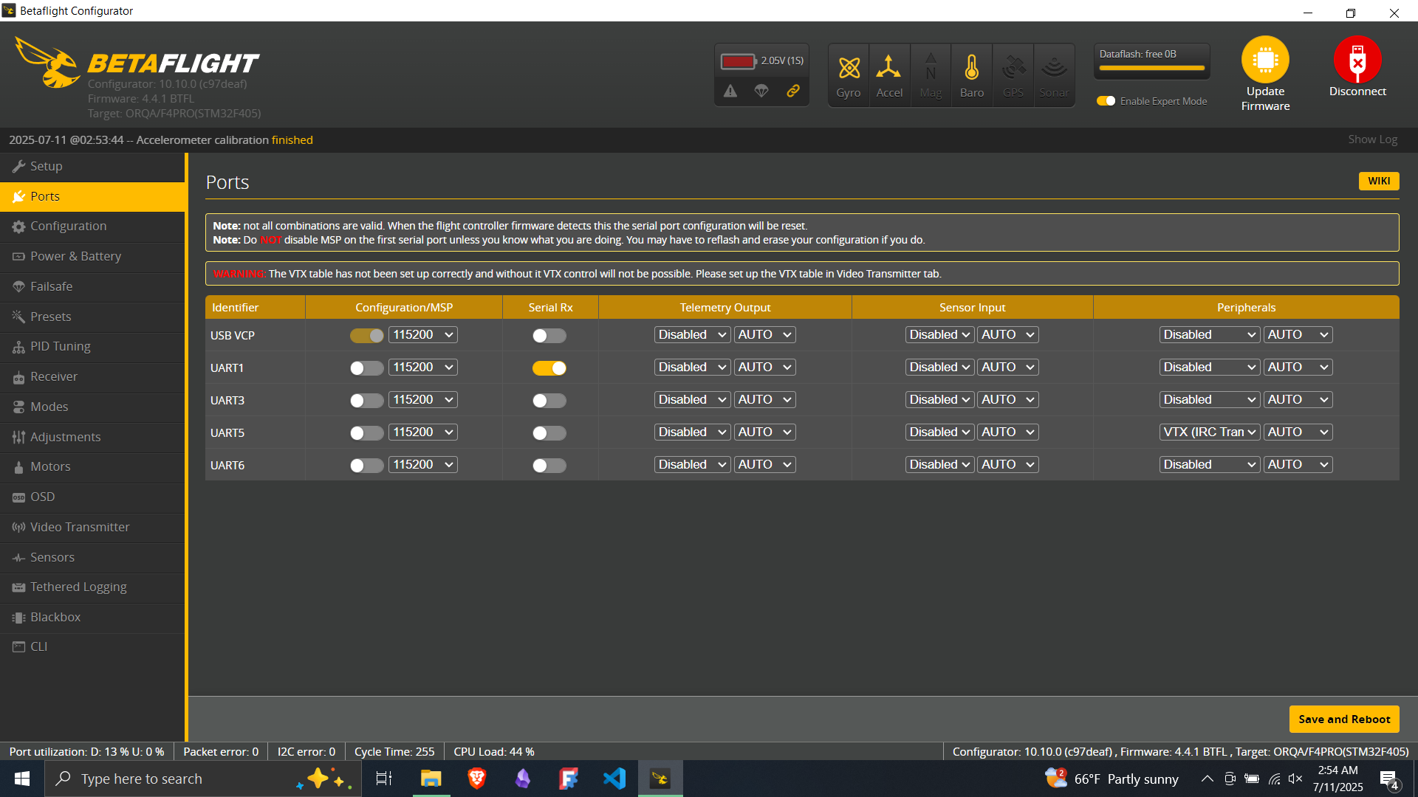
UART 1 is set as Serial RX
UART 5 is set as VTX (IRC Tramp Protocol)

Slide 6
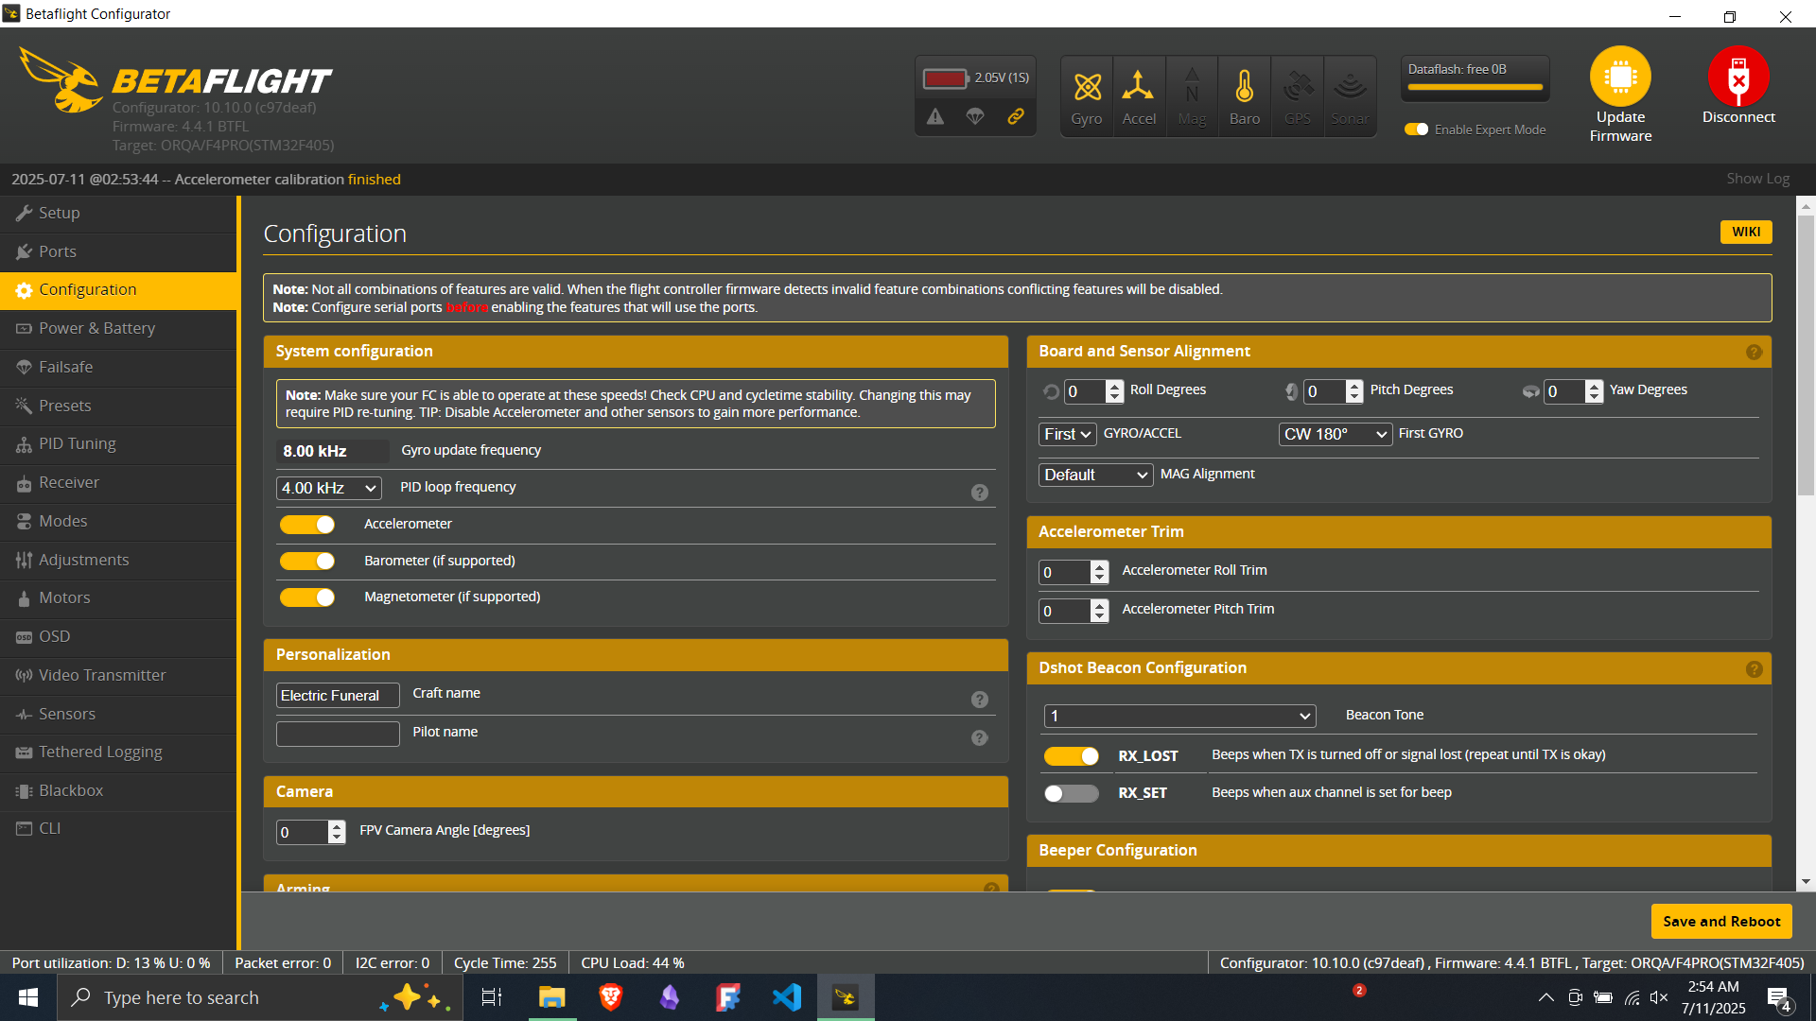
Flight Controller Orientation
Input your name into Pilot Name

Slide 7
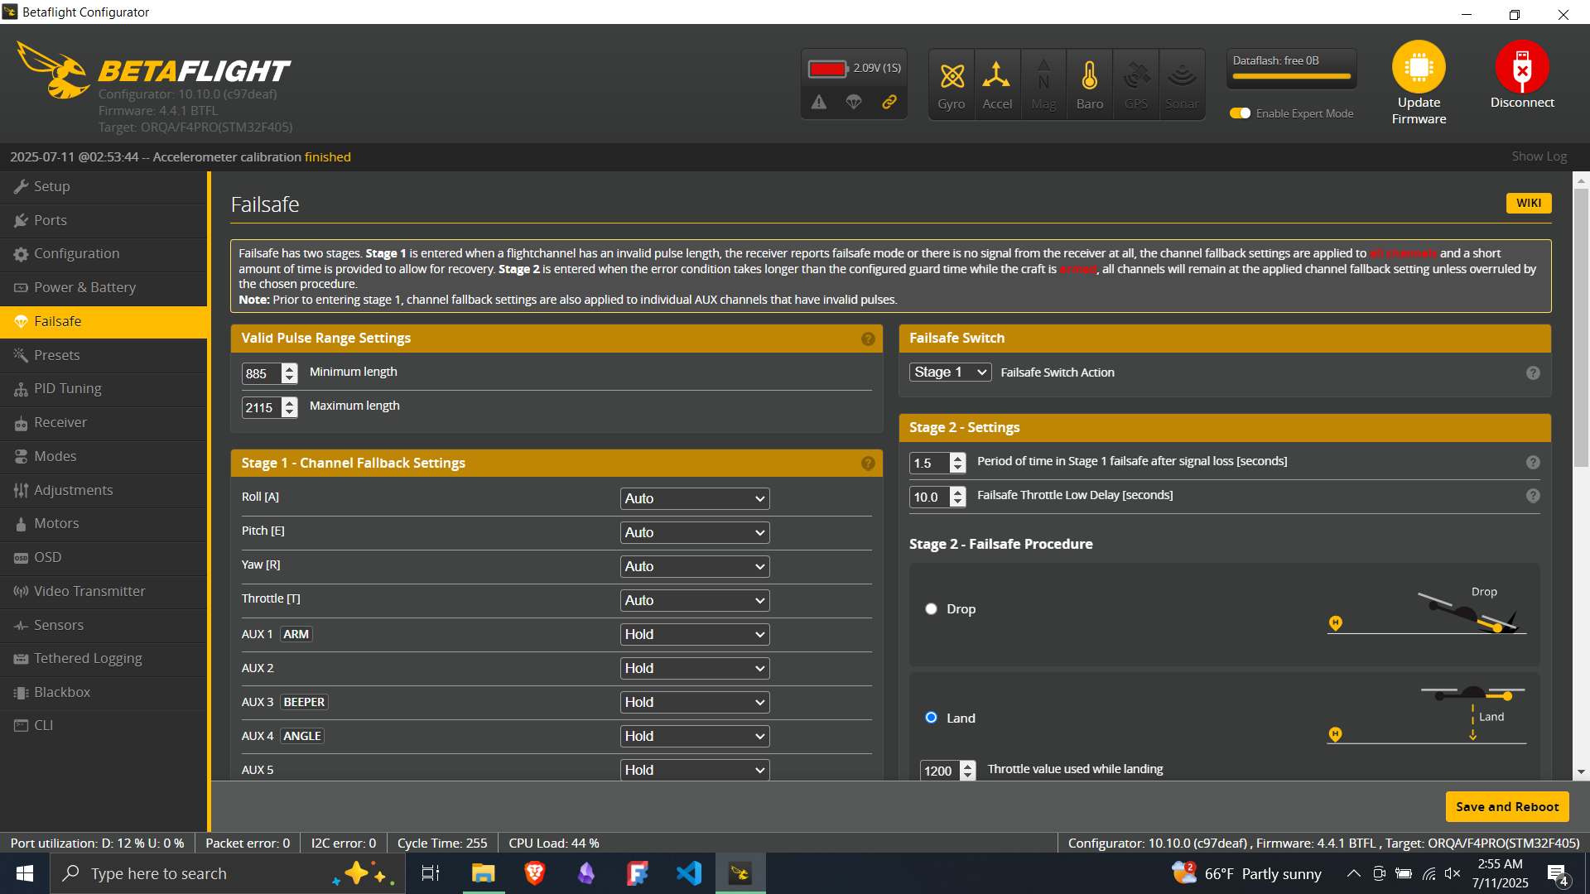
Signal Loss Failsafe – Select Drop

Slide 8

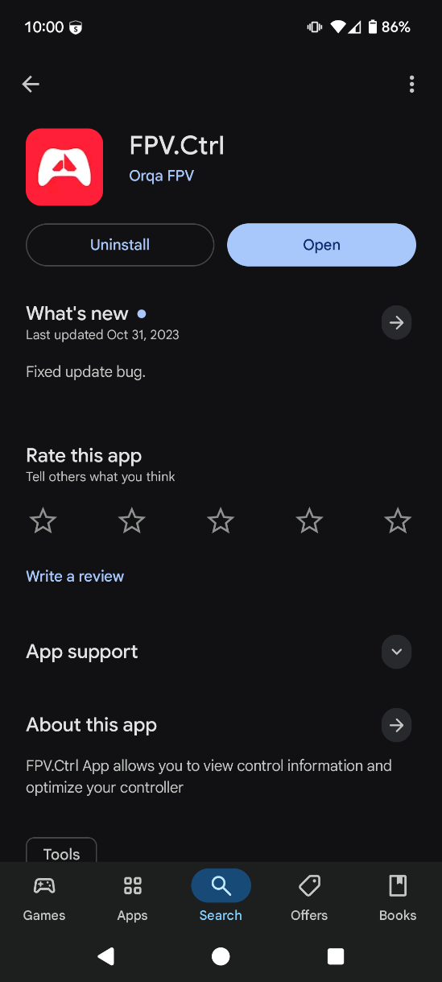

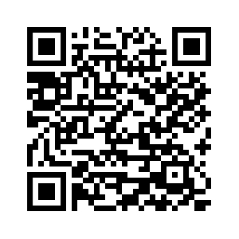


Slide 9
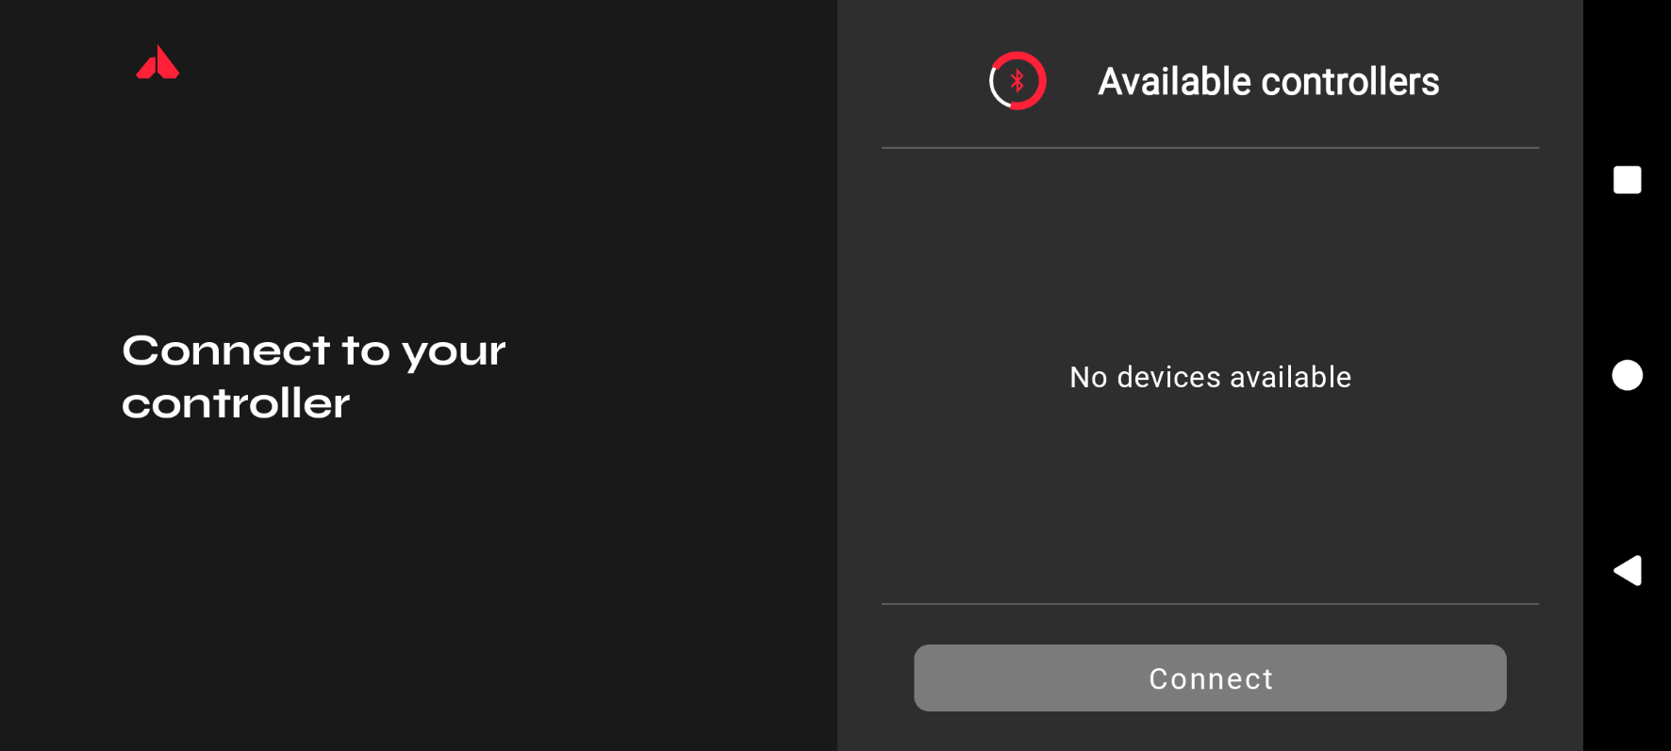
Pairing Controller to Drone
Steps:
Download the OrqaFPV.CTRL App
Turn on Bluetooth
Open the App
Turn on Controller
Note: Pair each drone and controller set one at a time to prevent an inadvertent mismatch

Slide 10
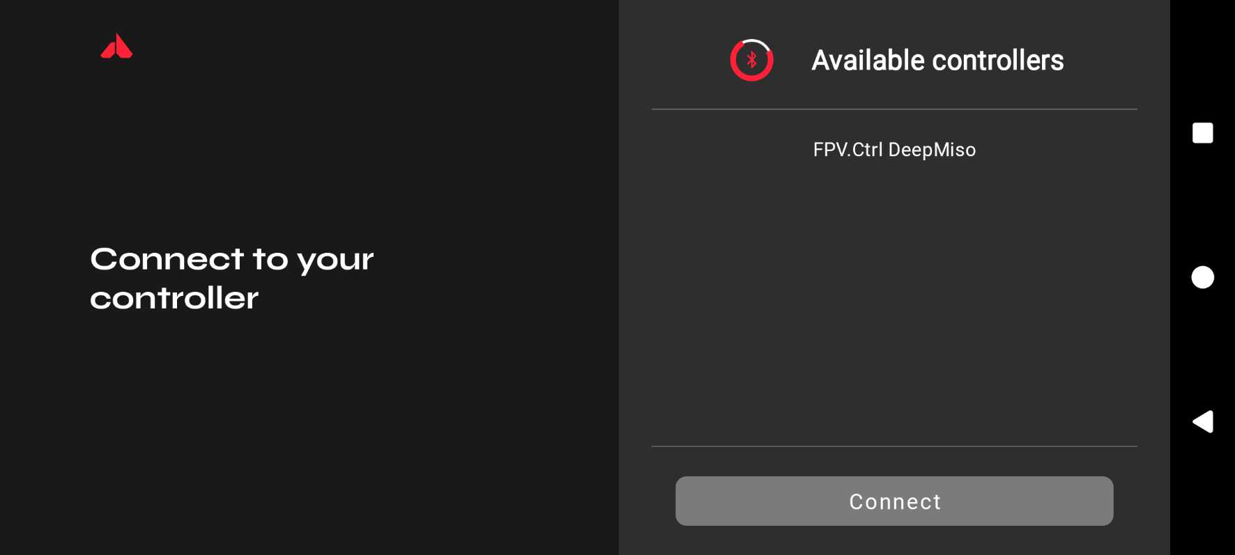
Pairing Controller to Drone
Steps:
Select your Controller
Press Connect

Slide 11
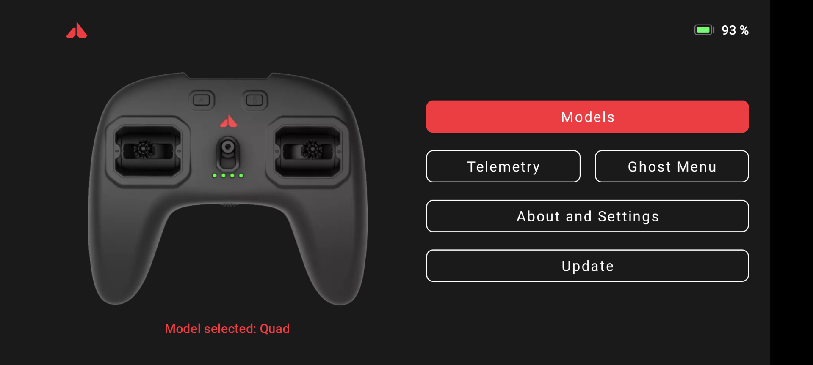
Pairing Controller to Drone
Steps:
Select Update (if prompted)
Complete update if required
Select Ghost Menu

Slide 12
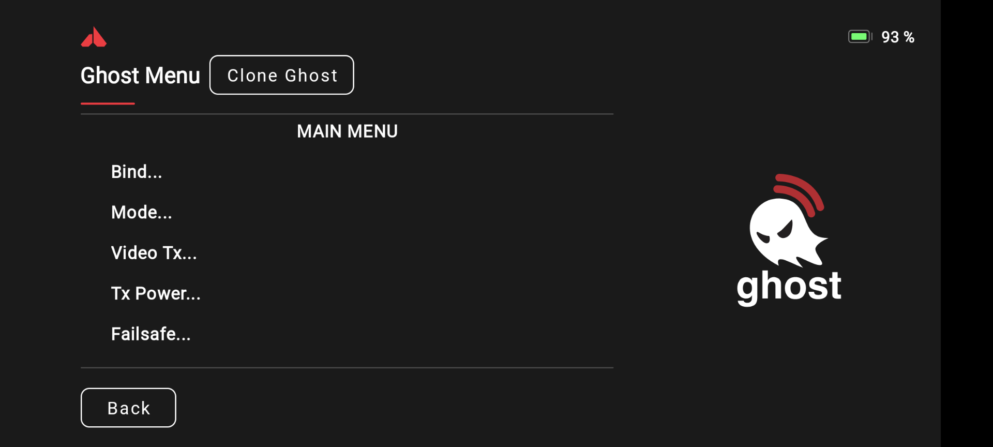
Pairing Controller to Drone
Steps:
Select Bind

Slide 13
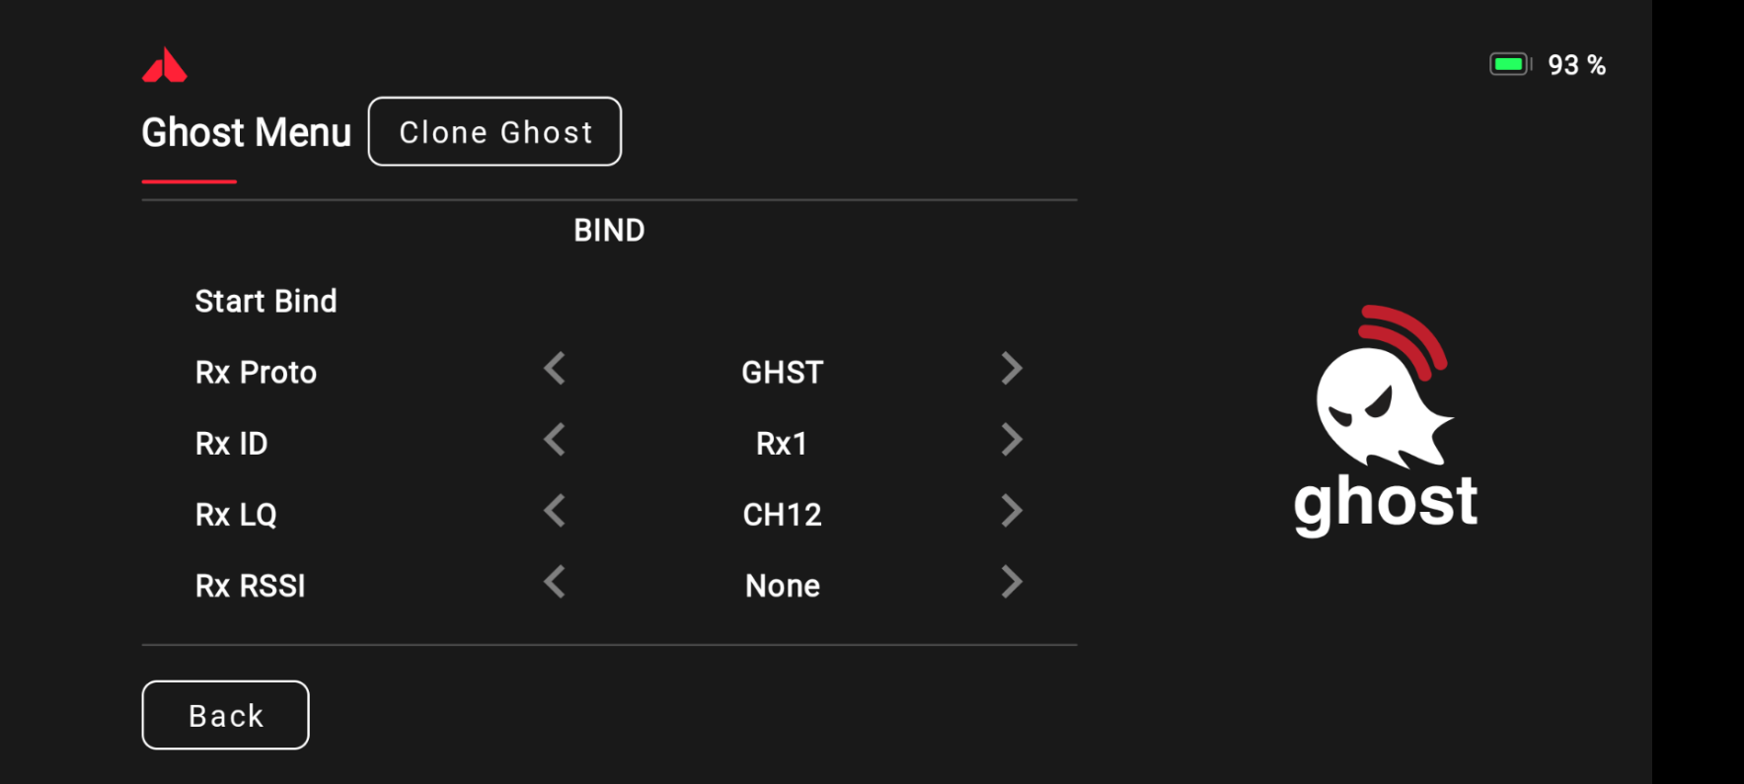
Pairing Controller to Drone
Steps:
Set RX Proto to GHST
Select RX ID
Select RX Channel
Depress Bind Button on the VTX/RX (between the status lights)
Plug battery into drone
Press Start Bind
Success should appear beneath the Start Bind Option

Slide 14
VTX / TX Setup
Steps:
Select Mode

Slide 15
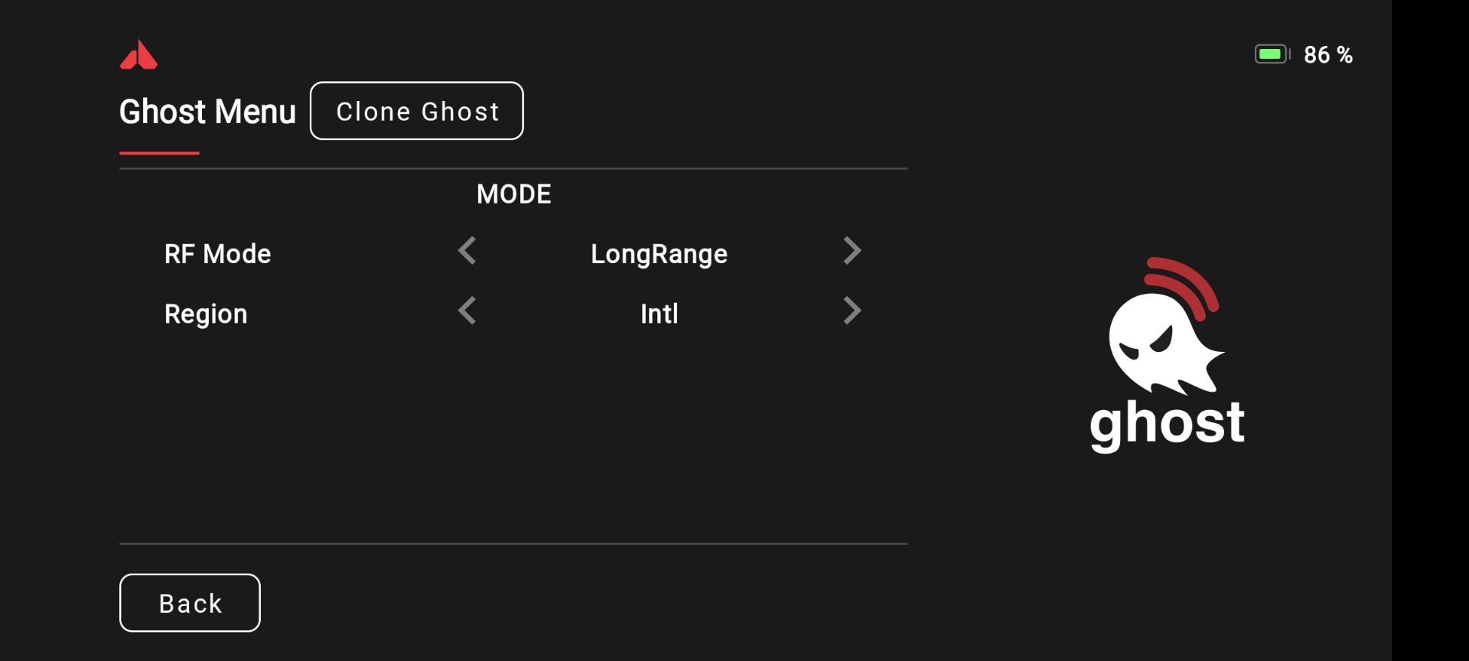
VTX / TX Setup
Steps:
Set RF Mode to LongeRange
Set Region to Intl
Press Back

Slide 16
VTX / TX Setup
Steps:
Select Video TX

Slide 17
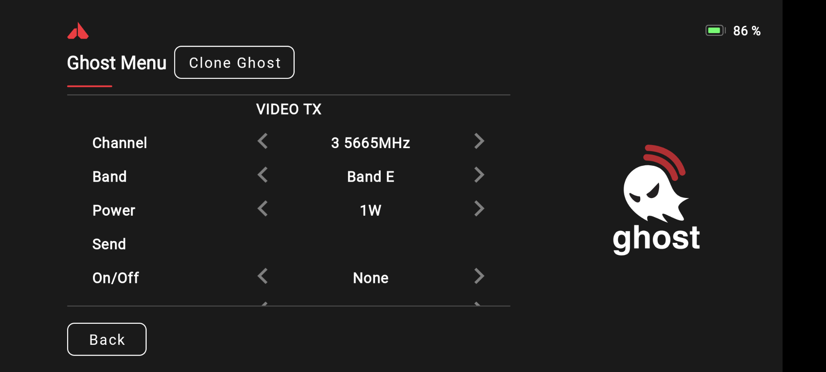
VTX / TX Setup
Steps:
Set Band and Channel (reference board for group channel)
Set Power to 1 W
Press Send

Slide 18
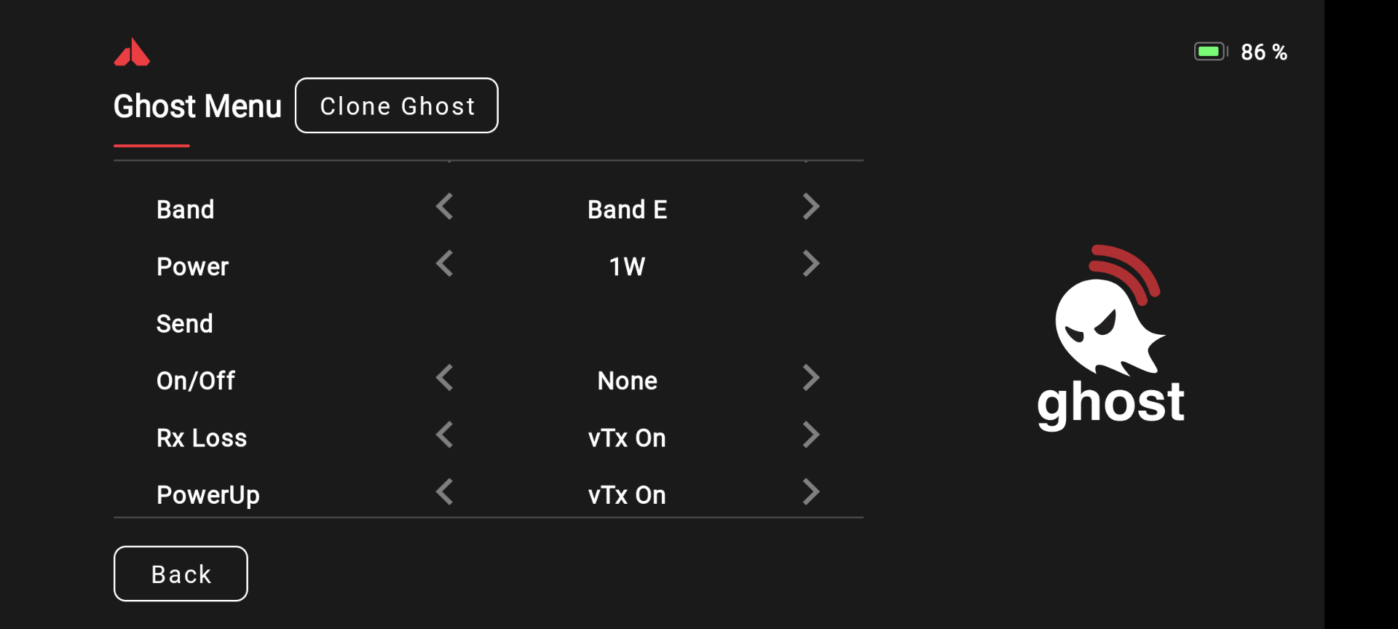
VTX / TX Setup
Steps:
Set RX Loss to VTX On
Set PowerUp to VTX On
Press Back

Slide 19
VTX / TX Setup
Steps:
Select TX Power

Slide 20
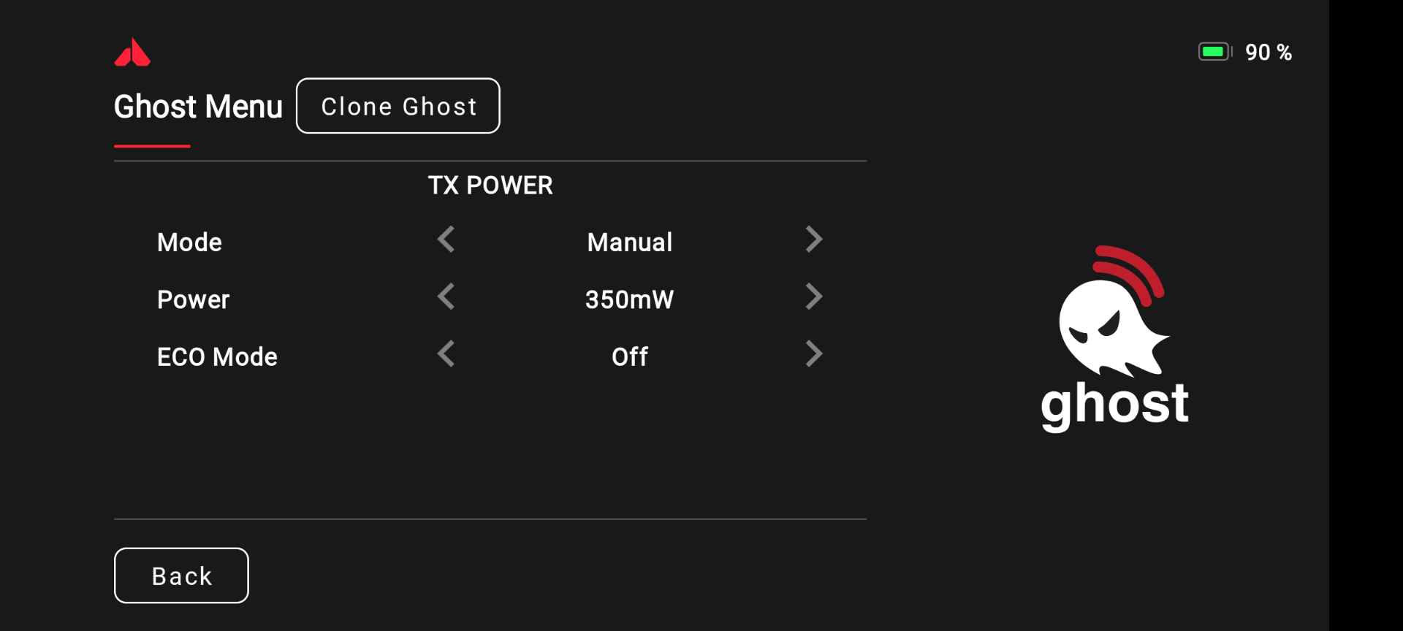
VTX / TX Setup
Steps:
Set Mode to Manual – 350 mW
Set ECO Mode to off
Press the Back Button

Slide 21
Calibrating Controller (TX)
Steps:
Select About and Settings

Slide 22
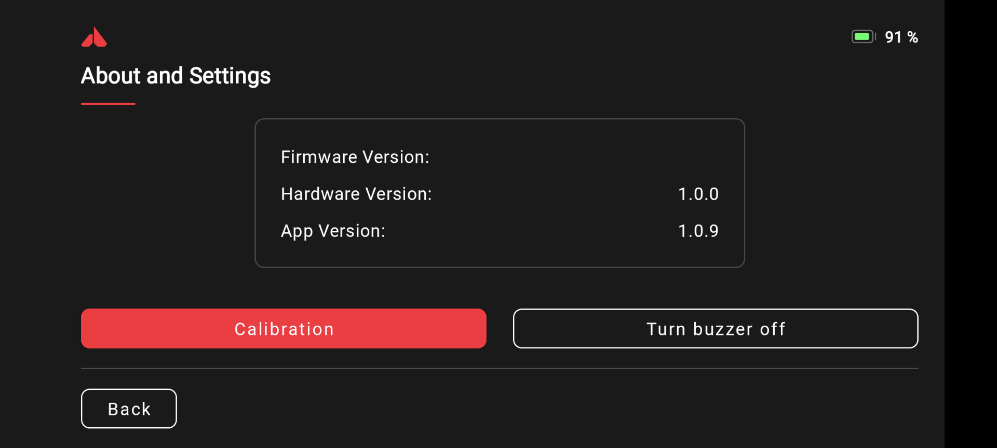
Calibrating Controller (TX)
Steps:
Select Calibration

Slide 23
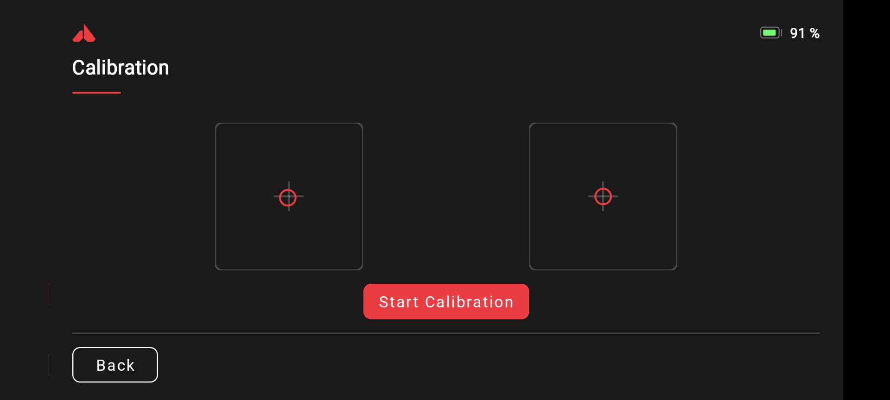
Calibrating Controller (TX)
Steps:
Select Start Calibration
Follow the onscreen steps to complete the calibration

Slide 24
Leave battery plugged in
Return to Betaflight

Slide 25
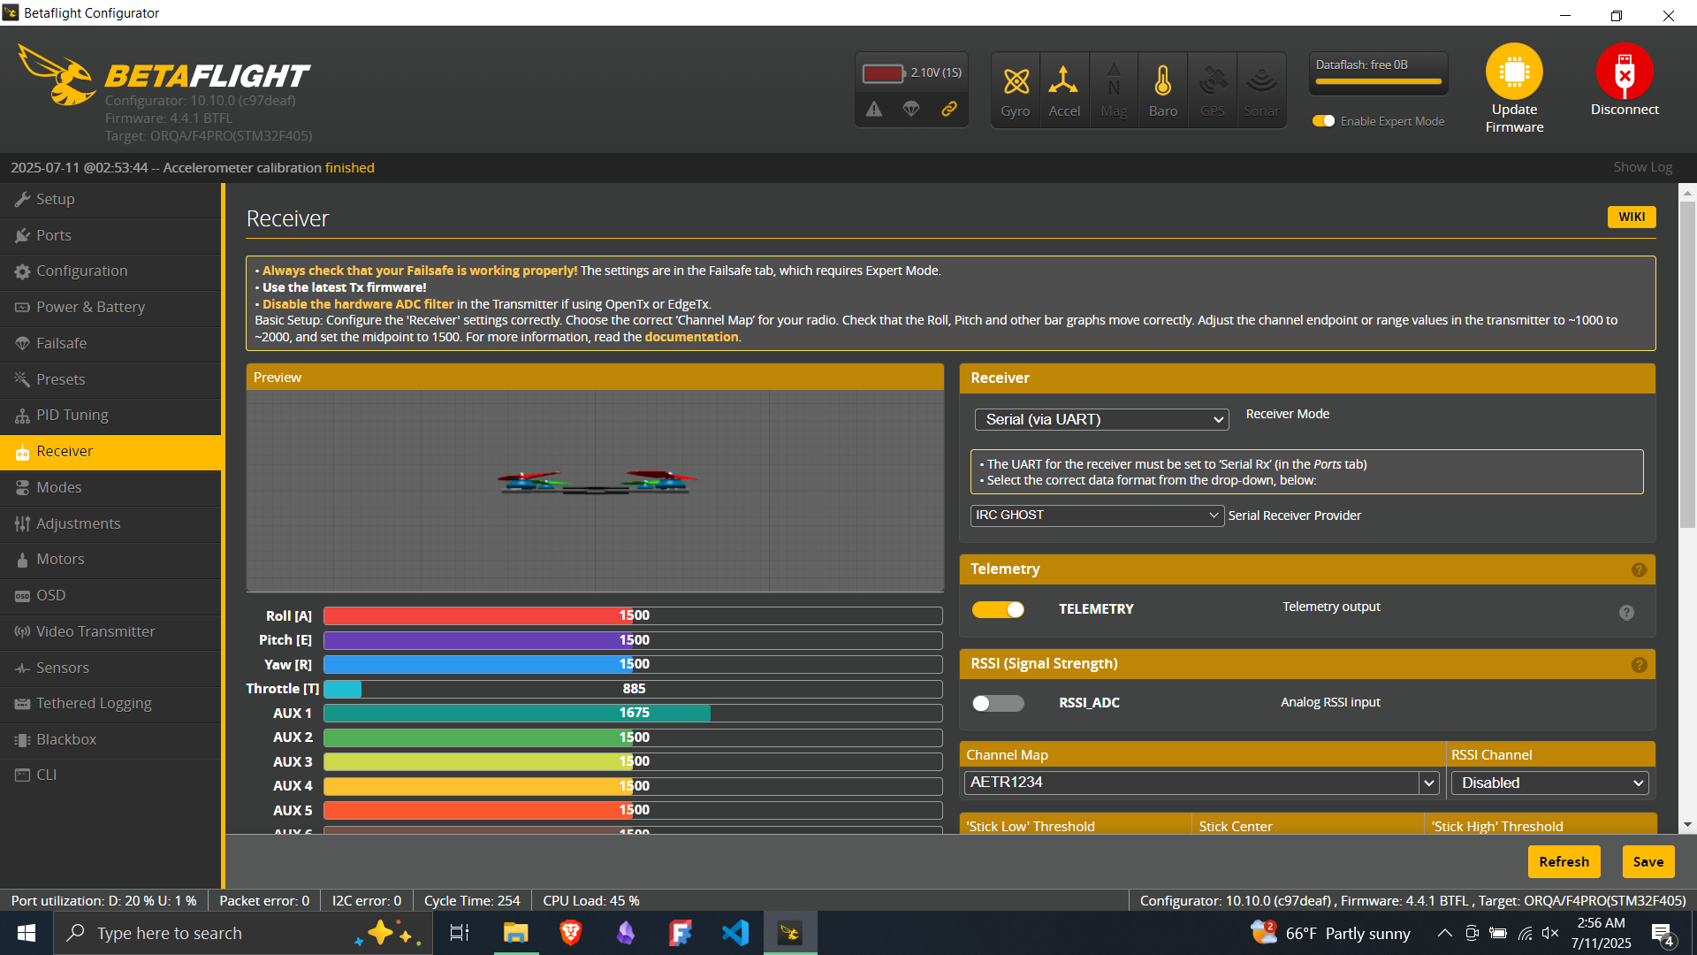
Control Inputs / Values
Receiver Protocol

Slide 26
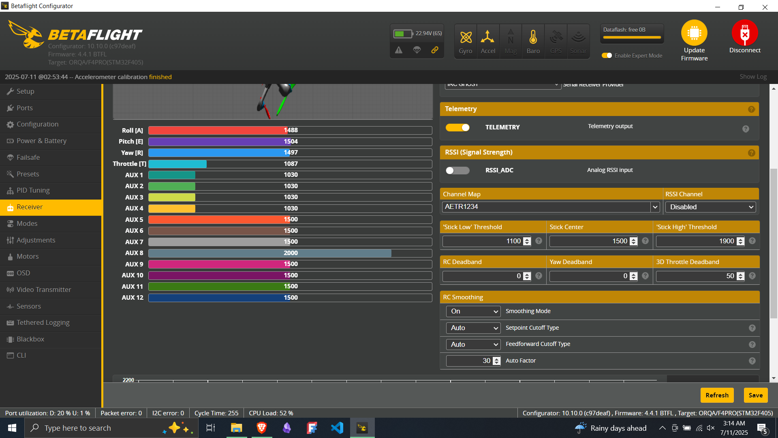
Throttle minimum must be lower than “Stick Low” Threshold value for drone to arm. Set this value to 50 greater than your Throttle value. Ensure Throttle is at minimum prior to this change.

Slide 27
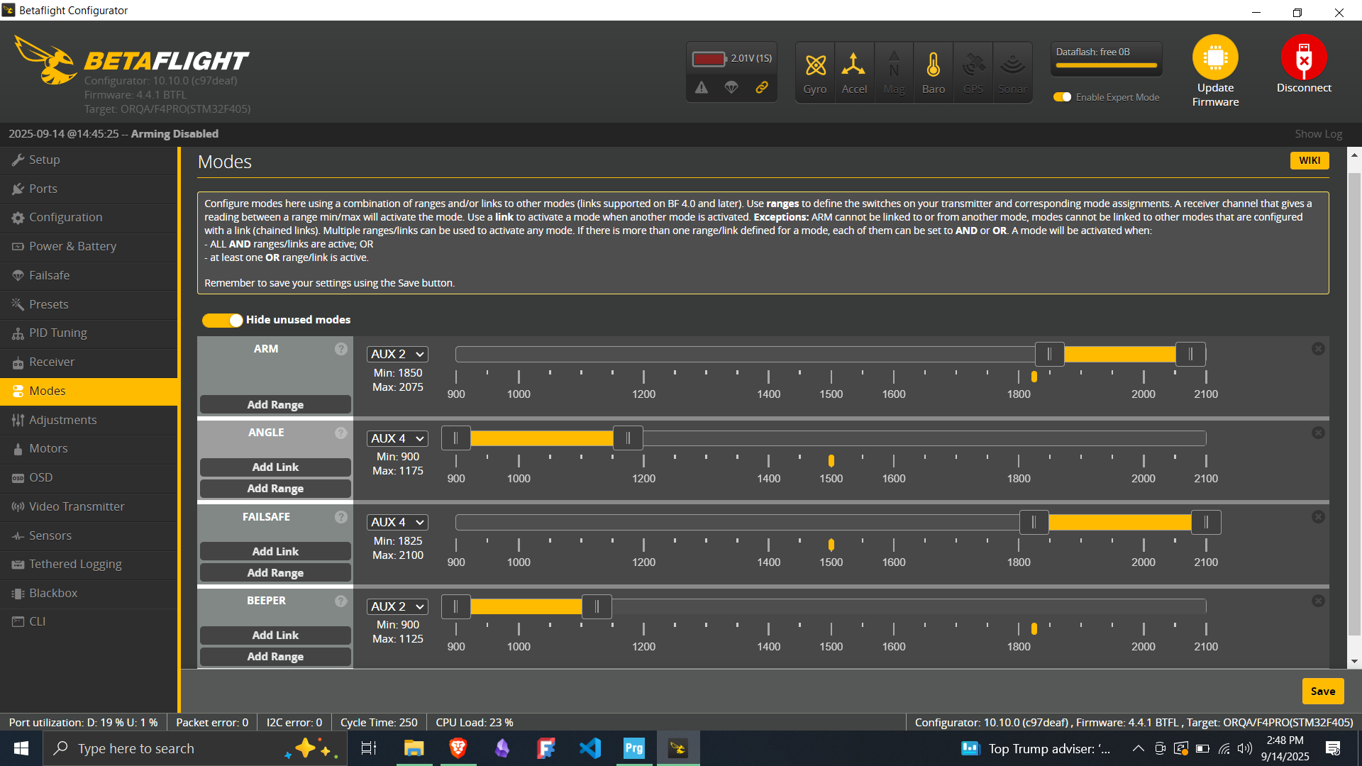

Slide 28
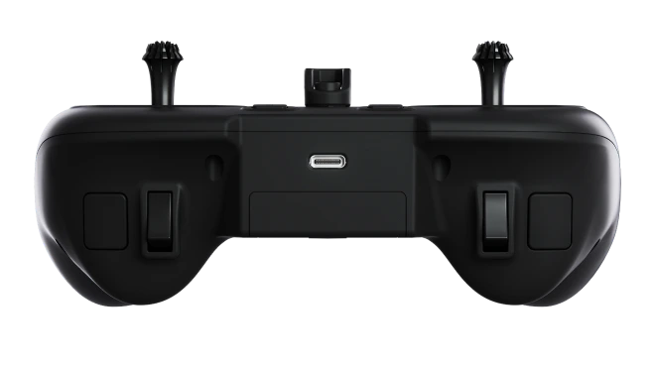
Arm
Beeper
Angle/Acro (Air)
Failsafe

Slide 29
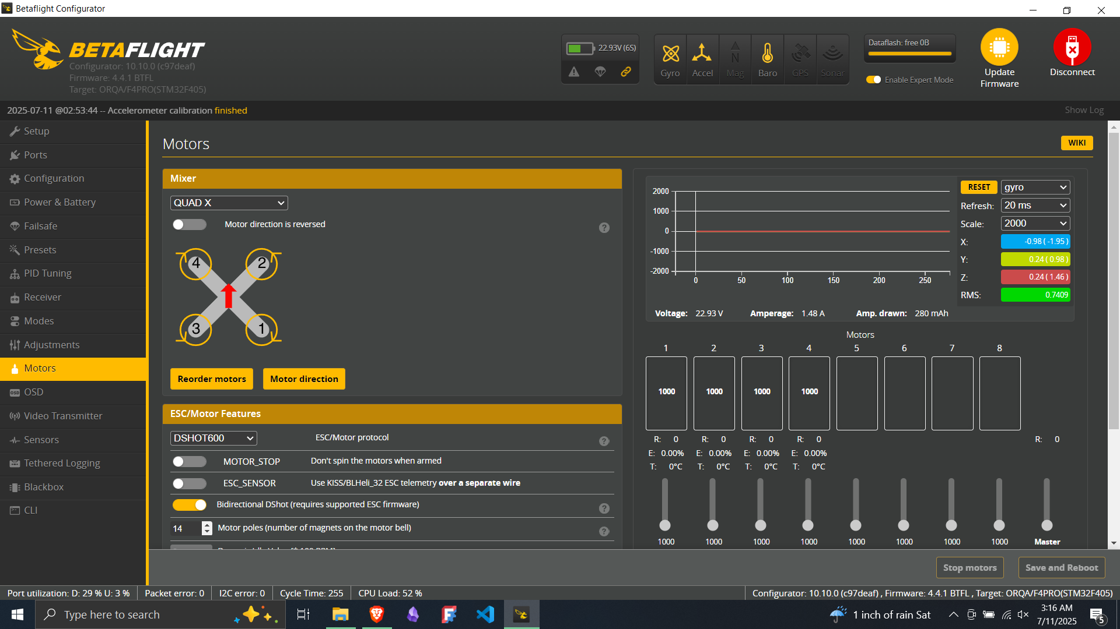

Slide 30
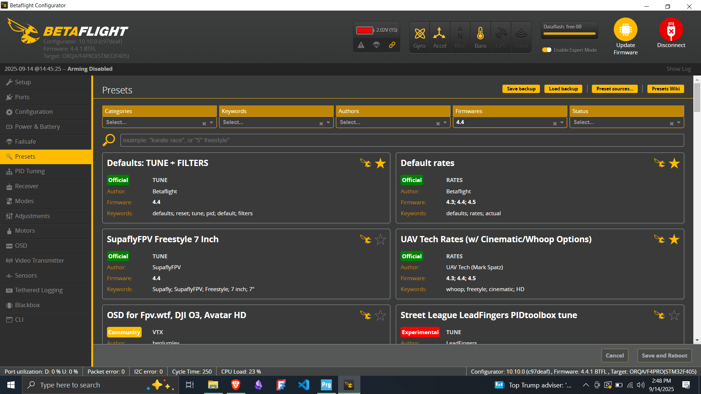
One at a time, apply the two default presets and save after each one

Slide 31
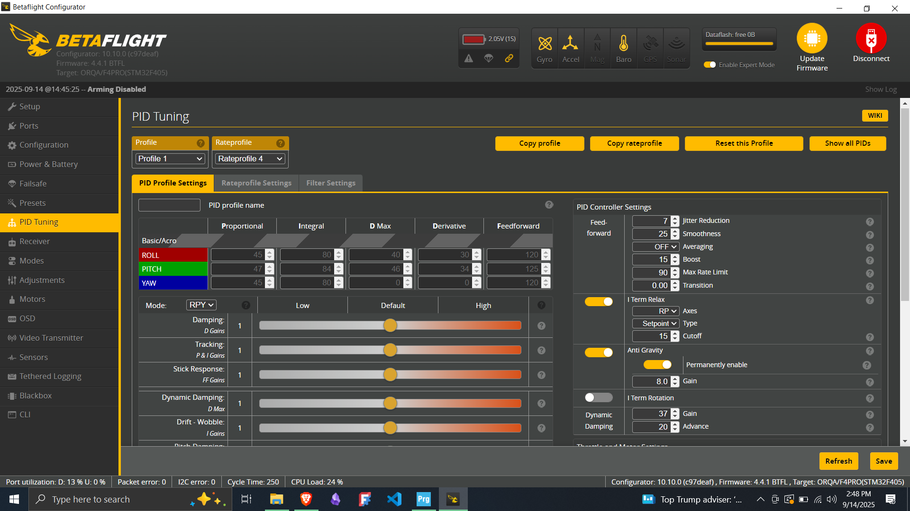
Due to limited time, fine tuning of the FPV is not covered in this course

Slide 32
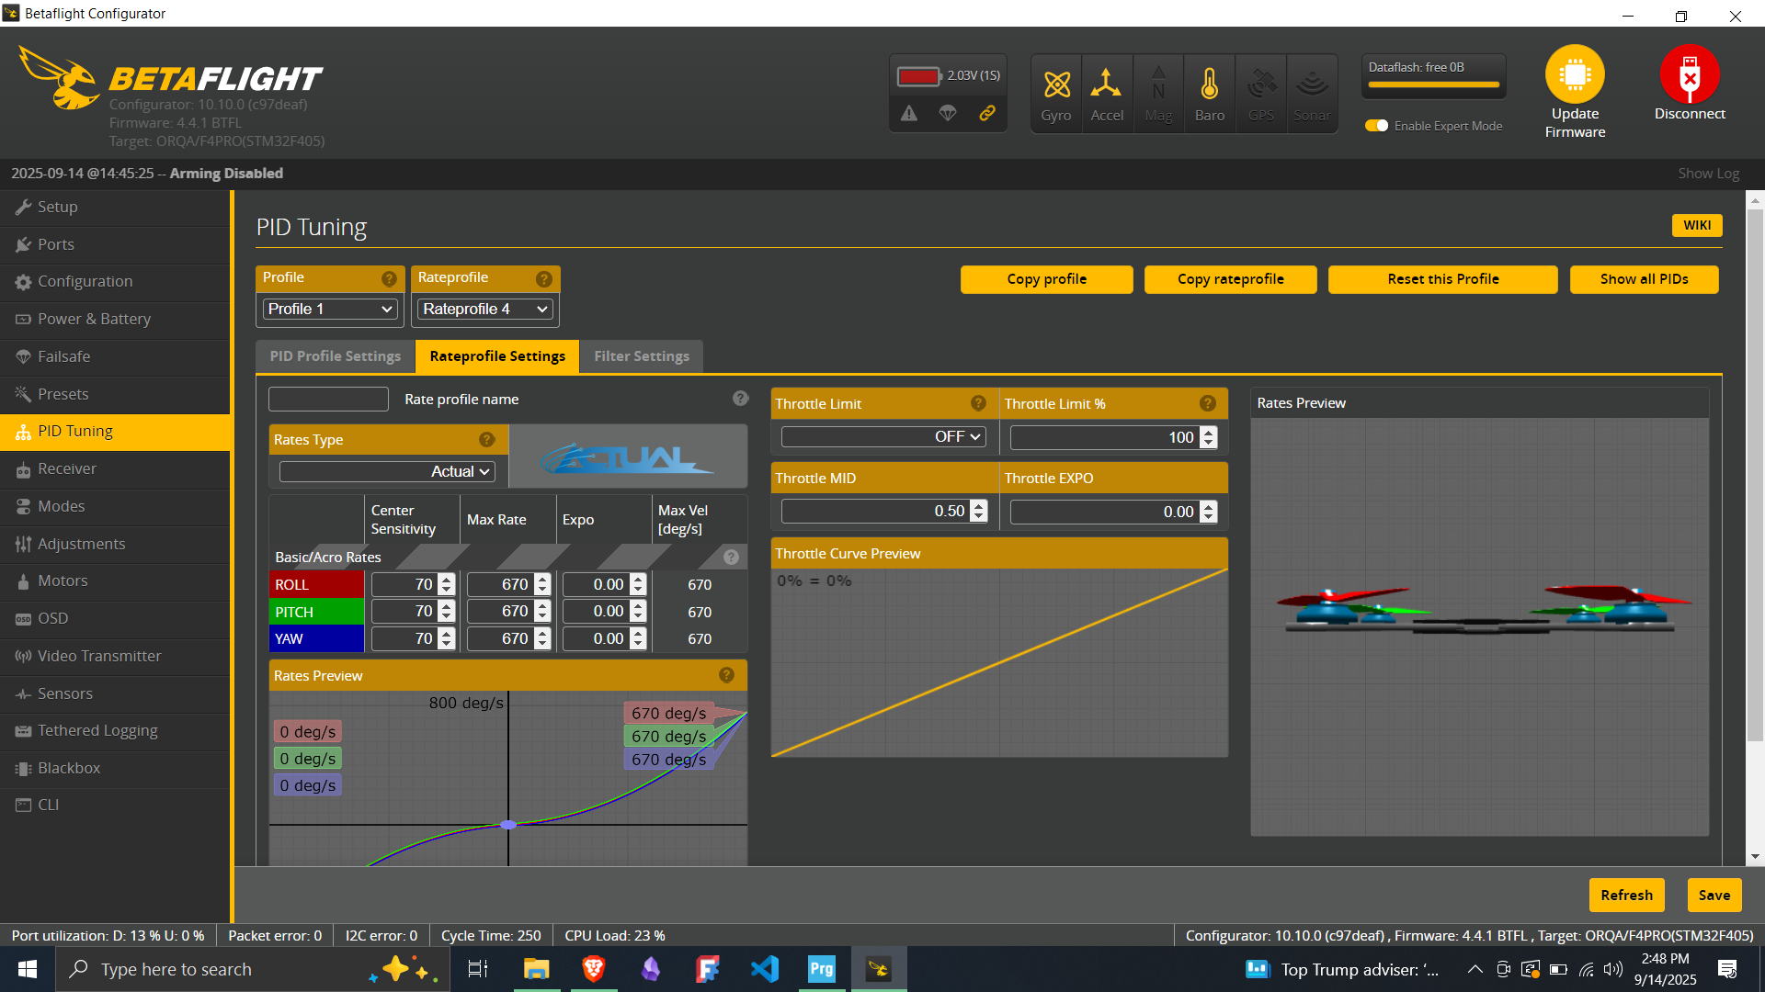
Due to limited time, fine tuning of the FPV is not covered in this course

Slide 33
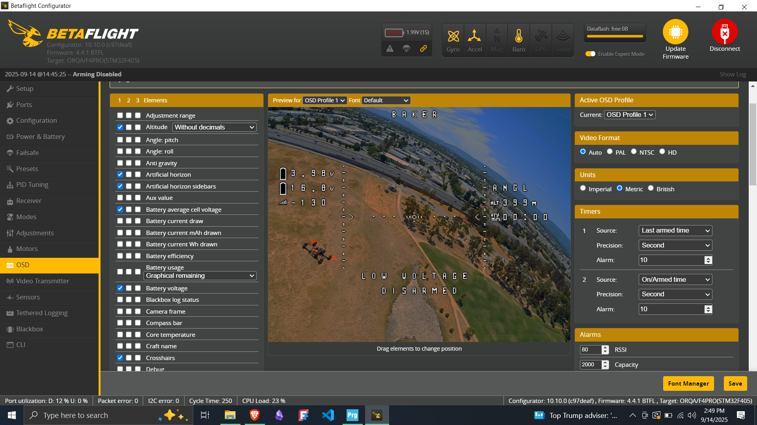
Copy and Paste the standard OSD into the CLI. This should be your output.

Slide 34
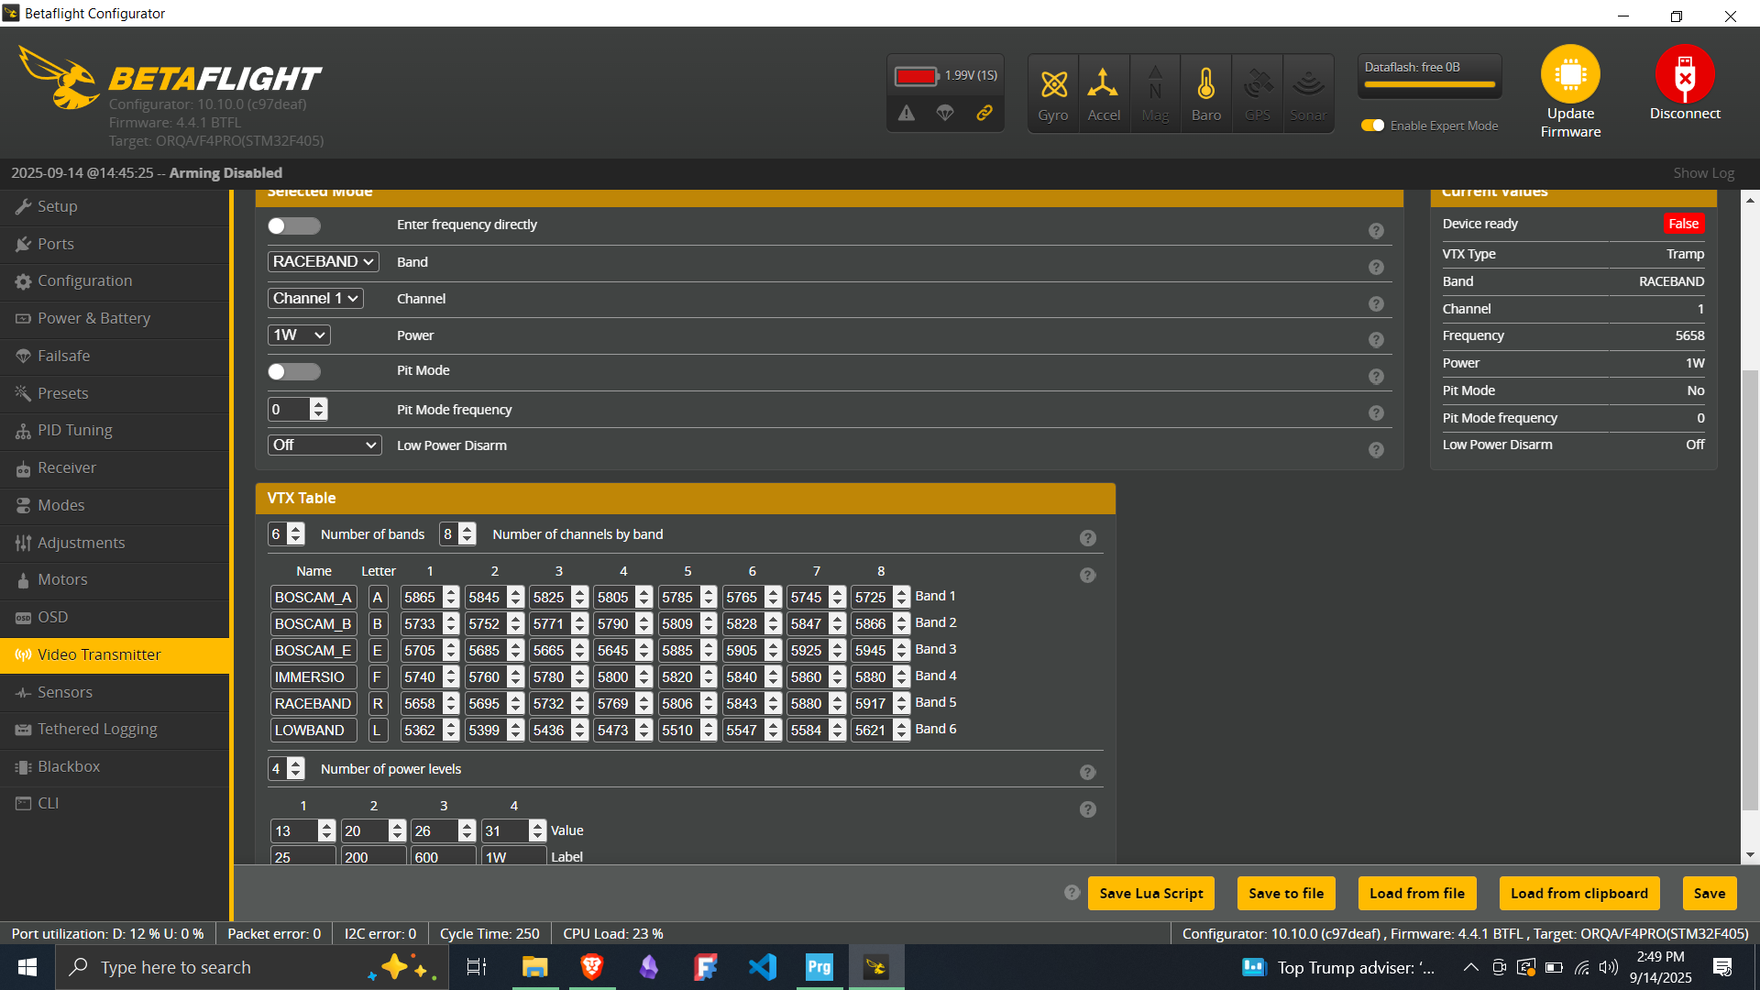
Though not applicable to our current hardware configuration, this is how a VTX table should look.

Slide 35
Resources
BetaFlight Wiki
  Complete repository of knowledge for betaflight
Tuning Tutorial
  BetaFlight
  Chis Rosser – Filter Tuning & PID Tuning
  For tuning beyond the default presets. This is time intensive and for advanced users
BetaFlight Step by Step Instructional Video
  Helpful video for following along in order to program FPV’s once you’ve completed this course
  Note: Hardware plays a large factor in BetaFlight setup. Use critical thinking to make the necessary changes to the process

