Slide 1
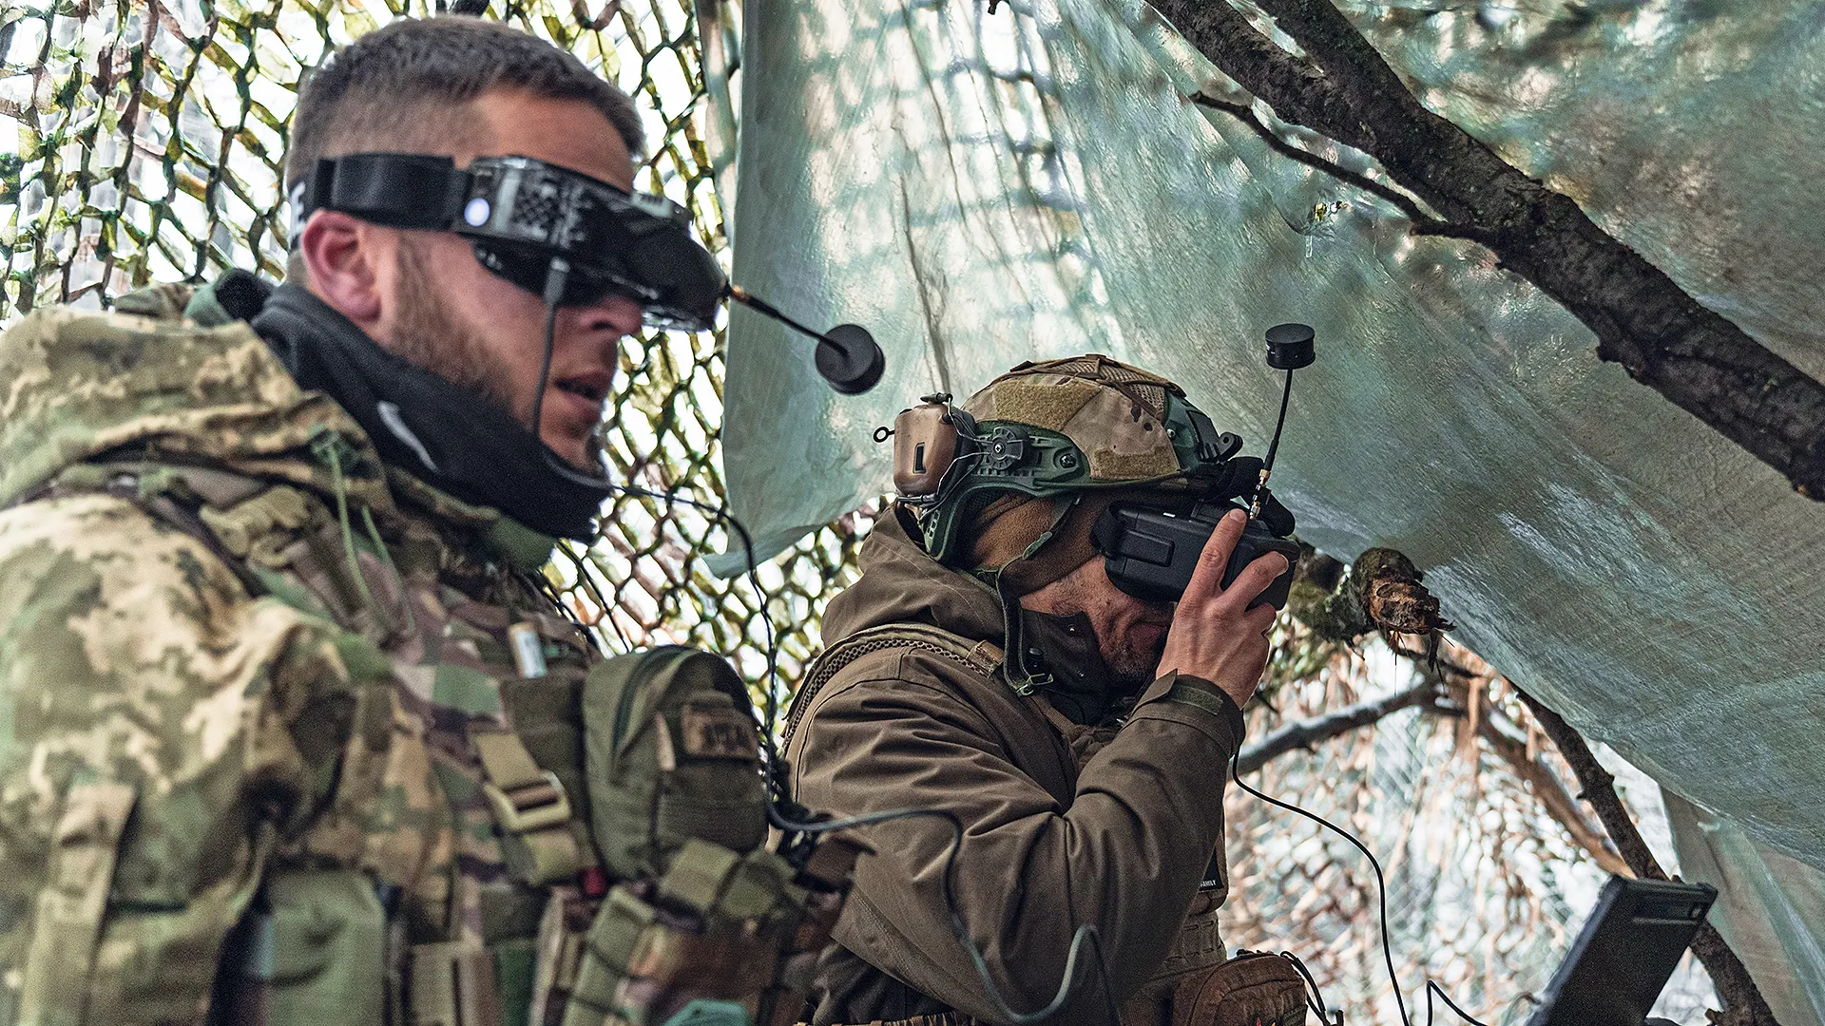
Ground Control Station Survivability

Slide 2
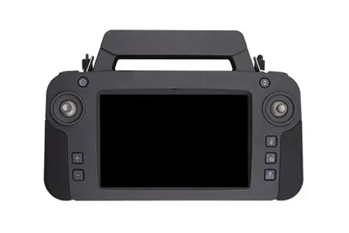
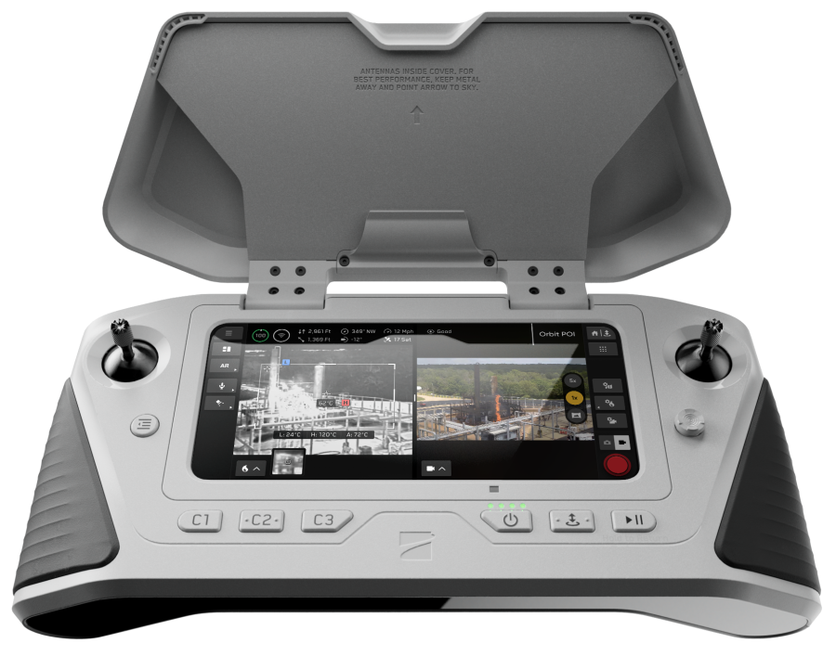
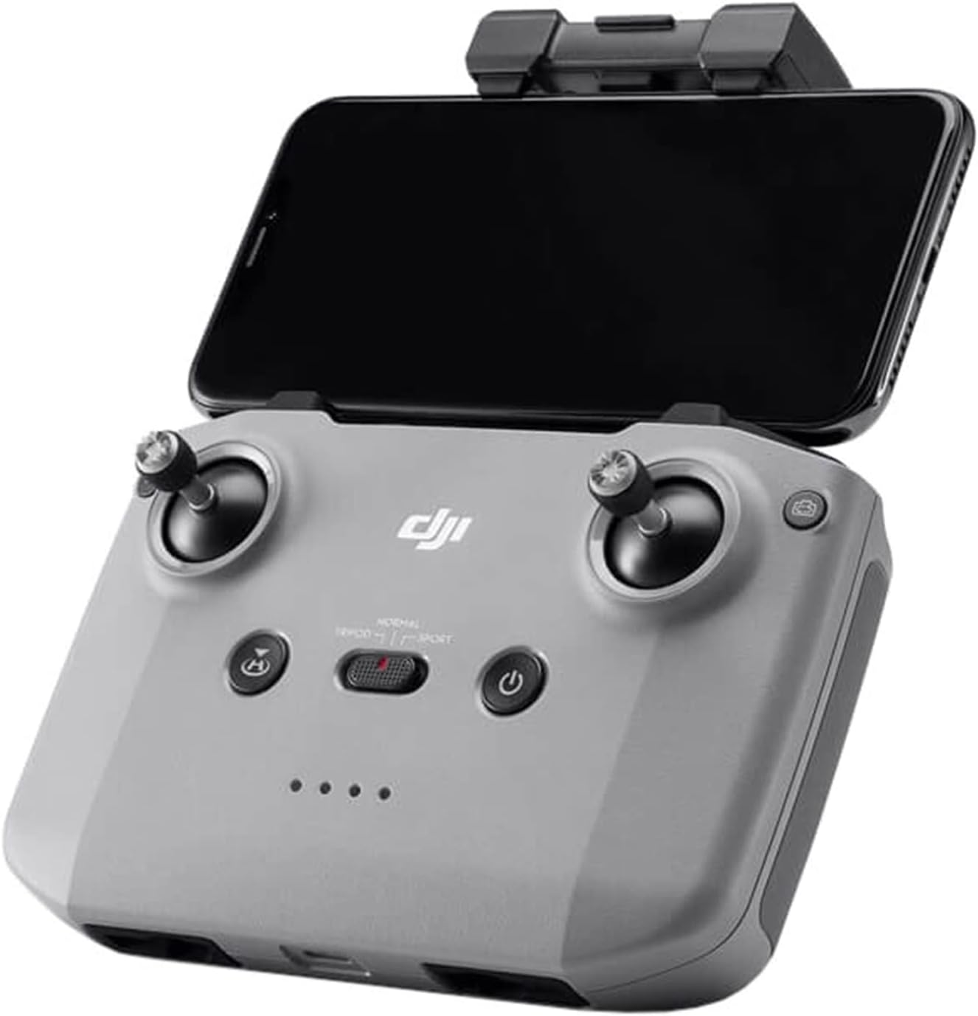
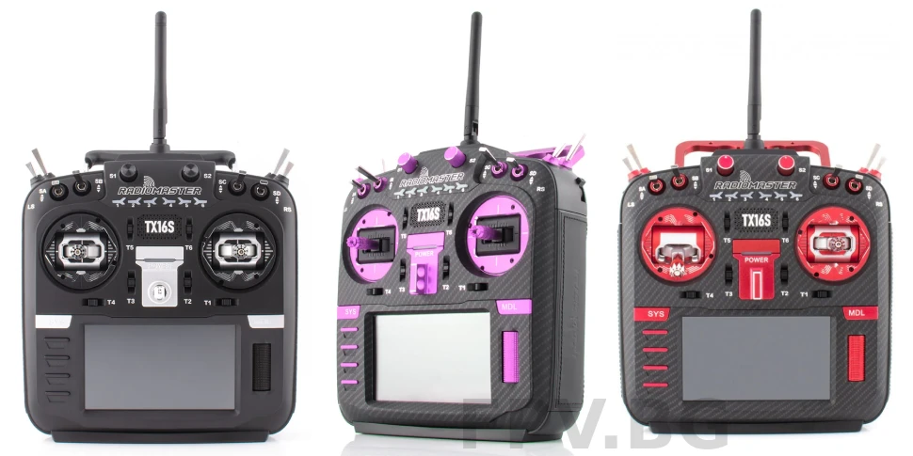
What does GCS survivability mean?

Slide 3
Topics for Discussion
When available how do we successfully launch a sUAS from cover and concealment?
In an environment where there are “eyes” everywhere we must remain aware that a GSC with a screen is an observable target.
As operators you must be able to launch the sUAS without being seen and recover the sUAS also without being seen.

Slide 4
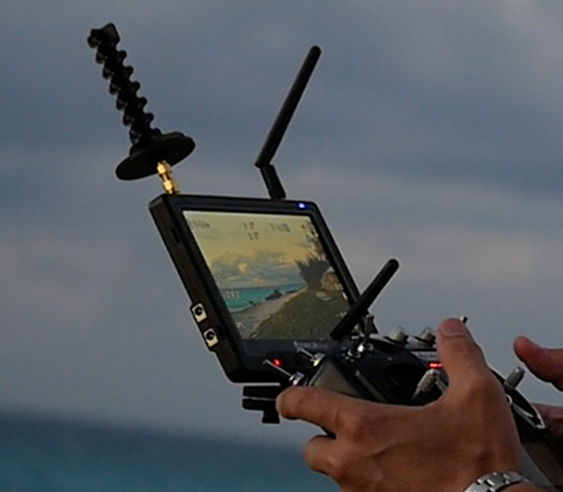
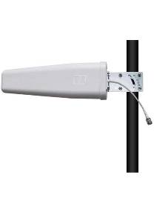
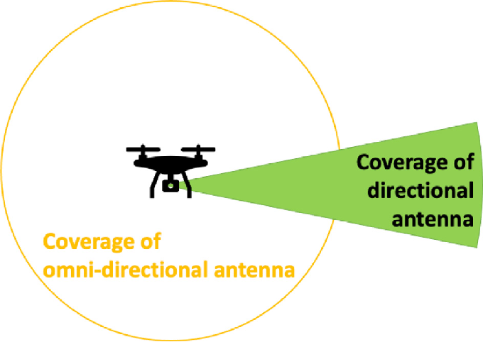
Directional Antennas
Directional Antennas will help with minimizing ENY EW ability use direction finding to locate your GCS.
A directional antenna will also increase the signal strength from controller to drone allowing for longer range.

Slide 5
Camouflage

Slide 6
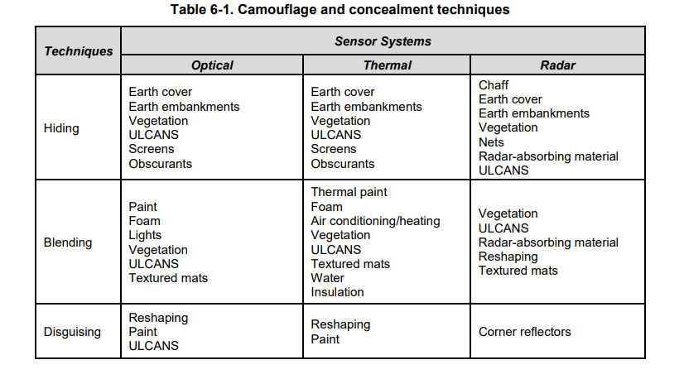
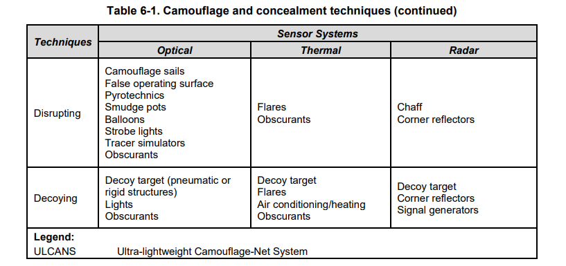
ATP 3-37.34 table 6-1
Notes:
ATP 3-37.34 table 6-1

Slide 7
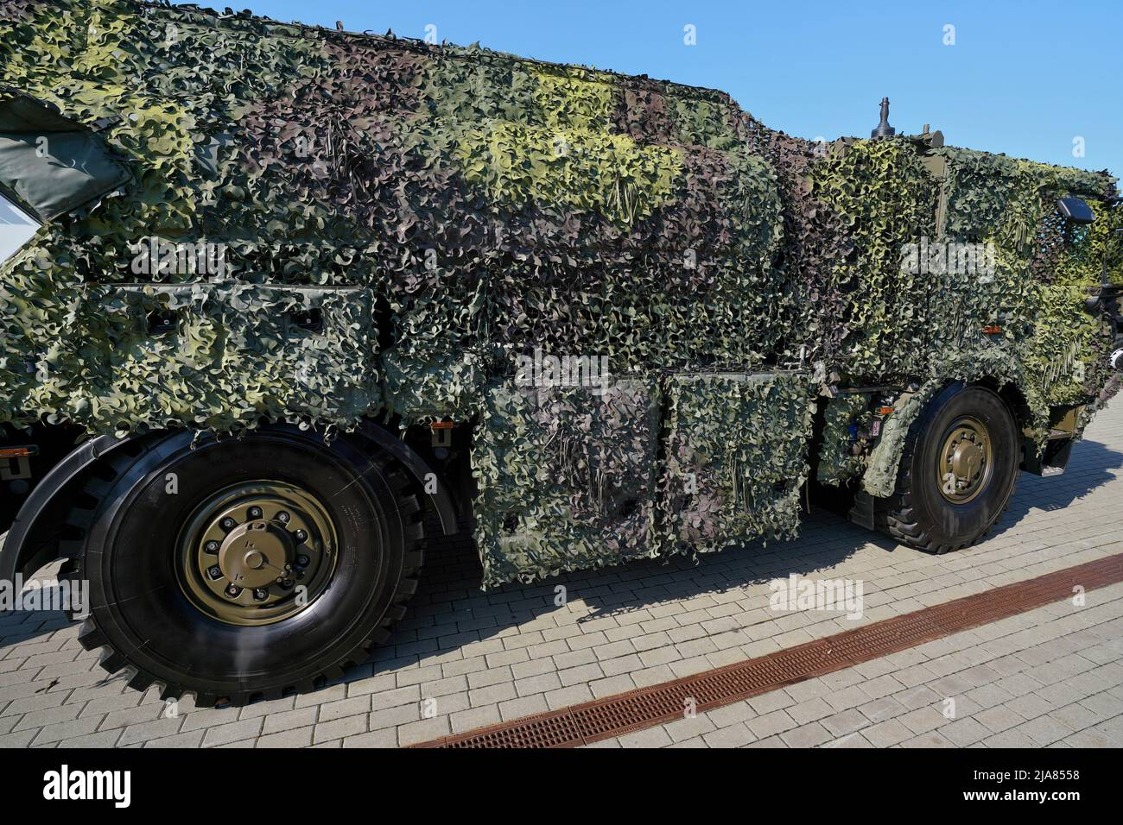

Slide 8
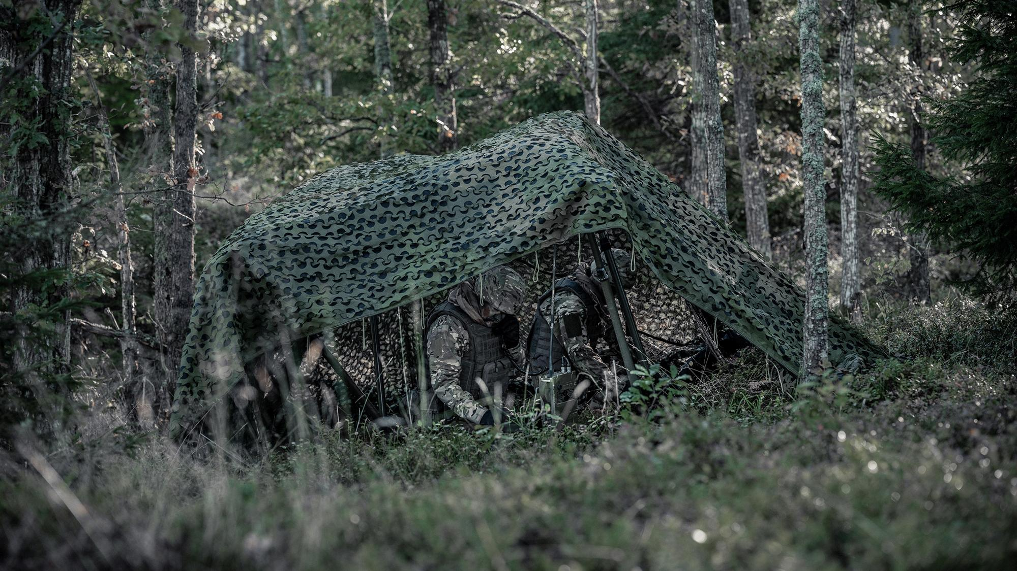

Slide 9
Digging a battle position
When digging a battle position a critical variable is the ability to transmit your signal if not using a displaced antenna.
Operating a FPV or any sUAS from a dug position will not work unless using a displaced antenna, fiber optic FPV, or the ability to have the antenna protrude from the fighting position.

Slide 10
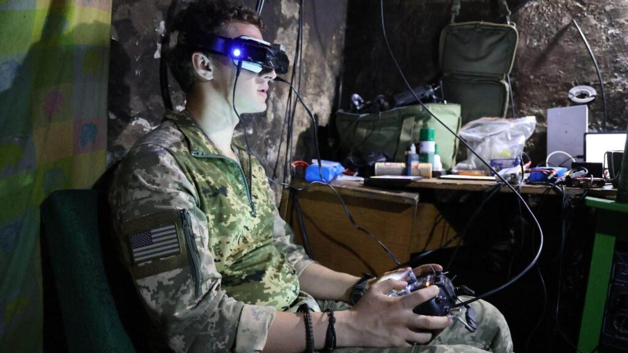
Notes:
Being able to have displaced antenna from the point of control. i.e bunker flying or building flying.

Slide 11
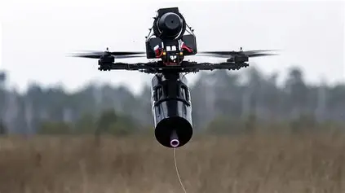
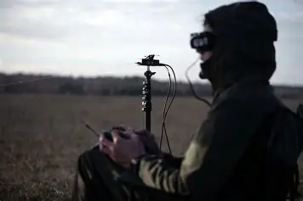
Notes:
Example of fiber optic FPC

Slide 12
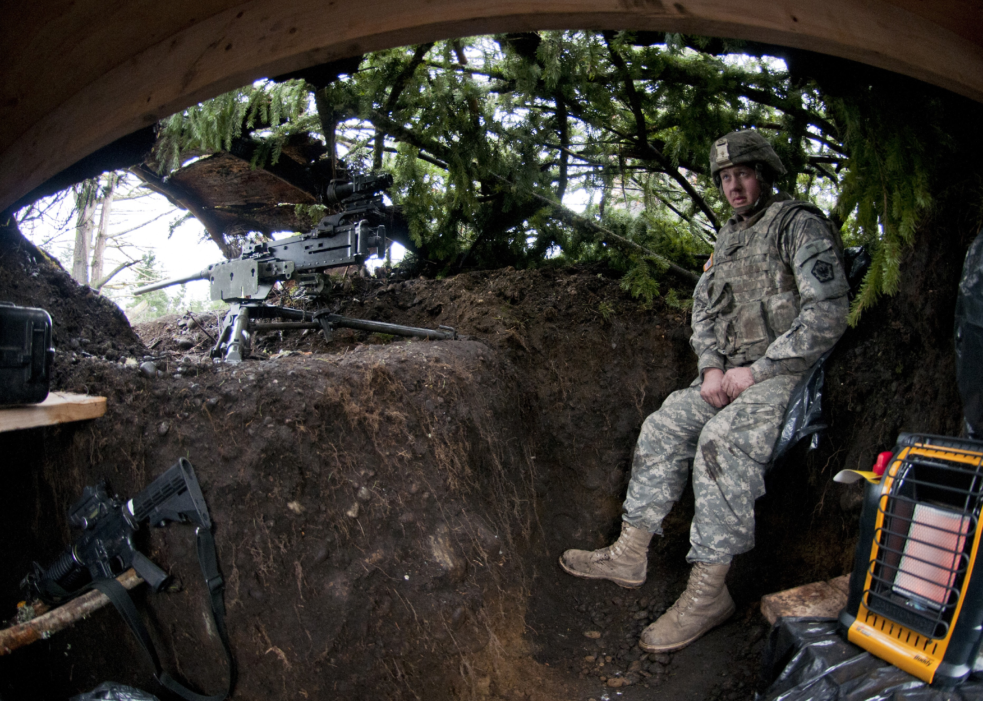
Notes:
Over head cover will protect you not only form visible ISR platforms but also thermal. The cover will break up your heat and not show through the cover. Think tree canopies or any type of hard cover.

Slide 13
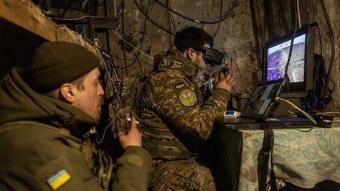
Notes:
Earthen bunkers are great for survivability but must be done with either a displaced antenna or fiber optic drone.

Slide 14
Urban Hide Sites

Slide 15
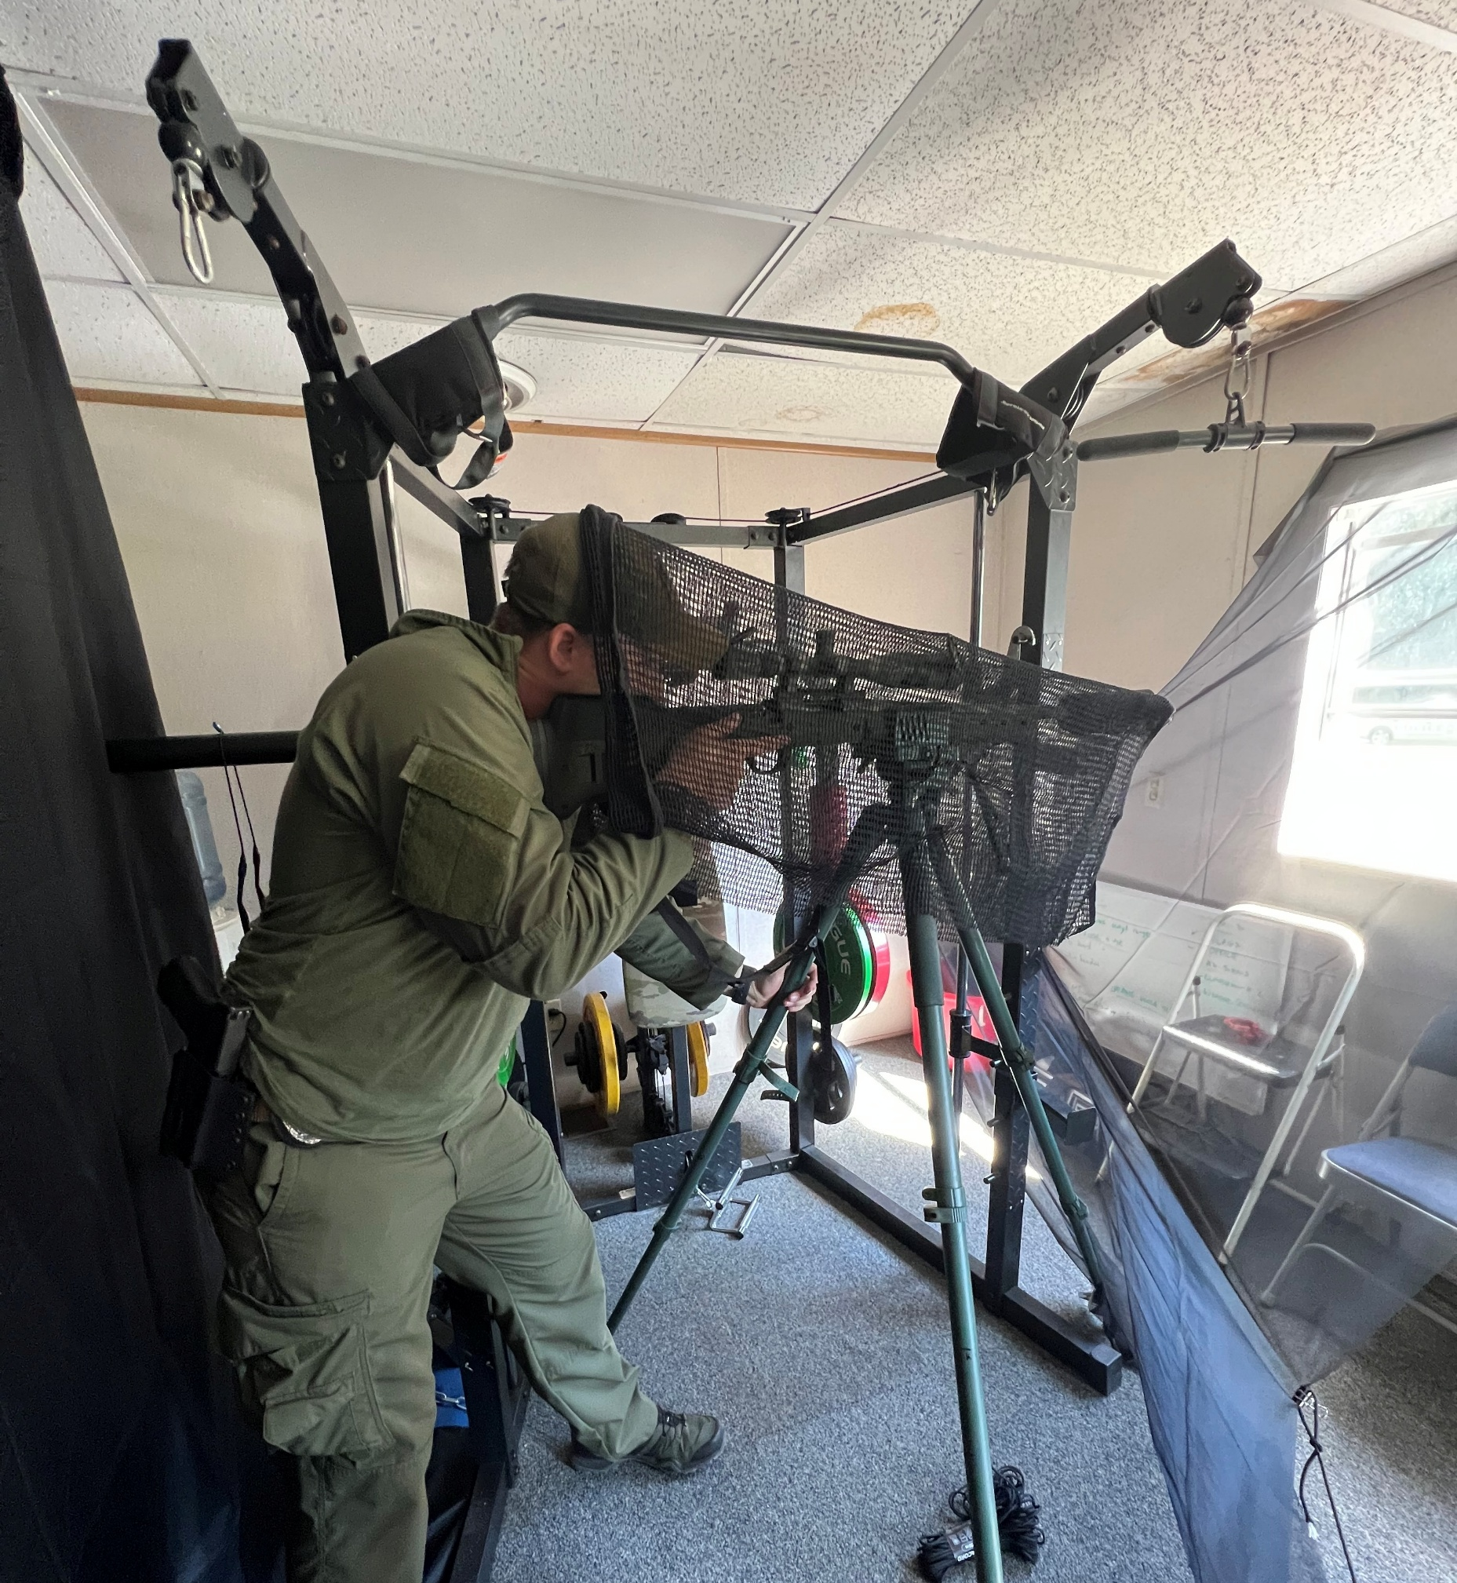
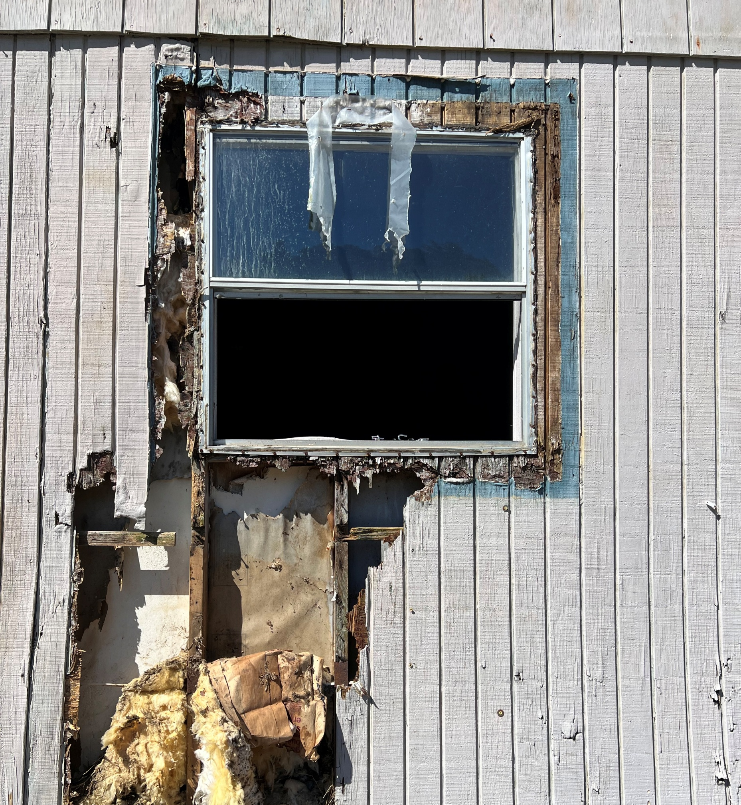
Notes:
Urban concealment can be done with a cheese cloth and black back drop.

Slide 16
Launch Site

Slide 17
Launch Methods
ISR quad sUAS will have the ability to be hand launched.
Most preferred is to launch in the prone position from an area of concealment.
FPV being lower to the ground will need either a stand or be hand launched.
Should you launch and recover form the same sight?

Slide 18
Recover methods
Recovering a sUAS like the Skydio family, Parrot, or Mavic, the best practice is to not return to the original launch site.
When recovering a sUAS you should always set the home point away from your current location if the sUAS is equipped with the ability to RTH when signal is lost. This helps prevent enemy forces from tracking the sUAS back to your location and firing on your position.
Notes:
https://www.youtube.com/watch?v=js1TC7MZItM – drone used to find launch and recovery point of enemy sUAS.

Slide 19
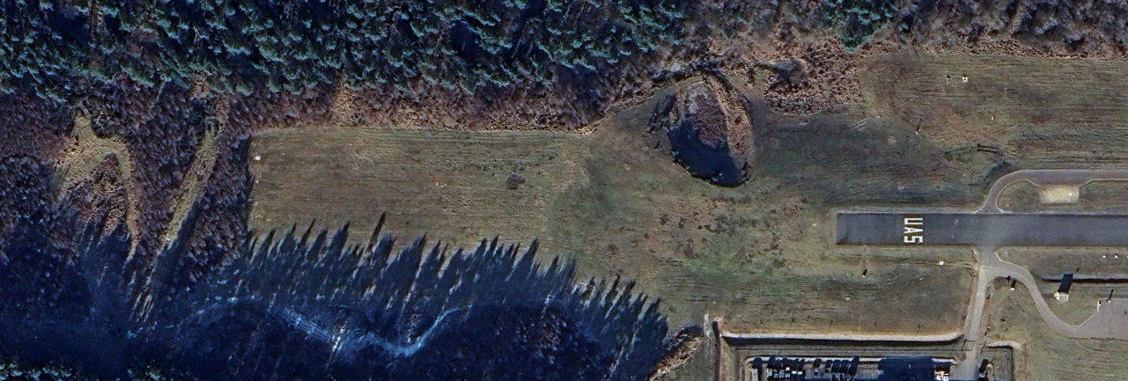

Concealment Practical
Task 1: Locate a hide sight that provides concealment from counter ISR IVO of BALI ROZ.
Conditions: In groups of 4 with a hasty observation post (OP) using available camouflage and the assigned ISR platform. Group rotates each round.
Standards: Establish a hasty OP which consists of a launch point, operations point, and recovery point within 45 minutes. Launch ISR platform and acquire the identification of a target in the vicinity of Balli Airfield. After identification recover the ISR platform successfully. All steps of this operation are to be done in a method to avoid detection and observation by enemy ISR.
UAS
OP

