Slide 1
Introduction to the Simulator

Slide 2
Agenda
Admin Information
Terminal Learning Objectives
Equipment
Good Habits vs Bad Habits
Liftoff Simulator Introduction
Daily Task List Introduction
Calibration Demonstration

Slide 3
Admin Information
Classification: UNCLASSIFIED
Risk Assessment: Low
Safety:
  Exits
  Fire Extinguisher
  Tripping Hazards
  Smoking Area
  Restrooms

Slide 4
Terminal Learning Objectives
Action: Learn the basics of flying an FPV drone.
Condition: In a classroom environment, utilizing the FPV simulator Liftoff, FPV transmitter and FPV goggles.
Standard: Complete daily tasks of increasing difficulty and pass the final simulator evaluation.

Slide 5
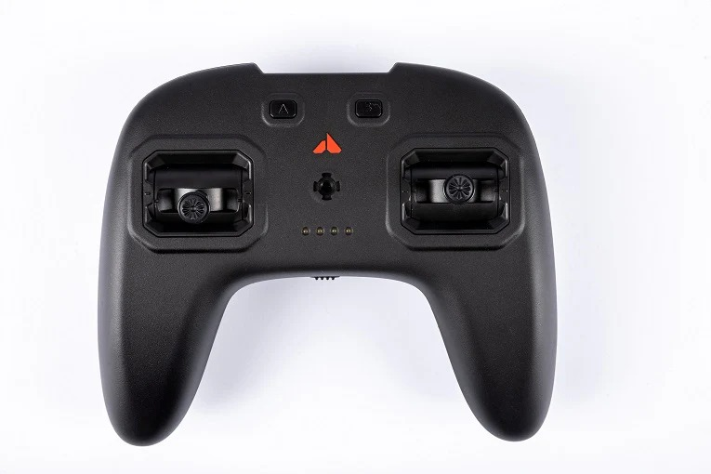
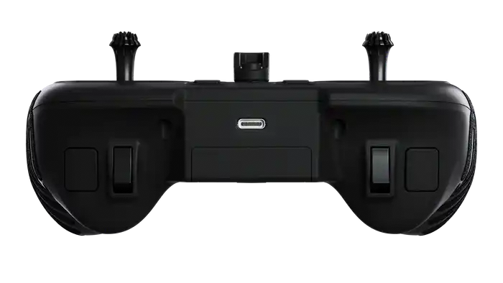
Orqa Controller Layout
Alternative
Reset
Arm/Disarm
Reset
Thrust/Yaw
Pitch/Roll
Power Switch

Slide 6
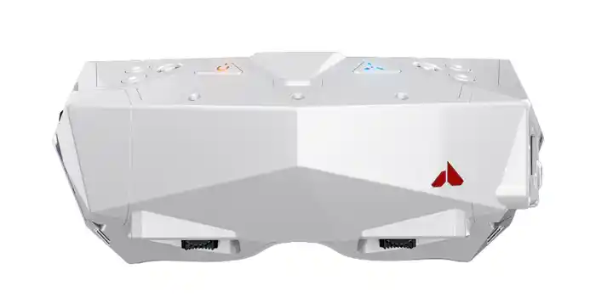
Orqa Goggle Layout
Power
Fan
Luminescence (Up & Down)
Color (Left & Right)
Brightness (Up & Down)
Contrast ( Left & Right)
Battery Port/
HDMI Mini Port
Antenna Mount/
Frequency Adjuster
Eye Distance Adjuster/
Focus Wheel

Slide 7
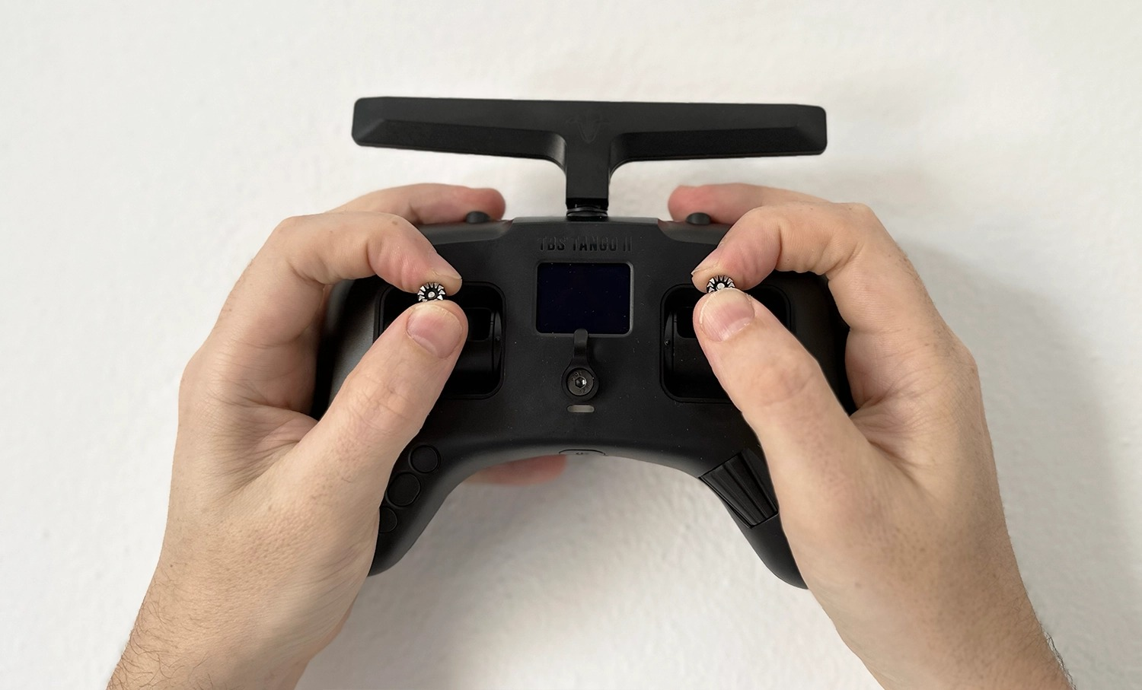
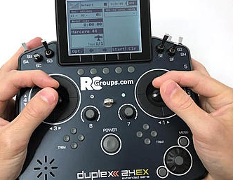
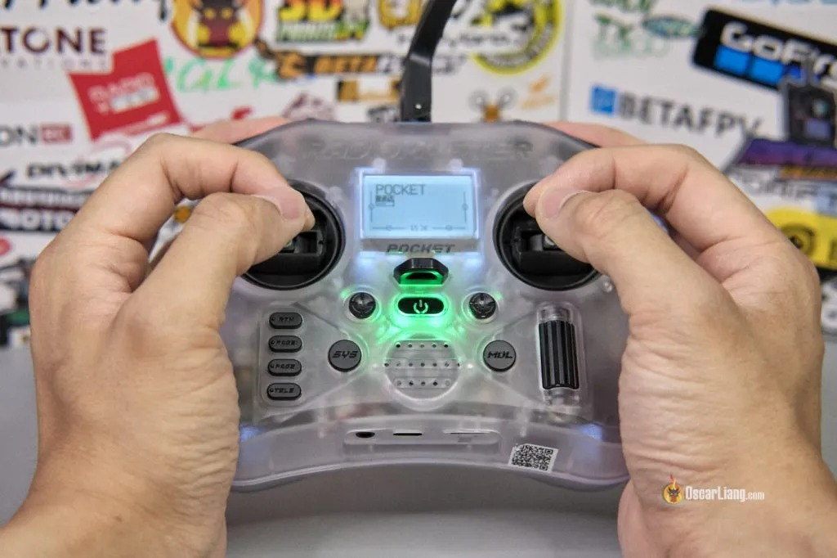
Good Habits vs Bad Habits
Pinch controller hold
Controlled micro movements
Take breaks as needed
Thumb/XBOX controller hold
Flicking of the sticks
Looking down w/ goggles on

Slide 8
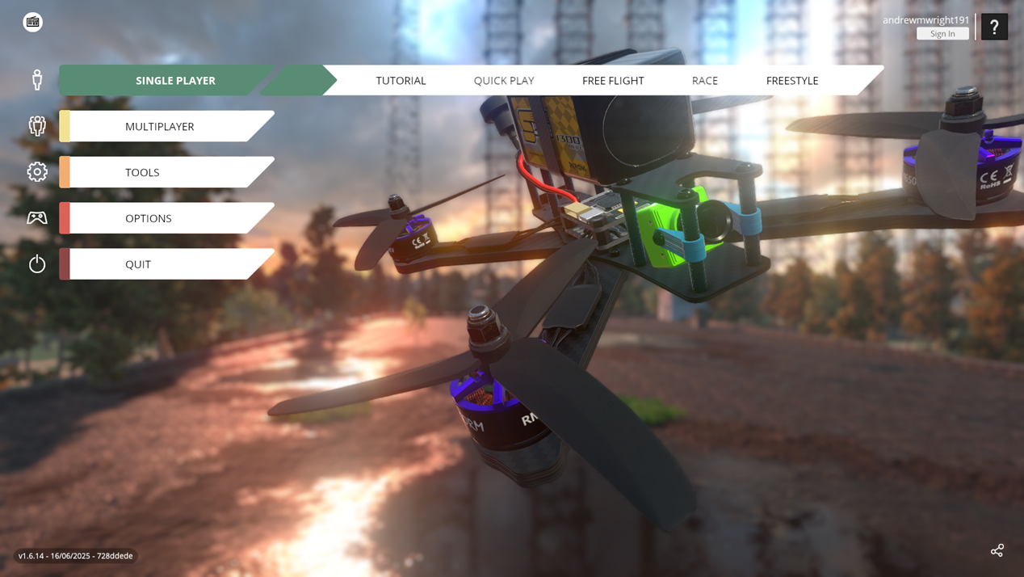
Liftoff FPV Simulator
Select Liftoff on the desktop.
Error message will appear because we are playing offline. Select “Play anyways”.

Slide 9
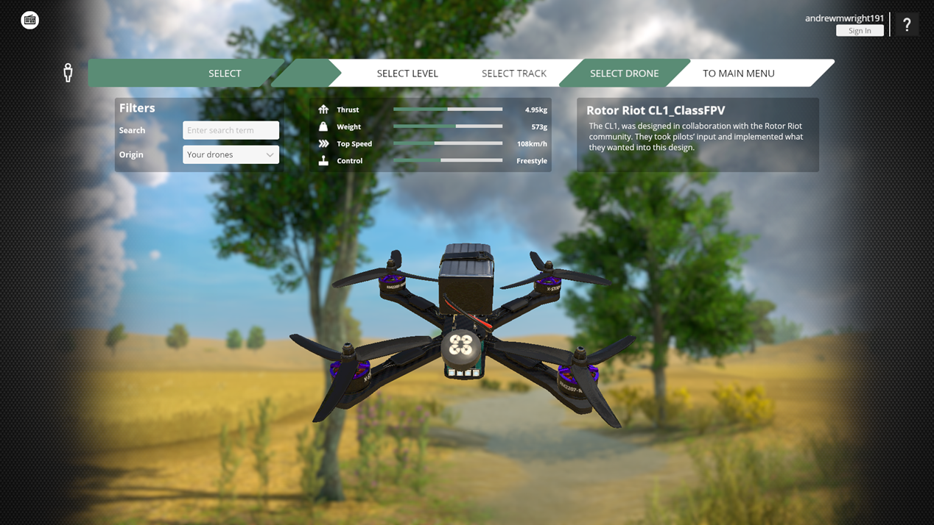
Liftoff FPV Simulator
All tasks for this course take place in single player.
The first couple of days we will be using “Free Flight” and then we will move into “Race” mode.
We will be using the drone “Rotor Riot CL1_ClassFPV”

Slide 10
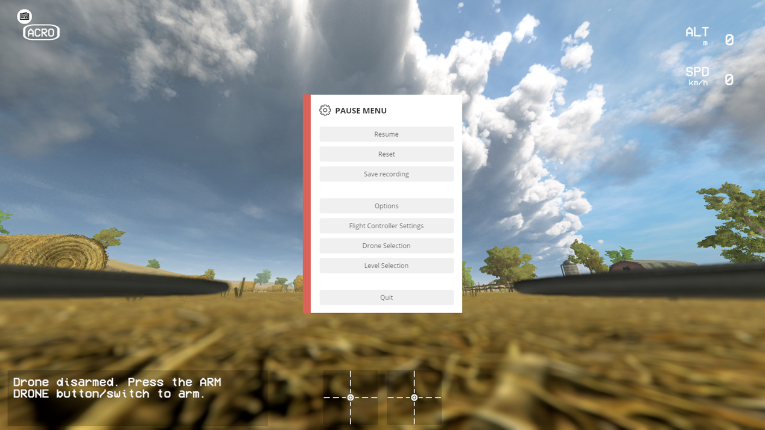
Liftoff FPV Simulator
We will begin with basic maneuver tasks and progress to more complex maneuvers and races as the course advances.
If there are any issues with the computers, controllers, goggles, or questions about the tasks please bring them to the instructor's attention.

Slide 11
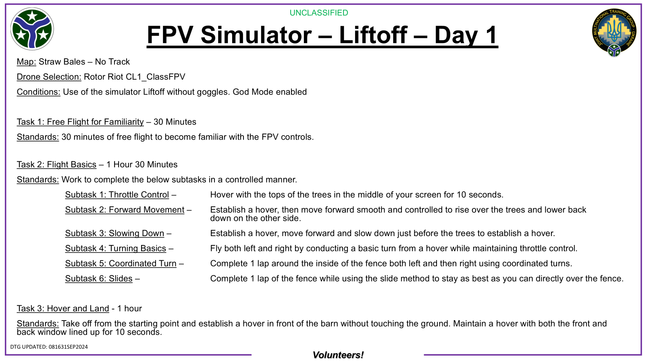
Daily Task List Introduction

Slide 12
Controller Calibration Example

Slide 13
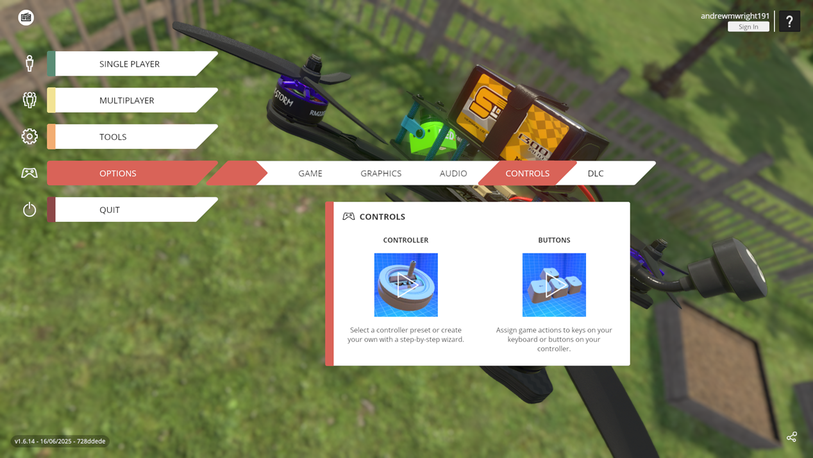
How To Calibrate Controller In Liftoff
Select “Options” from left side of homepage.
Select “Controls” and then “Controller”.

Slide 14
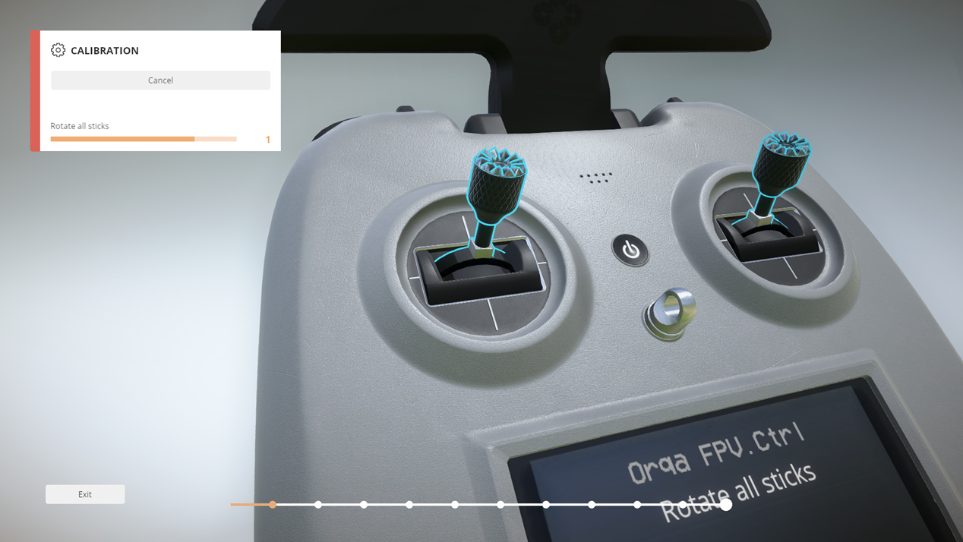
How To Calibrate Controller In Liftoff
Select “Calibrate” and then “Start Calibration”.
Move the gimbals in the instructed method returning them to center each time.
When complete select “Save” and then return to main menu using the “Exit” button on the bottom left.

Slide 15
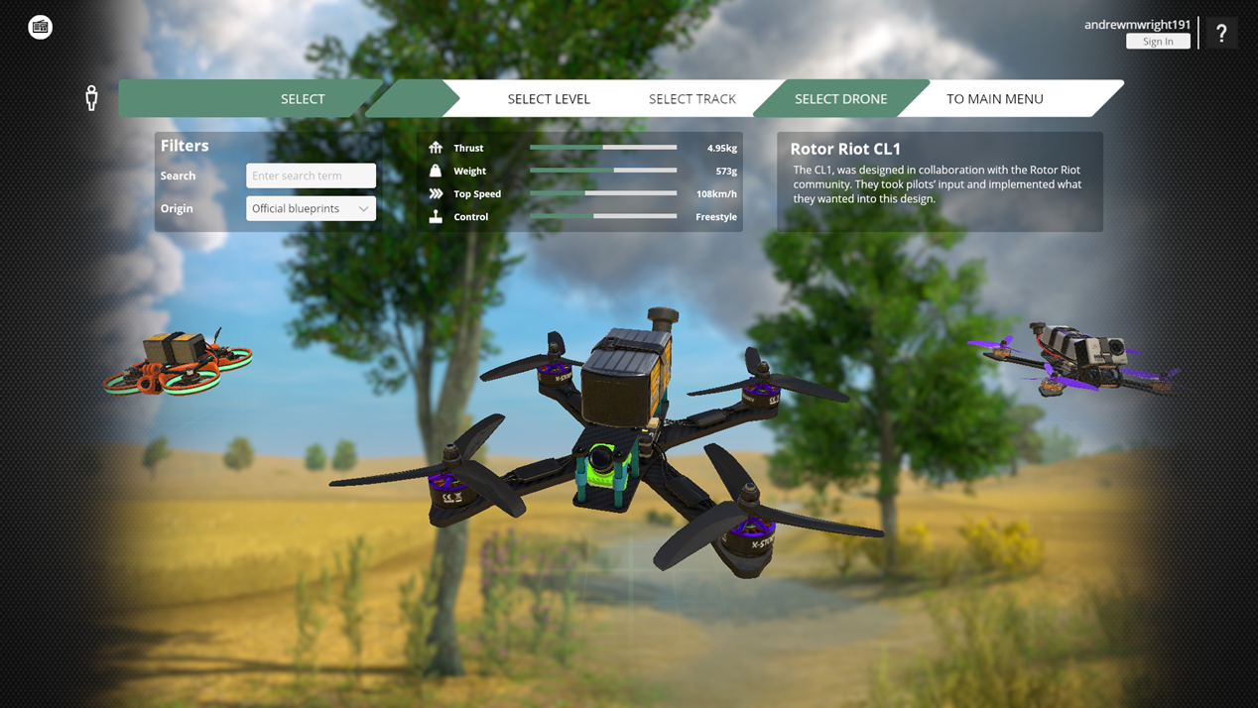
How To Calibrate Controller In Liftoff
Select “Free Flight”.
Select Level “Straw Bale”.
Select “No Track”.
Select Drone “Rotor Riot CL1”.

Slide 16
How To Calibrate Controller In Liftoff
Lower camera angle to 10-20 degrees using the down arrow on the keyboard.
Lower the throttle stick all the way down.
Arm the drone using the left trigger button.
Slowly increase throttle until you are lifting into the air. Do not move the right stick or yaw.
Your drone should not yaw, pitch, or roll in any direction. If it does not, then you are done.
Take note of the direction of any yaw, pitch, or roll observed.
Exit back to the main menu.

Slide 17
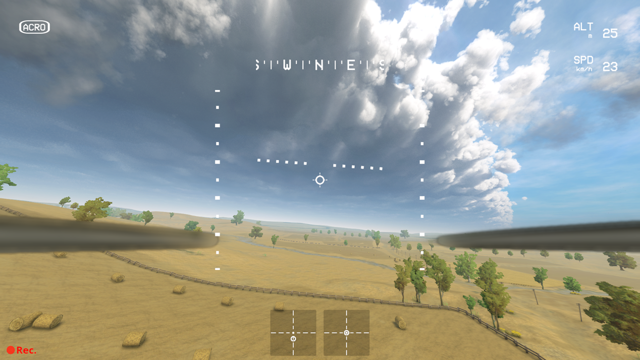
How To Calibrate Controller In Liftoff

Slide 18
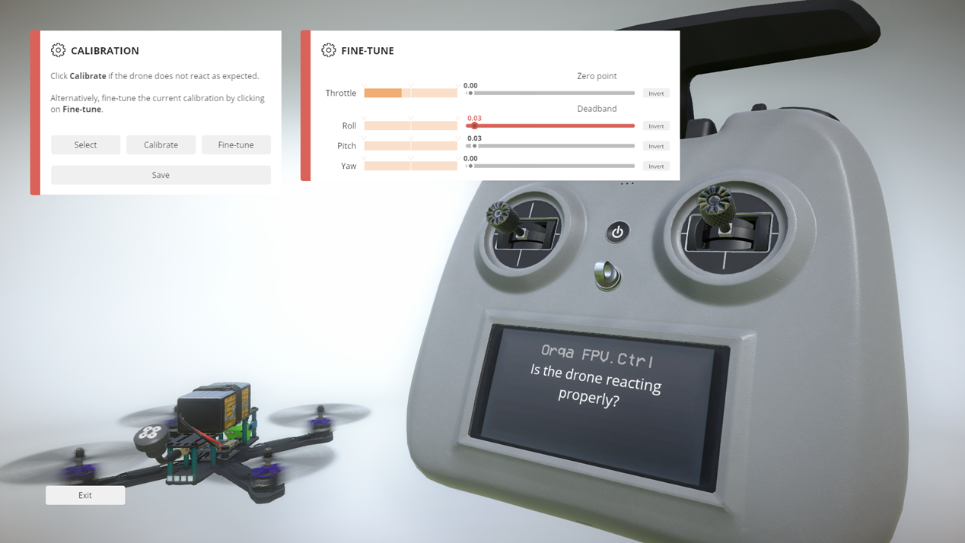
How To Calibrate Controller In Liftoff
If you had yaw, pitch, or roll return to the calibration menu.
Select “Fine-tune”.
Make minor adjustments to the line you were experiencing. Suggest starting with .03.
Click save and return to “Straw Bales” and try again.
Continue making minor adjustments until the drone does not yaw, pitch, or roll.

Slide 19
Questions?

