Slide 1
FPV 7in Flights – Take-off
Take-off Procedures
Ensure FPV has 3m radius clear of personnel
Arm the FPV and listen for any unusual sounds
Gently input enough throttle to lift the FPV to a hover no higher than 1.5m
Listen again for any unusual sounds and verify that all OSD readings are normal
Begin forward flight and gain altitude
Note:
Do not give a massive throttle “punch” to lift-off. This can burn out motors and does not allow enough to react to issues.
This is especially true for payload laden drones.

Slide 2
FPV 7in Flights
Task: Test Flight
Conditions: Use the 7-inch build FPV’s in the hangar.
Standards:
Perform Pre-Flight Inspection (Checklist)
Bring FPV to stable hover in Angle Mode
Land
Perform Pre-Flight Inspection (Checklist) to identify any issues – Check prop locking nuts and frame hardware specifically
Troubleshoot any issues identified and retest

Slide 3
FPV 7in Flights
Task: Test Flight
Conditions: Use the 7-inch build FPV’s outdoors in an open space. Students are not to fly further than 50 meters out into the field.
Standards:
Perform Pre-Flight Inspection (Checklist)
Bring FPV to stable hover in Angle Mode
Maneuver slowly in all axis of rotation: Roll, Pitch, and Yaw
Land
Perform Pre-Flight Inspection (Checklist) to identify any issues – Check prop locking nuts and frame hardware specifically
Bring FPV to stable hover in Acro/Air mode
Maneuver slowly in all axis of rotation: Roll, Pitch, and Yaw
Land
Perform Pre-Flight Inspection (Checklist) to identify any issues – Check prop locking nuts and frame hardware specifically
Instructor assumes control of FPV
Instructor conducts long range test to validate VTX operability
Land
Perform Pre-Flight Inspection (Checklist) to identify any issues

Slide 4
Intro FPV 7in Flight
Task: Introduction to flight
Conditions: Using the 7in FPV conduct the basic flight maneuvers of forward flight to a stop and hover than turn.
Standards: Launch the 7in FPV to a hover no more than 3 meters off the ground. Move the drone forward at a controlled and slow pace. Come to a stop. Turn around and move back and land. Next move the drone in a triangle pattern around the open area no more than 50m from the edge of the runway.

Slide 5
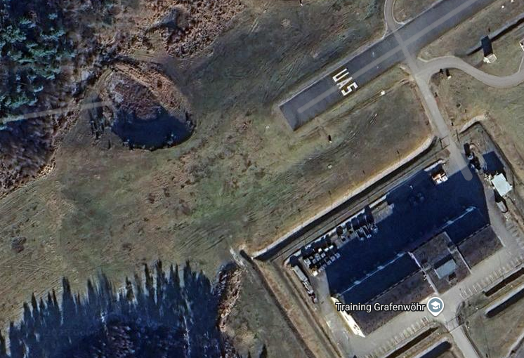
Test Flight CONOP
Key Tasks
  Hangar Flight Test
  Outdoor Flight Test
  BPT Conduct Repair Operations
  Introduction to Live Flight Task
  DJI FPV and SRR Instruction
Timeline
  Until complete
Coordinating Instructions
  QTY 2 Instructors for Hangar Test Flight
  QTY 2 Instructors for Outdoor Test Flight and Introduction to live flight task (minimum grade of E5 required)
  QTY 1 Instructor for DJI FPV and SRR Training
  QTY 1 Instructor for Repair Operations
Sustainment
  QTY 3 LIPO or LI-ION Batteries
  Goggle Battery – QTY dependent on class size
  QTY 1 Instructor Goggles or Monitor
  QTY 3 Slalom Poles
  QTY 1 Folding Table
  QTY 2 Chair
Outdoor Test Flight Area
Repair Station
Hangar Test Flight Area
NOTE:
The outdoor test will not be performed concurrently with hanger test. Once 75% of students have performed their hangar check, then Outdoor test flight can begin. This allows utilization of two instructors only for test flights.

Slide 6
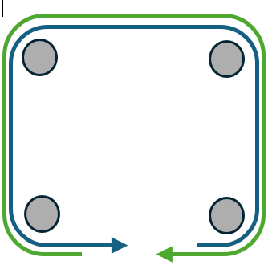
FPV 7in Flights– Day 1 Afternoon
Task 1: Turns and Hover
Conditions: Use the 7in and outdoor flight area with 4 posts or cones set up in a defined square and a full size window gate. Operate in teams of 4.
Standards: Fly 3 laps making left hand turns without touching the ground. Then without landing turn around and complete 3 laps making right hand turns without touching the ground. End with hovering in front of the window gate (approx. 10ft. away) with the goal of keeping the aircraft in the frame for 10 seconds. FPV shall not exceed 1 meter above the posts. Once complete swap with the next operator on your team.
Task 2: Slaloms / Weave Poles
Conditions: Use the 7in and outdoor flight area with 6 posts set up in line
Standards: Weave between the posts then turn around the last post and come back. Then complete a loiter around the first post. FPV shall not exceed 1 meter above the posts. Once complete swap with the next operator on your team.
Task 1
Task 2
40 m
20 m
*Those who no-go’d the sim eval will fly DJI FPVs through the tasks

Slide 7
Day 1 CONOP
Key Tasks
  Turn and Hover Task
  Slalom Task
  BPT Conduct Repair Operations
Timeline (Dependent on Daylight)
  Station Cycle Time: 1.5 Hours
Coordinating Instructions
  QTY 2 Instructors for Turn and Hover Task
  QTY 2 Instructors for Slalom Task
  QTY 1 NCOIC
Sustainment
  QTY 12 (min) LIPO or LI-ION Batteries
  Goggle Battery – QTY dependent on class size
  QTY 4 Battery Banks
  QTY 2 Battery Charging Kits
  QTY 2 Instructor Goggles or Monitor
  QTY 6 Slalom Poles
  QTY 1 Large Window
  QTY 4 GP Race Flags
  QTY 2 (min) Folding Table
  QTY 2 (min) Chair
  QTY 4 LMR Radios
Slalom Task
Battery Station
Battery Station
Turn & Hover Task
Repair Station

Slide 8
FPV 7in Flights – Day 2 Morning
Task 1: Altitude Change / Over-Through Gates
Conditions: Use the 7in and outdoor flight area with 3 large window gates and 2 small window set up
Standards: Fly through the large window gate then go over the top of the small window gate and repeat until through all the gates. Then turn around and fly back following the same alternating through and over the window gates. FPV shall not exceed 1 meter above the gates. Once complete swap with the next operator on your team.
Task 1
Window Gates
Side View
20 m
Window Gates
Front View
Small
Large

Slide 9
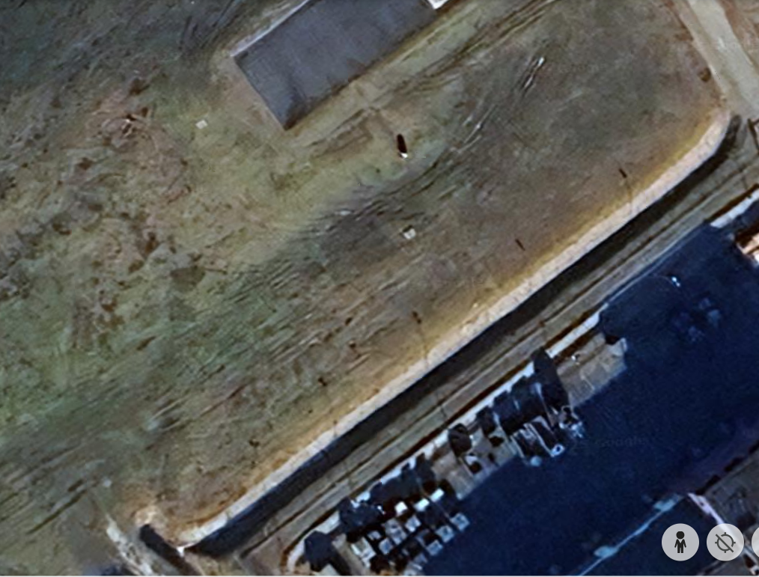
FPV 7in Flights – Day 2 Morning
Task: Trench and Window Gates
Conditions: Use the 7in and outdoor flight area with a trench, large window gate, and net
Standards: Fly down the trench line then climb up and turn around and fly through the large window gates. End task with strike into net.
DJI FPV pilots will NOT strike the net!!!!!

Slide 10
Day 2 Morning CONOP
Key Tasks
  Tench Run Task
  Altitude Change Task
  BPT Conduct Repair Operations
Timeline (Dependent on Daylight)
  Station Cycle Time: 1.5 Hours
Coordinating Instructions
  QTY 2 Instructors for Tench Run Task
  QTY 2 Instructors for Altitude Change Task
  QTY 1 NCOIC
Sustainment
  QTY 12 (min) LIPO or LI-ION Batteries
  Goggle Battery – QTY dependent on class size
  QTY 4 Battery Banks
  QTY 2 Battery Charging Kits
  QTY 2 Instructor Goggles or Monitor
  QTY 1 Net
  QTY 2 GP Race Nets
  QTY 5 Large Window
  QTY 2 Small Windows
  QTY 2 (min) Folding Table
  QTY 2 (min) Chair
  QTY 4 LMR Radios
Battery Station
Battery Station
Altitude Change
Trench Run Task
Repair Station

Slide 11
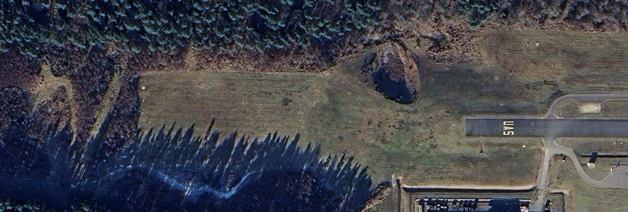
FPV 7in Flights – Day 2 afternoon
Task 1: Strike Accuracy and Navigation Practice from the trench
Conditions: Use the 7in and outdoor flight area with trees and target net
Standards: In teams of 4, operate from a UAS hide site located North of the flightline using camo net. Establish the hide site and launch 1st FPV within 15 minutes. Navigate down the tree line on the South side then upon approaching the road turn right and navigate down the road behind the first break in the trees and fly into the target net for simulated strike.
SRR operator will establish hover between 300 – 350 ft AGL and observe FPV as it negotiates the route.
Note: This task tests ability to operate beyond line of site with degraded video signal.
UAS
OP

Slide 12
SRR Flights – Day 2 afternoon
Task 1: Provide ISR for target acquisition and BDA
Conditions: Use the Mavic 3 Classic and outdoor flight area with trees and target net
Standards: With a team of FPV operators, operate from a UAS hide site located North of the flightline using camo net. Establish the hide site and launch ISR drone within 10 minutes. Navigate down the tree line on the North side then upon approaching the firebreak turn left and acquire a visual on the target net. Establish hover between 300 – 350 ft AGL. Communicate target location to FPV operators, observe FPV as it navigates the route, and monitor for BDA.
UAS
OP

Slide 13
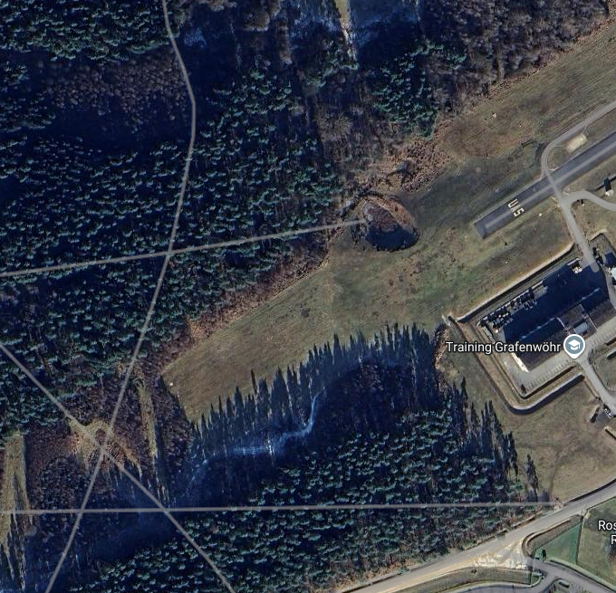
Day 2 Afternoon CONOP
Key Tasks
  Signal Loss Strike Task
  SRR Task
  BPT Conduct Repair Operations
Timeline
  Operations continuous until 30 min prior to sunset
Coordinating Instructions
  QTY 1 Instructors for Signal Loss Strike Task
  QTY 1 Instructors for SRR Task
  QTY 2 Instructor for Recovery Operations
  QTY 1 NCOIC
Sustainment
  QTY 12 (min) LIPO or LI-ION Batteries
  Goggle Battery – QTY dependent on class size
  QTY 4 Battery Banks
  QTY 2 Battery Charging Kits
  QTY 1 SRR Charging Kit w/ 8 Batteries
  QTY 2 Instructor Goggles or Monitor
  QTY 1 Net
  QTY 2 (min) Folding Table
  QTY 2 (min) Chair
  QTY 4 LMR Radios
  QTY 1 HMMWV
Operator Area
Battery Station
Repair Station
Target Area
Recovery Vehicle

Slide 14
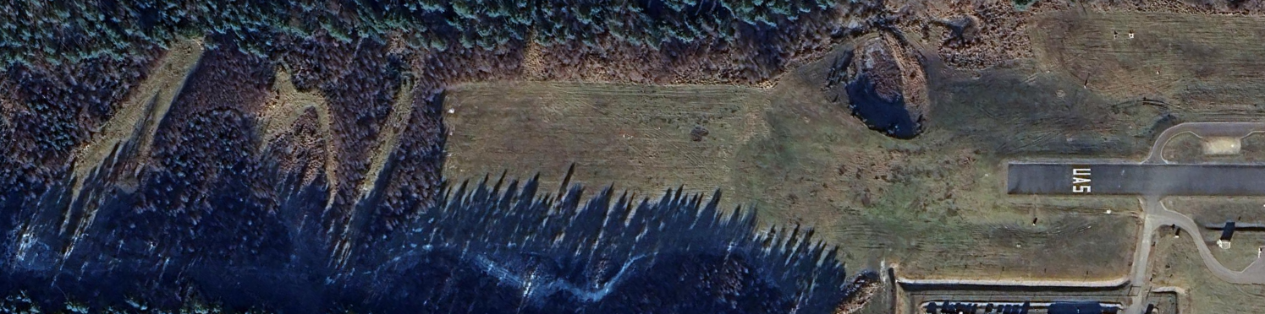
FPV 7in Flights – Day 3 Morning
Task: Long Range and Tree Navigation
Conditions: Use the 7in and outdoor flight area with trees and net
Standards: Fly out from the start point. Navigate down the tree line on the South side no higher than 1 meter, then upon approaching the road, turn left and navigate down the road behind the first break in the trees just below tree top height. Then climb and loiter around the MFP. Navigate back down the same route, turn right and right again down the next tree line break. Then climb up and come back to the launch location following the northern tree line. End the task with a strike into a net.
SRR operator will establish hover between 300 – 350 ft AGL and observe FPV as it negotiates the route.

Slide 15
Day 3 Morning CONOP
Key Tasks
  Long Range Flight Task
  SRR Task
  BPT Conduct Repair Operations
Coordinating Instructions
  QTY 2 Instructors for Long Range Flight Task
  QTY 1 Instructors for SRR Task
  QTY 2 Instructor for Recovery Operations
  QTY 1 NCOIC
Sustainment
  QTY 12 (min) LIPO or LI-ION Batteries
  Goggle Battery – QTY dependent on class size
  QTY 4 Battery Banks
  QTY 2 Battery Charging Kits
  QTY 1 SRR Charging Kit
  QTY 2 Instructor Goggles or Monitor
  QTY 2 Nets
  QTY 2 (min) Folding Table
  QTY 2 (min) Chair
  QTY 4 LMR Radios
  QTY 1 HMMWV
Target Area
Battery Station
Operator Area
Repair Station
Recovery Vehicle

Slide 16
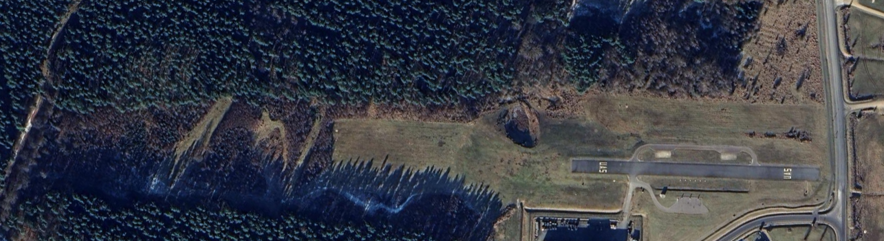
FPV 7in Flights – Day 3 Afternoon
Task 2: Movement to contact.
Conditions: Use the 7in and outdoor flight area with 7in FPV move from RZ Foxtrot and conduct multitarget kill.
Standards: From the start point (star), in groups of 4 move through the woods of RZ Foxtrot in a tactical manner. Launch SRR and conduct a security halt for the SRR operator to locate enemy targets (3-4 nets). Using the terrain, mask your position and conduct a simo strike on the targets hitting a minimum of 2 targets. Locate an OP that will give the best chance maintaining signal and insure good effects on target. Upon detection of the SRR drone or FPV drone feed, Red SRR will be launched. Displace tactically and move to SP1 for extraction after strikes are complete and an accurate BDA has been reported.
OBJ BUZZSAW
SP1
UASOP
SRR
ENY SRR
Notes:
While they prep we will give them the Freq allocations for the lane.

Slide 17
Day 3 Afternoon CONOP
Target Area
Key Tasks
  Movement to Contact Task
  BPT Conduct Repair Operations
Coordinating Instructions
  QTY 2 Instructors for Lane Walkers
  QTY 1 Instructor for Team Transport
  QTY 2 Instructor for Red Air Operations and Recovery
  QTY 1 NCOIC
Sustainment
  QTY 12 (min) LIPO or LI-ION Batteries
  Goggle Battery – QTY dependent on class size
  QTY 4 Battery Banks
  QTY 2 Battery Charging Kits
  QTY 1 SRR Charging Kit
  QTY 2 Instructor Goggles or Monitor
  QTY 2 Nets
  QTY 2 (min) Folding Table
  QTY 2 (min) Chair
  QTY 13 LMR Radios
  QTY 1 HMMWV
  QTY 1 TMP
Red Air Operator
Repair Station
Staging Area
Operator Area

Slide 18
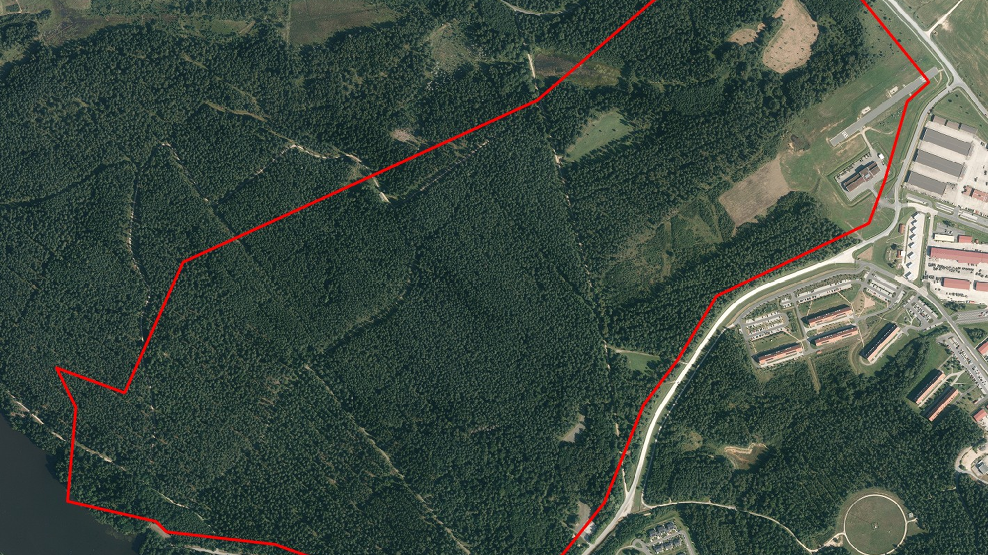
Day 3 Afternoon Scheme of Maneuver
Scheme of Maneuver
  Phase I: Team composed of 3 FPV operators and 1 SRR operator prep and stage all equipment to conduct operations. Team conducts PCC, PCI, and pre-flight checks to ensure mission capable status of equipment. BPT load into transport vehicle to begin mission (Orange Route).
  Phase II: Team arrives at insertion point and conducts link up with lane walkers. Team moves to SRR launch point and identifies targets in engagement area. Team finalizes launch positions based on target location and moves to occupy operator positions. Team executes targets with FPV strike drones and reports BDA.
  Phase III: Team tactically withdraws to insertion point and is extracted (Yellow Route) to staging area for hotwash. Team executes walk of shame to recover downed drones after failed strike if necessary.
  Phase IV: Team conducts recovery operations in preparation for next mission.
Signal
  Frequency Allocation:
    FPV: R1, R3, R5
    LMR: A1
Engagement Area
Staging Area
IP/ExP

Slide 19
Instructor and material support for day 3
Minimum 2 instructors as lane walkers and safeties
Minimum 1 instructor at ENY position to fly red air/give BDA
Minimum 1 instructor for student transport to lane
Minimum 3 baseball nets for catching drones
Minimum 1 target picture per net
Camo net
12 LMR radios for the instructors and students to maintain communication
DJI Mavic for BLUFOR SRR
Skydio X10D for OPFOR SRR – launch upon detection of Blue SRR or interception of FPV video feed.
Movement plan to get students to RZ FOX using the TMP or Razor or ISV. (The first gravel road that runs behind the tree line. Not the one with the big dip, you will know what Im talking about.)
Frequency allocation for 4 FPV flyers at once are R1, R3, R5, and R7
HPTL list

Slide 20
Movement to Contact Lane
Target location COAs
COA 1
Target 1: In open field north of Balli Airfield
Target 2: Northeastern edge of depression
Target 3: End of trench
COA 2
Target 1: Eastern side of IFV
Target 2: Eastern edge of sapling, in front of berm
Target 3: Next to airstrip (south)
COA 3
Target 1: Beginning of trench
Target 2: Behind window in front of airfield
Target 3: Near slalom poles

Slide 21
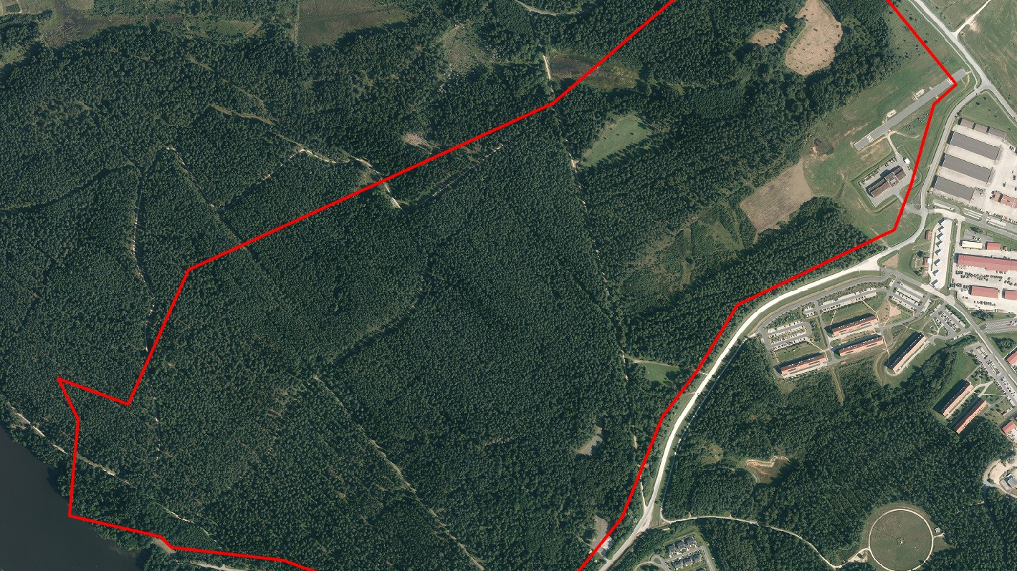




Movement to contact lane
- COA 1

Slide 22
Movement to contact lane
- COA 2

Slide 23
Movement to contact lane
- COA 3

Slide 24
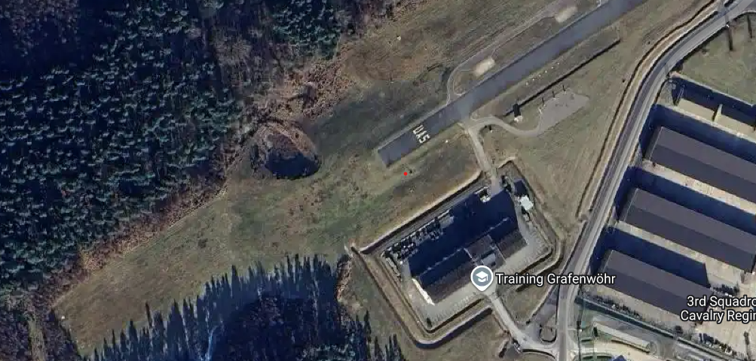
FPV 7in Flights – Day 4
Task 1: Circuit
Conditions: Use the 7in and outdoor flight area with window gates, poles, IFV, trench, and net.
Standards: From the start point (star), navigate the course in the following order: Slaloms, Loiter (clockwise & counter-clockwise), Gates, and Trench. End the circuit with strike into net.
L

Slide 25
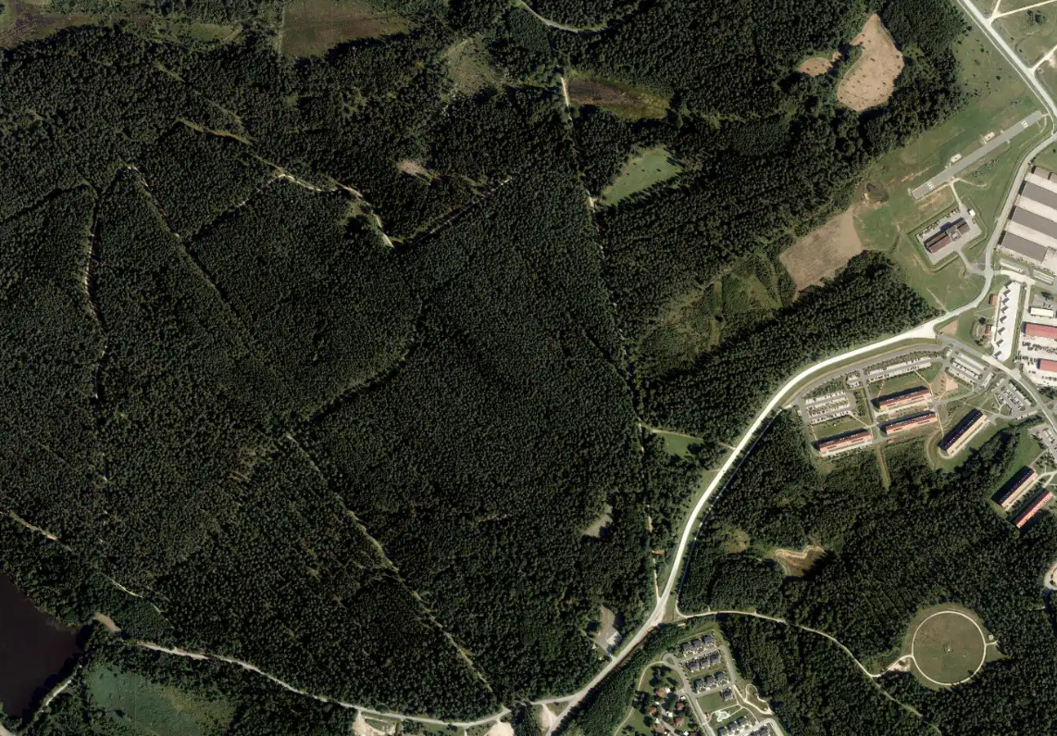
SRR Flights – Day 4
Task 1: ISR of multiple NAIs
Conditions: Use the Mavic Classic 3 and outdoor flight area with 2 or 3 NAIs with targets.
Standards: From the start point (star), navigate to NAI 1 in sequential order, scan area for target(s), navigate to NAI 2, scan area for target(s), and repeat until all NAIs are scanned or battery depletes to return threshold.
N
NAI 3
Fly to NAI 3
NAI 2
Fly to NAI 2
Fly to NAI 1
NAI 1
SRR Launch Site
Notes:
Provide map of operating area and target sheet (laminated or in sheet protectors, targets could be the alphanumeric papers or vehicle printouts from day 3) operator-navigator pairs if feasible.

Slide 26
Day 4 Morning CONOP
Key Tasks
  Obstacle Course Task
  SRR Task
  BPT Conduct Repair Operations
Coordinating Instructions
  QTY 2 Instructors for Obstacle Course Task
  QTY 1 Instructors for SRR Task
  QTY 1 NCOIC
Sustainment
  QTY 12 (min) LIPO or LI-ION Batteries
  Goggle Battery – QTY dependent on class size
  QTY 4 Battery Banks
  QTY 2 Battery Charging Kits
  QTY 1 SRR Charging Kit
  QTY 2 Instructor Goggles or Monitor
  QTY 1 Net
  QTY 2 (min) Folding Table
  QTY 2 (min) Chair
  QTY 4 LMR Radios
  QTY 3 NIST Trees
Battery Station
Target Area
Operator Area
Repair Station

Slide 27
FPV 7in Flights – Day 4 afternoon - Eval
Task 1: Strike, Navigation, and Trench eval
Conditions: Use the 7in and outdoor flight area with trees and a net
Standards: Operate from a UAS Op hide site, navigate down the tree line on the South side then enter and clear the trench. Turn left then execute a strike on the net.
UAS
OP

Slide 28
Day 4 Afternoon CONOP
Key Tasks
  Live Flight Eval
  BPT Conduct Repair Operations
Coordinating Instructions
  QTY 2 Instructors for Operate Area Observation
  QTY 1 Instructors for Tench and Net Observation
  QTY 1 NCOIC
Sustainment
  QTY 12 (min) LIPO or LI-ION Batteries
  Goggle Battery – QTY dependent on class size
  QTY 4 Battery Banks
  QTY 2 Battery Charging Kits
  QTY 2 Instructor Goggles or Monitor
  QTY 1 Net
  QTY 2 (min) Folding Table
  QTY 2 (min) Chair
  QTY 4 LMR Radios
Battery Station
Target Area
Repair Station
Operator Area

