Slide 1
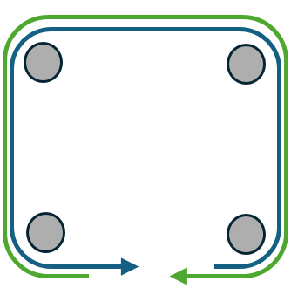
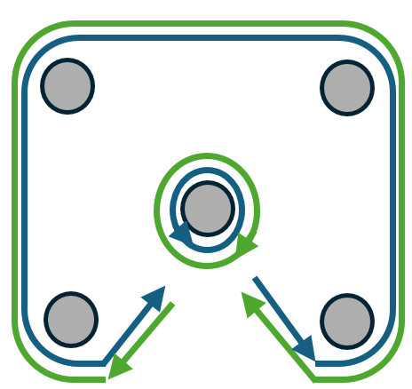
FPV Whoops– Day 1
Task 1: Free Flight
Conditions: Use the whoop and indoor flight area with no obstacle course
Standards: Fly 1-2 batteries to become familiar with the feel of live flight with a whoop.
Task 2: Turns and Hover
Conditions: Use the whoop and indoor flight area with 4 posts set up on the outer corners of the indoor flight area
Standards: Utilize 1 battery and fly two laps making left hand turns without touching the ground. Then without landing turn around and complete two laps making right hand turns without touching the ground. End with hovering the whoop in front of yourself (approx. 10ft. away) with the goal of keeping yourself in the frame.
Task 3: Turns and loiter
Conditions: Use the whoop and indoor flight area with 4 posts set up on the outer corners of the indoor flight area and one in the middle
Standards: Utilize 1 battery and fly 1 lap making left hand turns without touching the ground. Then without landing complete two left hand loiters around the center post. Then continue on and complete a lap around the outside making right turns. End with two right hand loiters around the center post.
Task 2
Task 3

Slide 2
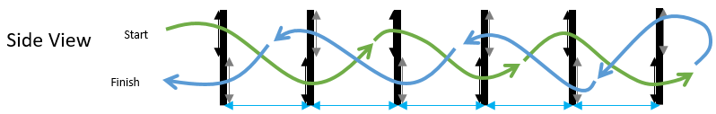


FPV Whoops– Day 2
Task 1: Slaloms / Weave Poles
Conditions: Use the whoop and indoor flight area with 5 posts set up in line
Standards: Utilize 1 battery and weave between the posts then turn around the last post and come back. Complete the weave poles twice down and back, without touching the ground.
Task 2: Altitude Change / Over-Under Gates
Conditions: Use the whoop and indoor flight area with 6 gates set up
Standards: Utilize 1 battery and fly through the gates starting with the top level gate then go through the lower section and repeat until through all the gates. Then turn around and fly back alternating top and bottom gates. Complete twice without touching the ground.
Task 2
Task 1

Slide 3
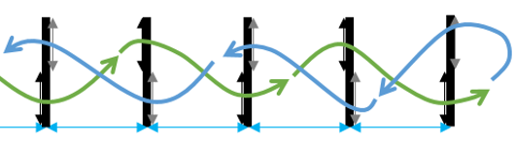
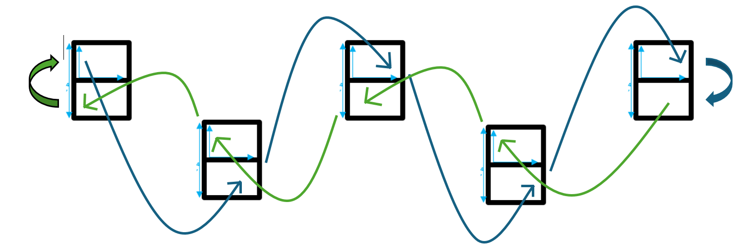
FPV Whoops– Day 3
Task 1: Weave & Over-Under Gates
Conditions: Use the whoop and indoor flight area with 5 gates set up
Standards: Utilize 1 battery and fly through the gates starting with the top level gate then go through the lower section and repeat until through all the gates. Then turn around and fly back alternating top and bottom gates. Complete twice without touching the ground.
Side View
Front View

Slide 4

FPV Whoops– Day 4
Task 1: Random Obstacle Course
Conditions: Random instructor directed obstacles incorporating turns and altitude variation. Instructors will emplace unspecified obstacles for students to navigate.
Standards: Complete the random obstacle course without touching the ground IOT prepare students to react to different flight environments.
Altitude Change
w/ Gap
Loiter x2
Altitude Change
w/ Gap
Weave
Start
/ End
Sample Course

Slide 5
FPV Whoops– Day 5 - Eval
Task 1: Random Obstacle Course Eval
Conditions: Random instructor directed obstacles incorporating turns and altitude variation. Instructors will emplace unspecified obstacles for students to navigate.
Standards: Complete two laps of the random obstacle course without touching the ground. The instructor will set the course time standards that enable controlled flight with a no faster than time and no slower than time that are within 15 seconds of each other.
Example: Sample course, complete no faster than 2 mins and no slower than 2:15.
Altitude Change
w/ Gap
Loiter x2
Altitude Change
w/ Gap
Weave
Start
/ End

