Slide 1
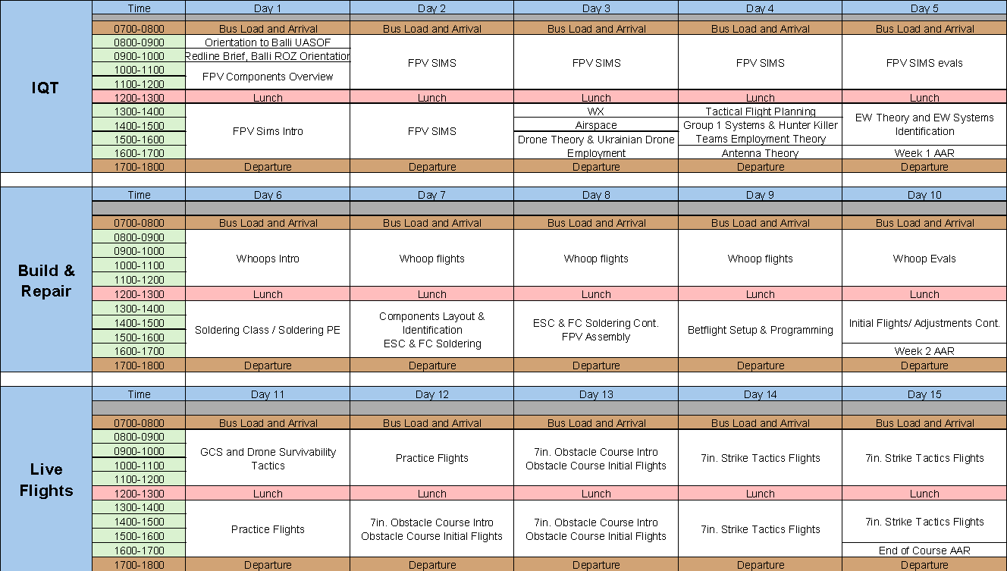
US/NATO FPV IQT Training
Week 1:
Consists of 24hrs of simulator time
sUAS/Aviation Basics
sUAS Planning
cUAS / EW Short Course
Week 2:
Micro UAS Flights
FPV UAS Construction & Repair Course
Week 2:
Basic FPV UAS Flights
Tactical FPV UAS Flights

Slide 2
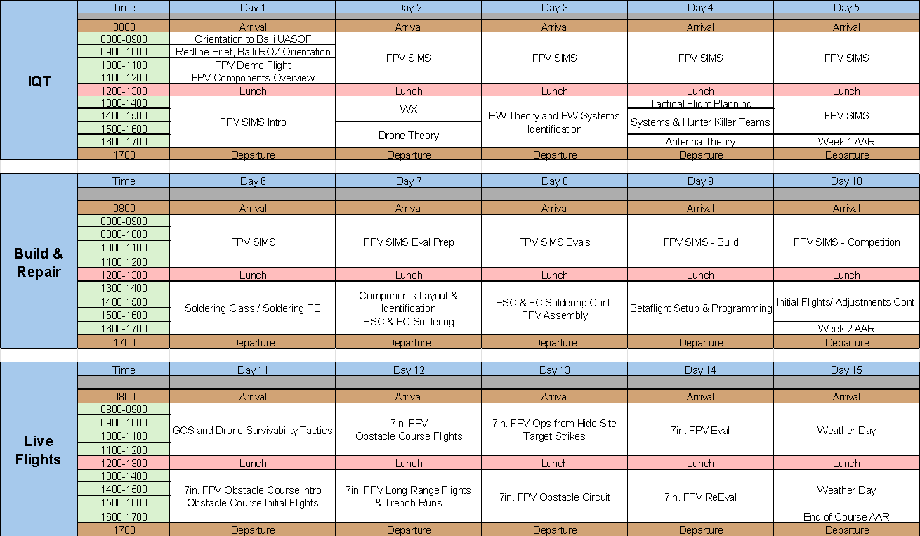
US/NATO FPV IQT Training
Week 1:
Consists of 24hrs of Simulator Time
sUAS/Aviation Basics
sUAS Planning
cUAS / EW Short Course
Week 2:
Additional FPV SIM
FPV SIM Evaluation
FPV UAS Construction & Repair Course
Week 3:
Basic FPV UAS Flights
Tactical FPV UAS Flights
Built in Bad Weather Day

Slide 3

FPV Simulator – Week 1
Day 1
Basic Flight Tasks
Day 2
Maneuver Tasks
Day 3
Race/Course Introduction
Day 4
Advanced Races
Day 5
Evaluation Day
Example Tasks
Day 1 Task 3: Turns - 1 hour
Conditions: Use of the simulator Lift Off with goggles. God Mode enabled, noise and battery disabled ​​
Standards: Left turns around the barn, move no faster than 25 kph, three laps without touching the ground or any obstacles, then gentle landing. ​Once successfully completed, switch to right hand turns around the barn with the same standards. Then loiter around the silo with crosshairs focused on the silo.​
Day 3 Task 3: Race Familiarity Elevation (Bando City – Who Needs Stairs)
Conditions: Use of the simulator Lift Off with goggles. Noise enabled, God Mode and battery disabled.
Standards: Focus on elevation changes through the buildings. Complete no faster than 2:15 and no slower than 3 mins.

Slide 4

Whoop Live Flights – Week 2
Day 1
Basic Flight Control
Day 2
Maneuver through Gates
Day 3
Elevation Control through Gates
Day 4
Combined Flight Control
Day 5
Evaluation Day
Day 1 Task 1 : Turns – 1-2 batteries
Conditions: : Use the whoop and indoor flight area with no obstacle course ​​
Standards: Fly 1-2 batteries to become familiar with the feel of live flight with a whoop.​
Day 4 Task 1: Random Obstacle Course
Conditions: Random instructor directed obstacles incorporating turns and altitude variation. Instructors will emplace unspecified obstacles for students to navigate.
Standards: Complete the random obstacle course without touching the ground IOT prepare students to react to different flight environments.
Altitude Change
w/ Gap
Loiter x2
Altitude Change
w/ Gap
Weave

