Slide 1
Local Area Overview

Slide 2
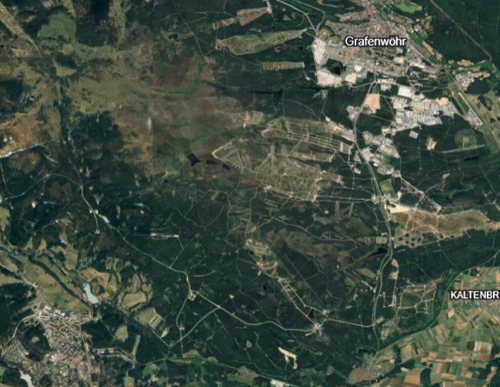
GTA Overview
Tower Barracks
Rose Barracks

Slide 3
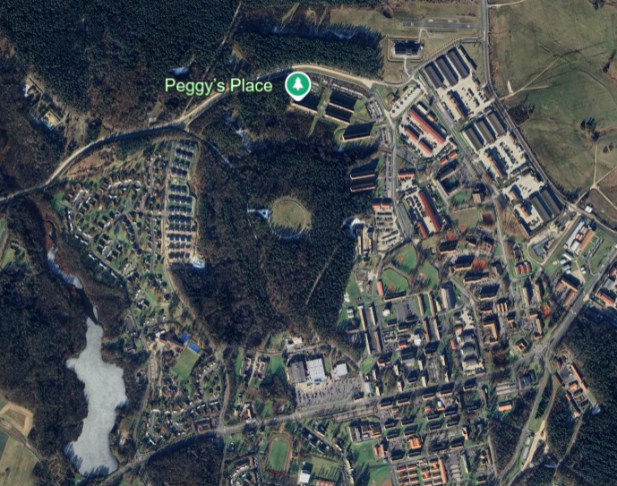
Rose Barracks Overview
Bali
Dragoon Inn DFAC
GAS/Shoppet
PX

Slide 4
Key facts to Know
To purchase tobacco, liquor, or coffee on post you will need a ration card. We cannot get that for you that is done from your unit.
To get gas on post you will need an ESSO card that can be picked up at the customs office located at Tower Barracks, Bldg. 621, Room 129 you can also call DSN 314-569-2896/2897, CIV 09641-70-569-2897/2896
Hours of operation M - F: 8 a.m. to 4 p.m. Sa - Su & U.S. Federal Holidays: Closed
Rose barracks PT is conducted in the morning and can cause traffic delays.

Slide 5
For NATO members
Aaron Haynes
7th Army Training Command
International Training Branch
DSN: 314-569-2593
CIV: +49 9641 70 569 2593
NIPR: aaron.m.haynes.civ@army.mil

