Slide 1

Additive Manufacturing
Basic Course

Slide 2
Daily Agenda
TUESDAY | WEDNESDAY
Additive Manufacturing Getting Started 3D Modeling Build ID Tag | Slicing Software Print ID Tag Reverse Engineering
THURSDAY | FRIDAY
Printer Maintenance Design for Additive Manufacturing Calibration Capstone Design and Print | Present Capstone Design Class Summary Certificates
Notes:
Mission: Teach Soldiers to use AM and apply that to their day to day lives along with pushing viable Products into their units
What we Do: Hon our skills along with continuously sharpening the Troopers to the left and right of us.

Slide 3
Day 1

Slide 4
DoD References
Department of Defense Additive Manufacturing Strategy
Army Directive 2019-29
(Enabling Readiness and Modernization Through Advanced Manufacturing)
DA PAM 750-1 Chapter 12:
Maintenance of Supplies and Equipment
Army Materiel Maintenance Procedures
Notes:
INSTRUCTORS: Start the students with opening Fusion 360 and creating an account. Once everyone is looking at a loading screen, tell them to give a thumbs up and continue with the class.

Slide 5
Additive Manufacturing

Slide 6
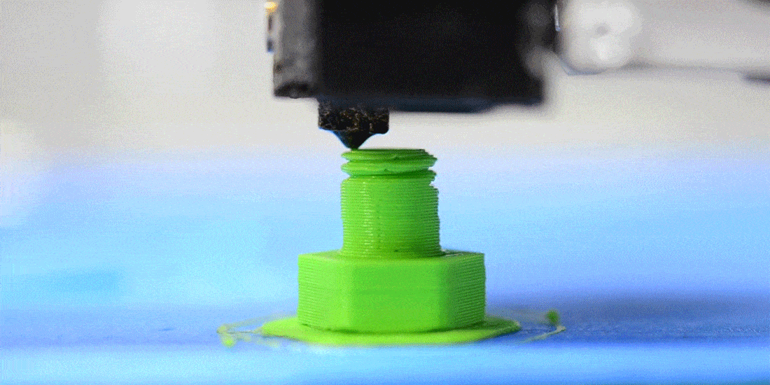
Additive Manufacturing
Intro to FDM
Additive Manufacturing is defined as the process of joining materials to make objects from 3D model data, usually layer upon layer.
The affordability, ability to create parts with little training, and the durability of produced parts make it an ideal technology for garrison and deployed environments.

Slide 7
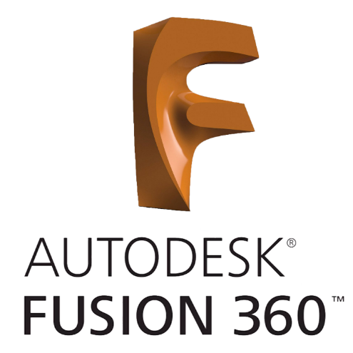
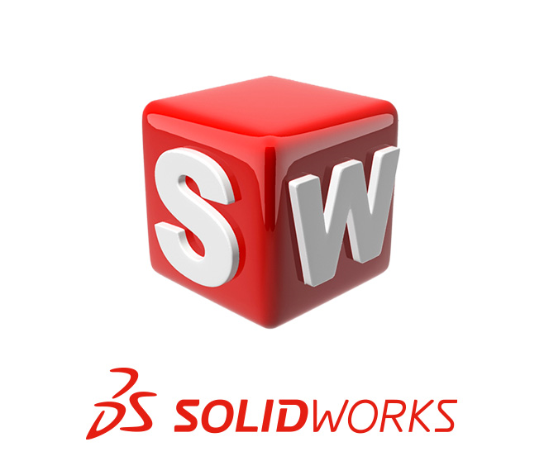

CAD Modeling Software
Fusion 360
Free*
Needs internet monthly (Cloud Based)
User friendly
SolidWorks
$20 for Veterans, personal use
Widely used in academia
User friendly
Shapr3D
Free*
iPad, macOS,Windows
Most User friendly

Slide 8
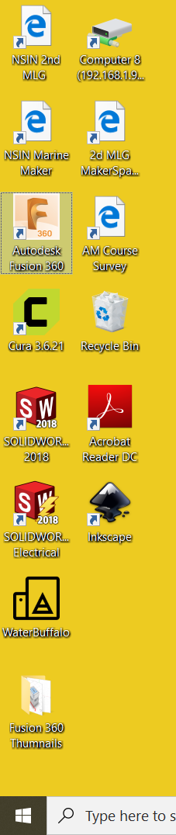
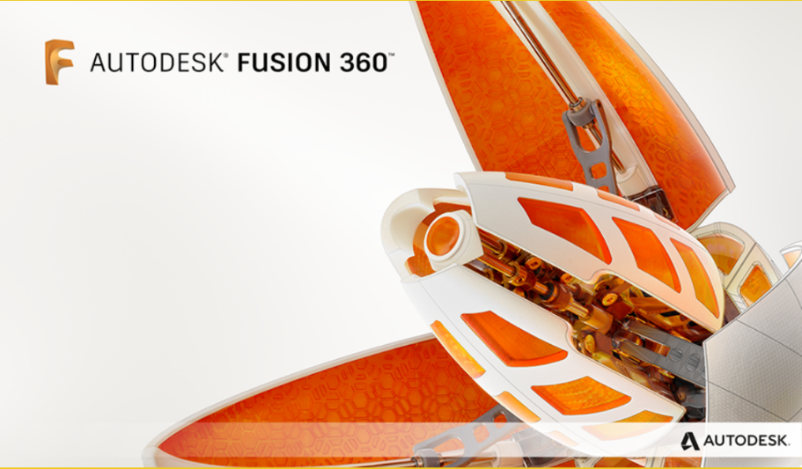
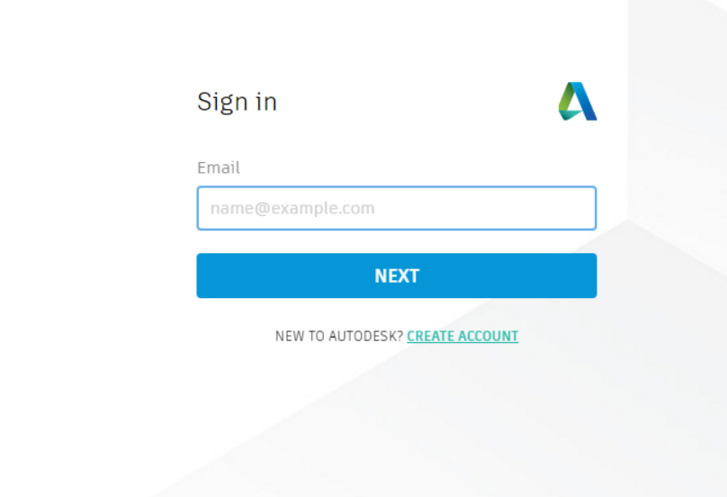
Fusion 360 Getting Started
Open Fusion 360 from your desktop.
Create an account.
Log into Fusion 360 using your credentials.
Follow instructor for next steps.
Notes:
-Design Hygiene: Creating and Saving Projects, Assemble, Components, Views, Origin, views

Slide 9
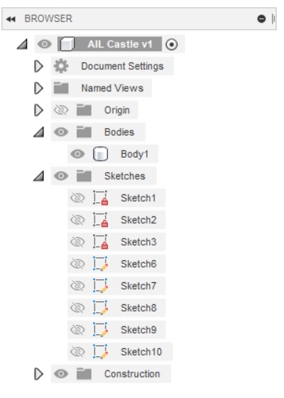
Bodies, Sketches, & Timeline
General guidelines “Hygiene”:
Try to keep minimal bodies
Viewing sketches may assist in deciding planes to view
Changing past details utilizing timeline may modify current design
Components can be created from bodies and moved as an assembly
Notes:
It is every move you have made while creating your object. You can use the navigation arrows in your timeline to move or the scroll bar at the top. The top color is your components. Yellow in the timeline could be a read error, normally happens when you change something. This may slow your computer. A red is a major read error that could be a issue with your object. To name items on your timeline for easy navigation, right click and rename.

Slide 10
1D Sketches
Line:
Lines are drawn by specifying the starting and ending point through the cursor. Lines can be modified using numerical inputs.
Use sketch dimension to show/edit distance
Set line as Construction line

Slide 11
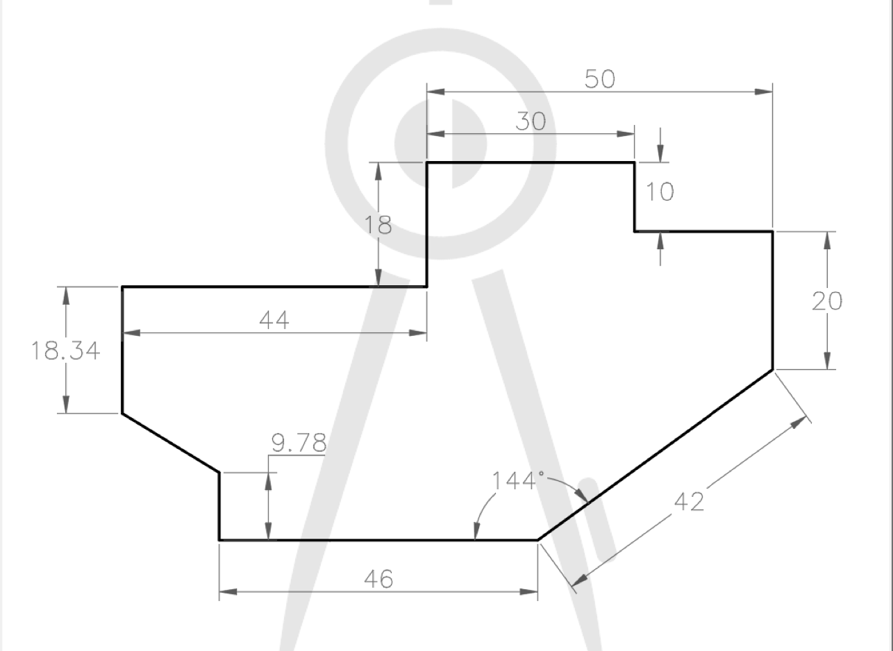
1D Drawing Practice

Slide 12
2D Sketches
Y
Two dimensional drawings are the cornerstone of creating objects in the digital environment.
A closed profile created by 2D sketches is required for any 3D construction.
X
All measurements are in metric ***

Slide 13
2D Rectangle
Two-Point Rectangle
Three-Point Rectangle
Center-Point Rectangle

Slide 14
2D Circle
Two-Point Circle
Three-Point Circle
Center-Point Circle

Slide 15
2D Polygon
Inscribed polygon
A Polygon is inscribed in a circle when all its vertices lie on the circle
Circumscribed polygon
A polygon is circumscribed about a circle when each of its sides is tangent to a circle
Edge polygon
Inscribed Polygon
Circumscribed Polygon

Slide 16
Other Shapes
Ellipse
Spline
Arc

Slide 17
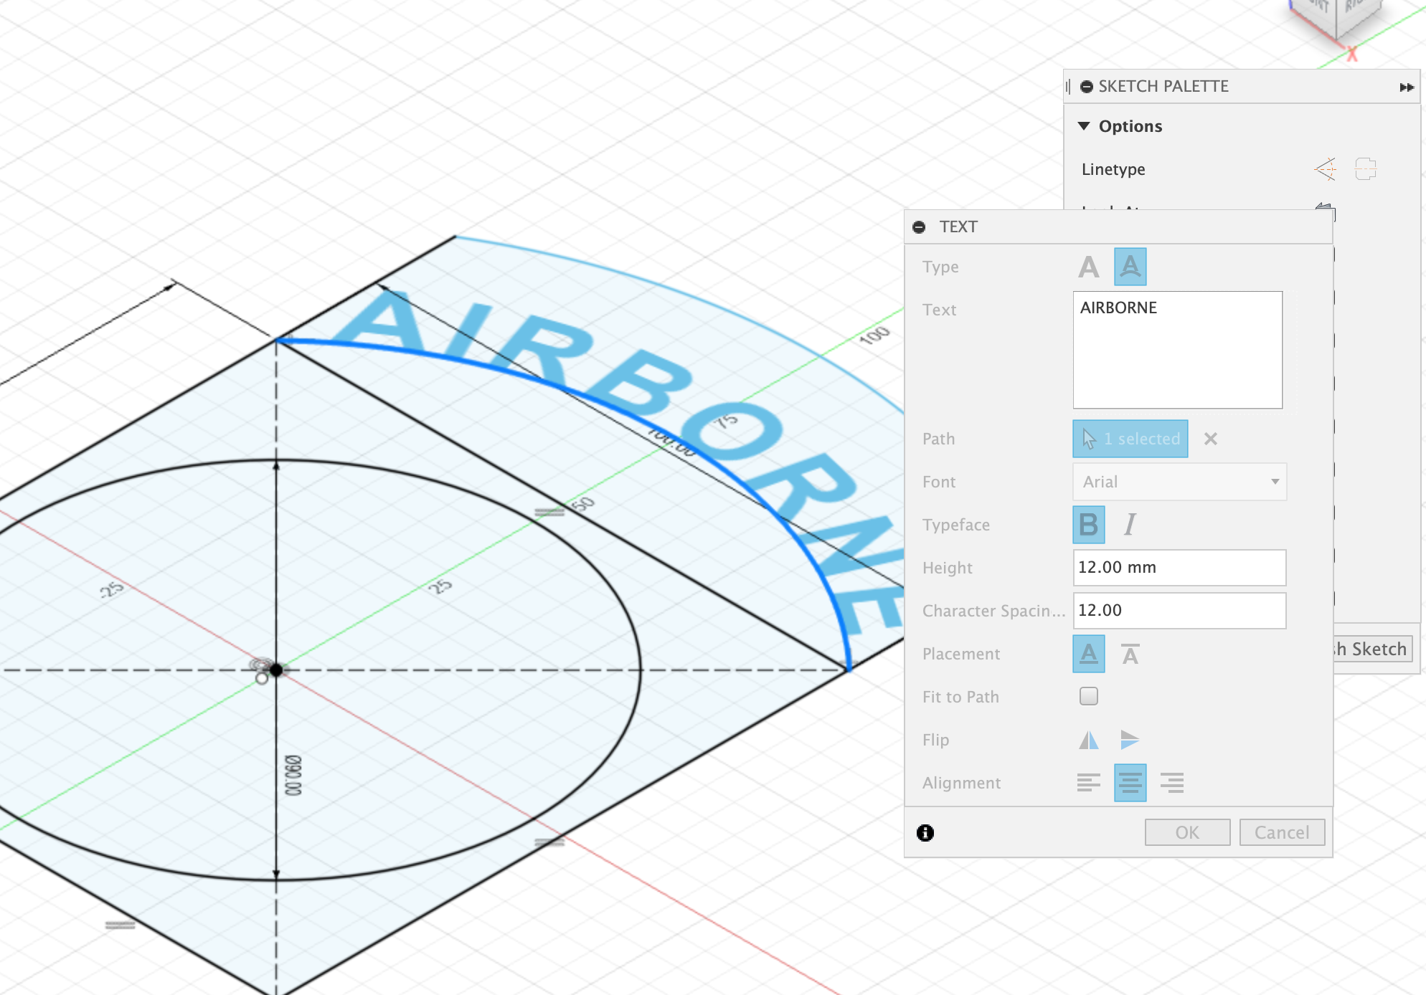
Text

Slide 18
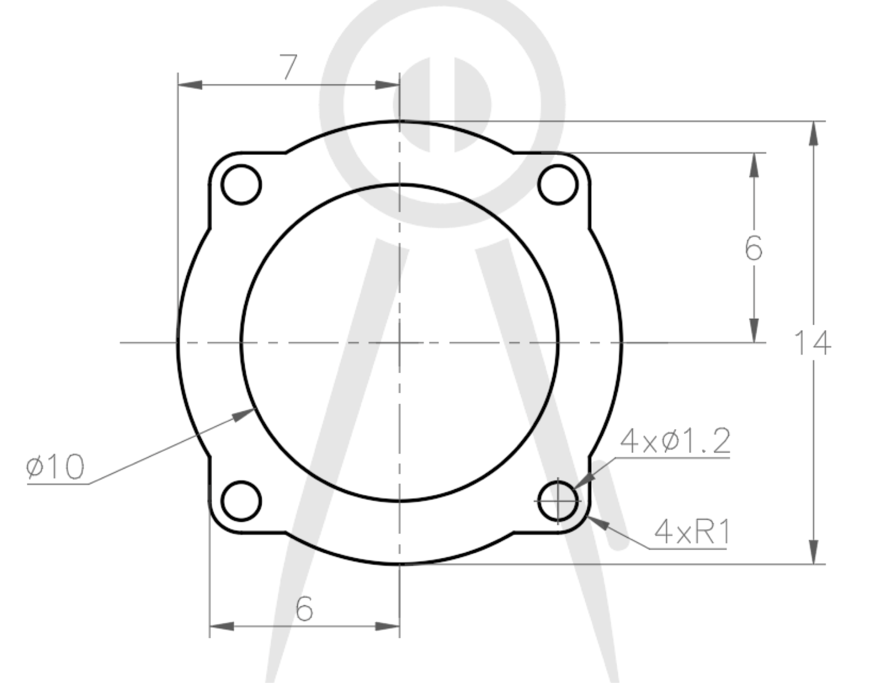
2D Tools
Mirror
Box/Circle Pattern
Fillet
Trim
Offset Edge
Constraints
Notes:
Fusion will take guesses, or best guesses on what you want it to do.

Slide 19
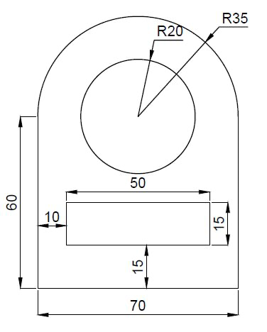
2D Drawing Practice

Slide 20
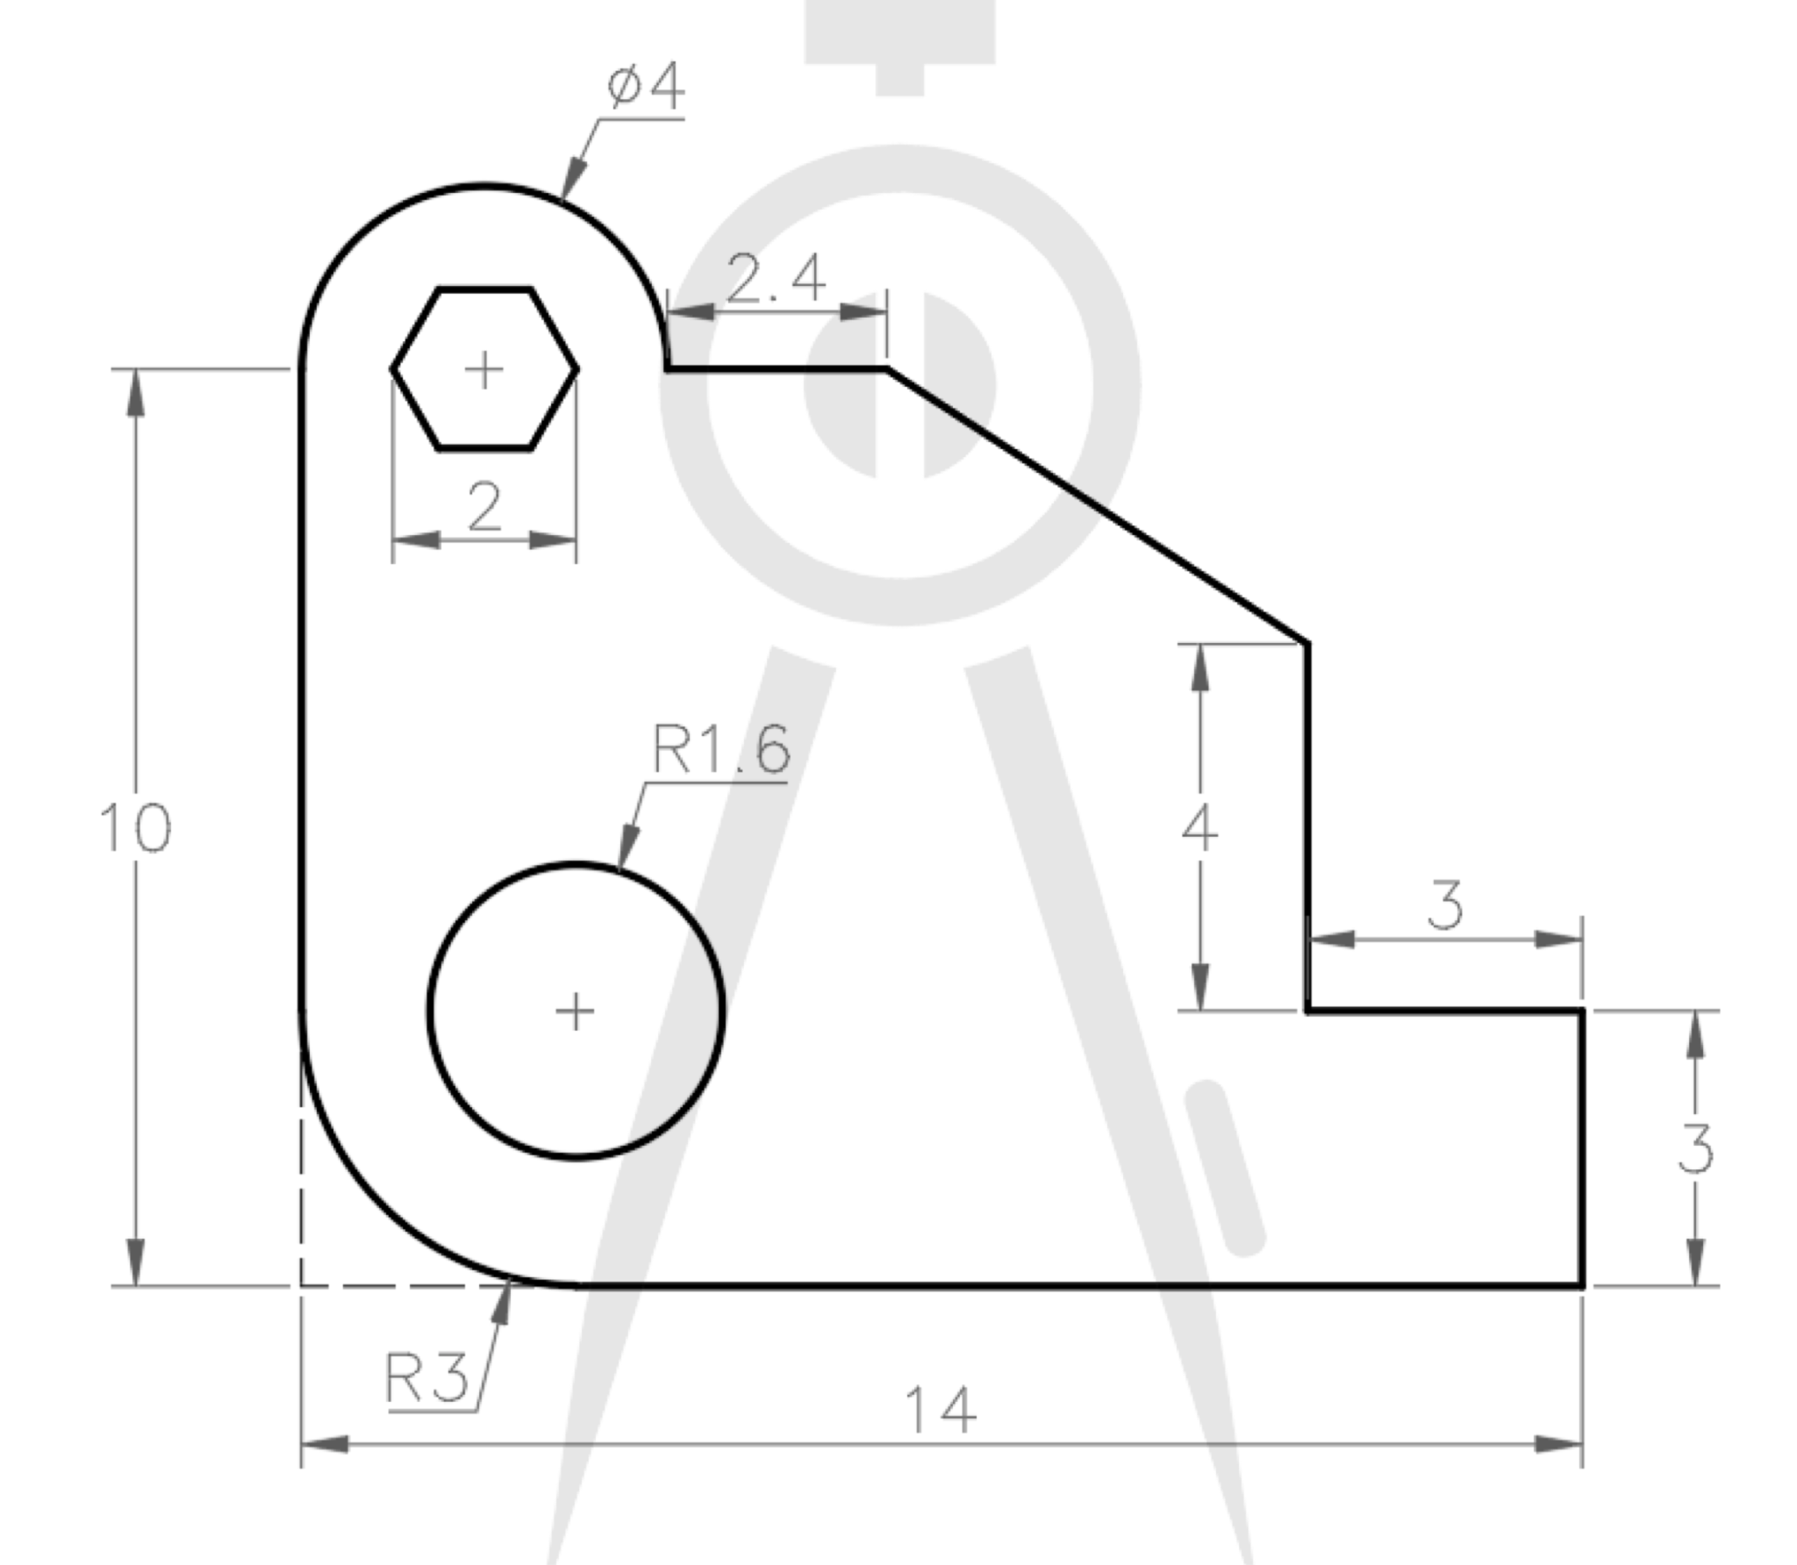
2D Drawing Practice

Slide 21
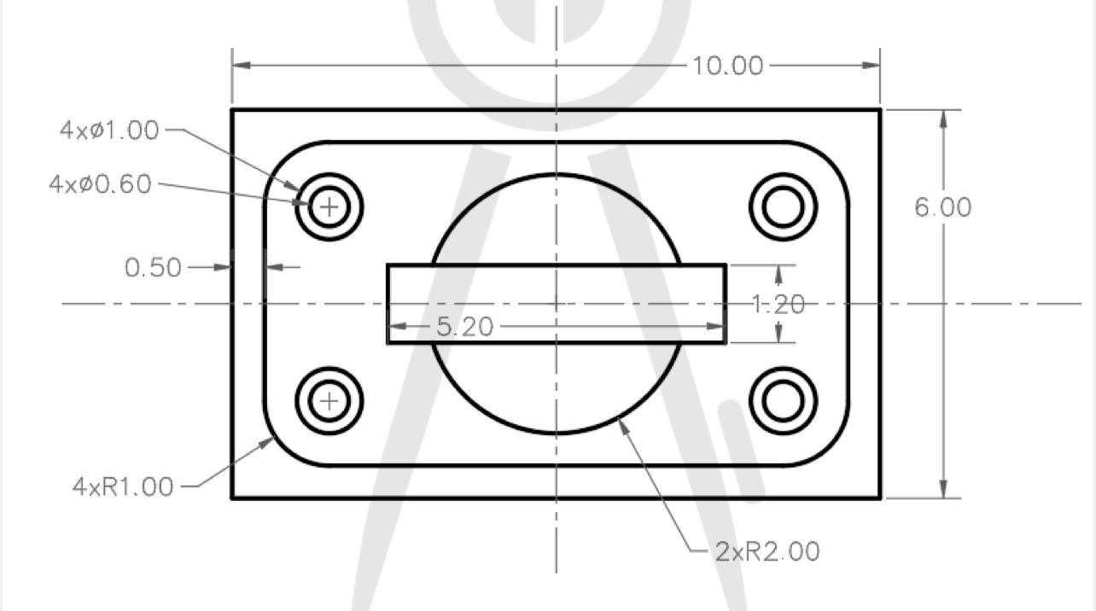
2D Drawing Practice
Notes:
Fusion will take guesses, or best guesses on what you want it to do.

Slide 22
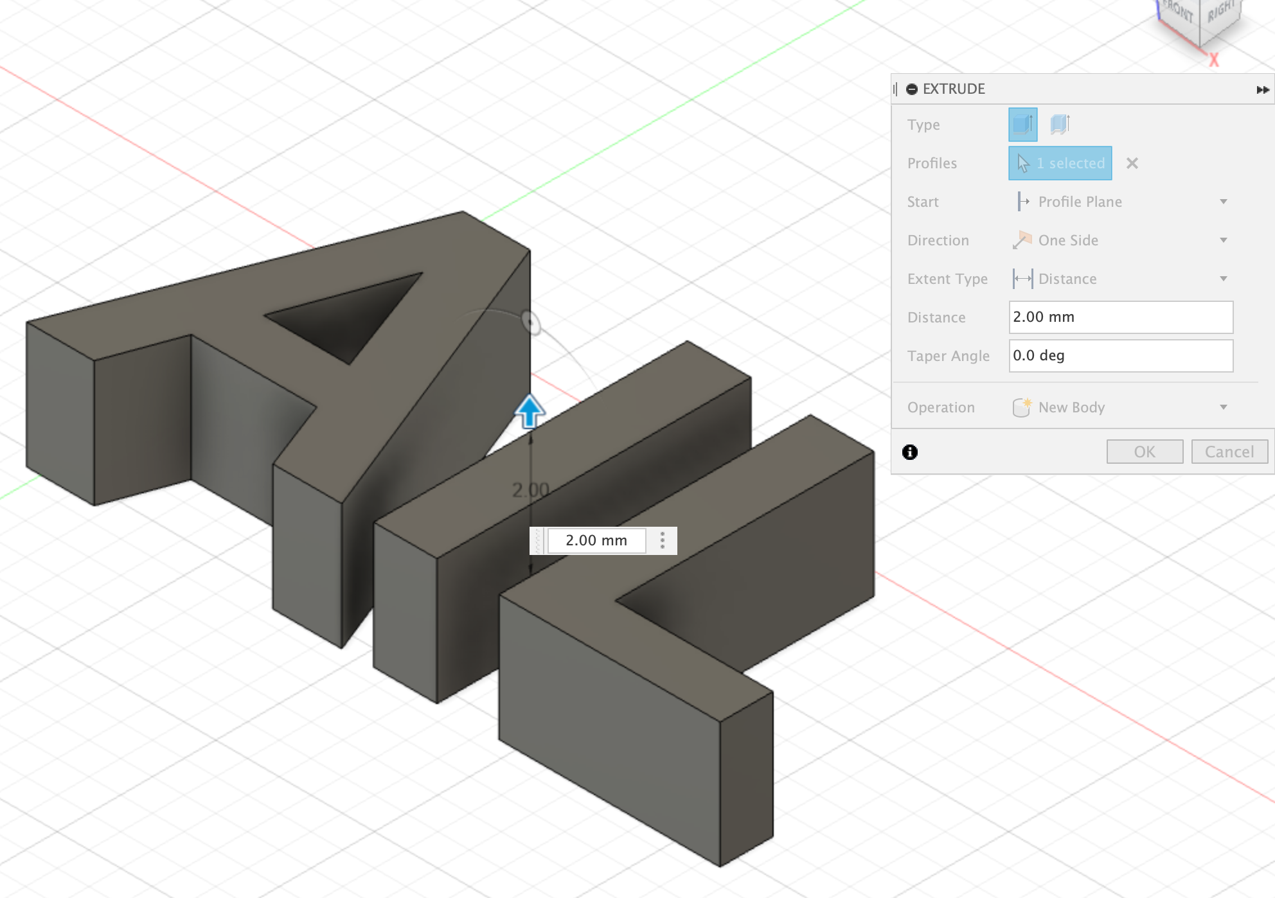
3D TOOLS
Extrude
Press/Pull
Fillet
Chamfer
Shell
Scale
Combine

Slide 23
Practice

Slide 24
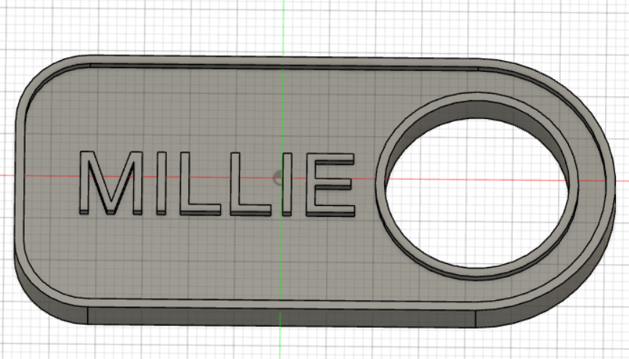
Build a ID tag with the following parameters:
No more than 100mm long
No more than 10mm thick
Hole is at least 5mm in diameter

Slide 25
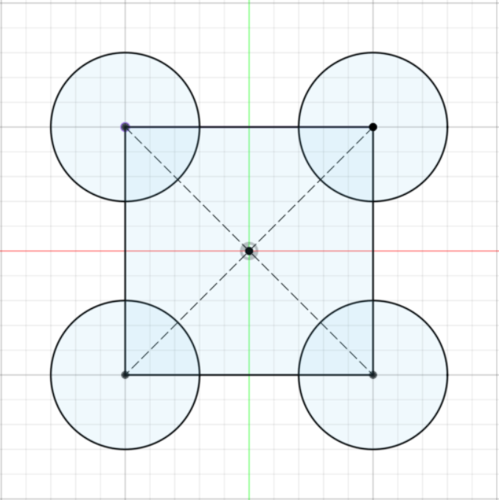
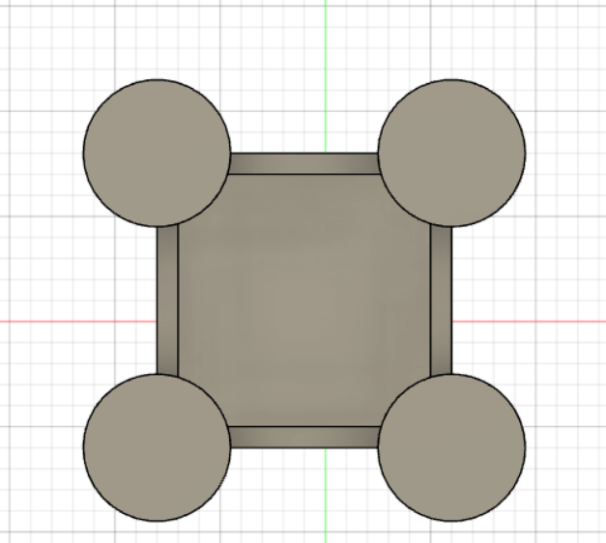
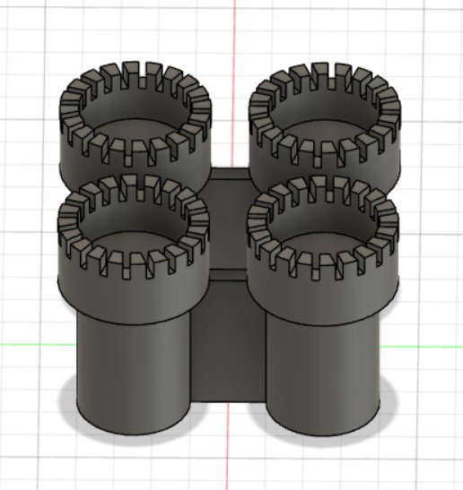
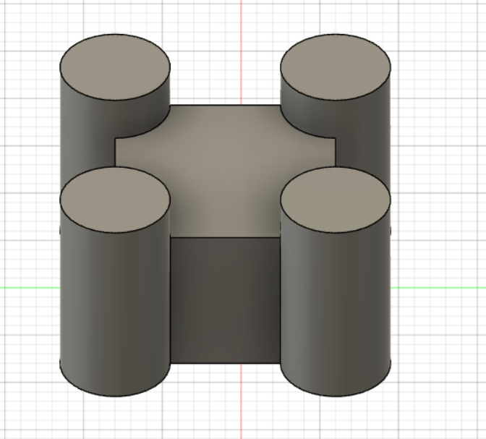
Mirror
Shell
Extrude
Pattern/Extrude

Slide 26
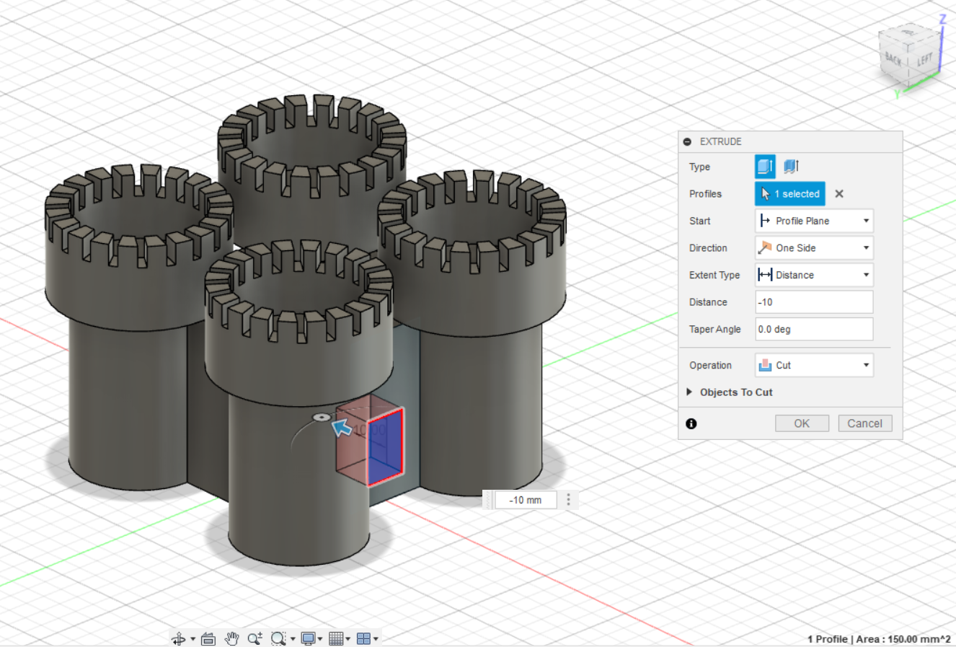
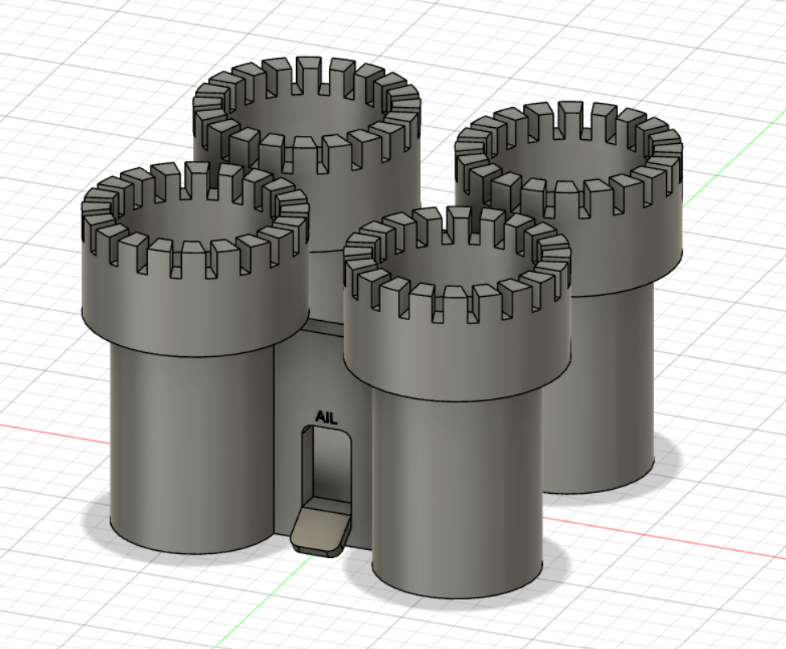
Cut
Plane at an Angle

Slide 27
Course Material For Day 1 Complete
Notes:
Castle/3d prac if they make it that far

Slide 28
Day 2

Slide 29
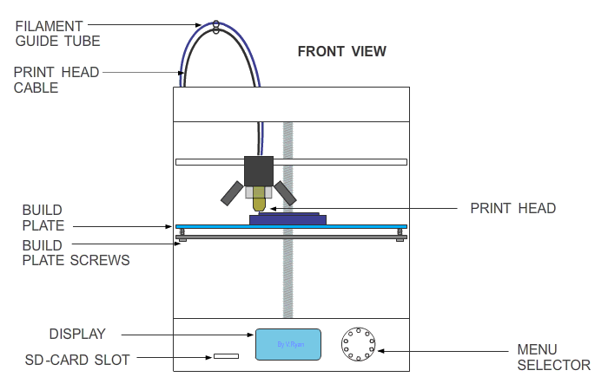
Fused Deposition Modeling (FDM)
FDM Printer Components
Fused Deposition Modeling (FDM) printers heat a thermoplastic filament to its melting point and extrudes it, layer by layer, to create solid object.
Components:
Control Interface
Print tool head
Hot End
Extruder
Print and part cooling fans
Heated Build Plate
Stepper motors for each axis
Spool of material

Slide 30
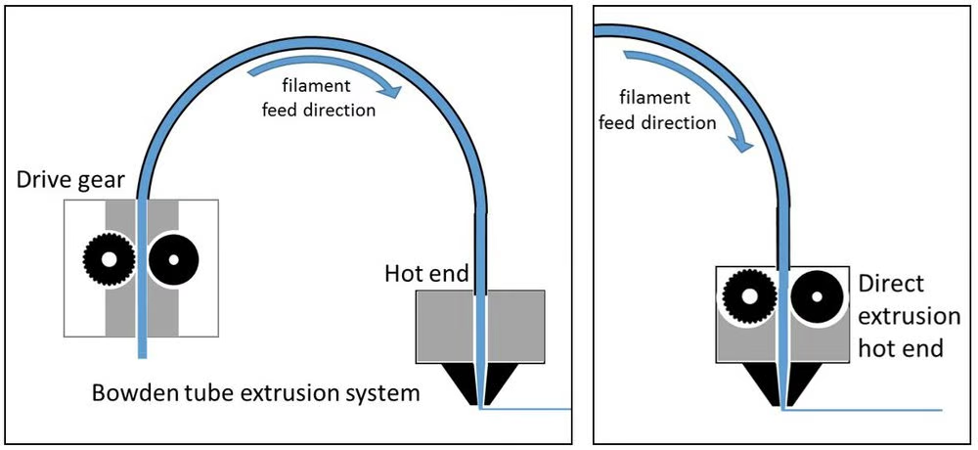
Fused Deposition Modeling (FDM)

Slide 31
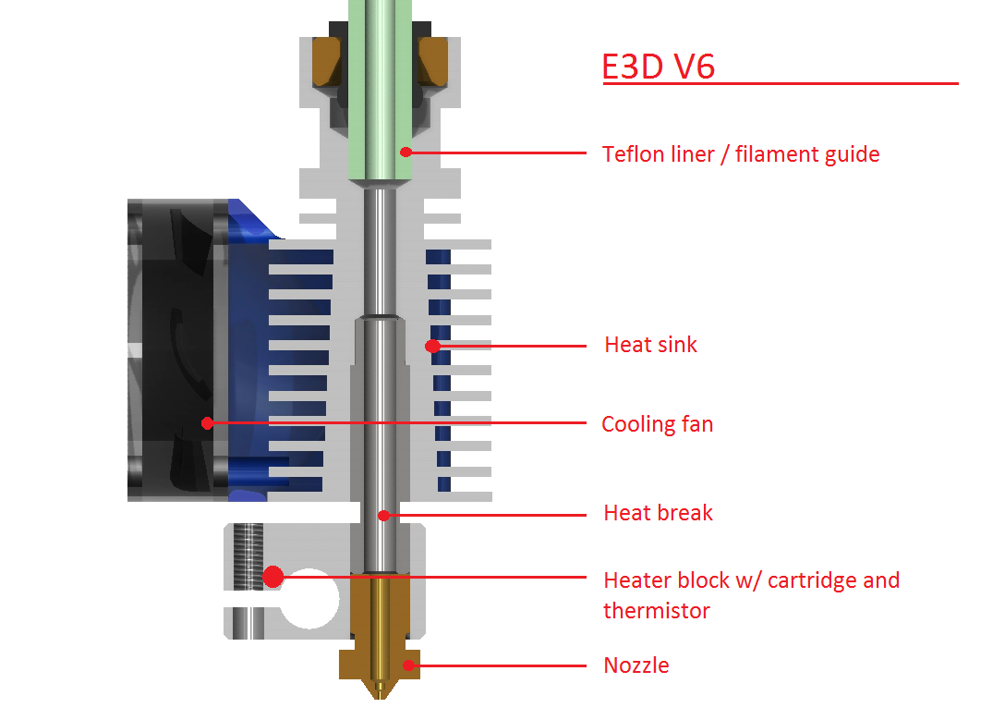
Fused Deposition Modeling (FDM)
FDM Printer Components

Slide 32
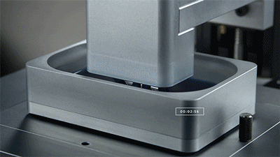
Stereolithography (SLA)
Intro to SLA
This SLA 3D printing process uses a vat of liquid photopolymer resin that can be cured. The build plate moves in small increments and the liquid polymer is exposed to light where the UV laser draws a cross-section layer by layer. The process repeats until a model is created.

Slide 33
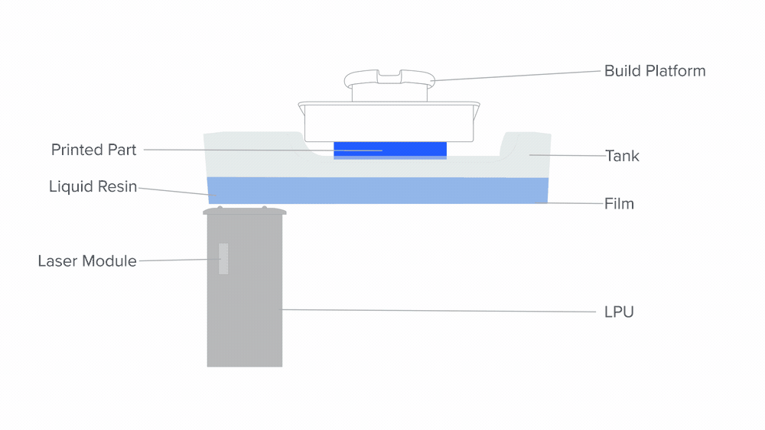
Stereolithography (SLA)
SLA Printer Components
Video

Slide 34
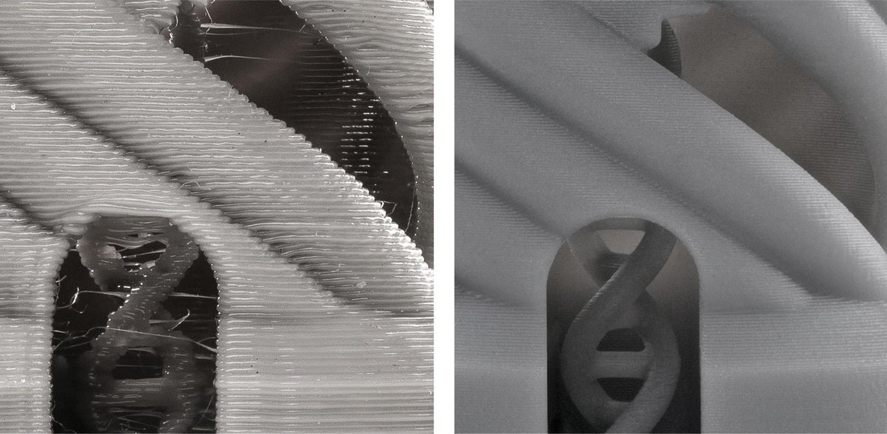
Stereolithography (SLA)
SLA Printer Components

Slide 35
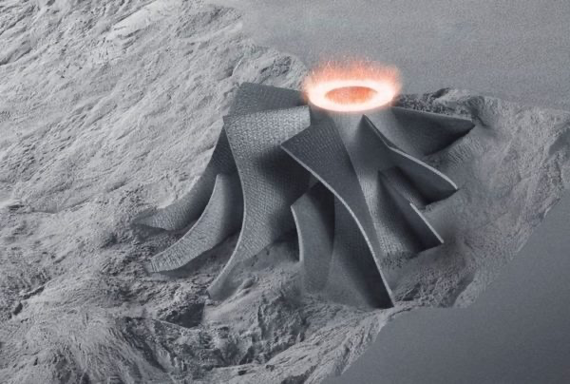
Selective Laser Sintering (SLS)
Intro to SLS
Selective Laser Sintering (SLS) printers are filled with a powdered material, which is raked on one layer at a time. SLS printers use a laser to fuse the powder to form a solid object.

Slide 36
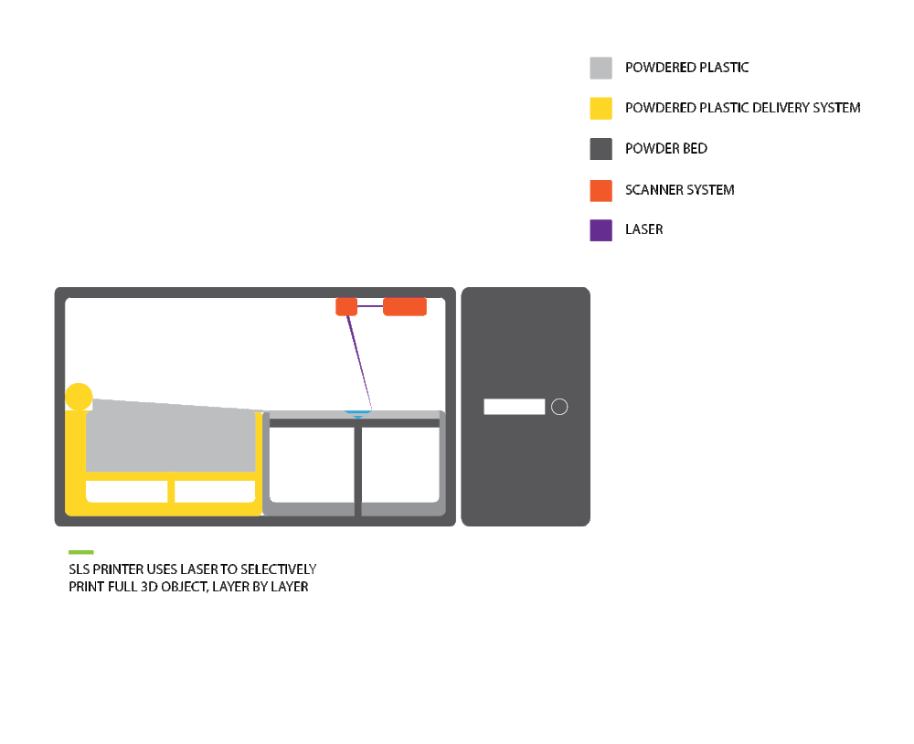
Selective Laser Sintering (SLS)
SLS Printer Components

Slide 37
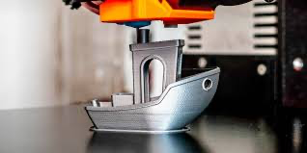
Weighing Capabilities: FDM
Key Differences
FDM = Cheap and modular
FDM has become the standard for desktop 3D printing. Its affordable, modular and can produce excellent results. However, FDM is usually limited to prototyping or low durability parts.
Notes:
FDM= cheap to buy, low safety risks for operation, and multiple materials.
FDM has become the standard for desktop 3D printing. Its affordable, modular and can produce excellent results. However, FDM is usually limited to prototyping.
SLA was the first 3D printing technology. SLA prints are 100% solid, have great print quality and are the fastest form of 3D printing available. However, the up front costs and maintenance behind SLA has become unfavorable for those hoping for minimal costs and post processing in 3D printing.
SLA= Created by Charles Hull in the 1980s. Although newer technology has improved on this process, this process remains very viable for detailed parts, such as dental implant molds.

Slide 38
Weighing Capabilities: SLA
Key Differences
SLA = Expensive and detailed
SLA was the first 3D printing technology. SLA prints are 100% solid, have great print quality and are the fastest form of 3D printing available. However, the up front costs and maintenance behind SLA has become unfavorable for those hoping for minimal costs and post processing in 3D printing.
Notes:
FDM= cheap to buy, low safety risks for operation, and multiple materials.
FDM has become the standard for desktop 3D printing. Its affordable, modular and can produce excellent results. However, FDM is usually limited to prototyping.
SLA was the first 3D printing technology. SLA prints are 100% solid, have great print quality and are the fastest form of 3D printing available. However, the up front costs and maintenance behind SLA has become unfavorable for those hoping for minimal costs and post processing in 3D printing.
SLA= Created by Charles Hull in the 1980s. Although newer technology has improved on this process, this process remains very viable for detailed parts, such as dental implant molds.

Slide 39
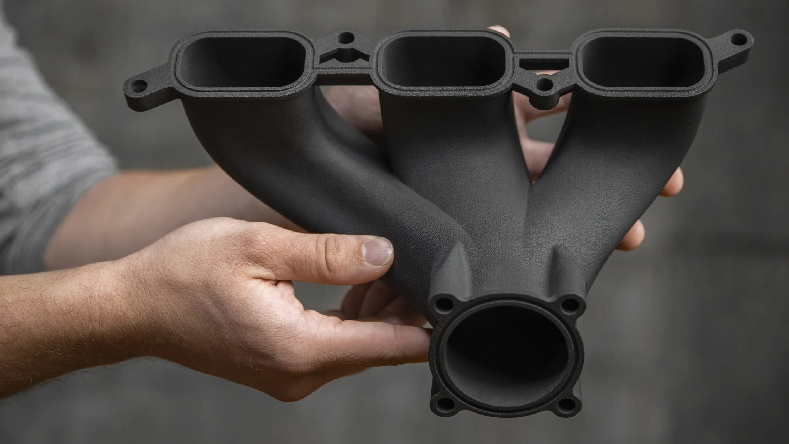
Weighing Capabilities: SLS
SLS= Numerous materials, from nylon and ceramics to stainless steel, titanium, cobalt chrome, and aluminum. Requires no supports, as the powder holds the part in place.
SLS is a 3D printing technology known for its ability to create objects with complex geometries, structures with thin walls and hidden voids or channels. It can produce parts out of virtually any material and complex parts that were previously only capable with machining and welding. However, its lofty costs and safety concerns has kept SLS at the industrial level.

Slide 40
Thermoplastics
Common FDM Filaments
PLA (Poly-lactic Acid)
“Environmentally friendly”
Easy to print
Weaker, unsuitable for outdoor environment
ABS (Acrylonitrile Butadiene Styrene)
High Strength, acetone soluble for smooth finish
Emits strong odor while printing
Difficult to print with
PETG (Polyethylene terephthalate-Glycol)
Easy to print like PLA
Strong and durable like ABS
Benefits of both PLA and ABS

Slide 41
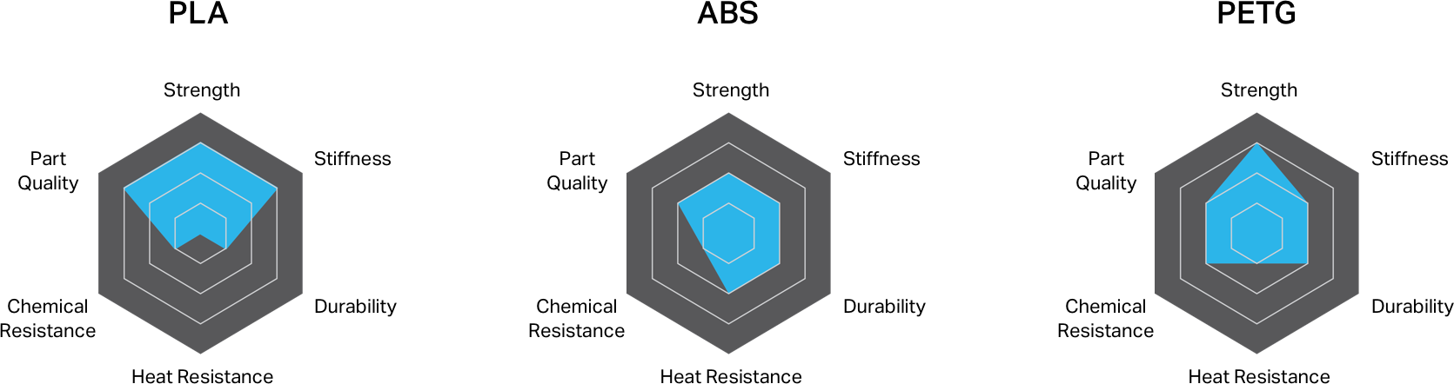
Material Selection

Slide 42
Design to Printer
3D Design
STL
Slicer
GCODE
Printer

Slide 43
Slicing
A Slicer is a program that converts digital 3D models such as an STL (Standard Triangle/Tessellation Language)file into printing instructions called a GCODE for a given 3D printer to build an object.
In addition to the model itself, the GCODE instructions contain user-entered 3D printing parameters, such as layer height, speed, temperature, and support structure settings.

Slide 44
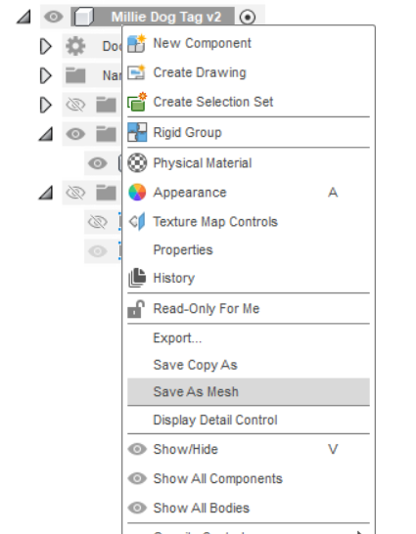
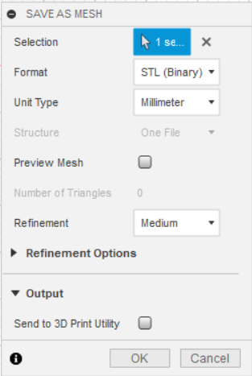
Export/Import STL
Export on Fusion360

Slide 45
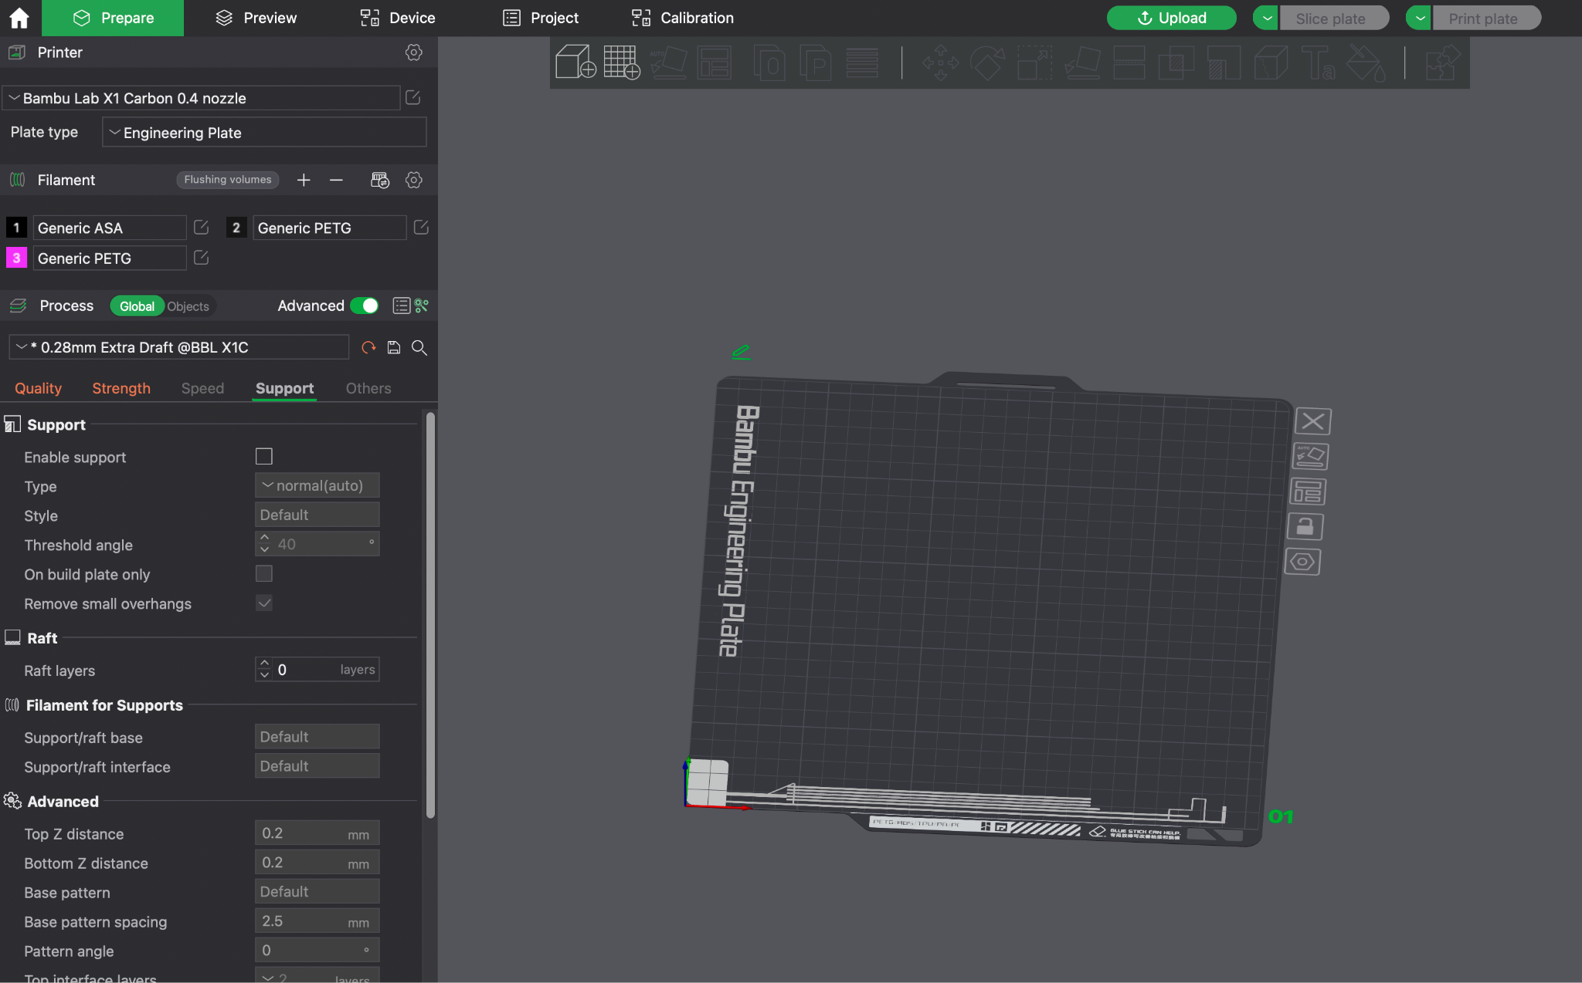
Slicer

Slide 46
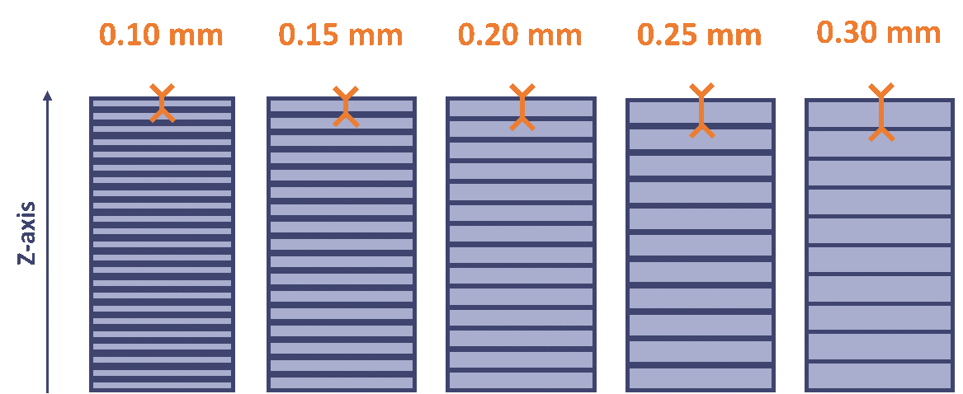
Layer Height
Layer Height is the thickness of the successive layers that builds the object.
Layer height has a direct correlation to resolution. Resolution is how “rough” the part’s walls appear to be.
Layer height also has a correlation with the speed of the print.
Notes:
A noteworthy analogy would be trying to build two pyramids of equal height ; one is built by stacking slices of bread, while the other is build from post-its.

Slide 47
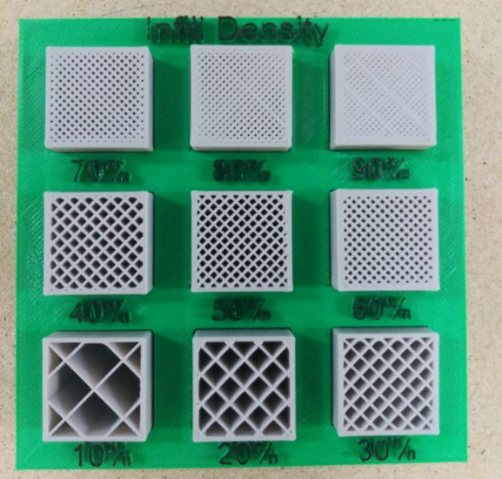
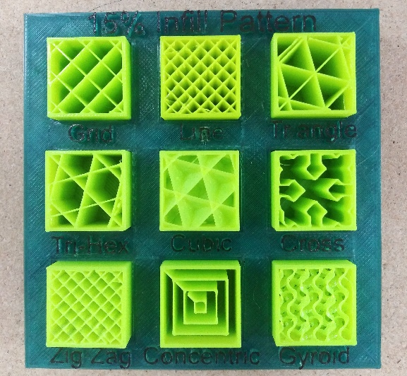
Infill
Infill, also known as fill density, is the percentage amount of solid volume inside a 3D printed part.
For most objects, 10% has been found to be a excellent trade-off between weight, cost, strength, and time spent printing.
Infill shape can also be customized based on strength requirements

Slide 48
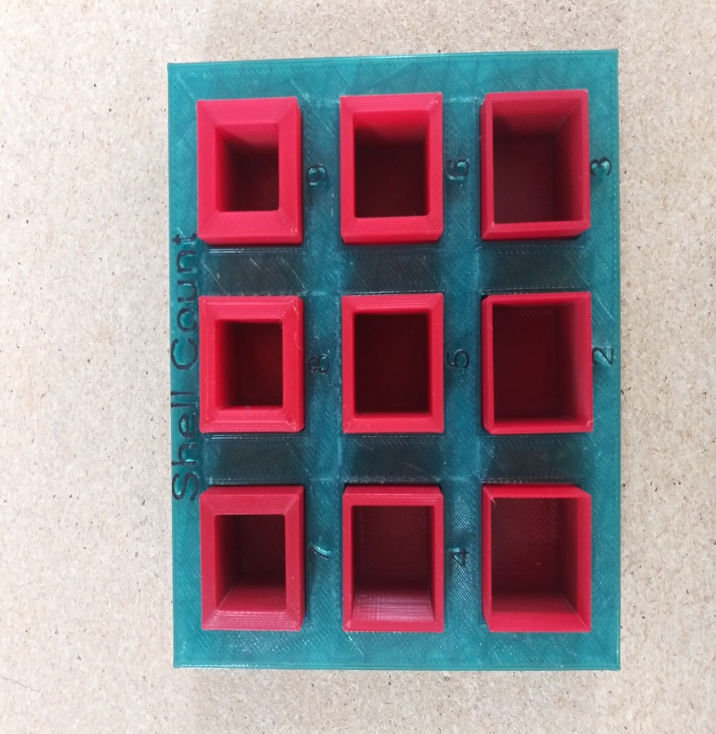
Shell Thickness
The thickness of the outside walls is dependent on the setting called “Shell Thickness”.
The thicker the shell, the stronger the outside walls but greater weight/density.
Notes:
Common wall thickness for prototyping ranges from 2 – 6 walls thick, or 1mm to 3mm thick

Slide 49
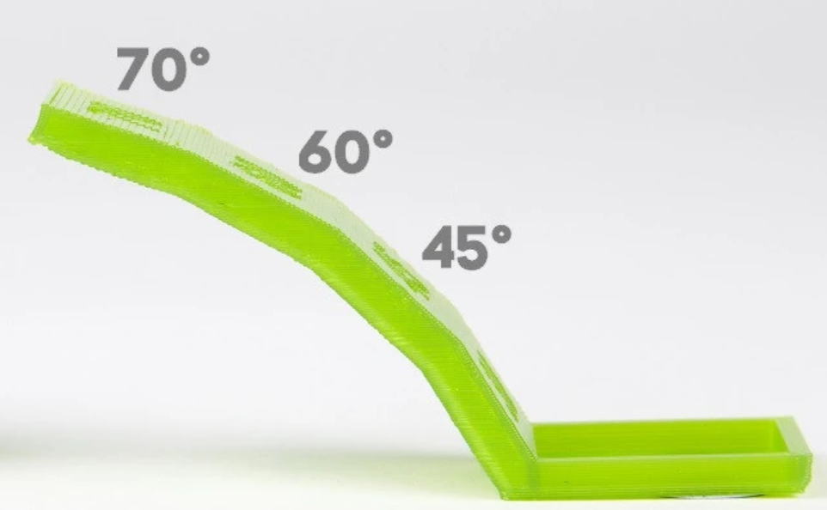
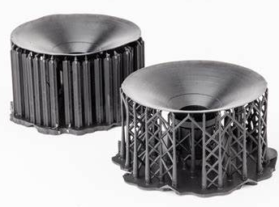
Support
A support is created below overhangs.
Support is usually a grid that stops short of where the overhang takes place.
An angle of 45 degrees from the print bed is a good place to start but this can vary widely based on print settings and material.
Notes:
As recalled from before, a 3D printed part is built layer upon layer. What happens if there is no layer beneath the next layer?

Slide 50
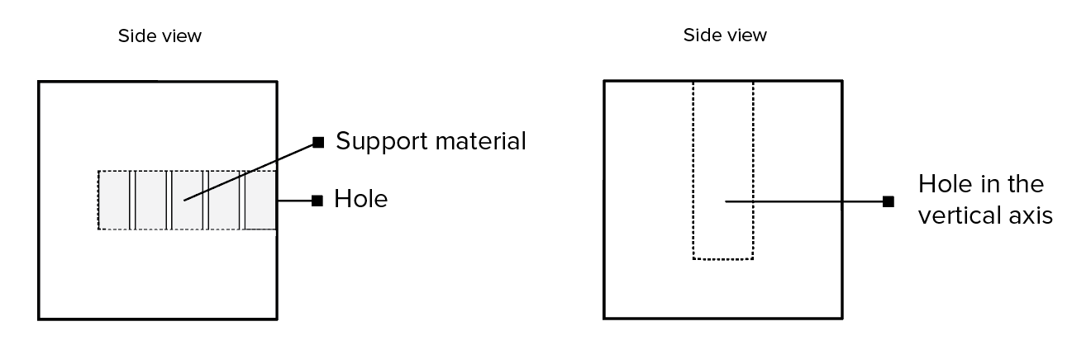
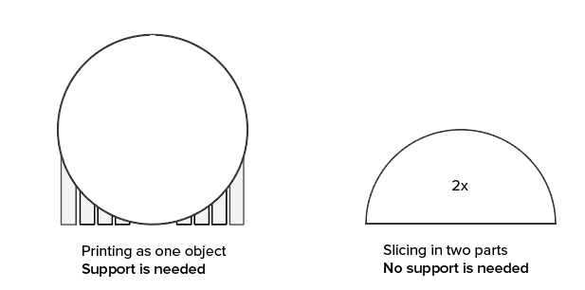
Support

Slide 51
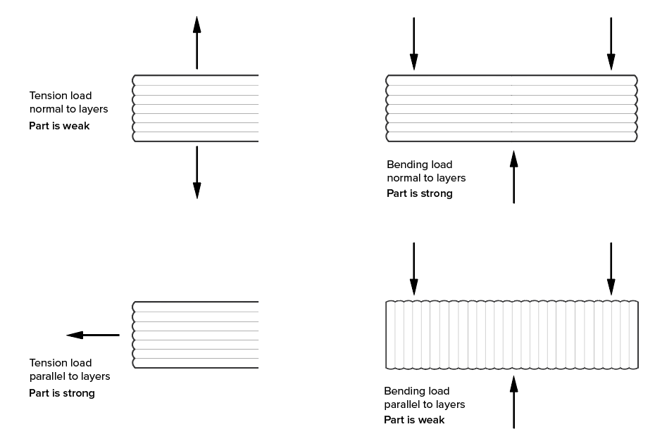
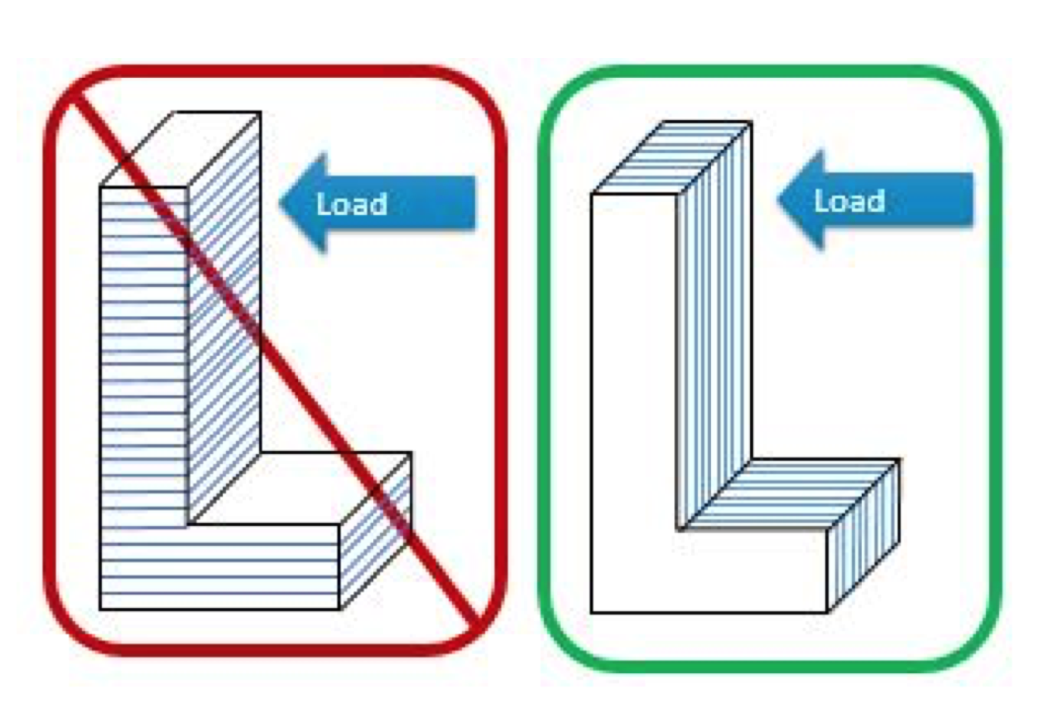
Load Direction
Sheer Strengths with FDM

Slide 52
Considerations
Layer heights have little impact on strength
Shells are the main strength member of a printed part
Will my layer height affect important details?
Infill is important in supporting the shells
Print cooling, temperatures, print speeds, and filaments will also all affect the strength of the part

Slide 53
Challenge
Slice your dog tag.
Price?
Time?
Normal infill:
10-20%
Shell Layer: 2-3

Slide 54
Print ID tag

Slide 55
Reverse Engineering
Reverse Engineering is a method which enables users to replicate an object or a part with the help of 3D printing.

Slide 56
Tips
Start with the largest, general shapes.
Identify what components are optional vs necessary.
Keep in mind DFAM (Design for additive manufacturing).

Slide 57
Post Processing
In post processing unwanted material is removed by trimming, cutting, sanding and even smoothing with certain chemicals.
Post processing provides the finishing touch to ensure your object is ready for use.

Slide 58
Course Material For Day 2 Complete
Notes:
Castle/3d prac if they make it that far

Slide 59
Day 3

Slide 60
Printer Maintenance

Slide 61
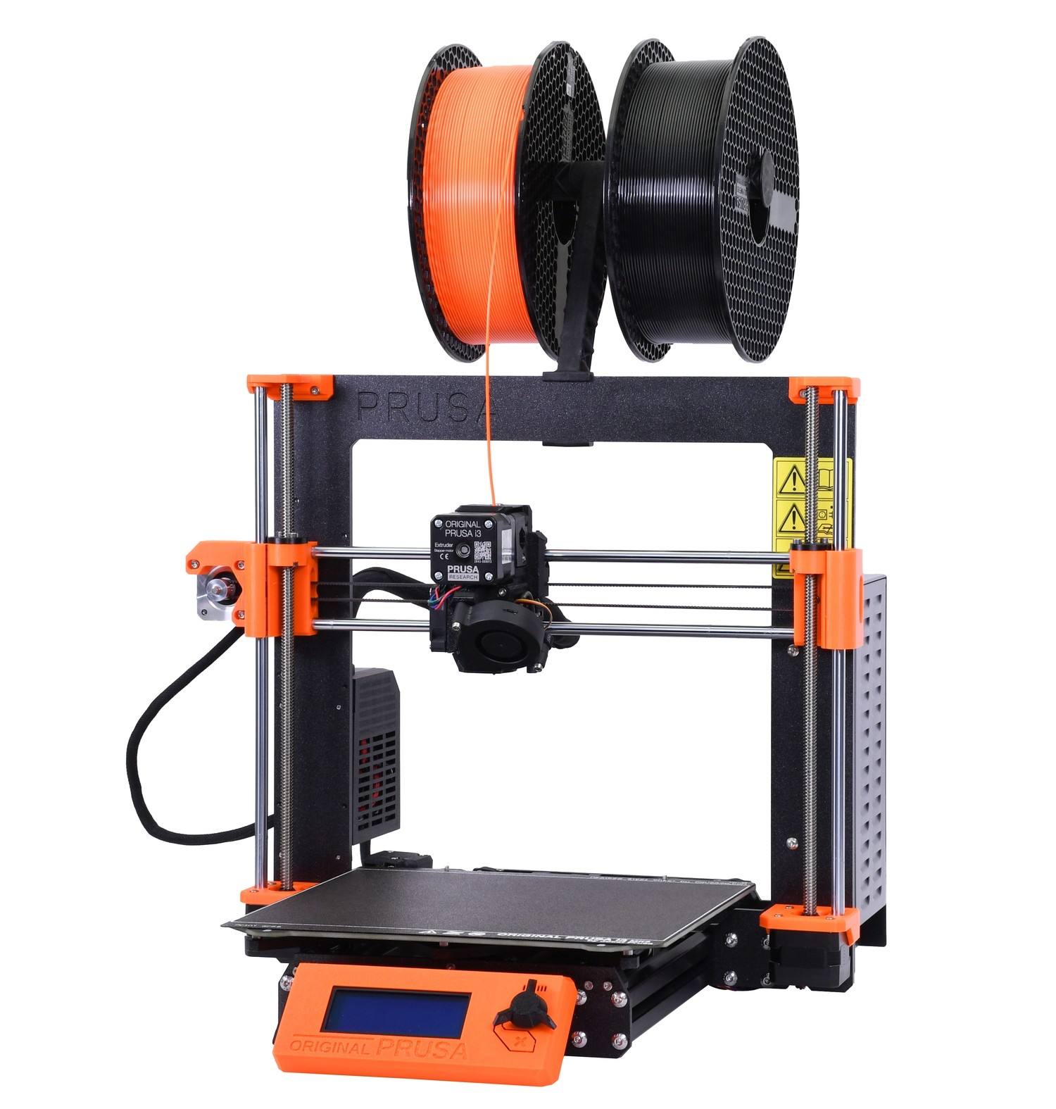
Basic 3d printer Maintenance
Like with any piece of equipment, 3D printers can lose their accuracy over time. 3D printing is very delicate, and as an operator you will be required to make adjustments to your printer to produce the best product.
Notes:
500 hours is a good interval for preventive maintenance

Slide 62
PMCS on Printers
Basic 3d printer Maintenance
Loose or cracked belts
Dirty lead screws
Dirty guide rods
Improper Z axis leveling
Contaminated heatbed
Delaminated PEI sheet
Shorted/Loose heatbed wires
Shorted/Loose extruder wires
Dirty or clogged nozzle
Dirty bed leveling contacts*
Loose filament guide
Tangled filament
Wobbly 3D printer
Notes:
* LUZBOT Specific.

Slide 63
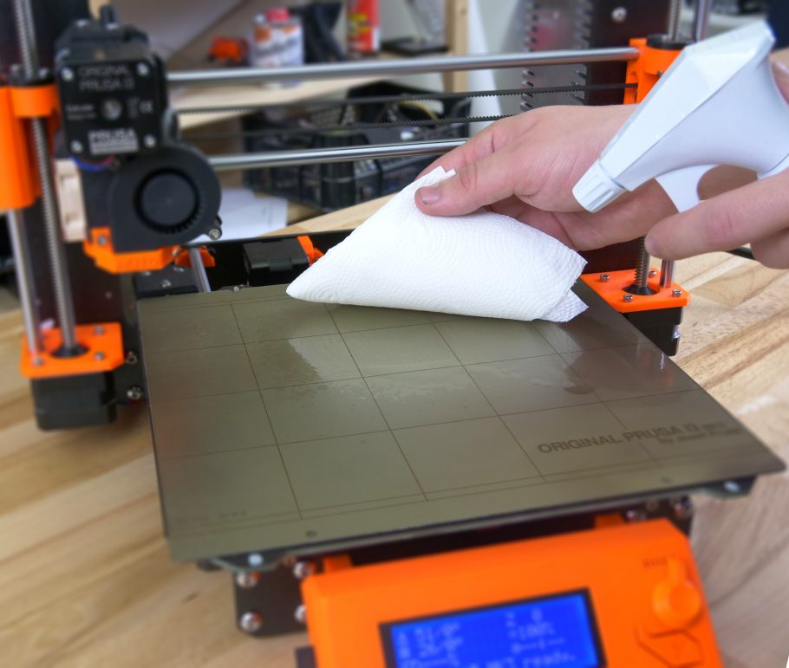
Dirty/Improper Build Plate
Contaminated Bed
If your bed is contaminated by oils or dust, you will have poor initial layer adhesion.
Clean your heatbed prior to every print for greater success. Use 90%> IPA. NEVER use acetone.
To remove old glue, dust or any other contaminants dish soap and warm water is recommended.
Surface type and finish will drastically change adhesion qualities.

Slide 64
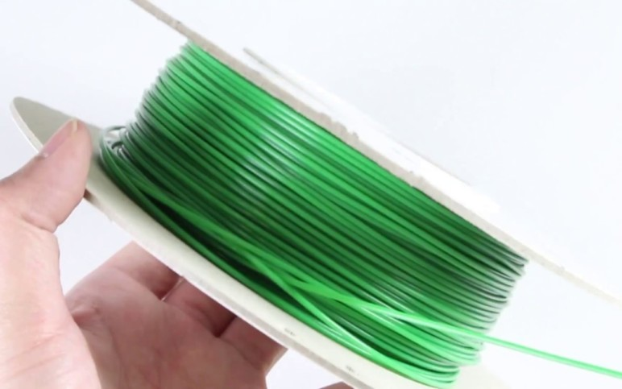
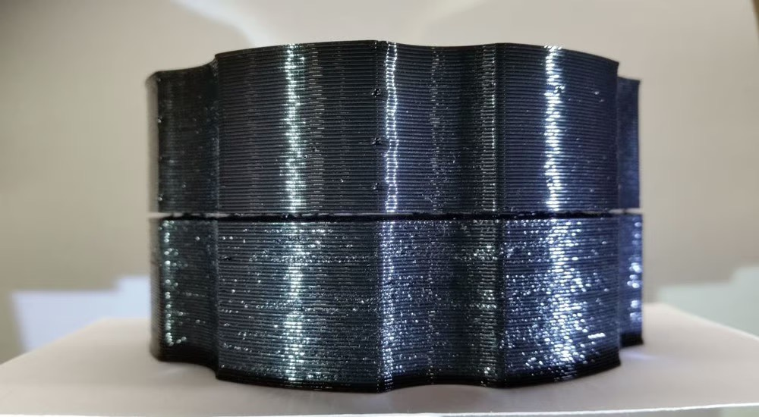
Tangled/Wet Filament
Tangled filament is one of the most common failures. Always maintain the free running end at all times.
Filament is highly hygroscopic, which means it quickly absorbs moisture from the air.
Bubbles in print layers
Extruder Jams
Brittle, soft and fragile parts
Poor bed adhesion

Slide 65
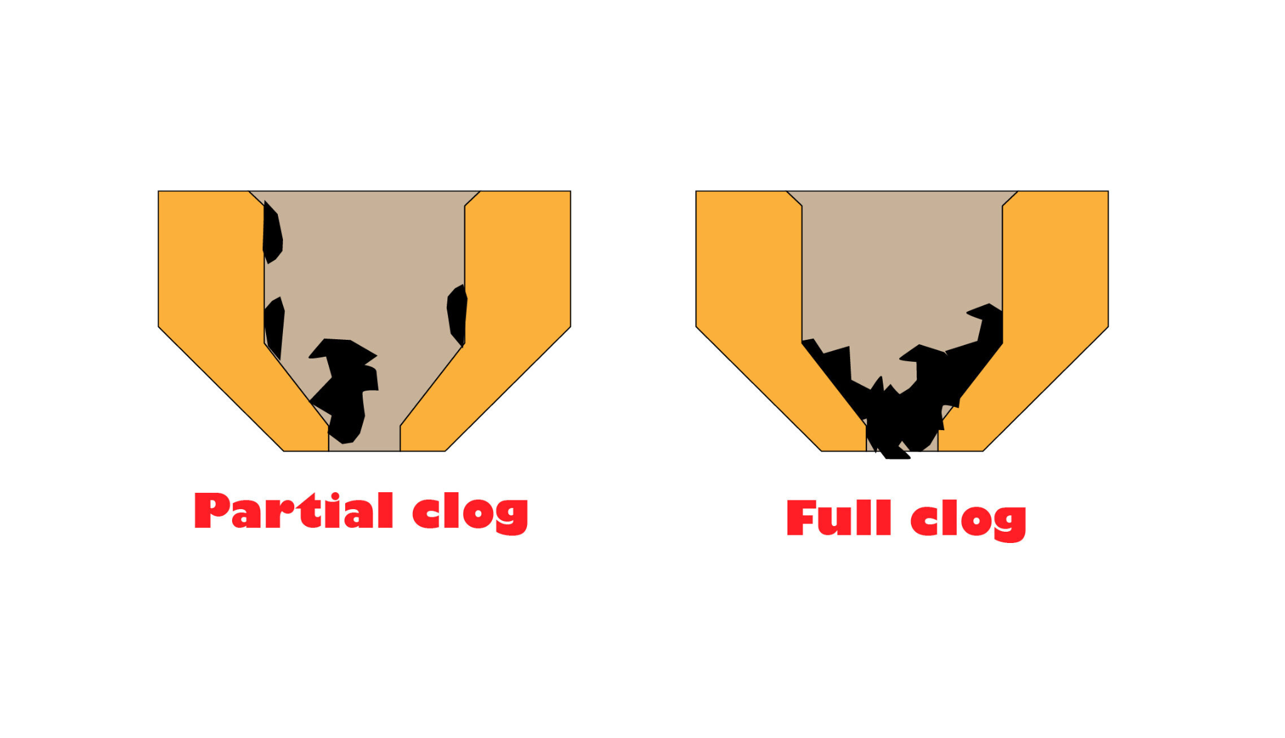
Clogged Extruder Nozzle
Clogged Nozzles can happen for various reasons.
improper filament changes
damaged nozzle
improper heat setting
improper extruder operation
wet filament

Slide 66

Wobbly Printer/Foundation
A stable foundation for a printer ensures accurate and consistent prints. A wobbly printer can lead to:
Improper auto bed leveling
Ghosting
Dimensionally inaccurate prints
Binding during printer movement

Slide 67


Loose or Cracked Belts
When checking the belts, you want to make sure they’re not dry rotted, stretched, loose, or overly tight. Adjust or replace the belts as necessary.

Slide 68

Greased lead screws
Lead screws are often used to move Z axis. They are exposed to environment and have to be kept clean and free of debris.
A light grease or lubricating oil can be recommended for some printers. While others MUST be DRY.
Notes:
* LUZBOT Specific.

Slide 69


Damaged Heatbed
Delaminated PEI sheet
Most 3D Printing heat beds used by the DoD have a PEI sheet adhered to it. This PEI sheet aids in layer adhesion when printing. Over time, the PEI sheet can separate from the heat bed and needs to be replaced. Look for excessive bubbling and cracks or fractures in the heat bed.
Notes:
The MarkForge and MakerBots have a slate heat bed with no PEI sheet.

Slide 70

Shorted/Loose Wires
Inspect all wiring subjected to repeated motion before each use.

Slide 71

DIRTY GUIDE RODS + BEARINGS
The linear bearings in your printer need to operate smooth and consistently for ultimate print success.
Keep guide rods clean, free of binding and dry.
Check frequently for seized or gritty bearings

Slide 72
Demonstration on calibration

Slide 73


First Layer Calibration
First layer height is .20mm of the time regardless of overall print layer height setting.
Notes:
This will improve bed adhesion and dimensional accuracy. When to calibrate?

Slide 74

Capstone Project

Slide 75
Capstone Parameters
Design and print a tool or item that will improve something within the Army with the following design limitations:
No more than a ~12 hour print. <1,000g of material
Final product must be functional
Must be able to be demonstrated live

Slide 76
Day 4

Slide 77
Capstone Presentation
What is it?
How does it benefit the Army?
What would you have done different?
How can AM be relevant in your daily Soldiering life?
What did you learn?

Slide 78
Course Review
2+ SUSTAINS
2+ IMPROVES
Don’t be shy.
We don't get better that way!!!!

Slide 79
Reset Classroom
Log off Fusion 360
Remove Personal files and data from desktops
Plug in Apple mice
Stow Corded mice, dongles, and calipers in drawers
Wipe down surfaces and return misc items to instructor
Straighten chairs/tables
Trash

