Slide 1

Start your future now
Barton Community College
2025

Slide 2
Barton College Carrer path and certifications:
Military Programs Certificates
Leadership
Logistics
Hazardous Materials and Handling
OSHA
Occupational Safety & Health
Specialist in Safety & Health Construction Industry
Specialist in Safety & Health General Industry
For more information on OSHA Contact: 785-238-8550

Slide 3
Leadership Certification
A leadership certification is a fast, effective way for younger professionals to stand out early in their careers by building real-world skills like strategic thinking, communication, and team management. It demonstrates commitment to growth, readiness for responsibility, and the ability to adapt to organizational change. This credential boosts credibility opens doors to better roles and higher earning potential and accelerates pathways to leadership.

Slide 5
Career Opportunities / Potential Earnings
Leadership certificates can significantly increase long-term earning potential.
According to the Bureau of Labor and Statistics, 42% of individuals who earned a Leadership Certificate reported an average $17,000 salary increase.
16% of certificate holders received an average $14,000 bonus.
Leadership certificate programs are typically more affordable than other educational options.
Many employers invest over $1,280 per employee in workplace learning, making employer-funded programs a cost-effective option.
Human Resources & Training | Project & Consulting | Management & Executive | Skilled Trades Leadership
Training and Development Specialist | Management Consultant | General Manager | Construction
Human Resources Specialist | Program Manager | Operations Manager | Plumbing
Human Resource Manager | Project Manager | Sales Manager | Electrical

Slide 6
Logistics Certification
A logistics certification is a powerful way for early-career professionals to stand out by gaining real-world skills in supply chain management, inventory control, distribution, and transportation operations. It demonstrates to employers that your detail-oriented, reliable, and equipped to keep modern supply chains running smoothly. This credential boosts credibility increases employability across multiple industries and opens doors to higher-paying roles with more responsibility. It’s an ideal pathway for anyone looking to advance quickly in warehousing, transportation, procurement, or operations support.

Slide 7
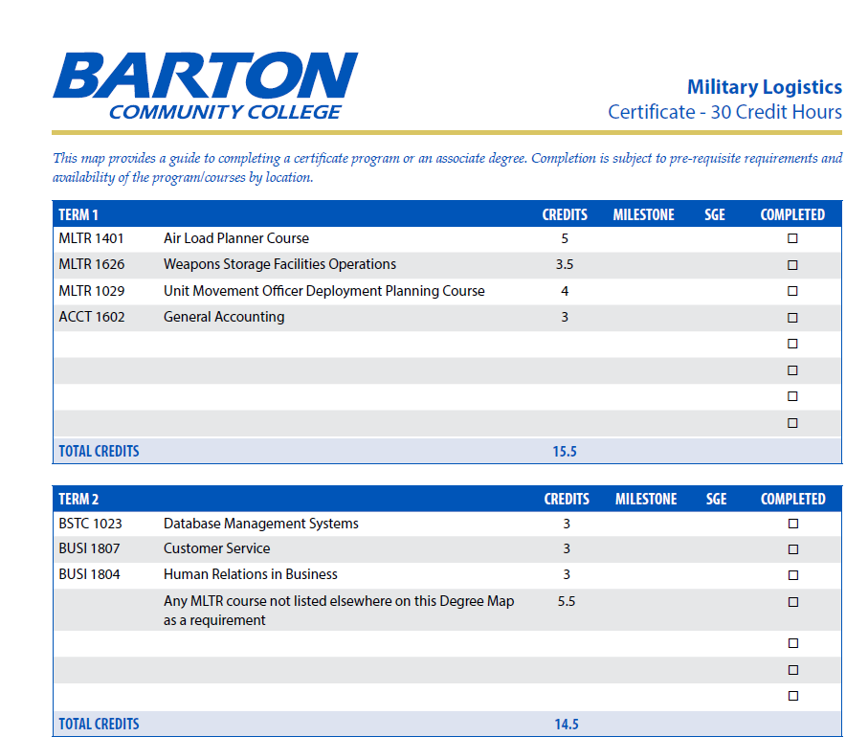

Slide 8
Carrer Opportunities / Potential Earning
Supply Chain & Inventory | Transportation & Distribution | Procurement & Planning | Operations & Logistics Leadership
Inventory Control Specialist | Transportation Coordinator | Procurement Specialist | Logistics Supervisor
Supply Chain Technician | Freight Dispatcher | Supply Planner | Warehouse Manager
Materials Handler | Fleet Operations Assistant | Purchasing Assistant | Distribution Center Supervisor
Logistics Analyst (entry-level) | Shipping/Receiving Lead | Contract Support Technician | Operations Coordinator
Logistics certificates can significantly increase long-term earning potential.
According to the Bureau of Labor and Statistics, a logistics certification can boost your salary by 10% to 25%, with some specific certifications like CSCP showing potential increases of up to 27% or 41%. Holding multiple certifications can lead to an even higher salary increase, with some reports showing a 34% or greater boost for those with two or more credentials
Professionals holding at least one credential enjoy 45% greater cash bonuses than those without a certification. For those with two or more credentials, the increase is even more significant, at 81% greater cash bonuses.
Logistics certificate programs are typically more affordable than other educational options.
Many employers invest heavily in supply chain and logistics training—often over $3,425 per employee—making employer-funded logistics certification programs a highly cost-effective option for advancing your career.

Slide 9
Military Hazardous Materials Handling Certification
A Military Hazardous Materials Handling Certification is a highly valuable credential that equips professionals with the knowledge and skills needed to safely manage, transport, store, and document hazardous materials in compliance with military, federal, and international regulations. This certification demonstrates to employers that you understand risk mitigation, safety standards, emergency response procedures, and strict regulatory requirements—critical skills across defense, government, and civilian industries.

Slide 10
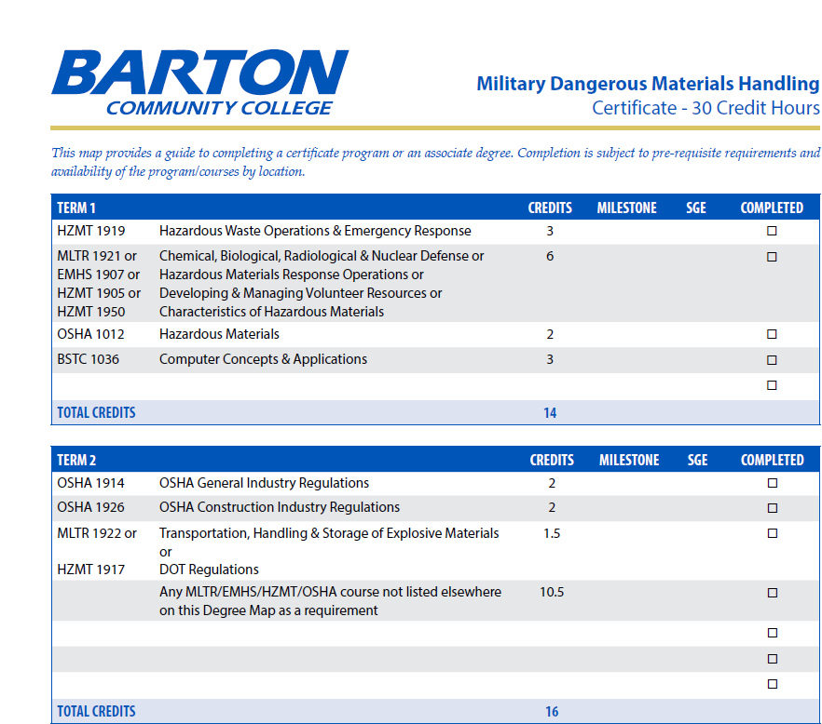

Slide 11
Career Opportunities / Potential Earnings
Defense & Government Compliance | Transportation & Distribution | Industrial & Environmental Safety | Leadership & Advanced Operations
Hazardous Materials Handler | Hazardous Materials Transportation Coordinator | Safety and Compliance Officer | HAZMAT Program Supervisor
HAZMAT Operations Specialist | Dangerous Goods Shipping Specialist | Environmental Health & Safety (EHS) Technician | Environmental Program Manager
Environmental Protection Technician | Compliance & Documentation Technician | Spill Response & Emergency Operations Assistant | Transportation Safety Manager
Munitions & Explosives Safety Specialist | Freight Safety Inspector | Industrial Safety Specialist (entry-level) | Hazardous Materials Training Coordinator
Certifications in hazardous materials handling consistently lead to higher-paying safety and compliance roles, especially in government, defense contracting, and transportation.
Professionals holding a recognized HAZMAT or Dangerous Goods certification often see salary increases ranging from 10% to 30%, especially when paired with logistics or safety credentials.
Many organizations offer additional pay incentives, bonuses, or stipends for certified HAZMAT personnel due to the specialized nature of the work and its direct impact on workplace safety.
Employees with multiple safety-related credentials—such as HAZMAT, OSHA, or Environmental Safety—frequently enjoy substantially higher bonus potential compared to those without certifications.
HAZMAT training programs are typically more affordable and quicker to complete compared to full academic degrees, making them a cost-effective option for rapid career advancement.
Many employers (military, federal agencies, defense contractors, logistics companies) fully fund HAZMAT certification training due to strict compliance requirements and the high operational value of certified personnel

Slide 12
Associate of Applied Science (AAS) Degree – Barton Community College
An Associate of Applied Science (AAS) degree from Barton Community College is a practical, career-focused pathway designed to prepare students for immediate entry into the workforce while building a strong foundation for long-term professional growth. The AAS provides hands-on, job-ready skills in high-demand fields such as business, healthcare, logistics, emergency services, information technology, and technical trades.

Slide 13
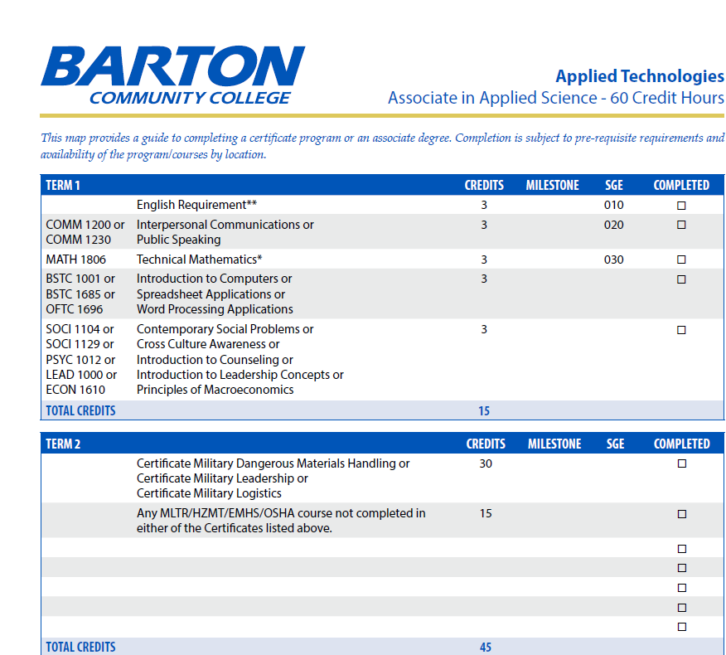

Slide 14
Career Opportunities / Potential Earnings
Business & Human Services | Management & Operations | Technical & Skilled Trades | Healthcare & Emergency Services
Human Resources Assistant | Operations Supervisor (entry-level) | Construction Technician | Medical Office Specialist
Training and Development Assistant | Business Operations Assistant | Automotive Service Technician | Emergency Medical Technician
Administrative Services Specialist | Project Coordinator | Welding and Fabrication Specialist | Radiologic Technology Pathway Support
Program Support Technician | Team Lead | Electrical Technician | Patient Care Technician
Graduates with an AAS degree often experience higher earning potential, with many industries offering increased wages for candidates holding two-year technical or professional degrees.
According to national workforce data, individuals with an associate degree earn $8,000–$15,000 more annually than those with only a high school diploma.
Many careers linked to AAS degrees provide opportunities for salary growth, bonuses, and supervisory pay as graduates gain experience.
AAS programs are often more affordable than four-year degrees, allowing students to advance their careers without incurring significant debt.
Many employers—especially in healthcare, technical fields, and logistics—invest in employee education, making employer-funded AAS degree programs a cost-effective pathway for career advancement.

Slide 15
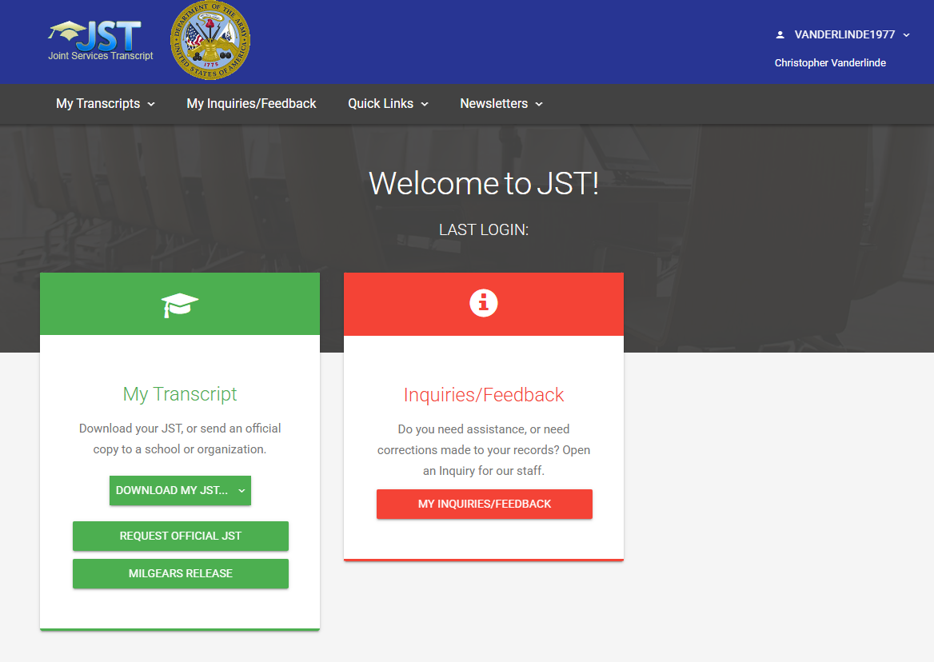
Request a JST Transfer
Website: https://jst.doded.mil

Slide 16
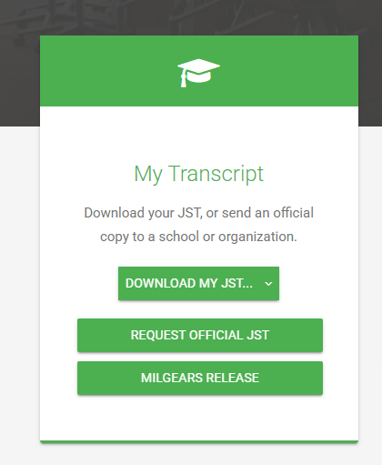
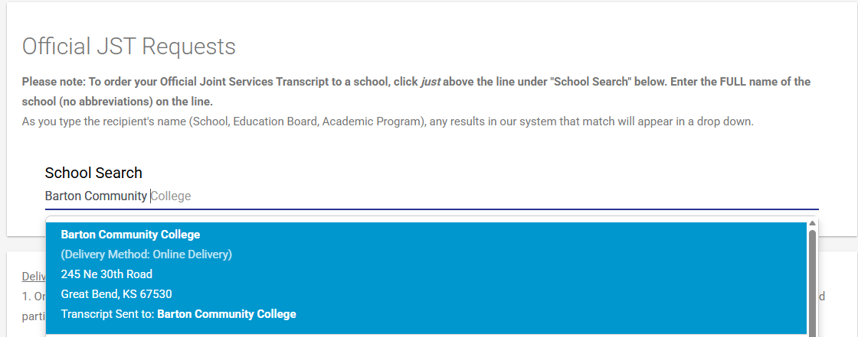
Request JST Transfer continued

