Slide 1
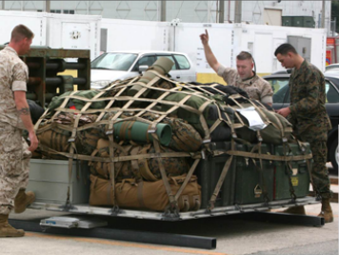
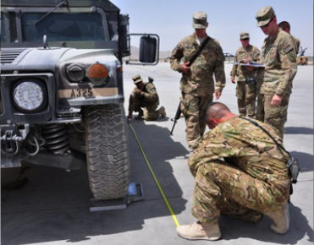
WEIGHING AND MARKING
CAO: 10 October 19

Slide 2
OVERVIEW
Weighing Cargo
Pallet Identifier
Center of Balance Calculations and Terms

Slide 3
WEIGHING CARGO
All cargo offered for shipment must be weighed
Portable or fixed scales
Indicate actual weight on both sides of items offered for shipment
Scale weight must be recorded on all copies of the manifest

Slide 4
WEIGHING CARGO
Accuracy of weights
Don’t weigh cargo until secondary load is secured
Don’t add or remove cargo
Any changes require cargo to be weighed again
The driver and/or passengers must be out of the vehicle prior to weighing

Slide 5
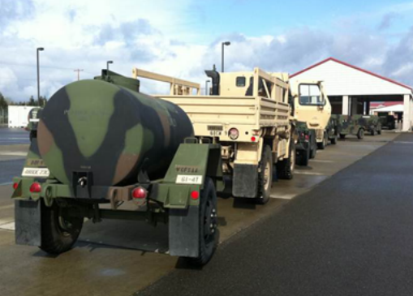
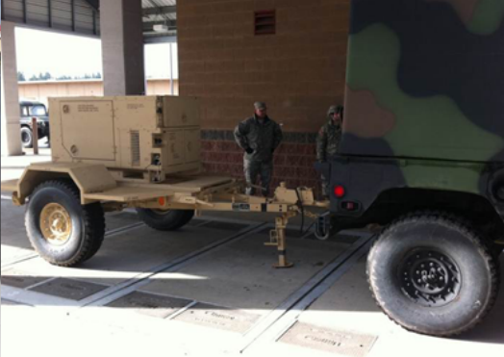
SCALES
Fixed Scales
Permanently installed weighing devices
These scales are capable of weighing most items of cargo
Notes:
Scales
Fixed scales are permanently installed weighing devices
Located at most major military installations
They are similar to most truck scales seen along side of major American highways
These scales are capable of weighing most items of cargo

Slide 6
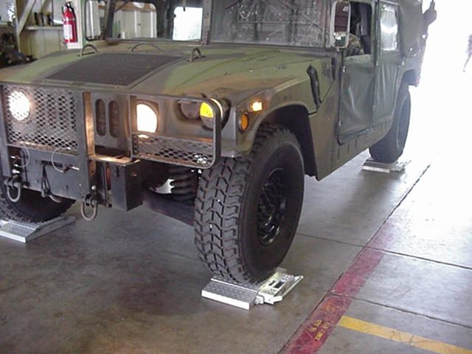
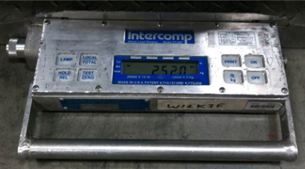
SCALES
Portable scales
Most commonly used
Capacity 20,000 lbs. per scale
Units should have their
own scales to help expedite deployment
Notes:
Portable scales
The most commonly used portable scales are capable of weighing cargo up to 20,000 pounds per scale
These scales are used extensively at airfields, unit areas, marshalling areas, inspection areas, and forward operating locations
Portable scales are normally used in multiples of four
A minimum of two scales will be used
It is advisable for all units to have their own scales to help ensure a smooth deployment

Slide 7
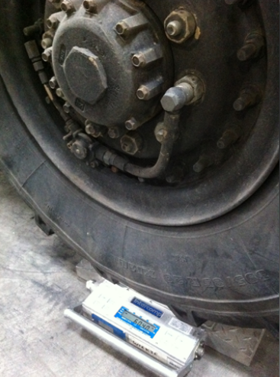
WEIGHING WHEELED VEHICLES
When only two portable scales are available:
Place the scales in front of the tires of the first axle
Drive the vehicle onto the scales; keep tires centered
Determine the axle weight
Continue process until all axles are weighed
Notes:
Note: The driver and/or passengers must be out of the vehicle prior to weighing the axle/axles

Slide 8
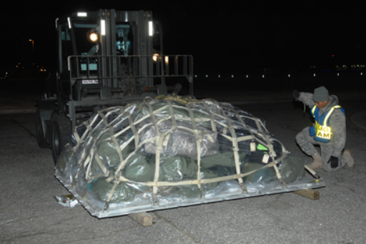
WEIGHING PALLETS
Each 463L pallet must be weighed
Scale weights must be recorded on all copies of the manifest

Slide 9
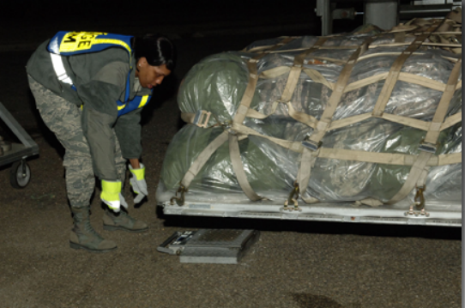
WEIGHING PALLETS
Place a loaded pallet evenly on two portable scales (Note: Three pieces of dunnage must be weighed with the pallet)
Add the two scale weights together to get the pallet gross weight
Notes:
Ensure the scale weight is clearly marked on:
Use DD Form 2775 (Pallet Identifier), to annotate the required information for cargo documentation
All container/pallet weights will also be marked with a Military Shipping Label or DD Form 1387

Slide 10
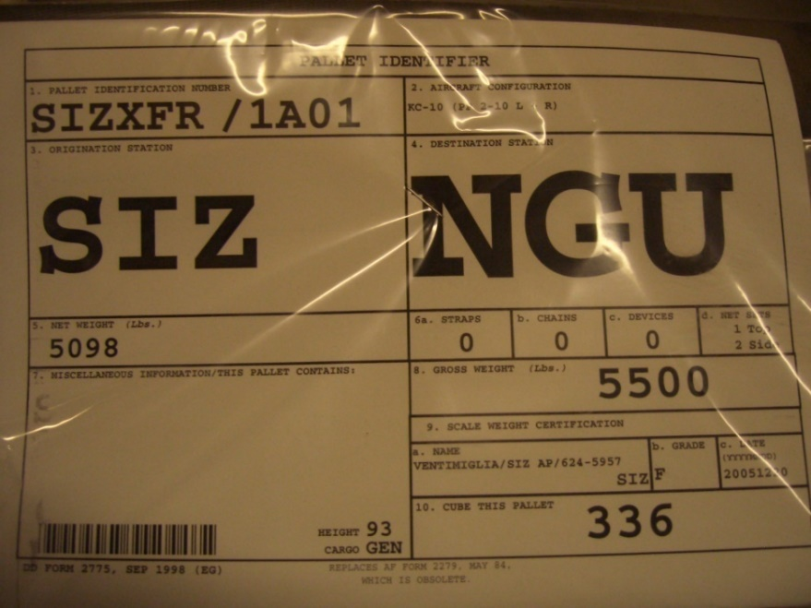
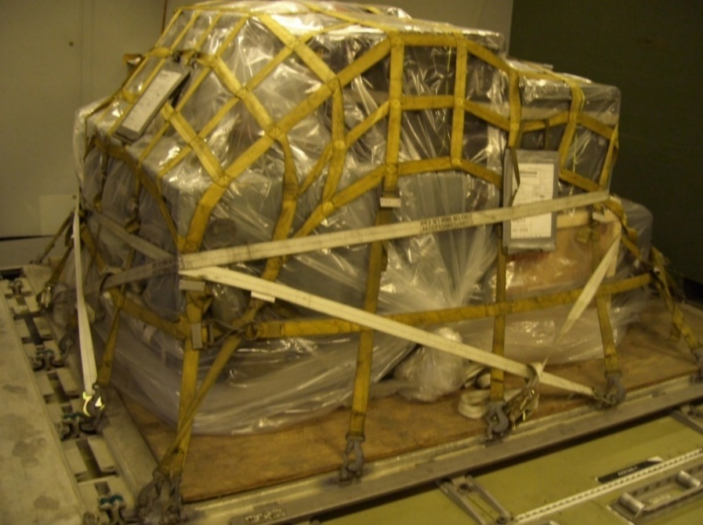
PALLET IDENTIFIER
Two copies of the pallet identifier will be completed for all 463L pallet/trains loaded with cargo/mail

Slide 11
PALLET IDENTIFIER
If the DD Form 2775 is unavailable, a legible substitute can be accepted with the following information, as a minimum
Point of Embarkation (POE)
Point of Debarkation (POD)
Gross weight
Net weight
TCN
Height

Slide 12
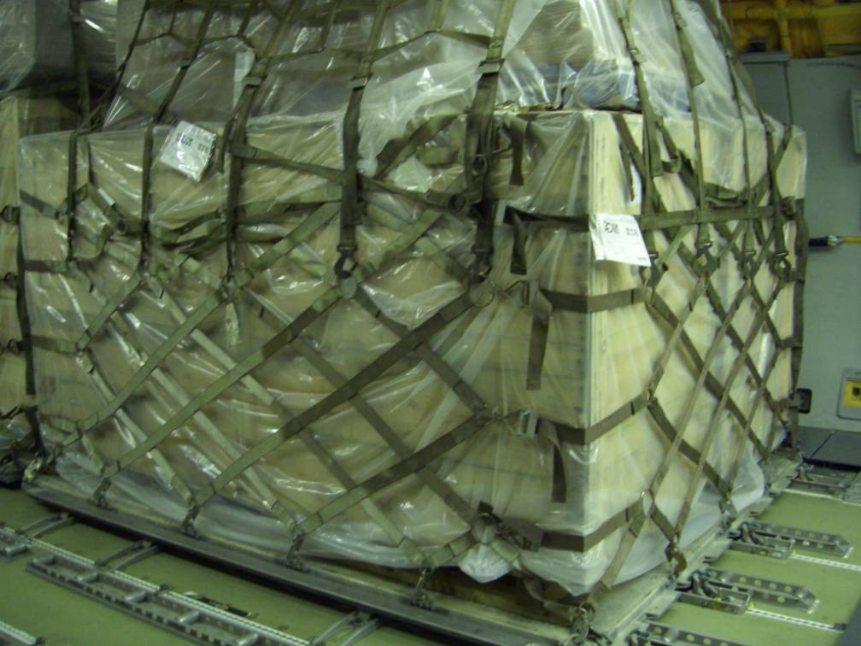
PALLET IDENTIFIER
Attach the copies to the upper left hand corner at eye level (when pallet height permits)
One on a 88” side
and one on a 108”
side of the pallet

Slide 13
PALLET IDENTIFIER
Place the form inside interlocking closure plastic bags for protection
Entries on the form are self-explanatory
Never reflect words “classified”, “small arms/weapons”, “munitions”, or other highly sensitive items by name

Slide 14
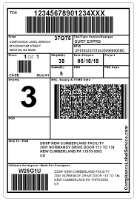
PALLET IDENTIFIER
Military Shipping Label/DD Form 1387
All containers and built-up 463L Pallets will also be marked with a Military Shipping Label (MSL)
The MSL allows automatic identification Technology to process unit move Shipments expeditiously
Two properly completed copies are required for each container/pallet
Notes:
The DD Form 1387, Military Shipment Label may be used only for contingency
operations when the automated MSL is
unavailable
Refer to DTR Part III Appendix H for detailed guidance

Slide 15
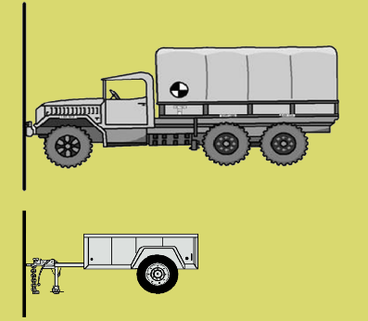
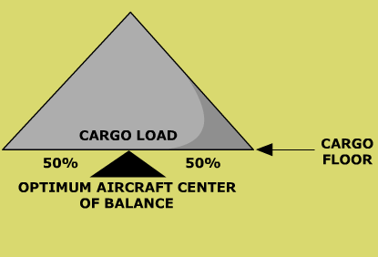
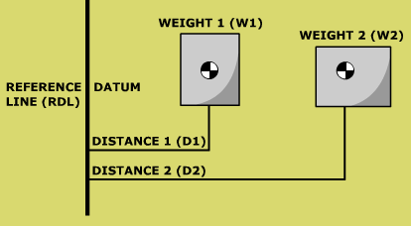
CENTER OF BALANCE TERMS
(RDL) = Reference datum line
(CB) = Center of Balance
(GW) = Gross weight
(W1) = Weight one
(W2) = Weight two
Note: Distance and Arm are interchangeable terms
Notes:
Reference datum line (RDL)
A line from which all measurements are taken, normally, the RDL is established at the forward edge of a vehicle
Once the reference line is established, don’t change it
Center of Balance (CB)
The point of balance of a piece of cargo
Gross weight (GW)
The total weight of an item of cargo, including all secondary cargo
Gross Weight (GW) and Total Weight (TW) are interchangeable terms
Weight one (W1)
Used in computing the CB
W1 - first weight from the RDL
Weight two (W2)
Used in computing the CB
W2 defines the second weight contacting the floor from the RDL
W3, W4, and W5 = weight three, weight four, and weight five. Terms used to define subsequent weights after W1 and W2

Slide 16
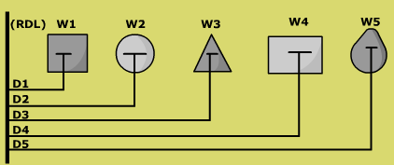
CENTER OF BALANCE TERMS
(D1) = Distance one
(D2) = Distance two
(M) = Moment (inch pound)
Note: Distance and Arm are interchangeable terms
Notes:
Distance (arm) one (D1)
The distance from the RDL to W1, measured in inches
Distance (arm) two (D2)
The distance from RDL to W2, measured in inches
D3, D4, and D5 = distance three, distance four, and distance five. Subsequent distances (always measured in inches) from the RDL to the appropriate weights
Moment (M)
M = product obtained by multiplying weight (in pounds) by distance (in inches) from the RDL

Slide 17
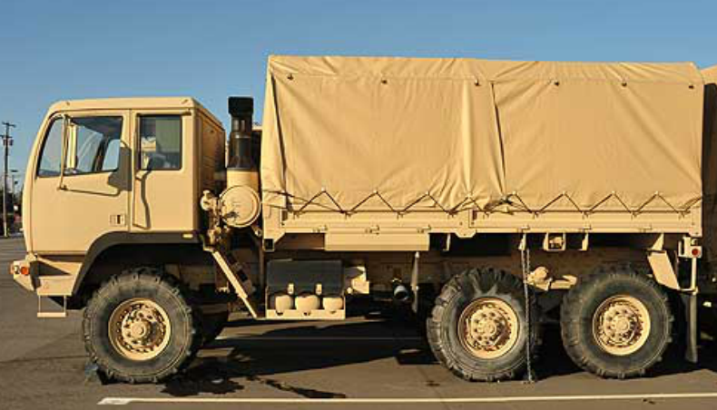
CENTER OF BALANCE TERMS
(FAW) = Front/forward axle weight
(MAW) = Middle axle weight
(RAW) = Rear axle weight
(FFE) = From forward end
Notes:
Front/forward axle weight (FAW)
The front axle of a vehicle. The first axle from the RDL (see figure 8.10.)
Middle axle weight (MAW)
The axle(s) between the front and rear axles. The middle axle weight is measured from the RDL (see figure 8.10.)
Rear axle weight (RAW)
The rear axle of the vehicle. The last axle of the vehicle from the RDL (see figure 8.10.)
Front forward edge (FFE)
Distance measured from the most forward edge of a vehicle to the CB of a vehicle

Slide 18
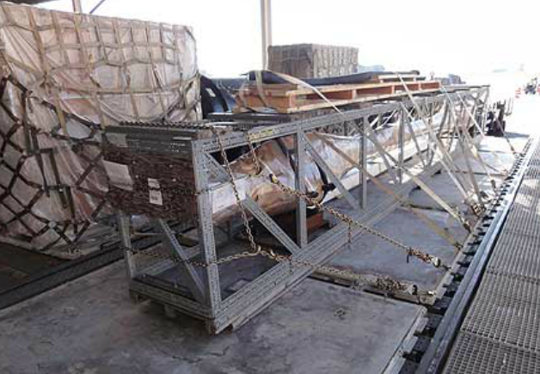
CENTER OF BALANCE CRITERIA
Center of balance markings are not required on individual 463L pallets
Mark the CB on all items of
cargo that meet the following
criteria
All vehicles
Any items of cargo 10’ or longer
Any item with a CB point other than its center
Notes:
If 463L pallets are built correctly, the center of balance will be at or near the center
You must place center of balance (CB) markings on married pallets (pallet trains)

Slide 19
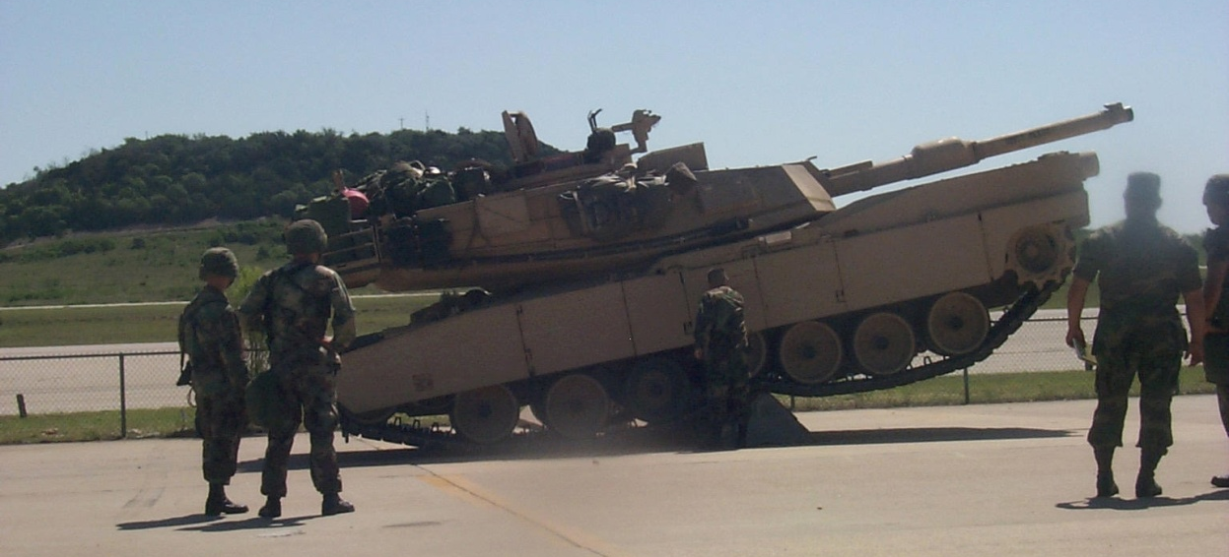
CENTER OF BALANCE CRITERIA
To determine the center of balance for a tracked vehicle, drive the vehicle over an object large enough to allow the vehicle to teeter
The location of where the vehicle teeters will be marked as the center of balance

Slide 20
CENTER OF BALANCE PROCEDURES
After computing the CB of the vehicle:
GW 17,530
Mark its location and gross weight on both sides of the vehicle
Using weather resistant masking tape and grease pencil/magic marker, forming the letter “T”
C.B.
99"
FAW 6320
F.F.E.
MAW 5690
RAW 5520
MAW 5690
RAW 5520
FAW 6320
GVW 17,530
C.B.
99"
F.F.E.

Slide 21
CENTER OF BALANCE PROCEDURES
“T” marking
The horizontal portion of the “T” will contain the gross weight
The vertical portion indicates the exact position of CB
Indicate number of inches from the RDL to the CB location and mark axle weights above each axle on both sides of the vehicle
GVW 5900
C
/
B
135”
FFE

Slide 22
CENTER OF BALANCE PROCEDURES
Weight 1 × Distance 1 = Moment 1
Weight 2 × Distance 2 = Moment 2
Total Moment ÷ Total Weight = C/B
NOTES:
Gross Moment and Total Moment are interchangeable terms
Round decimals to the nearest whole number

Slide 23
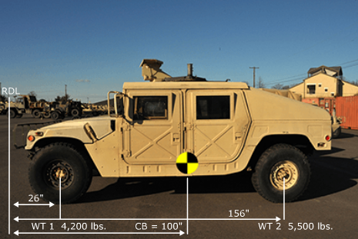
CENTER OF BALANCE COMPUTATIONS
W1 × D1 = M1
W2 × D2 = M2
W1 + W2 = GW
M1 + M2 = GM
GM ÷ GW = CB
Round decimals to the nearest whole number

Slide 24
CENTER OF BALANCE COMPUTATIONS
W1
W2
D1
D2

Slide 25
CENTER OF BALANCE COMPUTATIONS
W1
W2
W3
W4
D1
D2
D3
D4
(W1 × D1) + (W2 × D2) + (W3 × D3) + (W4 × D4)
GW
= CBFE

Slide 26
CENTER OF BALANCE COMPUTATIONS
WEIGHT × DISTANCE = MOMENT
1,400 × 25” =
1,050 × 97” =
GW = GM =

Slide 27
CENTER OF BALANCE COMPUTATIONS
WEIGHT × DISTANCE = MOMENT
1,400 × 25” = 35,000
1,050 × 97” = 101,850
GW = 2,450 GM = 136,850

Slide 28
CENTER OF BALANCE COMPUTATIONS
WEIGHT × DISTANCE = MOMENT
1,400 × 25” = 35,000
1,050 × 97” = 101,850
GW = 2,450 GM = 136,850
GM GW CGFE
136,850 ÷ 2450 = _____ inches
56

Slide 29
CENTER OF BALANCE COMPUTATIONS
RDL
W1
W2
D1
D2

Slide 30
CENTER OF BALANCE COMPUTATIONS
WEIGHT × DISTANCE = MOMENT
50 × 14” =
490 × 60” =
GW = GM =

Slide 31
CENTER OF BALANCE COMPUTATIONS
WEIGHT × DISTANCE = MOMENT
50 × 14” = 700
490 × 60” = 29,400
GW = 540 GM = 30,100
GM GW CGFE
30,100 ÷ 540 = _____ inches
56

Slide 32

PLACEMENT OF C/B AND
AXLE WEIGHT
GVW 2450
C
/
B
56”
FFE
FAW 1400
RAW 1050

Slide 33
SUMMARY
Weighing Cargo
Pallet Identifier
Center of Balance Calculations and Terms

