Slide 1
Hand and Arm
Signals

Slide 2
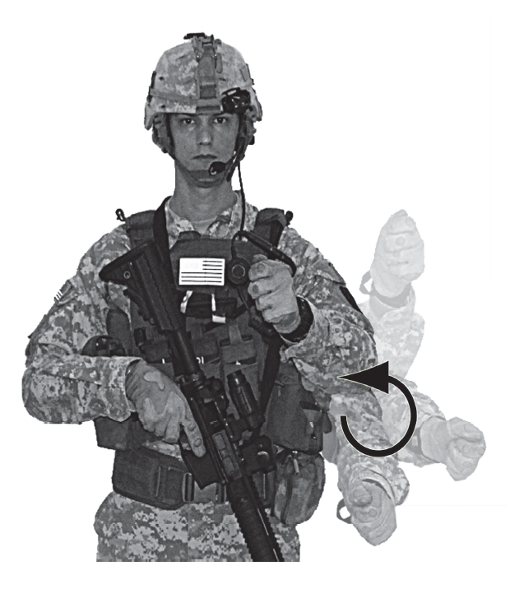
Start Engine or Prepare to Move (day)
At waist level, move the arm with fist in a circular motion
At waiste

Slide 3
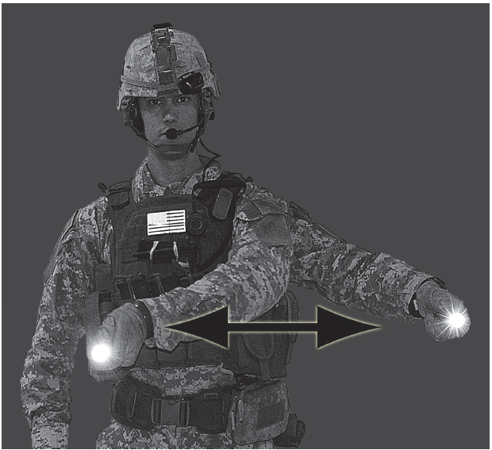
Halt or Stop (night)
Move a light horizontally back and forth several times across the path of approaching traffic
  Also used to stop engines

Slide 4
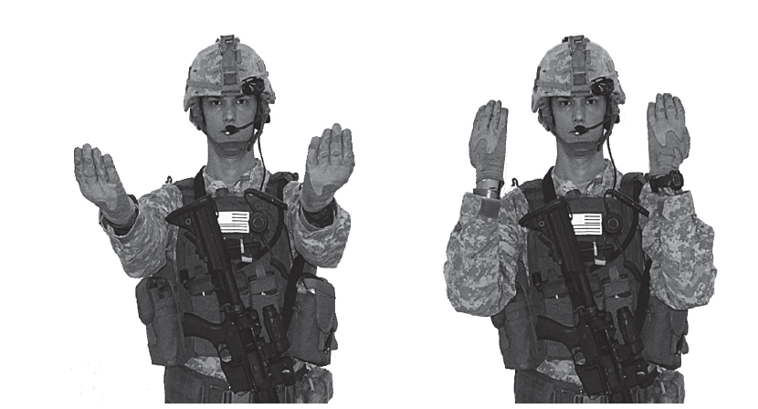
Move Forward (day)
Face the vehicle, extend arms at chest height, palms facing upward.
Bend arms at elbow in upward motion.
Extend, again.
Repeat motion.

Slide 5
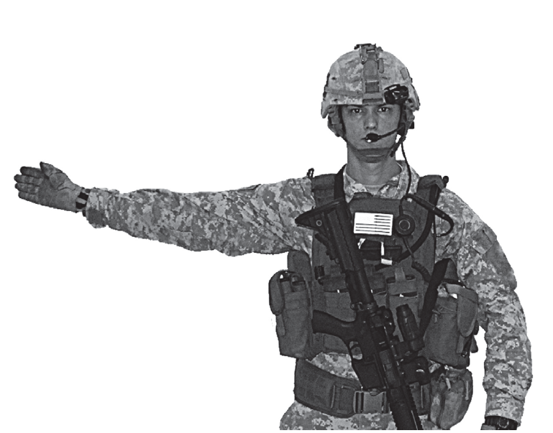
Left Turn
Facing the vehicle, raise the right hand to chest height.
Extend arm horizontally at elbow, palm toward vehicle, and fingers extended.
Repeat motion.

Slide 6
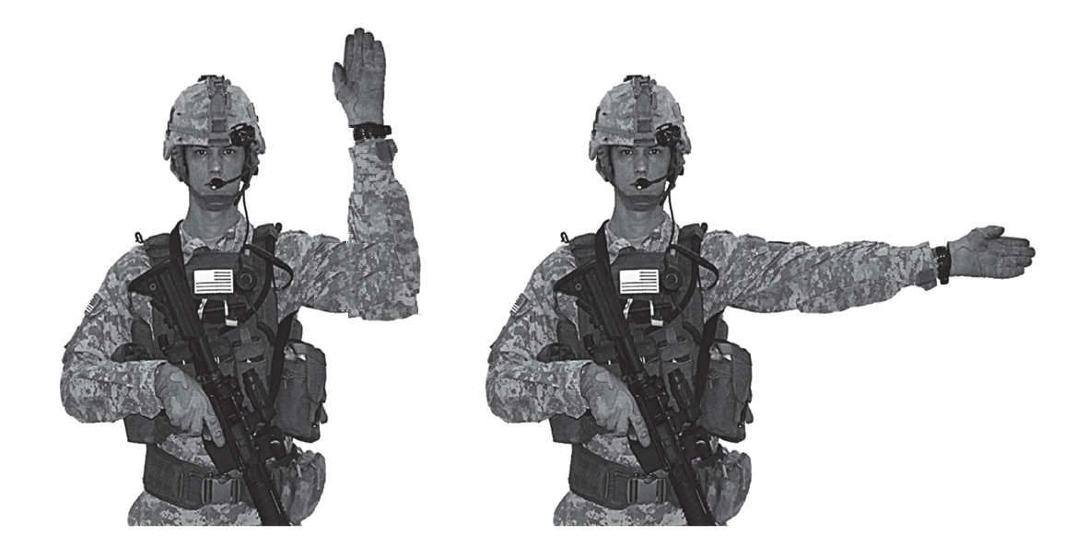
Right Turn (day)
Facing the vehicle, raise the left hand to chest height.
Extend arm horizontally at elbow, palm toward vehicle, fingers extended.
Repeat motion.

Slide 7
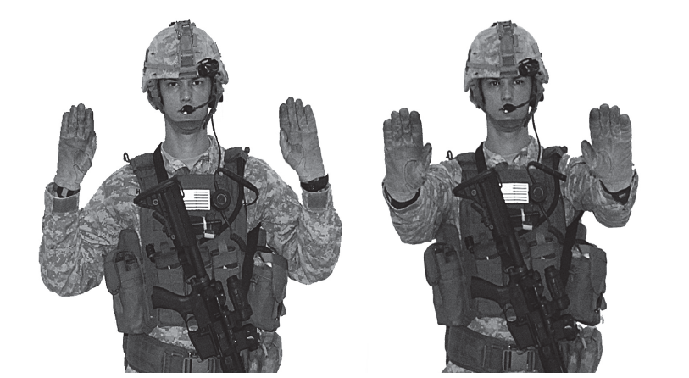
Move in Reverse (day)
Face the vehicle, extend arms at chest height, palms facing downward.
Bend arms at elbow in upward motion.
Extend, again.
Repeat motion.

Slide 8
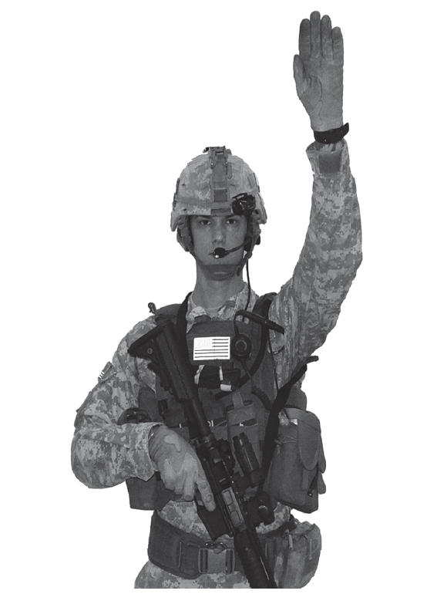
Halt or Stop
Raise the hand upward to the full extent of the arm, with palm to the front
Hold that position until the signal is understood

Slide 9
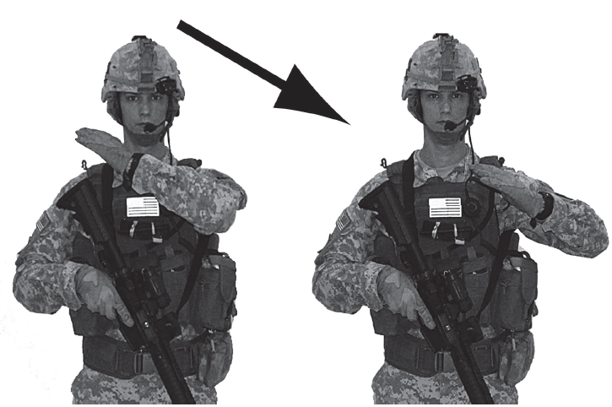
Stop Engine
Extend the arm parallel to the ground with hand open.
Move the arm across the body in a throat-cutting motion.

