Slide 1
Multi-Purpose Chain Assembly
Turnbuckle
Anchor lock
Channel notch
Channel
Anchor

Slide 2
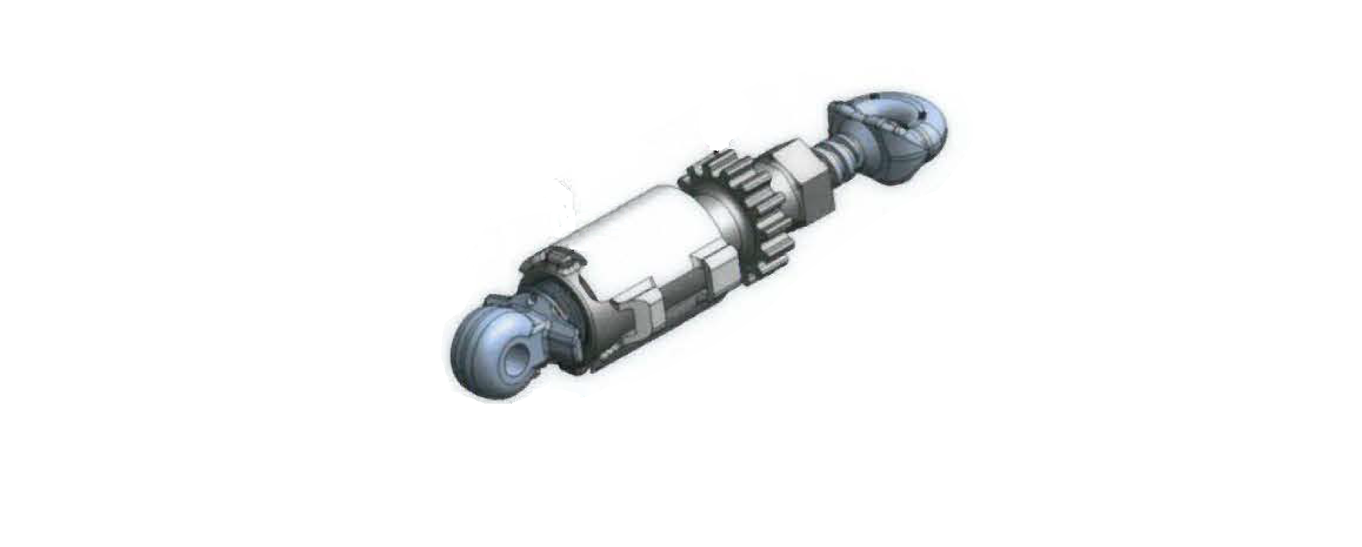
Multi-Purpose Chain Assembly
Unlocked Position
Top eyebolt
Notice that the notches on the gravity lock sleeve are resting on the ears of the turnbuckle.
Turn the gravity lock sleeve to the right to tighten
Gravity lock sleeve
ear
notch
Bottom eyebolt
Collar wing

Slide 3
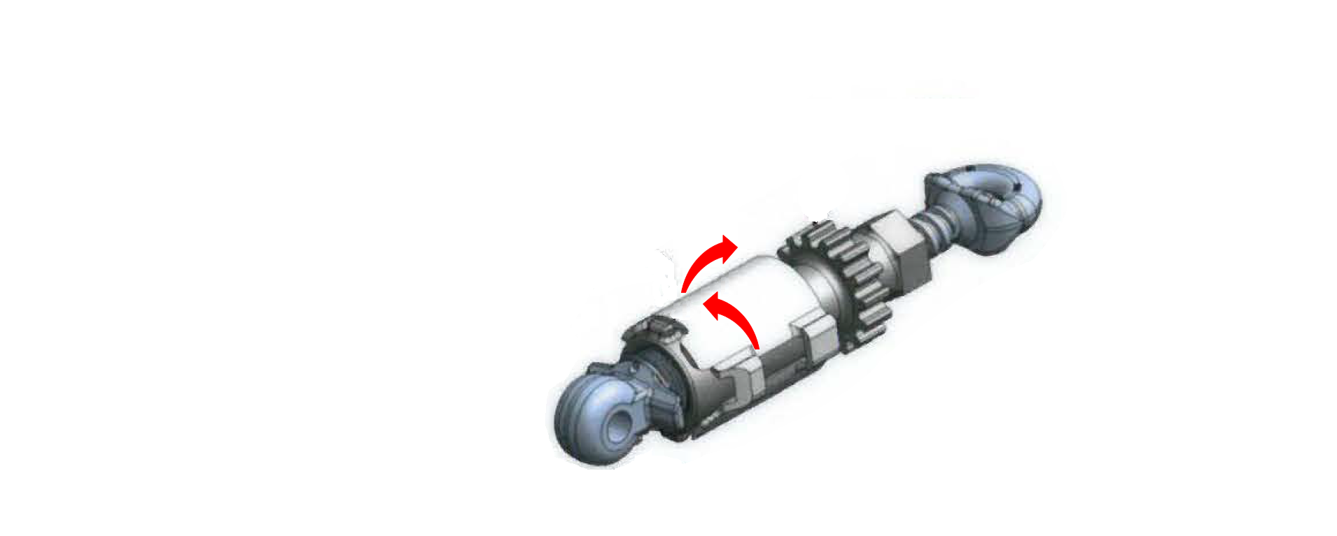
Multi-Purpose Chain Assembly
To Unlock
After turnbuckle is tightened, slide the gravity lock sleeve upward
Rotate the gravity lock sleeve ¼ turn to the left, or
Rotate the gravity lock sleeve ¼ turn to the right
3
2
1

Slide 4
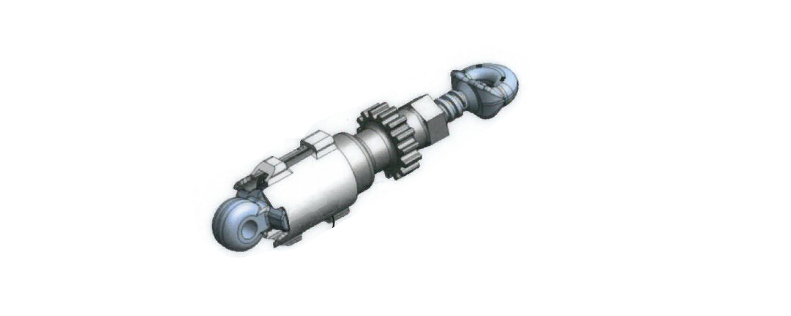
Multi-Purpose Chain Assembly
Lock Position
After the ¼ turn, slide the gravity sleeve lock downward
Rest the notches on the collar wings
2
1

