Slide 1
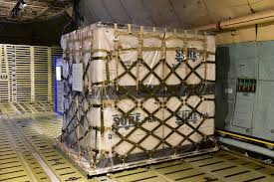
Pallet and Nets System

Slide 2
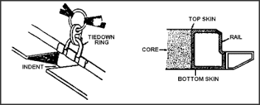
Pallet and Net System
436L Pallet
Has a balsa wood core, covered with corrosion resistant aluminum
Outer top and bottom layers are referred as “skin”
Side are referred as “rail”; with 22 tied down rings
  6 on long side; 5 on short side
Rails have indents (notches) to lock pallet in place

Slide 3
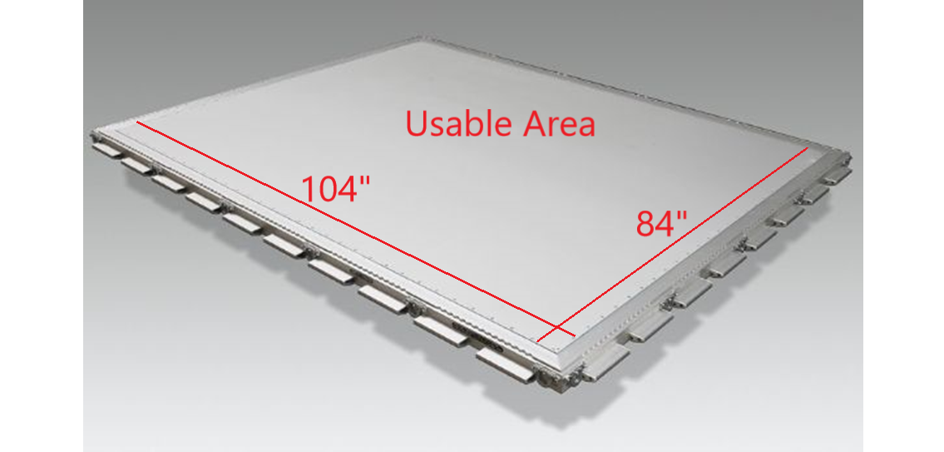
Pallet and Net System
436L Pallet
Dimensions
108 in. (long side) x 88 in. (short side)
  Usable dimensions 104 in. (long side) x 84 in (short side)
  22 steel tie down rings
Weighs 290 lbs.
  Nets weigh 65 lbs.
  Empty w/ nets 355 lbs.
  Desired load capacity 7500 lbs.
  Total load capacity 10,000 lbs.
  250 PSI limitation

Slide 4
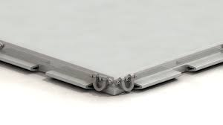
Pallet and Net System
Inspection
Outer skin free of damages, no:
  Dents
  Punctures
  Separating
Tiedown rings are serviceable
Pallet not warped
Free of corrosion
Clean and dry

Slide 5
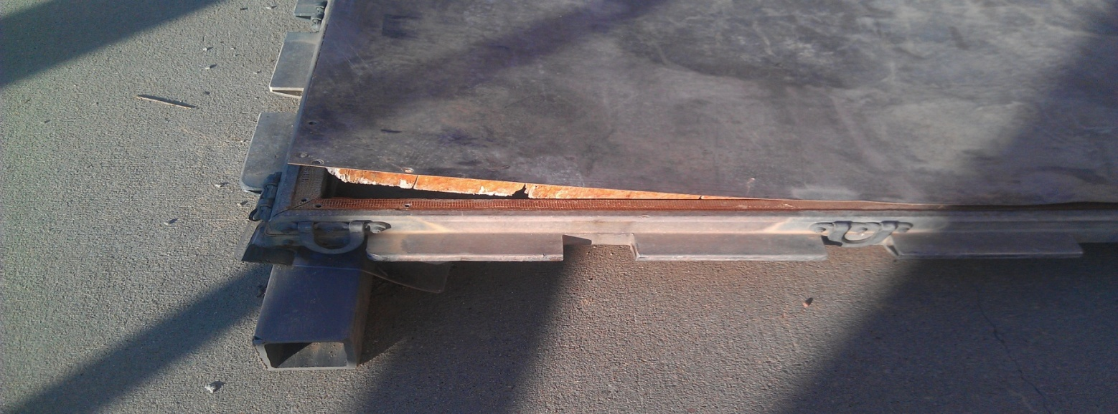
Pallet and Net System

Slide 6
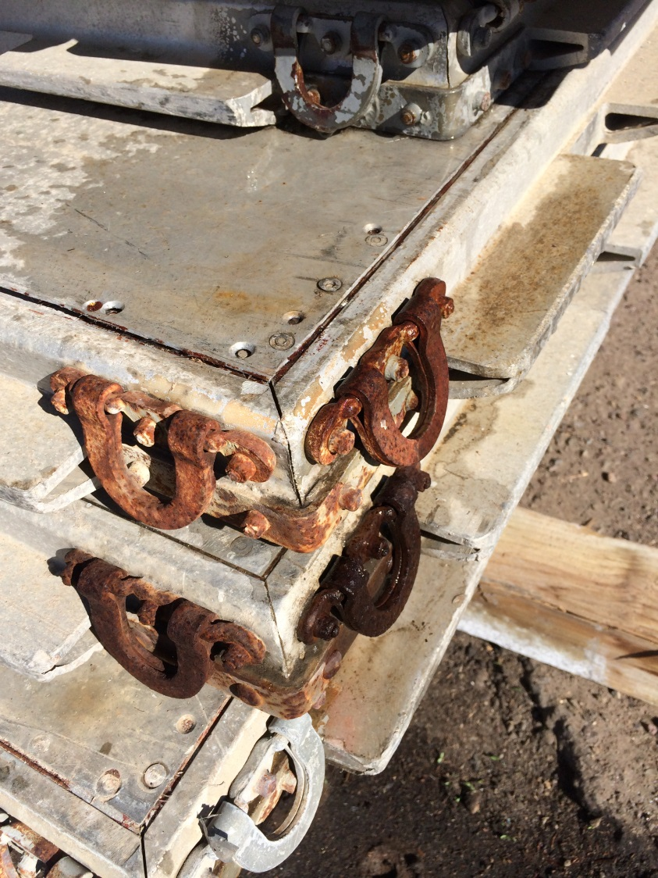
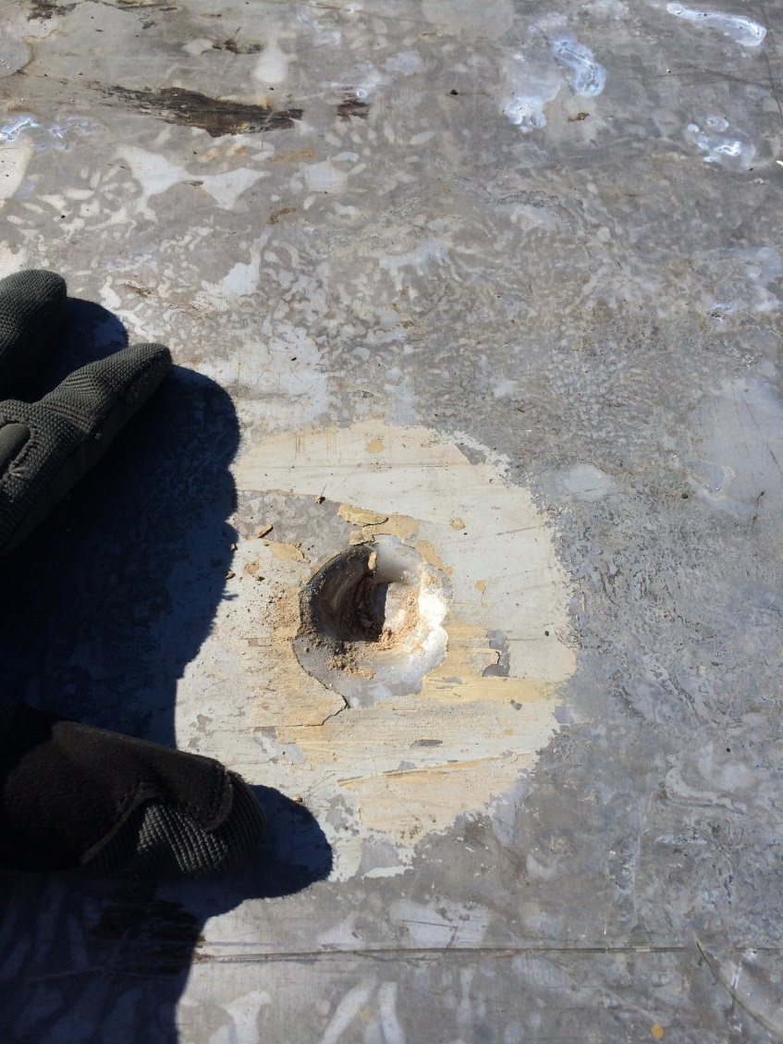
Pallet and Net System

Slide 7
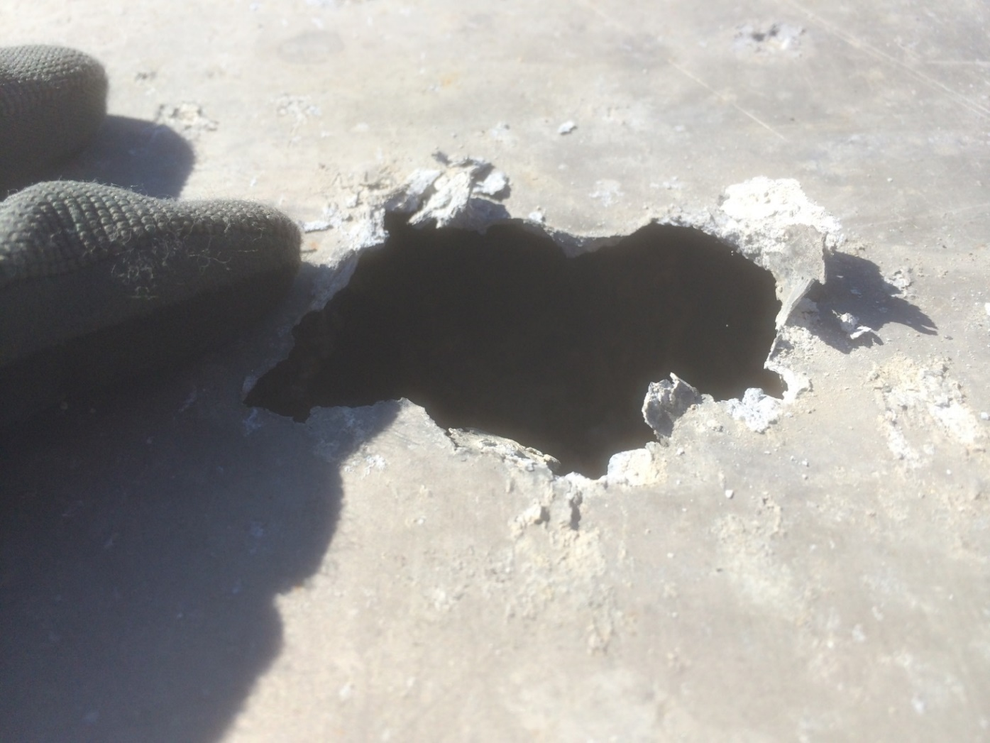
Pallet and Net System

Slide 8
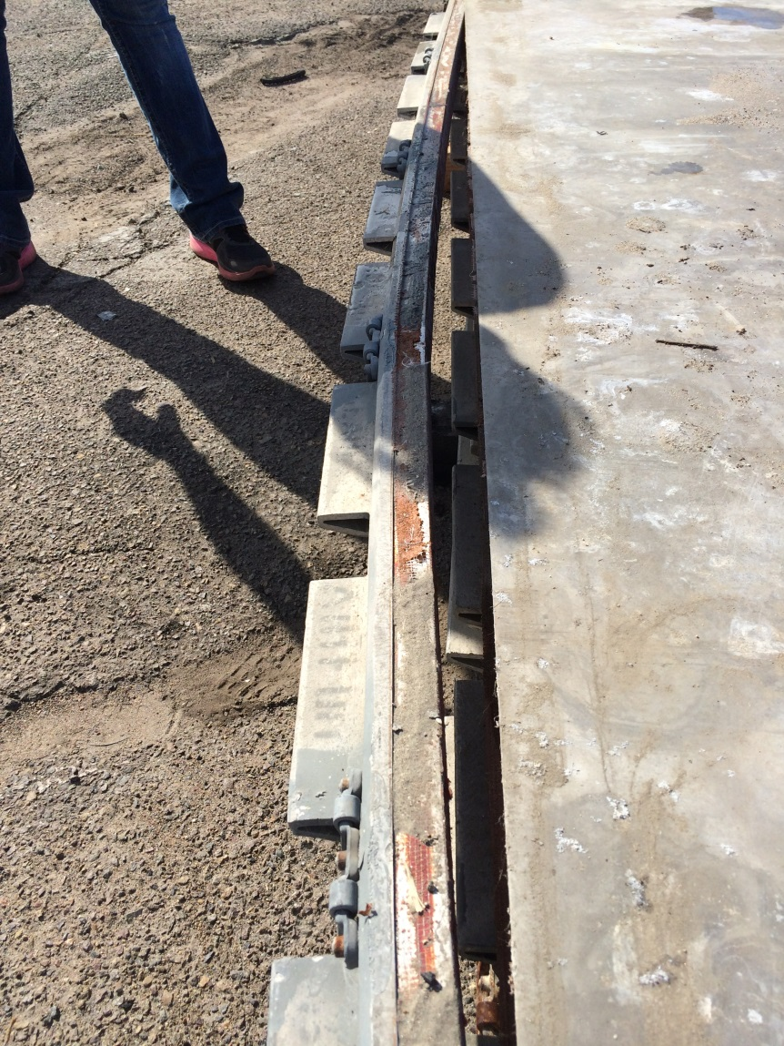
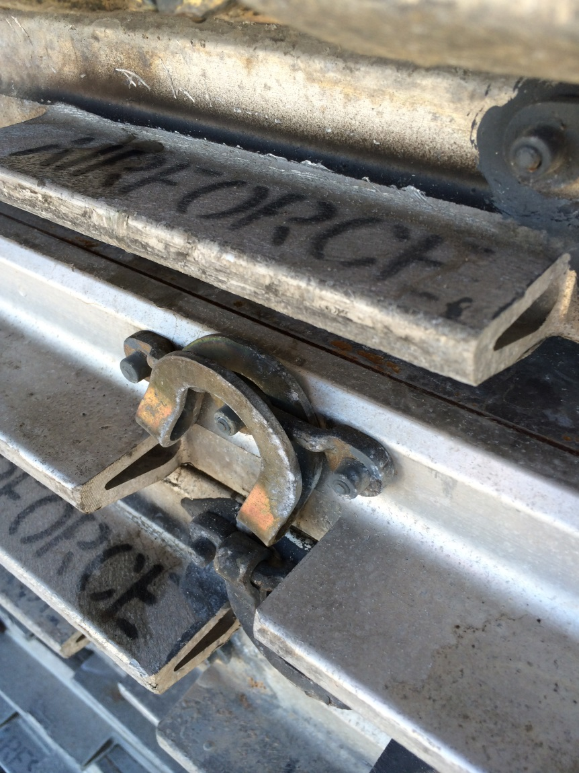
Pallet and Net System

Slide 9
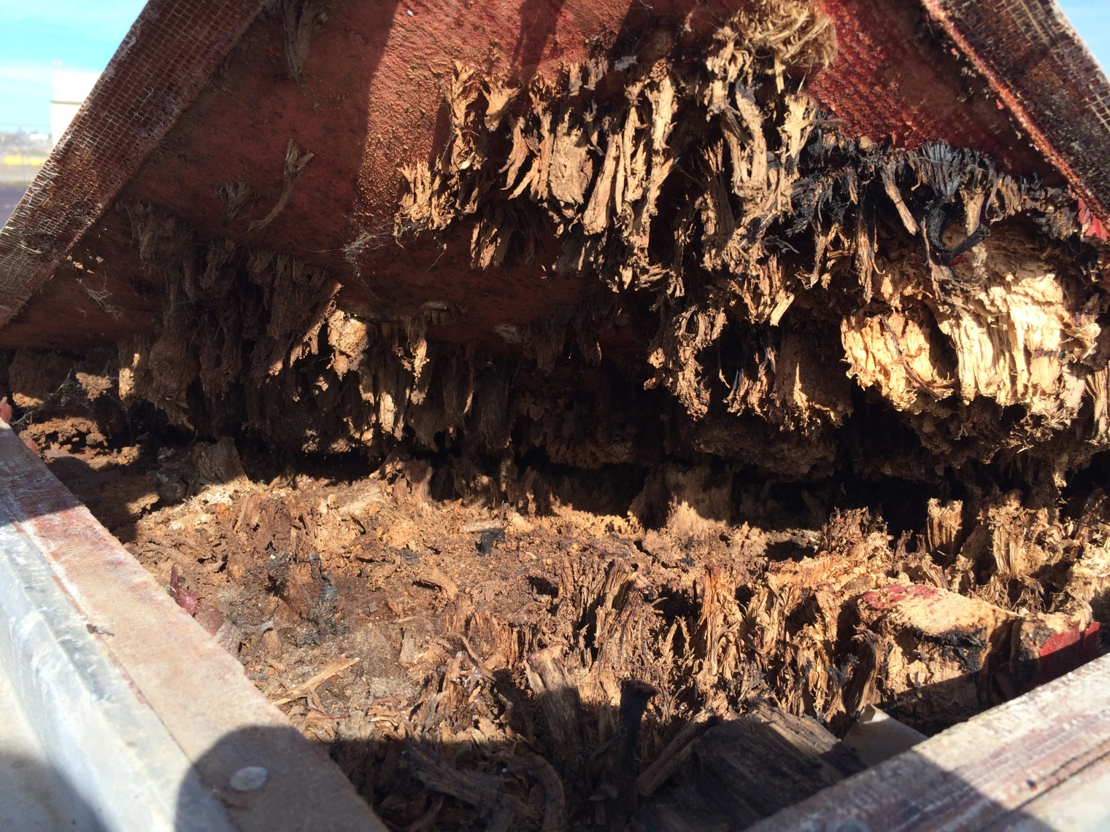
Pallet and Net System

Slide 10
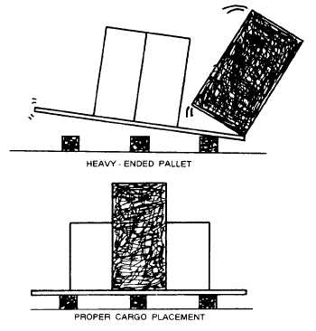
Pallet and Net System
Loading & Building
Lay pallet on three (3) 4x4x88 wood dunnage; top skin facing up
Load from the center, then outward
  Large heavy items placed evenly from center
  Lighter and smaller items should be placed on top or along the sides
  Maintain a center of balance

Slide 11
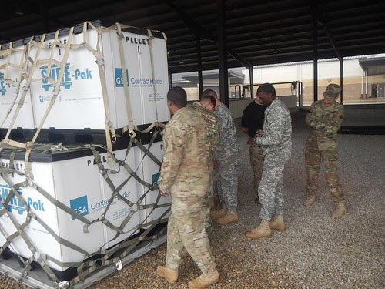
Pallet and Net System
Loading & Building
Build in a square or pyramid shape
Maximum height 96 inches; restricted area 76”
Be careful using bare tines on forklifts
Use two attaching points when winching

Slide 12
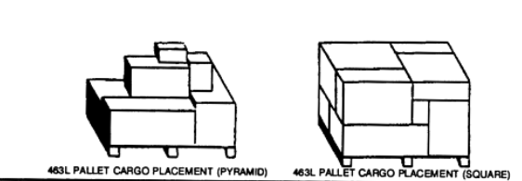
Pallet and Net System

Slide 13
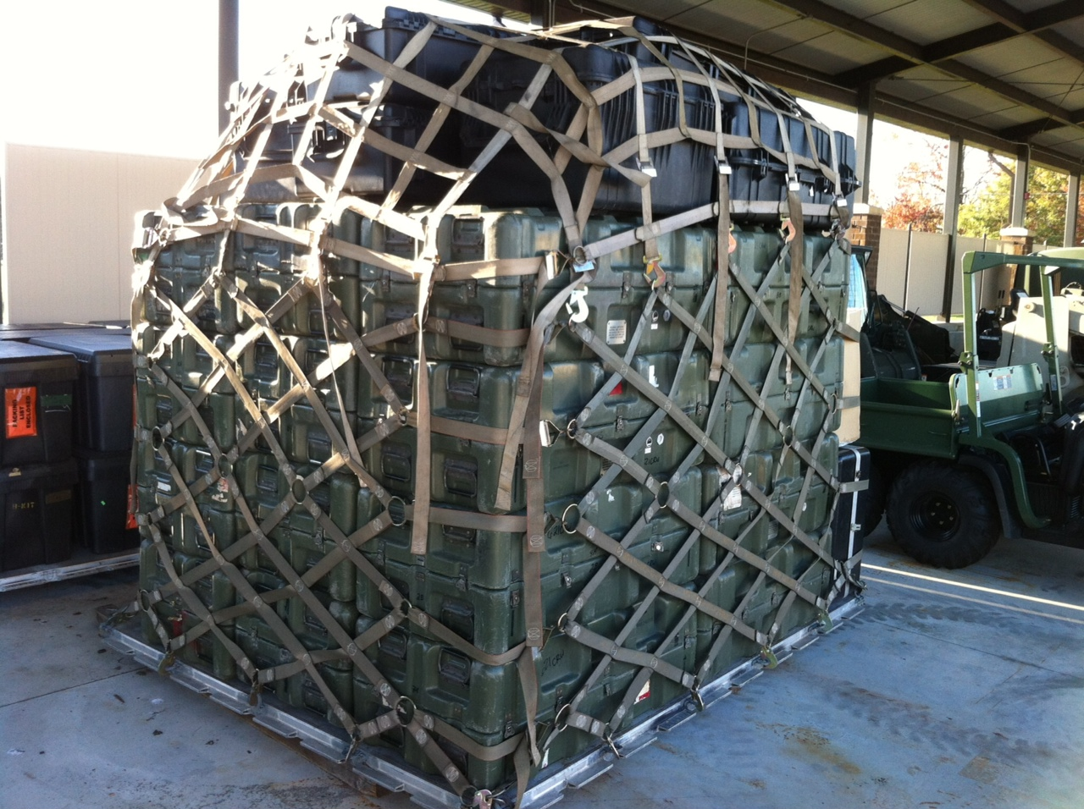
Pallet and Net System

Slide 14
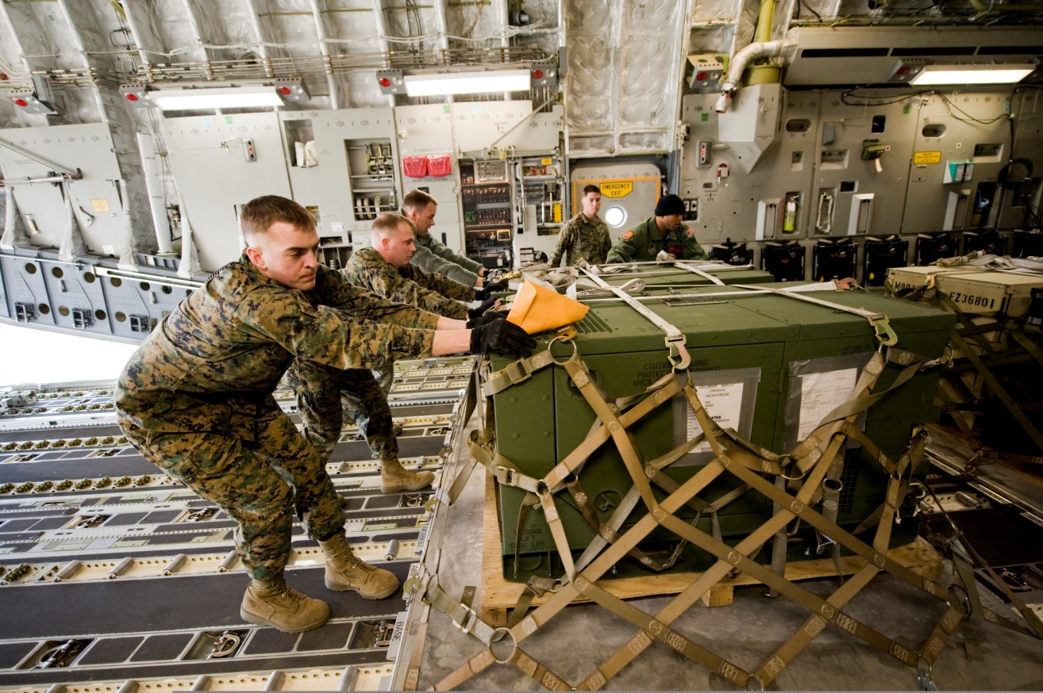
Pallet and Net System

Slide 15
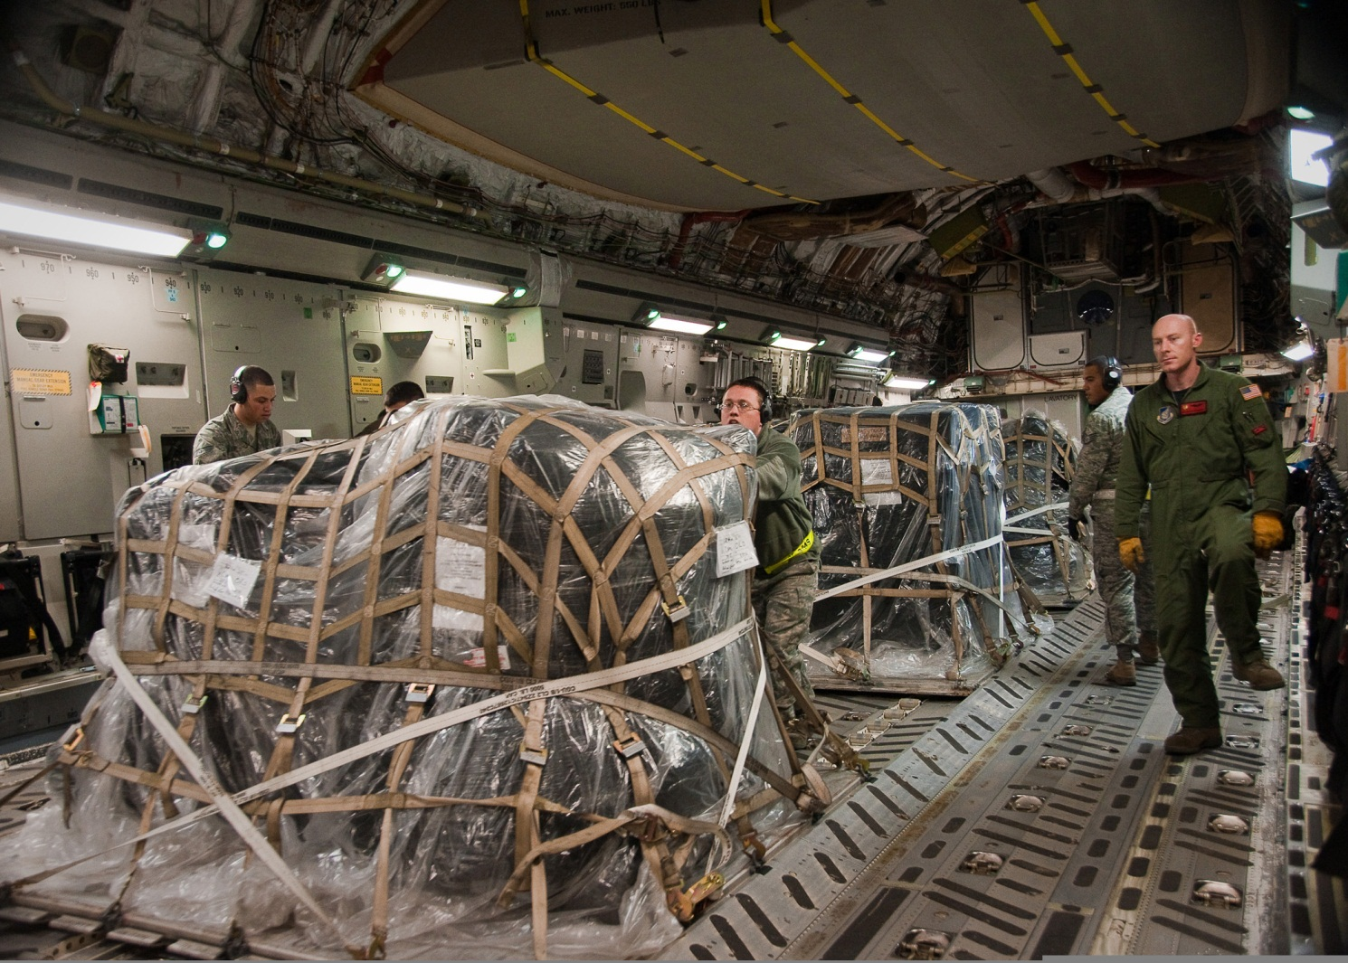
Pallet and Net System

Slide 16
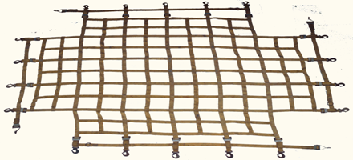
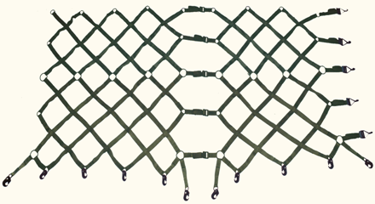
Pallet and Net System
Nets
3 nets make up a set
  2 side nets (beige, brown, or white)
  1 top net (green or gray)
Max capacity 10,000 lbs. at 8 G-forces
Top net attaches to side nets by hooks and rings
Many adjustment points; can fit any loads
A complete set weighs 65 lbs.

Slide 17
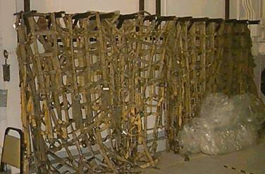
Pallet and Net System
Protecting Nets
Hang and dry all nets after use
Never pile wet nets together
Nets can mildew
Hooks can rust
Protect from the climate when not in use

Slide 18
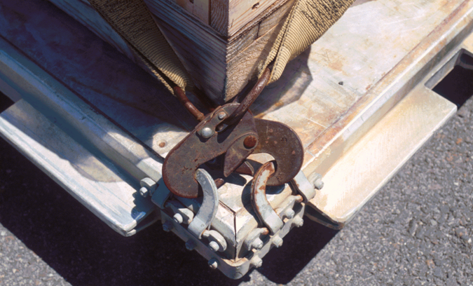
Pallet and Net System

Slide 19
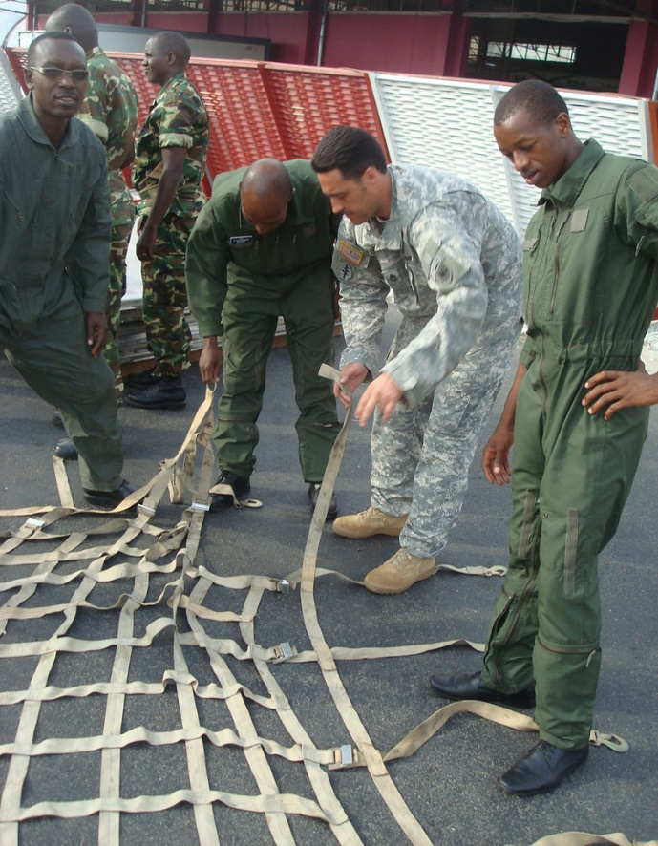
Pallet and Net System
Inspection the nets
Free of cuts and abrasions
Safety latches and hooks functioning properly
Ensure all stitching is not frayed
Straps can be adjusted
Hooks not damaged

Slide 20
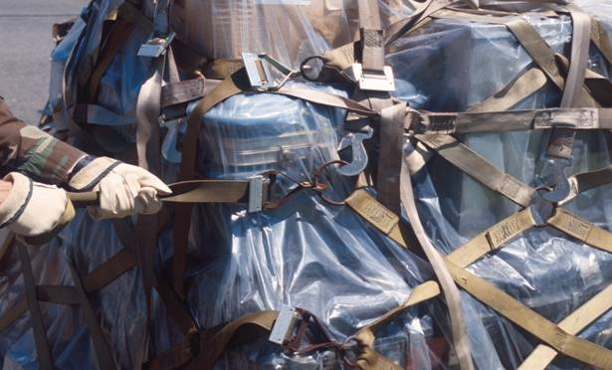
Pallet and Net System

Slide 21
Pallet and Net System

