Slide 1
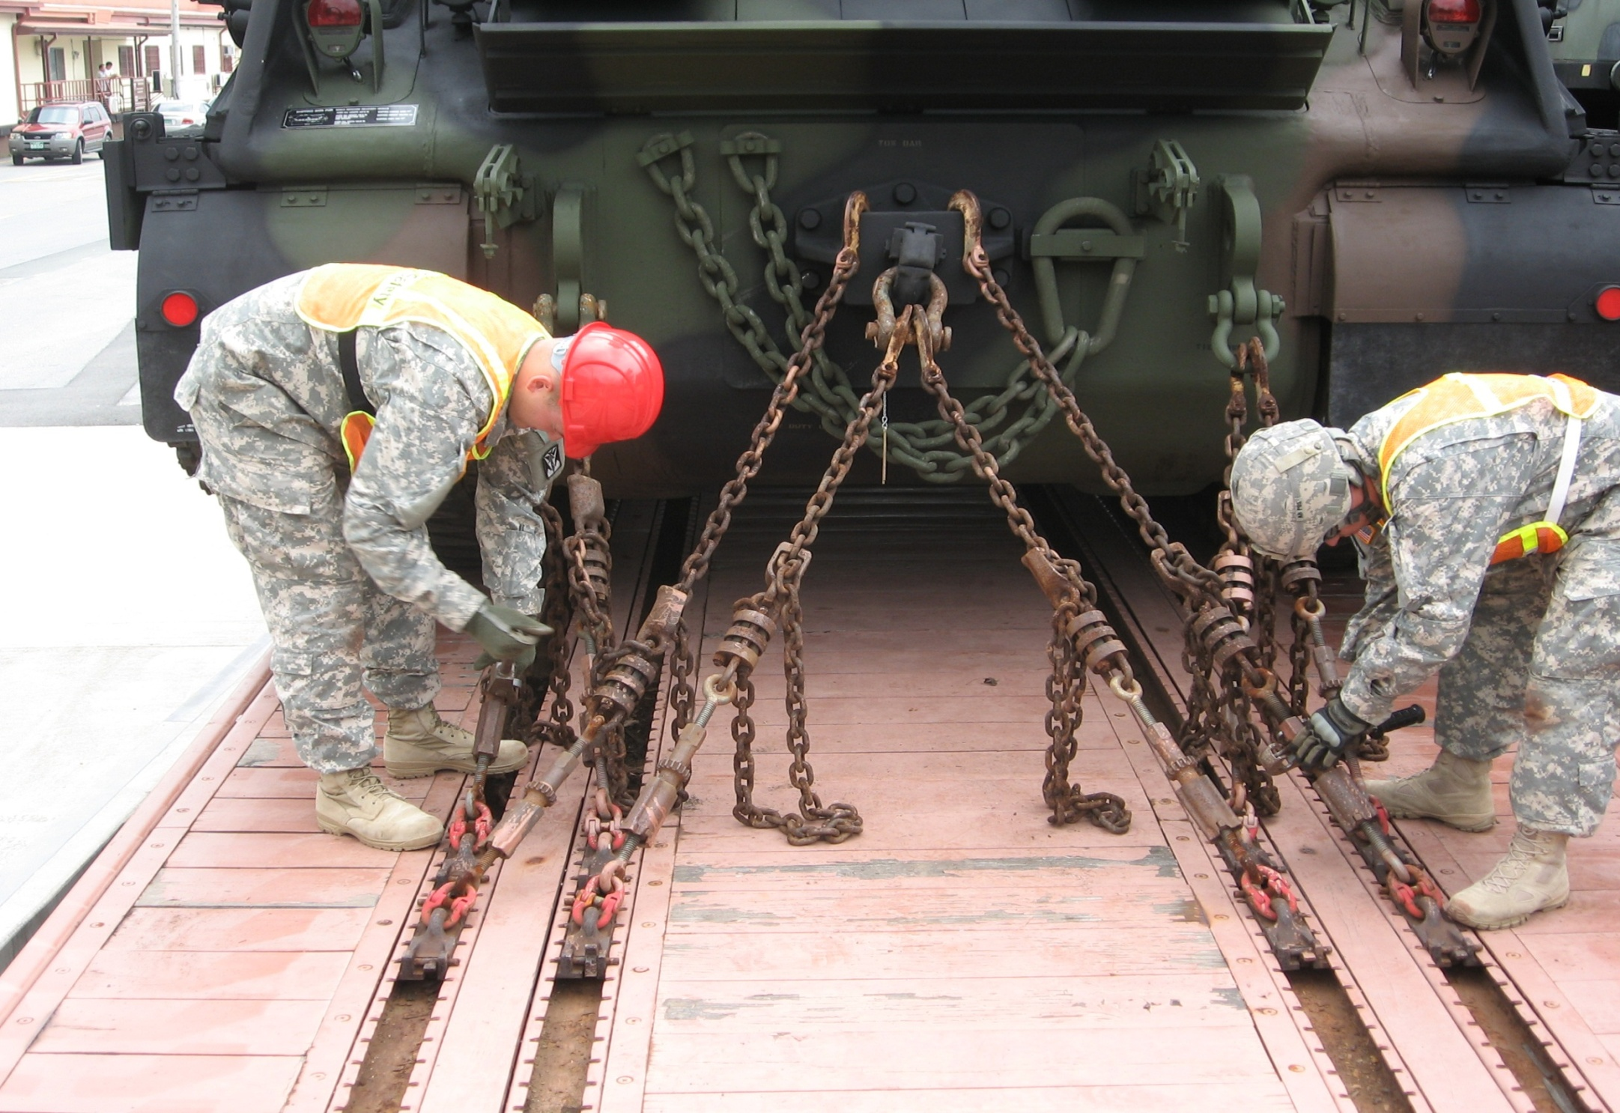
Rail Procedures
SDDC MI 19

Slide 2
Preparing Vehicles
All lifting and tiedown shackles are attached to the vehicle.
Do not use:
  Bumpers
  Axles
  Towing pintles
  Tow Hooks

Slide 3
Preparing Vehicle
Make sure fuel tanks are no more than ¾ full.
  Use DOT 5 (metal) or POP (Performance Oriented Packaging), empty or purged
  POP containers are the preferred
Remove canvases and bows
Protect windshield
  - follow local SOP
Reduce vehicle to their lowest configuration

Slide 4
Preparing Vehicle
Secure materials loaded in bed (nested or secondary loads) by banding or other means
  -steel banding should be at least ¾ in by .020 in. and AAR approved
Hood latches are functional and secured
Tires inflated to highway pressure
  Repair or replace leaking tires
  No loads rest on a flat tire
Stow chains in the anchor channels

Slide 5
Preparing Flatcar
Install locking pins on both sides of all PLS and LHS flatracks
Inspect flatcar to verify deck suitability
  - No holes
  - No bad odors
  Anchors and chains must be serviceable
  Channels should not be bent
Decks free of debris, spills, and leaks

Slide 6
Loading Vehicles
Use ground guides when loading and unloading.
  Never walk backwards
Use spanners when loading vehicles between flatcars or unequal deck height.
  Use dunnage to build up uneven spanners
  Secure to prevent movement
  Driver need to maintain a constant speed
Maintain 10 inches between vehicles.

Slide 7
Loading Vehicles
Exercise caution when going from one flatcar to another.
  Multi level cars, load bottom decks first
Do not overload car.
  Check weight against load limit requirement
  Keep center of gravity below 98 inches

Slide 8
Securing Vehicles
Turn turntable type winches in the proper direction
  Chain is taken up on the underside of ratchet wheel
  Winch pawl must wire tied
Chain makes a 45* angle from the deck to securing point
Be sure proper tension of chains exist.
  Strike chains with hammer or bar and then retighten
  Test by standing on chain, no more than an 1 inch of deflection

Slide 9
Securing Vehicles
Stow chains in the anchor channels.
Secure open hooks to chain link.
Lock tightening devices with wire
  Jam nuts tightened with wrenches
  Locking sleeve lowered over eyebolt

Slide 10
On
Learning

Slide 11
On
Learning
Question 1: What is the desired angle for chains to tie down vehicles on the rail car?
Answer 1: 45 degrees

Slide 12
On
Learning
Question 2: When tightening the chains, how much deflection is allowed?
Answer 2: No more than 1” of deflection

Slide 13
Spanners
WHAT?
Metal or wood bridge plates
Purpose?
Allow wheeled vehicles to roll from one flatcar to the next
SIZE?
Six or ten feet

Slide 14
Spanners
DO NOT!!!!
STOP on spanners
Take a running start to get over the spanners
BACK UP after crossing the spanners.

Slide 15
Other Considerations
Internal and secondary loads
  - Secured IAW TEA PAM 55-19
Hazardous Materials Markings and Documents
  Documented on DD Form 2890
  Markings, Labels and Placard must be visible
Tools
- See ITO
Safety brief
  Done before moving on the rail yard
  Keep ITO informed of changes

Slide 16
Loading and Tiedown Checklist
Make certain all hood latches are secured (to avoid wind damage).
Leave at least 10 inches between vehicles.
Check for proper brake wheel clearance (see Fig 1, p. 2).
Do not cross the chains.
Use symmetrical tiedown patterns (multiples of 4).
Secure tiedowns at approximately 45° angles.
Seat and lock chain anchor or winch.
Secure shackle in tiedown provision with wire tie or cotter pin.

Slide 17
Loading and Tiedown Checklist
Pull chain tight and attach hook above the compression unit.
Tighten chain.
Use appropriate tools.
Make sure chain is not kinked or binding.
Secure hooks with wire or nylon tie straps.
Make sure turnbuckles are wired or locked.
Tighten jamnuts with two wrenches. Lower locking sleeves over eyebolts.

Slide 18
Loading and Tiedown Checklist
Do not secure chains to axles or springs unless figure shows to.
Make certain turrets and guns, radiator doors, side skirts, outriggers, crane booms, expansible van bodies, movable parts, and secondary loads are secured from extending up or out over the side of the flatcar during transport.

Slide 19
On
Learning

Slide 20
On
Learning
Question 1: What is used to build up spaces in uneven spanners?
Answer 1: Dunnage

Slide 21
On
Learning
Question 2: What is the minimum distance between loaded vehicle?
Answer 2: 10 inches

