Slide 1
Welcome to Unit Load Team Training

Slide 2
Instructors
Chris Vanderlinde
Walter Brown
Eric Bundy

Slide 3
Classroom Recommendations
DO
Take Notes
Pay Attention
Ask Questions
Reading is Recommended
DON’T
Operate Cell Phones
Use Tobacco Products
Have Open Containers on Tables

Slide 4
Introduction
Rank / full name
Unit / MOS
Deployments
Rail Load/463L Pallet Packing background
Hobbies
Purpose for taking course

Slide 5
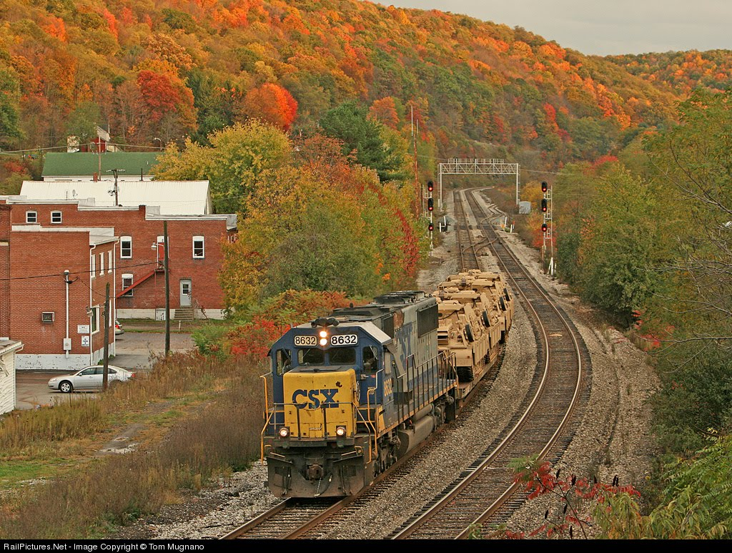
Fort to Port Operations
Rail Operations

Slide 6

References
ATP 3-35, Army Deployment and Redeployment
FM 4-01, Army Transportation Operations
FORSCOM/ARNG Reg 55-1, Unit Movement Planning
TM 55-2200-001-12, Application of Blocking, Bracing, Tie-down Materials
for Rail Transport
TEA PAM 55-19, Tie-Down Handbook for Rail Movements
TB 55-46-1, Standard Characteristics for Transportability of Military
Vehicles and Other Outsize/Overweight Equipment

Slide 7
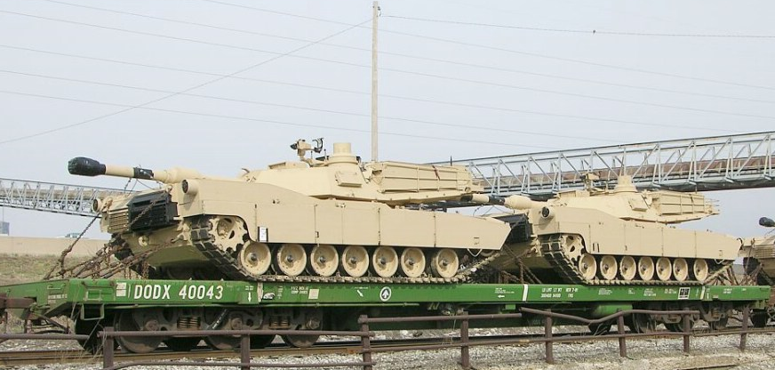
Surface Transportation
Used when equipment is non-roadable or beyond the unit’s organic lift capability
Rail requirements outlined in Annex N of Movement Order

Slide 8
General Responsibilities
The deploying unit & installation both have planning and execution responsibilities for major rail activities
Rail loading/unloading
Restraining Material
Rail site preparation
Rail car inspection
US ARMY
TRANSPORTATION CORPS
U M & O Railroad

Slide 9
Unit Responsibilities
Unit commander
Overall responsibility to prepare unit for rail operations
Major unit responsibilities:
Prepare rail movement plan (Unit Movement Plan, Annex N)
Submit movement requirements to the ITO (OEL to UDL)
Prepare equipment for rail movement
Load railcars (under the technical supervision of the UMC)
UMO specific responsibilities:
Appoint an OIC for the rail operation
Designate safety officer
Coordinate with DPW for blocking and bracing
Provide trained load teams
Provide all required HAZMAT documentation to ITO
Ensure vehicles are properly prepared/configured
Remove canvas and bows
Secure moving vehicle parts
Pack, crate, band, and block & brace secondary loads
Use SDDCTEA Pam 55-19

Slide 10
Unit Responsibilities Cont.
Coordinate logistical support for railhead ops
Lighting, latrines, mess, and medical
Ensure tie-down teams have proper equipment
Stage equipment
Ensure sufficient numbers of cars are spotted
Inspect rail cars
Conduct safety briefings
Prepare rail cars for loading
Load and tie-down equipment on rail cars

Slide 11
ITO Responsibilities
Order rail cars based on deploying unit’s requirements
Compute railcars based on shipping configuration of equipment
(requires accurate UDL)
Prepare Government Bill of Lading
Official liaison with SDDC and railway agent
Designate installation load-out staging area
Joint Inspection of railroad representative prior to loading

Slide 12
ITO Responsibilities cont
Provide technical advice to units on BBPCT (Blocking, Bracing, Packing, Crating, and Tie-down)
Provide spanners as required
Notify unit on schedule type and quantity of railcars (cognizant of
scheduled arrival date at POE - as listed in TPFDD (Time Phased Force Deployment Data))
Publish/maintain rail loading schedule according to movement order
Joint inspection of loaded railcars with railway agent to ensure
compliance with Army Regulations, AAR loading rules, and/or HN rules
Provide DD Form 2890, if necessary, for HAZMAT

Slide 13

SDDC Responsibilities
Obtain railcars and routing information from carrier supporting the move
Advises ITO of route restrictions (height / weight)
Units may request help through the SDDC Operations Center; Scott AFB, IL
Unit Movement Teams from Deployment Support Brigades (USAR) are available for dispatch to support unit preparation for movement
Request SDDC assistance through the UMC/ITO

Slide 14
Rail Carrier Responsibilities
Joint inspection with ITO before cars positioned at loading ramp
Final approving authority for accepting the rail loads
Inspection following railcar loading to ensure that loaded railcars comply
with AAR rules
Assumes responsibility of cargo after final inspection

Slide 15
Railcar Requirements
Based upon the deploying unit’s requirements (UDL)
Rail cars are obtained by ITO in the types and quantities required
Deployment may be by commercial or ‘DODX’ railcars
There are several types of railcars used for military exercises and
deployments depending on the type of cargo being moved:
Flat Cars
Box Cars
Gondola
Hopper Cars
Tank Cars
Caboose

Slide 16
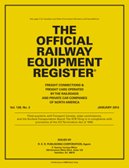
Official Railway Equipment Register
Used to determine type of rail cars
needed
Lists the capacity/dimensions of each
type of railcar
Excerpts for commercial & DODX
railcars contained in
TM 55-2200-001-12

Slide 17
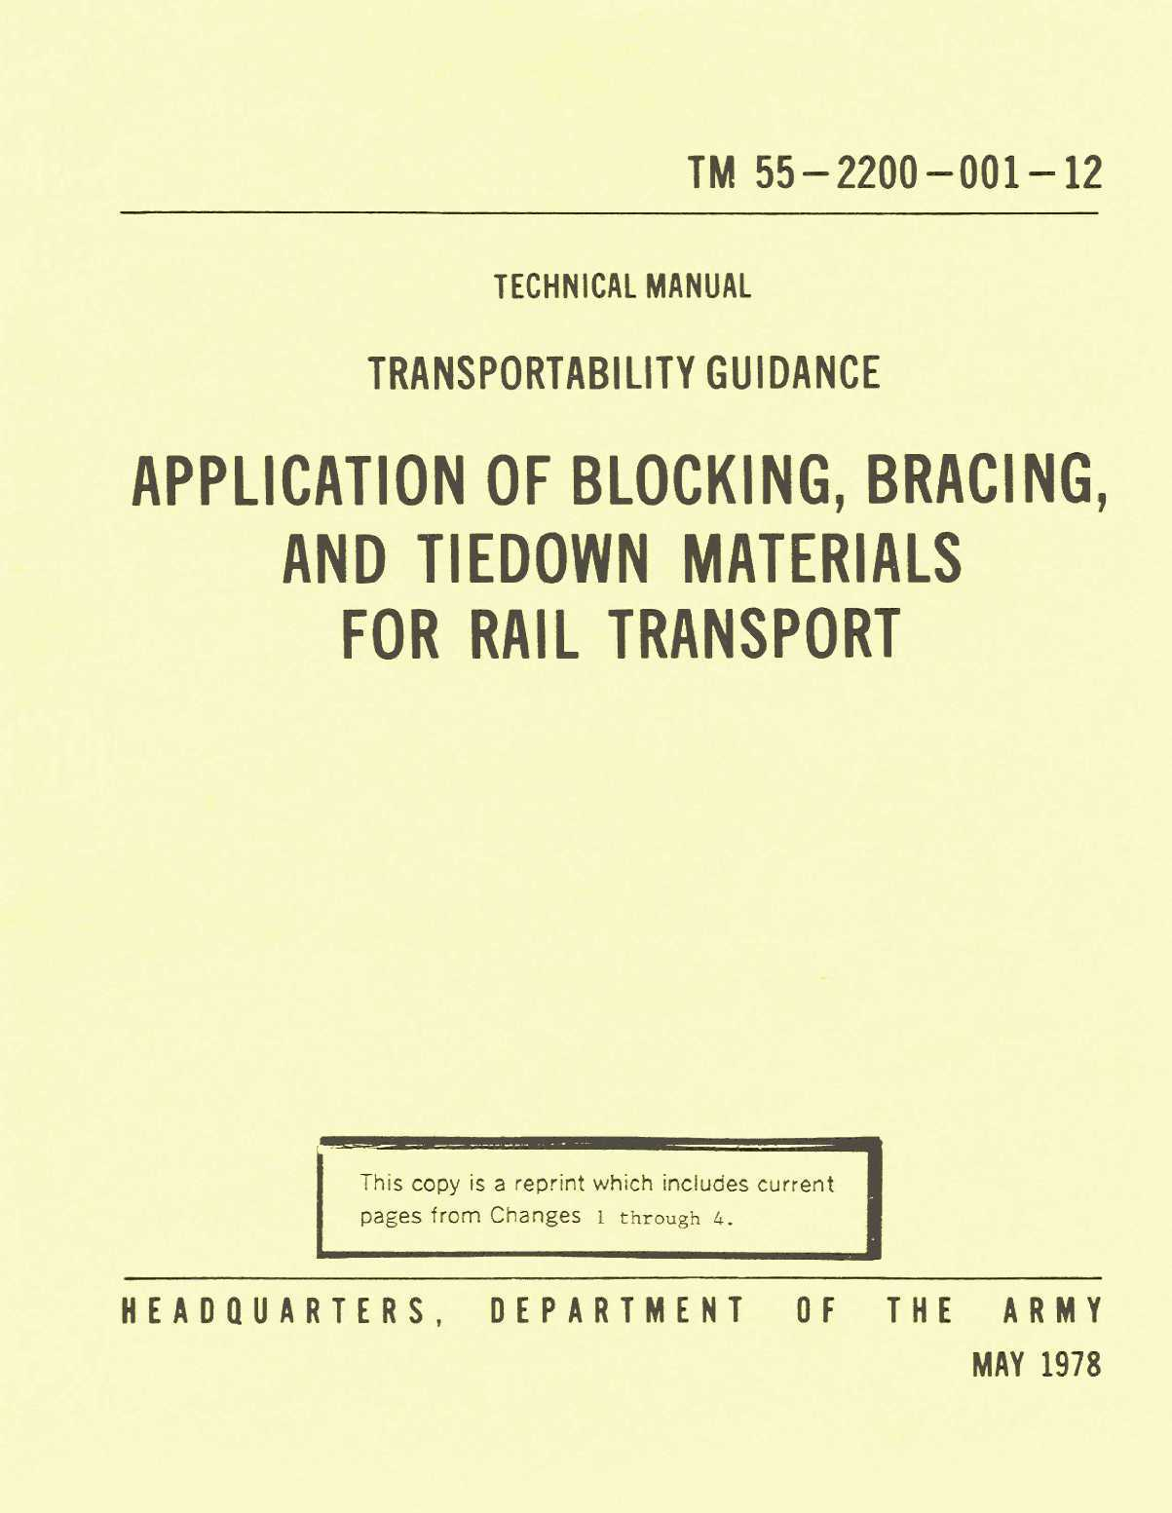
Association of American Railways (AAR)
Excerpts of AAR Rules contained in
TM 55-2200-001-12
Contains tie-down information for military vehicles & equipment
Abide by host nation rail rules and regulations OCONUS

Slide 18
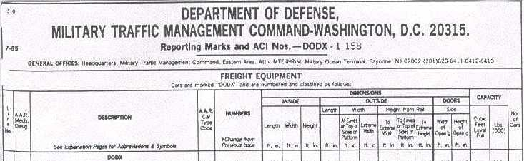
TM 55-2200-001-12
Appendix G contains information on commercial special-purpose railcars
Appendix H-1 contains the DODX table used to determine the types of DODX rail cars needed and their associated capacity and dimensions

Slide 19
On
Learning

Slide 20
On
Learning
Question 1: Who is responsible for obtaining rail cars for the deploying unit?
Answer 1: The Installation Transportation Office - ITO

Slide 21
On
Learning
Question 2: When railcars arrive on site,
who is responsible for inspecting the railcars prior to accepting the cars from the rail carrier?
Answer 2: The ITO is responsible for the initial inspection prior to accepting the railcars

Slide 22
On
Learning
Question 3: Who is responsible for providing the deploying unit with spanners for rail loading operations?
Answer 3: The Installation Transportation Office - ITO

Slide 23
On
Learning
Question 4: What established rules govern all rail movements in CONUS?
Answer 4: Association of American Railways (AAR) rules

Slide 24
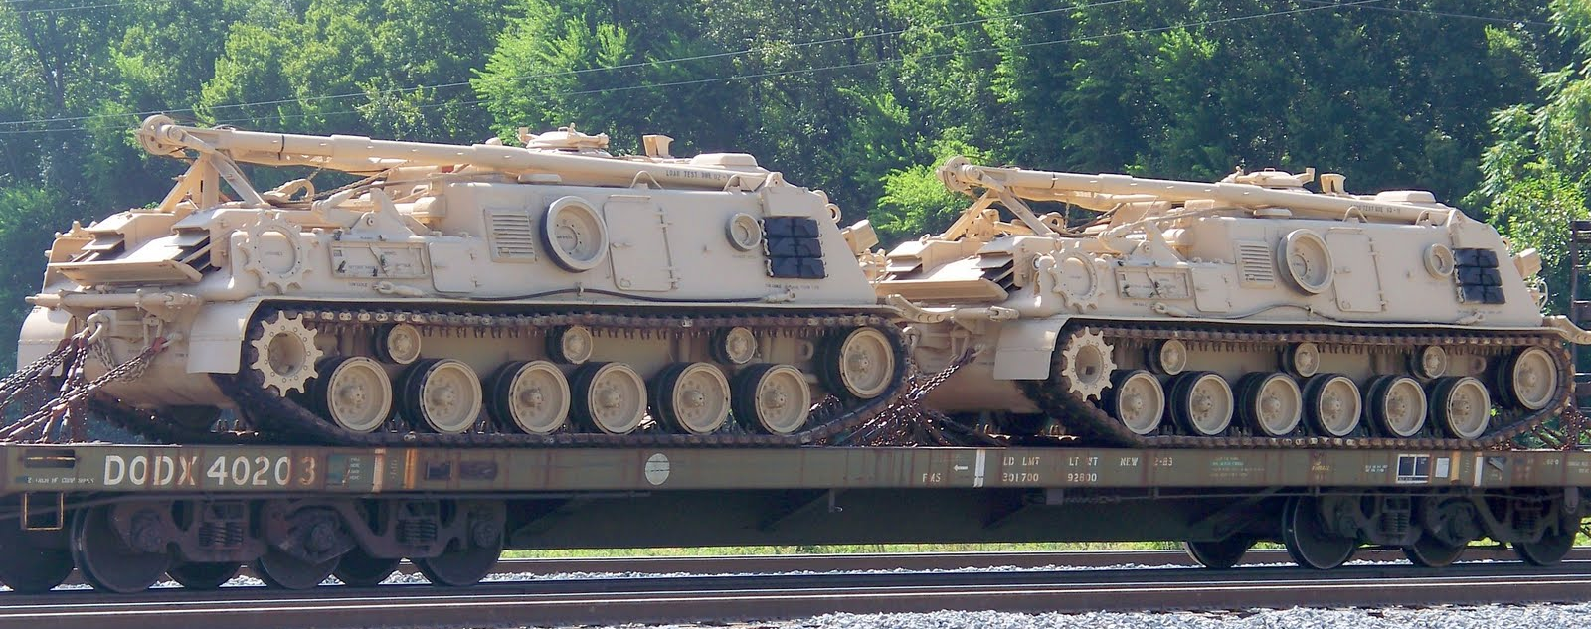
Summary
Responsibilities
Unit
ITO
SDDC
Rail Carrier
Official Railway Equipment Register
TM 55-2200-001-12

Slide 25
Combination Yard Layout
Siding # 7
Siding # 6
Siding # 5
Loading Ramps
Siding # 4
Siding # 3
Siding # 2
Siding # 1
Main Track
= Switch

Slide 26
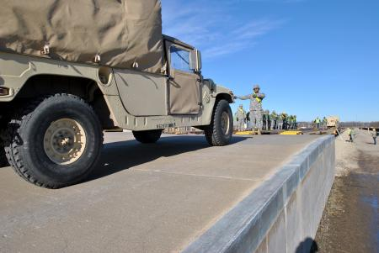
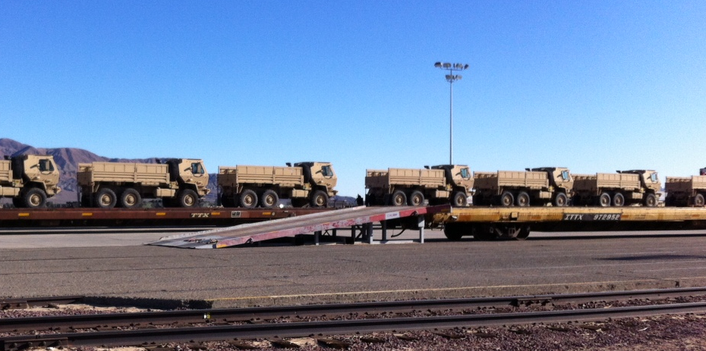
Types of Loading Ramps
Fixed Concrete Ramp
Portable Ramp

Slide 27
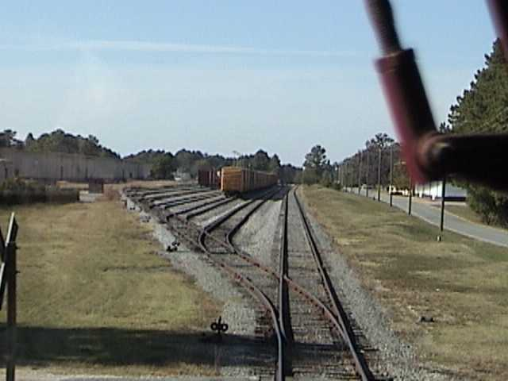
Hank’s Yard at JBLE

Slide 28
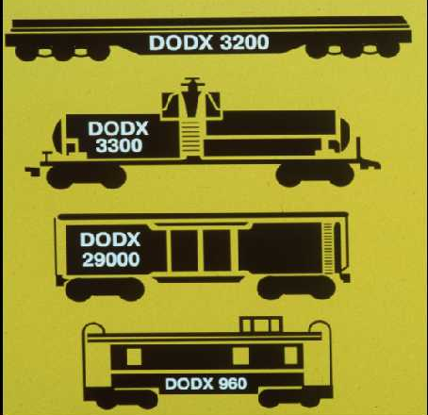
DFRIF
Defense Freight Rail Interchange Fleet
Mainly used for over-dimensional equipment or to meet deployment time constraints
Controlled by SDDC
Pre-positioned at PPP installations to meet time constraints
Flatcars:
General Purpose 1477
Special Purpose 139
Tank cars:
General Purpose 375
Special Purpose 18
Boxcars:
Special Purpose 30
Refrigerated 9
Misc cars:
Escort Cabooses 6
Guard Cars 5
Spec Lease 11
Total DODX: 2070

Slide 29
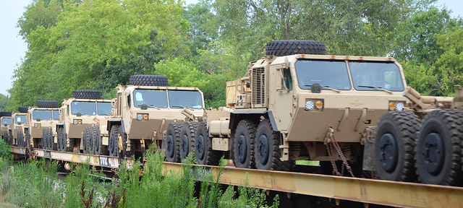
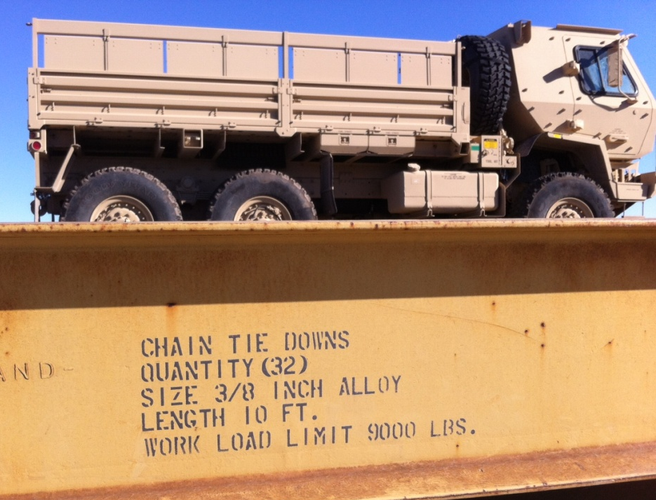
Flatcars
Ideal for transporting military cargo and vehicles
Equipment may be carried on DOD or common carrier flatcars
Tie-down information
on side of railcar

Slide 30
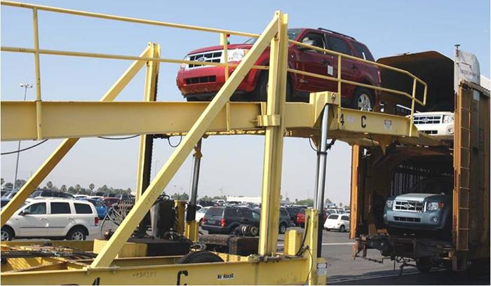
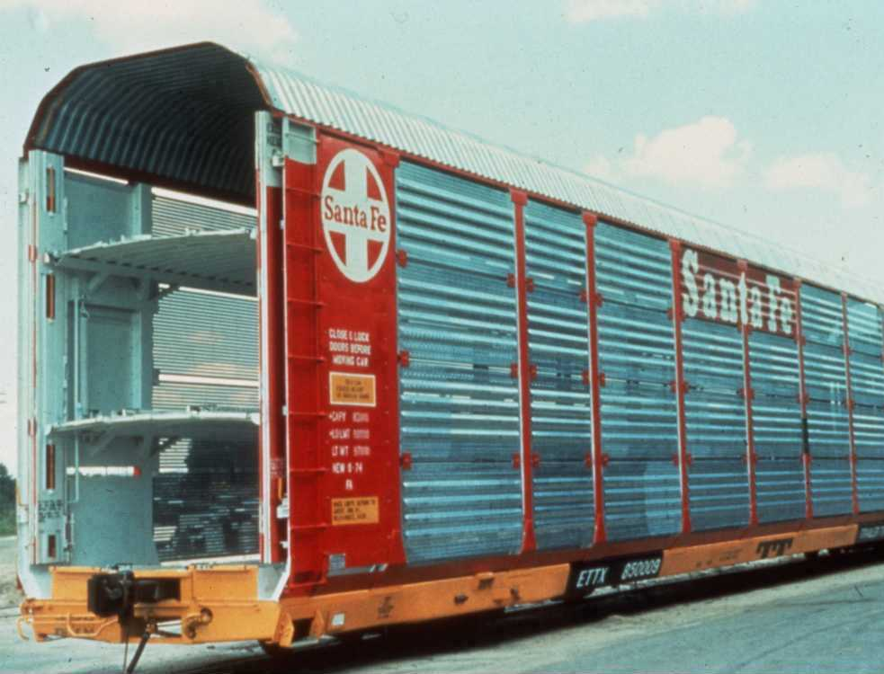
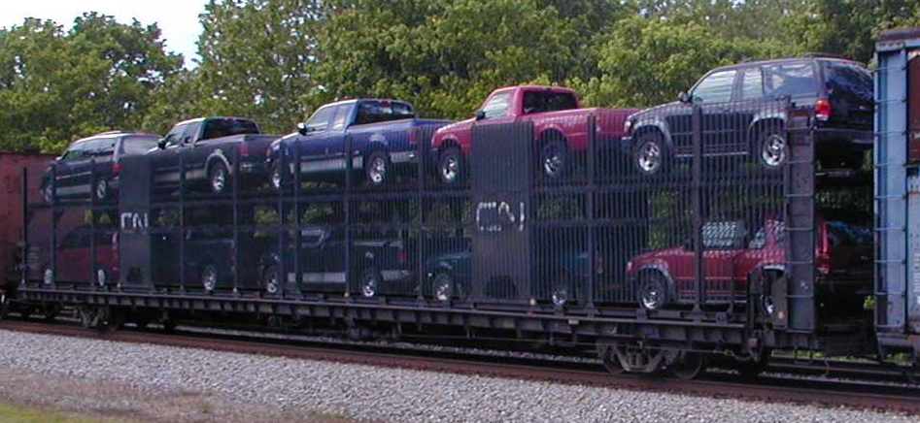
Multi-Level Flatcars
May be open or closed
Taller vehicles on upper level
Ramps used to load upper levels

Slide 31
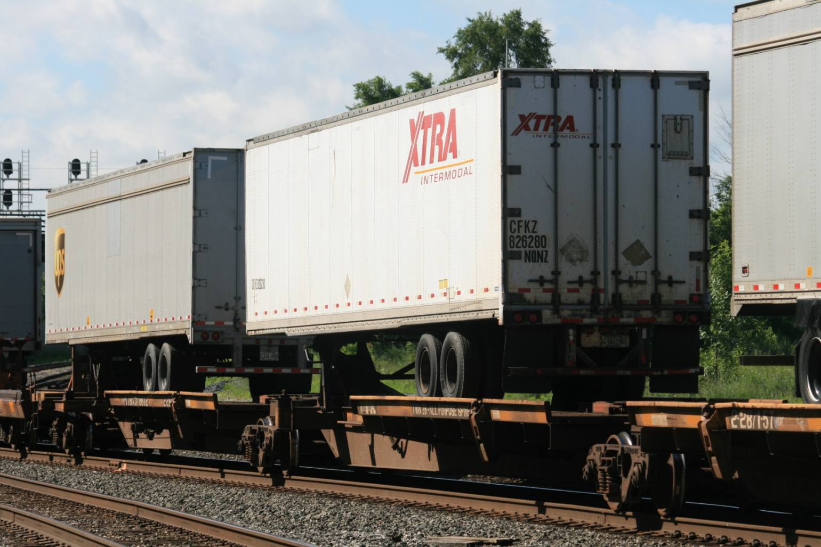
TOFC Flatcars
Trailer on Flatcar

Slide 32
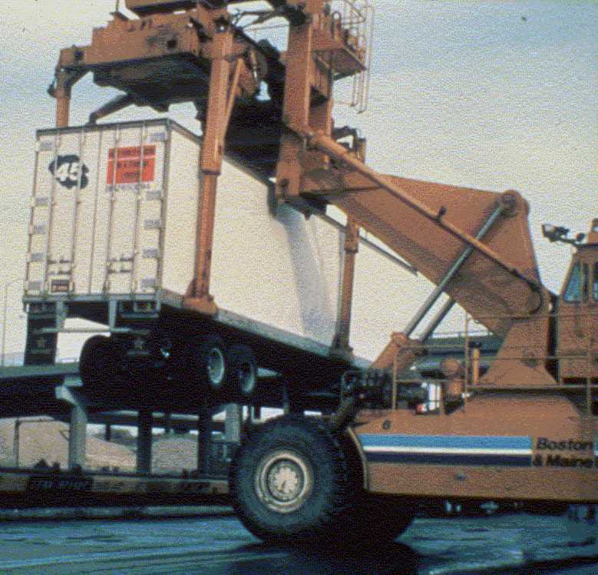
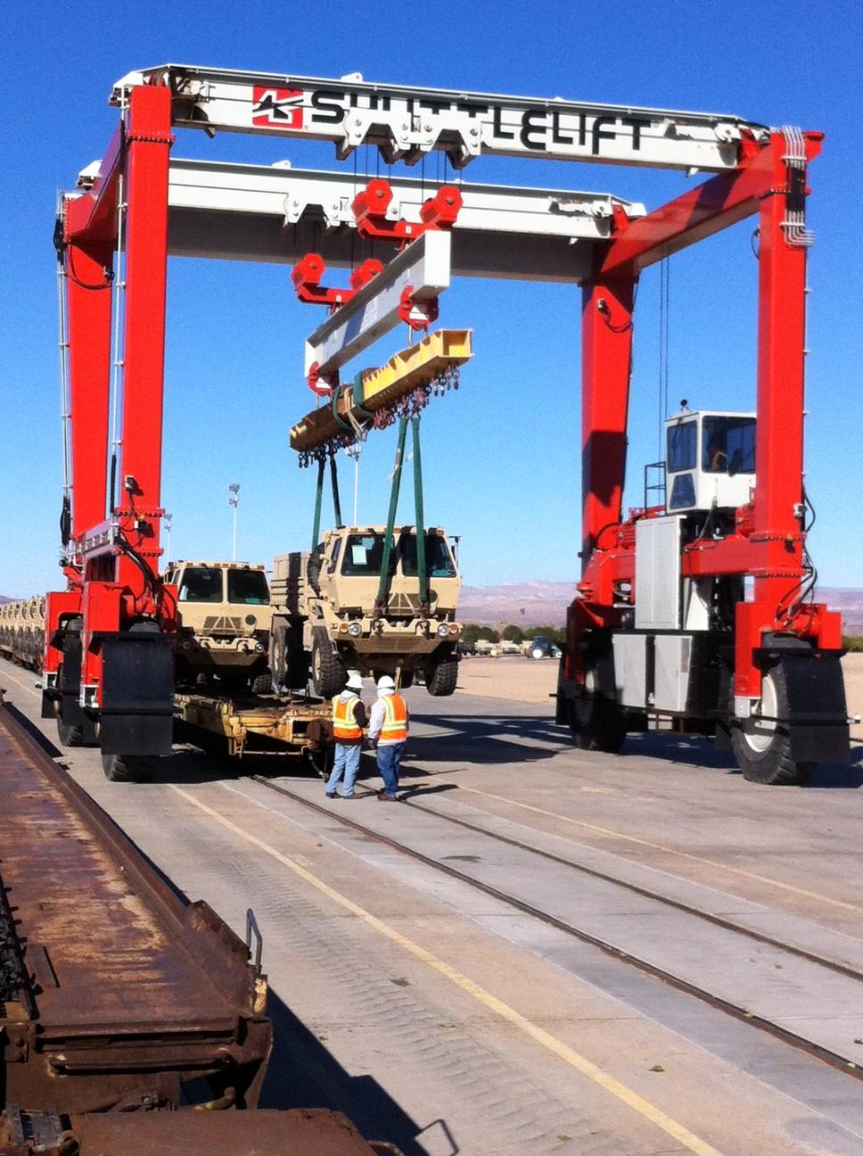
Types of MHE / CHE

Slide 33
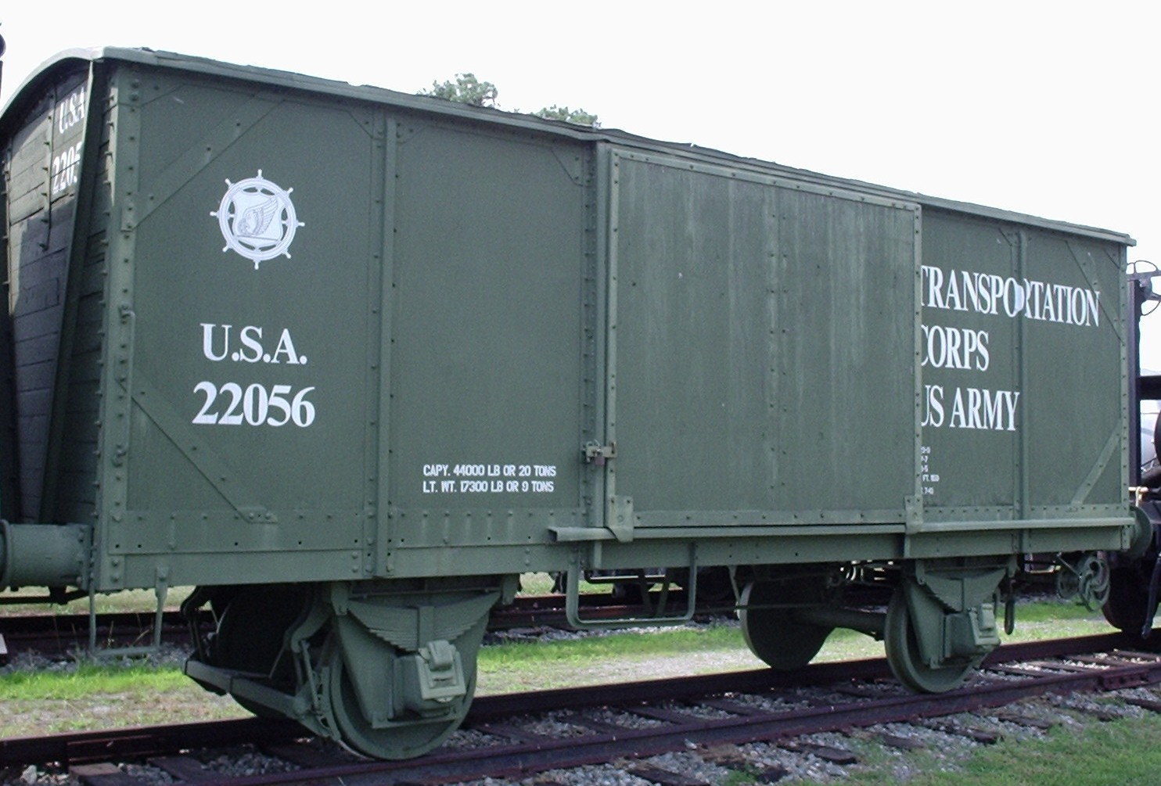
Boxcars
U.S. Boxcars in domestic service have a capacity of about 100k lbs or over 3900 cu. ft.
Ideal for commodities requiring protection from weather or susceptible to pilferage, such as:
Foodstuffs
Medicines
Electronics
Spare parts
Ammunition

Slide 34
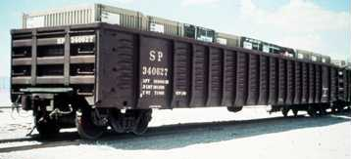
Gondola Cars
Gondola cars sides prevent bulk loads from shifting

Slide 35
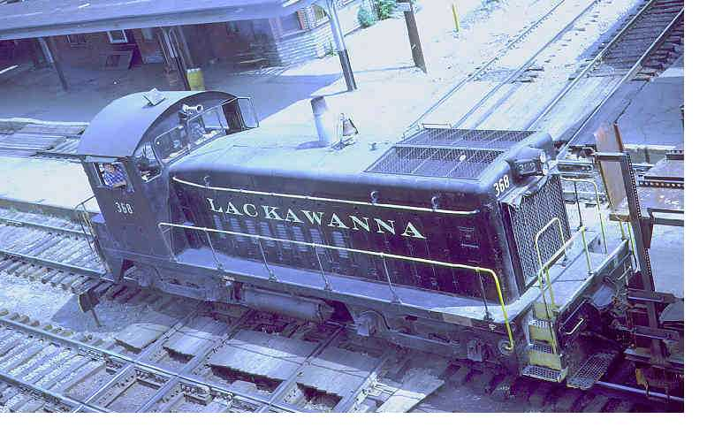
Switch Engines
Used to switch rail cars in and out of a loading area

Slide 36
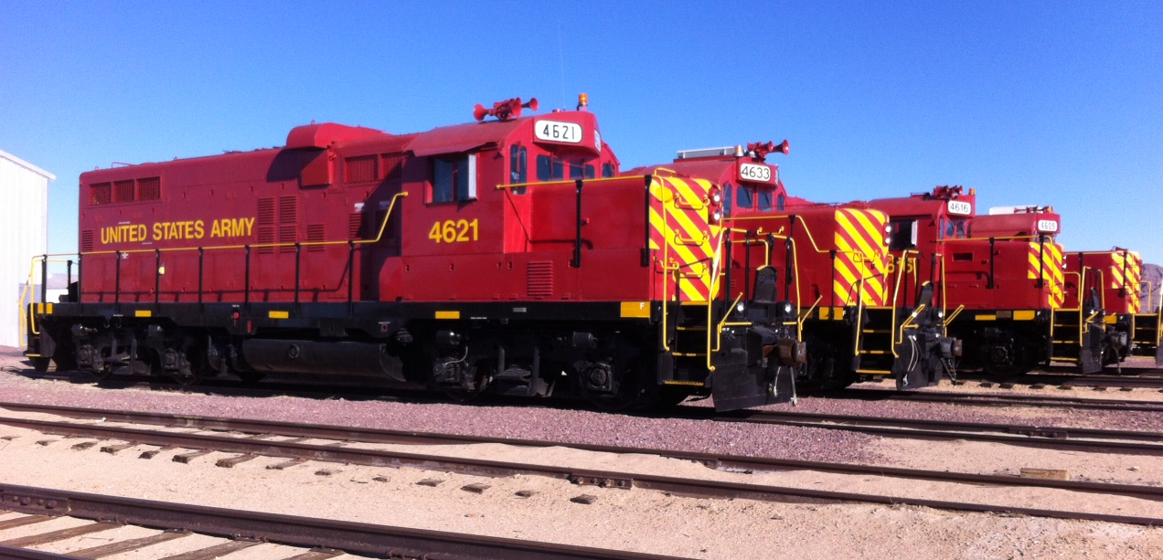
Line Haul Locomotives
Used to transport cargo over long distances

Slide 37
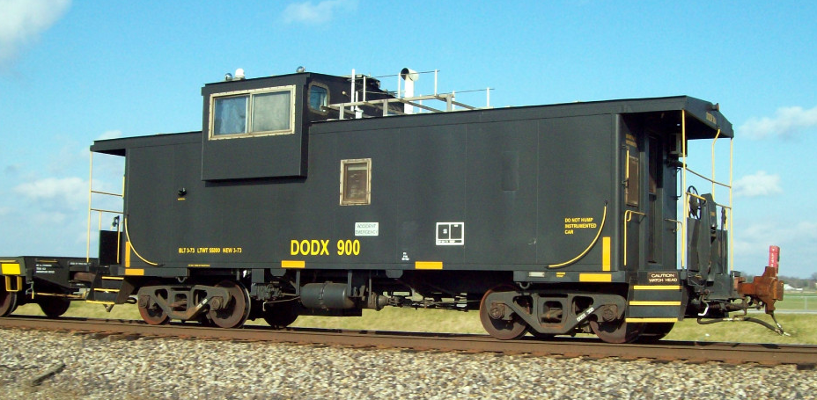
Caboose
Not used on civilian trains
Only used when escorts are required for transporting classified or sensitive items

Slide 38
On
Learning

Slide 39
On
Learning
Question 1: What enhanced rail deployment capability does the Defense Freight Rail Interchange Fleet (DFRIF) provide?
Answer 1: Pre-positioning of railcars at selected installations provides flexibility to quickly load military equipment for deployment operations.

Slide 40
On
Learning
Question 2: What type of railcar is ideal for
transporting wheeled and tracked vehicles
and oversized equipment?
Answer 2: Flat Cars

Slide 41
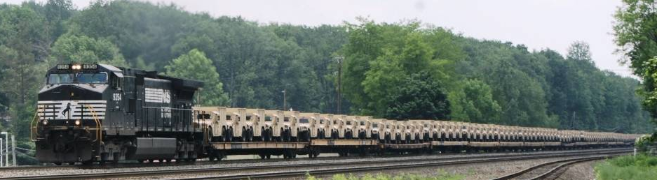
Summary
Rail Yard Layout
Types of Railcars
Defense Freight Rail Interchange Fleet (DFRIF)
DODX Railcars

Slide 42
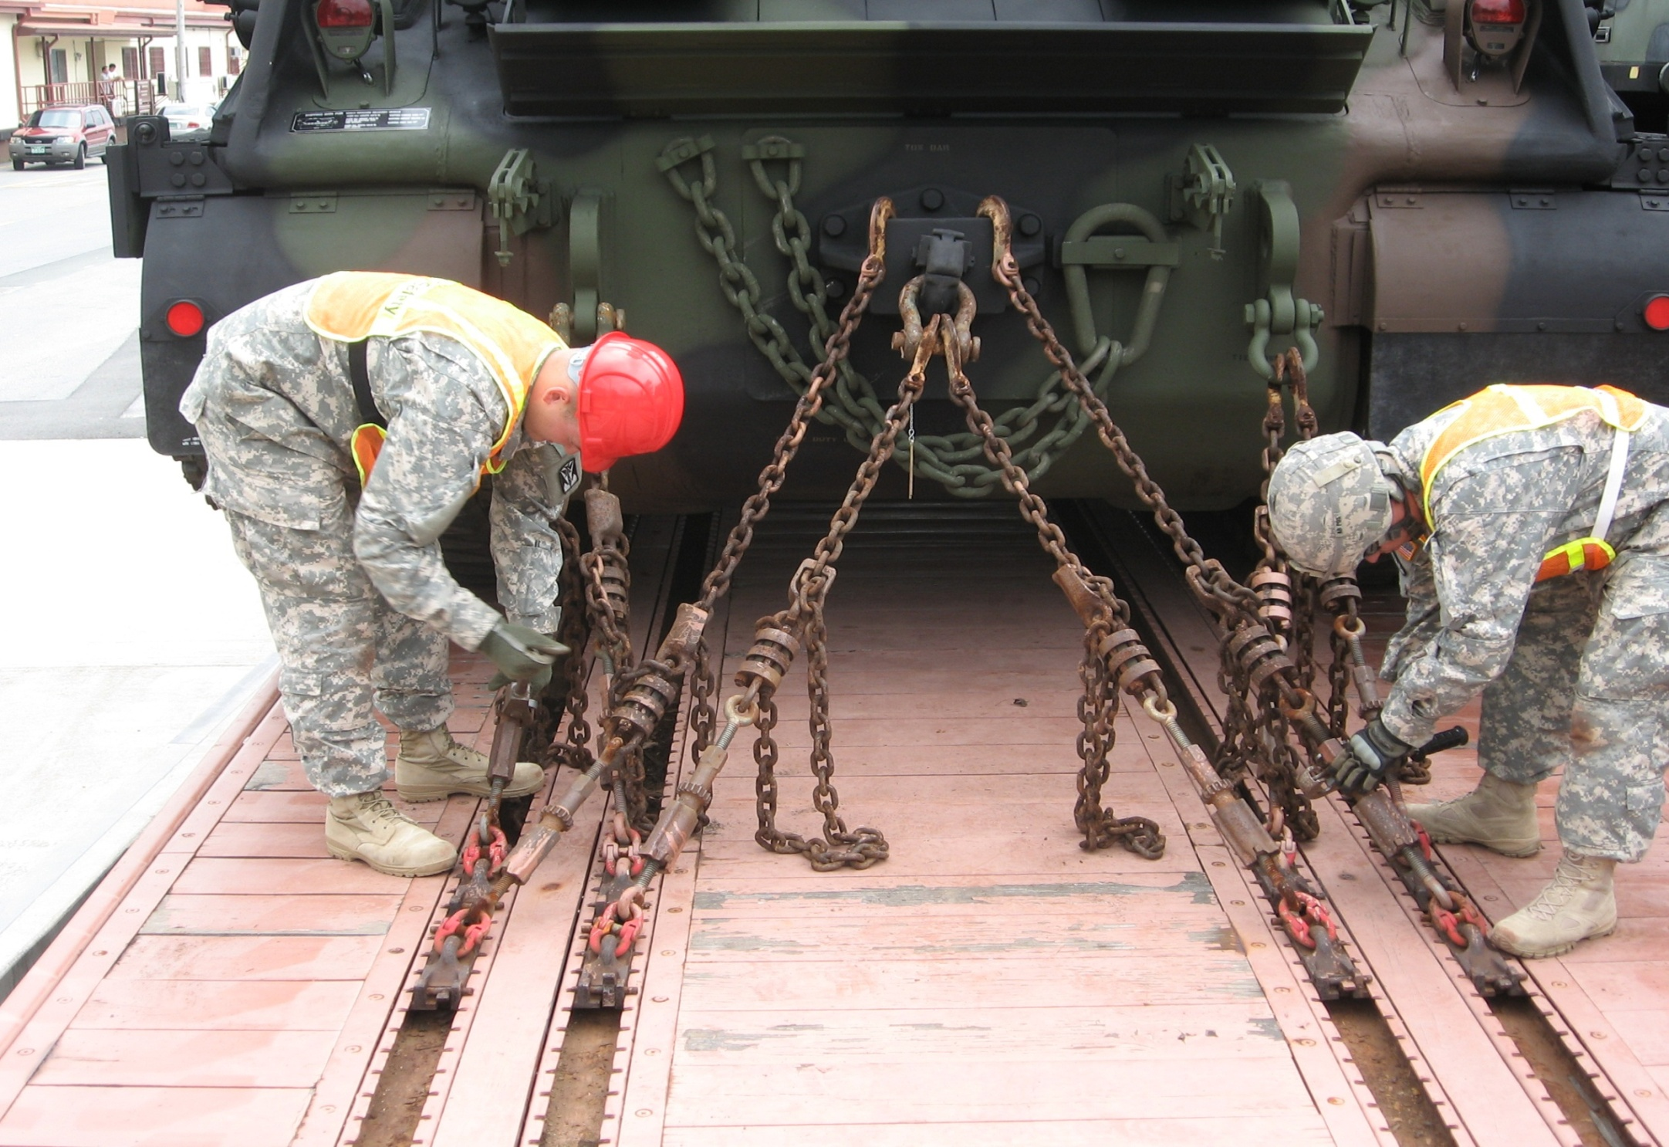
Rail Loading Requirements and Procedures

Slide 43
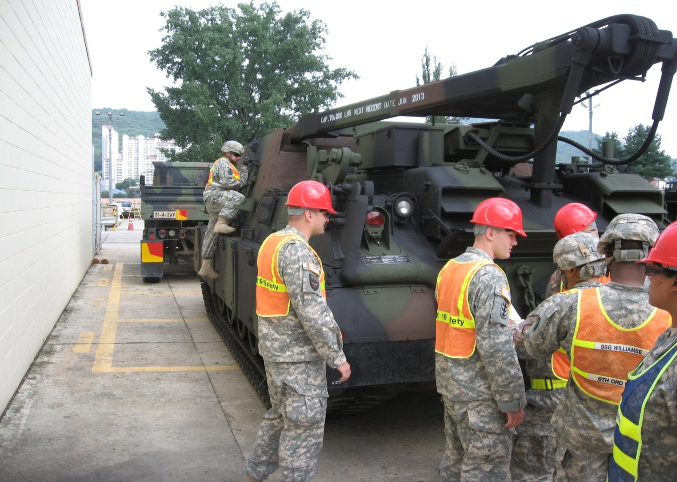
Equipment Prep for Rail Movement
The deploying unit is responsible for preparing its vehicles and
equipment for rail movement
Cleaning
Configuration
Documentation

Slide 44
General Guidance
Don’t carry ammunition and fuel as secondary cargo together
on any vehicle during rail movement
Place warning placards on all sides of hazardous cargo loads
Load as much unit equipment as possible in organic vehicles
Secure equipment loads properly
Lock/seal sensitive materials in approved security containers:
Arms
Ammo
Explosives

Slide 45
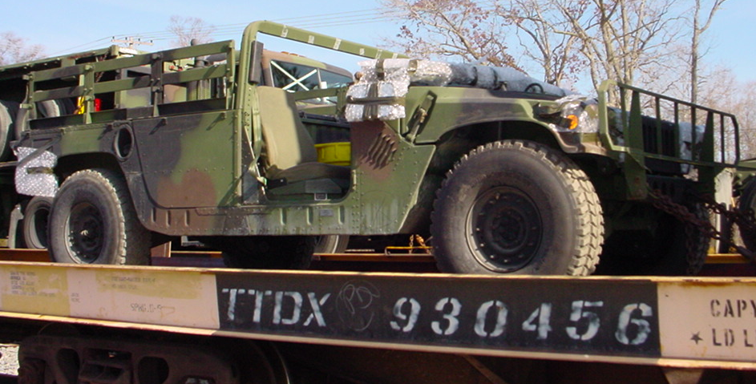
Vehicle Prep for Rail Movement
Vehicle Preparation Requirements:
All lifting and tie-down shackles attached to vehicles
Fuel tanks no more than 3/4 full
Canvas and bows removed or banded
Check inflation and condition of tires
New series vehicles (e.g. PLS, HET, HEMTT):
Windows remain up to prevent potential damage to electronic transmission
and central tire inflation systems
Protect with plywood, cardboard, or double layer of bubble wrap

Slide 46
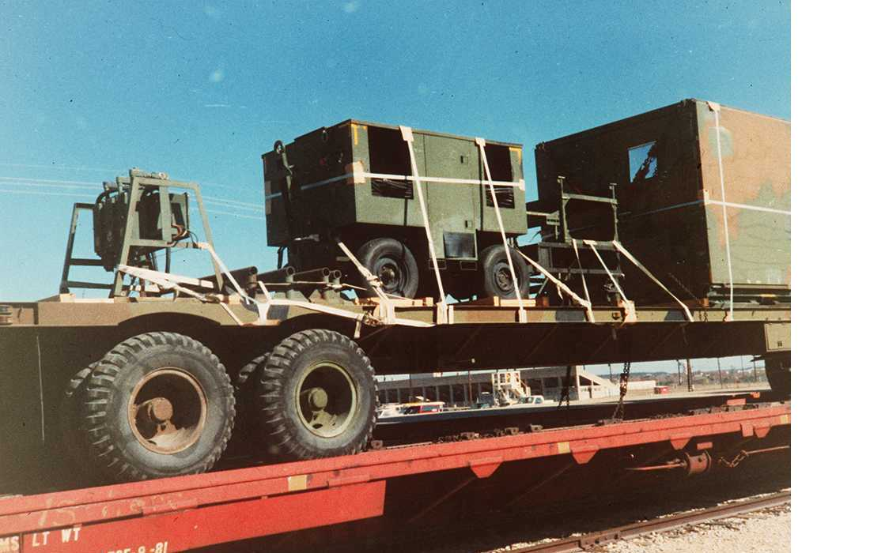
Vehicle Prep Cont.
Reduce vehicle configuration based on movement order
Secure any materials or equipment
Bands must be approved by AAR
Ensure hood latches are functional and secure

Slide 47
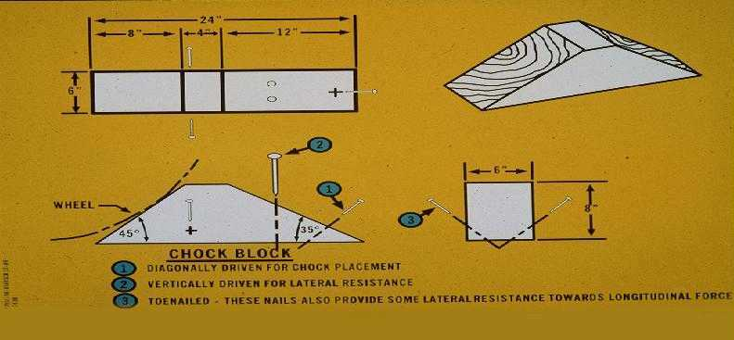
Blocking & Bracing Materials
B & B references contained in both TM 55-2200-001-12 and SDDCTEA Pam 55-19
May be reused if serviceable

Slide 48
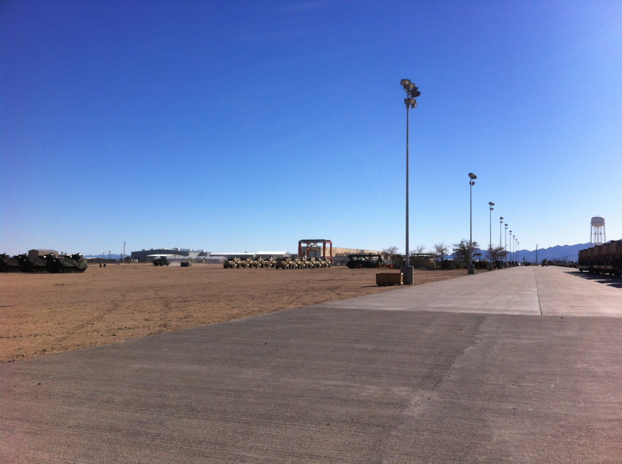
Rail Site Facilities
Command and control
Medical support
Warming Tent
Latrine facilities
Lighting
Messing

Slide 49
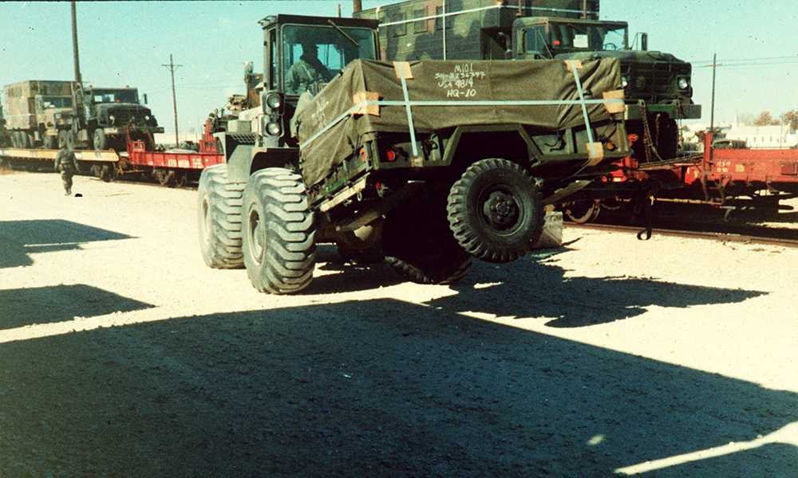
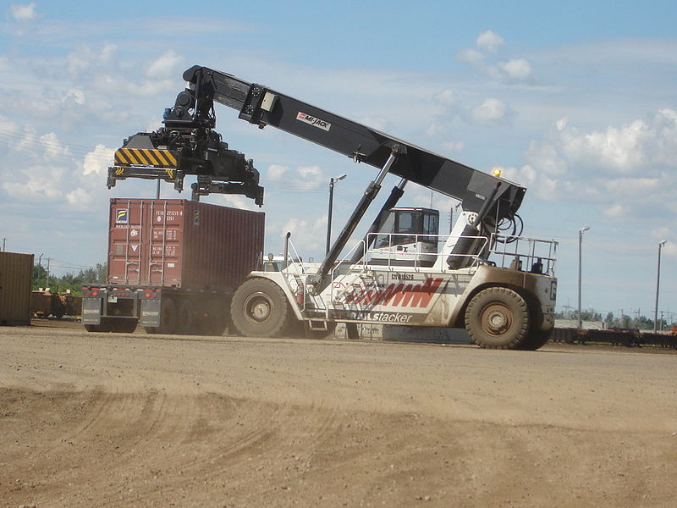
Rail Site Facilities
Rail site must be clean and free of debris
Ensure spanners are available
Ensure MHE is on site for equipment requiring support

Slide 50
Safety Requirements
Appoint Safety OIC or NCOIC to conduct risk assessment before loading
Qualified, properly equipped medical personnel on site
Brief soldiers on safety procedures prior to loading:
Must wear leather gloves & hard hats/helmets
Goggles & safety boots recommended
Night loading: Prepare adequate lighting and ensure personnel have reflector vests and flashlights
Do not step or walk on the rails
Never walk backwards on rail cars
Do not run on, jump between, or jump off of railcars use steps provided
Do not crawl under or walk between railcars
All vehicles moving on railcar must have 1 car guide (on the rail car in front of the vehicle) and 2 side guides (on the ground on each side of the vehicle)
Car guide gives instructions to the vehicle driver; side guides advise car guide of how close the vehicle is to the edge of the railcar

Slide 51
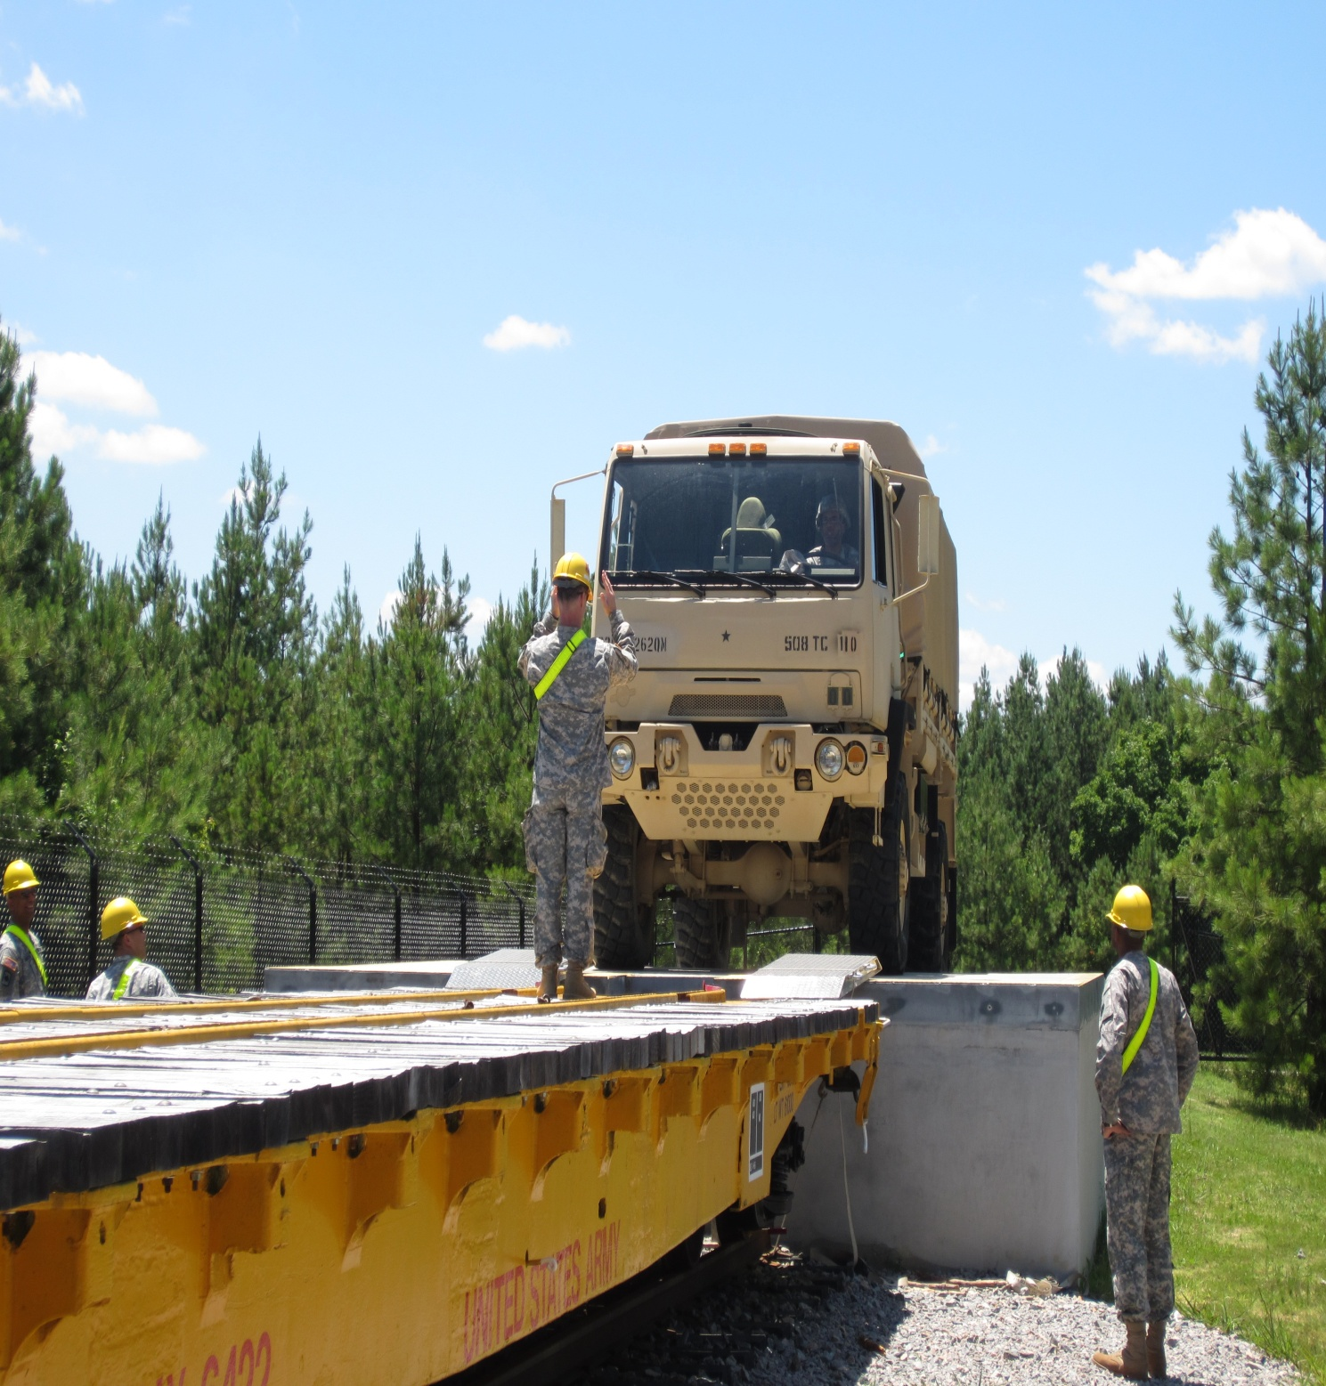
Safety Requirements Cont.
Car guide should stay one railcar ahead of vehicle being guided and be in clear view of the operator at all times
If vehicle is already on railcar, assume a secure and observable position on or beside the parked vehicle so that you cannot be pinned between the moving and parked vehicles
Car guides must use uniform hand signals (drivers must understand these signals)

Slide 52
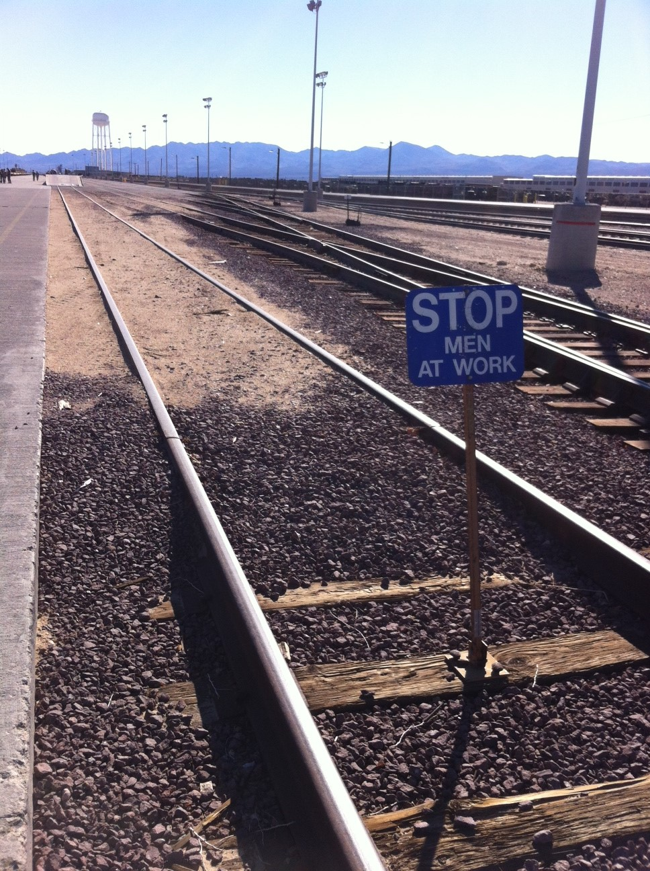
Safety Requirements Cont.
Ensure spanners are properly aligned and secured before a vehicle drivers over them
Do not stand beside spanners when vehicle drives over them
Reduced speed is used when driving vehicles onto railcars
Personnel must stay clear of main track and railcars when vehicles are moving on them (except designated guides)
No sleeping in or around rail cars
Be aware of overhead electric power lines
Display a blue flag on the track behind the
last car being loaded so other trains will
not approach

Slide 53
Inspection of Railcars
Inspect prior to being positioned at final loading locations
Purpose is to determine the cars suitability for intended equipment/vehicle loads
After railcars are accepted, military accepts full responsibility to comply with AAR rules
ITO and railway agent perform joint inspection of railcars prior to loading equipment
Checks include:
Doors on closed cars open and close and interior is free of debris
Open car decks free of residue and old B & B materials
Chains are present and serviceable on chain equipped rail cars

Slide 54
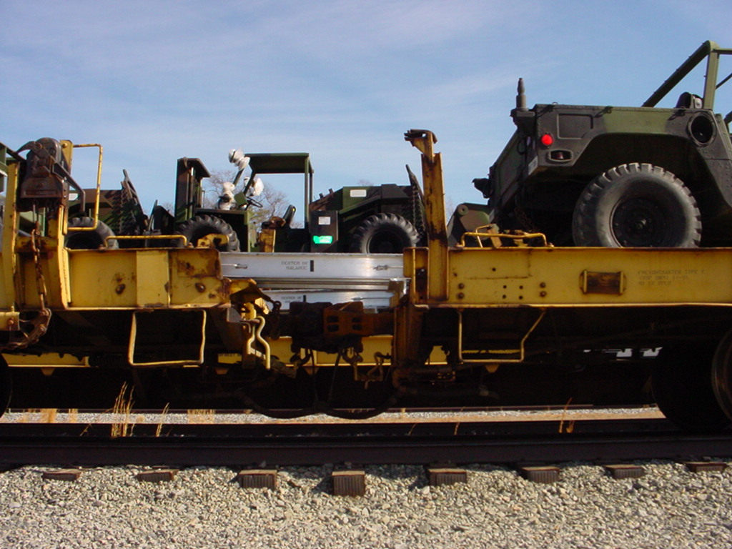
CONUS General Rail Loading
Rules
Front of Train

Slide 55
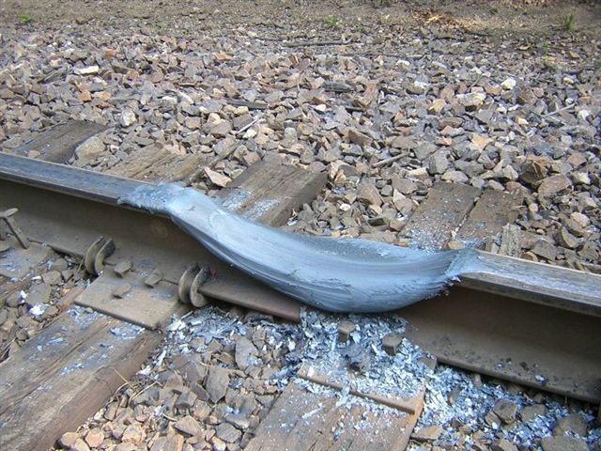
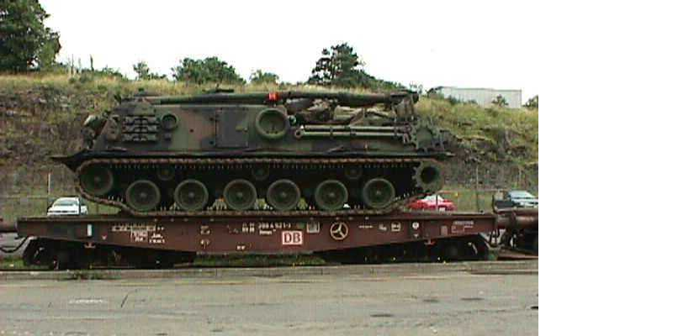
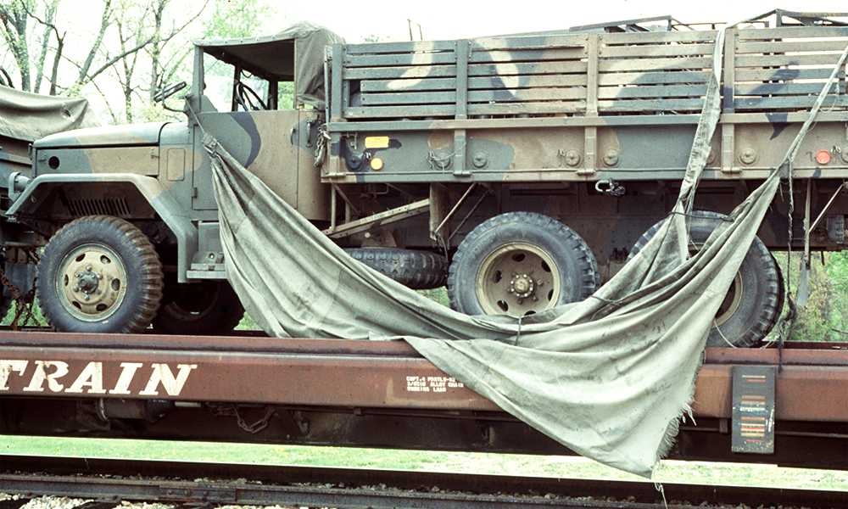
AAR Loading Rules
The AAR makes no provision to protect cargo from the elements or other forms of damage
Loading rules apply to both the railroad and the ITO/Unit
Railcar load and weight limits must not be exceeded

Slide 56
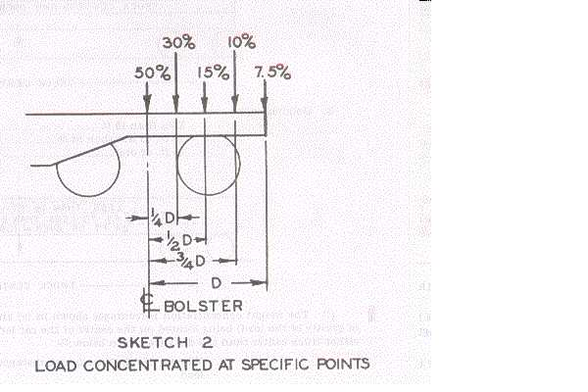
AAR Loading Rules Cont.
½ the load limit of the railcar must not be exceeded on any axle truck
Balance load evenly on car
For large/heavy items not covered by rules, load largest dimensions and
heaviest weight on floor to prevent tipping
Items with a high center of balance (C/B) must be secured to prevent
tipping while in transit
Loads must be adequately secured to railcars
Railcars must be suitable for safe transportation of load
Load must not exceed width/height restrictions of route

Slide 57
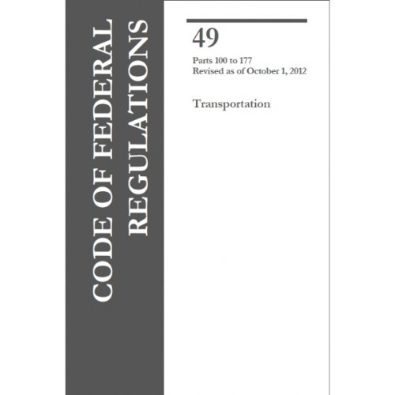
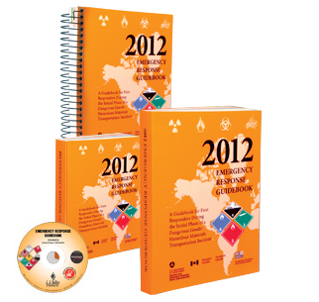
HAZMAT
IAW Title 49, CFR and DTR Part II
Consider exclusions, marking, and placarding
If exemption required, SDDC will request from carrier
Carrier provides certificates needed for Class 1 explosives
Rail cars used for shipment of explosives must be properly sealed
with Army approved seal

Slide 58
Sensitive / Classified Material
When shipping sensitive or classified material by rail, commanders may
be required to provide guards/escorts
Cargo guards/escorts maintain surveillance of military equipment during
the journey and notify railroad personnel of any problems
Escort supervisor given copy itinerary (interchange points, stops, etc.)
Escorts given portable radios and safety/ROE briefs prior to departure

Slide 59
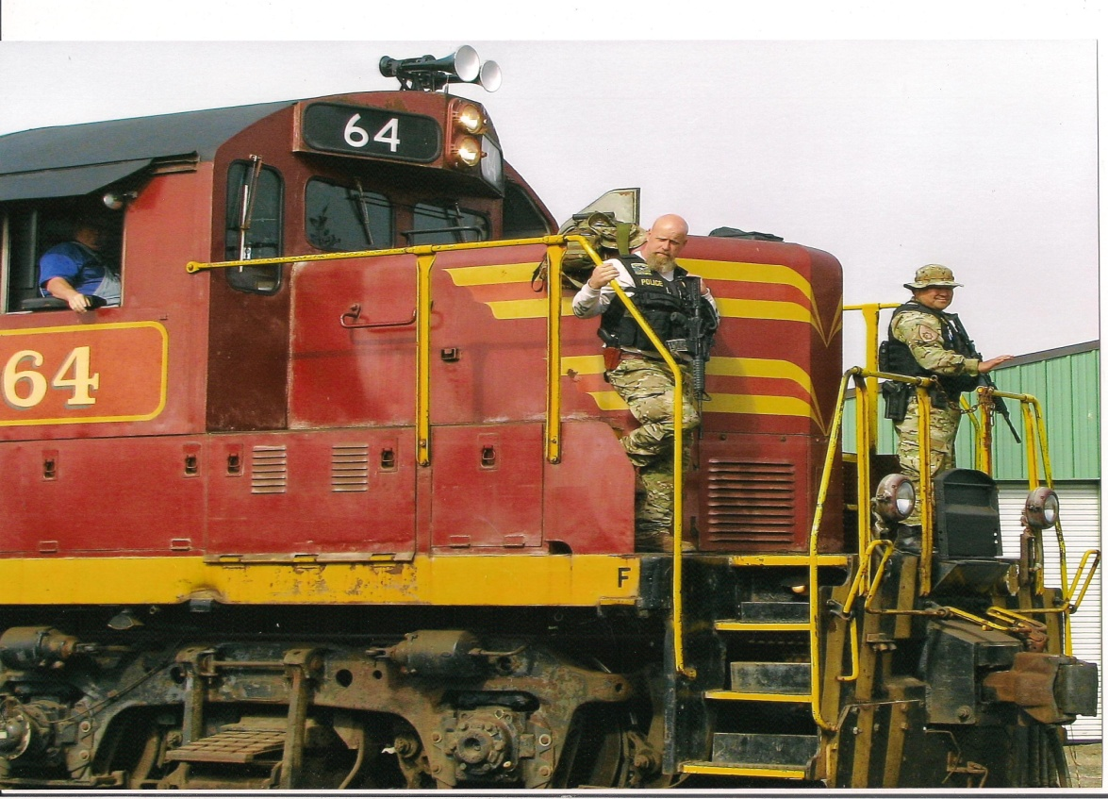
Escort / Guard Duties
Conduct cargo checks 1 - 2 hours before departure
Do cargo checks when train stops for 30 minutes or more
(check for shifting, tampering, missing seals, & missing/damaged cargo)
During stops, guards stagger along both sides of train
Report issues that could delay shipments to SDDC immediately

Slide 60
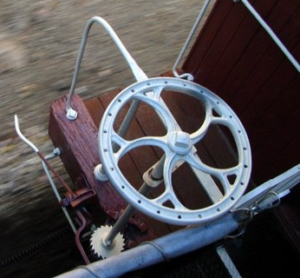
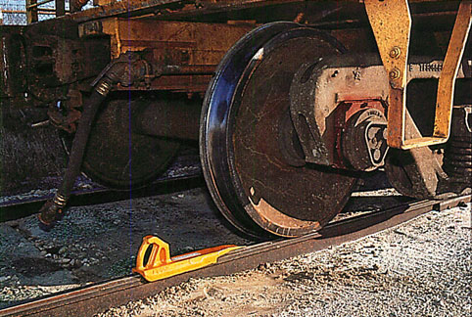
Preparation of Railcars
Deploying unit checks tie-downs and positions them on railcar to avoid
repositioning chains after vehicles are loaded
Unused chains placed in channels to prevent damage
Ensure railcar brakes are applied and wheels chocked to prevent railcars
shifting while loading
* Leave 6” clearance around brake wheel

Slide 61
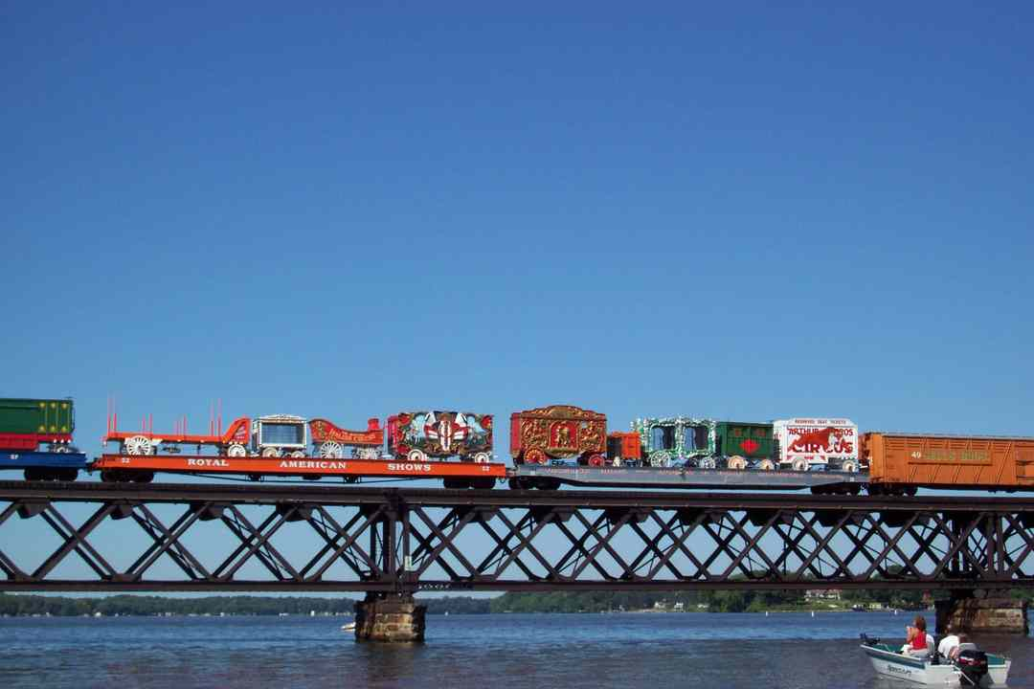
Vehicle and Equipment Loading
Prior to loading, stage vehicles in order of loading
Most common and expeditious method for loading vehicles on flatcars is
the “circus” method:
Flatcars and spanners used as roadbed
Spanners adjusted as required for each vehicle type
All vehicles loaded on rearmost car, then moved forward to assigned locations
Prior to loading the vehicle onto railcar, all personnel with the exception of the driver must dismount vehicle
Rail guide should be one car ahead of vehicle or positioned not to be caught between vehicles

Slide 62

Loading Cont.
Ensure spanners are properly positioned & capable of supporting the heaviest load anticipated
At least 12” of spanner should overlap the rail car deck
Most track vehicles don’t require spanners between rail cars
When loading vehicle between railcars of uneven deck heights, place dunnage under the spanner to prevent it from slipping
Spanner
Ramp

Slide 63
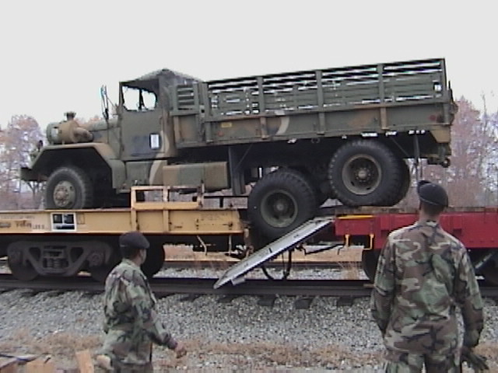
Loading Cont.
When driving on spanners, maintain a constant speed
Avoid jamming on brakes or reversing

Slide 64
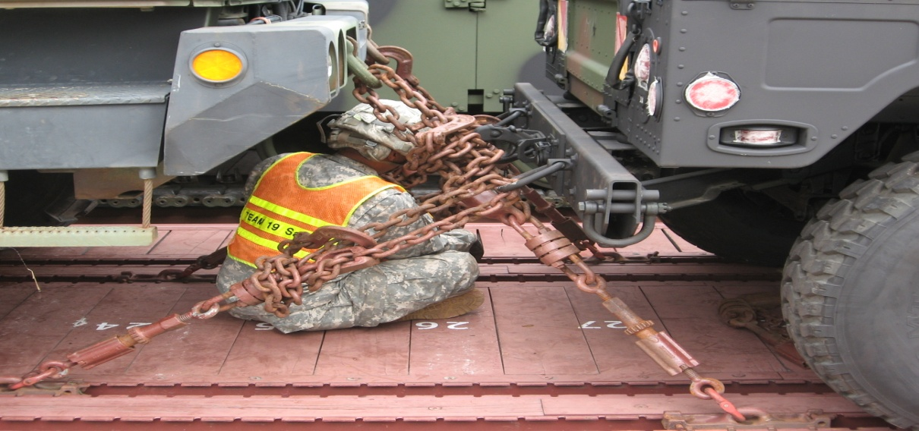
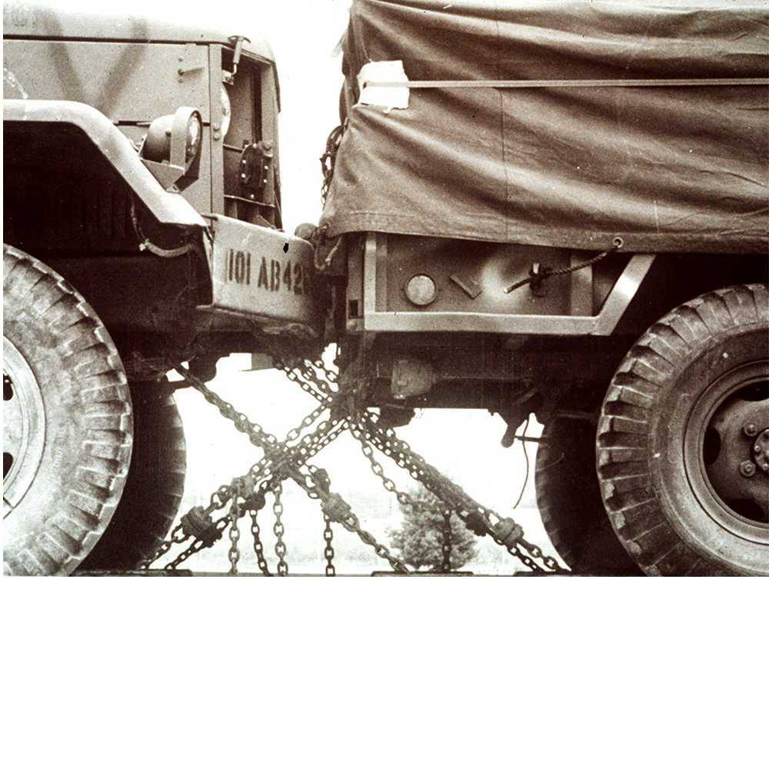
Vehicle Spacing
Vehicles require a minimum of 10” of space between vehicles
For rail cars with top mounted brake wheels, ensure there is sufficient space for operation
Correct spacing
Incorrect spacing
* See pg. 2 of TEA PAM 55-19

Slide 65
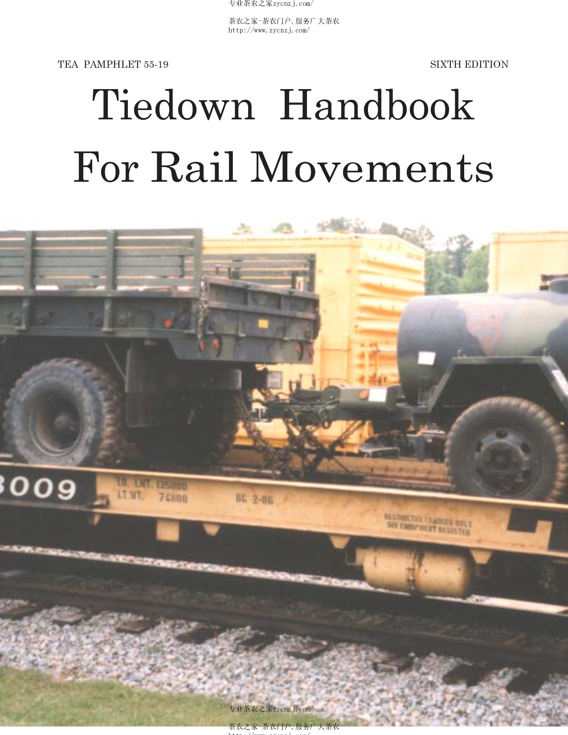
Tie down Procedures
When securing vehicles use these techniques:
Inspect chain assemblies and
components for damage, missing
parts, and proper operation
Apply chains in pairs and equal
numbers front and rear
Consult TEA PAM 55-19 for cargo
tie down requirements
Secure chain through tie-down points
at 45º angle

Slide 66
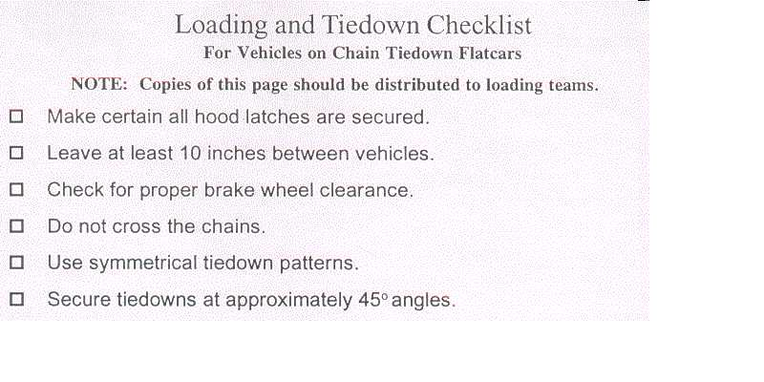


Loading & Tie down Checklist
Checklists should be distributed to the loading teams and should
contain the following:

Slide 67

TEA PAM 55-19
App A: Trucks and Trailers
App B: Tracked and Wheeled Armored Vehicles
App C: MHE, Construction Equipment, & Non-Vehicles
Checklists for tie-down procedures on page 34

Slide 68

Chain Tie-down Illustration
Trucks up to 80,000 lbs
Alloy Steel chain with a thickness of 3/8” or 1/2”
TEA PAM 55-19
Appendix A
Page A-2

Slide 69

Final Inspection
Final inspection is made after loading railcars to ensure that the contents are loaded and secured in compliance with AAR
The rail representative is the final approving authority for accepting rail loads

Slide 70

Unloading
Railcars off-loaded promptly at destination for return and to avoid demurrage or detention charges (usually within 48 hrs)
Units must remove BBPCT materials from unloaded cars before releasing to carrier

Slide 71
On
Learning

Slide 72
On Learning
Question 1: What is the procedure used in the “circus loading” of unit equipment on railcars?
Answer 1: The “circus loading” method uses flatcars as a roadbed with spanners between the railcars. Vehicles are loaded from the rear most railcar and then moved forward to their assigned locations.

Slide 73
On Learning
Question 2: What is the minimum amount of space that must be maintained between vehicles that are secured to the railcar deck?
Answer 2: AAR rules require a minimum of 10 inches between vehicles.

Slide 74
On Learning
Question 3: What reference provides a checklist for loading and tying down unit equipment on railcars?
Answer 3: SDDC TEA Pam 55-19, Tiedown Handbook for Rail Movements

Slide 75

Summary
Preparing for Rail Movement
Rail Site Facilities
Safety Requirements
Loading/Unloading Procedures

Slide 76
Questions?

Slide 77
Installation
Transportation
Office

Slide 78

Slip Hook

Slide 79

Grab Hook

Slide 80

Adjustable
Double
Grab
Hook

Slide 81

Lacing a Grab Hook with Chain

Slide 82

Claw

Slide 83

Donut Ring

Slide 84


Slide 85

Round Pin Anchor Shackle

Slide 86


Slide 87

Trailer Shackle

Slide 88

Tie Down
Absorber

Slide 89

Compression Unit
Eye Bolt
Jamnut

Slide 90

Air Force Pallet Hooks

Slide 91

Pipe Wrench

Slide 92

Wally Bar

Slide 93

Sledge Hammer

Slide 94

Crow Bar

Slide 95


Slide 96

Tie Down
Mock Up

Slide 97


