Slide 1
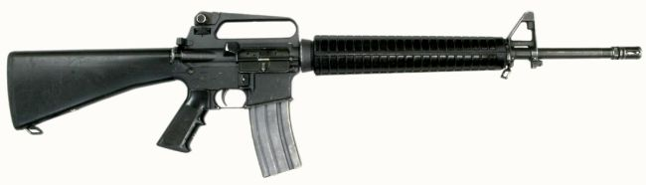
Perform
Organizational Maintenance on
Rifle, 5.56mm,
M16A2

Slide 2
Terminal Learning Objective
ACTION: Perform Organizational Maintenance on the Rifle, 5.56mm, M16A2.
CONDITION: In a classroom environment given the requirement to perform organizational maintenance on the M16A2 Rifle. Given TM 9-1005-319-10, TM 9-1005-319-23&P, DA Pam 750-8, DA Form 5988-E, DA Form 5990-E, armorer toolkit, safety equipment, CLP/LSA, pen or pencil, and a M16A2 Rifle.
STANDARD: Perform organizational maintenance on the M16A2 Rifle in accordance with TM 9-1005-319-10, TM 9-1005-319-23&P and DA Pam 750-8, finding all deficiencies without losing accountability.

Slide 3

Characteristics, Capabilities & Features, Major Components

Slide 4
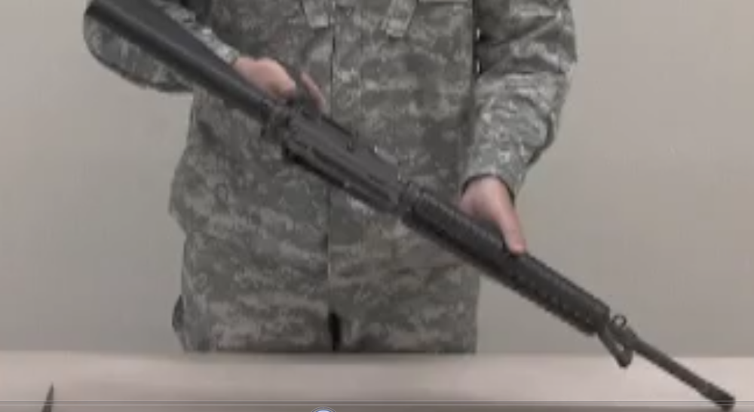
Unload, Clear and Disassemble the M16A2

Slide 5
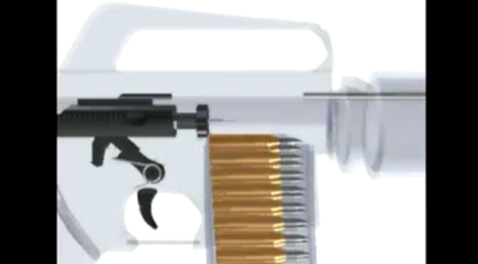
Cycle of Function
Feeding
Chambering
Locking
Firing
Unlocking
Extracting
Ejecting
Cocking

Slide 6
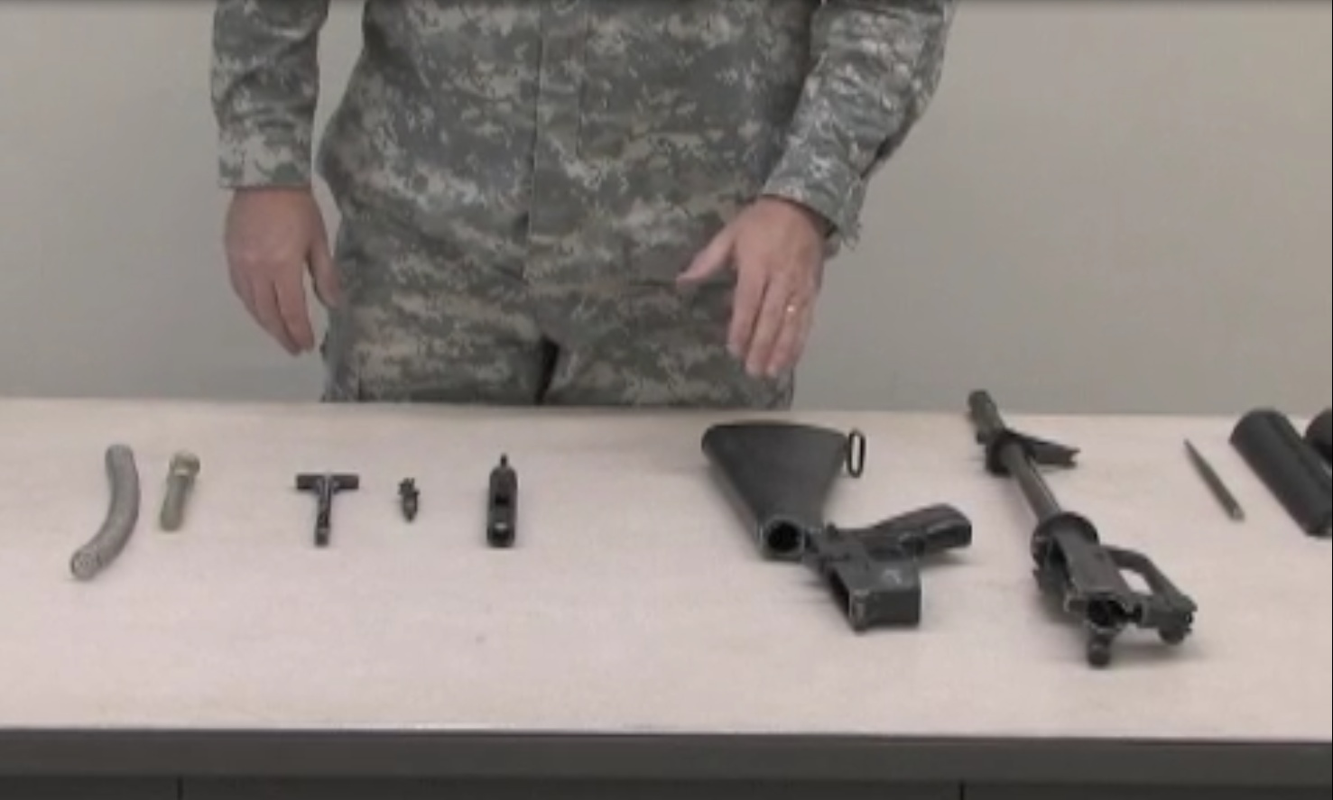
M16A2 Assembly and Functions Check

Slide 7
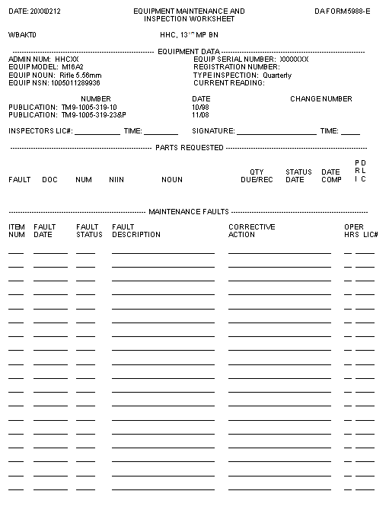
DA 5988-E
Student’s Info
4
14 Feb XX
X
Compensator is loose
DA Form 2407 (SPT)

Slide 8
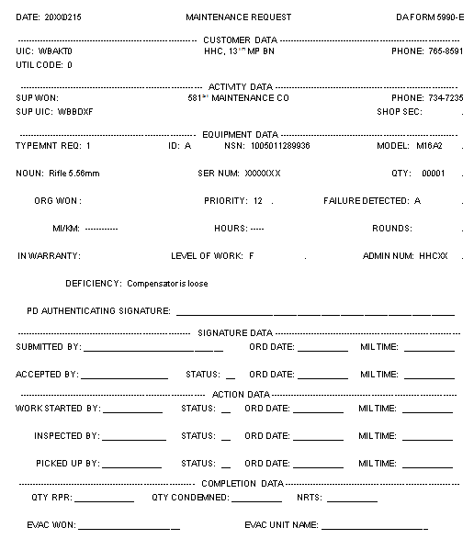
DA 5990-E

Slide 9
Summary
M16A2 equipment description, data and characteristics.
Unload and clear the M16A2.
Disassemble the M16A2.
Perform unit maintenance on the M16A2.
Reassemble the M16A2.
Perform function check on the M16A2.
Verify the DA Form 5990-E.

