Slide 1
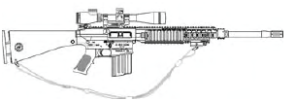
Perform Maintenance on The M110 Semi-Automatic Sniper System (SASS), 7.62mm

Slide 2
Terminal Learning Objective
ACTION: Perform Maintenance (PMCS) on the M110 Semi-Automatic Sniper System (SASS), 7.62mm.
CONDITION: In a classroom environment given the requirement to perform preventive maintenance on the M110 Sniper System. Given TM 9-1005-342-10, TM 9-1005-342-23&P, DA Pam 750-8. blank DA Form 2404, blank DA Form 2407, small arms tool kit, safety equipment, dummy rounds, CLP, pen or pencil, and a M110 Semi-automatic Sniper System.
STANDARD: The student will perform preventive maintenance on the M110 Semi-Automatic Sniper System (SASS), 7.62mm in accordance with TM 9-1005-342-10, TM 9-1005-342-23&P, and DA Pam 750-8 without losing accountability.

Slide 3

Characteristics, Capabilities & Features, Major Components

Slide 4
Cycle of Function
Feeding
Chambering
Locking
Firing
Unlocking
Extracting
Ejecting
Cocking

Slide 5
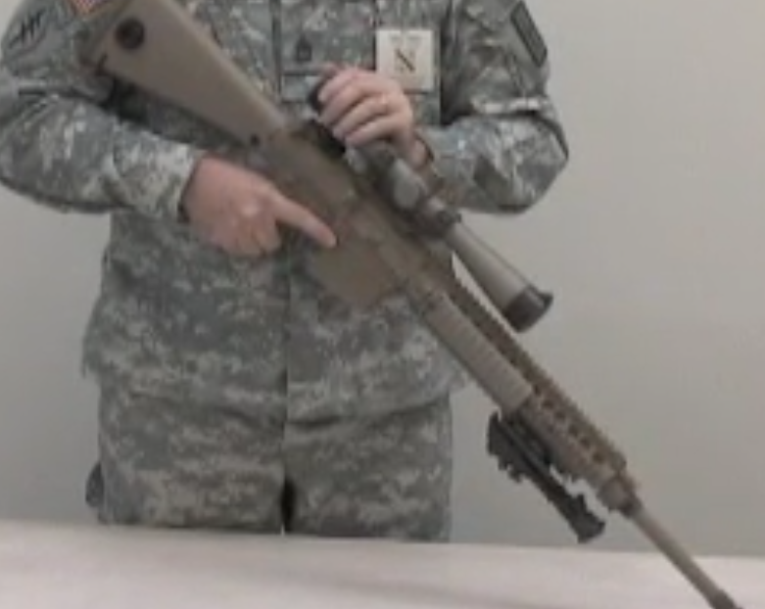
Unload, Clear and Disassemble the M110 SASS

Slide 6
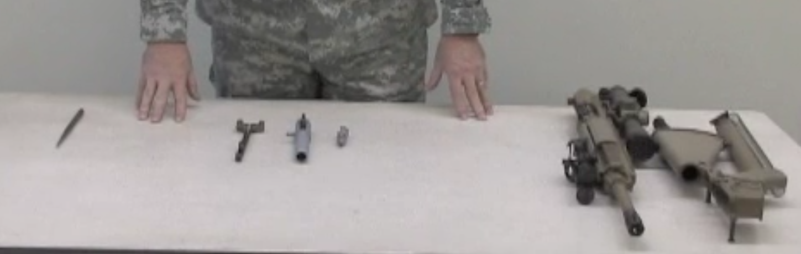
M110 SASS Assembly and Functions Check

Slide 7
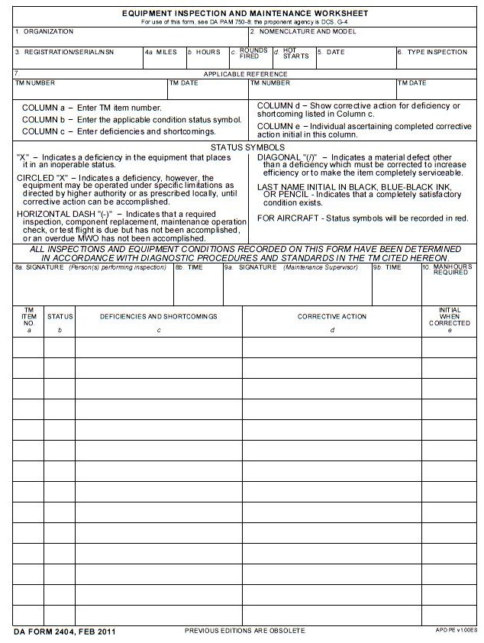
HHC, 13th Military Police Battalion
M110 Semi-Automatic Sniper System 7.62mm
568741
28 Feb XX
Quarterly
TM 9-1005-342-23&P 14 Dec 90
DA Form 2404
Student’s Signature
2
X
Damaged Carrier Key on Bolt Carrier
DA Form 2407 (DS)

Slide 8
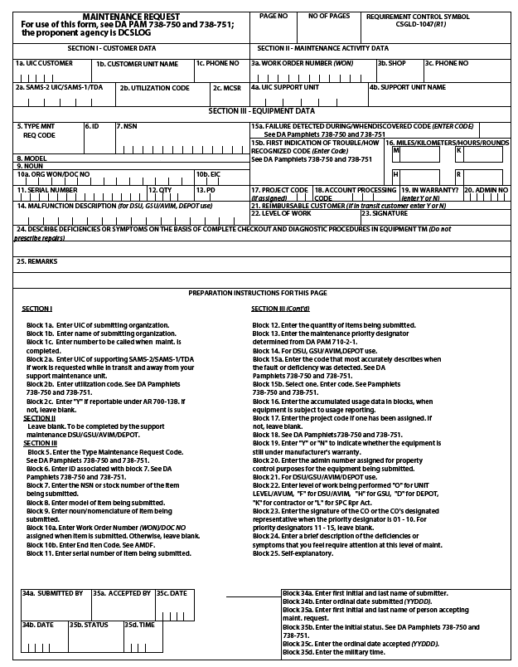
1
1
W B A K T 0
HHC 13th MP BN
765-3132
0
DA Form 2407
1
A
1 0 0 5 - 0 1 - 5 3 4 - 2 8 4 1
M110
Semi-Automatic Sniper System
4 F Z
5 6 8 7 4 1
0 0 0 0 1
1 2
N
F
Damaged Carrier Key

Slide 9
Summary
Identify the Characteristics, Capabilities and Features, and Major Components of the M110 Sniper System.
Unload and Clear the M110 Sniper System.
Disassemble and Troubleshoot the M110 Sniper System.
Reassemble the M110 Sniper System.
Perform Function Check on the M110 Sniper System.
Perform Preventive Maintenance on the M110 Semi-Automatic Sniper System.
Prepare the DA Form 2404 and DA Form 2407 on the M110 Sniper System.

