Slide 1
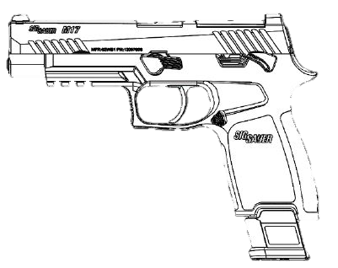
M17/M18
MODULAR HANDGUN SYSTEM

Slide 2
TLO
Unload/clear weapon
Insert empty magazine into magazine well. Magazine catch must lock magazine in place.
Grasp slide and pull completely to rear until slide catch lever locks slide open.
Press magazine catch. Magazine must fall free of pistol under its own weight.
Pull back and release slide to forward position.
Push up on manual safety lever to engage safety.
Press trigger to the rear. Striker should NOT be released.
Push down manual safety lever to disengage safety.
Press trigger to the rear and hold to rear. Striker should be released and an audible click should be heard.
While still holding trigger pressed to rear, pull slide completely to the rear and release slide.
Release trigger. A light audible click should be heard and felt as the striker resets.
Press trigger. The striker should release and you should hear and feel a loud audible click.

Slide 3
Modular Handgun System Pistol Series M17/M18 Equipment Description and Theory of Operation

Slide 4
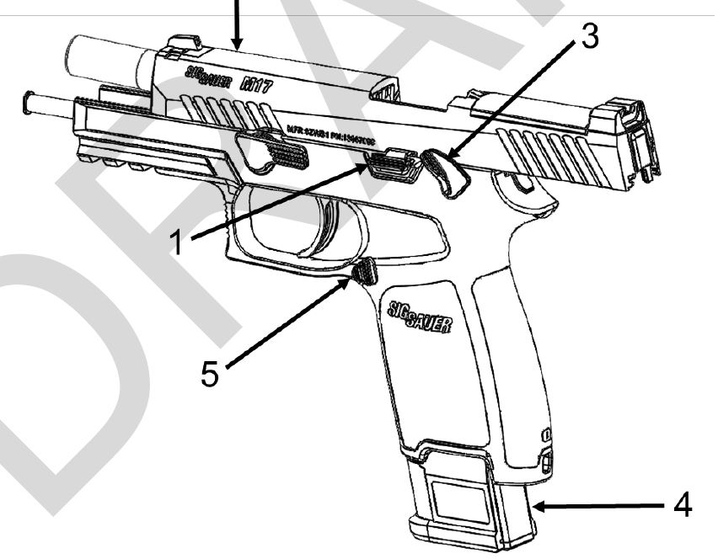
Clearing Procedures of M17/M18 MHS Pistol
Unloading and Clearing the Pistol:
Engage manual safety pushing it upward.
Press magazine catch to release magazine.
Push up on slide catch lever, while retracting slide locking it to rear. Visually watching to ensure last round has been extracted and ejected from chamber.
Conduct 3 Point Safety Check.
  Ensure chamber is empty
  Inspect for no magazine
  Inspect breech face
Press slide catch lever to release slide forward.

Slide 5
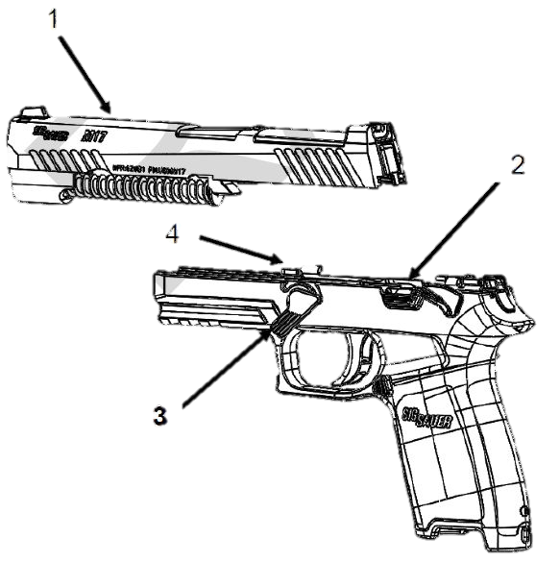
Disassembly of M17/M18 MHS Pistol
1. Clear/unload the pistol.
2. Push up on manual safety lever.
3. Retract slide and lock it to rear by pressing up on slide catch lever
4. Rotate takedown lever clockwise until it stops.
5. Slightly retract slide allowing slide catch lever to release the slide.
6. Guide slide forward and off of the receiver rails.

Slide 6
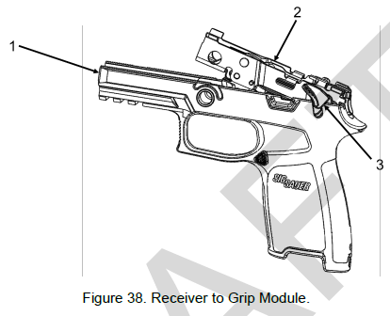
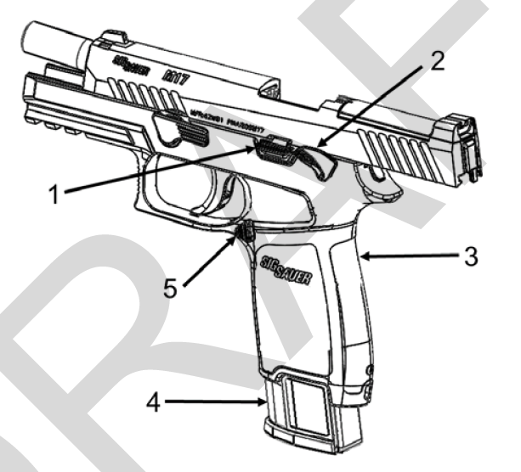
Reassembly of M17/M18 MHS Pistol

Slide 7
Safety/Function check for M17/M18 Pistol.
Unload/clear weapon
Insert empty magazine into magazine well. Magazine catch must lock magazine in place.
Grasp slide and pull completely to rear until slide catch lever locks slide open.
Press magazine catch. Magazine must fall free of pistol under its own weight.
Pull back and release slide to forward position.
Push up on manual safety lever to engage safety.
Press trigger to the rear. Striker should NOT be released.
Push down manual safety lever to disengage safety.
Press trigger to the rear and hold to rear. Striker should be released and an audible click should be heard.
While still holding trigger pressed to rear, pull slide completely to the rear and release slide.
Release trigger. A light audible click should be heard and felt as the striker resets.
Press trigger. The striker should release and you should hear and feel a loud audible click.

Slide 8
Summary
Equipment Description and Theory of Operation
Clearing Procedures
Disassembly
Reassembly
Safety/Function check

