Slide 1
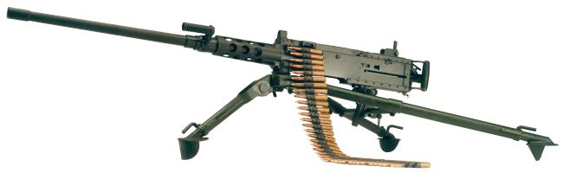
Perform Maintenance on The Machine Gun, Caliber .50; M2A1

Slide 2
Terminal Learning Objective
ACTION: Perform Maintenance on the Machine Gun, caliber .50; M2A1 W/Fixed Headspace and Timing.
CONDITION: In a classroom environment, given the requirement to perform maintenance on the M2A1 Machine Gun. Given TM 9-1005-347-10, TM 9-1005-347-23&P, DA Pam 750-8, a DA Form 5988-E, a DA Form 5990-E, armorer toolkit, safety equipment, and a M2A1 Machine Gun.
STANDARD: The student will perform maintenance on the M2A1 Machine Gun in accordance with TM 9-1005-347-23&P and DA Pam 750-8, finding all deficiencies without losing accountability.

Slide 3
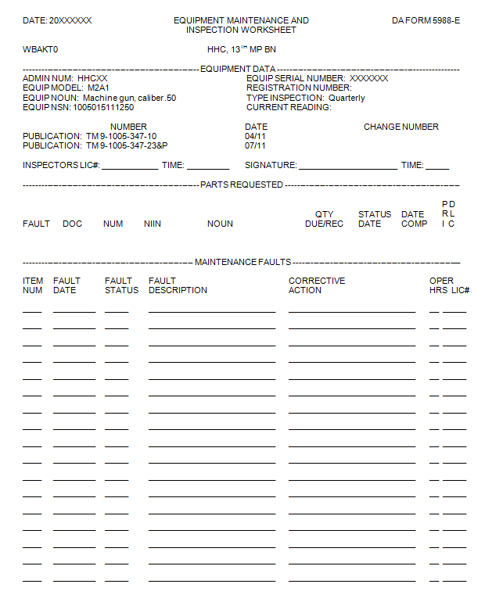
DA FORM 5988-E
Student’s Info
69
Date
X
Feed Lever Shoulder Pin Spring is elongated
5360-00-501-3516
82
Date
X
Failed Headspace and Timing
DA Form 5990-E (SPT MNT)

Slide 4
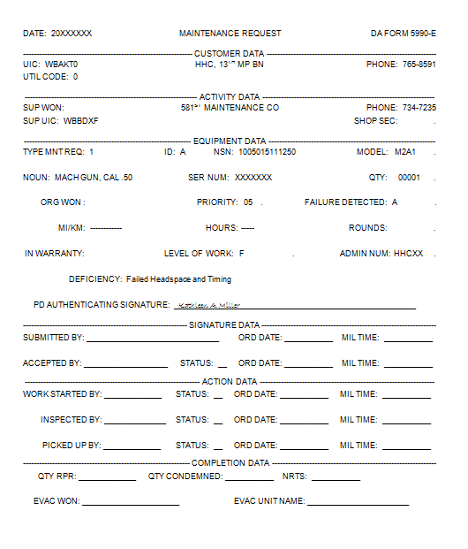
DA FORM 5990-E

Slide 5
Summary
Identify the Characteristics, Capabilities and Features, and Major Components of the M2A1
Unload and Clear the M2A1 Machine Gun.
Reassemble the M2A1 Machine Gun.
Perform a Function Check on the M2A1 Machine Gun
Fixed Headspace and Timing Verification on the M2A1 Machine Gun.
Perform Preventive Maintenance on the M2A1 Machine Gun.
Verify the DA Form 5990-E on the M2A1 Machine Gun

